Slide 1
Measuring Power and Influence in the Blogosphere
Norhidayah Azman
University of Southampton
11 February 2010

Slide 2
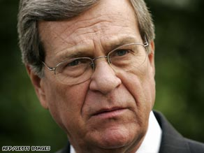
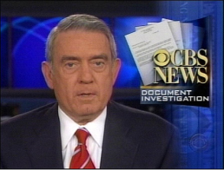
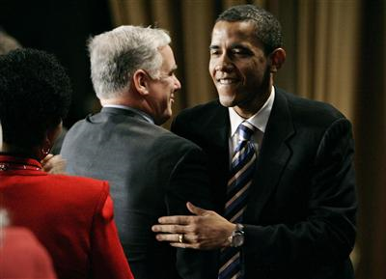

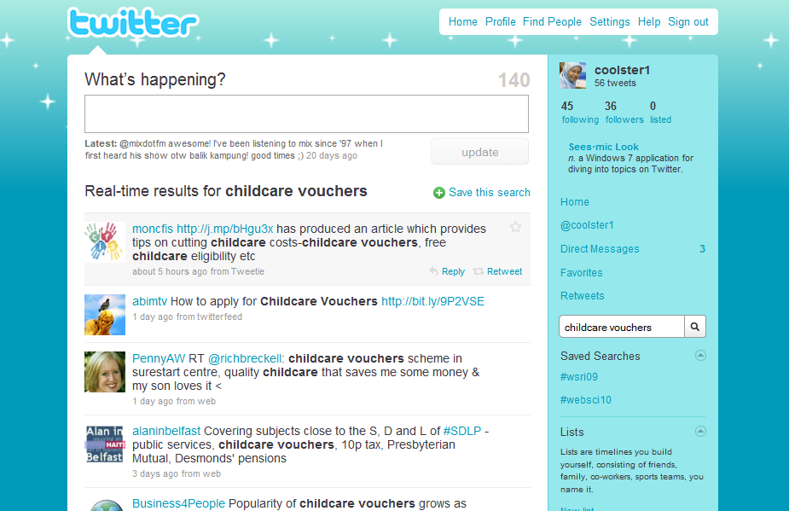

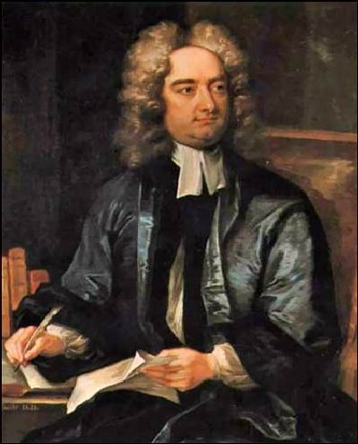
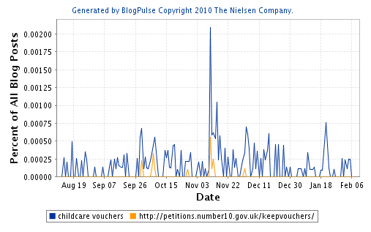


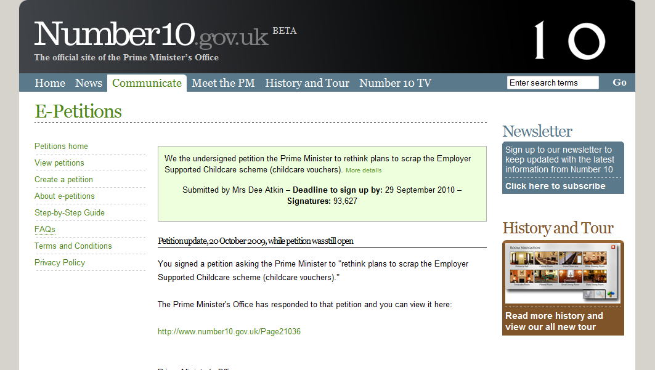
?
Anecdotal evidence
Power in the Blogosphere
Trent Lott resignation
Dan Rather scandal
Dean and Obama
Pamphleteering → Blogging
Measuring Power?
Blog + Action

