Slide 1

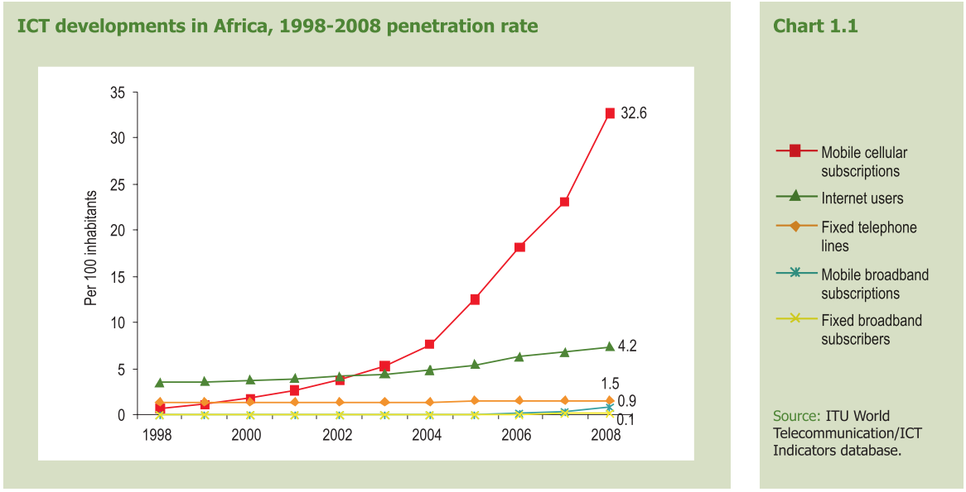
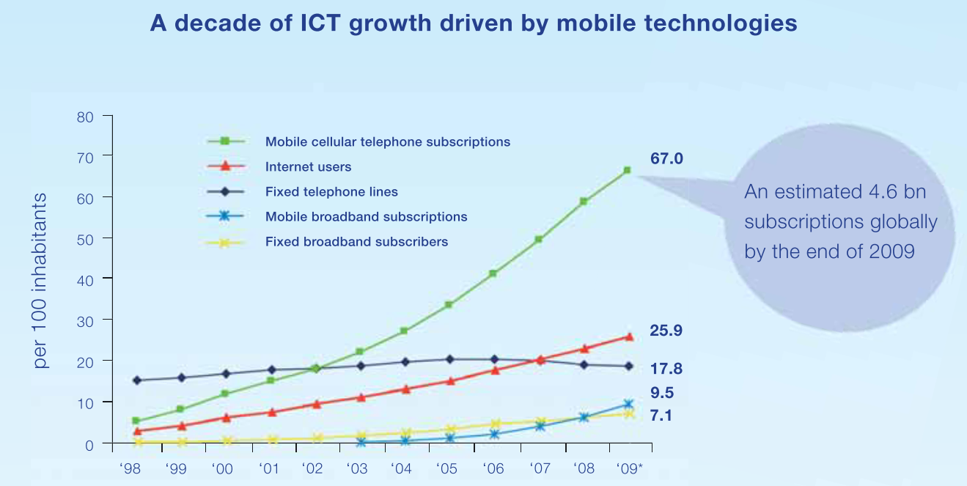
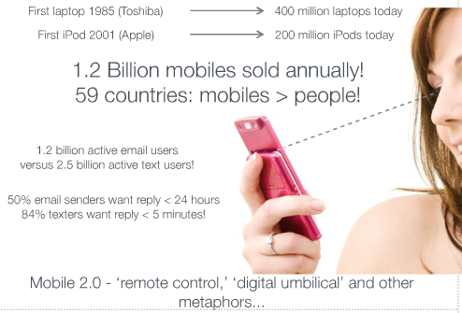
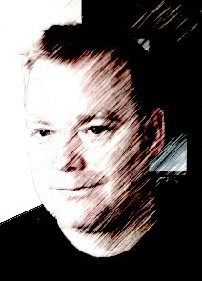




Are the Clouds gathering for Mobile Internet?
“Measuring the Impact of the Mobile Web on Community and Commerce in South Africa” – Mike Santer
“Measuring the Impact of the Mobile Web on Community and Commerce in South Africa”
Mike Santer
ECS, The University of Southampton
The world in 2009: ICT Facts and Figures
How Can You Help?
Discussion and commercial mentoring
Funding for Travel
Access to Mobile Technology
Access to commercial research and statistics
Mike Santer
Email: mhds@ecs.soton.ac.uk
Call: +44 (0)79 2000 2003
Skype: mikesanter
Twitter: MikeSanterPhD

Slide 2
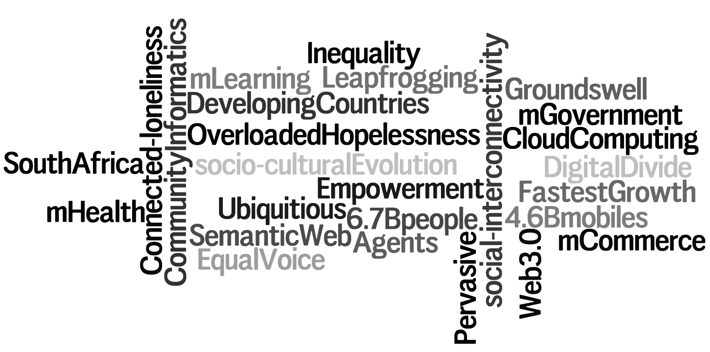
Are the Clouds gathering for Mobile Internet?
“Measuring the Impact of the Mobile Web on Community and Commerce in South Africa” – Mike Santer
How Can You Help?
Discussion and commercial mentoring
Funding for Travel
Access to Mobile Technology
Access to commercial research and statistics
Mike Santer
Email: mhds@ecs.soton.ac.uk
Call: +44 (0)79 2000 2003
Skype: mikesanter
Twitter: MikeSanterPhD

