Slide 1
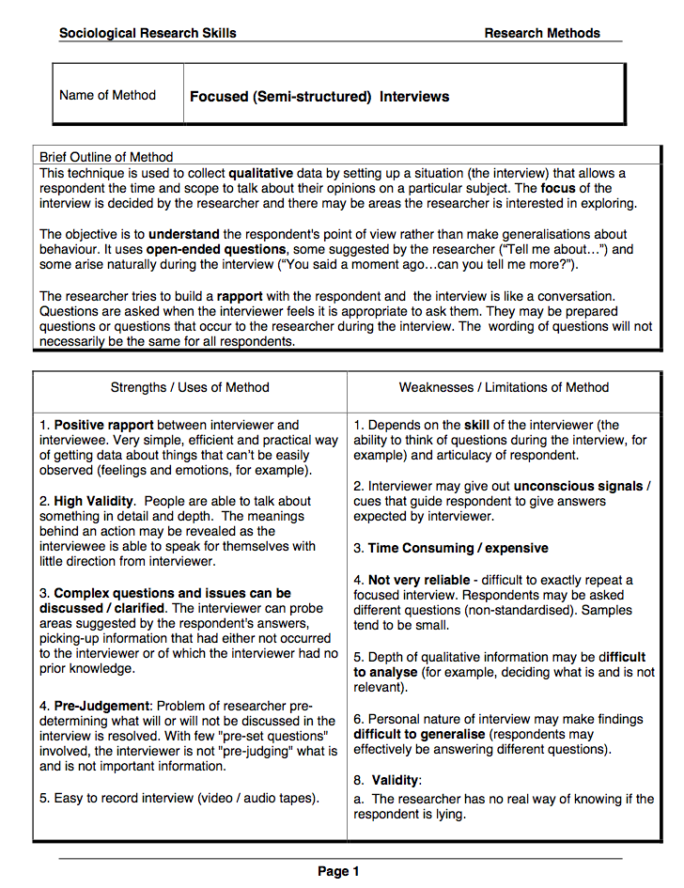
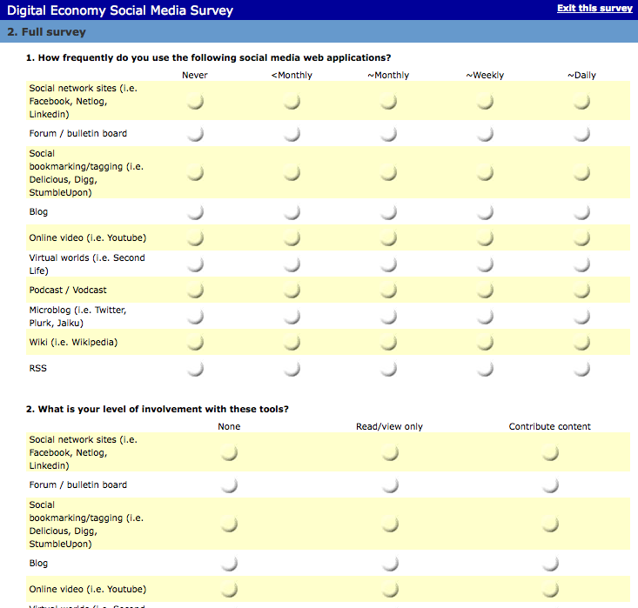
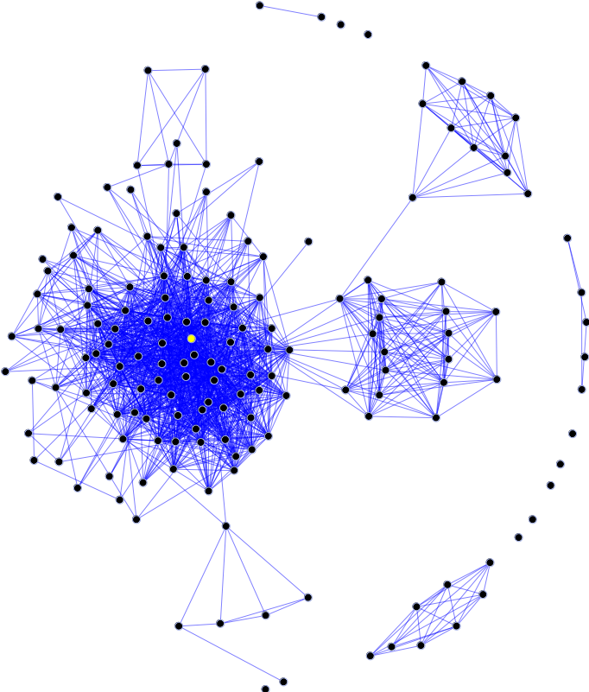
What are the actual effects of Enterprise 2.0?
Enterprise 2.0 defined: IP-enabled social software used in organizational settings.
Origins of social software
Enterprise 2.0 Typology
Research methods
In recent years an Internet explosion of new technologies has led to to many new applications of ever-increasing social and technical complexity and sophistication. This has led to the development of Enterprise 2.0.
Numerous applications serve a broad range of use cases, employing various technologies and variable communication vectors. Some examples of widely used applications and use cases follow:
This investigation will involve several case studies, making use of both qualitative and quantitative research methods, including longitudinal uses of surveys, semi-structured interviews, and social network analysis.
Phases of Web Usage
From its earliest days, the web supported read/write functionality. That is, it enabled users to edit or tag web pages in the browser. Editing features were little used and were subsequently removed from successive browsers. Thus, for the first several years, the web was primarily used as an idea space for one-direction publication. It was predominantly a read only web.
With the release of Java, JavaScript, and other browser-centric languages and tools in the mid-90s, broad bidirectional communication became facile and pervasive, helping to launch a multitude of web applications and fostering the dot-com boom. This was the read/write web.
Still later, with the introduction of weblogs, wikis, social tagging, media sharing, social networking, and similar web applications which offered capabilities for creating and advancing online social relationships of various sorts, the social web was born.
Although this chart appears to delineate fixed times for the beginnings and endings of these usage phases, these may nonetheless be considered fair approximations.
Social Software
Many older networked software applications such as email and Usenet offered social functionality but were not necessarily regarded as intentionally social in nature. More recently, with the advent of collaborative software such as blogs and wikis, applications became understood as social when they offered “community formation” capabilities. In broad terms, people form online communities by combining one-to-one (e.g., email and instant messaging), one-to-many (Web pages and blogs), and many-to-many (wikis) communication modes.
The hype and the question
Theoretic framework
A large and growing volume of discussion and hype, primarily commercial in origin and evangelistic in intent, attends the domain. Existing research reflects this focus and little has been undertaken to examine the social and organizational effects of uses of these tools. So what are the actual effects of Enterprise 2.0?
This investigation will rely on Organization Theory as well as Pierre Bourdieu’s concepts of field, capital, and habitus to provide key portions of its theoretic framework and to explain behavioral changes. It will also involve Normalization Process Theory to provide insight into the contingent nature of Enterprise 2.0 uptake.
Mark Schueler (mcs08r@ecs.soton.ac.uk)

