Slide 1



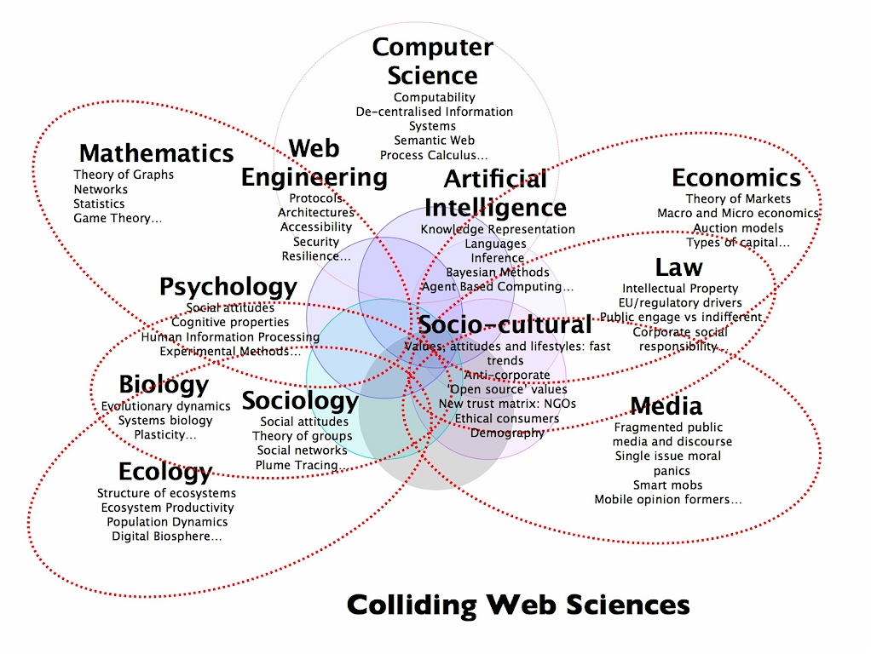
Why do we need Web Science?
Evangelos G. Lolos
A Web Scientist can…
…see the “Big Picture”
understand both the technical and social aspects of the Web
study web trends and phenomena by using an array of tools and methods ranging from graph analysis to ethnography
make estimates about the future of the Web, web trends and technologies
coordinate and collaborate with experts from various backgrounds and disciplines
be “ a strategist of the Web” because he can…
Some topics of interest :
Toolbox of the Web Scientist:
How is the Web built?
What is the shape of the Web?
How societies interact with the Web?
How the Web influences individuals?
Hypertext and semantic web technologies
Graph theory and statistical analysis
Sociology, Law, Economics, Political Science, Media
Psychology
Subjects that fascinate me:
Using semantic web technologies and social networking in e-government portals
Intelligent agents and the Web
Collective action and decision making on the Web
The law of unintended consequences and emergent properties of the Web
How to stop people from confusing the Web with the Internet ☺

