Slide 1
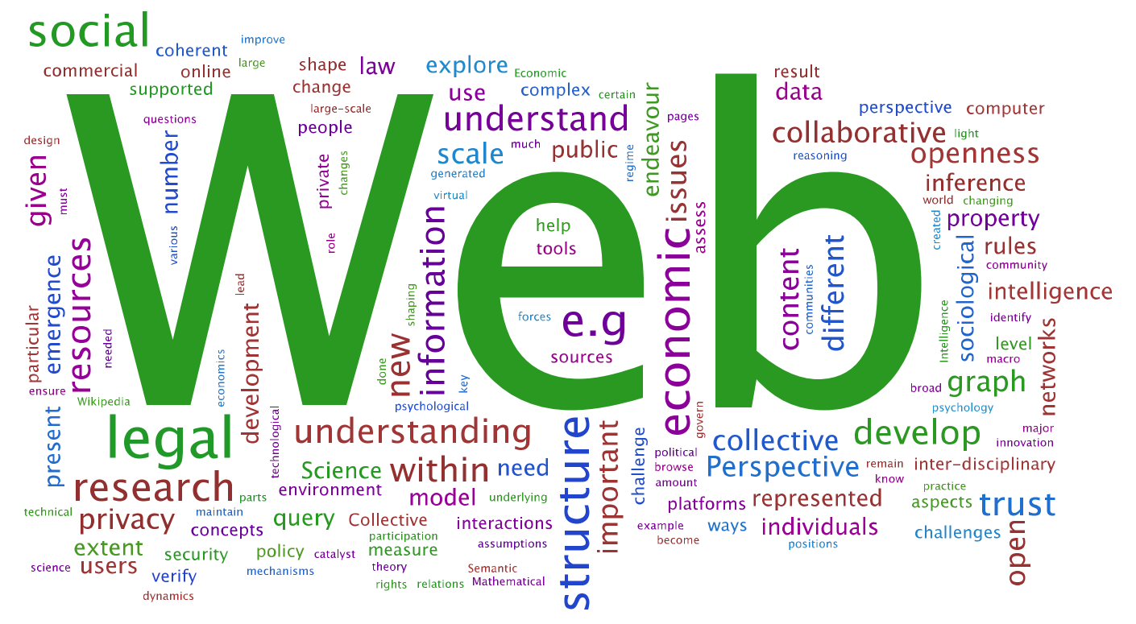
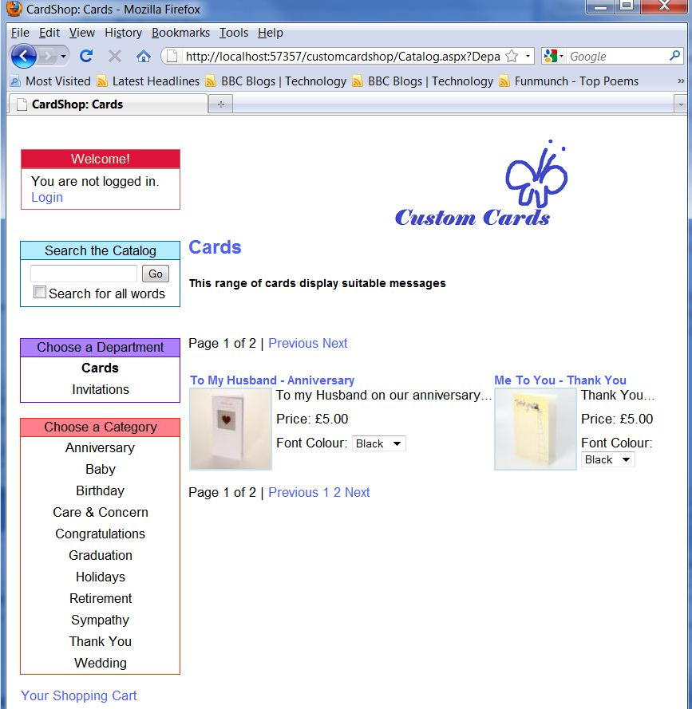
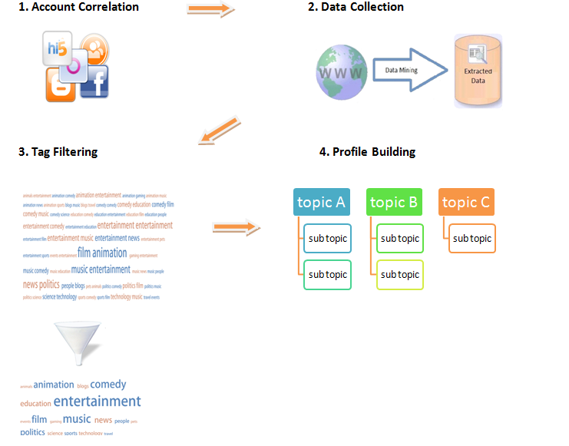
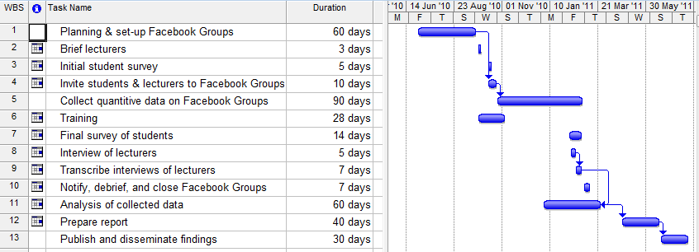
What is Web Science?
The Web is the largest human information construct in history and it is transforming society
Web Science is an interdisciplinary approach to understanding the Web as an entity. It concerns large-scale human collaboration on one hand, and individuals on the other. Web Science should help engineer a support framework for the Web so it can grow, and ensure that a future Web is tailored to it's society.
“The best way to predict the future is to invent it.” - Alan Kay, American computer scientist.
Web Science @ Southampton
DTC in Web Science
Year 1:
Semester 1:
Enterprise Web Development
Research Methods in Computing
Foundations of Web Science
Research Methods Group Project
Hypertext and Web Technologies for Masters
Semester 2:
Semantic Web Technologies
Independent Disciplinary Review
Distributed Computing Systems (optional)
Innovation and Technology Transfer(optional)
Other optional modules available:
Large-Scale Distributed Systems
Intelligent Agents
Public Economics
Microeconomic Theory
Copyright & Trade Mark Law
Internet Law: Privacy, Crime, Security
Language in Society
Discourse Analysis
Graph Theory
Advanced Research Skills
Semester 3:
MSc Project and Dissertation
Years 2,3,4:
PhD Research
Enterprise Web Development: Ecommerce website development
Research Methods in Computing: Review paper of recent computer research
Research Methods Group Project: Book review, and Funding Proposal including Pert diagram
Connor McCabe is student of Web Science within the school of Electronics and Computer Science,
University of Southampton. His professional interests include software engineering, distributed
computer systems, and the semantic web. He completed his undergraduate degree in software
engineering at University of Ulster in 2009, where his final year project involved building a data
mining application. He is a student member of ACM, BCS, IEEE, and IET.
MSc Web Scientist, cm7e09@ecs.soton.ac.uk

