Slide 1
Foundation Year Routes to Success Part III - Sustaining Success
Su White Semester 2
Week1 - Context
Notes:
Objective to get to know the each other and establish framework for future sessions
Introduce think pair share
Establish expectations for portfolio contribution for this part of the course
Much of the session will be run via discussion and question and answer
The slides will be used according to need, but can form a useful note for review and revision.
They can also be used as reference by students who do not attend the session.

Slide 2
The Plan today
4. Task
1. Intros
3. About feedback
2. Your objectives
Notes:
Intros
Your Objectives
Thinking about personal objectives
Scoping out the area
About Feedback
How can we get feedback
Where can we get feedback
What can we do with feedback
Initial understanding
Task
Framing expectations for the portfolio
Tasks will include
Reflecting on examination result
Making an action plan
Developing frameworks for future reflections
Making explicit understandings of learning by creating advice and guidance for future students

Slide 3
Intros
Me, you, the module and us ☺
Notes:
Need to establish how the classes will be run
Eg Q&A
Think share pair
zappers

Slide 4
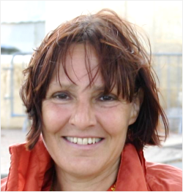
Intros: me and you?
What about you?
Me? Your lecturer
Dr Su White
Academic in ECS
saw@ecs.soton.ac.uk
Researcher in Learning Societies Lab
Why I am here
Senior tutor on the foundation year
Believe that all students can learn and succeed
Notes:
Objective to get some general feedback from the students – who are you, why are you here? This is also the opening question to the Portfolio interview
Establish the diversity of objectives, but also the commonality
Reminder – from induction….
Extra info - degree profile of students from FY same as that of A level point entry
Students may go on to do degree different to that first selected
Some students take the year a second time
Some students go on to study at another university
You have to pass the course to progress

Slide 5
Intros: Why We are here
Routes to success!
It’s a module
You have coursework
This is the lecture series
I want to make it useful
Each week we will rehearse part of the portfolio

Slide 6
Intros: The big picture
Notes:
1) Exam
2) Your motivations
3) Your progress
4) Self knowledge
5) Future Objectives

Slide 7
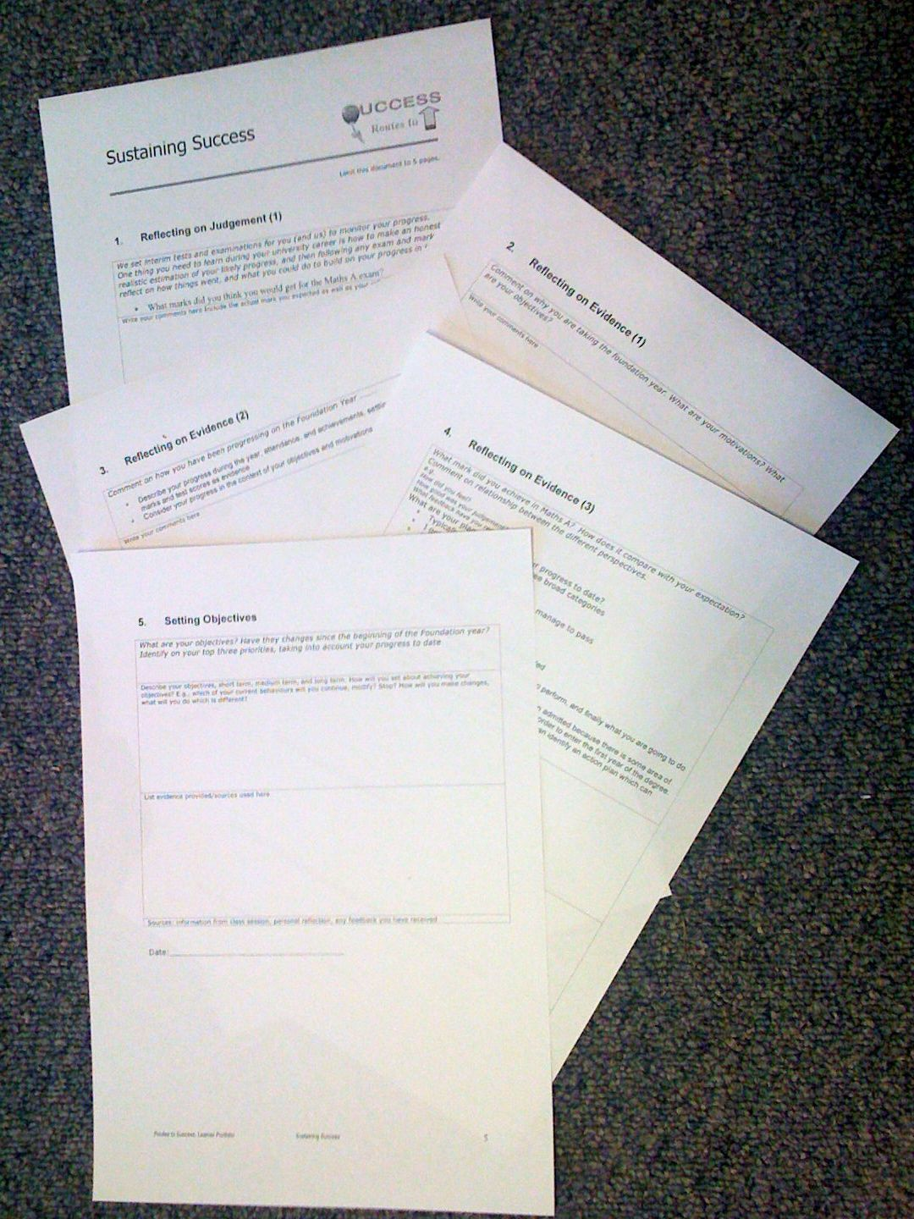
Intros: Look at the Portfolio
Notes:
Show the portfolio using the visualiser
Have a one page handout of the sections

Slide 8
Intros: what you have to think about

Slide 9
Intros:
What we will do
Weeks 1-5
Each week
will rehearse thinking
provide ideas for each section
Week 6
Handin your portfolio
Individual recorded interview

Slide 10
Intros: each section

Slide 11
Your objectives

Slide 12
Your formal objectives:
The module - Sustaining Success
Three portfolio components
Getting Started in Higher Education: November 2009 ✔
Making Progress: February 2010 ✔
Sustaining Success: 10-19 March 2010
Notes:
Recap on what has gone, and what is expected
Gauging the level of engagement, and motivation

Slide 13
Objectives (task)
Ambition, desire, need, want….
Identify your own objectives
Think for a moment…
What do you want to achieve?
Today
Tomorrow
This semester, year,
During the life of your degree
Should relate to why you are here :-)
Notes:
Relate the whole routes to success class back to the personal

Slide 14
About Feedback
How do we get it?
How? When? So What?

Slide 15
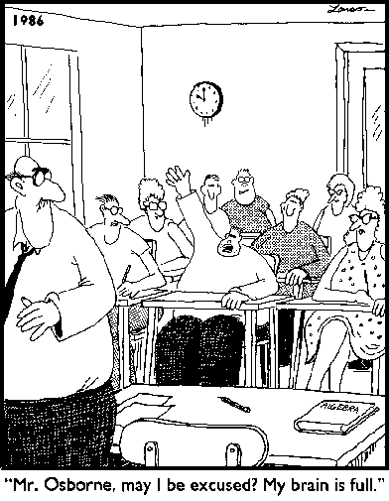
Varieties of Feedback: Full Brain?
Notes:
Opening for discussion of the range of types of feedback
Learning taking place in three domains
Cognitive
Affective
Psycho-motor

Slide 16
Tell me about this module
What have you done?
How do you rate it so far?
Obviously useful
Surprisingly useful
Still not sure
Don’t think it is helping
Notes:
Interactive discussion, write feedback on board/acetate

Slide 17
Reflection and Feedback 1
True of False?
You can only get feedback on your work from the lecturers or demonstrators
Notes:
Ask the question, get a vote, have some discussion

Slide 18
reflection and feedback 2
How can you get feedback from an exam?
Choose any which apply
Listen to the general feedback on how we all did
Think about how I did
Talk to fellow students about how we did
Read and analyse at my marked exam script
Attempt the exam a second time
Notes:
Discussion of different types of feedback
Relation between feedback and reflection
Peer learning

Slide 19
This week…

Slide 20
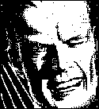
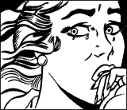
Maths A: How do we do it?

Slide 21
Thinking about your exam :-)
Before you took the exam..
1) What mark do you/did you expect to get for the exam?
70% or more -(excellent pass)
60-69% (good pass)
50-59% (pass)
40-49% (bare pass)
30-39% (near miss)
29% or less (unfortunately low)
Notes:
Same as previous slide
But also, point out difference in perceptions before and immediately after, its about learning, we are fine tuning our judgement
Folks
I think you will agree that Its important you get the most out of all the work you have put into the course, and that you do well in your exams. As you may be aware, I will be taking the routes for success sessions at the start of the new term. I have a simple request which I think can help with your long term success. Can you please each have a think about these following simple questions. and make a note of your answers ready for our first session.
They are designed to help you get feedback from the exam. I don't need to know the answers individually, but I will ask you to anonymously use this info during our first lecture session.
1) ***before the exam*** What mark do you/did you expect to get for the exam?
a) 70% or more -(excellent pass)
b)60-69% (good pass)
c)50-59% (pass)
d)40-49% (bare pass)
e)30-39% (near miss)
f) 29% or less (unfortunately low)
supplementary question, how do you feel about it? eg please, good, ok, resigned, disappointed (use your own words/phrases)
Why do you feel that way?
2) ***immediately after the exam*** What mark do you expect to get for the exam
a) 70% or more -(excellent pass)
b)60-69% (good pass)
c)50-59% (pass)
d)40-49% (bare pass)
e)30-39% (near miss)
f) 29% or less (unfortunately low)
supplementary question, how do you feel about it? eg please, good, ok, resigned, disappointed (use your own words/phrases)
Why do you feel that way?
that's it :-) Its good training to go through this process with any exam you take, but I will discuss that with you more when I see you in February. Meanwhile I hope you all do well in the exam and look forward to meeting you all next term.

Slide 22
Thinking about your exam :-)
Immediately after you took the exam..
1) What mark do you/did you expect to get for the exam?
70% or more -(excellent pass)
60-69% (good pass)
50-59% (pass)
40-49% (bare pass)
30-39% (near miss)
29% or less (unfortunately low)
Notes:
Designed to make explicit evaluation
Also point out that the bounds relate to class of degrees
Most students at soton get 2.1 or above
……
Email sent before class
Folks
I think you will agree that Its important you get the most out of all the work you have put into the course, and that you do well in your exams. As you may be aware, I will be taking the routes for success sessions at the start of the new term. I have a simple request which I think can help with your long term success. Can you please each have a think about these following simple questions. and make a note of your answers ready for our first session.
They are designed to help you get feedback from the exam. I don't need to know the answers individually, but I will ask you to anonymously use this info during our first lecture session.
1) ***before the exam*** What mark do you/did you expect to get for the exam?
a) 70% or more -(excellent pass)
b)60-69% (good pass)
c)50-59% (pass)
d)40-49% (bare pass)
e)30-39% (near miss)
f) 29% or less (unfortunately low)
supplementary question, how do you feel about it? eg please, good, ok, resigned, disappointed (use your own words/phrases)
Why do you feel that way?
2) ***immediately after the exam*** What mark do you expect to get for the exam
a) 70% or more -(excellent pass)
b)60-69% (good pass)
c)50-59% (pass)
d)40-49% (bare pass)
e)30-39% (near miss)
f) 29% or less (unfortunately low)
supplementary question, how do you feel about it? eg please, good, ok, resigned, disappointed (use your own words/phrases)
Why do you feel that way?
that's it :-) Its good training to go through this process with any exam you take, but I will discuss that with you more when I see you in February. Meanwhile I hope you all do well in the exam and look forward to meeting you all next term.

Slide 23
Feedback from previous years…
Available on EdShare
Notes:
This document is available from EdShare

Slide 24
Your Tasks
Somethings for you…
And the portfolio ;-)

Slide 25
Your tips for success
Think, pair, share
What are your top three tips for academic success?
Analyse how you have succeeded
I will be asking for feedback from some groups :-)

Slide 26
1) Progress review
Think about your progress so far this year
What will you continue?
What will you modify?
What will you stop?

Slide 27
Thank You :-)

Slide 28
Follow Up Activities..
Think about evidence…
Where will you get evidence?
What sort of evidence can you use?
Watch the video
Take a look at EdShare - how could you use it to assemble evidence?

Slide 29
Task: A vision of students today
Swap to web browser!
Work by Michael Wesch of Kansas State University - Digital Ethnography Project
Notes:
This is a five minute video clip which looks at the student experience from the students perspective
Opens up discussion into the tensions between academic and non academic life
Need for work life balance

Slide 30
Week I resources
These slides
The portfolio template
Portfolio Summary
Feedback from previous years
A vision of students today (video clip)
Notes:
Portfolio template handout on page with five boxes

