Slide 1
Politics and Privacy.
Kieron O’Hara
25 October 2009
Notes:
Please use the dd month yyyy format for the date for example 11 January 2008. The main title can be one or two lines long.

Slide 2
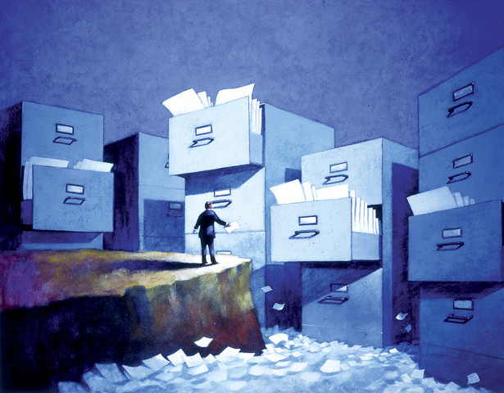
Practical Obscurity
Used to be our best protection
Information could be held, but not found easily
Information could be distributed over several sources
2

Slide 3
The Power of Digital Information
Longevity
Ease of copying & transfer
Accuracy of copying & transfer
Effective search
Power of amalgamated databases
Difficulties of suppression
Fluidity of identity/anonymity
Lack of centralisation of veridical representations
Few arenas for well-publicised error correction
Difficulty in identifying breaches
Difficulties of tracing
Comprehensiveness
Pervasiveness
Independence of medium
Compact
Attracts subterranean behaviour
… doubtless many more …
  Compare paper to all these
  Compare memory
  Compare gossip

Slide 4
Who Cares/Why Care?
Protection of freedom
Respect for persons
  Personal space
Autonomy (informed, uncoerced freedom)
I need to control access to:
  My person
  My decisions
  Information about me
But much depends on what privacy actually entails

Slide 5
Ambiguity of Public/Private
What is a private space?
  This room?
A relative concept? Cf. Habermas
What about the Web?
  Private communications
  Public infrastructure

Slide 6
Types of Privacy
Epistemological privacy
Spatial privacy
Ideological privacy
Decisional privacy
Economic privacy

Slide 7
(i) Epistemological Privacy
You have no right to learn or broadcast information about me
  Information could be used to identify me
  The threat of release of information could be used to prevent my acting
  Information about me could prevent or hinder me from public action
  Information could be false
Libel, slander, data protection laws
Accountability, transparency
Regulation of markets for information
Information spreads like wildfire online

Slide 8
(ii) Spatial Privacy
You have no right to intrude in my space (either real or metaphorical)
  Space needed for reflection
  Space needed for intimate relations
  Space needed for autonomy
Political argument determines the boundaries between public & private space (Mill)
Online space – little understood, poorly regulated
  Server logs
  Hacking

Slide 9
(iii) Ideological Privacy
You have no right to prevent me from, or punish me for, having particular political or religious beliefs
Tolerant society
Democratic government
Perceptions of danger
Censorship
The Web is a prime arena for extremism and minority interests
  Some harmless, others not
  Perceptions of harm differ

Slide 10
(iv) Decisional Privacy
You have no right to interfere with my making some decision
  Freedom of action is curtailed
Enforceable and enforced rights
Need to be able to argue that the decision doesn’t affect others
Special problem for cyberspace?
  Decision-making is liberated by architectures (Lessig)

Slide 11
(v) Economic Privacy
You have no right to prevent me from exchanging resources over which I have appropriate property rights
Trading society
Respect for law, contracts
Gov’t respect for free trade
Danger from morality watchdogs, impecunious gov’ts
The rules for e-commerce are still evolving
Special case of (iv)

Slide 12
Rights and Preferences
Is privacy a right or a preference?
Right = entitlement
Preference = appears high up in ranked list of choices
I have a right to life and a preference for champagne
Rights are inalienable (cannot be given away)
  I cannot swap my right to privacy for a right to champagne

Slide 13
Generational Issues
The young are keen consumers and generally unconcerned
  Palfrey & Gasser, Born Digital
Uninterested in informational privacy
Lack of awareness
Will attitudes change?
  What will be the effects on identity?
  What will be the effects on biography/reputation?
Ignorance among potential teachers
What is legitimate in a democracy?

Slide 14
Why Not Privacy?
Ideological criticisms of liberalism
  Postmodernism
  Conservatism
  Socialism
  Green theory
  Identity politics
  Asian values
  Islamism
Theoretical arguments against privacy (a)-(e)
Pragmatic arguments against privacy (f)-(g)

Slide 15
(a) Egalitarianism
To the extent that equality of outcomes is important, you cannot have total control of your private space
Your private property may have to be distributed against your wishes
Policy: increased transparency in financial matters
  Increased access for disadvantaged to ICT

Slide 16
(b) Communitarianism
Amitai Etzioni, The Limits of Privacy
Community is trumps
  Individual rights make sense only against the background of a community that creates and defends them
  ∴Communities have rights too!
Policy: increased transparency in social & political matters
  Rights of community to access your laptop

Slide 17
(c) Too Much Private
Richard Sennett, The Fall of Public Man
Public life is being increasingly intruded upon (judged) by private concepts
  Erosion of strong public life
Policy: Focus on impersonal
  Closing off of political space and debate
  Critique of blogging

Slide 18
(d) Feminism
The private space is often a space for oppression
  Domestic violence
  Child abuse
  Public authorities reluctant to intervene
  Prejudice against women in the workplace
Policy: increased transparency
  Emails
  Surfing trails
  More explicit rule-following

Slide 19
(e) Sousveillance
David Brin, The Transparent Society
“Privacy” protects the powerful against the weak
  Everyone wants to increase their own privacy
  Everyone wants to decrease that of others
  Enforcing rights to privacy is a rich man’s game
  The truly liberal solution is to watch the watchers
  Make all information open to everyone
Policy: reciprocal transparency

Slide 20
(f) Security/Efficiency
Various competing goods in society
  Under current circumstances, security outweighs privacy
  Gov’t actions more effective with the right data
    Singaporean argument
    Prosperity provides legitimacy
Policy: increased transparency
  Surveillance
  Amalgamation of information
    Singaporean approach (SingPass)
    UK approach (Transformational Gov’t)

Slide 21
(g) Realism
The information is out there
  Privacy is a normative concept
  But information is de facto unstoppable
  We need to ensure information is accountable, and usage is transparent
Policy: pursuit of compensation, not remedy
  Accountability of information users
  Accountability of informants
  Transparency of use
  Shift from hiding information to defining misuse

Slide 22
Accountability
Policy Aware Web
  Weitzner et al, http://www.w3.org/2004/09/Policy-Aware-Web-acl.pdf
  http://www.policyawareweb.org/
Use Semantic Web technology
  Rule-based policy management system
  Exchange rules and proofs on the SW
Shift from enforcement to transparency
Tied up in court?

Slide 23
Consent
I give consent for my personal data to be used
What is personal data?
How can I enforce this?
Consent model: presumption that information cannot be used without permission
Accountability model: presumption that information will be used under conditions

Slide 24
Conclusions
Privacy is hard to define and hard to protect
Current legal approaches try to balance individual and community rights
  Data protection
Consumerism and apathy
Cultural differences

Slide 25
Readings
Beate Rössler, The Value of Privacy
  Liberal defence of the right to privacy
Amitai Etzioni, The Limits of Privacy
  Communitarian attack on individual rights to privacy
Adam D. Moore (ed.), Information Ethics
  Collection of classic papers
Simson Garfinkel, Database Nation
  Early warning of trouble
David Brin, The Transparent Society
  Defence of the radical idea of sousveillance
Lawrence Lessig, Code
  Discussion of the relationship between architecture and regulation
Kieron O’Hara & Nigel Shadbolt, The Spy in the Coffee Machine
  Review of various technologies and their effects on privacy

