Slide 1
COMP6043 Week 5 Survey Systems November 2009
Dr Su White

Slide 2
The plan
I may skip over some slides, but use them as notes
Survey Tools – The Landscape
Comparative Functionality
Selecting the right question type
Next Steps
Notes:
5/10 WK 1 Background and course structure by LC & SAW Susan White: anecdotal tales of an exemplar of interdisciplinary research.
12/10 WK 2 Comparison/ Social science methodologies (Gerry Stoker introduced by LC. SAW to listen.) BOTH LECTURES ACTUALLY ON THURSDAY 10-11:30
19/10 WK 3 Research design Su White?
Background and course structure by LC & SAW Su White: anecdotal tales of interdisciplinary research. Intro by CP Methodology & method, strategies and underlying philosophies Disciplinary and paradigm differences and how they influence research practice 12/10 Comparison/ Social science methodologies Prof Gerry Stoker . BOTH LECTURES ACTUALLY ON THURSDAY 10-11:30 Experiments /causality Prof Gerry Stoker 19/10 Research design

Slide 4
Opening Protocol
Surveys will often be anonymous
but you might still want some demographics
Example
Gender

Slide 5
Walk through Survey

Slide 6
Demographics
Surveys will often be anonymous
but you might still want some demographics
Example
Gender

Slide 7
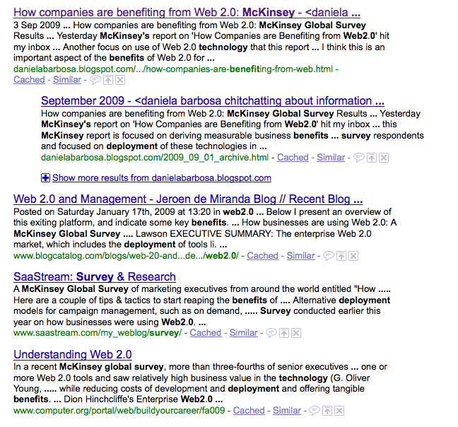
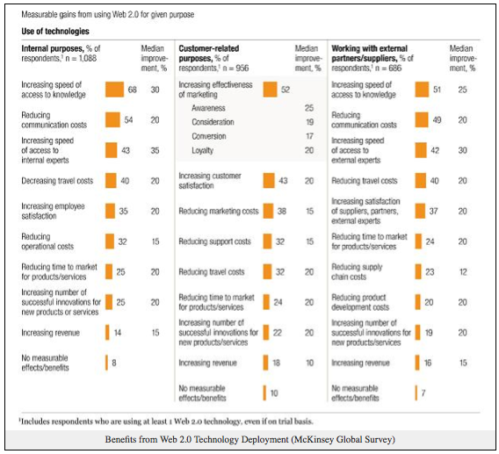
Surveys grab attention…

Slide 8
Approaching a survey

Slide 9
Purpose
Why do we conduct research?
Validate
Confound
Generate new evidence
What sort of evidence
Convincing
Objective
Valid
Does this raise issues?
Enable analysis
Generate Conclusions
Publication

Slide 10
Purpose: to publish…
This is the way the world is (survey?)
This is what is wrong with the world (evidence?)
This is my startling idea (paradigm/epistemology?)
This is what I found (valid method, evidence and conclusions)

Slide 11
Paradigm
Epistemology
Will determine where we start
Where we want to engage in discourse
May constrain our beliefs
May determine the contents of our survey
Methodology
What sort of survey?
What sort of data
Anticipates analysis

Slide 12
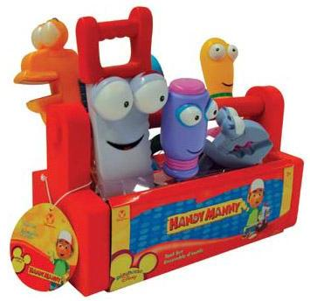
Paradigm: What tools do we have?
Methodology – a way of thinking about or studying (social reality)
Method – a set of procedures and techniques for gathering and analysing data
Analytical Processes – the application of set techniques appropriate to quantitative or qualitative methodologies
Thanks (in part) to Strauss and Corbin)
Notes:
Background and course structure by LC & SAW Su White: anecdotal tales of interdisciplinary research. Intro by CP Methodology & method, strategies and underlying philosophies Disciplinary and paradigm differences and how they influence research practice 12/10 Comparison/ Social science methodologies Prof Gerry Stoker . BOTH LECTURES ACTUALLY ON THURSDAY 10-11:30 Experiments /causality Prof Gerry Stoker 19/10 Research design

Slide 13
Paradigm: an example…
Folksonomies are internet based collections of user assigned labels, or “tags”, for web resources. There is a debate within the Web Science community as to the importance of social tagging in general, and folksonomies in particular.
This report surveys a range of current social tagging systems and distinguishes between true folksonomy systems such as Del.icio.us, which attempt to enhance the classification of resources, and simple tagging systems such as Flickr, which merely improve description.
The paper concludes by describing some research work in progress to extract semantic metadata from folksonomies in order to improve search engine performance.

Slide 14
Protocols
Ethics, Privacy and Data Protection
Just think about the personal…
You are asking for information
Respect your contributors

Slide 15
Pragmatics
Constraints
Timing and access
Population/sample size
Consequences
Data Volume
Design
Expertise
Tools
Draft and Review
Solutions
Smart surveys
Existing data
Previous Surveys
Sanity Check
Peer Review
Process
Pre-test/Trial/Pilot …then survey
Follow up survey

Slide 16
Pragmatics – bringing it together
What you want to explore/find out/prove/discover
Who will you interview
How you will do it
What you will ask
Pre-test, pilot
Conduct survey/collect data
Analyse data
Interim conclusions/discussion/
Draft, review, publish

Slide 17
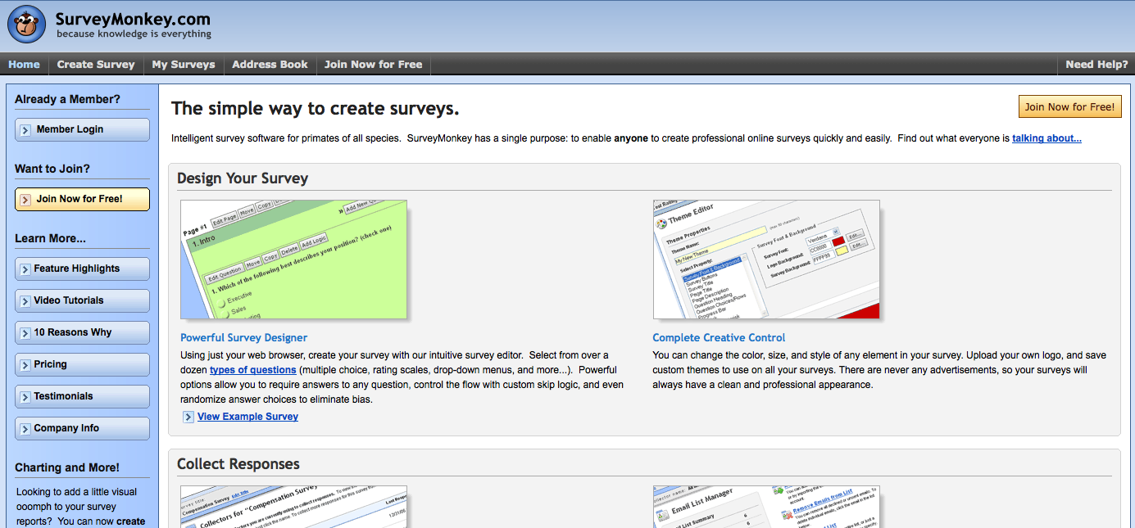
Pragmatics: some options

Slide 18
Pragmatics – some options
Thanks to Tony Hirst http://ouseful.wordpress.com/2009/02/17/creating-your-own-results-charts-for-surveys-created-with-google-forms/

Slide 19
References
for background and related material and references please see the course web page
de Leeuw et al, 2008
International handbook of survey methodology
http://www.xs4all.nl/~edithl/surveyhandbook/contents.htm

Slide 20
my details
Dr Su White
saw@ecs.soton.ac.uk
+44 (0)23 8059 4471
http://www.ecs.soton.ac.uk/~saw

Slide 21
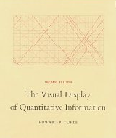
Further Reading
Moore McCabe and Craig - Introduction to the practice of statistics (and associated excel manual)
Tufte – The visual display of quantitative analysis

