Slide 1
The Spatial Hypertext Model and Temporal Hypertext
Hugh Davis
hcd@ecs.soton.ac.uk
Slides on https://secure.ecs.soton.ac.uk/module/0910/COMP3016/

Slide 2
What is Spatial Hypertext?
Tools for supporting emergent structure
Tools to visualise implicit or explicit relationships

Slide 3
Tools that Support emergent structure
a visual/spatial metaphor allows people to express the nuances of structure, especially ambiguous or partial
Focus on creation of structure
As well as spatial properties
Colour
Border
Shape
font
These tools suport common understanding
Less confusing than networks
Represent implicit stucture and explicit structure

Slide 4
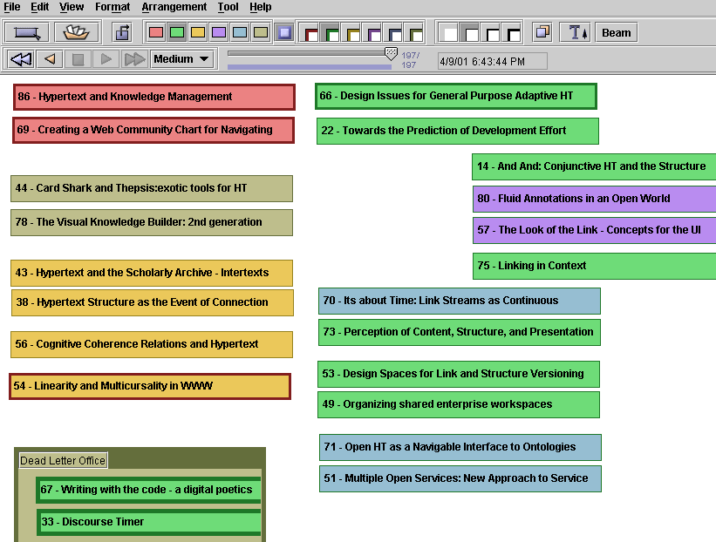
VKB

Slide 5
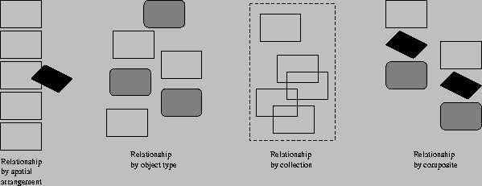
Structure and Spatial HT
Aggregates arranged by
Spatial arrangement
Object type
Collection (user selects)
Composite (defined by template)

Slide 6
Spatial Parsers
produce explicit structure by interpreting the implicit structure in a space.
The problem is for the parser to understand what structure is deliberate and what is not intended.
Rely heavily on heuristics determined for the user

Slide 7
Structure Parsing in VIKI
VIKI performs a bottom-up hierarchical parse using empirically-determined heuristics
Recognition is based on three attributes of visual symbols;
position,
extent
object type.
The order of structure recognition is:
Aggregates based on overlaps.
Sets based on homogeneity and alignment are found.
Then composites are located.
Found structures are re-parsed according to the same rules to find higher level structures

Slide 8
Structures the parser might recognise

Slide 9
Spatial Hypertext Systems
Much of the literature is based around systems that have arisen from a particular line of SHS
Notecards
gIBIS
VNS
Aquanet
VIKI
VKB
This work emerged almost exclusively from Xerox Parc
We will now look at some other related work

Slide 10
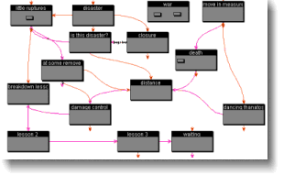
Storyspace (www.eastgate.com)
Storyspace is a hypertext writing tool..
provides a variety of maps and views to help writers create, organize, and revise dynamically.

Slide 11
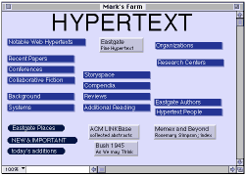
Websquirrel (www.eastgate.com)
Spatial URL shortcut/ bookmark organizer

Slide 12
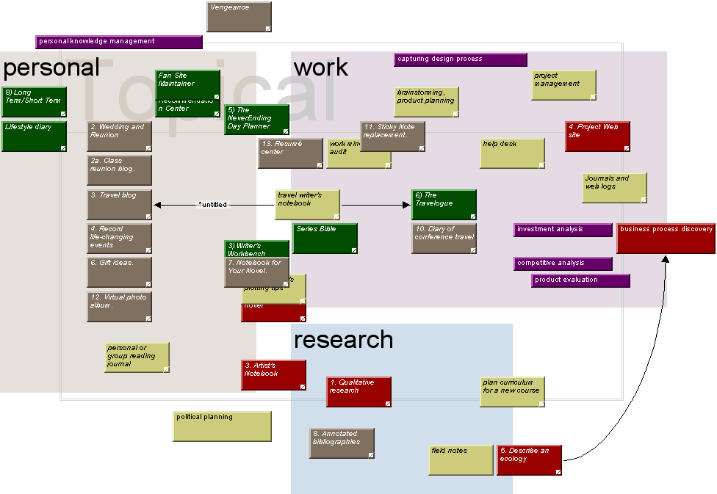
Tinderbox (www.eastgate.com)
A personal content management assistant
Agents that help to build structure from content

Slide 13
Cybergeography
See http://www.cybergeography.org/atlas/
Lots of research using visual tools to map
The topology of hyperspace
People’s browsing through hyperspace
The social structures of hyperspace
Individual web site maps
Important hypertext research in this area
Visualising hypertext link clusters by presenting nodes in 3D space
Better search engines (identifying hubs and authorities)

Slide 14
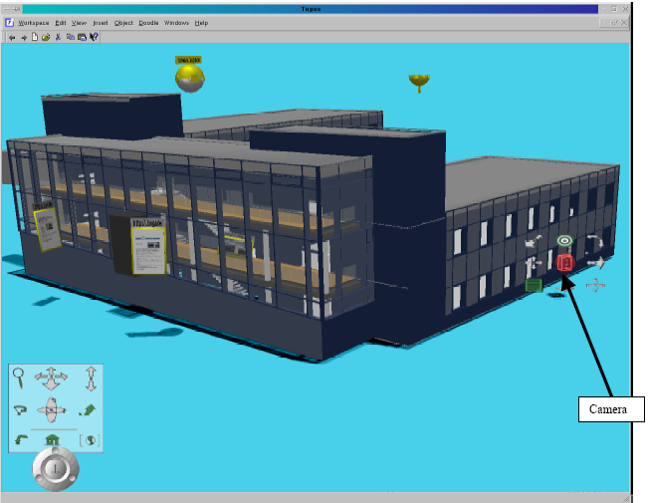
Augmented Reality and Geospatial Systems
Links are placed over virtual reality images
The goal is to be able to walk around with specs on that superimpose the virtual on the real

Slide 15
Hypertext and Time

Slide 16
Time Based Hypertext
The business of inserting links into temporal and continuous media (sound, animations and video)
Links can be for
Providing hypertext jumps to other contexts
Annotation of the current item playing
Synchronization of multiple media

Slide 17
Issues that arise in Putting Links into Multimedia
Embed the links or point from outside?
Standards
If embedded – what format media does this?
If linking by reference, how to describe the place the link is?
QOS issues (and will things happen when they should?)
These notes will look at some important works in the area and highlight their significant contributions

Slide 18
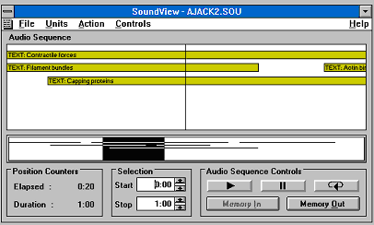
Microcosm Sound Viewer (c. 1993)

Slide 19
Sound Viewer
Early innovative work on putting jump links into sound files
Top window shows clickable links and bar is the “now point”
Bottom window shows top window in context of whole file
Links can be user activated or automatically invoked (decided by author)
Link anchors described as start and finish times in seconds through file

Slide 20
Southampton Work on links in Video
Microcosm also supported links in Video using principally the same idea, visible links appeared as polygons within the picture, and could be authored so that they moved with an object.
Later improvements in Windows component technology made it possible to develop a version of this framing the Windows Media Player.
Later work at Southampton has implemented combining streamed mm data (RTP / RTCP) with streamed metadata.
The Bay 2 Presentation

Slide 21
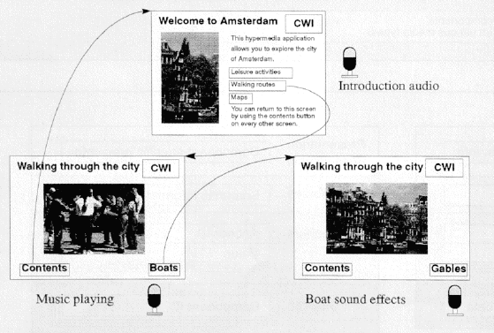
The Amsterdam Hypermedia Model c. 1994
Basically concerned with provision of systems to author multimedia presentations and synchronise multiple data streams

Slide 22
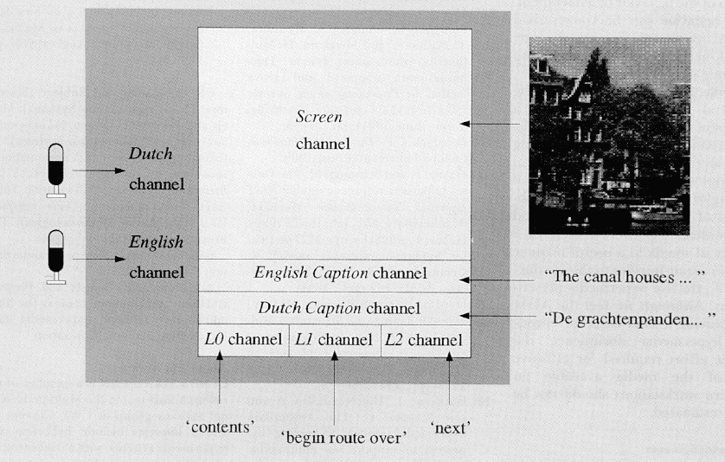
The model had an idea of parallel “channels”
Links into temporal media could be “offset” by some time.
But clickable links were limited to stationary hotspots
This work developed into SMIL

Slide 23
HyTime
Hypermedia/Time-based Structuring Language ISO/IEC 10744:1992 (and version 2 1997)
Added sophisticated cross document links to SGML – the predecessor to XML
The link mechanism is the basis of Xlink/ XPointer
Hub Document for linkbases
Multiple ways of doing links with sophisticated location addressing by
Name (inserted in the SGML)
Counting (including Document trees and reverse counts)
(HyTime allowed counting in non SGML docs too)
Query (find the bit that matches this HyQ query)
(note the similarity to Microcosm and use of OPAQUES)

Slide 24
An Opaque HyTime Link

Slide 25
MPEG-7
MPEG-7 is a standard for describing features of multimedia content.
formally named “Multimedia Content Description Inter-face
describes multimedia content so users can search, browse, and retrieve that content (search engines for Multimedia)
MPEG-7 uses XML Schema for content description and is interoperable with other content description langauges (Dublin Core etc)

Slide 26
MPEG-7
descriptions are based on
catalogue (e.g., title, creator, rights)
semantic (e.g., the who, what, when, where information about objects and events)
structural (e.g., the colour histogram - measurement of the amount of colour associated with an image or the timbre of an recorded instrument)
The ability to describe objects within media means that we can also link to them
We can create semantically generated dynamic links – and semantic search engines

Slide 27
SMIL
Synchronized Multimedia Integration Language, the W3C format for multimedia on the Web
XML syntax encodes the
Timing
screen layout
interaction
adaptivity.
Uses CSS, XPointer, XLink and namespaces
Nested par (parallel) and seq (sequence) elements
Switch element, which establishes alternative means of presenting the same information (e.g. for different users or different displays)
Originally link start points were pretty simple
Latest versions look more and more like HyTime and include animation in XML

