Slide 1
Software Engineering: Models
David Millard
(dem@ecs.soton.ac.uk)

Slide 2
Overview
Definitions of Modeling
UML Use Case Diagrams (recap)
A Modeling Problem
UML Activity Models
What are they?
How do you create them?
When do you use them?

Slide 3
Definitions
Modeling (n)
“A modeling language is any artificial language that can be used to express information or knowledge or systems in a structure that is defined by a consistent set of rules. The rules are used for interpretation of the meaning of components in the structure.”
Wikipedia
"Modeling has been an essential part of engineering, art and construction for centuries. Complex software designs that would be difficult for you to describe textually can readily be conveyed through diagrams. Modeling provides three key benefits: visualization, complexity management and clear communication.”
IBM
“Some development managers wonder why modeling is important at all. After all, the code should speak for itself… Why add an extra layer of abstraction that we have to maintain as the project progresses? The reason is that there are a number of clear benefits that models provide a development organization. They are enhanced communication, better planning, reduced risk, and reduced costs”
Software Modeling Introduction – Borland White Paper

Slide 4
Definitions
Modeling (n)
“A modeling language is any artificial language that can be used to express information or knowledge or systems in a structure that is defined by a consistent set of rules. The rules are used for interpretation of the meaning of components in the structure.”
Wikipedia
"Modeling has been an essential part of engineering, art and construction for centuries. Complex software designs that would be difficult for you to describe textually can readily be conveyed through diagrams. Modeling provides three key benefits: visualization, complexity management and clear communication.”
IBM
“Some development managers wonder why modeling is important at all. After all, the code should speak for itself… Why add an extra layer of abstraction that we have to maintain as the project progresses? The reason is that there are a number of clear benefits that models provide a development organization. They are enhanced communication, better planning, reduced risk, and reduced costs”
Software Modeling Introduction – Borland White Paper

Slide 5
Definitions
Modeling (n)
“A modeling language is any artificial language that can be used to express information or knowledge or systems in a structure that is defined by a consistent set of rules. The rules are used for interpretation of the meaning of components in the structure.”
Wikipedia
"Modeling has been an essential part of engineering, art and construction for centuries. Complex software designs that would be difficult for you to describe textually can readily be conveyed through diagrams. Modeling provides three key benefits: visualization, complexity management and clear communication.”
IBM
“Some development managers wonder why modeling is important at all. After all, the code should speak for itself… Why add an extra layer of abstraction that we have to maintain as the project progresses? The reason is that there are a number of clear benefits that models provide a development organization. They are enhanced communication, better planning, reduced risk, and reduced costs”
Software Modeling Introduction – Borland White Paper

Slide 6
Definitions
Modeling (n)
“A modeling language is any artificial language that can be used to express information or knowledge or systems in a structure that is defined by a consistent set of rules. The rules are used for interpretation of the meaning of components in the structure.”
Wikipedia
"Modeling has been an essential part of engineering, art and construction for centuries. Complex software designs that would be difficult for you to describe textually can readily be conveyed through diagrams. Modeling provides three key benefits: visualization, complexity management and clear communication.”
IBM
“Some development managers wonder why modeling is important at all. After all, the code should speak for itself… Why add an extra layer of abstraction that we have to maintain as the project progresses? The reason is that there are a number of clear benefits that models provide a development organization. They are enhanced communication, better planning, reduced risk, and reduced costs”
Software Modeling Introduction – Borland White Paper

Slide 7
Unified Modeling Language
UML - Unified Modelling Language - 3 creators:
Grady Booch, Ivar Jacobson and James Rumbaugh
started in early 1990’s
A visual language for developing software systems

Slide 8
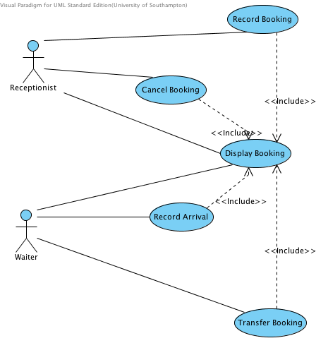
UML Use Cases to capture requirements
Use cases model
What the system should do
Who uses (benefits from) the system
From the user’s point of view

Slide 9
…but how to capture behaviour?

Slide 10
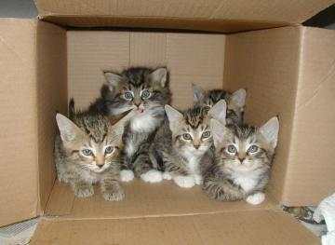
…but how to capture behaviour?
Inside the box!

Slide 11
Problem
With a partner draw a diagram to capture the following process (as if you were graphically describing it):
“You’re dozing in bed, waiting for your alarm. When it goes off you get up, get dressed and go downstairs. You make some breakfast and eat it while reading the morning paper. When you finish you leave the house.”

Slide 12
Look at Your Diagram
What were the features of your diagram?
Actions or Events
…

Slide 13
Look at Your Diagram
What were the features of your diagram?
Actions or Events
Sequence
Parallel
A Start and Stop
Decisions
Logical Partitions?

Slide 14
UML Activity Diagrams
UML Equivalent of a FlowChart
Provides a high level view of what’s going on inside a Use Case
(Is a variation of a UML State Diagram)

Slide 15
UML Activity Diagrams
Is based on:
Activities
Linked with Transitions
With one Start and one Stop
Start
Activity
Transition
Activity
Stop
Get Up
Get Dressed

Slide 16
UML Activity Diagrams
Decisions points (branches) are written as diamonds
A Branch has an optional description
Transitions out of a branch are labeled (guard conditions)
Branch
Alarm gone off?
Doze
Get Up
[Yes]
[No]
Guard Conditions

Slide 17
UML Activity Diagrams
Bars (Forks and Joins)
Used to show that things happen in parallel
Or to bring together several transitions
Fork
Join
Eat Breakfast
Make Breakfast
Leave House
Read Paper

Slide 18
Putting it All Together
Alarm gone off?
[Yes]
Doze
Get Up
Get Dressed
[No]
Go Downstairs
Eat Breakfast
Make Breakfast
Leave House
Read Paper

Slide 19
Adding Swimlanes
Alarm gone off?
[Yes]
Doze
Get Up
Get Dressed
[No]
Upstairs
Go Downstairs
Eat Breakfast
Downstairs
Make Breakfast
Leave House
Read Paper

Slide 20
Adding Swimlanes
Swimlanes partition a diagram
Used to show different logical areas
Diagrams can often be partitioned in different ways
According to a Phase
According to the Actor
According to Department
There is no right way
Partition in whatever is the most useful way

Slide 21
When to use Activity Diagrams?

Slide 22
When to use Activity Diagrams?
When analysing a use case
What actions are there and when do they happen?
This is sometimes called Workflow
Useful for communicating order and dependency
But they do not show Interactions, Data or State
Other UML diagrams for this!

Slide 23
Summary
Modeling is
An abstract representation…
…of some complex knowledge or design…
…to help communicate it
UML Use Cases model requirements from the user view
UML Activity Diagrams model workflow from the system view
Formal version of flowcharts
Activity Diagrams include:
Branching (decision making)
Forks and Join (parallel activities)
Swimlanes (logical partitioning)

