Slide 1
Coming up
Variables
Quick look at scope
Primitives | Objects
defined in Java | defined in classes
stored in variables directly | references stored in variables
Pass a copy | Pass a reference

Slide 2

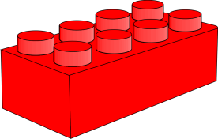
Lecture 3
OO
Chucking variables around

Slide 3
So far we know
that variables store ‘things’ like ints, booleans and elephants

Slide 4
What is a variable?
it’s also known as a field
it can store a primitive type
it can store an object reference

Slide 5
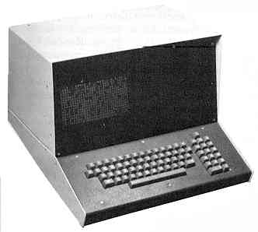

What is a primitive?
OO
Not one of these
or these
Primitive types are defined in Java
Primitive types are stored in variables directly
Primitive types are “passed by value”
eg: int, char, boolean

Slide 6
What is an object type?
OO
Object types are those defined in classes
Variables store references to objects
Passing a reference is not passing a copy
eg Dog, Array, Connection
Are you a little confused yet?

Slide 7
The Big Picture
Primitives | Objects
defined in Java | defined in classes
stored in variables directly | references stored in variables
Pass a copy | Pass a reference

Slide 8
Defined in the Language
Data types like:
  int whole numbers
  float floating point numbers (i.e. decimals)
  char a single character
  boolean true or false
  and some others are taken care of by the Java language. We just use them

Slide 9
The Big Picture
Primitives | Objects
defined in Java | defined in classes
stored in variables directly | references stored in variables
Pass a copy | Pass a reference

Slide 10
Defined in Classes
OO
1 is a primitive of type int
nellie is an object of type Elephant
Objects can be of a type defined by:
  a class you write
  a class someone else writes
    Sun have a library of useful classes, ones that can read files on your computer or output sounds and many other tasks. We use these a lot later on.

Slide 11
The Big Picture
Primitives | Objects
defined in Java | defined in classes
stored in variables directly | references stored in variables
Pass a copy | Pass a reference

Slide 12
Cups
A variable is a space in memory that the computer uses to store a value
It’s like a cup
int myNumber;
myNumber = 7;
A primitive ‘fits into’ a cup
myNumber
7
int

Slide 13
The Big Picture
Primitives | Objects
defined in Java | defined in classes
stored in variables directly | references stored in variables
Pass a copy | Pass a reference

Slide 14
Objects and cups
OO
An object does not fit into a cup...
Elephant nellie;
nellie = new Elephant();
So what does Java do?
nellie
Elephant?!?!

Slide 15
Remote controls
Java leaves the elephant object in memory somewhere...
And references it – like using a remote control

Slide 16
Elephant nellie;
nellie = new Elephant();
nellie.eat();
Memory
nellie
Nom
Nom
Nom
Eat
Elephant
Sleep
Trumpet

Slide 17
The Big Picture
Primitives | Objects
defined in Java | defined in classes
stored in variables directly | references stored in variables
Pass a copy | Pass a reference

Slide 18
Pass a copy
a
int a;
a = 10;
int b;
b = 5;
int c;
c = a;
c = 2*c;
b = a*c;
10
b
int
200
5
c
int
10
20
int

Slide 19
The Big Picture
Primitives | Objects
defined in Java | defined in classes
stored in variables directly | references stored in variables
Pass a copy | Pass a reference

Slide 20

Object assignment
OO
Memory
Student a;
a = new Student();
Student b;
b = new Student();
Student c;
c=a;
a=b;
c=b;
c=null;
a
b
c

Slide 21
A word about Local variables
Fields are one sort of variable.
  They store values through the life of an object.
  They are accessible throughout the class.
Methods can include shorter-lived variables.
  They exist only as long as the method is being executed.
  They are only accessible from within the method.
This is called scope. It is covered in detail later in the course.

Slide 22
The rule of thumb...
...is that a variable can be seen anywhere within the {} that it was declared in

Slide 23
public class canYouSeeMe{
int number = 5;
public void doodah(){
String word = “hello”
}
public void dahdoo(){
number =10;
}
public void printer(){
doodah();
dahdoo();
System.out.print(word + “ “ + number);
}
}
What happens when this is run?

Slide 24
Local variable example from BlueJ Book
A local variable
public int refundBalance()
{
int amountToRefund;
amountToRefund = balance;
balance = 0;
return amountToRefund;
}
No visibility
modifier

Slide 25
Summary
Primitives | Objects
defined in Java | defined in classes
stored in variables directly | references stored in variables
Pass a copy | Pass a reference
a variable can be seen anywhere within the {} that it was declared in

