Slide 2
Writing your Project Report
COMP3200 Part III Individual Project
Nick Gibbins
21st November 2024

Slide 3
tl;dr
Hand your report in on time
10% penalty per day!
Keep to the word limit
Don’t use more than 3,000 words in the main body of your progress report
Don’t use more than 10,000 words in the main body of your final report
Proof-read your report
Perhaps swap-read with a friend
Ideally someone with better writing skills than you ☺
Use proper references
Leave plenty of time in case of delays

Slide 4
Typical progress report content
Clear statement of the problem and project goals
Review of the background literature
Analysis of problem and specification of the solution
Description of work to date: high-level design, initial implementation
Project plan
References to the literature
Appendix
copy of original project brief, one or more Gantt/PERT charts

Slide 5
Typical final report content
Clear statement of the problem and project goals
Review of the background literature (possibly expanded from progress report)
Analysis of problem and specification of the solution
Detailed design
Description of implementation
Testing strategy and results
Critical evaluation
Conclusions and future work
References to the literature
Appendix
copy of original project brief, one or more Gantt/PERT charts

Slide 6
Typical report structure: Front matter
Title page
Abstract
Table of contents
Acknowledgments
Statement of originality

Slide 7
Typical report structure: Main body
Introduction describing the problem
Review of literature/previous approaches
Description of final approach
4... Discussion of system implementation or experiments
n-1.Results and discussion
n. Conclusion and proposal of further work and ideas
References (not included in word count)

Slide 8
Typical report structure: Appendices
Copy of your initial project brief
Time/project management (if not covered earlier)
Updated Gantt/PERT chart(s)
Cost breakdown
Table of contents of your design archive, …

Slide 9
Talk to your supervisor!
Your supervisor will advise on structure
Every project is different
You may need to vary the typical structure
Don’t expect your supervisor to proof-read your report
If you are dyslexic, Student Disability and Wellbeing may be able to help
If your written English is particularly poor, you may need to use a professional proof reader, but this is expensive and slow
https://www.southampton.ac.uk/edusupport/study_support/index.page

Slide 10
Look at:
The “project report standards” pages in the detailed project guidelines
The project marking scheme
Reports from past projects (available online at link below)
Ask your supervisor to show you some examples
https://secure.ecs.soton.ac.uk/notes/comp3200/e_archive/

Slide 11
Detailed Advice

Slide 12
Things you should know
How to use your word processor
To use styles, chapter and section numbering, …
To check your spelling and grammar
To generate a table of contents
How to use a reference manager
EndNote, Mendelay, Zotero, etc
What your supervisor and examiner expect
Appropriate report format and structure
Appropriate writing style (use of personal pronoun)
Notes:
Chapters start on a new page
Overlea

Slide 13
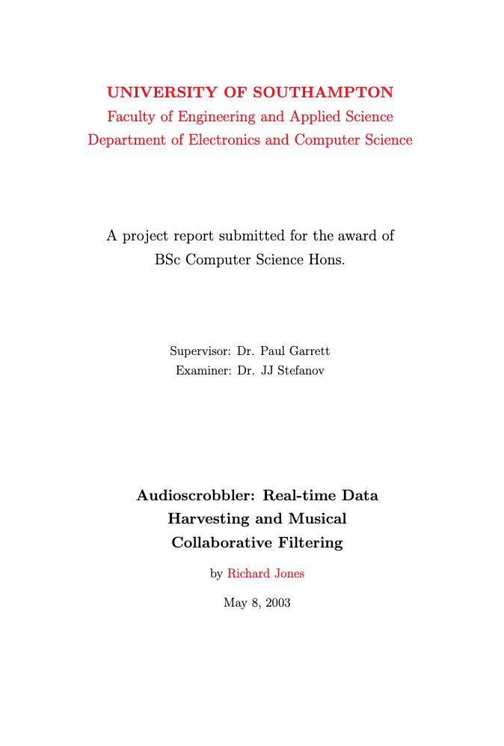
Why do you need to write a report?
So you can qualify as
an honours graduate (this report is your dissertation)
an engineering professional (and get a job)
So you can defend yourself
to any third examiner
e.g. if you are on a borderline
and (perhaps in future) in a court of law

Slide 14
Writing to a word limit
Set yourself a word budget for the sections of your report
(and be prepared to revise that budget if necessary)
Use concise language
Use figures, diagrams, photographs, tables where appropriate
Move detailed material to the appendix*
* Remember to cite your figures (fig. 1) and appendix (see appendix A) as well as your external sources

Slide 15
Approaches to writing
Top down
Start with a list of chapters
Add section and sub-section headings
Write each section
Bottom up
Start by writing something
(whatever seems important)
Arrange the material into sections and chapters
In reality – you will do a mixture of both

Slide 16
Writer’s block
Some of you may struggle to start
You get stuck trying to perfect your first sentence
You are distracted by displacement activities
You can’t start writing yet because you are still building/testing/etc
This is an engineering document
“fit for purpose”; doesn’t need to be perfect
Don’t wait for inspiration to strike!
Professional writers are usually very disciplined
They write a certain amount of words every day
Often in the same time and the same place – get into a routine
Notes:
The imperfect report you write is better than the perfect one you don’t

Slide 17
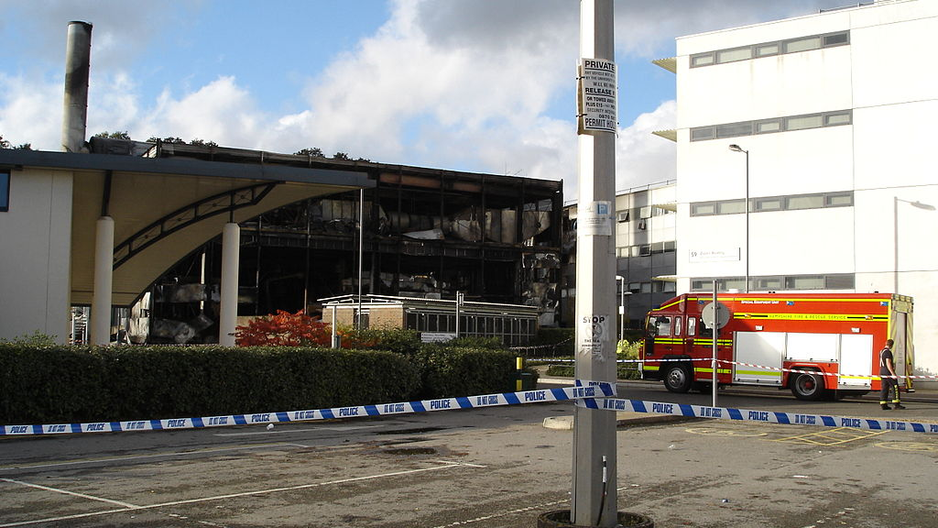

Slide 18
Backing up
It is certain that one of you here will suffer a hard disk crash, or burglary, or fire, or…
You must be able to carry on regardless
In severe cases we can allow one or two days extra, but don’t expect several weeks
Keep backups online (the University provides OneDrive)
Keep physical backups in a separate room and building

Slide 19
Statement of Originality
You should include a statement of originality using the ECS template (see link below)
“this is all my own work” is rarely true
You should acknowledge the help you have received
Was the idea for the project yours, or was it based on an earlier project, or your supervisor’s research?
Your examiners will assume that the analysis, design, implementation, testing, … are your own work
Tell them explicitly where this is not the case
e.g. “the design of component X follows a standard technique/pattern described in [...]”
e.g. “this is my own code except for <package/class/method> which I have taken from [...]”
https://secure.ecs.soton.ac.uk/notes/ai/ai_statement.pdf

Slide 20
Recycling (self-plagiarism)
Normally, you would be penalised if you re-use material from one assignment in another (see §1.3.6 in University regulations below)
In this case you are encouraged, however, to copy all or part of your progress report
This is okay because it’s all part of the same project
It is taken into account in the mark scheme
https://www.southampton.ac.uk/about/governance/regulations-policies/student-regulations/academic-integrity

Slide 21
Project marking scheme
The examiners will consider:
Your progress (interim) report
Your project management and planning
Your technical approach, engineering, analysis, design
Your testing, evaluation, reflection
Your achievement, innovation, challenge, contribution
Your report writing, format, structure, references
Your knowledge and understanding in your viva/demo/report
The notes page has assessment descriptors (see link below)
You can gain credit even if some/all goals unmet
https://secure.ecs.soton.ac.uk/notes/comp3200/marking/MarkingScheme.pdf

Slide 22
Interpreting the marking scheme
There are many kinds of project
Design/build/test, scientific experiment, systems analysis, large-scale survey, …
The kind of design, implementation, and testing you do will vary accordingly
Design implies planning
Implementation is carrying out your plan
Testing shows (some) goals were met
If you are not sure, consult your supervisor

Slide 23
What type of project?
What has been your main project focus?
hardware, software, or something else?
How much time and intellectual effort have you spent on each aspect?
Your write-up should cover the aspects that, in your opinion, deserve the credit
The limit is 10,000 words (30–40 pages) for the final report
Plus appendices for e.g. detailed test results
And a design archive for e.g. source code

Slide 24
How not to start your report
Don’t start your report, for example, with:
“I decided to use Java Swing for my GUI”
Why not?

Slide 25
How not to start your report
Don’t start your report, for example, with:
“I decided to use Java Swing for my GUI”
Why not?
Before you jump into implementation details you should have:
Project goals
Detailed requirements
High level design or architecture
Comparison of alternative technologies

Slide 26
How not to finish your report
Don’t finish your report with:
“I tested it and everything worked”
Why not?

Slide 27
How not to finish your report
Don’t finish your report with:
“I tested it and everything worked”
Why not?
After this you should have:
Results or measurements
Comparative and critical evaluation
Reflection
Future work
Summary and conclusions

Slide 28
The report philosophy
A justified approach
alternatives, feature list, selection, known-good practice
Claims supported by evidence
measurements, audit trail, log book
Appropriate use of tools, techniques, metrics and methods
fit for purpose (engineering perspective)
to gain marks (educational perspective)

Slide 29
Evidence
Evidence helps to avoid misunderstanding
(and prevent scientific fraud)
Depending on the type of project, you have
Design diagrams
Source code
Measurements, or questionnaire results
Interview transcripts
May be too much to include in the main report
(or even in the appendix)
Submit these in your electronic design archive

Slide 30
Evaluation and Reflection
Comparative evaluation (cf. competition)
performance graphs, feature lists
Critical evaluation
with respect to your project goals and plan
Reflection
Did you use the right tools, techniques, metrics and methods?
What did you learn?
Were your goals and plan sensible?
How could you have done it better/differently?

Slide 31
Project Management and Planning
Time is the main expense in most projects
Compare your initial time plan with actual
The original project brief as an appendix
plus one or more Gantt/PERT charts
and perhaps include a project diary as well
If you fell behind, how did you catch up?
or decide which features to drop
Did you consider and allow for risks?
illness, equipment failure or delays

Slide 32
Summary

Slide 33
Summary
Produce a professional report and dissertation...
...taking into account the marking scheme...
...so you get the mark your work deserves
Start early and hand in on time!

Slide 34
Any questions?

