Slide 1
COMP6204 Software Project Management & Secure Development
Security by Design
Dr Sarah Hewitt
Lecture 1 – Introduction

Slide 2
Main points
Review course structure
Changes week 9 and 11
Everything in these lectures is examinable
What text books are available to help with the course?

Slide 3
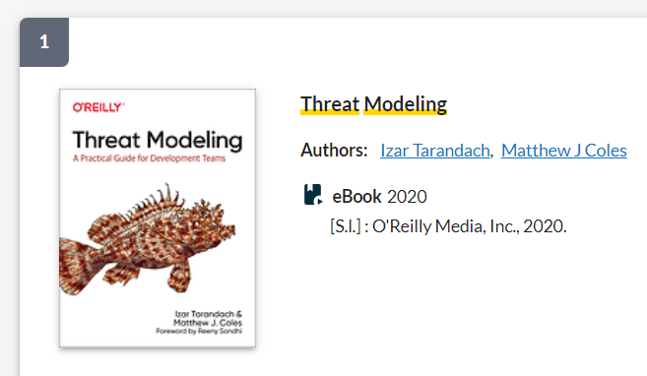
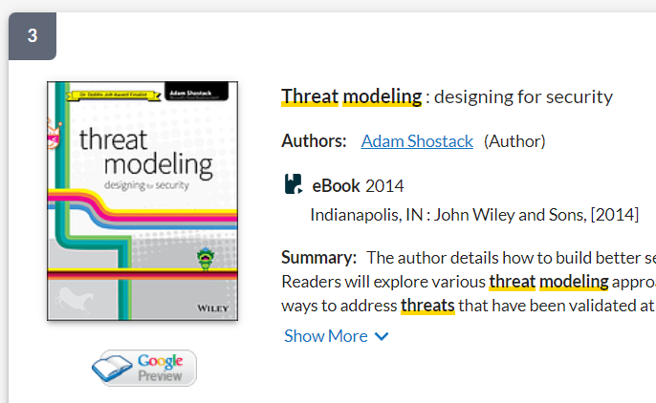

Slide 4
Course Structure
STRIDE
Introduction
LINDUN
Principles etc.
CIA
PASTA
Worked examples
Threat Modelling Representations
TRIKE
Threat Modelling Methodologies
OCTAVE
VAST

Slide 5
Learning objectives
Be able to explain why ‘security by design’ is essential
Explain the meaning of Security-by-Design
Identify the impact of security design principles
How does security-by-design influence the development life cycle?
MAP | Kaspersky Cyberthreat live map

Slide 6
Revisiting security
We all know security is important - but why?
  protection against malice, mistakes and mischance
  theft, fraud, destruction, disruption
Security is a risk management business
  loss of time, money, privacy, reputation, advantage
insurance model - balance costs against risk of loss

Slide 7
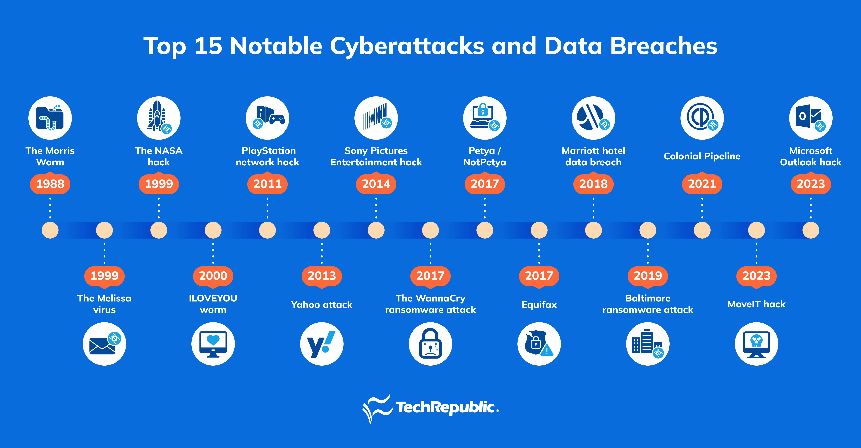
Revisiting security
See also https://privacyrights.org/data-breaches, World’s Biggest Data Breaches & Hacks — Information is Beautiful

Slide 8
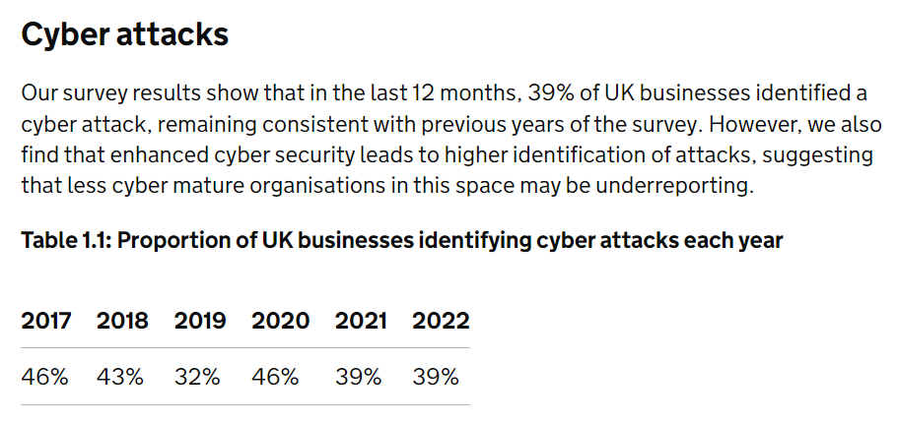
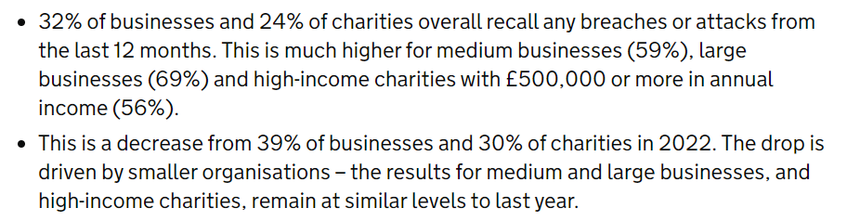
The Uk’s threat landscape
Cybersecurity Breaches Survey 2022 and 2023

Slide 9
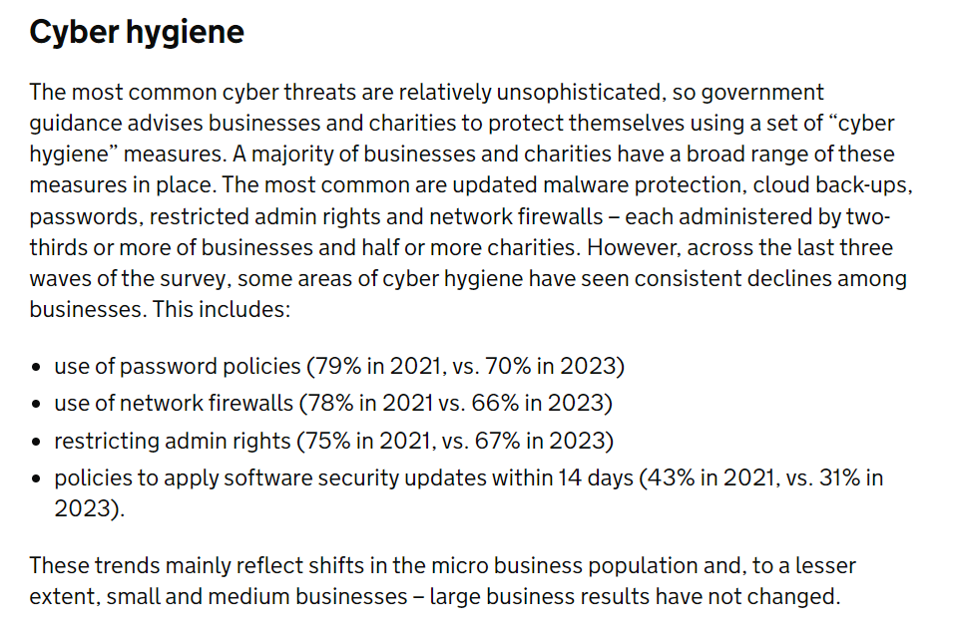
The Uk’s threat landscape
Cybersecurity Breaches Survey 2023

Slide 10
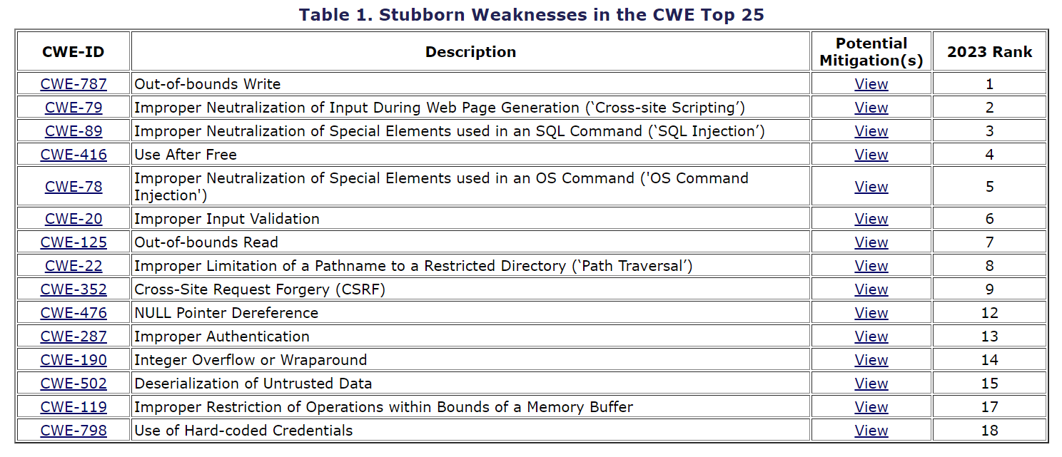
Common Weakness Enumeration (CWE)
CWE - 2023 CWE Top 25 Most Dangerous Software Weaknesses (mitre.org)
“Over the span of the last five publications of the CWE Top 25 Most Dangerous Software Weaknesses (2019-2023), there are 15 weaknesses that have been present in every list. This suggests that despite ongoing visibility to the community, these 15 weaknesses represent the most challenging weaknesses that exist today. A more focused training effort is needed to enhance developer practices to ensure that these weaknesses do not continue to introduce unnecessary risk to customer data and services.

Slide 11
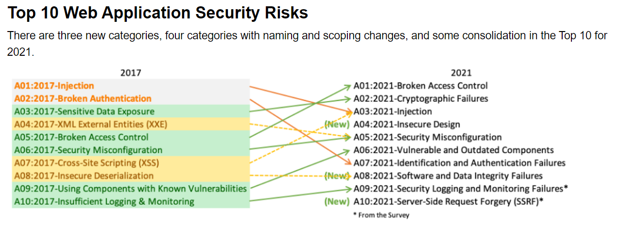
Open Worldwide Application Security Project (OWASP)
OWASP Top Ten | OWASP Foundation
Currently collecting data for the next data release in 2025.

Slide 12
Learning objectives
Be able to explain why ‘security by design’ is essential
Explain the meaning of Security-by-Design
Identify the impact of security design principles
How does security-by-design influence the development life cycle?

Slide 13
Basic concepts and terminology
Asset: Anything we need to protect
Threat: Anything that could let someone or something obtain, damage, or destroy an asset, if we fail to protect against it
Weakness: An underlying defect that modifies behaviour or functionality
Vulnerability: A weakness or gap in our protection efforts
Risk: The potential for loss, damage, or destruction of an asset, due to a threat’s having successfully exploited a vulnerability

Slide 14
What is security by design?
We define a security design principle as ….
a declarative statement made with the intention of guiding security design decisions in order to meet the goals of a system
Security by design is an approach that builds a system with security in mind right from the beginning.
  A proactive approach to security
  Focuses on incorporating security measures throughout the development and implementation process

Slide 15
Aspects of security practice
Secure application design
Secure infrastructure design
Secure application implementation
Secure infrastructure deployment
Secure system operation

Slide 16
Learning objectives
Be able to explain why ‘security by design’ is essential
Explain the meaning of Security-by-Design
Identify the impact of security design principles
How does security-by-design influence the development life cycle?

Slide 17
Design principles
High-Level Guidelines: These are broad, general guidelines that inform good software design practices. They help ensure that the software is robust, maintainable, and scalable.
Examples: Principles like “least privilege,” “defense in depth,” and “secure by default” are common in security-focused design.
Purpose: They guide the overall approach to designing systems, ensuring that security is integrated from the ground up.

Slide 18
Example of ‘10 important principles’ useful in practice
Assign the least privilege possible
Implement defence in depth
Fail securely & use secure defaults
Separate responsibilities
Economy of mechanism (Occam’s razor)
Open Design
Least common mechanism
Complete mediation
Psychological acceptability
Secure by default
Please read the accompanying notes!

Slide 19
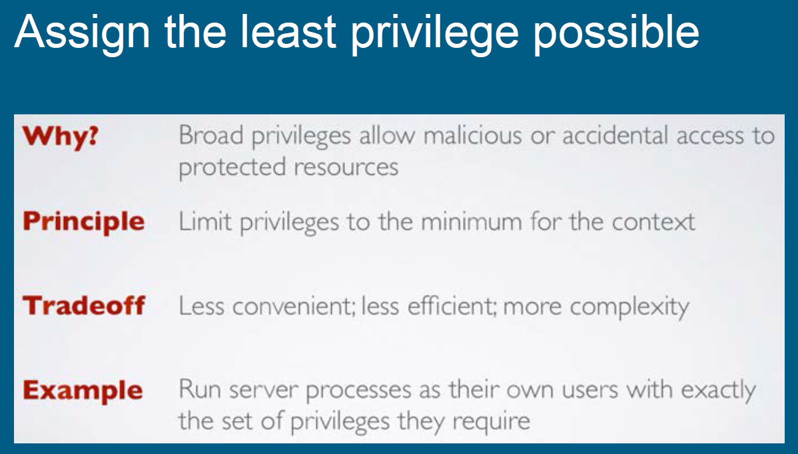
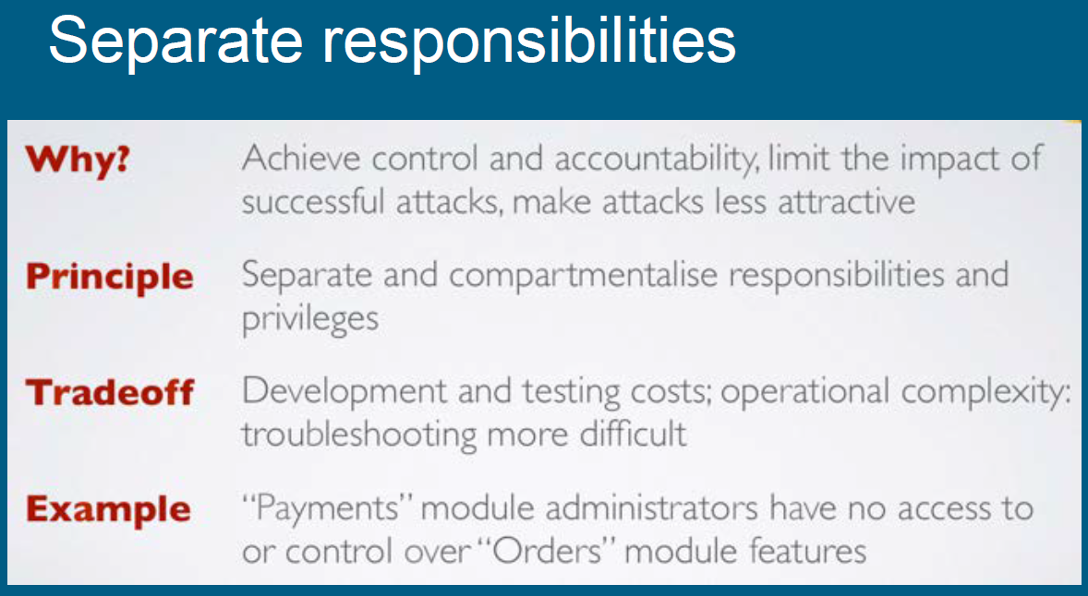
Choose one of the others and complete a similar table……

Slide 20
Learning objectives
Be able to explain why ‘security by design’ is essential
Explain the meaning of Security-by-Design
Identify the impact of security design principles
How does security-by-design influence the development life cycle?

Slide 21
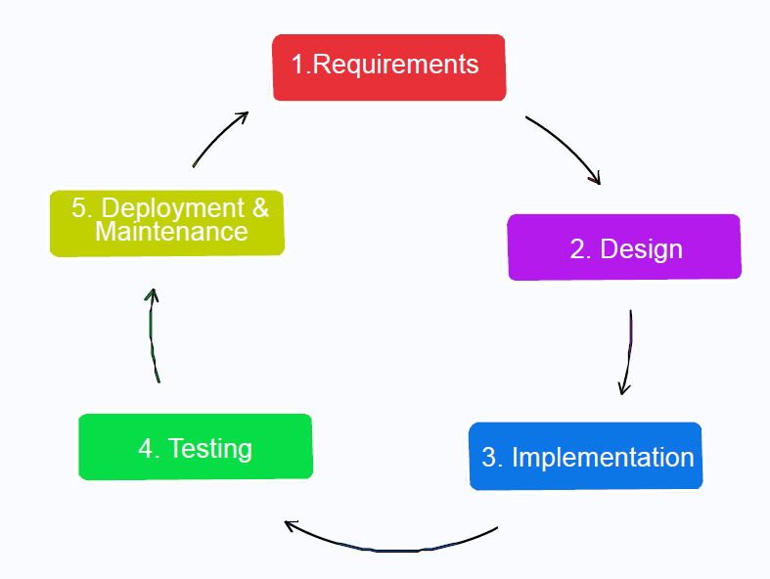
System Development Life Cycle (SDLC)

Slide 22
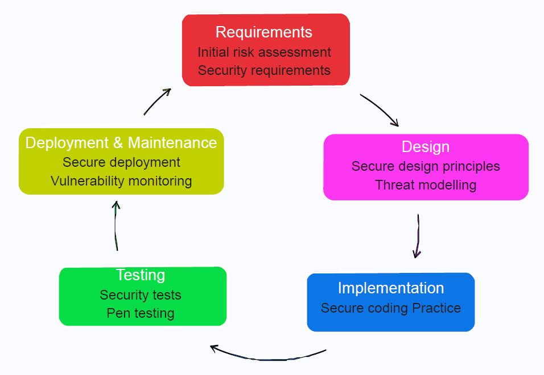
Introducing Security to
System Development Life Cycle (SDLC)

Slide 23
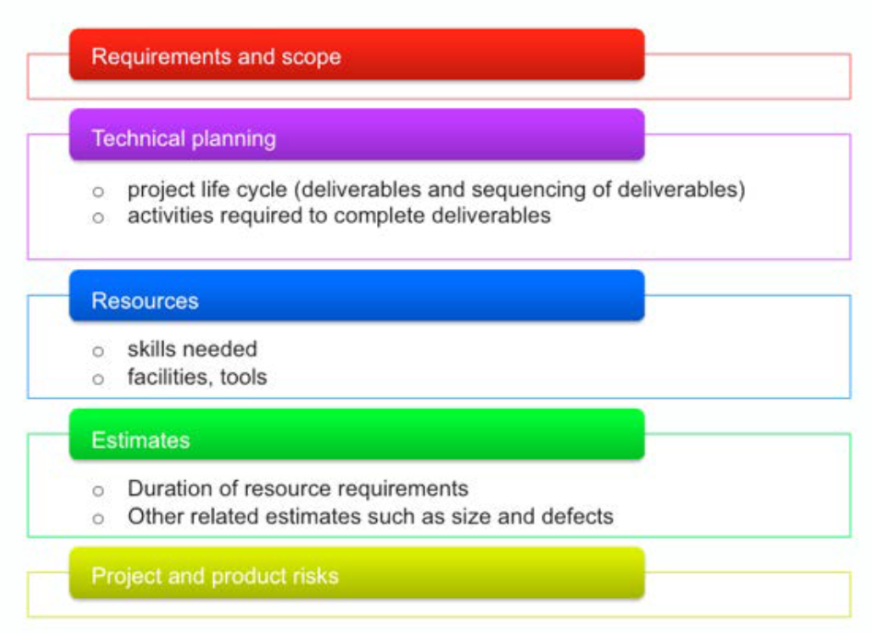
Security Impacts on Project Management

Slide 24
Threat Modeling: Microsoft Security Development Lifecycle (SDL)
Threat modeling is a core element of the Microsoft Security Development Lifecycle (SDL)
Threat modeling is an engineering technique you can use to help you identify threats, attacks, vulnerabilities, and countermeasures that could affect your application
You can use threat modeling to shape your application's design, meet your company's security objectives, and reduce risk.

Slide 25
5 major threat modelling steps
Defining security requirements
Creating an application diagram
Identifying threats
Mitigating threats
Validating that threats have been mitigated
Microsoft Security Development Lifecycle Threat Modelling

Slide 26
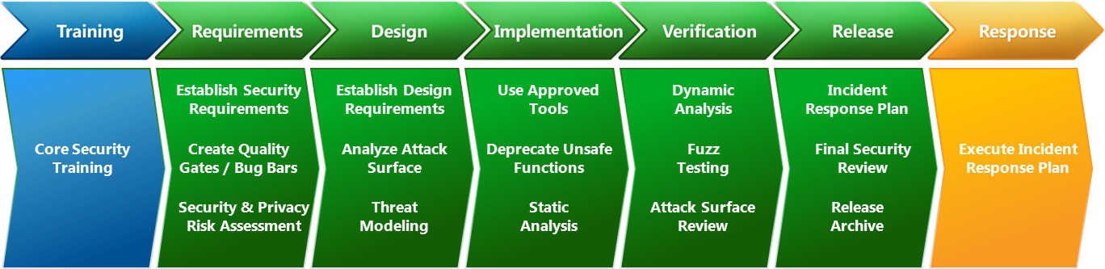
Simplified SDL security activities
Microsoft Security Development Lifecycle Resources

Slide 27
Quiz
Why is security by design so important?
How many of the ‘essential security principles’ can you identify?

Slide 28
