Slide 1
COMP6204 Software Project Management & Secure Development
Security by Design
Dr Sarah Hewitt
Lecture 2 – Threat Modelling basics

Slide 2
Learning objectives
Be able to explain what ‘threat modelling’ is
Explain the core properties of threat modelling
Identify the fundamental controls of threat modelling
Be able to explain where threat modelling fits into the SDC, and why it is important
Identify the main threat modelling methods

Slide 3
Security: Core properties
He CIA Triad:
Confidentiality - Guarantees access to data to only those with appropriate access rights according to their need to know the information.
Integrity - When data or activity can be verified to be authentic and not modified
Availability - When authorised actors can have access to data or functionality whenever they need to.

Slide 4
Consider the cash machine (ATM)
Confidentiality: It provides confidentiality by requiring two-factor authentication (both a physical card and a PIN code) before allowing access to data
Integrity: The ATM and bank software enforce data integrity by ensuring that any transfers or withdrawals made via the machine are reflected in the accounting for the user’s bank account
Availability: The machine provides availability because it’s in a public place and is accessible even when the bank branch is closed

Slide 5
Other properties
Privacy
  The right of not having information exposed to unauthorised third parties.
  Related to confidentiality
• Safety
  Freedom from physical injury or damage to health whether directly or indirectly
  Related to integrity and availability

Slide 6
Fundamental Security Controls
Identification: Actors in the system must be assigned unique identifiers to the system.
Authentication: Allows the users of the system to provide a proof of their identity.
Authorisation: Authenticated actors can be granted access rights according to their verified identity.
Logging: Providing traceability by recording the performed events of the actors.
Auditing: Audit records are well defined, ordered in time and tamper-resistant records. Gives the capability to look back in time and understand the order of events.

Slide 7
Security Impact
Depends on the nature of the threats and their consequences
Low likelihood threats can be left to discretion of project leader and limited management review
High likelihood threats with medium consequences would likely require external expert assessment and well-defined systematic review (more resources required)
  Affect security activities during development process e.g., influence on test planning
  Action required to provide assurance

Slide 8
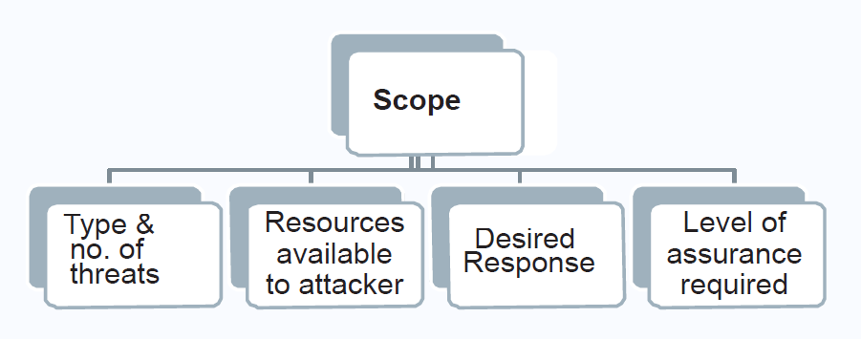
Security Impact
A risk assessment is required to identify the priority of threats
Response can be passive or active
Level of assurance depends on the failure consequences

Slide 9
Identifying Security Issues
Static analysis of code
Fuzzing or other dynamic testing (introducing invalid, unexpected or random data)
Penetration testing/red team
Bug reports
Threat modelling
  Think about security issues early
  Understand your requirements better
  Don’t write bugs into the code
  Improved stakeholder confidence

Slide 10
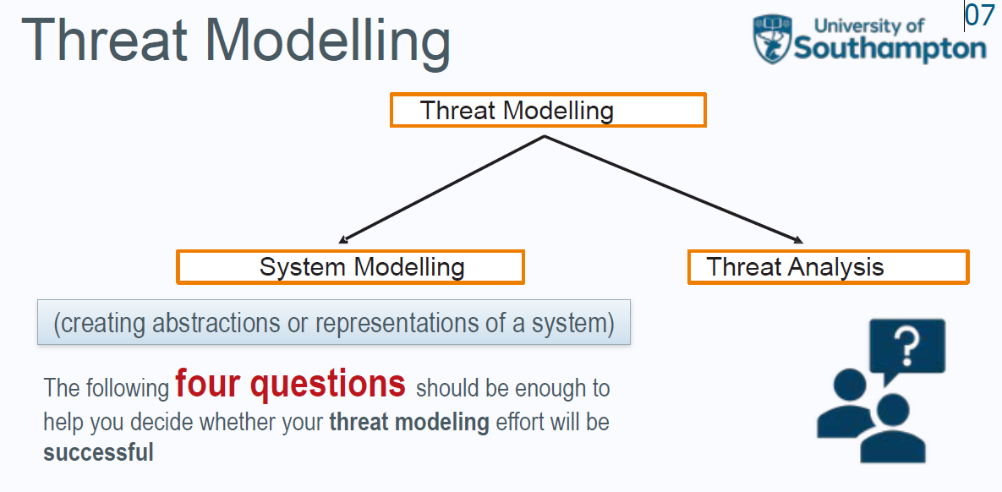
1. What are we working on?
2. What can go wrong?
3. What are we going to do about it?
4. Did we do a good job?

Slide 11
Threat Modelling: Stages
Threat modelling is a four-step process
  Model the threat using the system (system modelling)
  Apply a methodology or methodologies to the system model
  Analyse the threat
  Evaluate the outcome
This starts in the development process

Slide 12
Threat Modelling: System Modelling
A method for representing the threat(s)
What is system modelling?
  Abstractions or representations of a system
  Diagramming is a key approach
Why do we create system models?
  Easier to visualise
  Easier & cheaper to make changes
  Helps us to understand the system
  Reduces system complexity

Slide 13
Modelling Methods
Whiteboard diagrams
Brainstorming
Structured (“formal”) diagrams
  Data flow diagrams
  Sequence diagrams
  State machines
  Mathematical representations of code

Slide 14
Graphical System Modelling Types
Data flow diagrams: Describe the flow of data
Sequence diagrams: Describe the interactions of system components in an ordered manner
Process flow diagrams: Operational flow through actions (not common in threat modeling)
Attack trees: Steps along a path an attacker might try
Fishbone diagrams: Cause and effect diagrams shows the relationships between an outcome and root causes

Slide 15
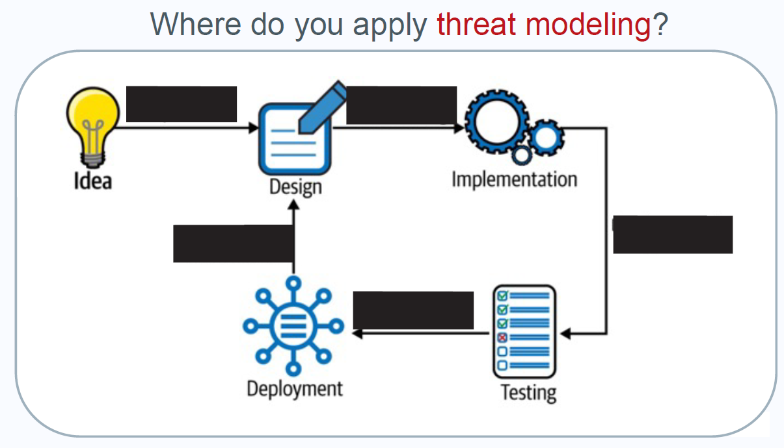

Slide 16
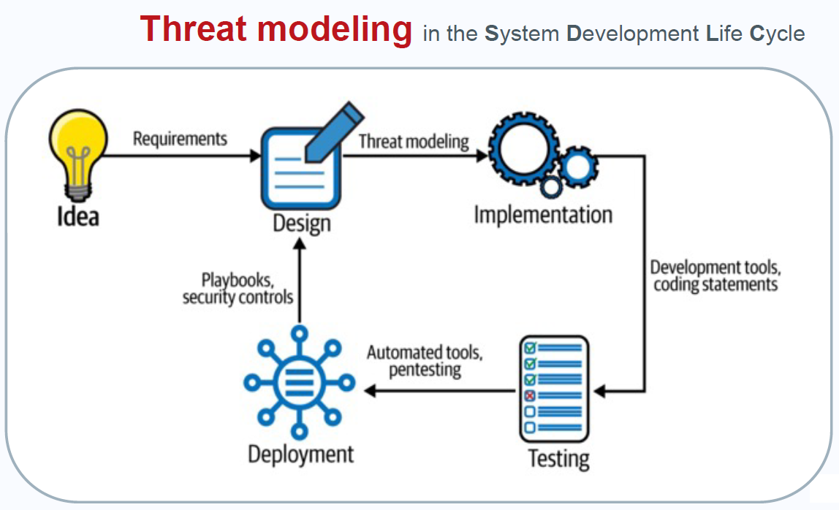

Slide 17
