Slide 1
COMP6204 Software Project Management & Secure Development
Security by Design
Dr Sarah Hewitt
Lecture 3 – Threat/System Modelling Methods

Slide 2
What are the four questions?

Slide 3
1. What are we working on?
2. What can go wrong?
3. What are we going to do about it?
4. Did we do a good job?

Slide 4
Graphical System Modelling Types
Data flow diagrams: Describe the flow of data
Sequence diagrams: Describe the interactions of system components in an ordered manner
Process flow diagrams: Operational flow through actions (not common in threat modeling)
Attack trees: Steps along a path an attacker might try
Fishbone diagrams: Cause and effect diagrams shows the relationships between an outcome and root causes

Slide 5
Learning objectives
Be able to construct a data flow diagram (DFD), and
Identify the elements of a DFD

Slide 6
Data Flow Diagrams (DFDs)
A data flow diagram is a depiction of how information flows through your system. It shows each place that data is input into or output from each process or subsystem. It includes anywhere that data is stored in the system, either temporarily or long-term.

Slide 8
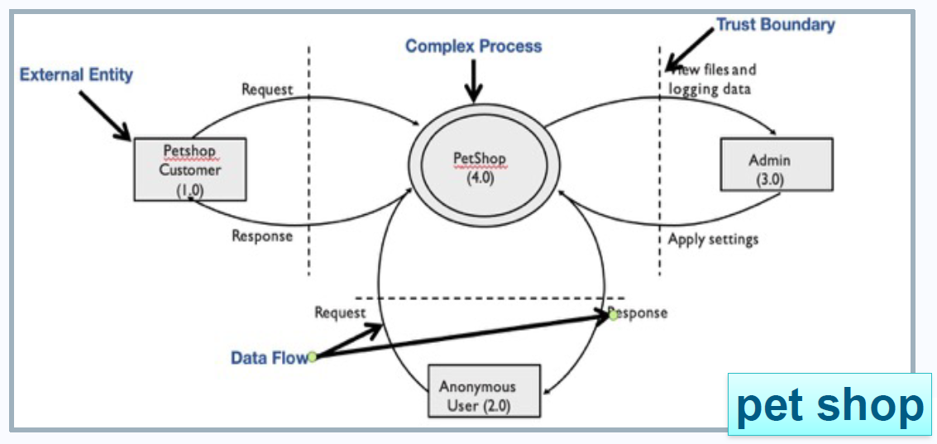
Data Flow Diagrams (DFDs)
Describe the flow of data among the system components
Most used system modelling type in threat modelling
Multiple drawings for different layers of abstractions

Slide 9
Trust Boundaries
A trust boundary is everywhere two or more principals interact
e.g., entities with different privileges
If you do not see where to draw trust boundary, consider…
Does everything in the system has the same level of privilege?
Is everything your software communicate with inside the same boundary?
Threats tend to cluster around trust boundaries

Slide 10
Data Flow Diagrams (DFDs)
The data flows are represented by arrows leading to processes (circles).
Circles within circles signify abstractions of complex processes which will be decomposed in other DFDs.
Data sources are represented by rectangles, while data files are straight lines.

Slide 11
Data Flow Diagrams (DFDs) Decomposition
Iterate over processes, data stores, and see where they need to be broken down
Initially draw a context diagram
Very high-level; software and external entities interacting with it
Then draw a level 1 diagram
High level; major business processes
Then processes can be further decomposed in level 2 diagrams
And so on until no further decomposition is possible

Slide 12
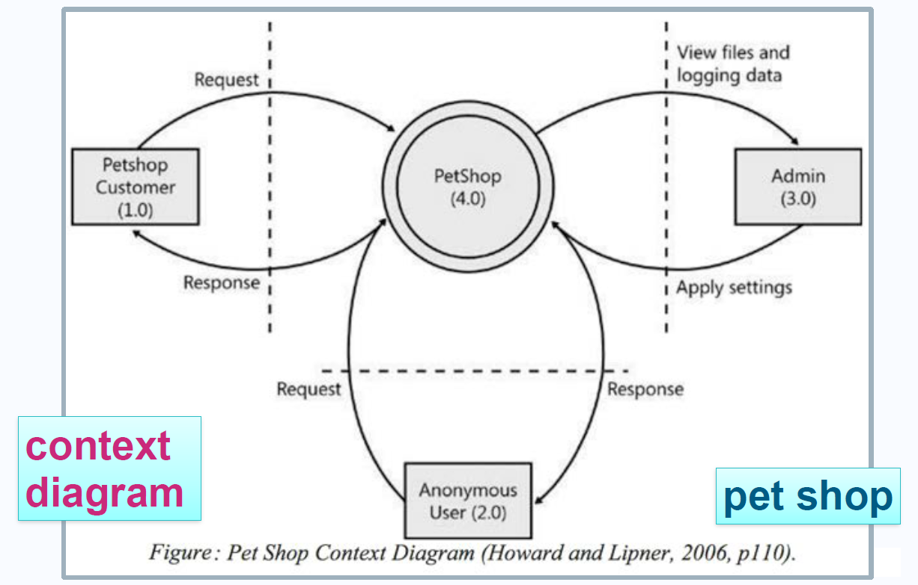

Slide 13
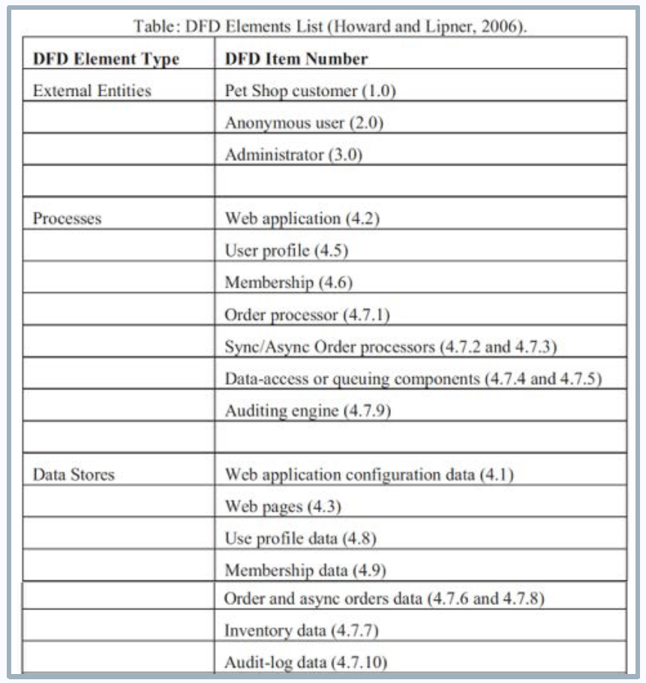

Slide 15
Exercise
Construct a Level 1 DFD using the supplied information.

