Slide 2
Telling Tales: Hypertext Writing
COMP3227 Web Architecture and Hypertext Technologies
Dr Nicholas Gibbins - nmg@ecs.soton.ac.uk

Slide 3
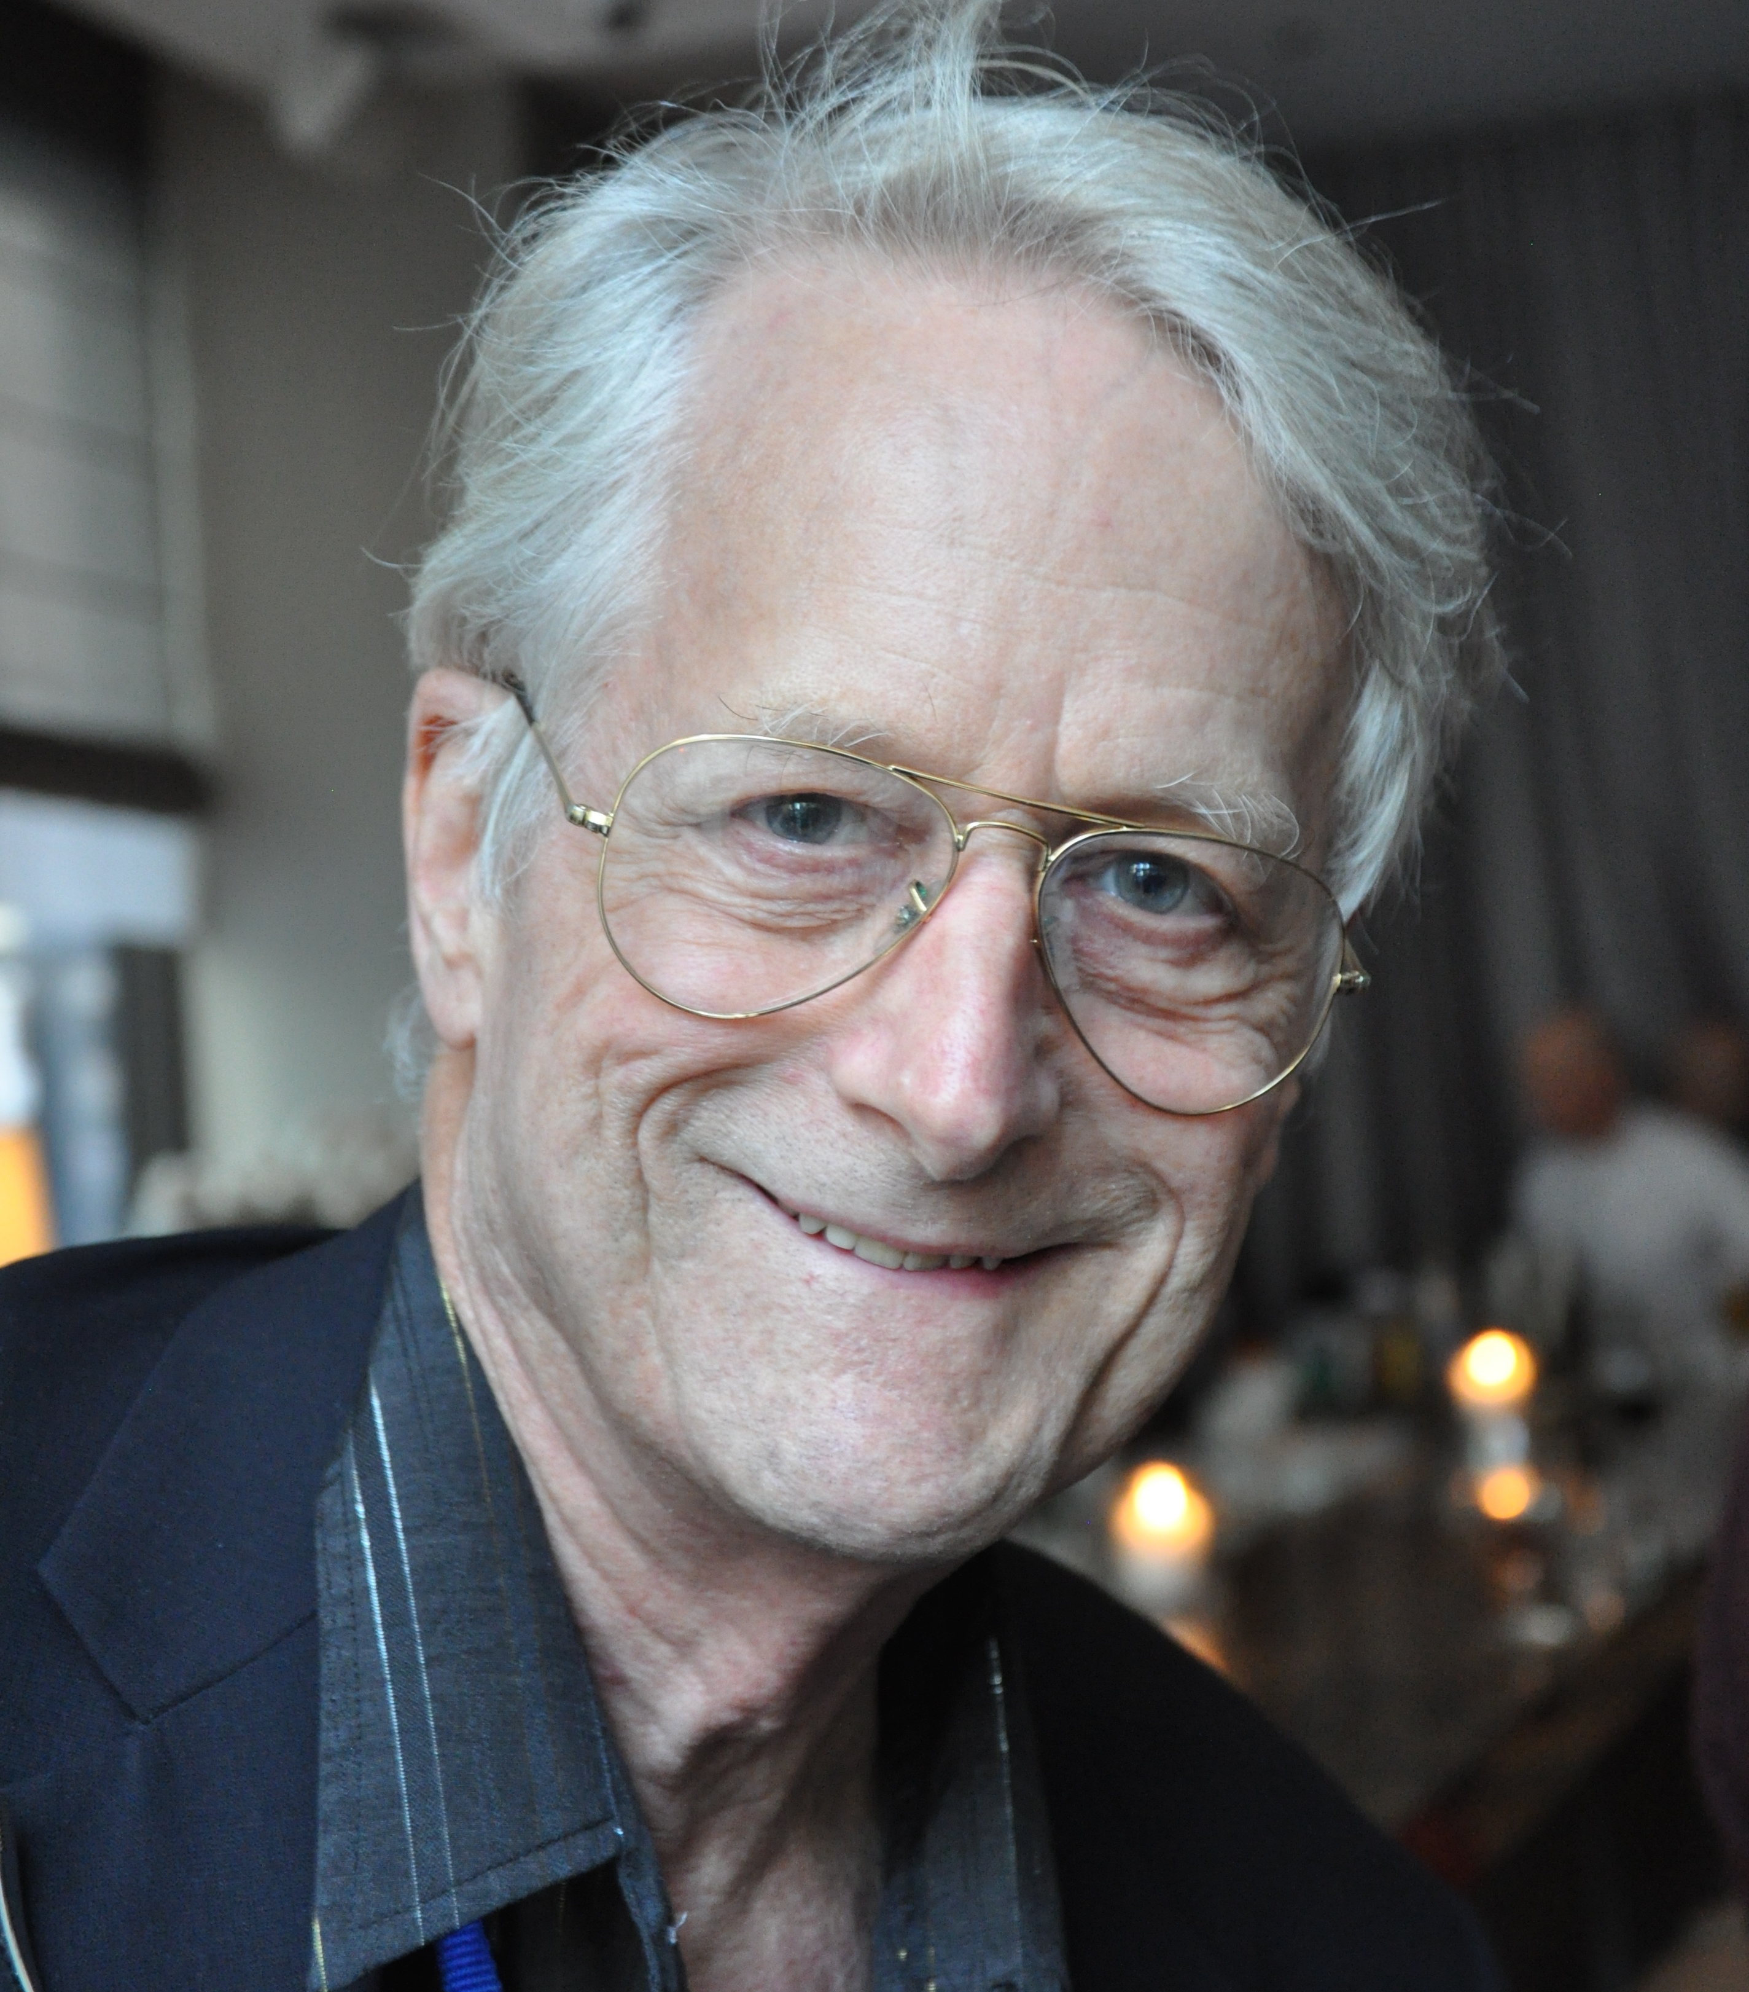
A Working Definition
By ‘hypertext’, I mean non-sequential writing - text that branches and allows choices to the reader, best read at an interactive screen. As popularly conceived, this is a series of text chunks connected by links which offer the reader different pathways.
Nelson, T.H. (1981) Literary Machines, Sausalito, CA: Mindful Press.

Slide 4
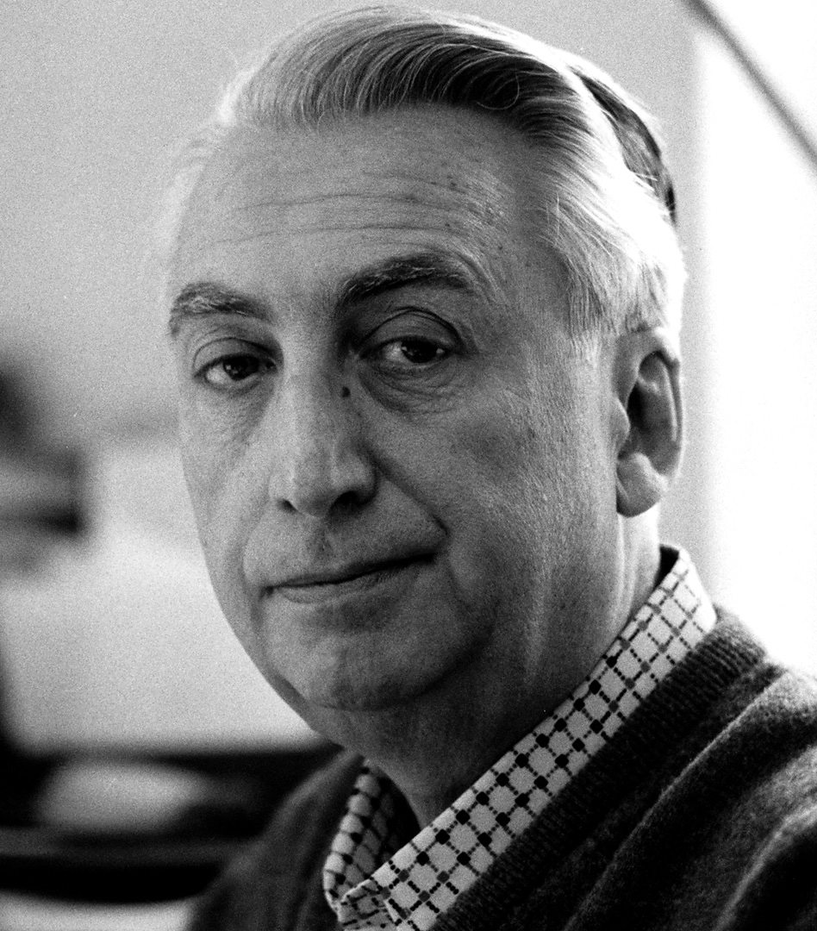
The Death of the Author
We know now that a text is not a line of words releasing a single ‘theological’ meaning (the ‘message’ of the Author-God) but a multi-dimensional space in which a variety of writings, none of them original, blend and clash.
To give a text an Author is to impose a limit on that text, to furnish it with a final signified, to close the writing.
Barthes, R.G. (1967) The Death of the Author. Aspen, no. 5-6.

Slide 5
Hypertext and the Death of the Author
“It is tempting to see hypertext as realizing Barthes' utopian dreams of a writing liberated from the Author. The ability for each reader to add to, alter, or simply edit a hypertext opens possibilities of collective authorship that breaks down the idea of writing as originating from a single fixed source.
Similarly, the ability to plot out unique patterns of reading, to move through a text in an aleatory, non-linear fashion, serves to highlight the importance of the reader in the “writing” of a text - each reading, even if it does not physically change the words - writes the text anew simply by re-arranging it, by placing different emphases that might subtly inflect its meanings.”
Keep, C., McLaughlin, T. and Parmar, R. (1993-2000) The Electronic Labyrinth. http://elab.eserver.org/
Notes:
Aleatory: dependent on the throw of a die

Slide 6
Forking Paths
“In all fictional works, each time a man is confronted with several alternatives, he chooses one and eliminates the others; in the fiction of Ts’ui Pên, he chooses— simultaneously—all of them. He creates, in this way, diverse futures, diverse times which themselves also proliferate and fork. Here, then, is the explanation of the novel’s contradictions.
Fang, let us say, has a secret; a stranger calls at his door; Fang resolves to kill him. Naturally, there are several possible outcomes: Fang can kill the intruder, the intruder can kill Fang, they both can escape, they both can die, and so forth. In the work of Ts’ui Pên, all possible outcomes occur; each one is the point of departure for other forkings.”
Borges, J.L. (1941) The Garden of Forking Paths, Translated from Spanish by Yates, D.A.

Slide 7

Ergodic Literature
http://www.flickr.com/photos/danielygo/5391176827/

Slide 8
Ergodic Literature
“Ergodic […] derives from the Greek words ergon and hodos, meaning "work" and "path." In ergodic literature, nontrivial effort is required to allow the reader to traverse the text. If ergodic literature is to make sense as a concept, there must also be nonergodic literature, where the effort to traverse the text is trivial, with no extranoematic responsibilities placed on the reader except (for example) eye movement and the periodic or arbitrary turning of pages.”
Aarseth, E. (1997) Cybertext: Perspectives on Ergodic Literature. Baltimore, MD: The John Hopkins University Press.
Notes:
Typically, the nontrivial effort manifests itself as a choice (possibly random) that is applied to the text.
Extranoematic: A process that occurs outside of the confines of human thought

Slide 9
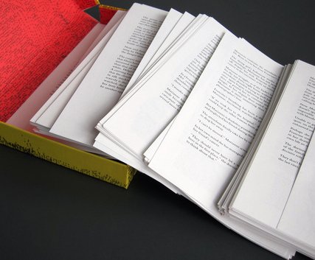
Composition No. 1, Roman (1962)
150 loose leaf pages
  Pages are to be shuffled before reading
  CONTENT WARNING!
Saporta, M. (1963) Composition No. 1, Roman. Translated from French by Howard, R., New York: Simon and Schuster.

Slide 10

Hopscotch (Rayuela) (1963)
Structured as 155 chapters
  Chapters 57-155 designated as ‘expendable’
Two readings of the book:
  Chapters 1-56 in order
  All chapters, following the reading order given in the instructions: 73-1-2-116-3-…
Cortázar, J. (1966) Hopscotch. Translated from Spanish by Rabassa, G. New York: Pantheon Books.
Notes:
Two interwoven narratives:
Horacio Oliveira and La Maga in Paris
Traveler and Horacio in Argentina
Fourth key character, Morelli, an experimental novelist admired by Horacio and his friends who is involved in an accident
p.556 (§154)
“But what if we should make a mistake,” Oliveira said, “and get things all mixed up. There was a terrible complication in the first volume, this guy here and I argued hours on end as to whether there hadn’t been some mistake in the printing of the texts.”
“Who cares,” Morelli said, “You can read my book any way you want to. Liber Fulguralis, mantic pages, and that’s how it goes. The most I do is set it up the way I would like to reread it. And in the worst of cases, if they do make a mistake, it might just turn out perfect. [...]”

Slide 11
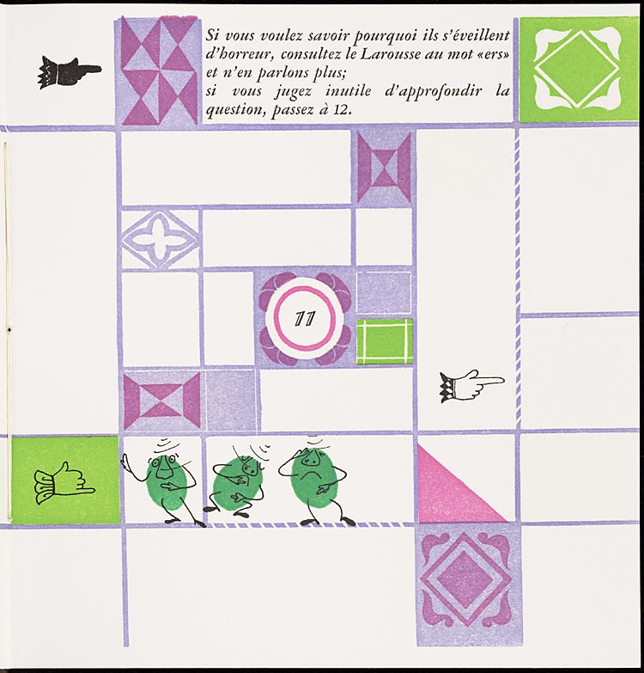
Un conte à votre façon (1967)
Numbered double-page spreads
  Story on verso pages
  Explicit choices on recto pages
Queneau, R. (1982) Un conte à votre façon, Paris: Kickshaws.
Notes:
“A story your way” published in English as “Yours for the Telling”
Do you wish to hear the story of the three alert peas?
11. They dreamed they would get their soup at the soup kitchen, and on opening their bowl they discovered that it was ers soup. In horror, they woke up.
If you want to know why they woke up in horror, look up the word “bean” in Larousse and say no more
If you feel that it is useless to pursue the issue, go to 12
A work by one of the oulipo (Ouvroir de littérature potentielle – workshop of potential literature) group

Slide 12
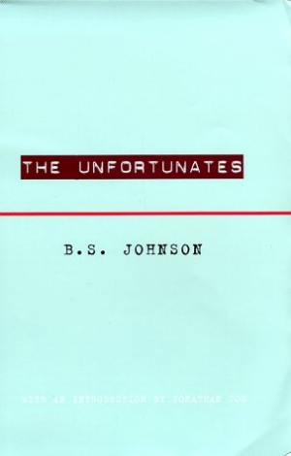
The Unfortunates (1969)
27 chapters, bound as pamphlets
  Designated first chapter
  25 chapters, to be read in any order
  Designated last chapter
Johnson, B.S. (1969) The Unfortunates, London: Secker and Warburg.
Notes:
Semi-autobiographical work
Narrator is a sports reporter (thinly veiled version of Johnson, himself a sports writer for the Observer) who travels to a city in the East Midlands (Nottingham) to cover a football match, and recalls the times that he’d been to the city before when visiting a close friend (a lecturer, who had since died of cancer).

Slide 13
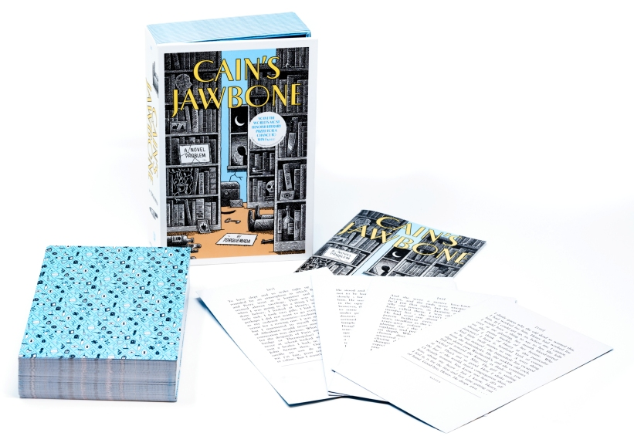
Cain's Jawbone (1934)
100 loose leaf pages
  Only one correct reading order!
  Book is presented as a puzzle: identify the murderer and victims, and determine the correct reading order
Mathers, E.P. (1934) Cain's Jawbone. In The Torquemada Puzzle Book. London: Victor Gollancz
Notes:
Written by at crossword setter at The Observer (Torquemada)
Republished in 2019 by Unbound.
A Tiktok sensation earlier this year!

Slide 14
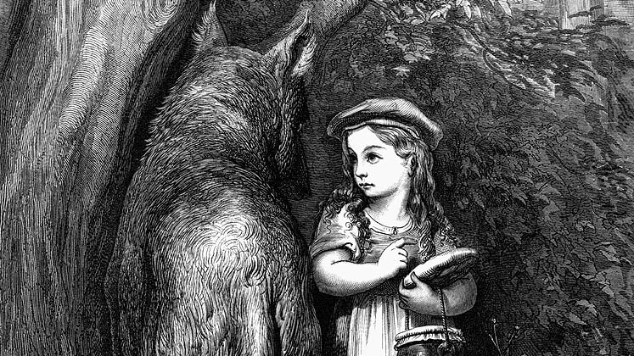
Story, Narrative and Text

Slide 15
Story, Narrative and Text
Narrative theory identifies three levels in fiction:
  Story: the content of a tale; the underlying events related in a tale (also referred to as fabula)
  Narrative: a recounting of a story; the reorganisation of events by time or point-of-view (also referred to as syuzhet or plot)
  Text: the signs (words, images) that are processed by the reader
Non-linearity may be introduced at any or all of these levels
Lowe, N.J. (2009) A Cognitive Model, In Reading Hypertext, Bernstein, M. and Greco, D. (eds), Watertown, MA: Eastgate Systems
Notes:
Story = Fabula
Narrative = Plot

Slide 16
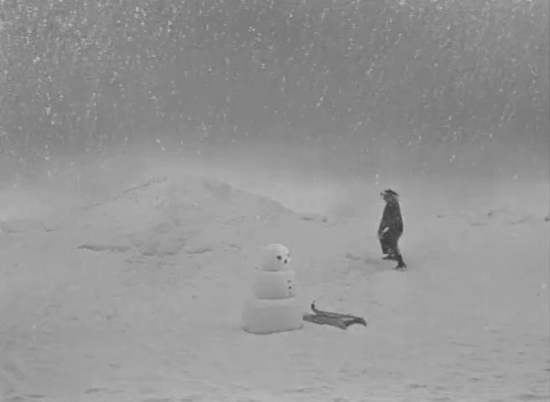
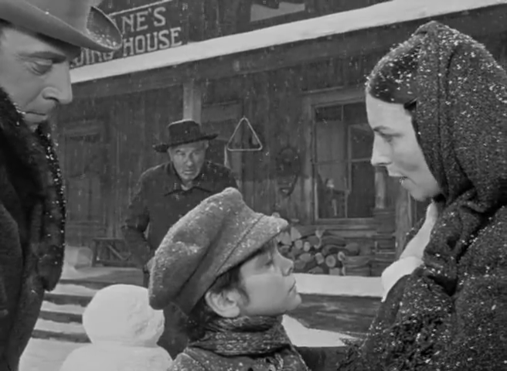
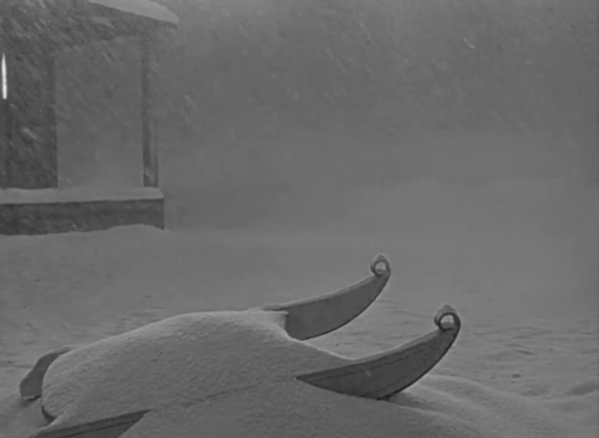
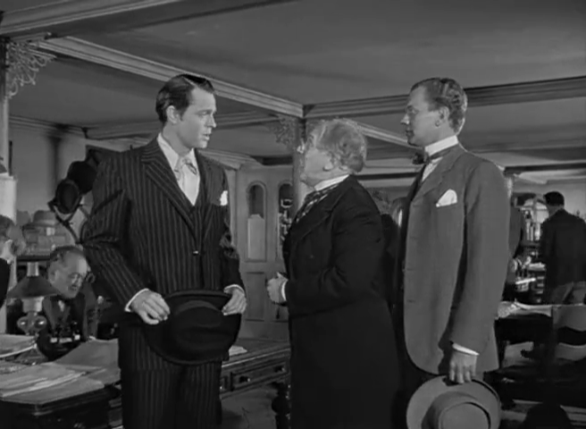
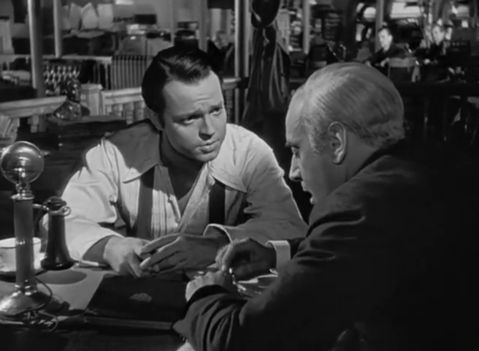
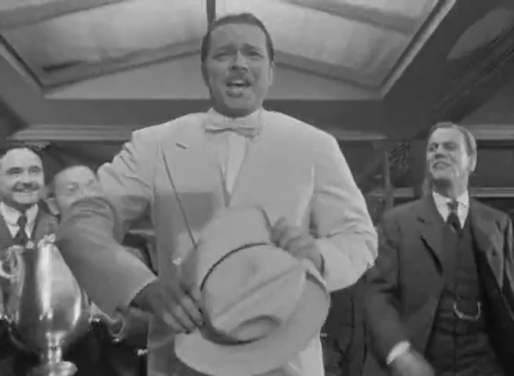
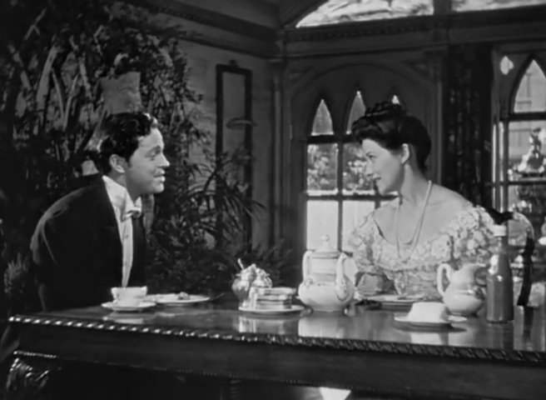
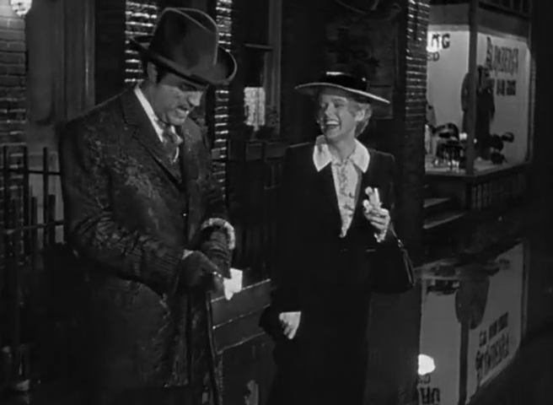
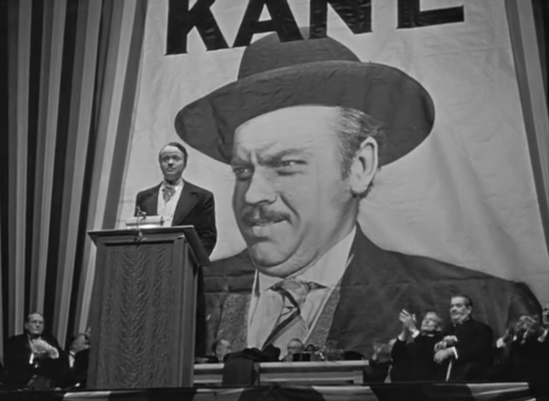
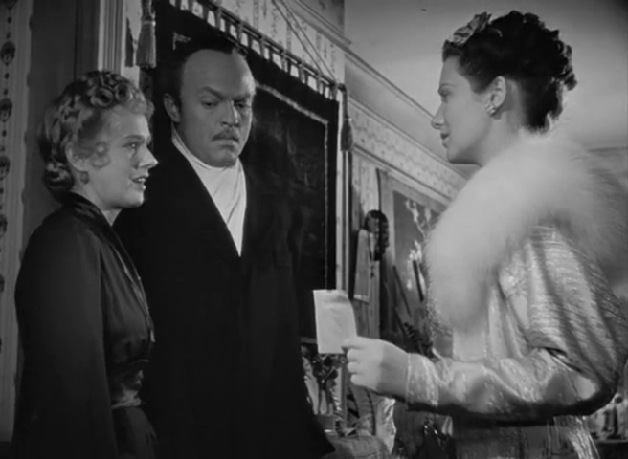
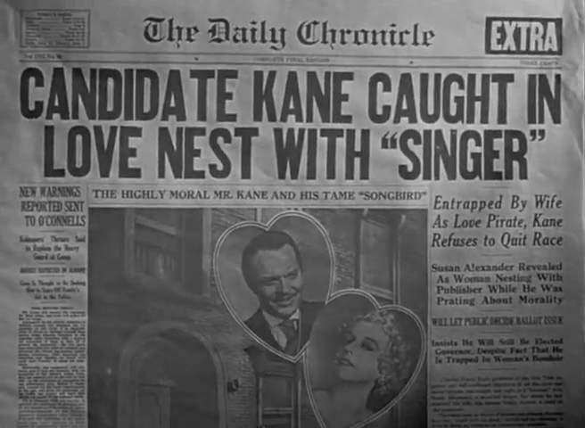
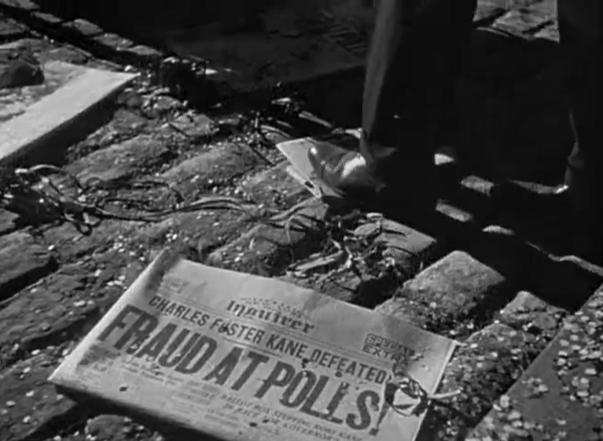
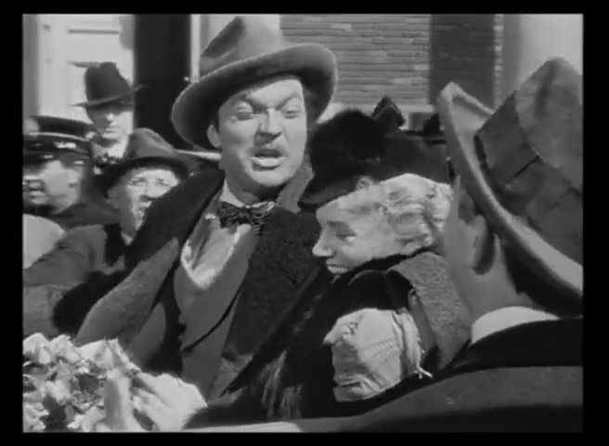

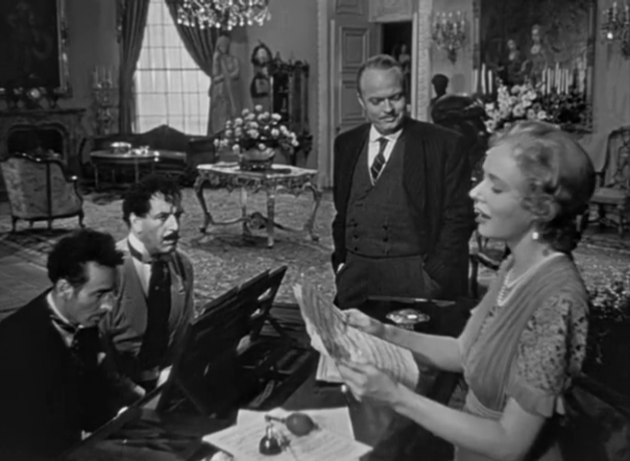
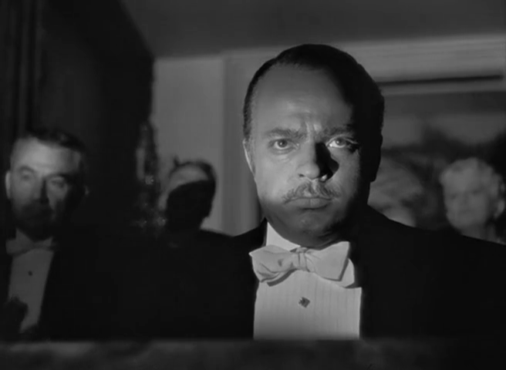
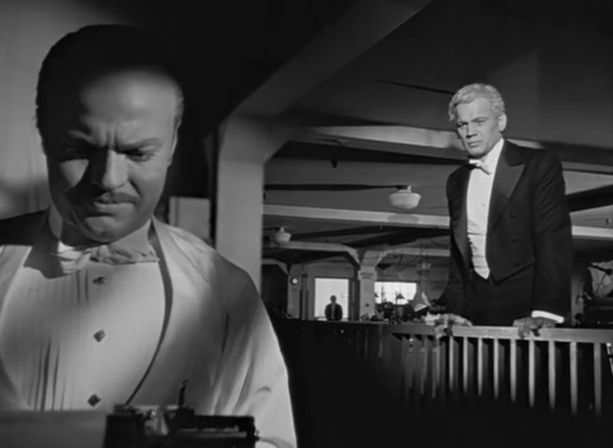
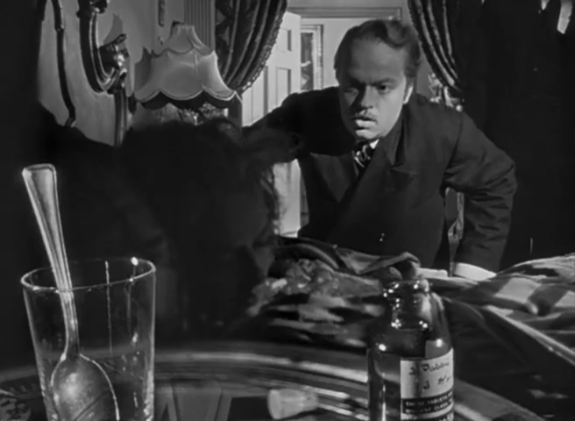
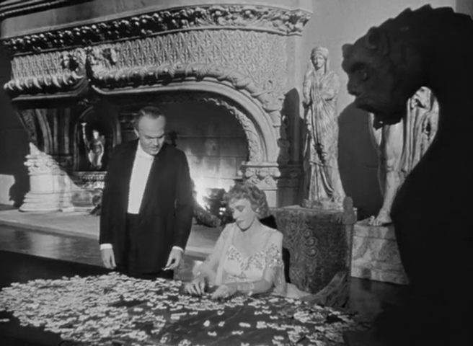
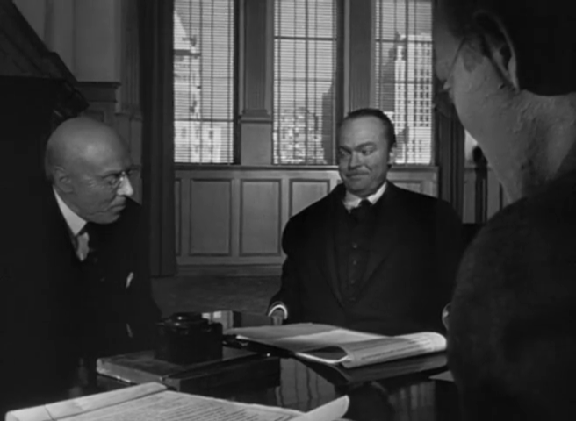
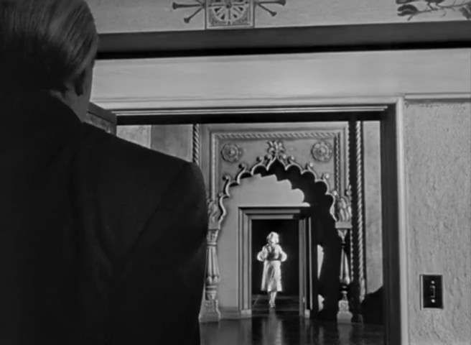
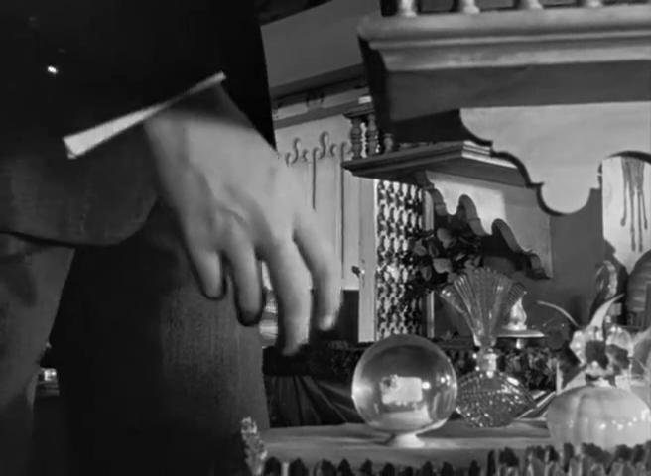
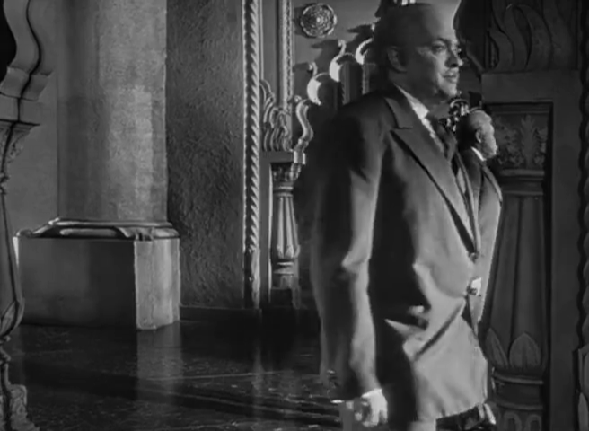
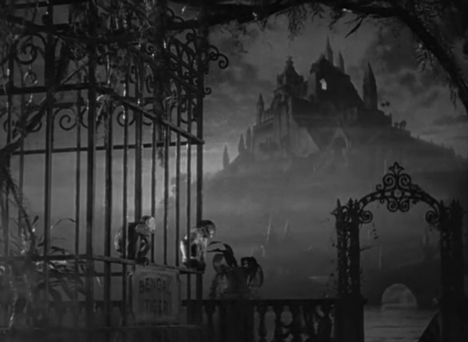
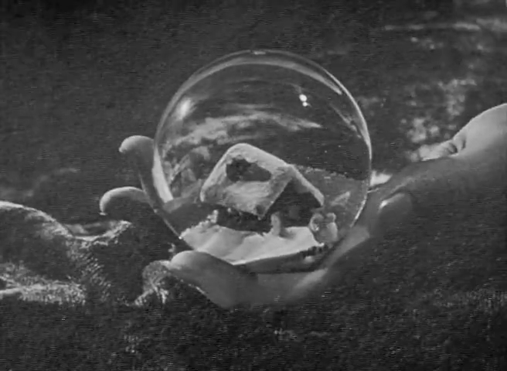
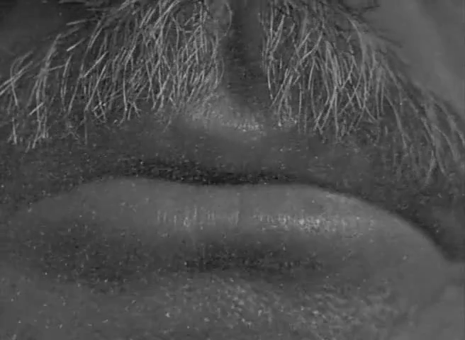
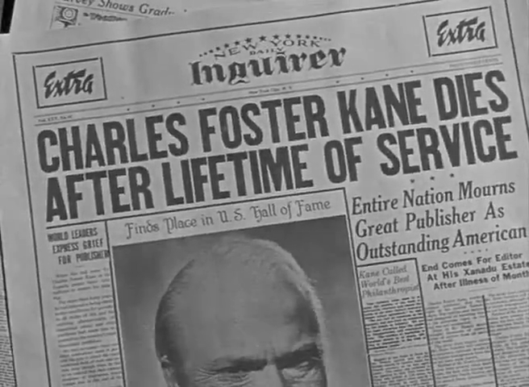
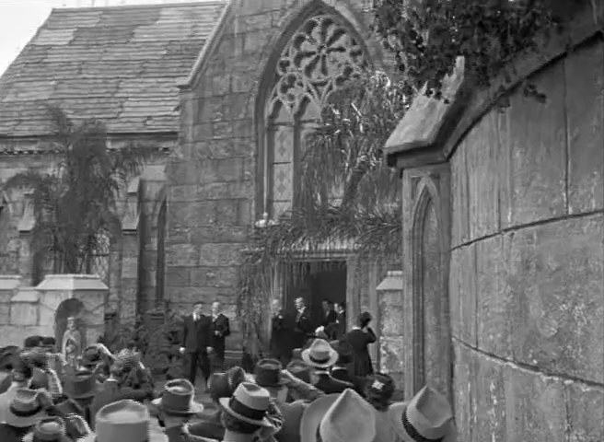
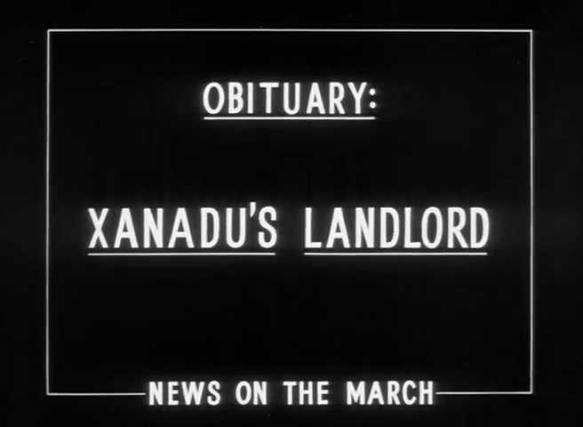
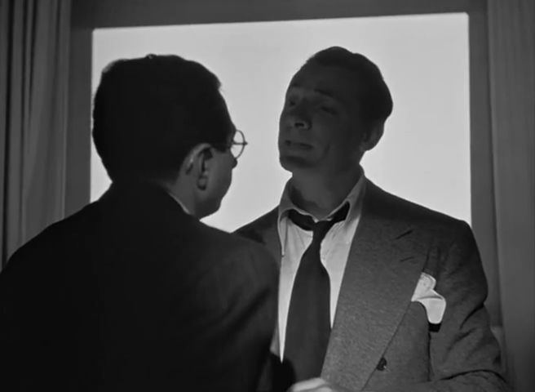
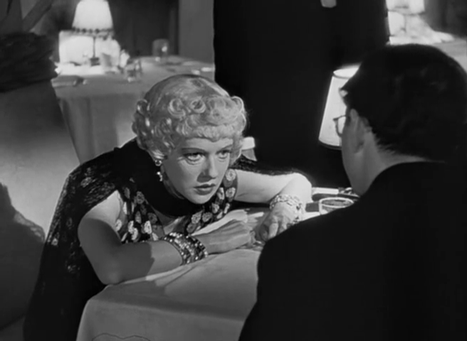
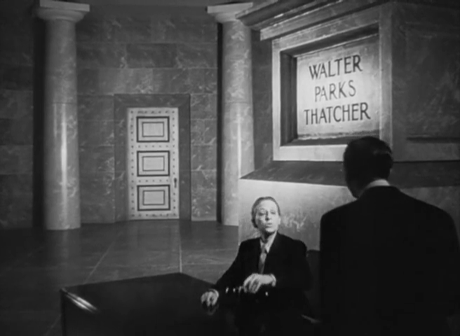
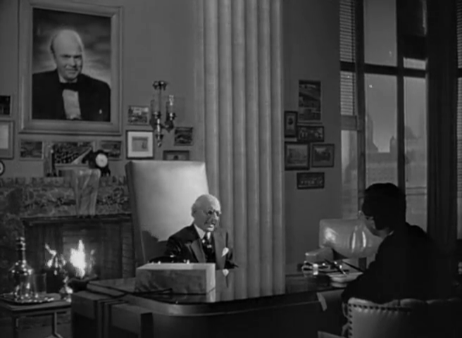
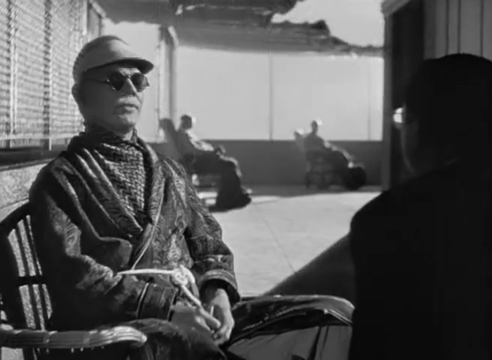
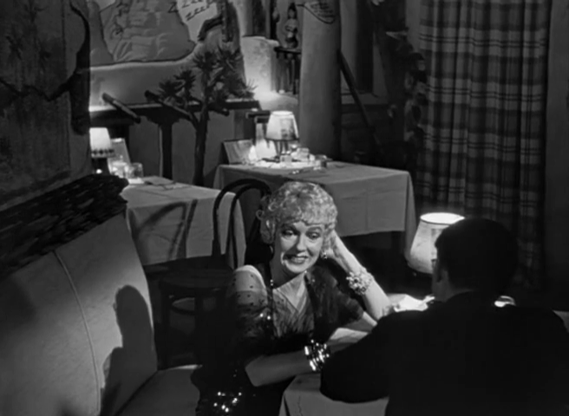
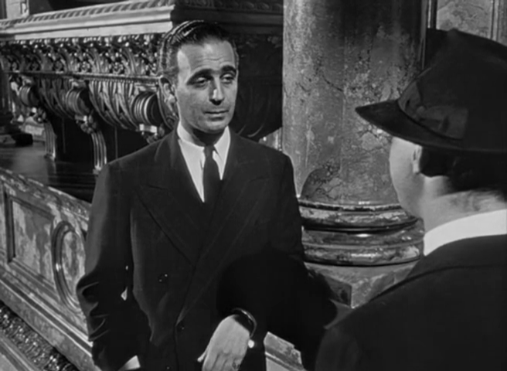
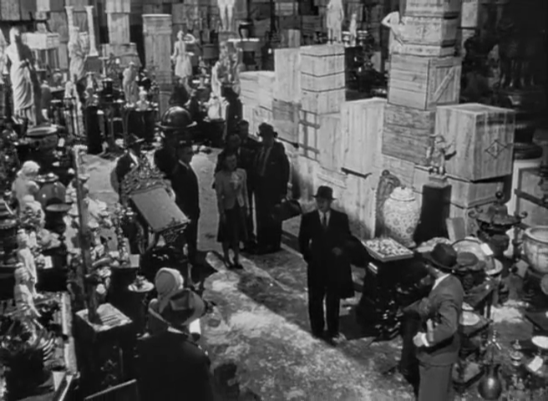
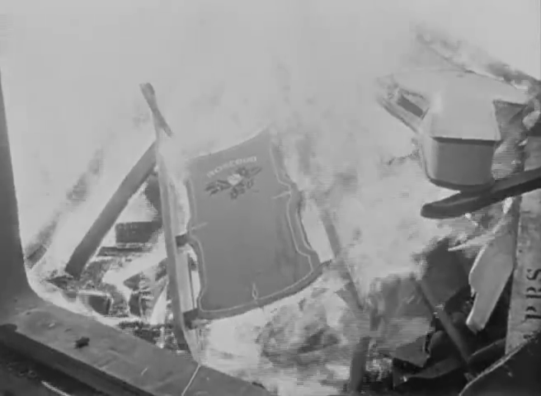
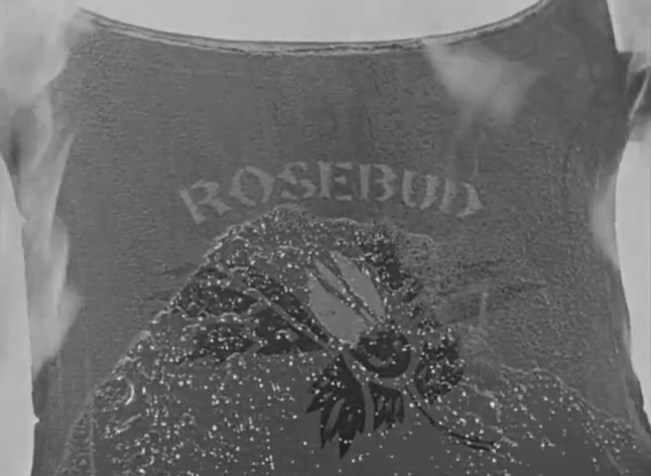
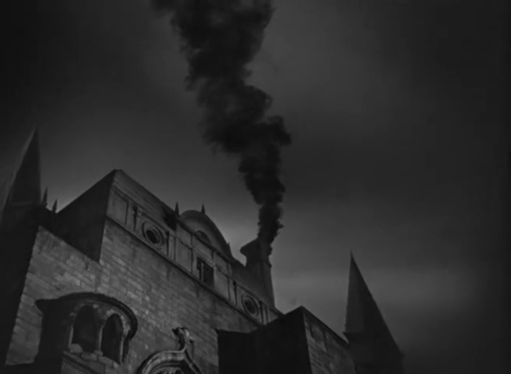
Story versus Narrative: Citizen Kane
Citizen Kane (1941) Directed by Orson Welles [Film]. NYC, USA: RKO Radio Pictures.

Slide 17
Story versus Narrative: Citizen Kane
Citizen Kane (1941) Directed by Orson Welles [Film]. NYC, USA: RKO Radio Pictures.
Notes:
Charles Foster Kane
Jerry Thompson (reporter)
Jedediah Leland (best friend)
Susan Alexander (mistress and second wife)
Mr Bernstein (employee)
Walter Parks Thatcher (guardian)
Emily Monroe Norton Kane (first wife)
Raymond (butler)

Slide 18
Story versus Narrative: Citizen Kane
Citizen Kane (1941) Directed by Orson Welles [Film]. NYC, USA: RKO Radio Pictures.
Notes:
Other notable examples of non-linearity in film:
Citizen Kane (Orson Welles) – told as flashback/recounting
Short Cuts (Robert Altman) – multi-threaded narrative
Pulp Fiction (Quentin Tarantino) – multi-threaded and flashbacks
Timecode (Mike Figgis) – multiple simultaneous viewpoints
Film does not generally expect the audience to choose – non-ergodic.

Slide 19
Story versus Narrative: Citizen Kane
Citizen Kane (1941) Directed by Orson Welles [Film]. NYC, USA: RKO Radio Pictures.
Notes:
Charles Foster Kane
Jerry Thompson (reporter)
Jedediah Leland (best friend)
Susan Alexander (mistress and second wife)
Mr Bernstein (employee)
Walter Parks Thatcher (guardian)
Emily Monroe Norton Kane (first wife)
Raymond (butler)

Slide 20
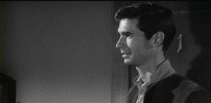
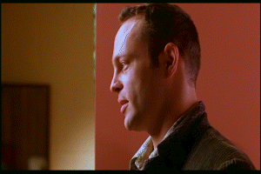
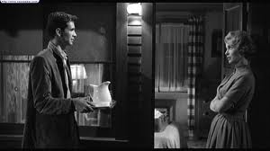
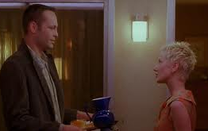


Narrative versus Text: Psycho
Psycho (1960)
Psycho (1998)
Psycho (1960) Directed by Alfred Hitchcock [Film]. Los Angeles, USA: Paramount Pictures.
Psycho (1998) Directed by Gus Van Sant [Film]. Los Angeles, USA: Universal Pictures.
Notes:
Psycho

Slide 21

Hypertext Fiction
http://www.flickr.com/photos/nealy-j/4579505879/

Slide 22



Hypertext Fiction
A selection:
  Michael Joyce (1987) - afternoon, a story
  Stuart Moulthrop (1992) - Victory Garden
  Geoff Ryman (1996) - 253

Slide 23

afternoon, a story (1987)
"I want to say I may have seen my son die this morning.”
Non-linear narrative with default path
  Notecard-like lexias
  No explicit anchors; all words are anchors
  Built as demonstration of the hypertext authoring system Storyspace
Joyce, M. (1990) afternoon, a story. Watertown, MA: Eastgate Systems.
Notes:
Follows the story of Peter, who begins his afternoon with the suspicion that the car crash he saw earlier might have involved his ex-wife.

Slide 24

Victory Garden (1992)
Follows a central character (Emily) and the interactions of those connected with her, set during Gulf War I.
  Multiple non-linear narratives with default paths
  Anchors indicate branches to other narratives (initially hidden, but can be made explicit)
  Provides a taxonomic overview map
Moulthrop, S. (1992) Victory Garden. Watertown, MA: Eastgate Systems.

Slide 25

253 (1996)
Descriptions of the 253 occupants (passengers plus driver) of a London Underground train
  Extensive cross-referencing and footnotes support a non-linear narrative
  Each description is 253 words long
  Originally published on the Web
Ryman, G. (1998) 253: the print remix. London: Flamingo.
https://web.archive.org/web/20140530180412/http://www.ryman-novel.com/

Slide 26
Hypertext Fiction
Academic study concentrates on literary hypertext (c.f. literary fiction)
  Typified by non-linear narratives, rather than non-linear stories
What about the hypertext equivalent of genre or popular fiction?

Slide 27

Consider the Consequences (1930)
Earliest known example of a branching novel!
Third person narrative
Relatively fine-grained, non-linear story
  Multi-paragraph lexias
  Three intertwined stories within the book
  (a woman and her two suitors)
  Introductory text suggests that the ”game” may be played by a group
Webster, D. and Hopkins, M.A. (1930) Consider the Consequences. New York: The Century Company

Slide 28

Lucky Les (1967)
Third person narrative
Coarse-grained, non-linear story
  Multi-page lexias corresponding to episodes in Les’ life
  Each episode concludes with an explicit choice for the reader
Hildick, E.W. (1967) Lucky Les: the adventures of a cat of five tales, Leicester: Brockhampton Press.
Notes:
B.F. Skinner – programmed instruction

Slide 29

State of Emergency (1969)
Crossover between hypertext fiction and programmed instruction
  Intent of book is to teach the reader about the challenges of running a newly-independent African state
  Coarse-grained (multipage) lexia
  Non-linear story
Guerrier, D. and Richards, J. (1969) State of Emergency: A Programmed Entertainment. Harmondsworth: Penguin
Notes:
Guerrier produced other related books, including a solo noughts and crosses gamebook.

Slide 30


Choose Your Own Adventure (1979-)
Second person narrative
Again, non-linear story
  Single page lexias
  Numbered pages
  with explicit
  choices
See also interactive fiction
(Colossal Cave/Advent, etc)
Montgomery, R.A. (1979) Journey Under the Sea. New York: Bantam Books.
Notes:
Ludic hypertext

Slide 31


Slide 32

Life’s Lottery (1999)
Increasing sophistication – not a children’s book!
  Lexias vary in size from a paragraph of a few sentences to several pages
  Non-linear story, but with an additional narrative if lexias are read in order, rather than by following the directions in the lexias
Newman, K. (1999) Life’s Lottery, London: Simon and Schuster.

Slide 33
Next Lecture: Telling Tales, part 2

