Slide 2

Trailblazers: History of Hypertext
Part 2
COMP3227 Web Architecture and Hypertext Technology
Dr Nicholas Gibbins – nmg@ecs.soton.ac.uk

Slide 3
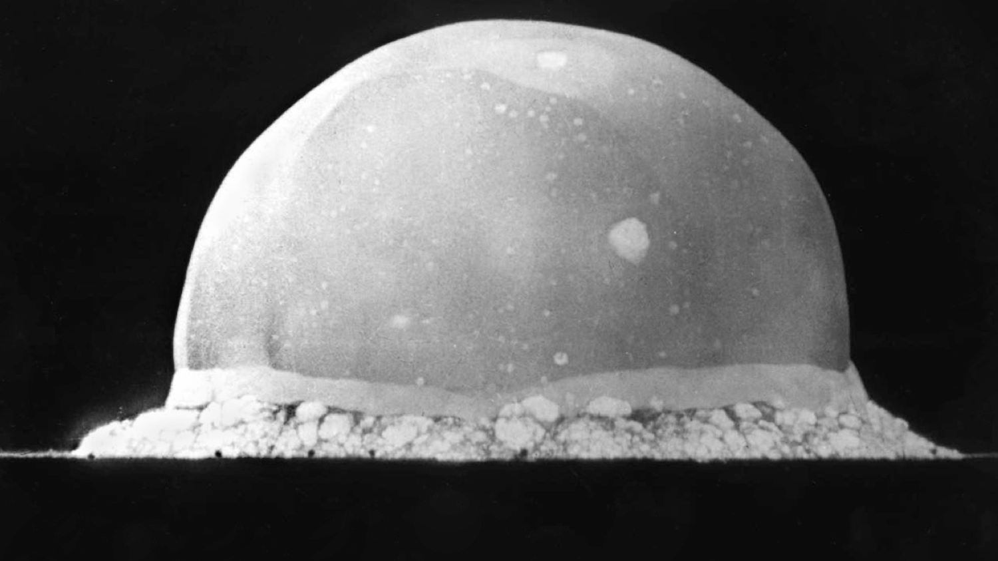
Interlude, 1939-1945
Notes:
Mundaneum damaged in 1940 during German occupation (building was used to exhibit art of the Third Reich)
Ostwald died in 1932
Otlet died in 1944
Wells died in 1946
Slide shows the Trinity Test explosion – the first atomic bomb.

Slide 4
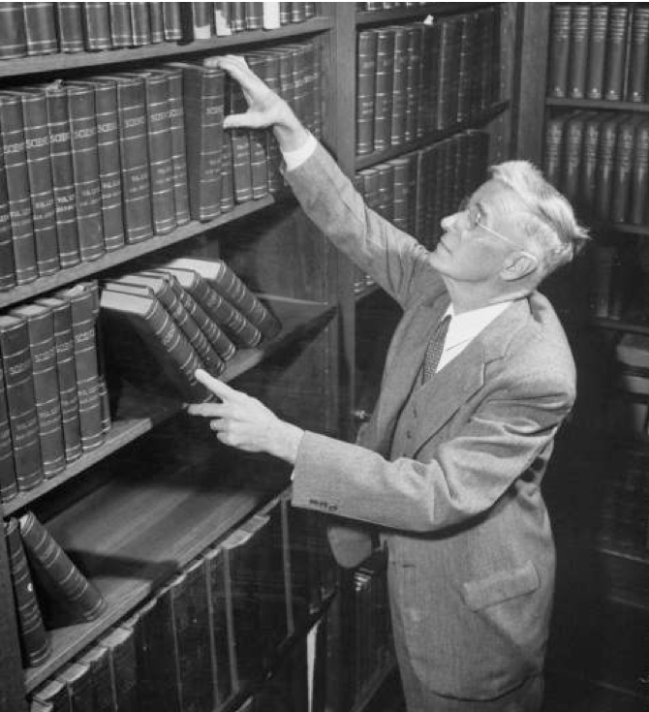
Vannevar Bush
Engineer, inventor and
science administrator
Co-founder of Raytheon (1922)
First vice-president of MIT (1932)
Chair of the National Advisory Committee for Aeronautics (1940-41)
Director of the US Office of Scientific Research and Development during WWII
(1941-47)
De facto director of the Manhattan Project until 1943
Zachary, G.P. (1995) Vannevar Bush, IEEE Spectrum, 32(7) pp. 65-69.
Notes:
While a professor at MIT, had Claude Shannon as a PhD student (founded the discipline of information theory, coined the term bit)
NACA – predecessor of the National Aeronautics and Space Administration
OSRD succeeded the earlier National Defense Research Committee (of which Bush was the first chair, and which he had been instrumental in setting up in 1940 – made proposal directly to FDR)
NDRC/OSRD work included liaison with the Tizard Mission (cavity magnetron, radar proximity fuse, jet engine, Frisch-Peirls memo/MAUD Committee/Tube Alloys)
Uranium Committee reported directly to Bush in both NDRC and OSRD, pivotal role in proposing Manhattan Project to FDR

Slide 5
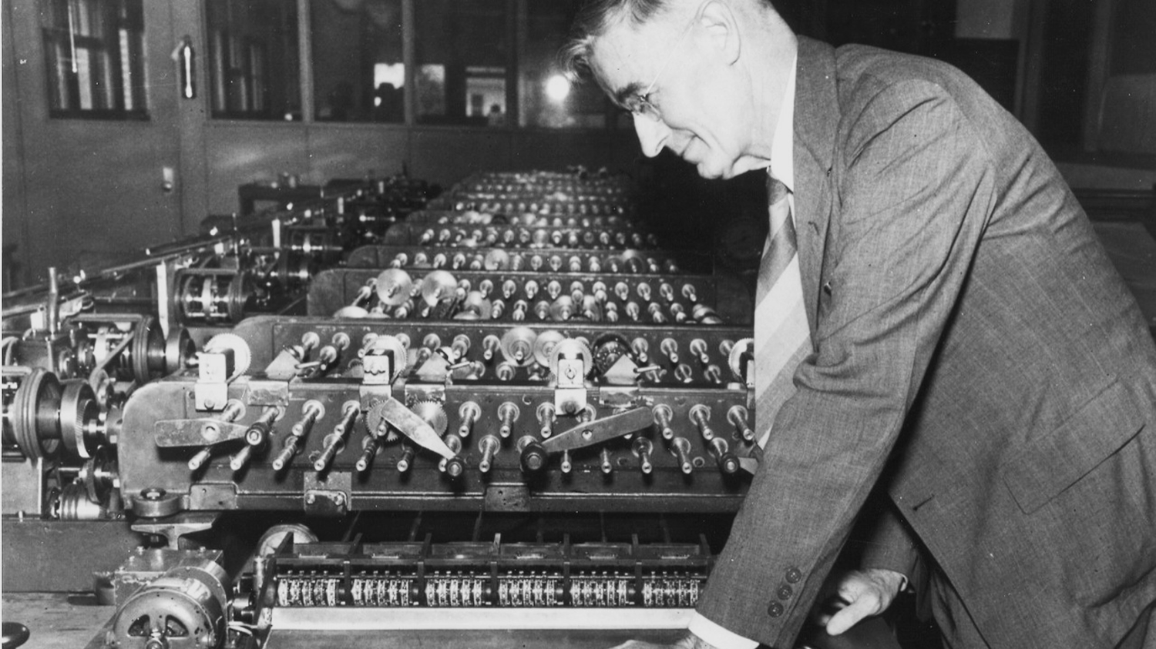
Bush, V. (1931) The differential analyzer. A new machine for solving differential equations. Journal of the Franklin Institute. 212(4), 447-488.
Notes:
Differential Analyser – analogue computer built in 1931 (Shannon hired in 1936 to run it)
(pre-Bush work on mechanical devices for integrating differential equations goes back to Kelvin's tide predicting machine of the 1870s and the work of his brother James Thompson)
Long rods running through machine represent terms in a differential equation, with rotation representing value.
Rods are geared together using differentials (for addition). Multiplication and integration handled by disc integrators (visible on left, with their torque amplifiers)
Work on the Differential Analyser informed US developments in military fire control (everything from the Norden Bombsight to the Mark I Fire Control Computer, both of which were in use as late as the Vietnam War)

Slide 6
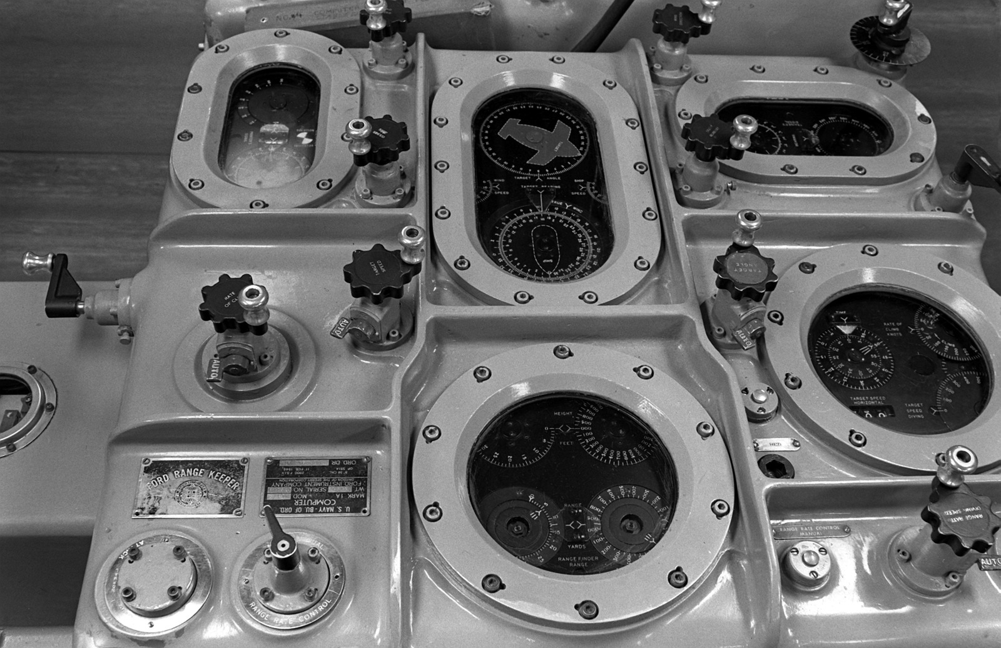
U.S. National Archives
Notes:
Work on the Differential Analyser informed US developments in military fire control (everything from the Norden Bombsight to the Mark I Fire Control Computer, both of which were in use as late as the Vietnam War)
Mark 1A, as mounted on USS Iowa. Combines line-of-sight data (bearing, range, altitude) from fire director with other information (roll/pitch, speed through water, wind speed and direction, muzzle velocity) to determine line-of-fire (lead angle taking into account movement of target, windage, etc).

Slide 7
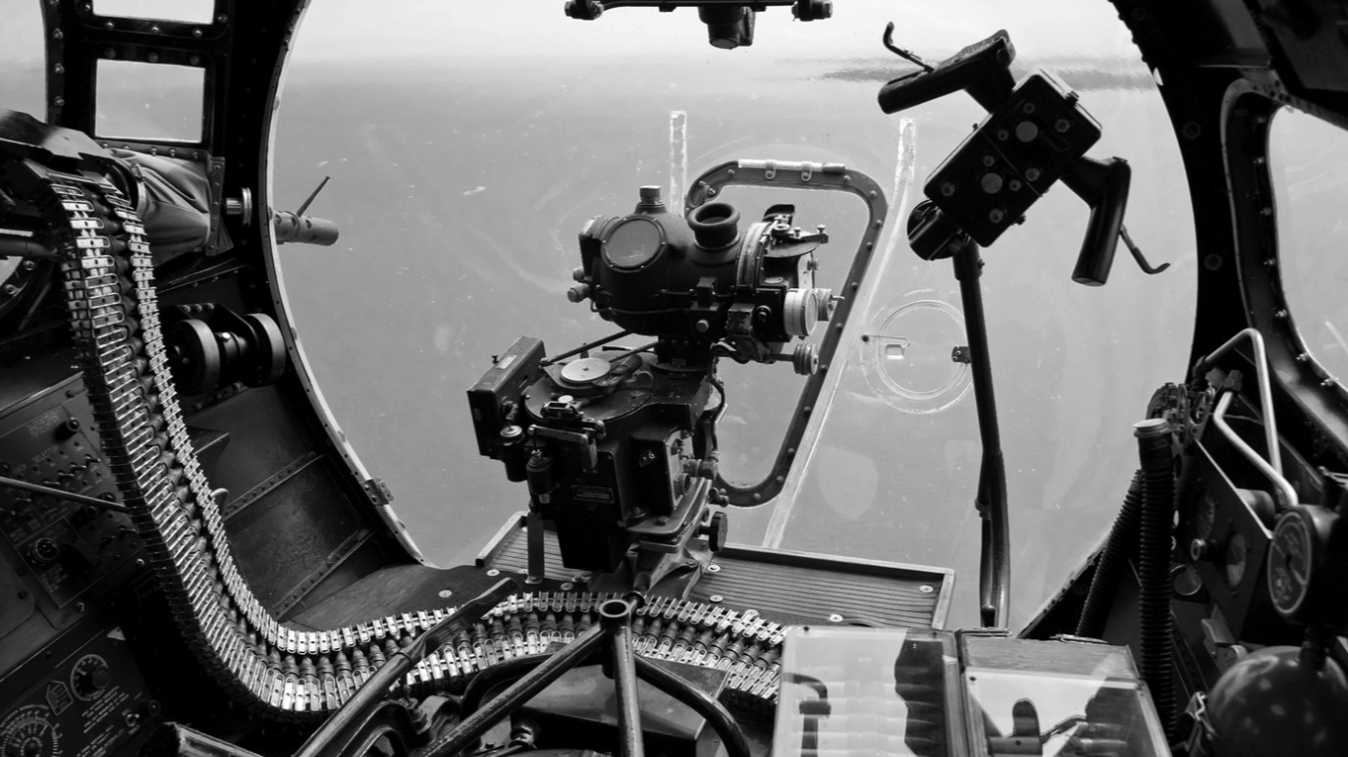
Notes:
Work on the Differential Analyser informed US developments in military fire control (everything from the Norden Bombsight to the Mark I Fire Control Computer, both of which were in use as late as the Vietnam War)
Norden bombsight shown mounted in the nose of a B-17 Flying Fortress
Production of the bombsight (more than 72,000 manufactured during WW2) was an industrial activity on a par with the Manhattan Project. Classified until 1944, the Tizard Mission wasn't able to secure its use by the RAF because the US was concerned that it might fall into German hands.

Slide 8
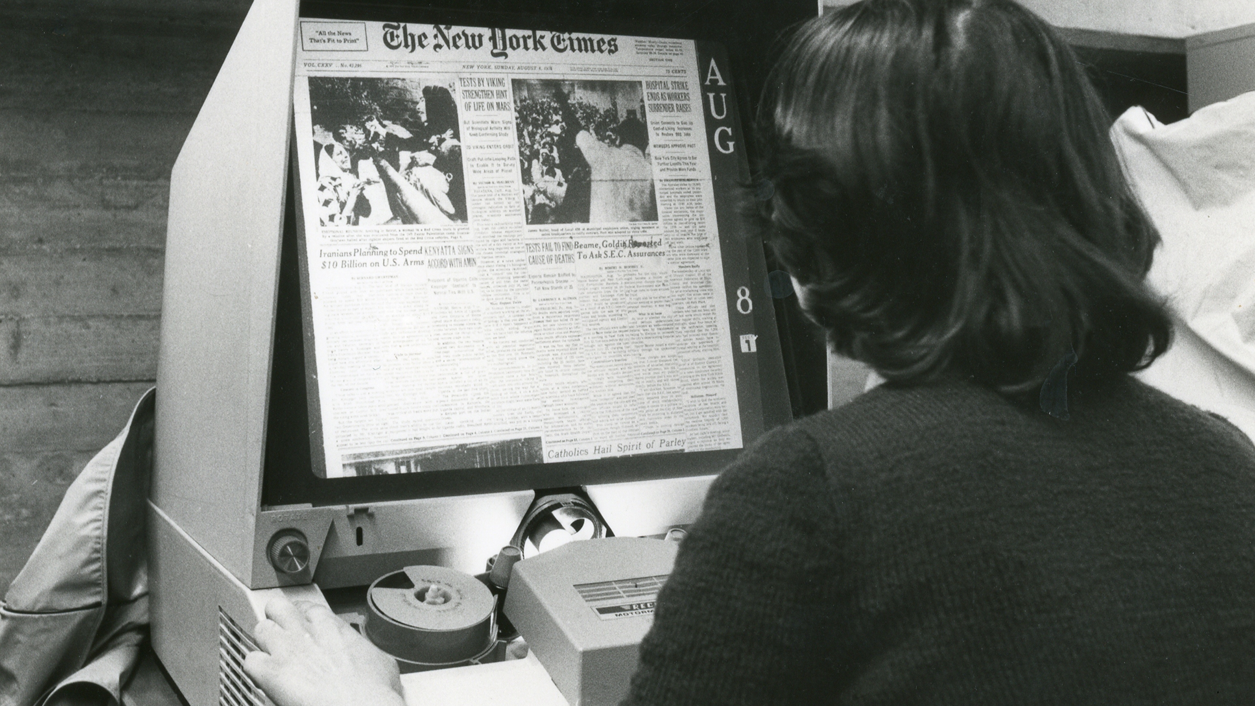
Notes:
We've already seen microfiche as a type of microphotography.
Microfilm uses spools of 16mm film with up to 6000 pages per spool (compared to ~100 per microfiche sheet).
Storage density is offset by its physical affordances as a linear medium – need to spool through to find a given page.

Slide 9
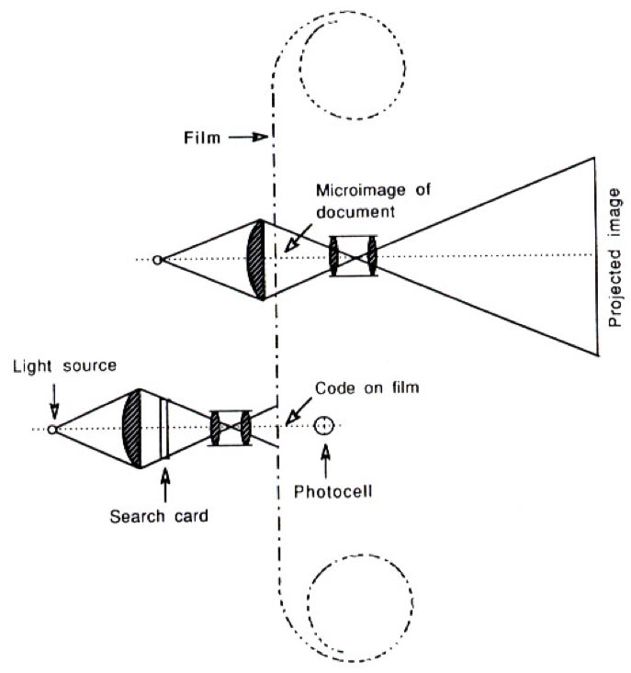
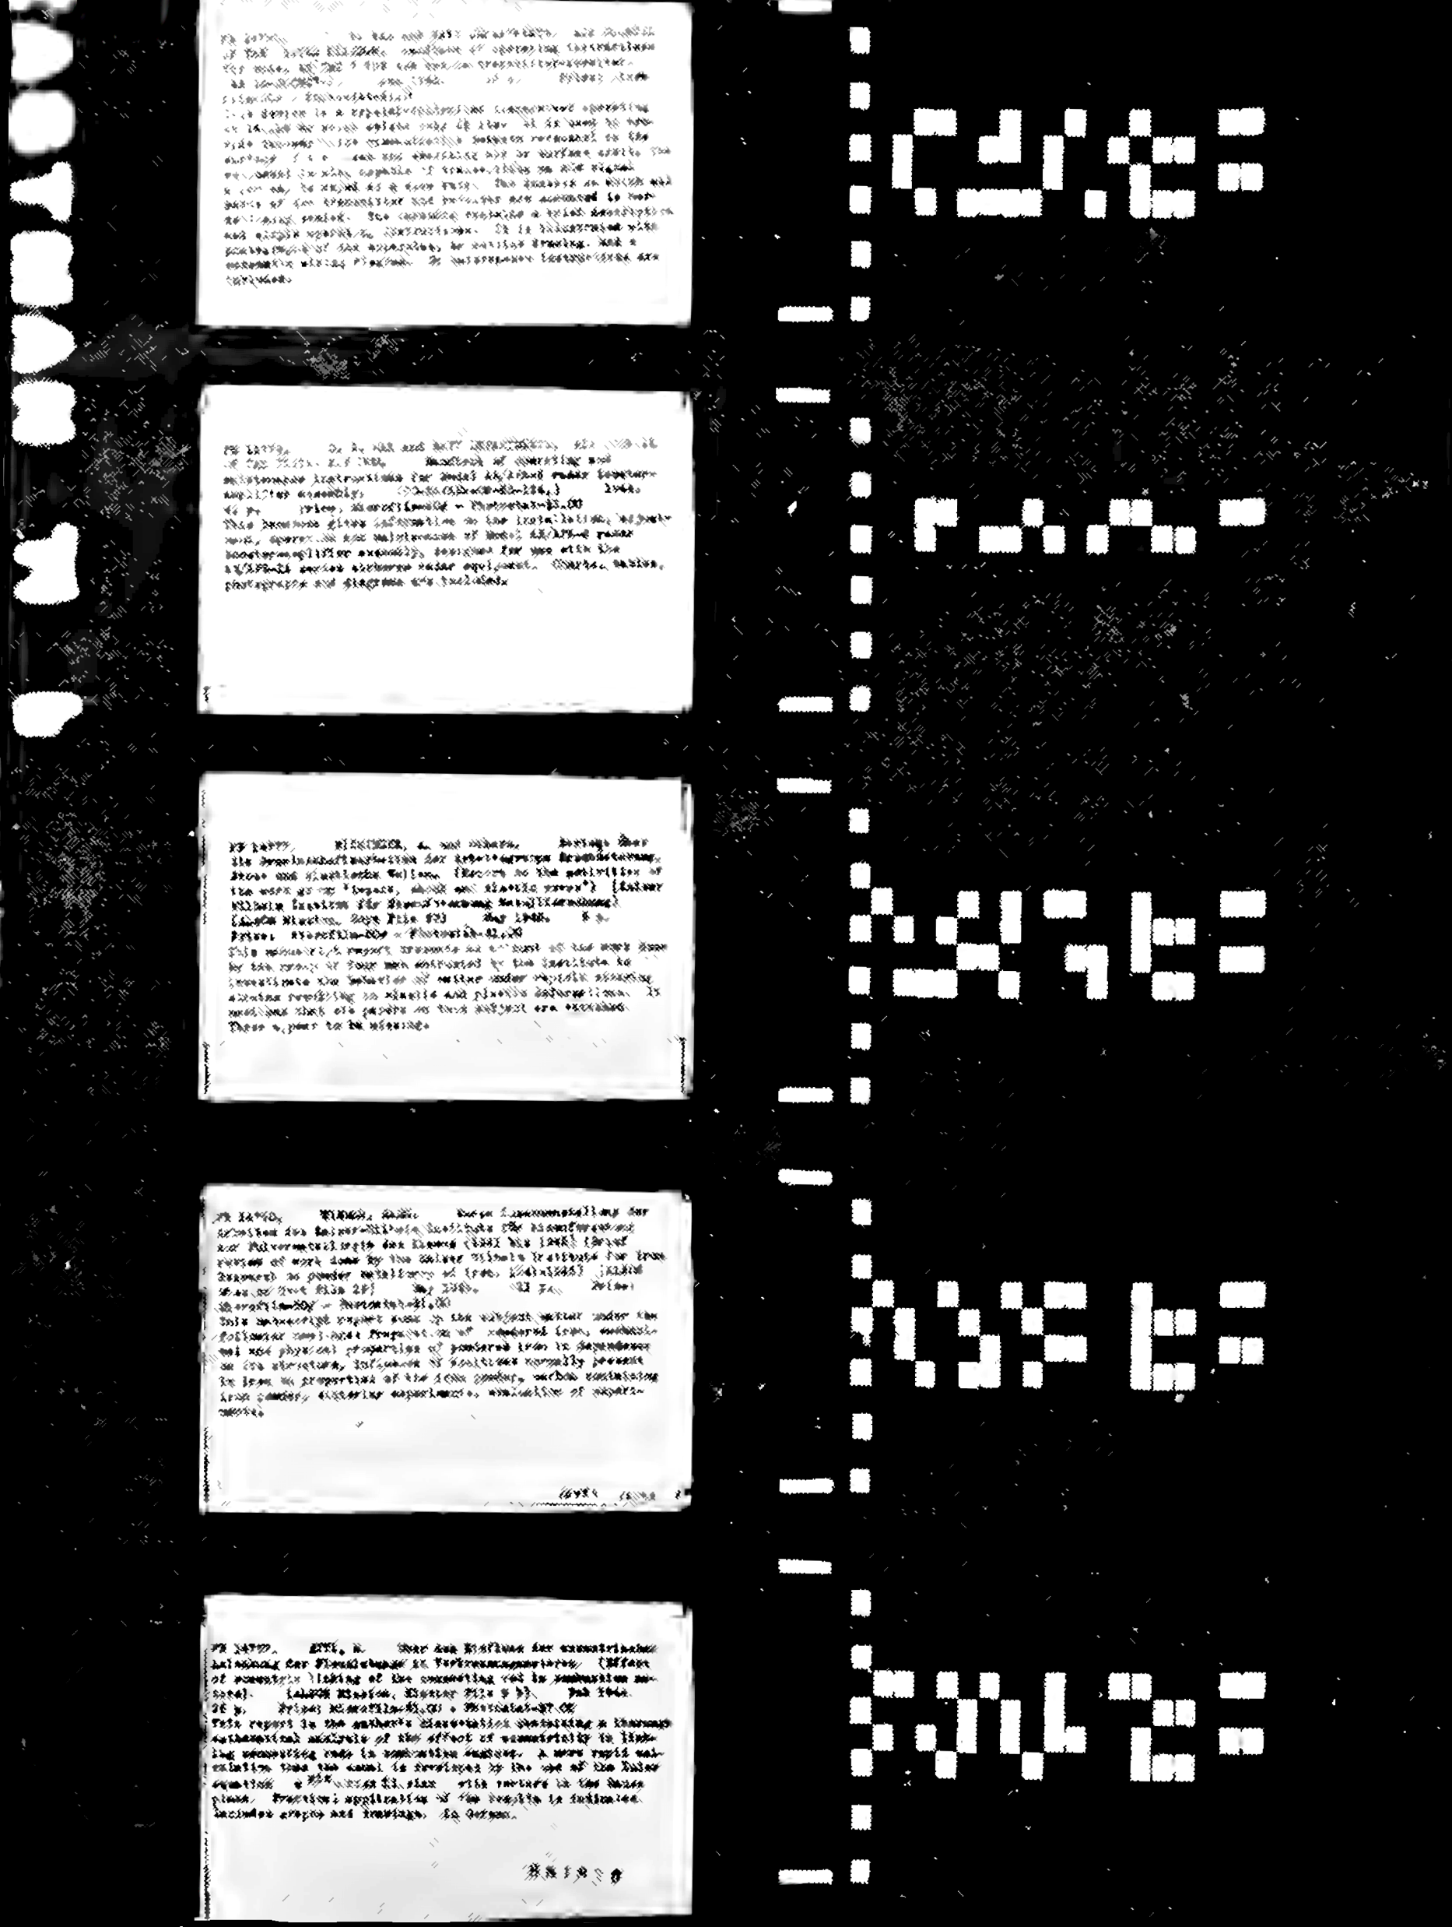
The Rapid Selector
Buckland, M.K. (1992) Emanuel Goldberg, electronic document retrieval, and Vannevar Bush's Memex. Journal of the American Society of Information Science, 43(4), pp. 284-294.
Notes:
Photoelectric microfilm selector developed at MIT in 1938
Metadata about page encoded as a bitmap
Based on earlier (patented!) work by Emanuel Goldberg of Zeiss Ikon (US Patent 1838389) from 1931 (the Statistical Machine)

Slide 10
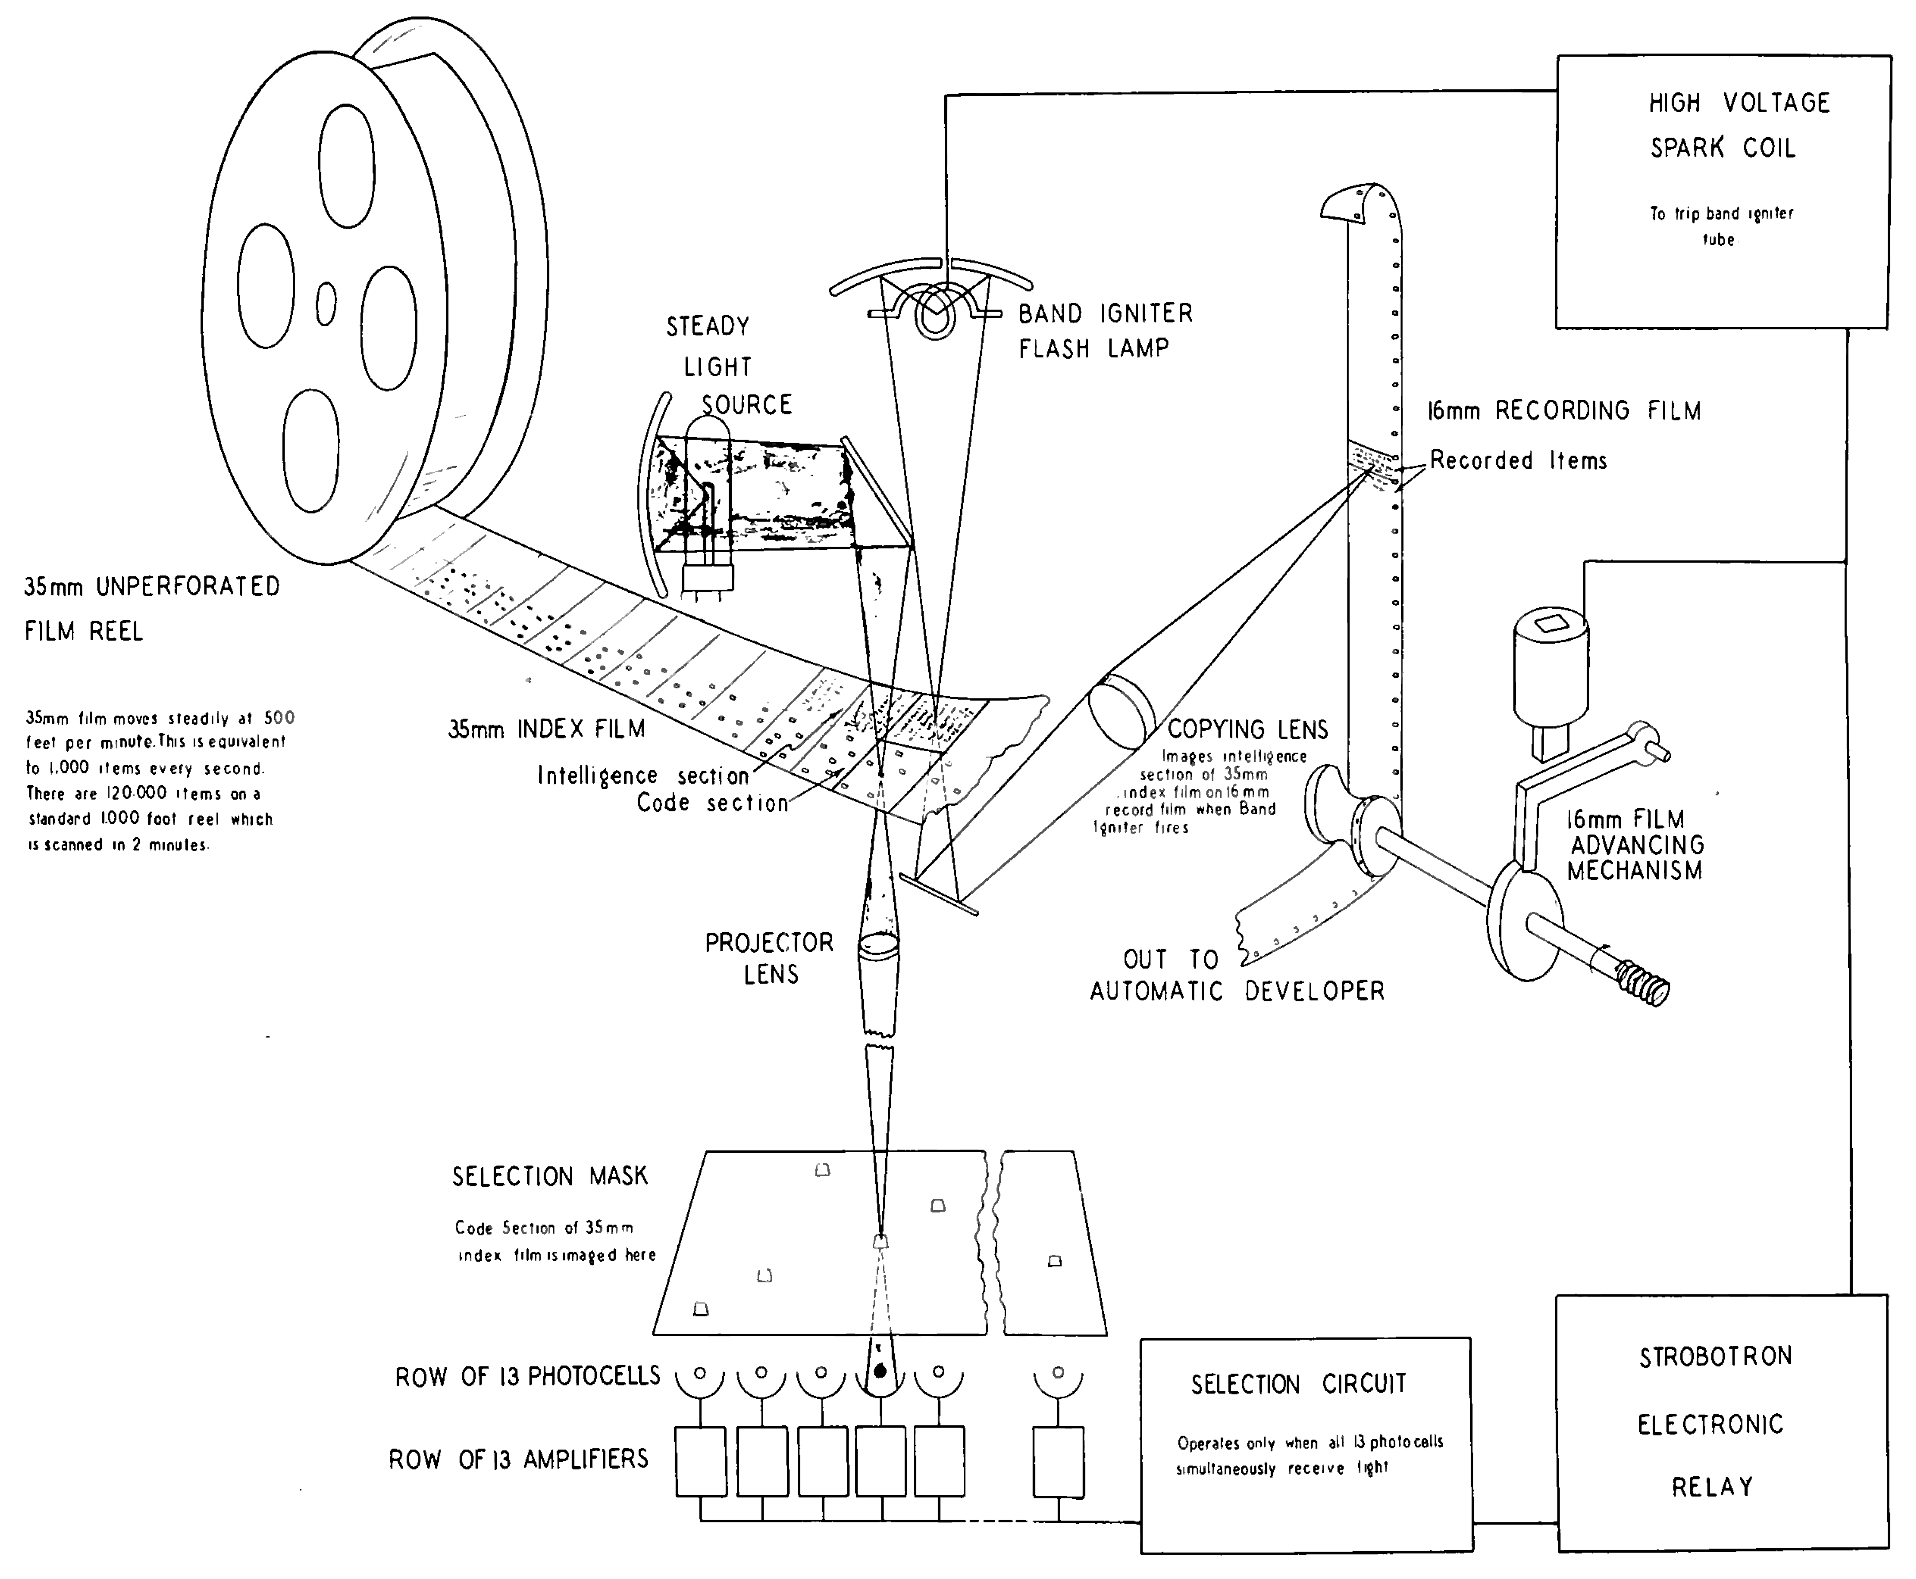
Notes:
As shown, master reel of 35mm film with bitmaps is spooled at high speed
Every time a page matching the selection mask is found, page is copied to conventional 16mm microfilm

Slide 11
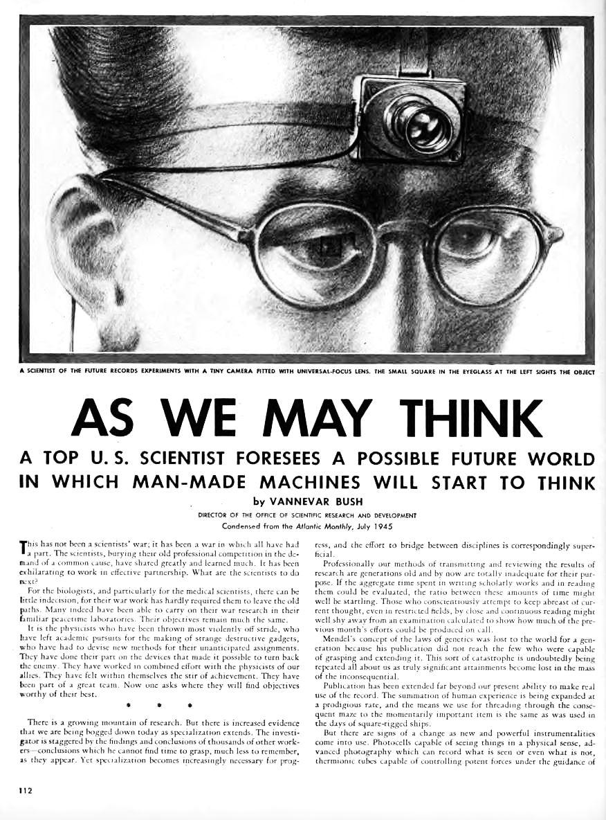
Notes:
Article published in Atlantic Monthly July 1945 (illustration comes from a later republication in LIFE magazine)

Slide 12
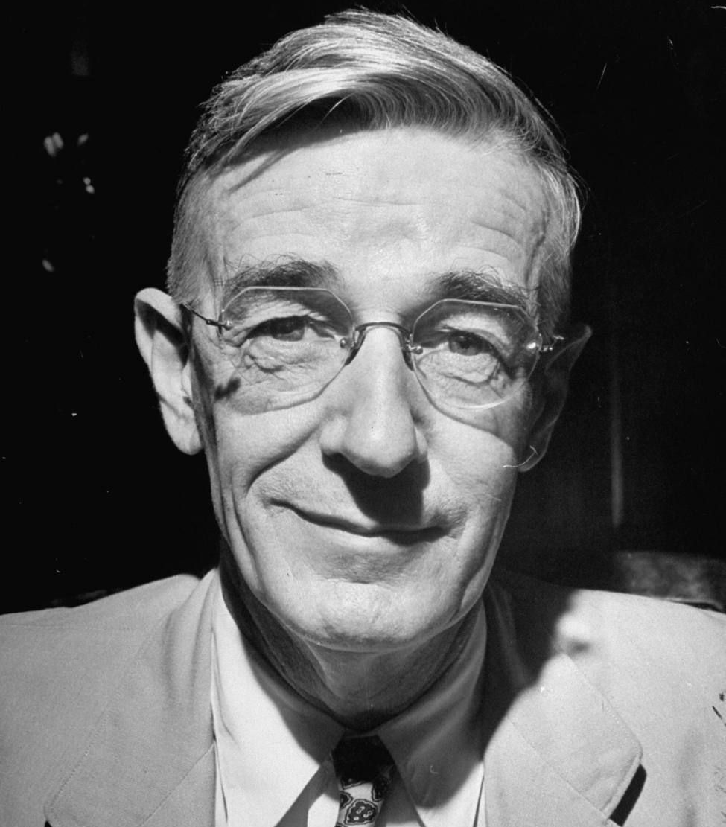
As We May Think
The difficulty seems to be, not so much that we publish unduly in view of the extent and variety of present-day interests, but rather that publication has been extended far beyond our present ability to make real use of the record.
Bush, V. (1945) As We May Think. The Atlantic Monthly, 176, pp.101-108.
Notes:
As We May Think is based in a large part on Bush's experience of managing the OSRD

Slide 13
As We May Think
Our ineptitude in getting at the record is largely caused by the artificiality of systems of indexing. When data of any sort are placed in storage, they are filed alphabetically or numerically, and information is found (when it is) by tracing it down from subclass to subclass. [...] Having found one item, moreover, one has to emerge from the system and re-enter on a new path.
Bush, V. (1945) As We May Think. The Atlantic Monthly, 176, pp.101-108.
Notes:
A direct critique of things like Otlet's UDC?

Slide 14
As We May Think
The human mind does not work that way. It operates by association. With one item in its grasp, it snaps instantly to the next that is suggested by the association of thoughts, in accordance with some intricate web of trails carried by the cells of the brain.
Bush, V. (1945) As We May Think. The Atlantic Monthly, 176, pp.101-108.

Slide 15
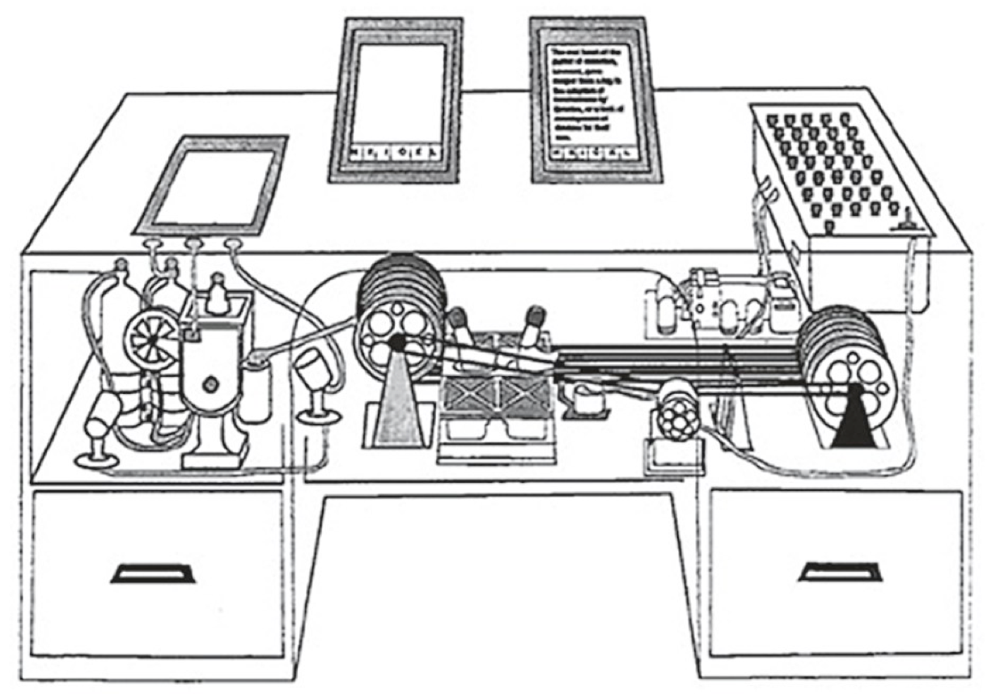
microfilm displays
photographic
platen
controls
microfilm
developer
microfilm storage
with rapid selectors
Notes:
The Memex – a thought experiment
Image is from LIFE magazine.

Slide 16
The Memex
“The process of tying two things together is the important thing”
Key notion is of a trail:
Link between pages
Stored (branching) sequence of pages
“a new profession of trail blazers, those who find delight in the task of establishing useful trails through the enormous mass of the common record”
Notes:
Ideas first formulated c. 1932.
When the user is building a trail, he names it, inserts the name in his code book, and taps it out on his keyboard. Before him are the two items to be joined, projected onto adjacent viewing positions. At the bottom of each there are a number of blank code spaces, and a pointer is set to indicate one of these on each item. The user taps a single key, and the items are permanently joined. In each code space appears the code word. Out of view, but also in the code space, is inserted a set of dots for photocell viewing; and on each item these dots by their positions designate the index number of the other item.

Slide 17

As We May Think
Wholly new forms of encyclopedias will appear, ready made with a mesh of associative trails running through them, ready to be dropped into the memex and there amplified.
Bush, V. (1945) As We May Think. The Atlantic Monthly, 176, pp.101-108.

Slide 18
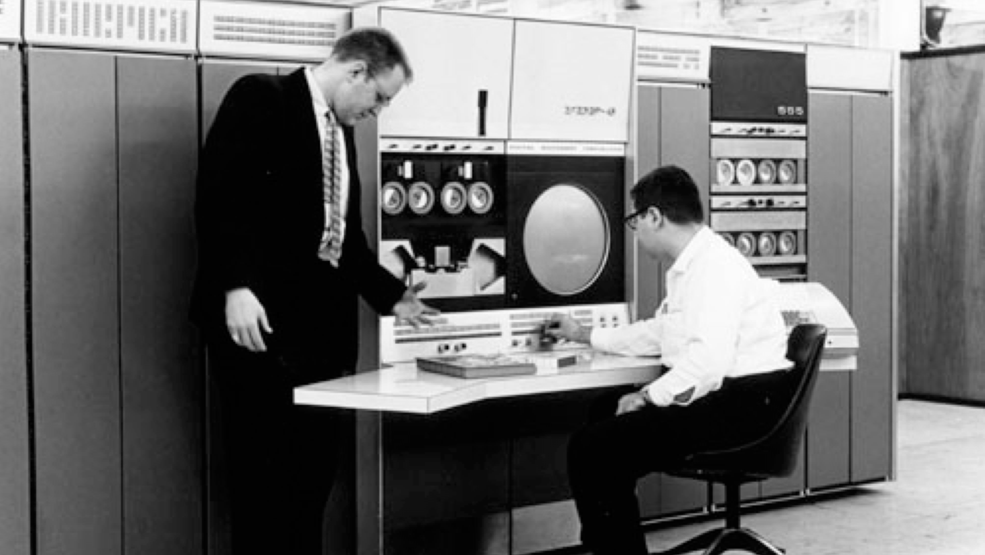
The Information Age
Computer History Museum
Notes:
Standing: Gordon Bell
architect of the PDP-4 and PDP-6, VP in charge of the development of the DEC VAX.
In later years, the experimental subject of the Microsoft MyLifeBits project – lifelogging experiment inspired by Bush’s Memex
Seated: Alan Kotok
As an undergraduate at MIT, helped develop the first video game: Spacewar
While at Digital in 1994, encouraged Berners-Lee to start a new organisation at MIT to coordinate Web development
Associate chairman of W3C from 1997

Slide 19
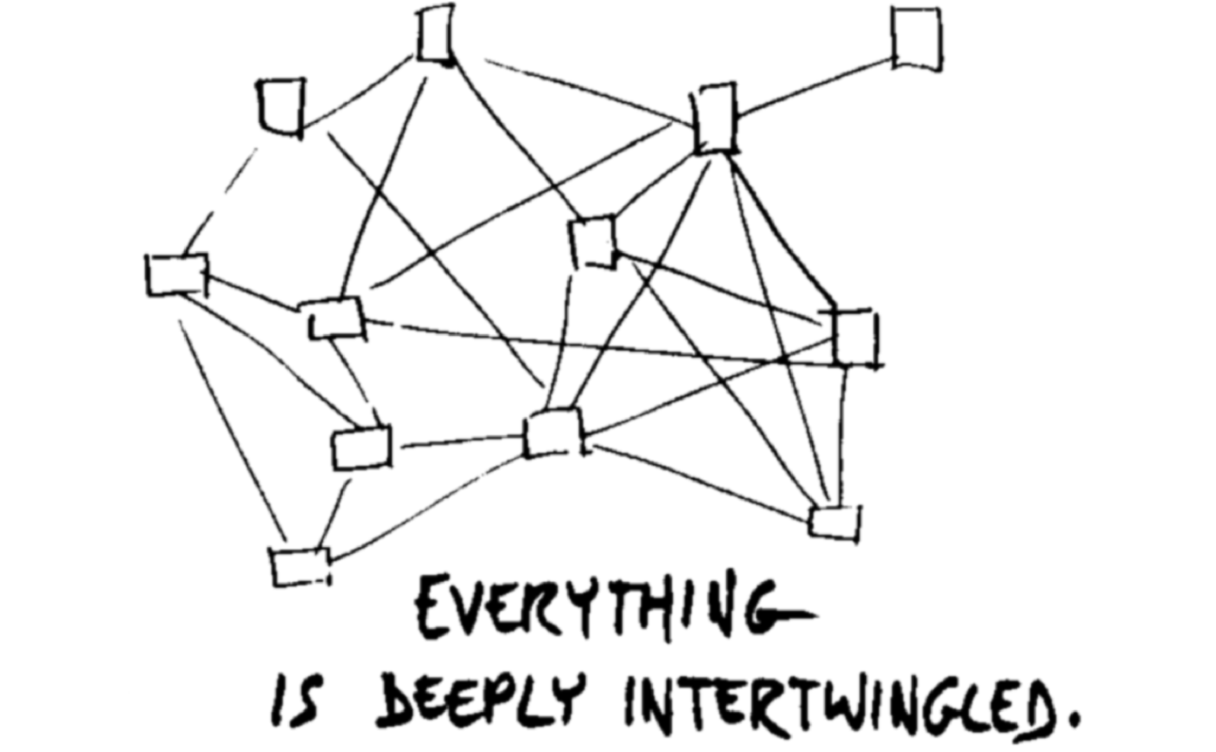
Nelson, T.H. (1974) Computer Lib/Dream Machines. Chicago, IL: Nelson, T.H.
Notes:
“In an important sense, there are no “subjects” at all; there is only all knowledge, since the cross-connections among the myriad topics of this world cannot be divided up neatly.
Hypertext at last offers the possibility of representing and exploring it all without carving it up destructively”

Slide 20
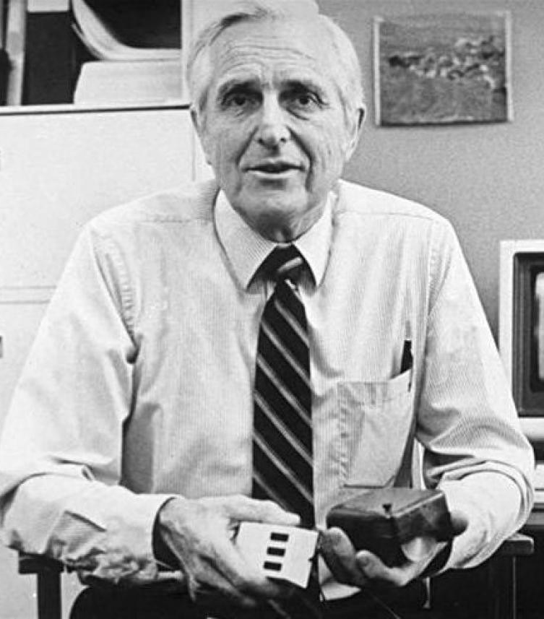
Doug Engelbart
Member of the Stanford Research Institute
While at SRI, founded the
Augmentation Research Center
Notes:
Served in the Philippines after WW2 as a radar technician (ironically, his ship left San Francisco on VJ Day)
While stationed on Leyte in 1945, he read Bush’s article in the Atlantic.
When ARC folded in the 70s, many researchers went to Xerox PARC, creators of the modern GUI (windows, icons, menus) on the Xerox Star

Slide 21
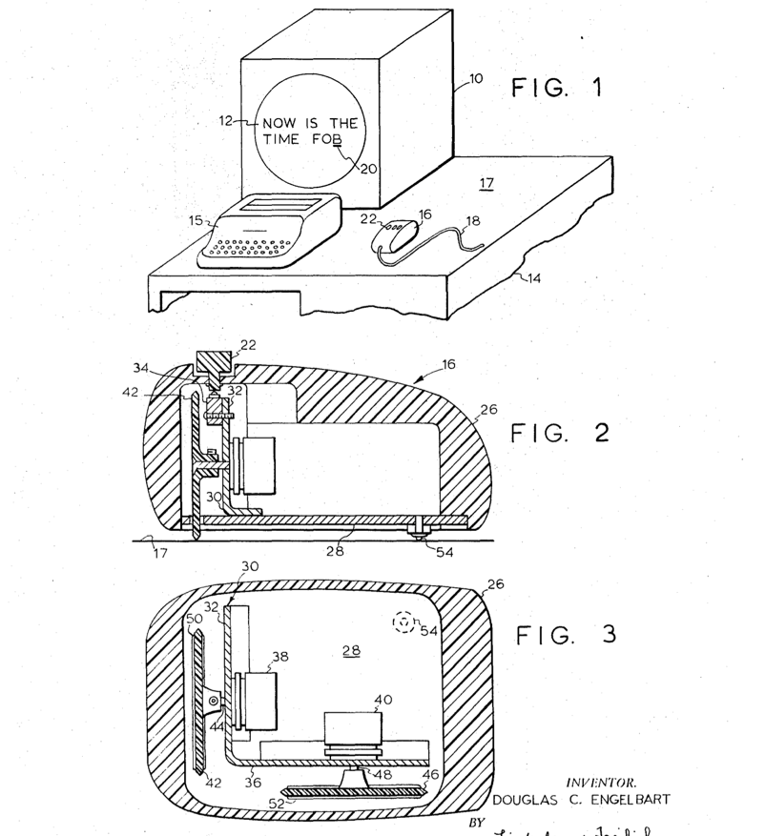
Engelbart, D.C. (1970) X-Y Position Indicator for a Display System. US Patent 3,541,541.

Slide 22
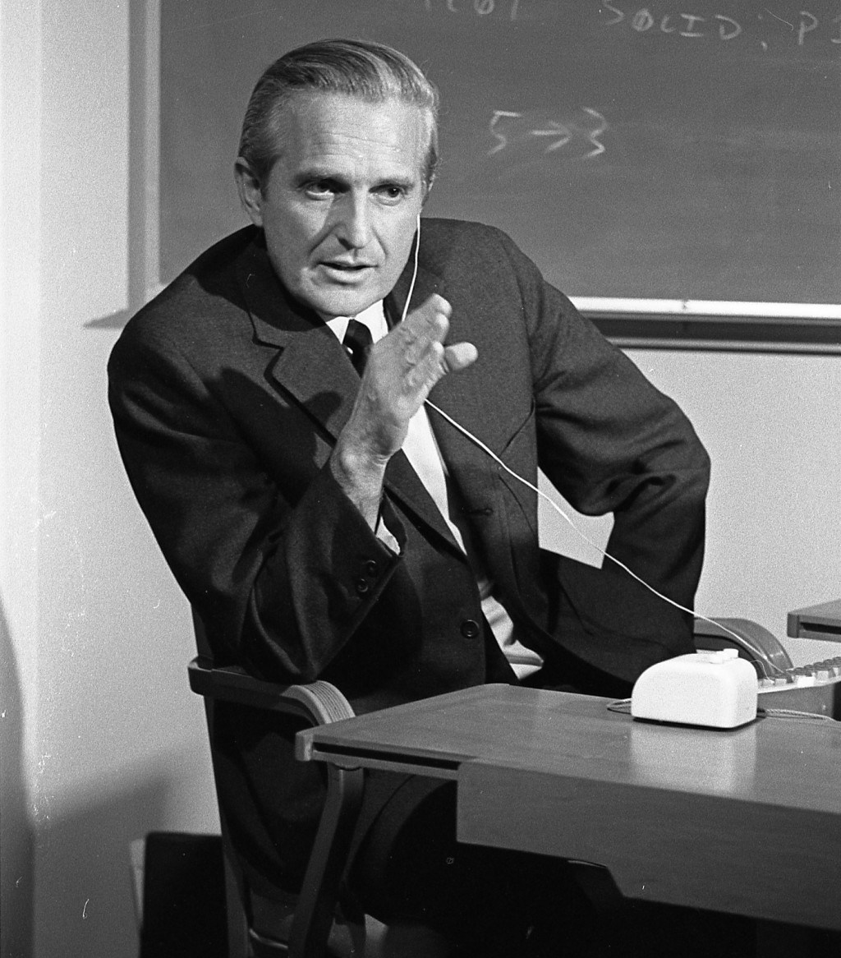
Augmented external symbol manipulation
In this stage [of the evolution of individual human intellectual capability], symbols with which the human represents the concepts he is manipulating can be arranged before his eyes, moved, stored, recalled, operated upon according to extremely complex rules—all in very rapid response to a minimum amount of information supplied by the human, by means of special cooperative technological devices.
Engelbart D.C. (1962) Augmenting Human Intellect: A Conceptual Framework. SRI Summary Report AFOSR-3223. USA: Stanford Research Institute.

Slide 23
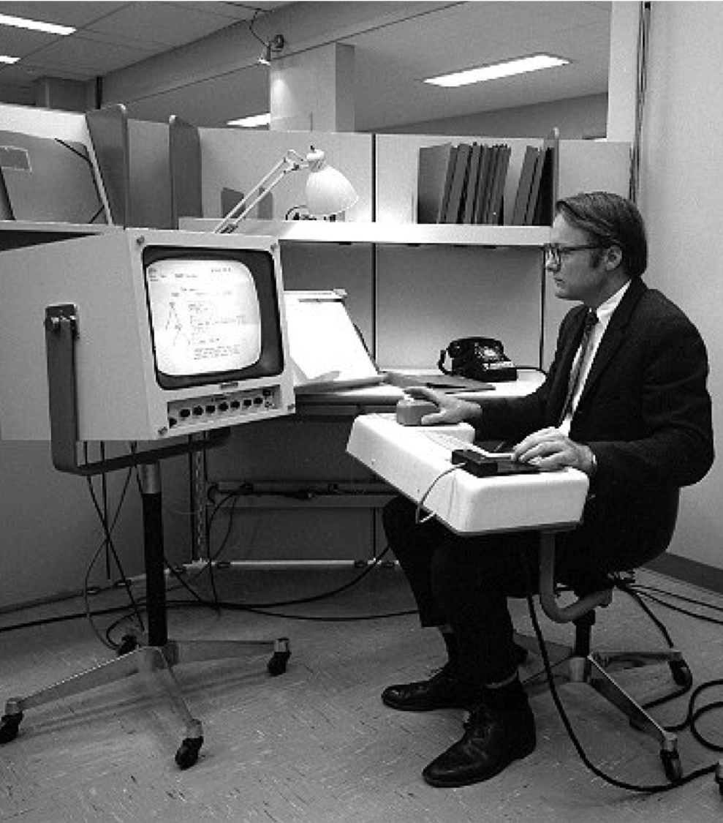
NLS: the oN-Line System
Timesharing computer with multiple consoles
UI features:
  Windowed display
  Mouse
  Chorded keyboard
  Videoconferencing
  Links in content!
Notes:
Ergonomic workstation designed by Jack Kelley of Herman Miller, based around an Eames Shell chair.

Slide 24
Augmenting human intellect
[...] we are concentrating fully upon reaching the point where we can do all of our work on line — placing in computer store all of our specifications, plans, designs, programs, documentation, reports, memos, bibliography and reference notes, etc., and doing all of our scratch work, planning, designing, debugging, etc., and a good deal of our intercommunication, via the consoles.
Engelbart D.C. and English W.K. (1968) A Research Center for Augmenting Human Intellect. AFIPS Conference Proceedings of the 1968 Fall Joint Computer Conference. Vol.33, pp.395-410.

Slide 25
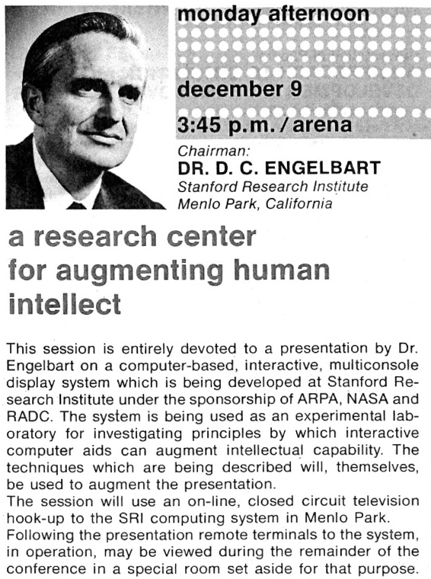
http://thedemo.org/
Notes:
9 December 1968 in San Francisco
Nicknamed “the mother of all demos” by Stephen Levy in his 1994 history of the Apple Macintosh.
Next slide – Engelbart demonstrating links in NLS

Slide 26
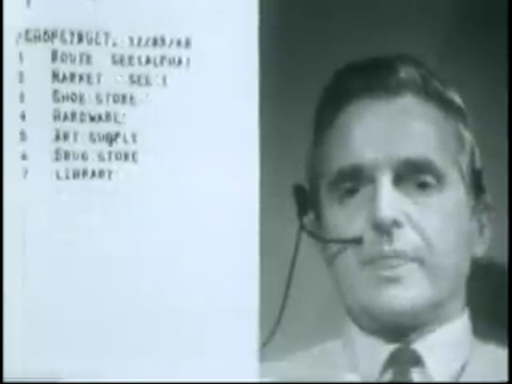
Notes:
Next slide – a live demonstration of the mouse

Slide 27
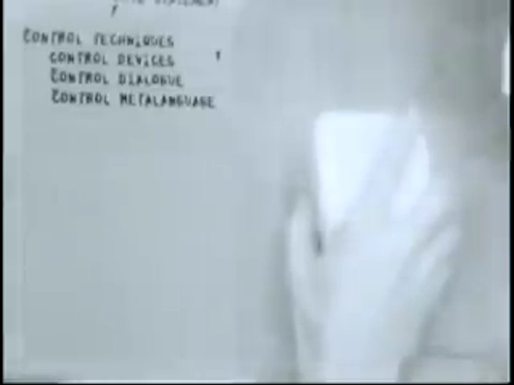
Notes:
What happened to NLS? SRI sold the system to Tymshare in 1977, who then marketed the technologies as AUGMENT.
About half of the members of ARC (including Engelbart) went to Tymshare.
Most of the remainder (notably including Bill English) went to the nascent Xerox PARC.

Slide 28
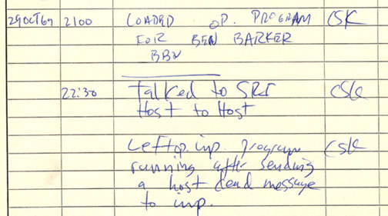
Notes:
Less than a year after the NLS demo
ARC played key role in early history of the Internet (or as it was then, ARPANET)
First message on ARPANET from UCLA to SRI on 29 October 1969 at 2230 PST
The host at SRI that received the message was the SDS940 on which NLS ran
ARC-run ARPANET reference library service turned into InterNIC (domain name and IP address allocations until 1998 -> ICANN)

Slide 29
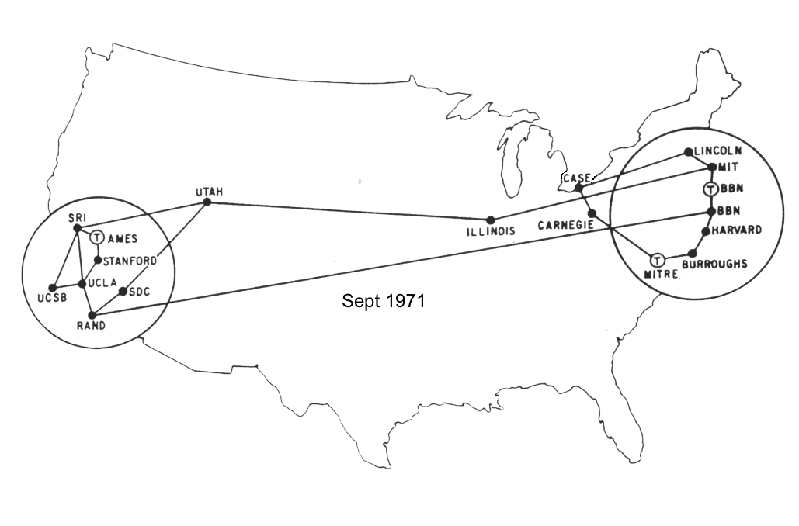
The birth of the Internet
Notes:
ARPANET Email invented by Ray Tomlinson in 1971 (also the creator of Creeper, the first computer virus)
FTP invented by Abhay Bhushan in 1971
On this map ILLINOIS is the University of Illinois at Urbana-Champaign (later home of the National Center for Supercomputing Applications, creators of the Mosaic web browser)

Slide 30
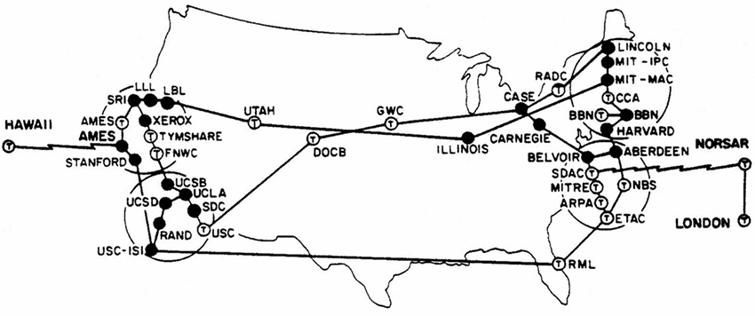
The birth of the Internet
Notes:
September 1973
Note satellite link from SDAC (Seismic Data Analysis Centre) to NORSAR (Norwegian Seismic Array) and ongoing link to London (UCL)
Note also Tymshare and XEROX – two destinations of ex-ARC members
1974: TCP (Transmission Control Program) created by Vint Cerf and Paul Kahn
1978: Split into Transmission Control Protocol and Internet Protocol: TCP/IP
1982: ARPANET adopts TCP/IP

Slide 31
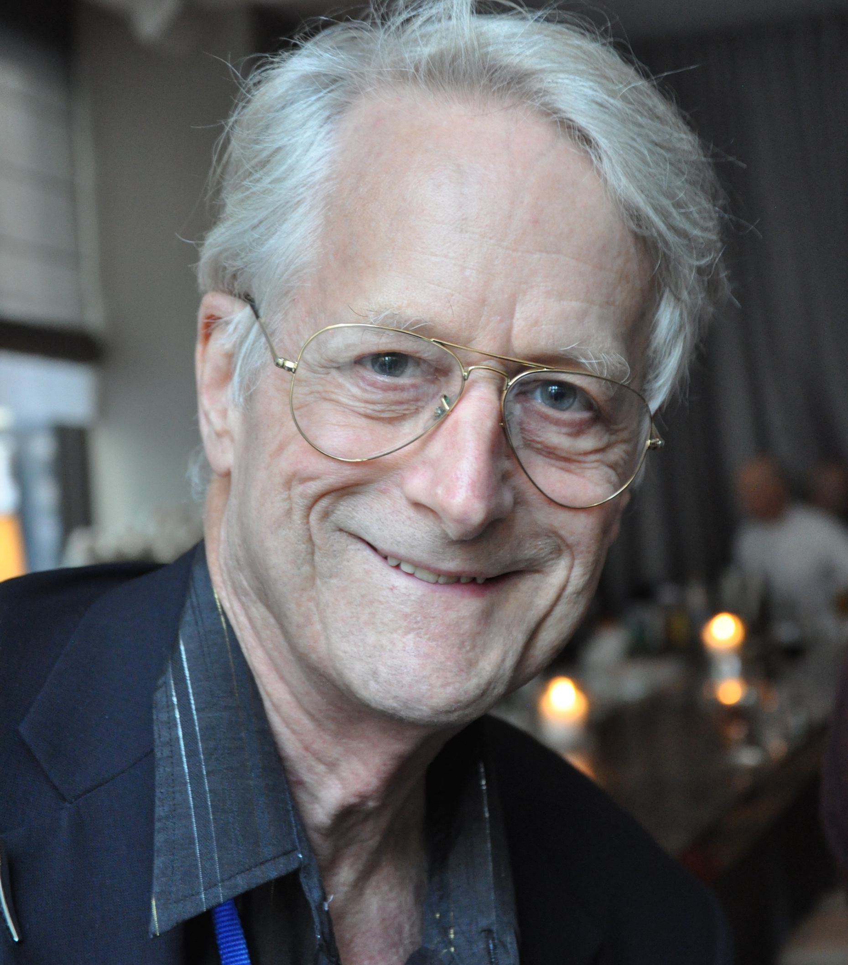
Ted Nelson
Sociologist, philosopher and film maker
Coined the term “hypertext” in 1965
A user interface should be so simple that a beginner in an emergency can understand it within ten seconds.”
Most people are fools, most authority is malignant, God does not exist, and everything is wrong.
Notes:
Son of Ralph Nelson (film director best known for Charly, Lilies of the Field, and Father Goose) and Celeste Holm (actress best known for her roles in All About Eve and High Society)

Slide 32
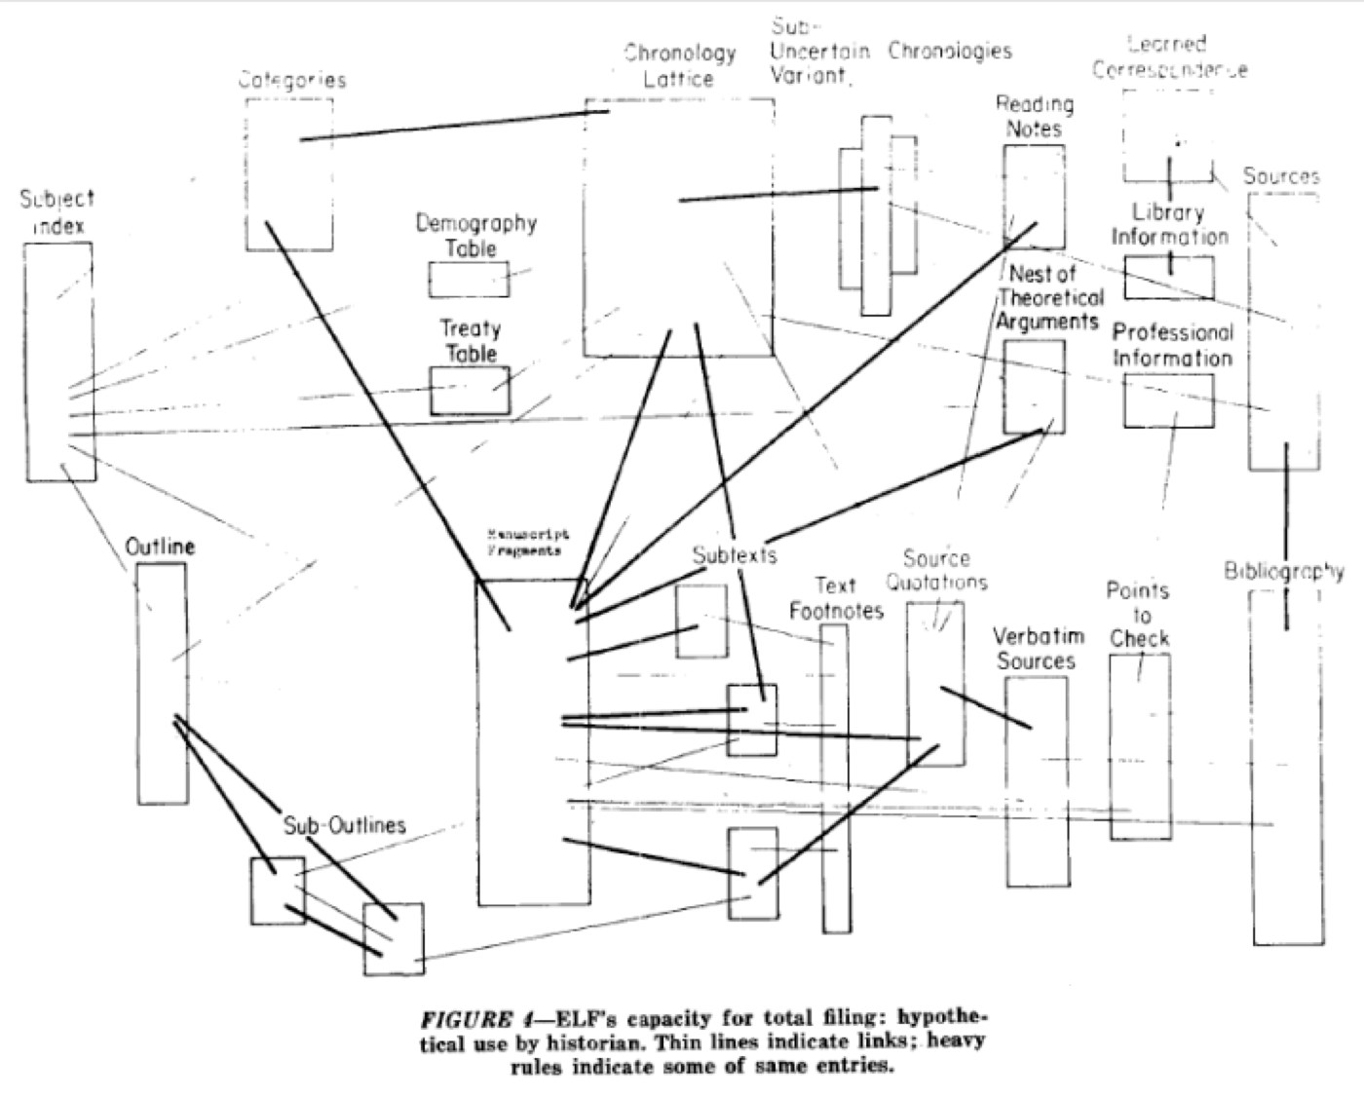
Nelson, T.H. (1965) A File Structure for the Complex, the Changing and the Indeterminate. Proceedings of the ACM 20th National Conference, pp. 84-100
Notes:
First use of the term “hypertext” – this is where we came in.
Next slide – clip from 1990 documentary Hyperland in which Nelson talks about hypertext

Slide 33
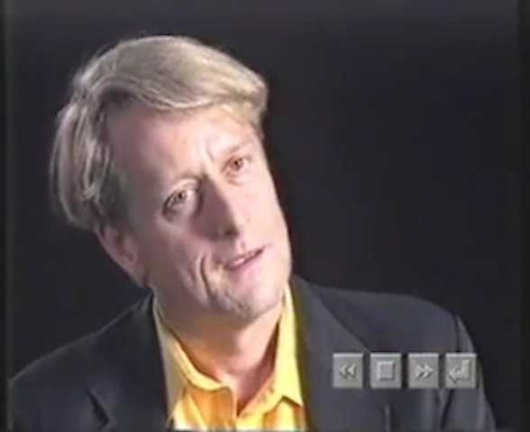
Hyperland (1990) Produced by Max Whitby [Television Programme]. London: British Broadcasting Corporation.

Slide 34
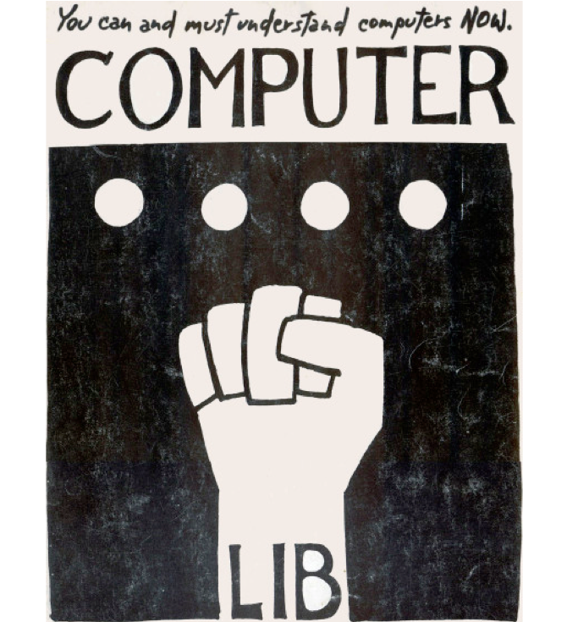
Computer Lib /
Dream Machines
“No one's life has yet been simplified by a computer.”
Two books in a dos-a-dos binding:
Computer Lib is a clarion call for people to understand computers deeply
Dream Machines is a sketch of the flexible media potential of computers
Nelson, T.H. (1974) Computer Lib/Dream Machines. Chicago, IL: Nelson, T.H.
Notes:
"Down with Cybercrud"
anti centralisation
democratisation of computing – computer experts intentionally obscure

Slide 35
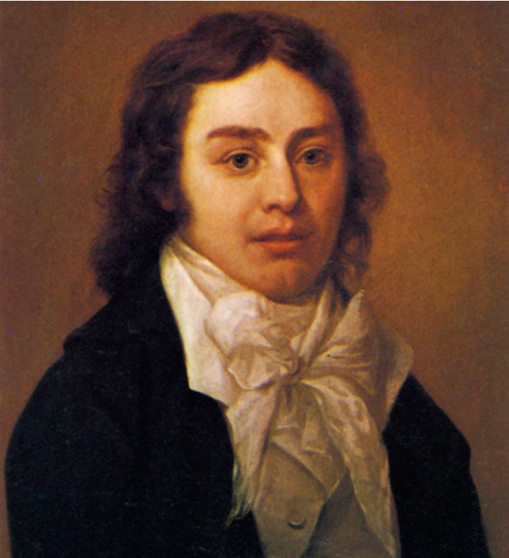
A Vision in a Dream
In 1797, Samuel Taylor Coleridge (supposedly) wrote the poem Kubla Khan after awaking from an opium dream:
In Xanadu did Kubla Khan
A stately pleasure-dome decree:
Where Alph, the sacred river, ran
Through caverns measureless to man
Down to a sunless sea.
He was interrupted by a visitor from Porlock, and never completed the poem…

Slide 36

Project Xanadu (1960-)
Founded in 1960, still ongoing
(also famously never completed...)
Hugely influential, nonetheless
Described in Dream Machines, and Nelson’s subsequent book Literary Machines
Nelson, TH. (1993) Literary Machines. Sausalito, CA: Mindful Press.
Notes:
"longest-running vaporware story in the history of the computer industry” – Gary Wolf in WiReD (rather unkind)
First demo version in 1972
With Roger Gregory, Mark Miller, Stuart Greene in 1979
1983-1992 – With Autodesk
1992- Xanadu Operating Company
Open-sourced in 1998
2007 - XanaduSpace
Literary machines – first published 1980
Next slide – Nelson on Xanadu

Slide 37
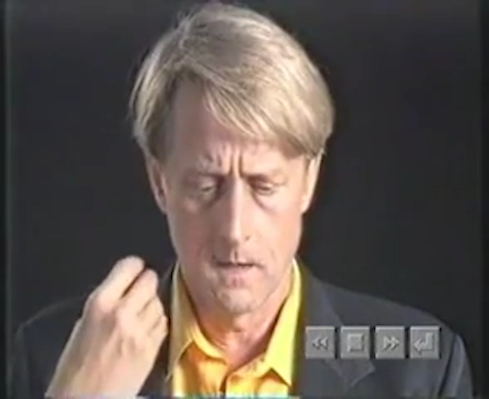
Hyperland (1990) Produced by Max Whitby [Television Programme]. London: British Broadcasting Corporation.

Slide 38
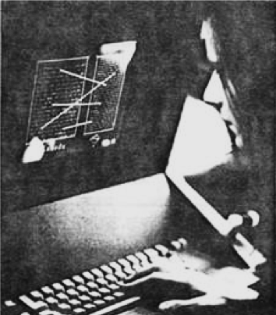
Project Xanadu
Intercomparison of parallel documents
World-wide publishing without barriers
Transclusion
Transcopyright
Versioning
Links that don't break
Nelson, T.H. (1972) As We Will Think. Proceedings of Online 72 Conference, Uxbridge, England.
Notes:
Photograph in As We Will Think is a simulation of Xanadu – tape stuck on a screen

Slide 39
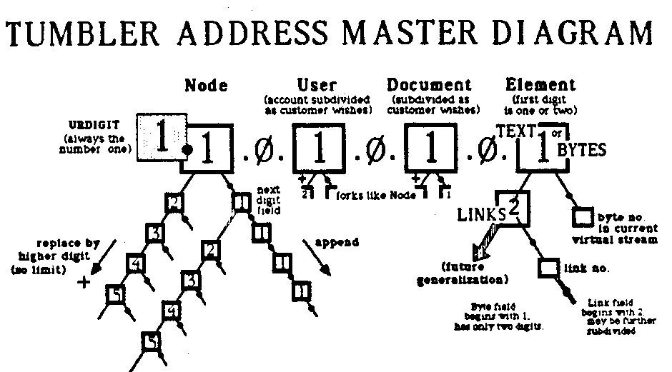
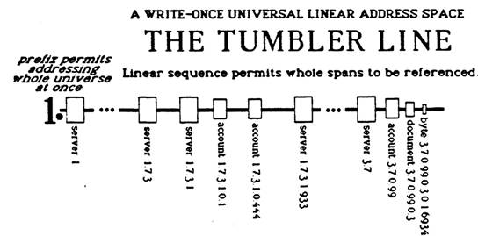
Addressing
Document addressing in Xanadu uses numeric identifiers known as tumblers
Expandable, write-once address space that allows referencing of document fragments
Nelson, TH. (1993) Literary Machines. Sausalito, CA: Mindful Press.

Slide 40
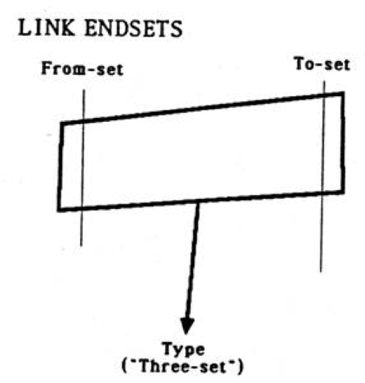
Links
Can be stored separately from documents (i.e. first-class)
Can be stored within a document
(in its link-train)
N-ary – multiple addresses in the from-set and to-set
Multiple types associated with the link (via the three-set – more addresses)
Markup considered as link type!
Nelson, T.H. (1997) Embedded markup considered harmful, World Wide Web Journal 2(4).
Notes:
Stand-off markup later popularised by the Text Encoding Initiative (TEI)

Slide 41
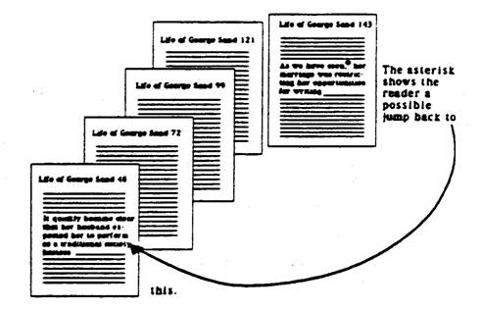
Transclusion
Documents are composite objects that can contain parts of other documents, via special links: transclusions
Instead of copy and pasting, the address of a fragment of another document is inserted and the referenced content is retrieved and displayed at runtime
(also provides a mechanism for tracking fractional royalties for use of these fragments – transcopyright)
Nelson, TH. (1993) Literary Machines. Sausalito, CA: Mindful Press.

Slide 42
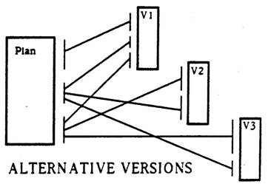
Versioning
Transparent versioning of documents
Editing a document creates a new revision (possibly with transclusion of material from previous version)
Versioning also permits different variants (alternative versions) of a document
Nelson, TH. (1993) Literary Machines. Sausalito, CA: Mindful Press.

Slide 43
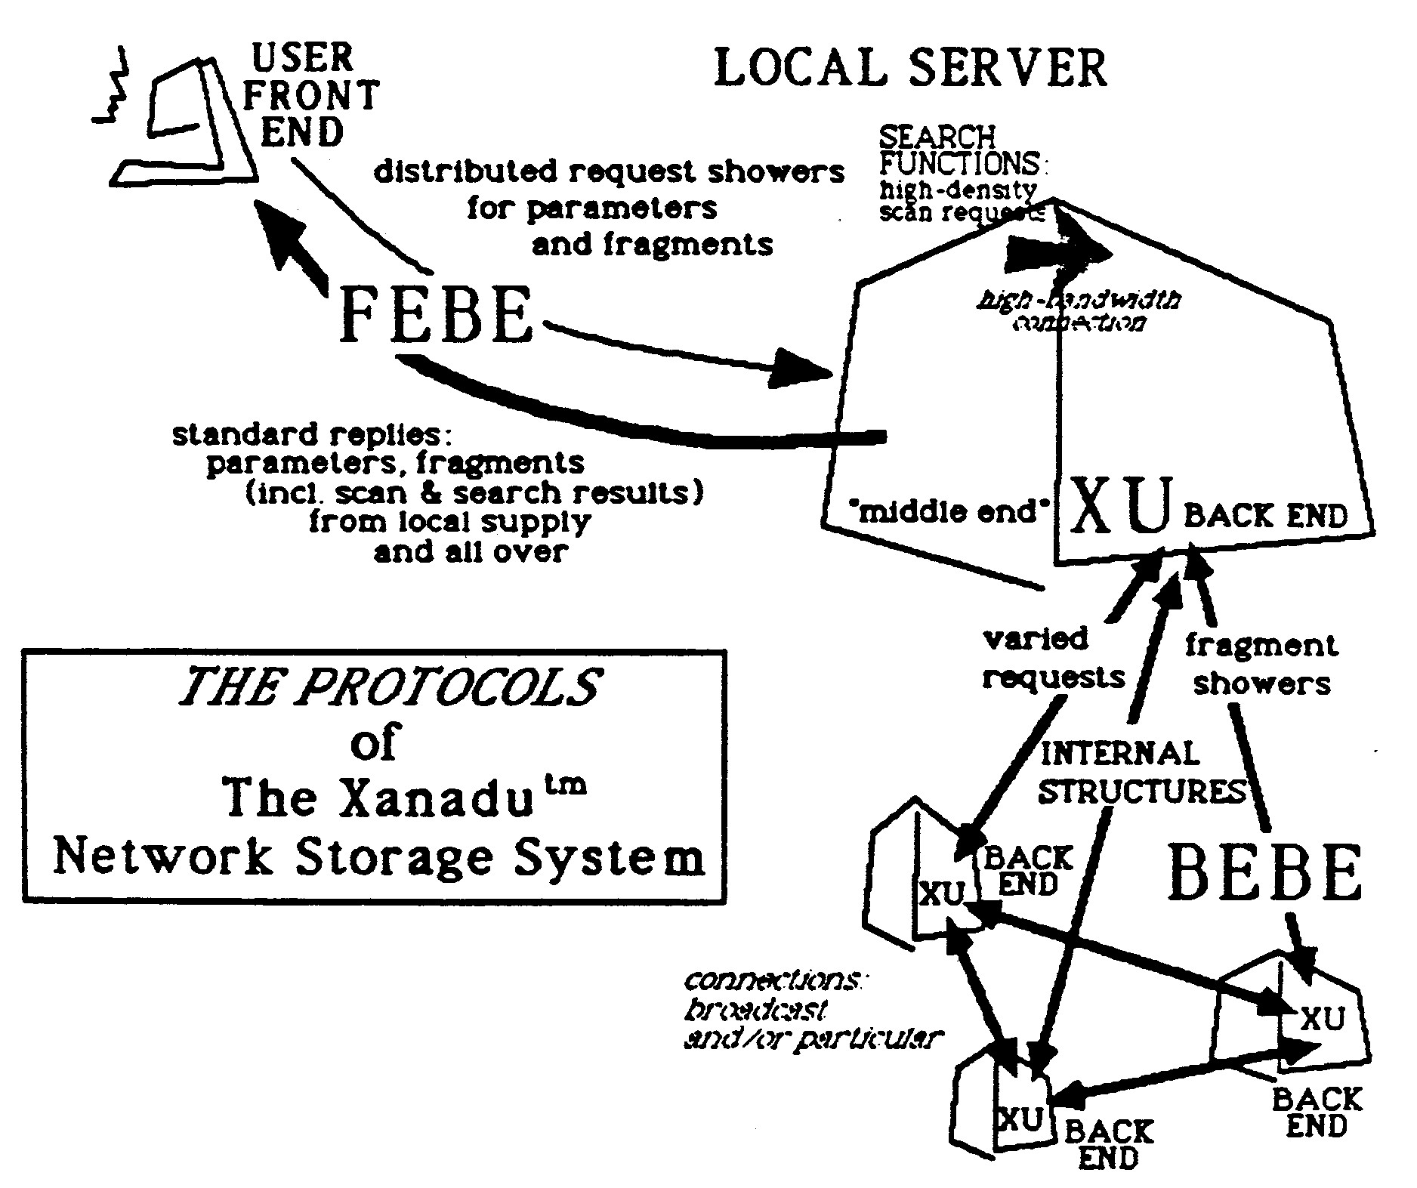
Distribution
Xanadu separates the front end clients that display content to users from the back end servers that manage that content
Front End to Back End (FEBE) Protocol
  Used for user interaction
Back End to Back End (BEBE) Protocol
  Used to manage consistency between back end servers
Nelson, TH. (1993) Literary Machines. Sausalito, CA: Mindful Press.
Notes:
FEBE described in some detail in Literary Machines, BEBE didn’t exist...

Slide 44
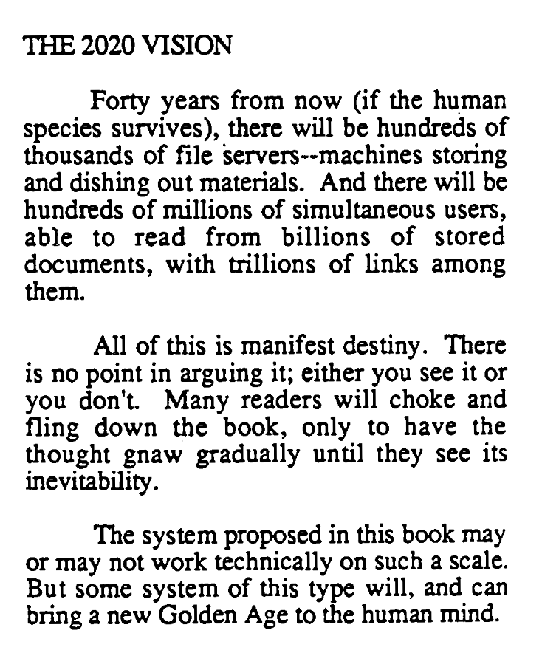
Nelson, TH. (1980) Literary Machines. Sausalito, CA: Mindful Press.

Slide 45
Nelson on the Web
The Xanadu project did not ‘fail to invent HTML’. HTML is precisely what we were trying to PREVENT – ever-breaking links, links going outward only, quotes you can't follow to their origins, no version management, no rights management.

Slide 46
Next Lecture: Trailblazers, Part 3

