Slide 2
OAuth and CORS
COMP3227 Web Architecture and Hypertext Technologies
Dr Nicholas Gibbins – nmg@ecs.soton.ac.uk

Slide 3
OAuth 2.0
Modern Web applications are federations of interacting services
The password problem: how can we give an application access to our data held by a service (a "protected resource") without giving it our password for that service?
This is a problem of authorisation, rather than simply authentication

Slide 4


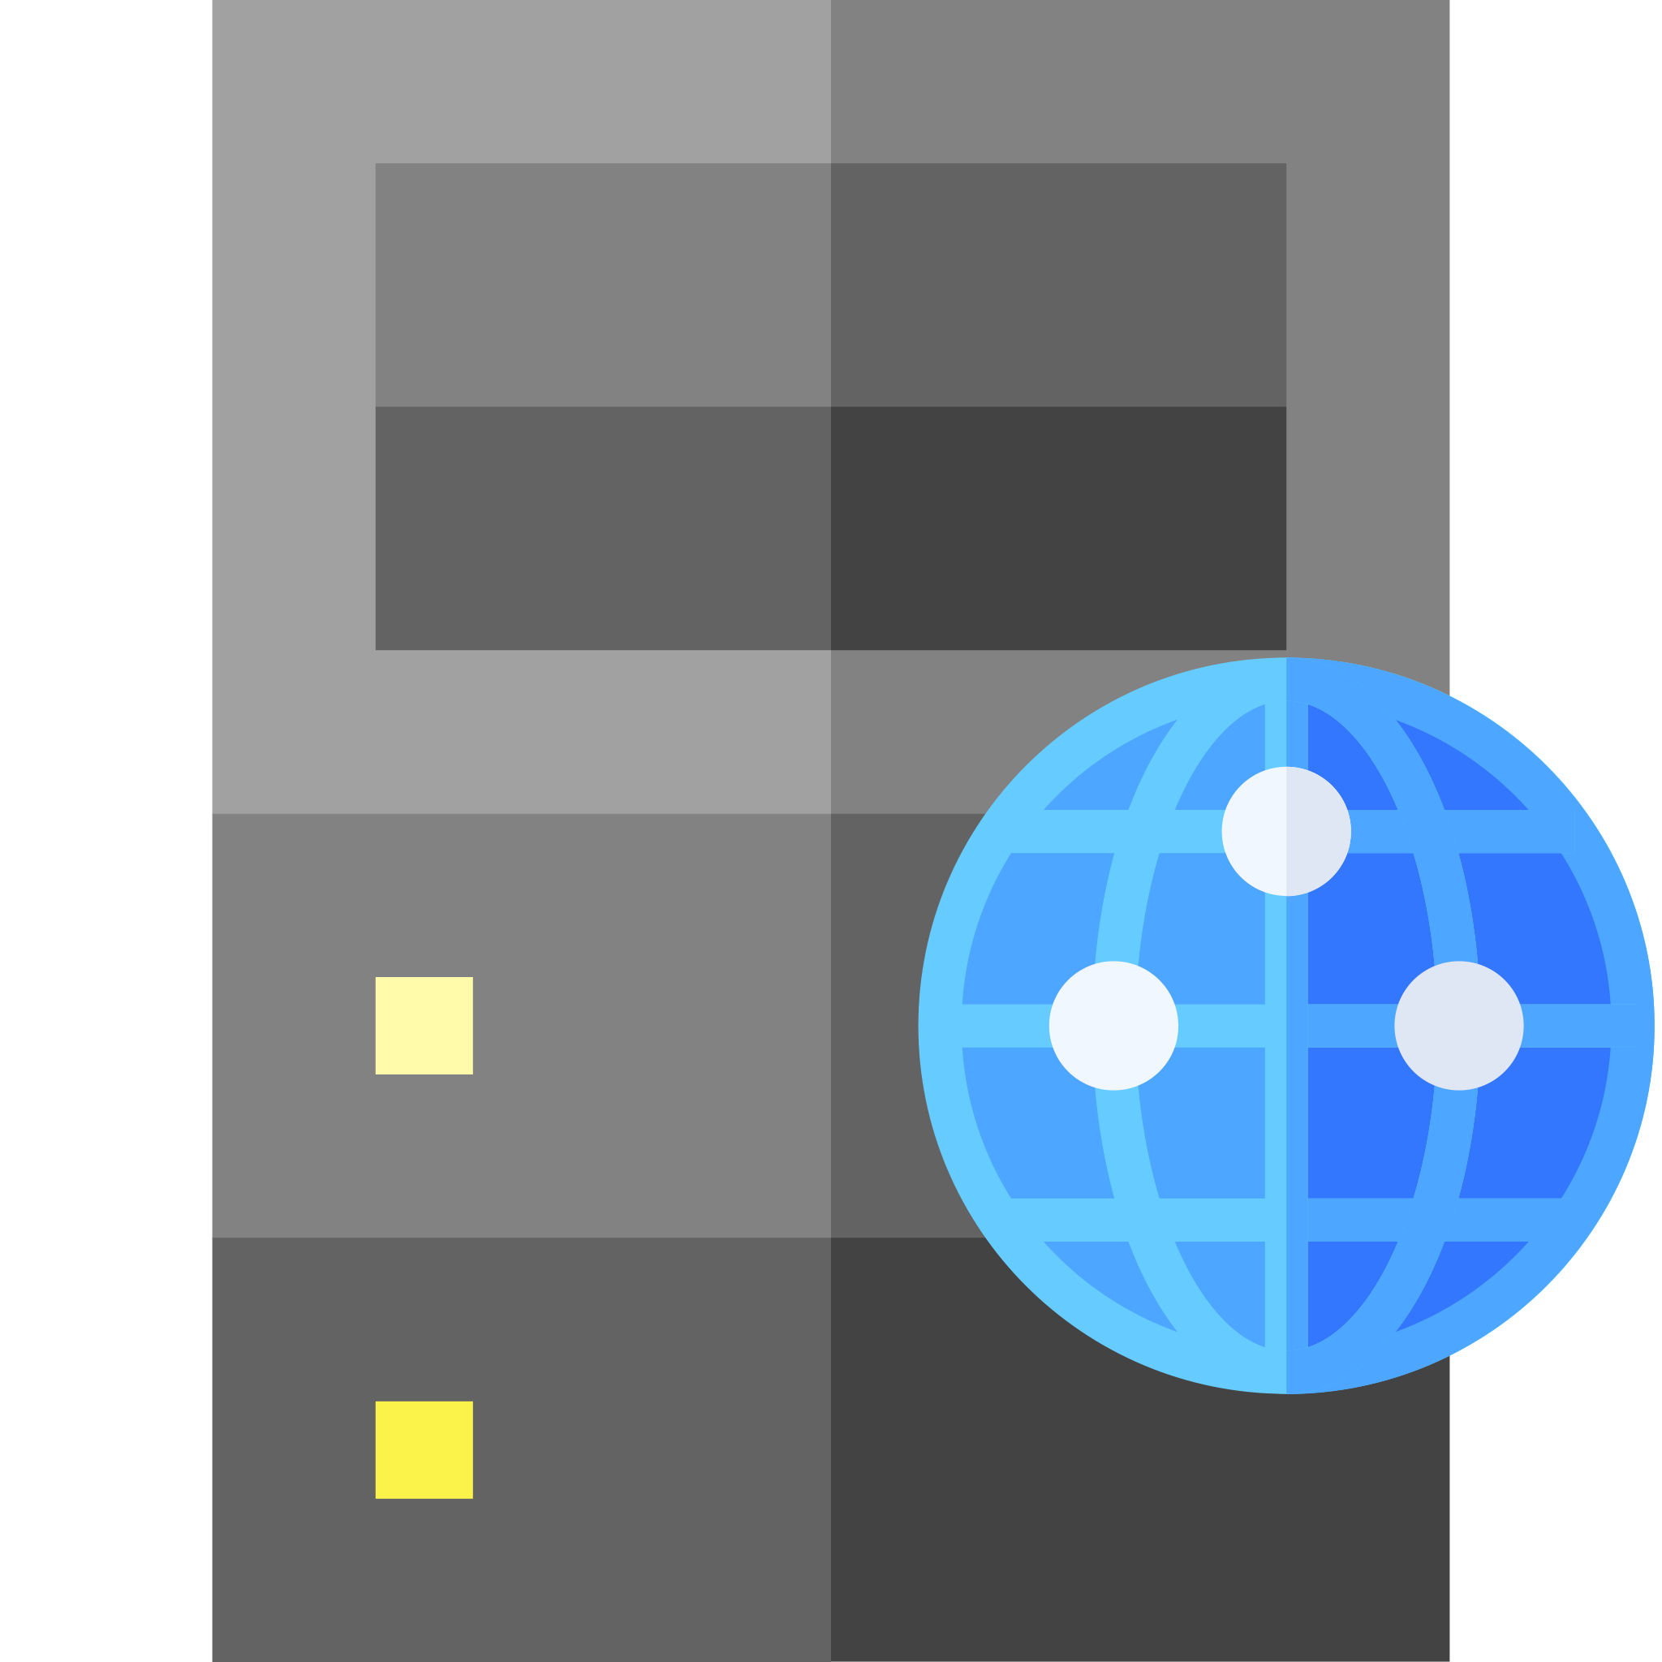


OAuth 2.0 roles
The resource owner
  An entity capable of granting access to a protected resource. May be a combination of a person (an end-user) and their user agent
The resource server
  The server hosting the protected resources, capable of accepting and responding to protected resource requests using access tokens
The client
  An application making protected resource requests on behalf of the resource owner and with its authorisation
The authorisation server
  The server issuing access tokens to the client after successfully authenticating the resource owner and obtaining authorisation.

Slide 5
Abstract protocol flow
obtain
access
token
use
access
token
delegate
access

Slide 6
OAuth 2.0 protocol flows
Authorisation Code Grant
  Client obtains access token directly from authorisation server ("3-legged")
  Flow relies on redirection via user agent
Implicit Grant
  All communication goes through user agent ("2-legged")
  Commonly used by single page applications
Resource Owner Password Credentials Grant
  Resource owner gives credentials to client (requires trust relationship)
Client Credential Grant
  Client authenticates directly with authorisation server

Slide 7
Registration
Client registers with the authorisation server before the protocol starts
  Client issued with a client_id – unique string (not a secret)
Client and authorisation server establish an authentication method
  Client password, use with HTTP Basic Authentication
  client_id, client_secret sent in request body (not recommended)
Endpoints
  Authorisation endpoint (e.g. https://auth.org/auth )
  Client redirection endpoint (e.g. https://client.org/cb )
  Token endpoint (e.g. https://auth.org/token )

Slide 8
Authorisation Code Grant
2. user authenticates
4. authorisation
code
5. access token
1. authorisation
request
6. resource
access
3. authorisation
code

Slide 9
1. authorisation request
1. authorisation request
3. authorisation code
3. authorisation code
HTTP/1.1 302 Found
Location: https://auth.org/auth?
response_type=code&
client_id=s6BhdRkqt3&
redirect_uri=https://client.org/cb
authorisation endpoint
issued during registration
redirection endpoint
GET /auth?response_type=code&client_id=s6BhdRkqt3&redirect_uri=
https%3A%2F%2Fclient%2Eorg%2Fcb HTTP/1.1
Host: auth.org
authorisation code
HTTP/1.1 302 Found
Location: https://client.org/cb?code=SplxlOBeZQQYbYS6WxSbIA
GET /cb?code=SplxlOBeZQQYbYS6WxSbIA HTTP/1.1
Host: client.org

Slide 10
4. authorisation code
5. access token
POST /token HTTP/1.1
Host: auth.org
Authorization: Basic czZCaGRSa3F0MzpnWDFmQmF0M2JW
Content-Type: application/x-www-form-urlencoded
grant_type=authorization_code&
code=SplxlOBeZQQYbYS6WxSbIA&
redirect_uri=https://client.org/cb
agreed during registration
authorisation code
HTTP/1.1 200 OK
Content-Type: application/json;charset=UTF-8
Cache-Control: no-store
{ "access_token":"2YotnFZFEjr1zCsicMWpAA",
"token_type":"bearer",
"expires_in":3600,
"refresh_token":"tGzv3JOkF0XG5Qx2TlKWIA" }
used to access resource
used to get new access token

Slide 11
6. resource access
access token
GET /resource HTTP/1.1
Host: example.org
Authorization: Bearer 2YotnFZFEjr1zCsicMWpAA
HTTP/1.1 200 OK
...

Slide 12
4. refresh token
5. access token
POST /token HTTP/1.1
Host: auth.org
Authorization: Basic czZCaGRSa3F0MzpnWDFmQmF0M2JW
Content-Type: application/x-www-form-urlencoded
grant_type=refresh_token&
refresh_token=tGzv3JOkF0XG5Qx2TlKWIA
HTTP/1.1 200 OK
Content-Type: application/json;charset=UTF-8
Cache-Control: no-store
{ "access_token":"2YotnFZFEjr1zCsicMWpAA",
"token_type":"bearer",
"expires_in":3600,
"refresh_token":"tGzv3JOkF0XG5Qx2TlKWIA" }

Slide 13
Further reading
Fielding, R. and Reschke, J. (2014) Hypertext Transfer Protocol (HTTP/1.1): Authentication. RFC7235.
  https://tools.ietf.org/html/rfc7235
Reschke, J. (2015) The 'Basic' HTTP authentication scheme. RFC7617.
  https://tools.ietf.org/html/rfc7617
Hardt, D. (2012) The OAuth 2.0 authorization framework. RFC6749.
  https://tools.ietf.org/html/rfc6749
Jones, M. and Hardt, D. (2012) The OAuth 2.0 Authorization Framework: Bearer Token Usage. RFC6750
  https://tools.ietf.org/html/rfc6750

Slide 14
Cross-Origin Resource Sharing

Slide 15
Cross-Site Request Forgery
If user agents allow one origin to talk to a different origin, there may be security issues
  User agent will send cookies if available and applicable
  Privilege escalation attack – confused deputy
GET
.js
dodgysite.org
XMLHttpRequest
trustedsite.com

Slide 16
Same-Origin Policy
By default, browsers restrict how a resource from one origin interacts with resources from other origins
GET
.js
dodgysite.org
Fetch/XMLHttpRequest
trustedsite.com
Barth, A. (2011) The Web Origin Concept. RFC6454. Available online at: https://tools.ietf.org/html/rfc6454

Slide 17
Same-Origin Policy
Two resources have the same origin if:
  Their URIs use the same protocol (i.e. no mixing of http and https)
  Their URIs have the same host
  Their URIs have the same port
(path is ignored for the purposes of determining origin)

Slide 18
Same-Origin Policy
All the same origin
All different origins
http://example.org/
http://example.org:80/
http://example.org/foo
http://example.org/
https://example.org/
http://example.org:8080/
http://www.example.org/
http://example.com/
https://example.org:80/

Slide 19
Same-Origin Policy
By default, the SOP blocks cross-origin reads by the browser
Exception: embedded resources:
  Media (img/audio/video)
  external stylesheets (<link rel="stylesheet" href="..."/>)
  scripts (<script src="..."></script>)
  @font-face (some variability between browsers)
  iframe
Cross-origin POSTS that result from form submission are allowed

Slide 20
Cross-Origin Resource Sharing
Mechanism for selectively relaxing the Same-Origin Policy
At a protocol level:
  Adds new headers that let servers indicate which origins may make requests
  Restricts the headers which may be sent in requests (i.e. avoiding taint)
  Restricts the headers which may be received in responses
At an API level:
  CORS requests sent via fetch() API
  Client-side enforcement
  Disallowed request may still result in a message being sent by the browser
  Result of a disallowed request is not sent to the script by the browser
  Reason for CORS error written to browser console, but not available to script

Slide 21
CORS requests
Simple requests satisfy all of the following
  GET, HEAD or POST only
  Accept:, Accept-Language:, Content-Type: or Content-Language: are the only headers set manually
  Content-Type: is one of text/plain, application/x-www-form-urlencode or multipart/formdata only
All other requests trigger a CORS preflight

Slide 22
CORS flow
call fetch()
GET/HEAD?
yes
no
POST?
yes
standard
Content-Type?
yes
custom
headers?
no
execute fetch()
no
no
yes
send OPTIONS
access
granted?
yes
no
error
preflight

Slide 23
CORS headers
Client header
  Origin: - like Referer:, but excludes path (automatically added by browser)
  Access-Control-Request-Method: – used in preflight (see later)
  Access-Control-Request-Headers: – used in preflight (see later)
Server headers
  Access-Control-Allow-Origin: – which origins are accepted? (* for any)
  Access-Control-Allow-Methods: – which methods are accepted?
  Access-Control-Allow-Headers: – which headers are accepted?
  Access-Control-Max-Age: – for how long is a preflight check valid?
  Access-Control-Allow-Credentials: – include cookies (etc) in request

Slide 24
Simple request example
GET /page.html
.js
site-a.org
fetch("http://site-b.com/bar.json")
site-b.org

Slide 25
Simple request example
// in a script in https://site-a.org/page.html
fetch("https://site-b.org/bar.json",
{mode: "cors",
method: "GET"})
.then(response => {
if (!response.ok) {
throw new Error("HTTP status " + response.status);
}
return response.json();
})
.then(data => console.log(data))
.catch(error => {
console.error("Error: " + error);
});

Slide 26
Simple request example
fetch()
GET /bar.json HTTP/1.1
Host: site-b.org
Origin: https://site-a.org
HTTP/1.1 200 OK
Access-Control-Allow-Origin: https://site-a.org
Vary: origin
...
response

Slide 27
Simple request example
fetch()
GET /bar.json HTTP/1.1
Host: site-b.org
Origin: https://site-a.org
HTTP/1.1 200 OK
Access-Control-Allow-Origin: *
Vary: origin
...
response

Slide 28
Simple request example
fetch()
GET /bar.json HTTP/1.1
Host: site-b.org
Origin: https://site-c.org
HTTP/1.1 403 Forbidden
Access-Control-Allow-Origin: https://site-a.org/
Vary: origin
...
error
Reason: CORS header 'Access-Control-Allow-Origin' does not match 'https://site-c.org/'

Slide 29
Preflight requests
Unsafe requests (POST, PUT, DELETE ) require a preflight check
Client sends an OPTIONS message to determine if the intended request may be sent
  Access-Control-Request-*: headers used to express intended request
  Server responds with Access-Control-Allow-*: headers to express permissions

Slide 30
Preflight request example
// in a script in https://site-a.org/page.html
fetch("https://site-b.org/qux.json",
{mode: "cors",
method: "PUT",
body: <...>})
.then(response => {
if (!response.ok) {
throw new Error("HTTP status " + response.status);
}
return response.json();
})
.then(data => console.log(data))
.catch(error => {
console.error("Error: " + error);
});

Slide 31
OPTIONS /qux.json HTTP/1.1
Host: site-b.org
Origin: https://site-a.org
Access-Control-Request-Method: PUT
fetch()
HTTP/1.1 204 No Content
Access-Control-Allow-Origin: https://site-a.org
Access-Control-Allow-Methods: GET, PUT, OPTIONS
PUT /qux.json HTTP/1.1
Host: site-b.org
Origin: https://site-a.org
response
HTTP/1.1 200 OK
Access-Control-Allow-Origin: https://site-a.org
Access-Control-Allow-Methods: GET, PUT, OPTIONS

Slide 32
OPTIONS /qux.json HTTP/1.1
Host: site-b.org
Origin: https://site-a.org
Access-Control-Request-Method: PUT
fetch()
HTTP/1.1 204 No Content
Access-Control-Allow-Origin: https://site-a.org
Access-Control-Allow-Methods: GET, OPTIONS
error
Reason: Did not find method in CORS header 'Access-Control-Allow-Methods'

Slide 33
Further reading
Barth, A. (2011) The Web Origin Concept. RFC6454
  https://tools.ietf.org/html/rfc6454
CORS for developers
  https://w3c.github.io/webappsec-cors-for-developers/
HTML5 Fetch API
  https://fetch.spec.whatwg.org/
Cross-Origin Resource Sharing at MDN
  https://developer.mozilla.org/en-US/docs/Web/HTTP/CORS

Slide 34
Next Lecture: Proxies and Caching

