Slide 2
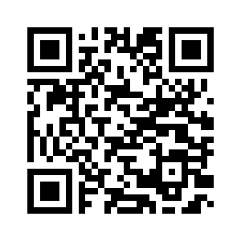
Computer Science Induction 2023-2024
Dr Nicholas Gibbins, CS Programme Leader

Slide 3
Are you in the right place?
Computer Science – YES
Software Engineering – NO
Electronic Engineering – NO
Electrical Engineering – NO
Electrical and Electronic Engineering - NO
Mechatronic Engineering – NO
Biomedical Engineering - NO
Aerospace Electronic Engineering - NO

Slide 4
What this talk is about
Making sure you know what to expect (tomorrow, next week, this year, next year)
Introducing your programme leader

Slide 5
You should already have:
University ID card
University email address (your username@soton.ac.uk)
Timetable – timetable.soton.ac.uk
Campus Map – maps.soton.ac.uk
Your tutor allocation – secure.ecs.soton.ac.uk/people/your username

Slide 6
Life on Campus

Slide 7
Timetable – timetable.soton.ac.uk
Lectures start next Monday, 2nd October
Lectures are all over the Highfield campus (make sure you have a map!)
If a room is shown on your timetable, turn up!
If no room is shown, you will be told about it in due course (e.g. lab arrangements)
Read your University email and the module web pages regularly: ECS runs this way!

Slide 8
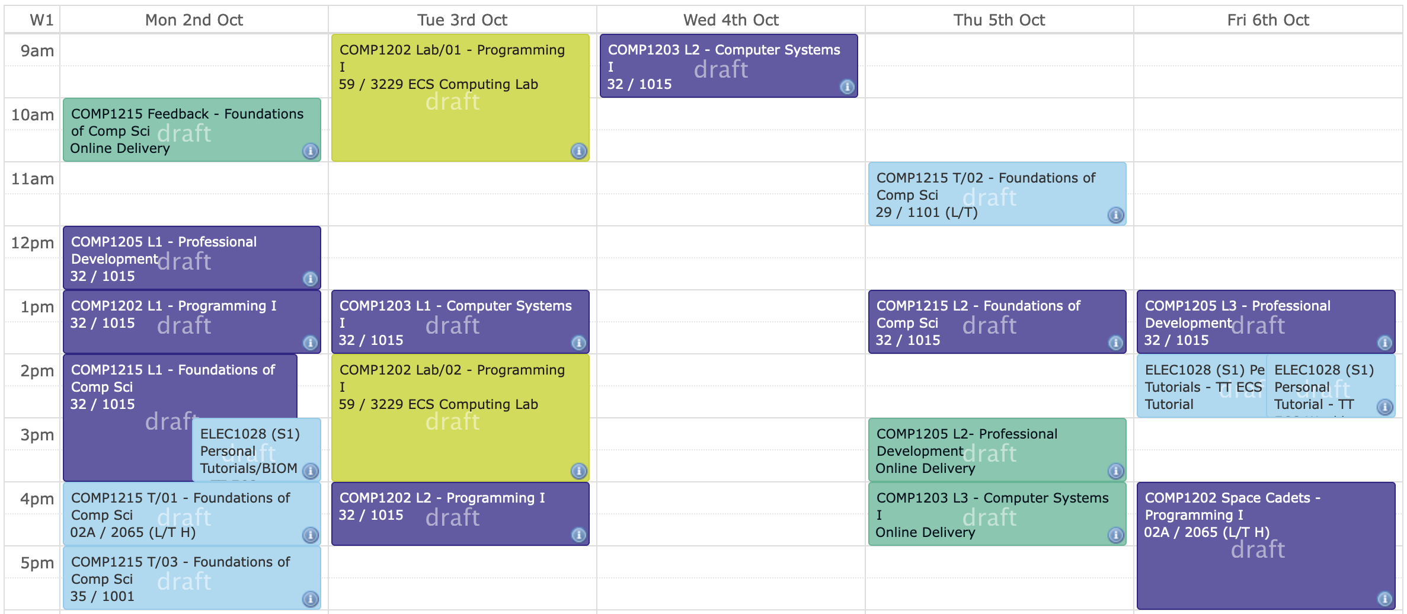

Slide 9
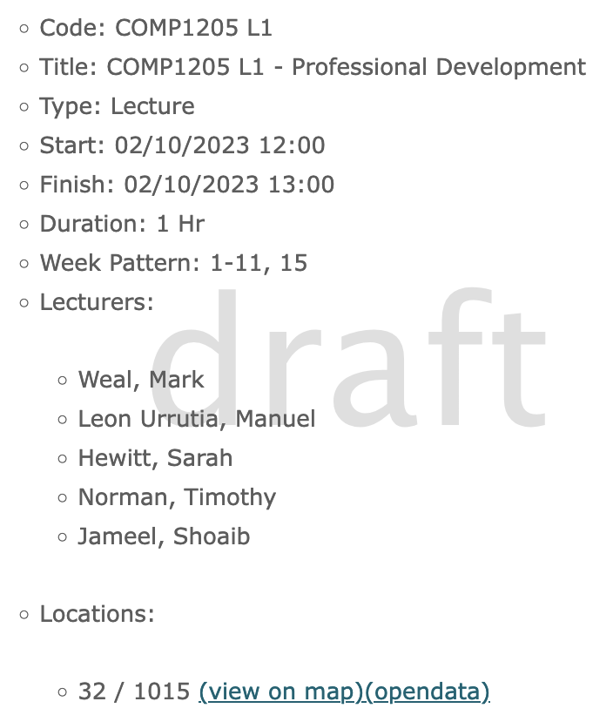
Deciphering your timetable
Module
title/code
Activity type
Time
Weeks taught
Module Lecturers
Location building/room

Slide 10
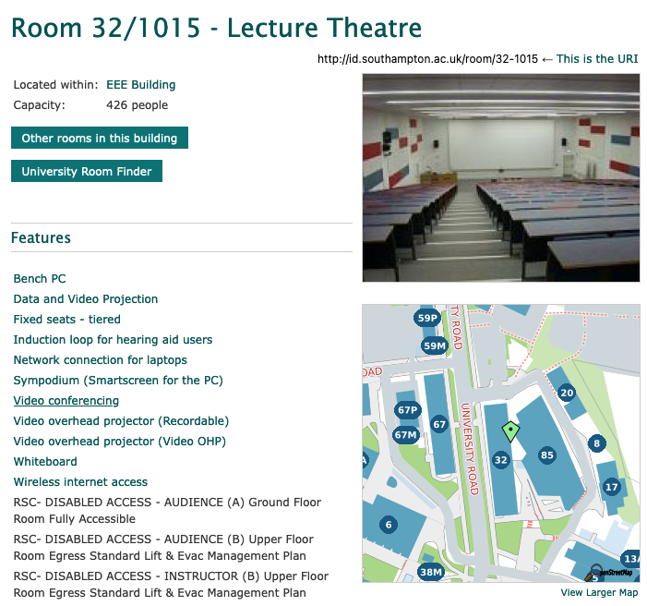

Slide 11
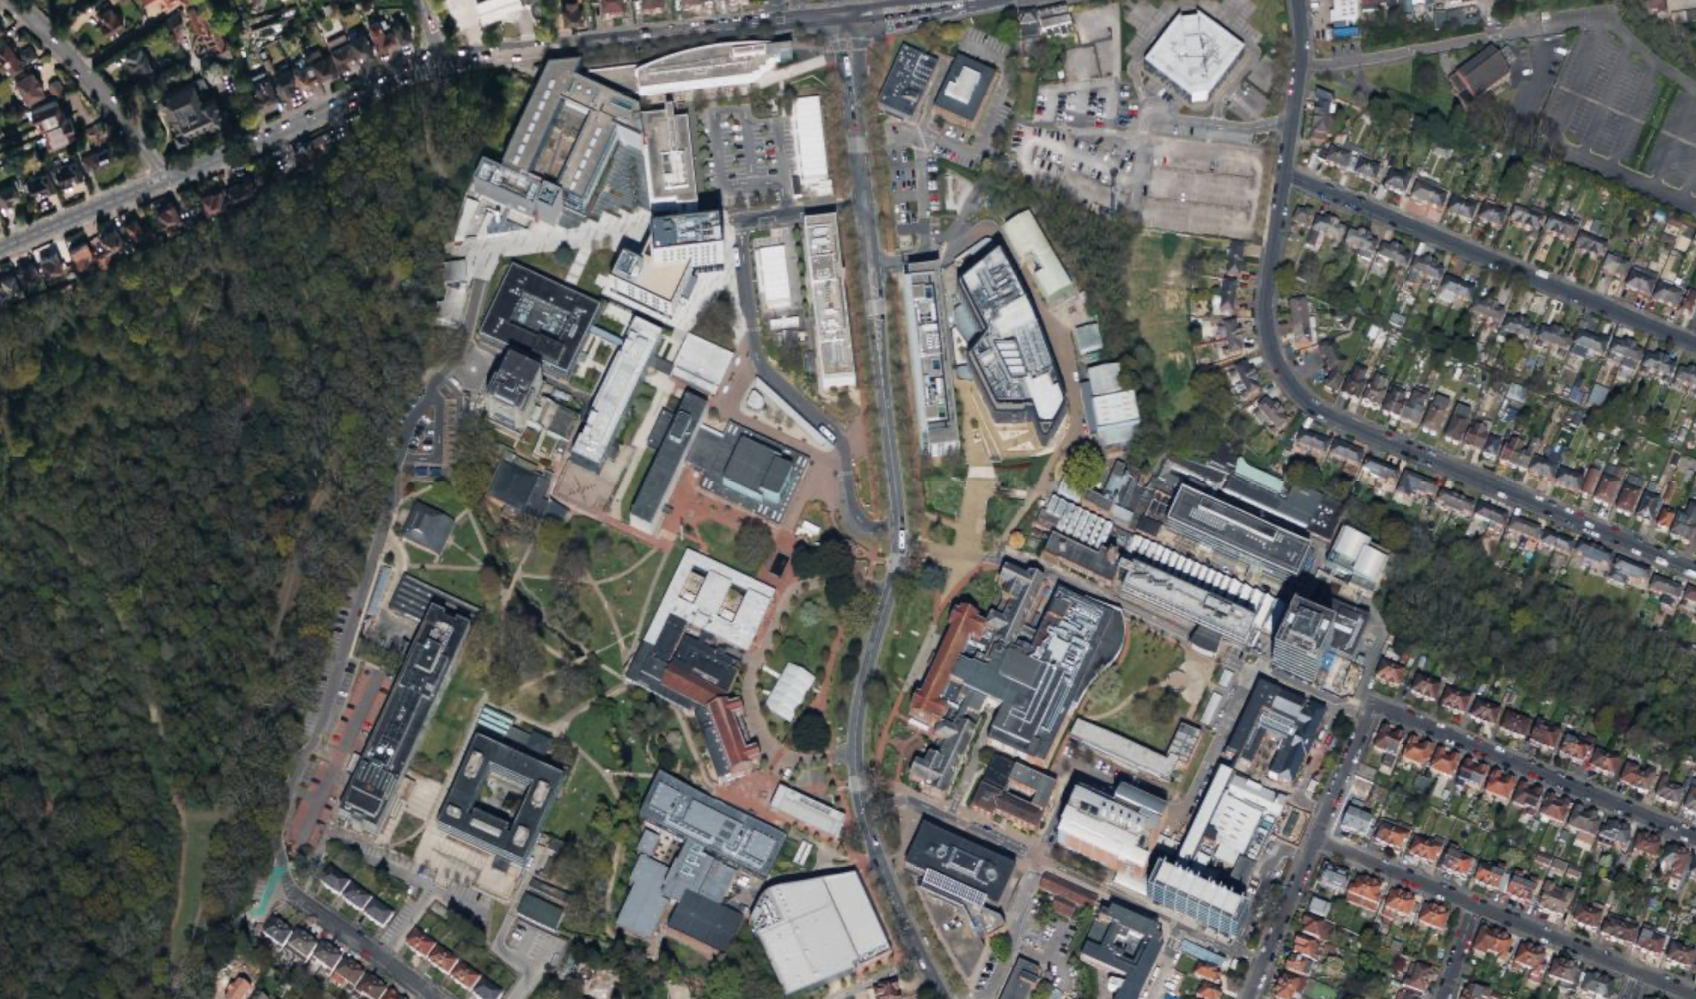

Slide 12
Building 60 (Gower)
Building 16
Building 100 (Centenary)
Building 53 (Mountbatten)
Building 32 (EEE)
Building 59 (Zepler)
Building 13 (Tizard)
Students' Union
Library
Building 37 (Student Hub)

Slide 13
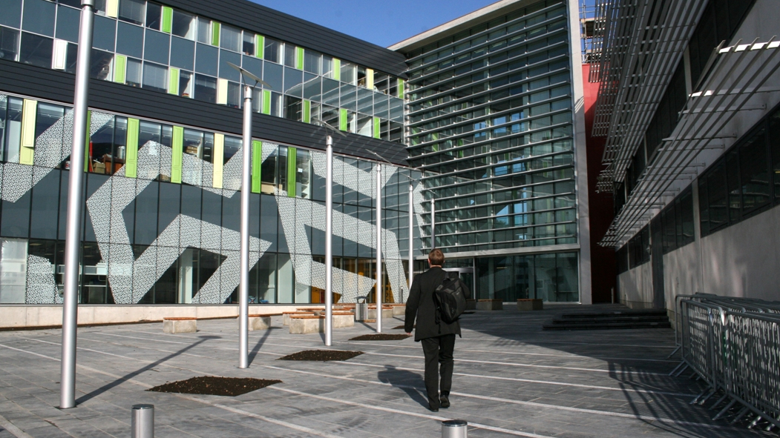
Building 53 (Mountbatten)
Building 59 (Zepler)

Slide 14
Laboratories
Arthur Brunnschweiler Laboratory in the Zepler Building (building 59)
Level 2, next to the lift and main stairs
Reserved for teaching
David Barron Laboratory in the Zepler Building
Level 3, next to the lift and main stairs
Reserved for teaching
Location of iSolutions Helpdesk – go here if you have computing problems
Level 2 lab in Building 16
Independent learning space for ECS students
Level 2 lab in the Gower Building (building 60)
New independent learning space, due to open at the end of November
You will need your ID card to access these

Slide 15
Programme Structure

Slide 16
Part I Structure
COMP1215 Foundations of Computer Science
COMP1215 Algorithmics
COMP1202 Programming I
COMP1206 Programming II
COMP1203 Computer Systems I
COMP1216 Software Modelling and Design
COMP1205 Professional Development
COMP1205 Data Management

Slide 17
Part II Structure
COMP2208 Intelligent Systems
COMP2207 Distributed Systems
COMP2209 Programming III
COMP2212 Programming Language Concepts
COMP2213 Interaction Design
COMP2211 Software Engineering Group Proj.
COMP2210 Theory of Computing
OPTION

Slide 18
Part III Structure
COMP3200 Individual Project
COMP3200 Individual Project
OPTION
OPTION
OPTION
OPTION
OPTION

Slide 19
Part IV Structure
ELEC6200 Group Design Project
OPTION
OPTION
OPTION
OPTION
OPTION

Slide 20
UN Sustainable Development Goals
The University commits to embed sustainability in everything we do
The Sustainable Development Goals shown below are covered in core:
BSc Computer Science
MEng Computer Science

Slide 21
Academic Regulations

Slide 22
Attendance
Our expectation is that you will attend all timetabled sessions
This is especially important for international students holding Tier 4 visas, for whom continued engagement is a condition of their visa
The University is introducing MyEngagement, a university-wide system for recording and monitoring attendance at timetabled sessions
Further information about MyEngagement will be made available in due course

Slide 23
Coursework Deadlines
Late submissions are penalised at 10% per working day.
Work submitted more than five working days late will not be marked, unless an extension has been granted.
In the case of assignments worth less than 10% of a module, work must be submitted on time or it will not be marked, unless an extension has been granted.
Notes:
Working days are defined to be weekdays during term time, or the summer vacation, or the first week of the Christmas or Easter vacation, but excluding bank holidays.

Slide 24
Course Progression
Exams are in January and June
The module pass mark is 40% (in all subjects) for Parts I-III
The module pass mark in Part IV is 50%
The following modules are core and must be passed
All Part I modules
All Part II modules (MEng only)
Part III Individual Project
Part IV Group Design Project

Slide 25
Course Progression
If you fail a module:
You will be referred in that module (in Aug/Sep), or
You may have to re-sit (repeat) the whole year
This is to redeem failure, not to improve your mark
If you fail two or fewer non-core single modules but have achieved the qualifying mark (30% in Parts II-III, 40% in Part IV) and have an average mark above the pass mark (40% in Parts II-III, 50% in Part IV):
You may be compensated in that module (you don’t need to refer)
No compensation in Part I (everything is core)
MEng students need an average of 58% or greater in Part III to continue to Part IV

Slide 26
Degree Classification
Your final degree classification will be based on your aggregate mark:
First 70+%
Upper second (2.i) 60-69%
Lower second (2.ii) 50-59%
Third 40-49%
Aggregate mark calculation depends on your degree: BSc or MEng
BSc parts are weighted 0:1:2
MEng parts are weighted 0:1:2:2
Students who barely pass Part I often go on to fail in later years
Don’t aim for the pass mark – aim higher!
Aim for at least 60% (2.i/2.ii boundary)

Slide 27
University-approved Calculators
For use in those examinations where a calculator is permitted
Casio calculators are allowed but they must be non-programmable, scientific models. Graphical calculators are not permitted.
Can be purchased from the Students’ Union Shop on the Highfield campus (or elsewhere)

Slide 28
Getting Help

Slide 29
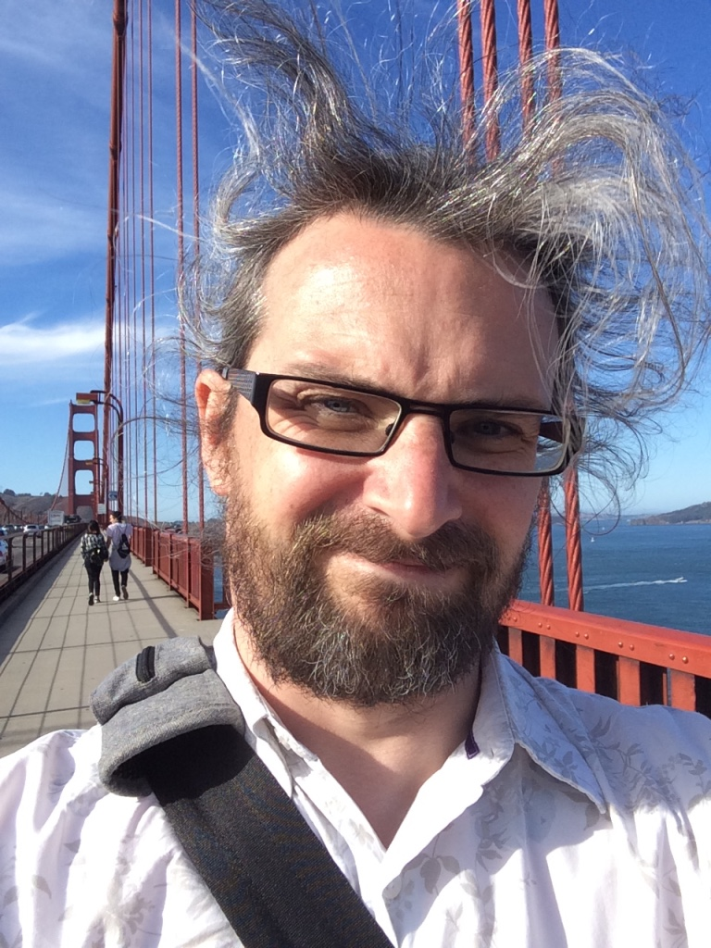
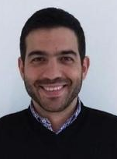
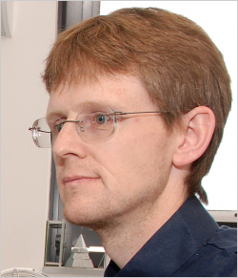
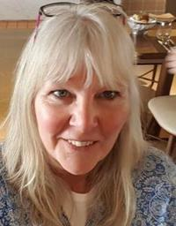
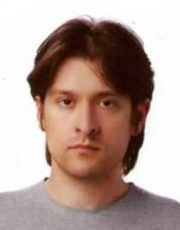
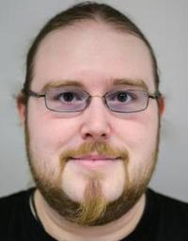
Dr Nick Gibbins CS Programme Leader
Dr George Konstantinidis
Director of Programmes
Prof. Jon Hare
Deputy Head (Education)
Julian Field
Senior Tutor
Dr Sarah Hewitt
Senior Tutor
Dr Nawfal Fadhel
Senior Tutor
Dr Graeme Bragg
Senior Tutor

Slide 30
Personal Tutors
Provide help and counselling
On matters connected with your programme of study
On University life in general
Provide informal feedback on work to improve your learning
First meeting immediately after this talk! (location will be their office, unless you've been informed otherwise)
Weekly meetings in your first year (timetabled at 2pm on Fridays, or by other arrangement)
Termly meetings in subsequent years (and whenever you need help or advice)

Slide 31
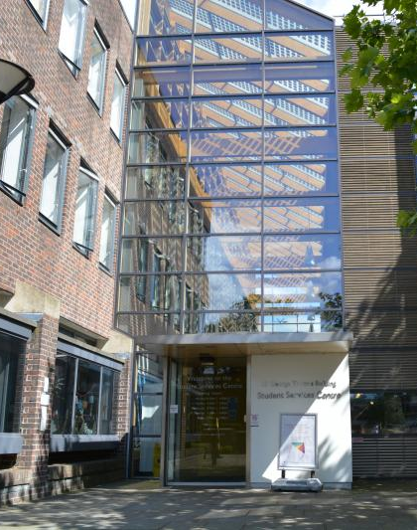
Administration
Student Hub in building 37 (George Thomas building) www.southampton.ac.uk/studentservices studenthub@soton.ac.uk
Make sure we have correct contact details
Make sure your programme registration is correct
Information on how to do this is in the Student Hub knowledge base at the link above

Slide 32
For international students only
You must book and attend a Right To Study check
This takes precedence over attending scheduled teaching events (lectures, labs, etc)
If you have not attended an RTS check, your access to university services will be suspended
Questions regarding RTS checks should be directed to the Student Hub in B37

Slide 33
Why Students Fail
Not smart enough
This is rare in ECS
On the wrong course, de-motivated
Transfer ASAP, to save yourself time and money
One of the dreaded dangerous difficulties
Debt, depression, disease, divorce, drinking, drugs
These may happen to you, or a friend, or relative
Talk to someone about it and get help (tutor, senior tutor, etc)
www.southampton.ac.uk/quality/assessment/special_considerations.page

Slide 34
On the Bright Side
ECS is full of clever people, and there is a lot going on:
interesting projects and kit
both in the School and University
Join ECSS if you haven’t done so already!
Many other societies: DevECS, RoboSoc, ECS Empower, HackaSoton…
society.ecs.soton.ac.uk/societies/
We want you to have fun
and work hard
and succeed

Slide 35
Can you...
Cook?
Vote? www.gov.uk/register-to-vote
Exercise? www.southampton.ac.uk/sportandwellbeing/
Sleep? And get up?
Travel? (bike, bus) key.unilinkbus.co.uk/smart-card/
Keep healthy? (register with a local doctor, dentist)

Slide 36
Finding out more
ECS Student Intranet
secure.ecs.soton.ac.uk/ug
Timetables
timetable.soton.ac.uk
University Student Services
www.southampton.ac.uk/studentservices
Your personal tutor
Don’t be afraid to ask!

Slide 37
Any questions?

