Slide 2
Knowledge Graphs and Wikidata
COMP6256 Knowledge Graphs for AI Systems
Nicholas Gibbins
Based on slides from Steffen Staab and Markus Krötzsch

Slide 3

Panel at ISWC-2018
Google
Microsoft
IBM
Facebook
eBay
Google
http://iswc2018.semanticweb.org/wp-content/uploads/2018/10/Panel-all.pdf

Slide 4
Many, many others
BBC
Flickr
Thomson Reuters
New York Times
HP
Samsung
Siemens
Huawei ...

Slide 5
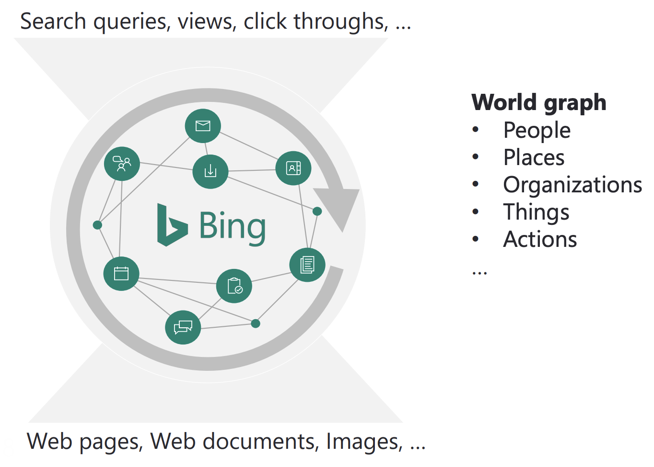

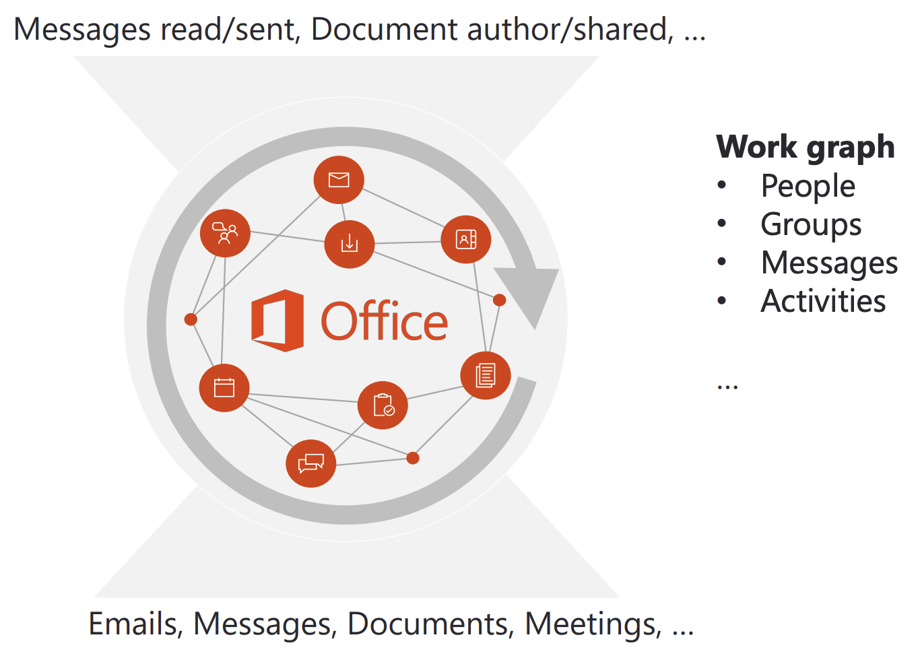

Microsoft‘s Satori

Slide 6
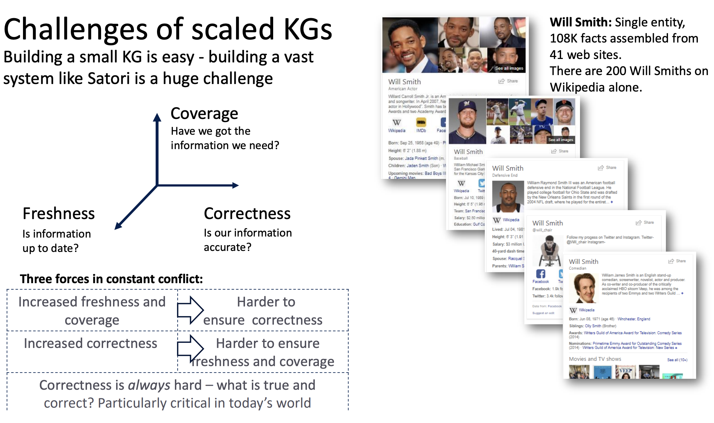
Microsoft‘s Satori

Slide 7
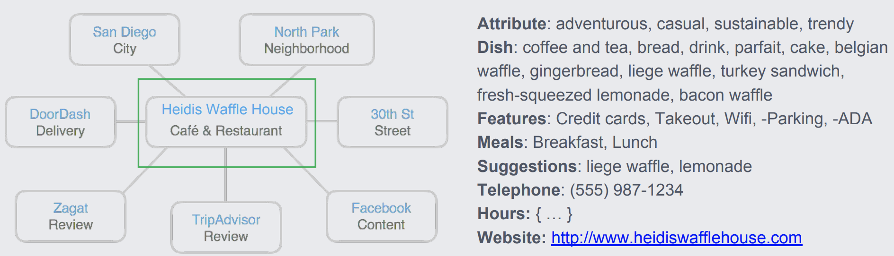
Facebook‘s Social Graph
Billions of entities, trillions of assertions
Coverage:
socially relevant entities, concepts and words.
People, Celebrities, Places, Points of Interest, Movies, TV, Music, Sports
US only:
  ~500M assertions
  ~50M entities
  ~100s of types

Slide 8
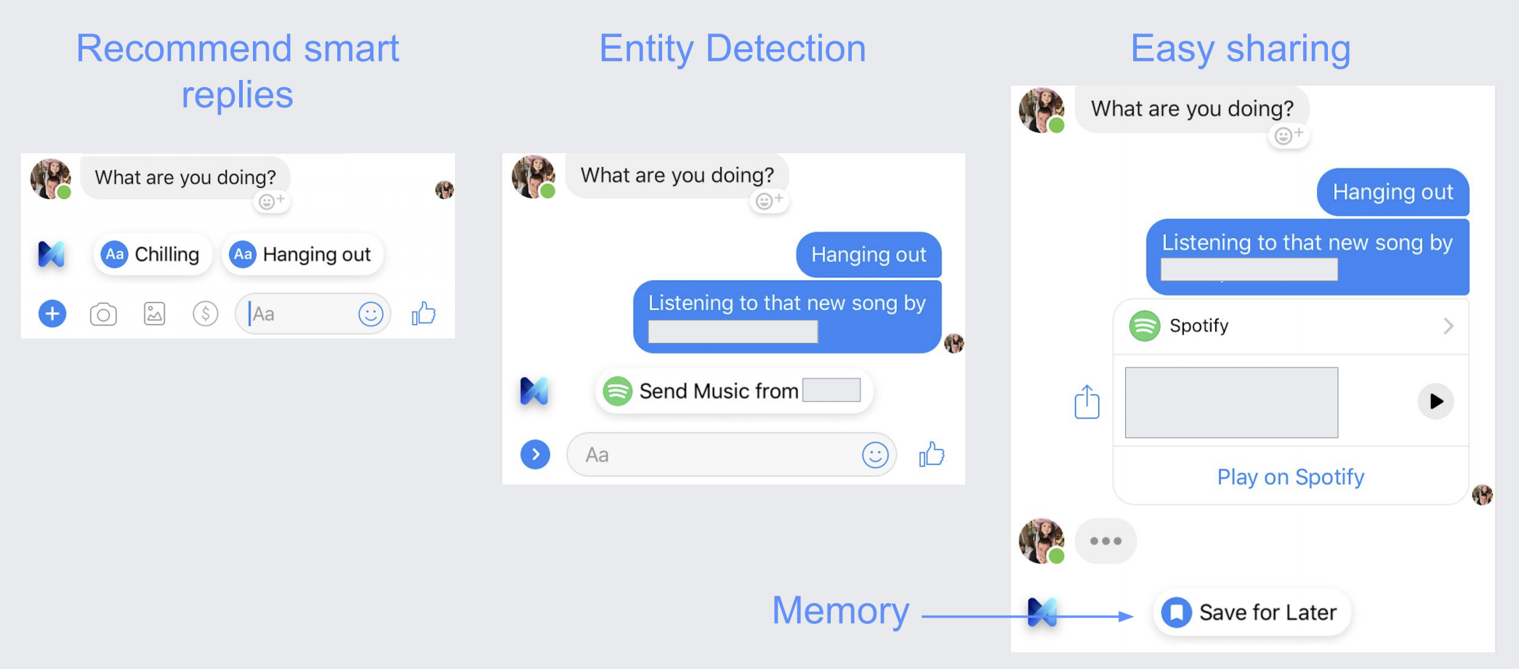
Facebook‘s Social Graph

Slide 9
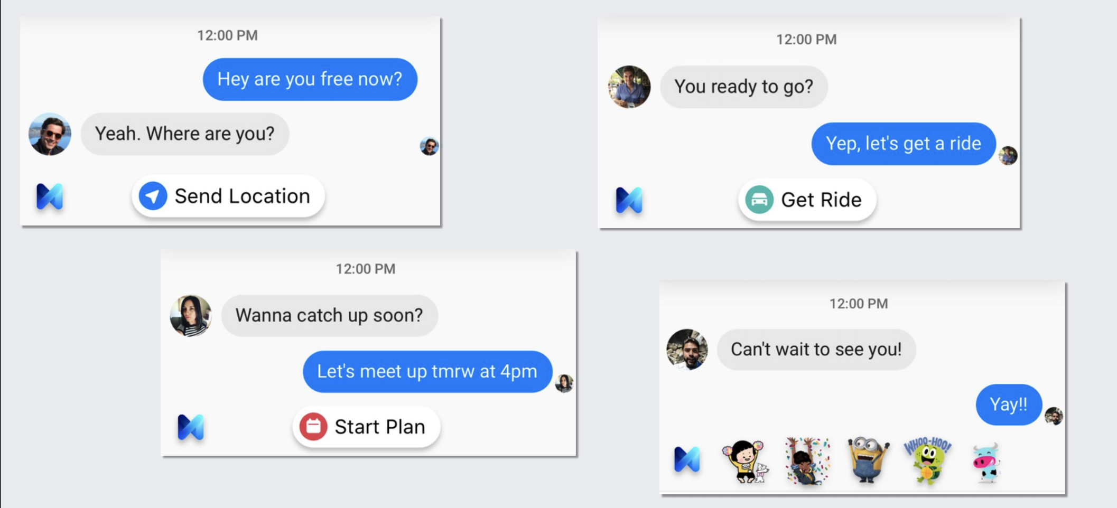
Facebook’s Social Graph

Slide 10

eBay KG: Faceted Browsing and Search
Long list / ontology

Slide 11
eBay Knowledge Graph
Graph - Products, properties, value types, fitment, relationships, standards, variations, people, places, brands, companies, events, dates.
Biggest Problem: Identity
  Are these listings the same product?
  Identity depends on who’s asking
  Buyer and Seller have different requirements

Slide 12

eBay / Amazon identity

Slide 13
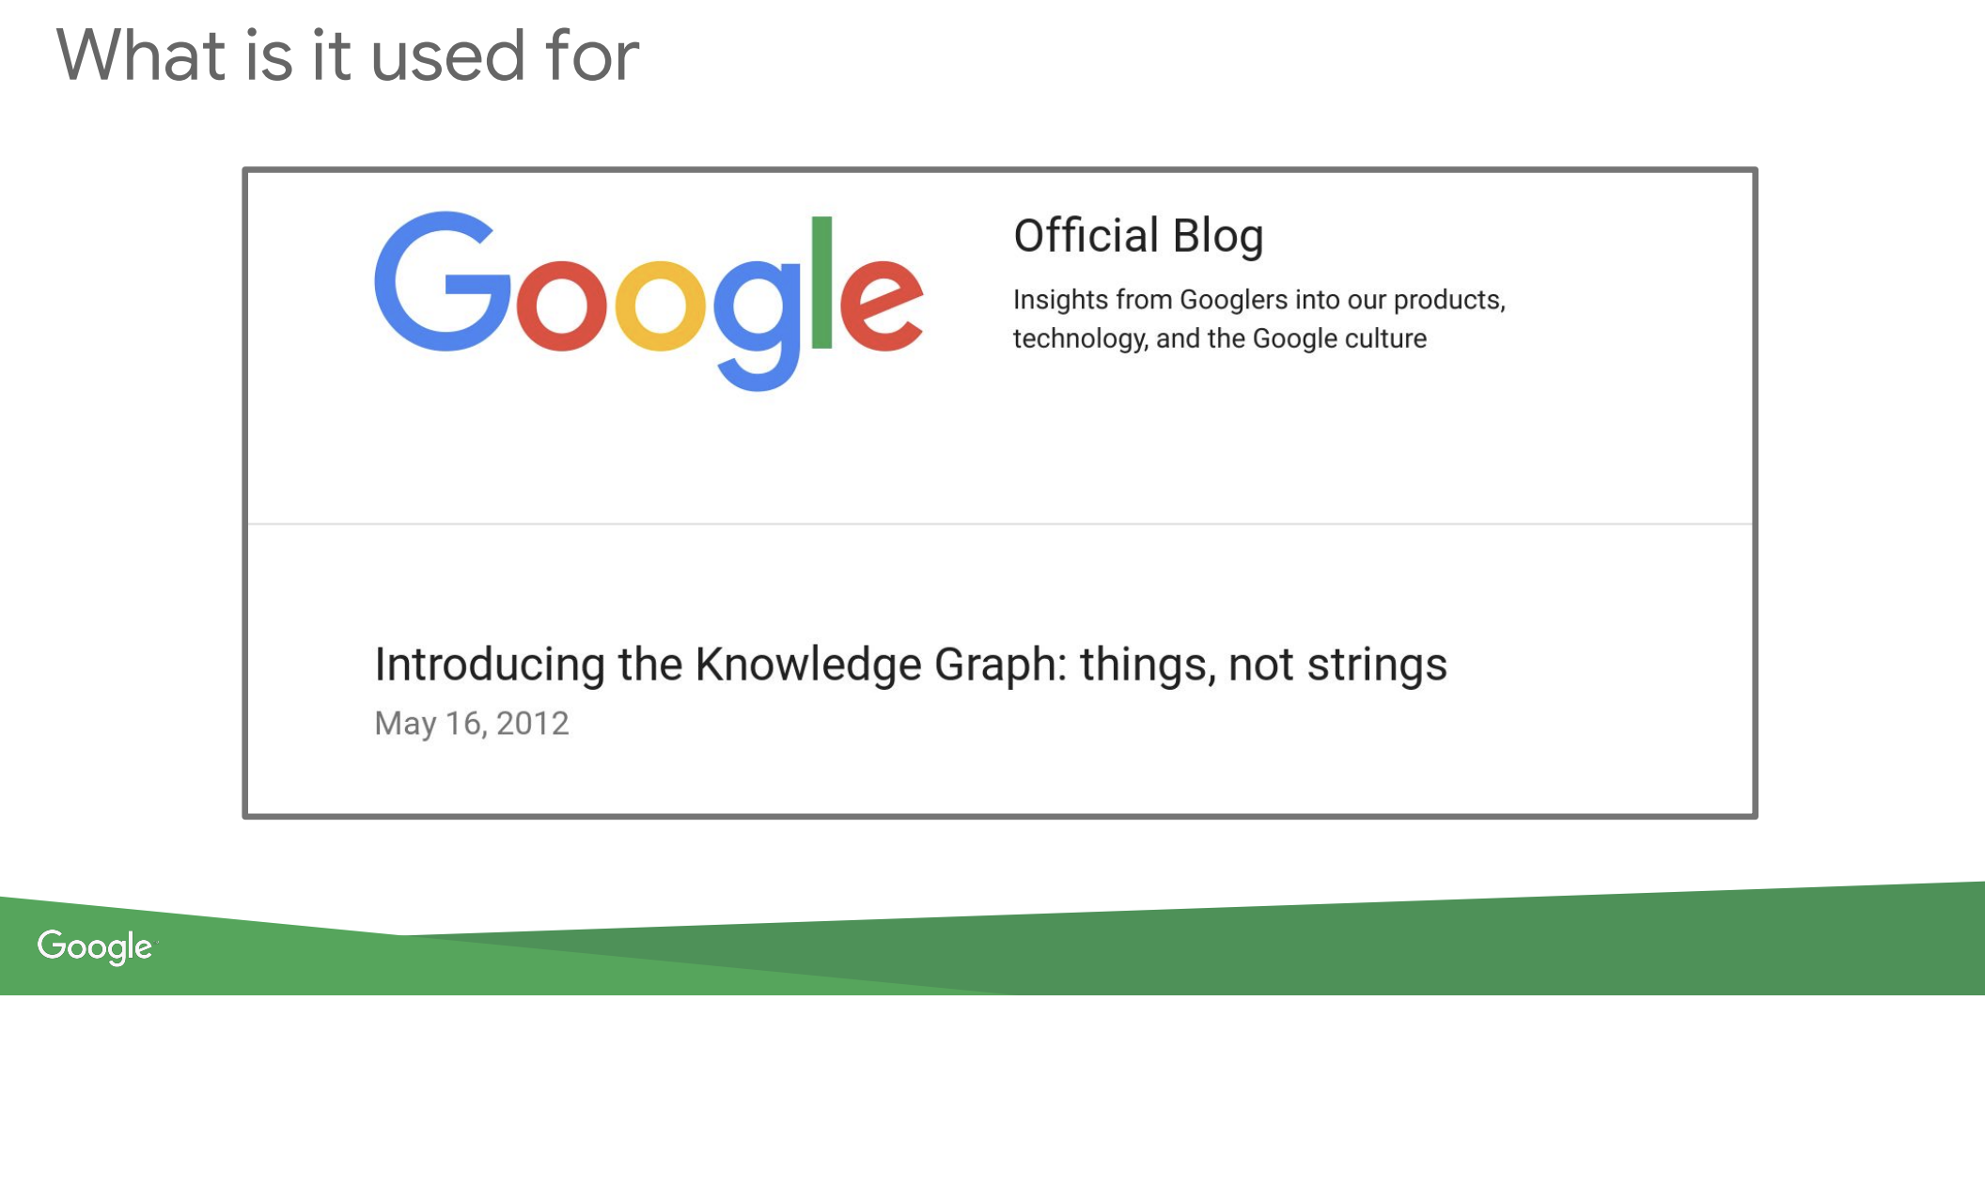

Slide 14
Google Knowledge Graph
Strong Typing
  Guiding
    Natural language processing
    Machine learning
    Alignment
    ...
Metatypes
  Time-independent identities are not substructures of time-dependent ones

Slide 15
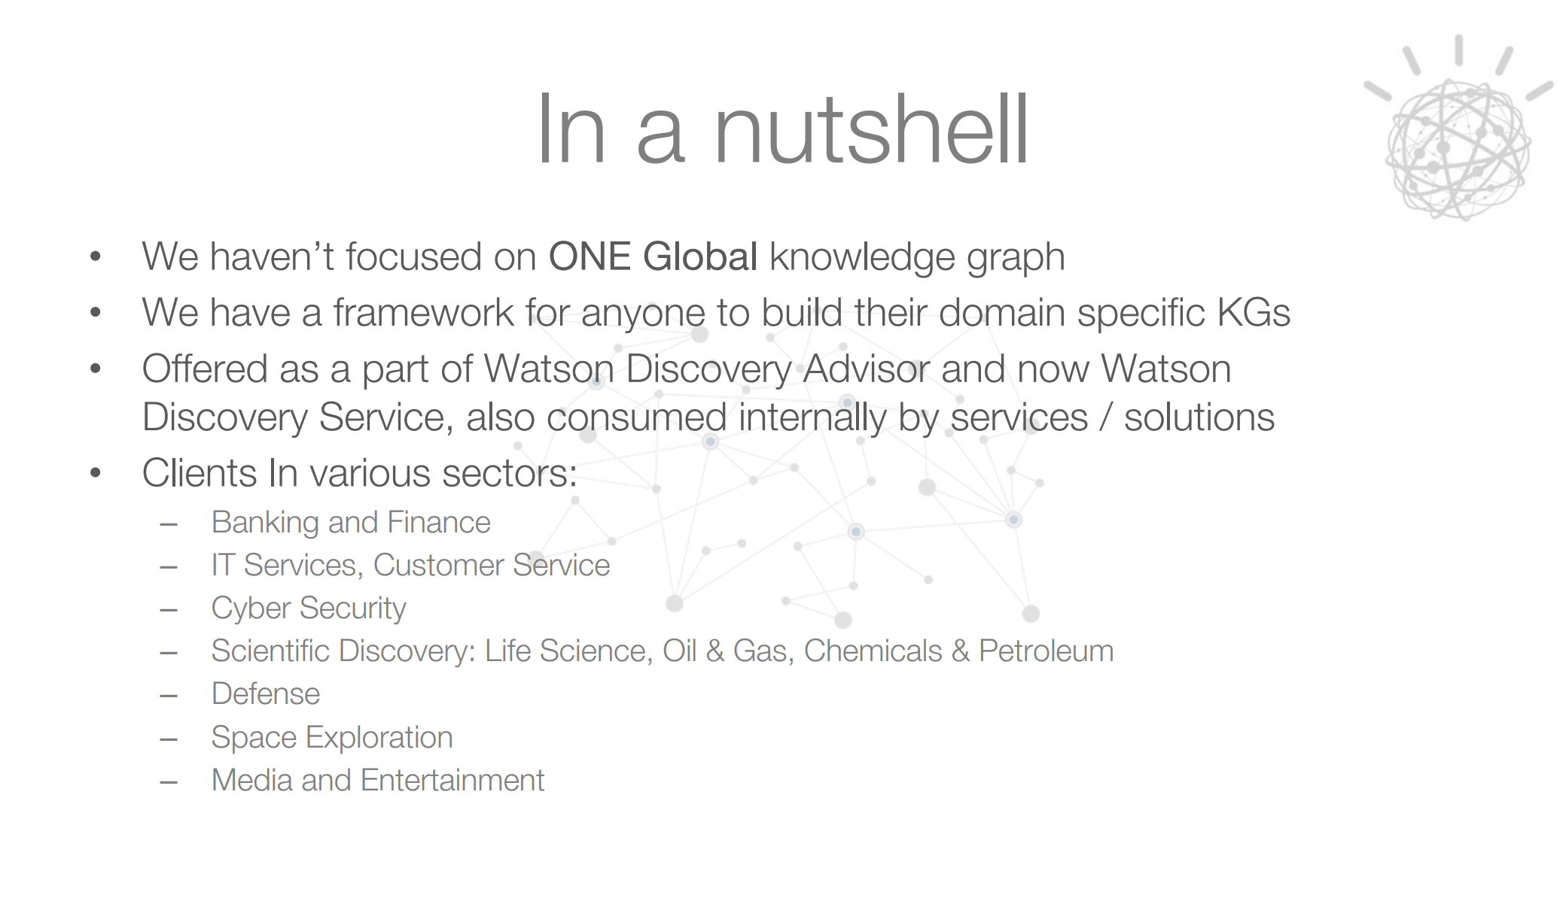

IBM

Slide 16
IBM Lessons Learned / Open problems
polymorphic stores
evidence is primitive to the system, which every node and edge maps to
push entity resolution to runtime through context
every new piece of knowledge should know its cascade effect
modeling and analyzing changing knowledge
merge relationships discovered from unstructured data with known relationships
federation of global, domain specific and customer specific knowledge
incremental update of global knowledge on horizontally scaled stores

Slide 17
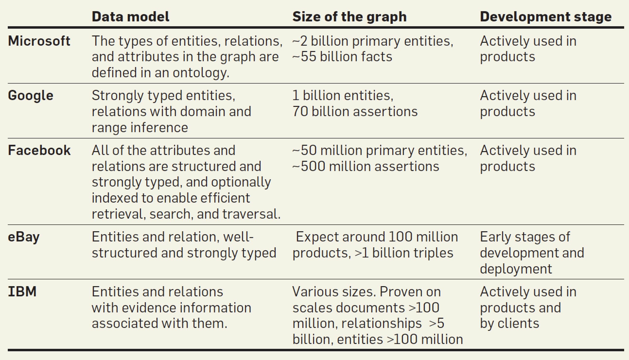

Slide 18
(Some) Pervasive Challenges
Modelling
  No unique way
  Graphs get large
  Maintained by large teams (600 for Google?)
Machine learning and data mining
  Refining the graph
  Completing the graph
dentity / entity alignment
Many (live) sources / provenance

Slide 19
Wikidata

Slide 20

Wikipedia in 2016
A project that has shaped the Web
Huge global reach: over 500M unique visitors/month
The answer to all questions in all languages

Slide 21
The answer to all questions … ?
What are the ten largest cities with a female mayor?
(stored knowledge ≠ usable knowledge)

Slide 22
Wikipedia content reuse...
Wikipedia as an information cul-de-sac
Extremely restricted access paths
(main access method: reading lengthy pages of text)
Information extraction is hard
Question answering is hard
Adapting to new contexts is hard

Slide 23
… in all languages?
There are approx. 300 language editions of Wikipedia
How many exactly?

Slide 24
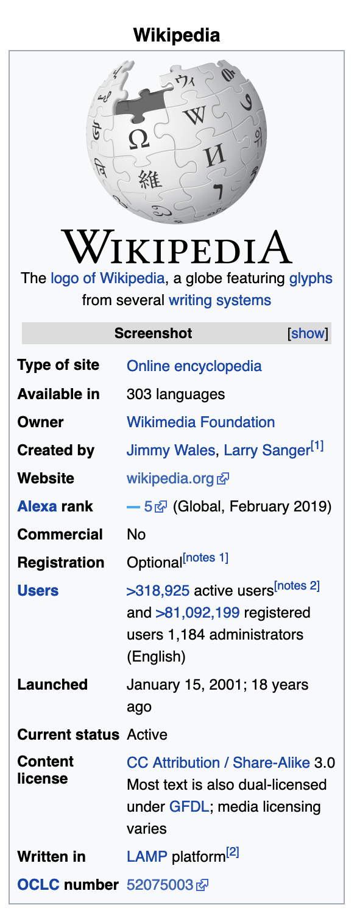
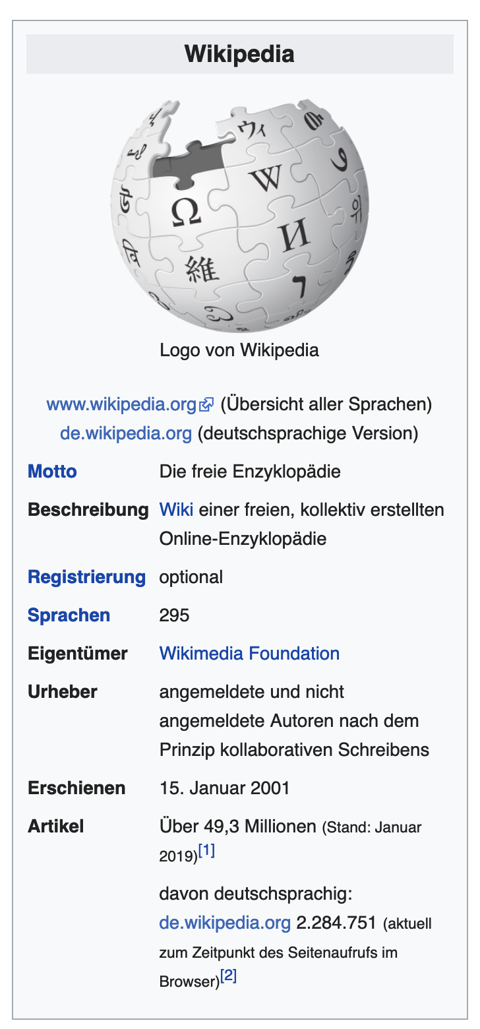

Slide 25

Wikidata
Official “Wikipedia Database”
Live at www.wikidata.org
Data used by most Wikimedia projects
  All 285 (?) language editions of Wikipedia
  Wikivoyage, Wikiquote, Wikimedia Commons, ...
Large, active community
  More than 115K editors so far
  Among the most active Wikimedia projects by edits
2019-03-15: Wikidata records its 883,173,631 edit, overtaking the English Wikipedia to become the most edited Wikimedia website.

Slide 26
Wikidata content
Main tasks:
  Provide mapping between pages on all Wikimedia projects (including all Wikipedias)
  Store data needed in these projects
  Store additional data by community consensus
What is “data”?
  Property-value pairs, with optional annotations
  At least 2,144 distinct properties
How is data maintained?
  Manually, by volunteers, like on Wikipedia

Slide 27
Data Model

Slide 28

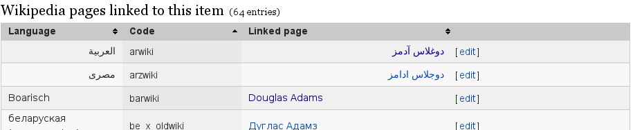
The Content of Wikidata

Slide 29
Terms and Languages
Three kinds of terms: labels, descriptions, aliases
  Term: string in a language (“monolingual text value”)
  Over 350 languages
Used for labelling and searching
Terms as keys:
  Label-description pair globally unique

Slide 30
Terms and Languages
“(Q42)”
Identifier usually meaningless
Three kinds of terms: labels, descriptions, aliases
  Term: string in a language (“monolingual text value”)
  Over 350 languages
Used for labelling and searching
Terms as keys:
  Label-description pair globally unique

Slide 31
Site Links
Links to other Wikimedia projects
Used in all Wikipedias to create language links
Site links as keys:
  At most one link per project (functional)
  At most one item per site link (inverse functional)

Slide 32
Statements
The richest part of Wikidata's data
Property
Value
Reference(s)

Slide 33
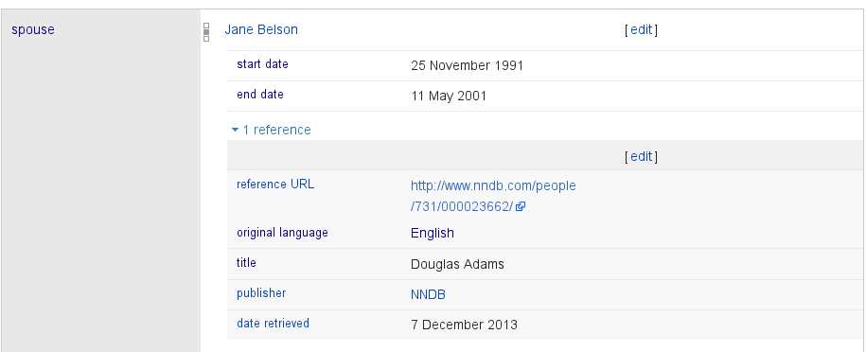
Statements
The richest part of Wikidata's data
Provenance data
all over the place

Slide 34
Statements
The richest part of Wikidata's data
Value
Property
Rank
List of qualifiers
List of references
Reference =
List of property-value pairs

Slide 35
Properties and Datatypes
Properties have datatypes
  Datatype fixed after creation
Datatypes: Item, Property, String, URL, CommonsMedia, Time, Geo Coordinates, Quantity, Monolingual Text, External ID (new), Math (new)
Properties can have statements (since late 2014)

Slide 36
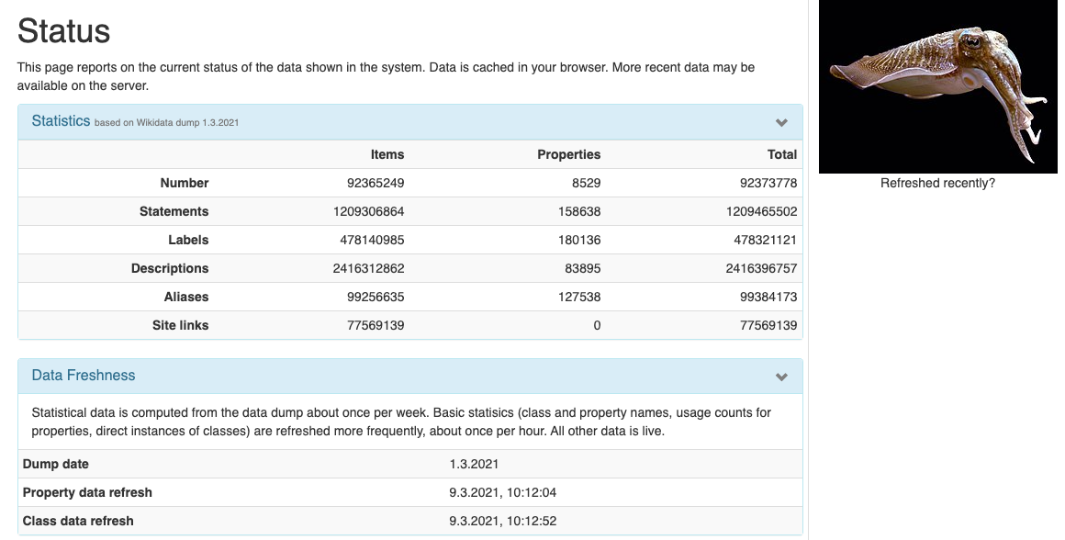
Wikidata Statistics
https://tools.wmflabs.org/sqid/#/status

Slide 37
Usage & Applications

Slide 38
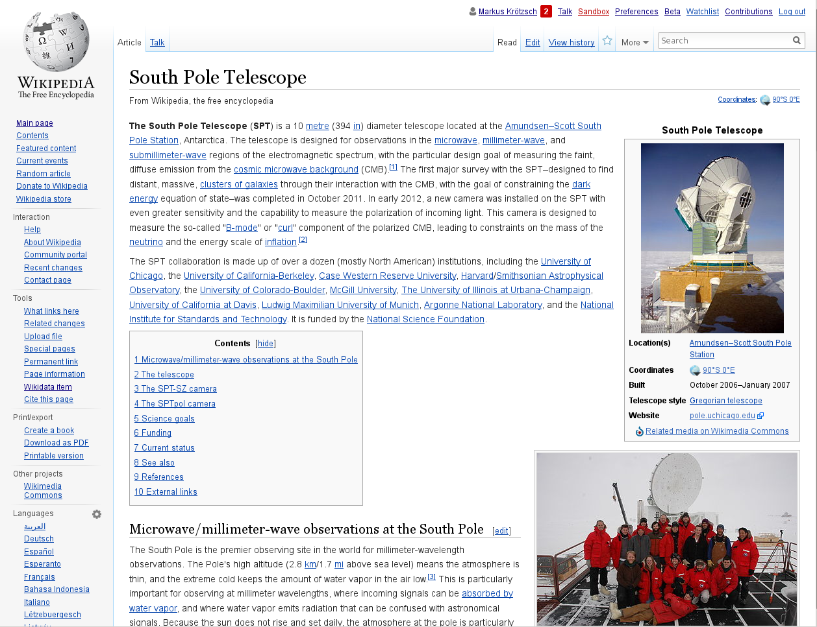
Primary Use Case: Wikipedia

Slide 39
Primary Use Case: Wikipedia
language links

Slide 40
Primary Use Case: Wikipedia
infobox

Slide 41
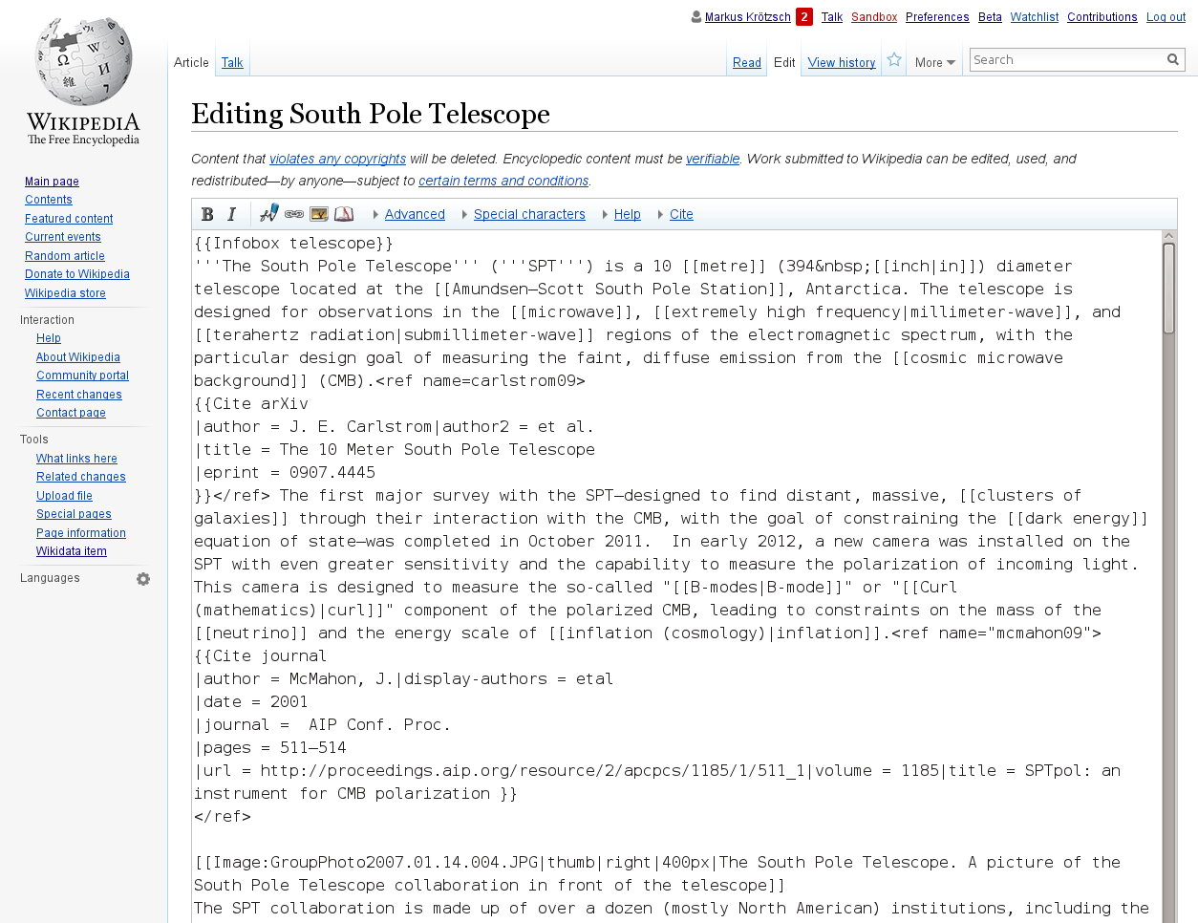
Primary Use Case: Wikipedia
Look! No inline data!

Slide 42
Primary Use Case: Wikipedia
Move inline data to Wikidata
  In progress; still incomplete
  Process changes (Example: English Wikipedia PersonData)
Populate Infoboxes from Wikidata
  Only just starting (technical support since May 2015)
  Several examples in production, first community decisions made on how to use this
Create list articles (semi)automatically with queries
  Technology still under development
  Community discussions have started

Slide 43
Third-Party Application Areas
Labels and descriptions
  Use as a language resource
Identifiers
  Data integration, authority control, linking
Data access
  Embed Wikipedia-related data anywhere
  Answer complex questions
Advanced analytics
  Data science
  Analyse Wikipedia community processes

Slide 44
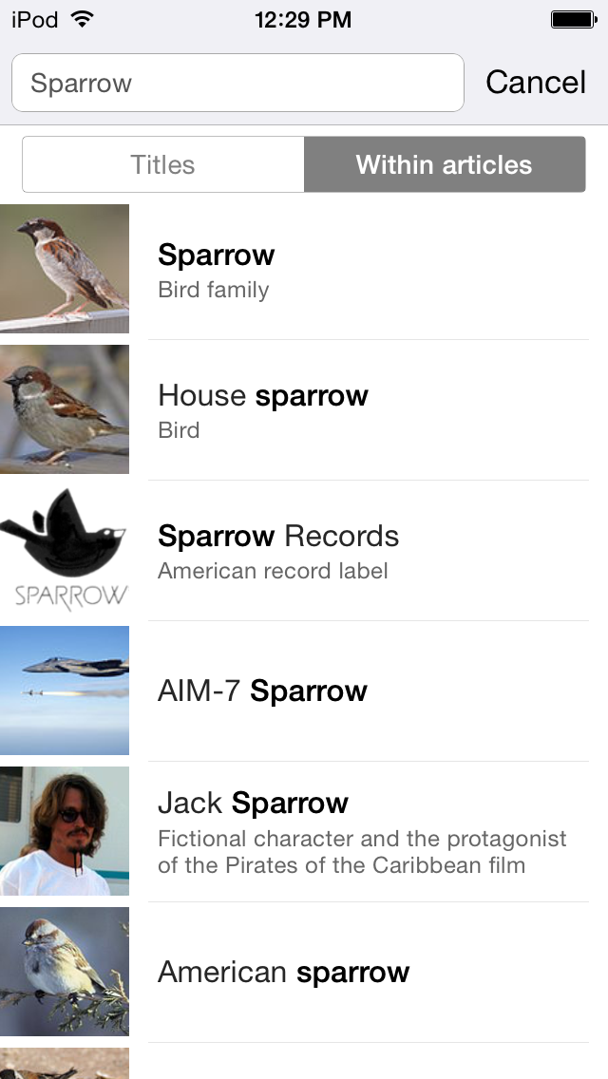
Wikidata applications: Status
Tools for Wikidata editors
  Mass editing, data integration,
  browsing, error detection, …
Wikipedia-related usage
  Data use on Wikimedia projects
  Analysis of Wikipedia content
Third-party use
  Data integrated in other DBs
  (authority files, thesauri, open data
  repositories)
  Identifier/vocabulary reuse

Slide 45
Wikidata as Knowledge Graphs
Graph-based information collections come in many formats:
  W3C Resource Description Format
  Property Graph (Blueprints/Tinkerpop)
  Custom JSON structures
  Facebook Open Graph…
How does Wikidata fit in?

Slide 46
Wikidata internally
Wikidata uses custom JSON as its main format

Slide 47
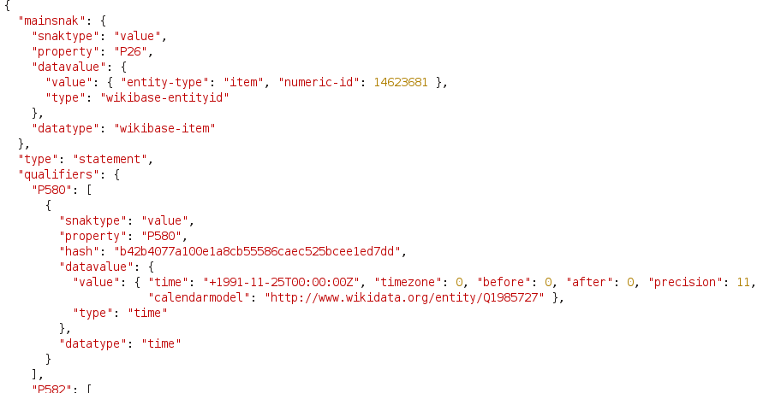
Wikidata internally
Wikidata uses custom JSON as its main format

Slide 48
Property Graph model
Directed graph where nodes and edges can have lists of attribute-value pairs
Generalises many “annotated edge” graph models
Differences to Wikidata:
  Only one value per annotation attribute
  Nodes != attribute-values, edge types != attributes
  Custom extension needed for required value types
Id: “Q42”
Label-en: “Douglas Adams”
...
P26 (spouse)
Id: “Q14623681”
Label-en: “Jane Belson”
...
Start: 1991-11-25
End: 2001-05-11
Reference: ref1234

Slide 49
RDF (Resource Description Framework)
Directed graph where nodes are URIs or data values, and edges are labelled with IRIs
Graph = set of triples “subject predicate object”
Differences to Wikidata:
  No annotations for edges
entity:Q42
property:P26
entity:Q14623681
rdfs:label
rdfs:label
“Douglas Adams”@en
“Jane Belson”@en

Slide 50
Representing Wikidata in RDF
Use new nodes to represent relations between objects
entity:Q42
prop:P26s
stmt:Q42#123
prop:P26v
entity:Q14623681
rdfs:label
prop:P580q
rdfs:label
“Douglas Adams”@en
“Jane Belson”@en
prop:P582q
reference
“2001-05-11”
“1991-11-25”
Ref:1234
…

Slide 51
Wikidata and RDF: current status
All data available in RDF:
Live exports of all data (“Linked Data”)
Dump files (around 500M-1000M triples)
Official Wikidata live query service based on SPARQL
https://query.wikidata.org/
URIs (“RDF identifiers”) used as main identifiers for Wikidata content (even in non-RDF applications)

Slide 52
Wikidata and DBpedia
DBpedia
Wikidata
Data related to Wikipedia
Started in 2006
Automated extraction
One dataset per language
Based on triples (RDF)
>10k properties
Stand-alone dataset
Unique community
Data related to Wikipedia
Online since late 2012*
Manual editing
One multilingual dataset
Based on statements
About 5k properties
Wikipedia integration
Unique community
* influenced by Semantic MediaWiki (started 2005)

Slide 53
Wikidata Vocabulary and Ontology

Slide 54
Vocabulary
Wikidata items often are well-defined concepts:
  Linked to many Wikipedia articles
  Linked to hundreds of external databases
  Most items are classified (given a type)
  Labels and descriptions in many languages
Wikidata item IDs are stable
  Might be deleted but never re-used
Wikidata items have canonical URIs that provide further data in various formats (content negotiation)

Slide 55
Classification
Properties subclass of (P279) and instance of (P31)
  P31 is the most used property on Wikidata
Often (but not always) used without qualifiers
Interesting class hierarchy:
  Around 160,000 entities used like classes
  Subclass of: 11,643
Property hierarchy now also emerging

Slide 56
Wikidata as an ontology of everything?
Modelling is hard:
  Semantic drift across content areas
  Incoherent modelling decisions
  Concepts do not always translate faithfully into other languages
  Upper level modelling is philosophically challenging

Slide 57
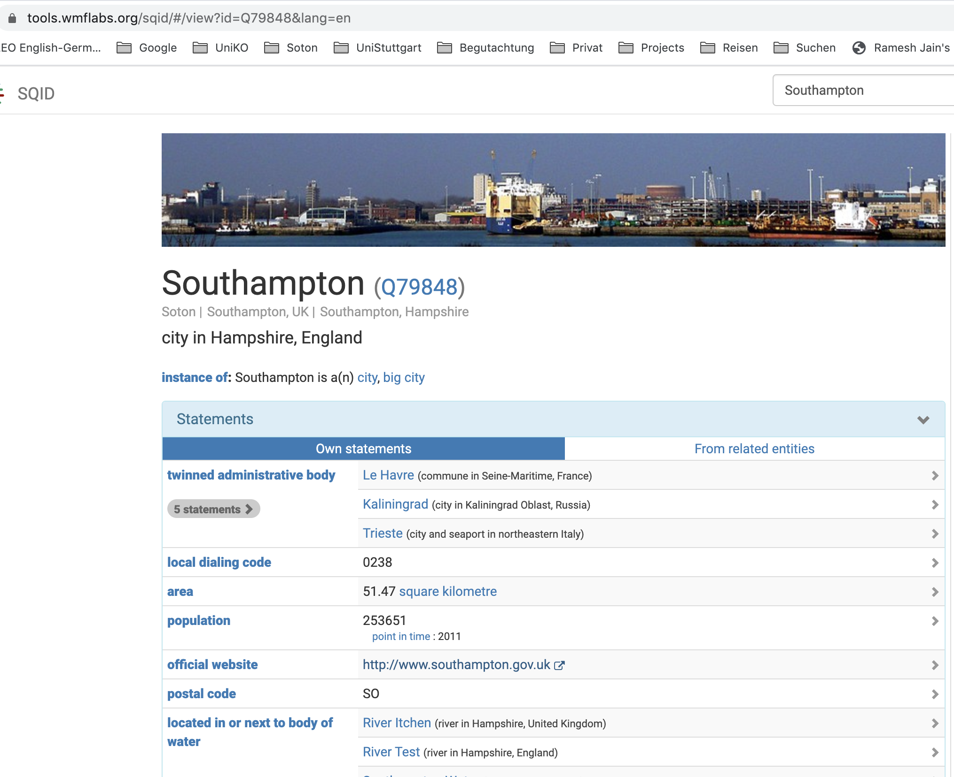
Where are we now?
In Southampton?

Slide 58
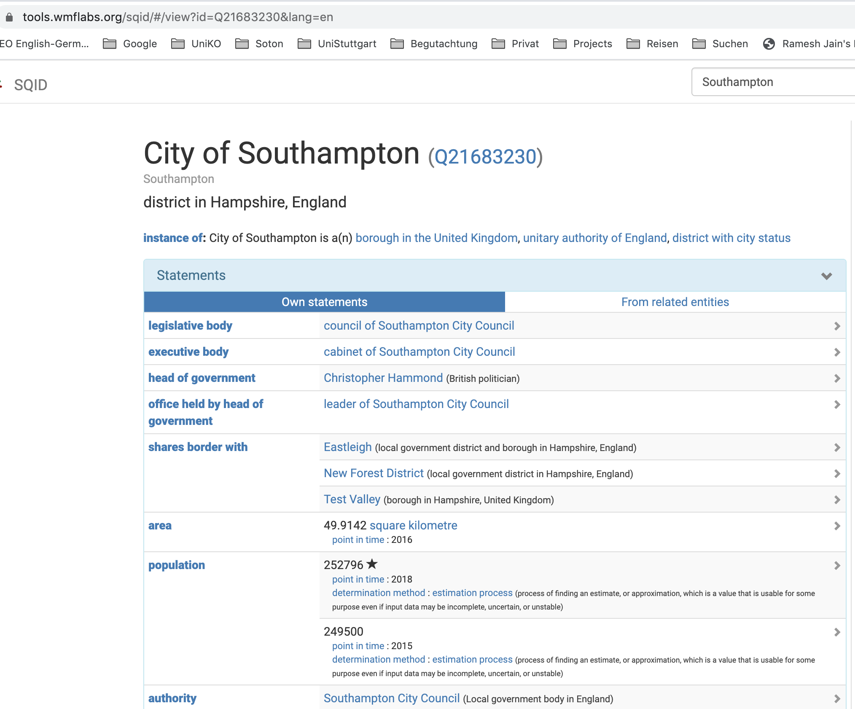
Where are we now?
In City of Southampton?

Slide 59
Abstract Wikipedia / Wikifunctions
Enable the creation of language-independent articles.
Increase the number of articles available in all languages, especially less used ones
Share knowledge from local culture and contexts with a global audience

Slide 60
Final Remarks

Slide 61
Getting the Data
See www.wikidata.org/wiki/Wikidata:Data_access
Direct access per item (Web API, JSON, RDF, …)
Database dumps (JSON)
  Use Wikidata Toolkit to parse dumps in Java
  https://www.mediawiki.org/wiki/Wikidata_Toolkit
RDF dumps
SPARQL endpoint

Slide 62
Conclusions
Wikidata is developing rapidly
  Data size
  Vocabulary size
  Technical features and community processes
A platform for data integration
  Including links to many other databases
Data access is easy, both legally and technically
  Extended exports and query facilities under way

Slide 63
References

Slide 64

Free content at: https://kgbook.org/

Slide 65
Further reading
Denny Vrandecic, Markus Krötzsch. Wikidata: A Free Collaborative Knowledge Base.
Communications of the ACM 2014.
→ general first introduction to Wikidata
Fredo Erxleben, Michael Günther, Markus Krötzsch, Julian Mendez, Denny Vrandečić. Introducing Wikidata to the Linked Data Web.
Proc. Int. Semantic Web Conf. (ISWC) 2014.
→ introduction of the Wikidata RDF export and data model

Slide 66
Own work, e.g.
Knowledge graph completion
Bo Xiong, Nico Potyka, Trung-Kien Tran, Mojtaba Nayyeri, Steffen Staab: Box Embeddings for the Description Logic EL++. CoRR abs/2201.09919 (2022)
Knowledge graph evolution
Lukas Schmelzeisen, Corina Dima, Steffen Staab: Wikidated 1.0: An Evolving Knowledge Graph Dataset of Wikidata's Revision History. Wikidata@ISWC 2021

Slide 67
Explore yourself
https://tools.wmflabs.org/sqid/
Statistics:
https://tools.wmflabs.org/sqid/#/status
Example queries:
https://query.wikidata.org/

