Slide 2
Query Processing
COMP3211 Advanced Databases
Nicholas Gibbins - nmg@ecs.soton.ac.uk

Slide 3
Query Processing
Query in a high-level language (DML)
Scanning, parsing and validating
Intermediate form of query
Query Optimiser
Execution plan
Query Code Generator
Code to execute the query
Runtime Database Processor
Result of query

Slide 4
Query Plans
Logical Query Plan
  algebraic representation of query
  operators taken from relational algebra
  abstract!
Physical Query Plan
  algorithms selected for each operator in plan
  execution order specified for operators

Slide 5
Query Processing
Query in a high-level language (DML)
Scanning, parsing and validating
Intermediate form of query
Query Optimiser
query
optimisation
Execution plan
Query Code Generator
Code to execute the query
Runtime Database Processor
Result of query

Slide 6
Query Processing
Parse query
Select logical query plan
Generate logical query plan
Rewrite logical query plan
Select physical query plan
Execute plan

Slide 7
Overview
Logical query plans
  Cost estimation
  Improving logical query plans
  Cost-based plan selection
  Join ordering
Physical query plans
  Physical query plan operators
  One-pass algorithms
  Nested-loop joins
  Two-pass algorithms
  Index-based algorithms

Slide 8
Optimisation
A challenge and an opportunity for relational systems
  Optimisation must be carried out to achieve performance
  Because queries are expressed at such a high semantic level, it is possible for the DBMS to work out the best way to do things
Need to start optimisation from a canonical form

Slide 9
Optimisation Example
PROJECT
PNUMBER | PLOCATION | DNUM
DEPARTMENT
DNUMBER | MGRSSN
EMPLOYEE
SSN | LNAME | ADDRESS | DATE
For every project located in Stafford, retrieve the project number, the controlling department number, and the department manager’s last name, address and birth date
SELECT PNUMBER, DNUM, LNAME, ADDRESS, DATE
FROM PROJECT, DEPARTMENT, EMPLOYEE
WHERE DNUM=DNUMBER AND
MGRSSN=SSN AND
PLOCATION=‘Stafford’

Slide 10






Query Tree
$$π_{PNUMBER, DNUM, LNAME,ADDRESS, BDATE}$$
$$⋈_{MGRSSN=SSN}$$
$$⋈_{DNUM=DNUMBER}$$
$$EMPLOYEE$$
$$σ_{PLOCATION=“Stafford”}$$
$$DEPARTMENT$$
$$PROJECT$$

Slide 11





Canonical Form
$$π_{PNUMBER, DNUM, LNAME, ADDRESS, BDATE}$$
$$σ_{DNUM=DNUMBER ∧ MGRSSN=SSN ∧ PLOCATION=“Stafford”}$$
$$×$$
$$×$$
$$EMPLOYEE$$
$$PROJECT$$
$$DEPARTMENT$$

Slide 12
Cost Estimation

Slide 13
Cost Estimation
At this stage, no commitment to a particular physical plan
  Estimate the “cost” of each operator in terms of the size relation(s) on which it operates
  Choose a logical query plan that minimises the size of the intermediate relations (= minimises the cost of the plan)
Assumption: system catalogue stores statistics about each relation

Slide 14

Statistics
$T(R)$: Number of tuples in relation $R$ (cardinality of $R$)
$V(R, A)$: Number of distinct values for attribute $A$ in relation $R$
Note: for any relation $R$, $V(R, A)≤T(R)$ for all attributes $A$ on $R$

Slide 15

Scan
Operation of reading all tuples of a relation
$$T(scan(R))=T(R)$$
For all $A$ in $R$, $V(scan(R), A)=V(R, A)$

Slide 16

Product
$$T(R × S)=T(R)T(S)$$
For all $A$ in $R$, $V(R × S, A)=V(R, A)$
For all $B$ in $S$, $V\left(R × S, B\right)=V(S, B)$

Slide 17

Projection
$T(π_{A}(R)) = T(R)$
For all A in R and $π_{A}\left(R\right)$, $V(π_{A}(R)), A) = V(R, A)$
Assumption: projection does not remove duplicate tuples (value counts don’t change)

Slide 18

Selection
Two forms to consider:
$σ_{attribute=value}(R)$
$σ_{attribute1=attribute2}(R)$

Slide 19

Selection case 1: attr=val
$$T(σ_{A=c}(R))=\frac{T(R)}{V(R, A) }$$
$$V(σ_{A=c}(R), A)=1$$
Assumption: all values of A appear with equal frequency

Slide 20

Example: selection case 1: attr=val
$$T(R) = 1000$$
$$V(R, A) = 10$$
$$V(R, B) = 1000$$
$$T\left(σ_{A=c}(R)\right)=\frac{T(R)}{V(R,A)}=100$$
$$V\left(σ_{A=c}\left(R\right),A\right)=1$$
$V\left(R,B\right)>T\left(σ_{A=c}\left(R\right)\right)$ so $V\left(σ_{A=c}\left(R\right), B\right)=T\left(σ_{A=c}\left(R\right)\right)=100$

Slide 21
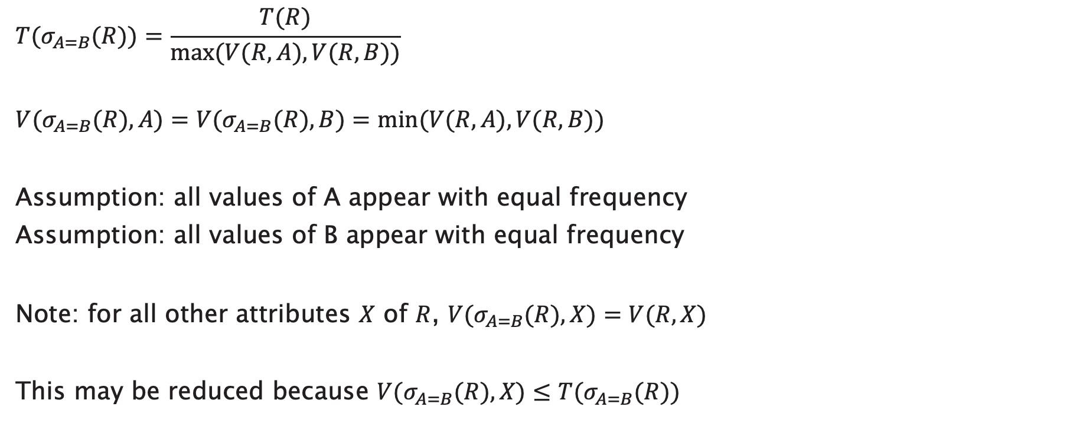
Selection case 2: attr=attr
$$T(σ_{A=B}(R))=\frac{T(R)}{max⁡(V(R, A),V(R, B))}$$
$$V(σ_{A=B}(R), A)=V(σ_{A=B}(R), B)=min⁡(V(R, A), V(R, B))$$
Assumption: all values of A appear with equal frequency
Assumption: all values of B appear with equal frequency
Note: for all other attributes $X$ of $R$, $V(σ_{A=B}(R), X)=V(R, X)$
This may be reduced because $V(σ_{A=B}(R), X)≤T(σ_{A=B}(R))$

Slide 22
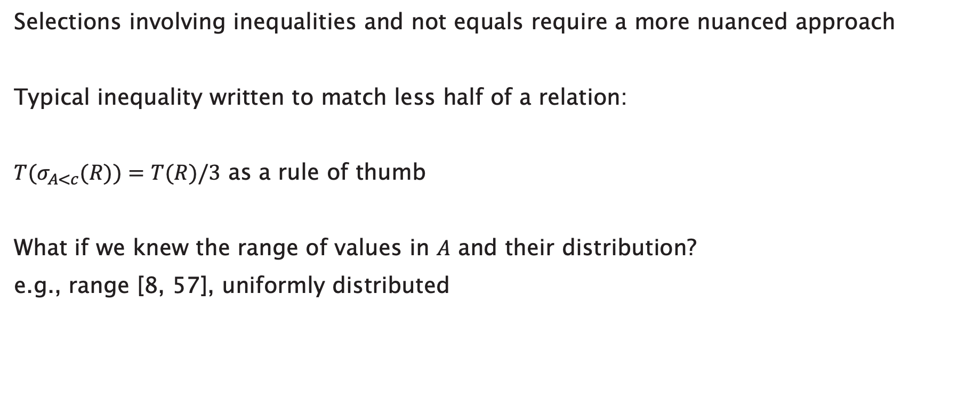
Further Selection: Inequality
Selections involving inequalities and not equals require a more nuanced approach
Typical inequality written to match less half of a relation:
$T(σ_{A<c}(R))=T(R)/3$ as a rule of thumb
What if we knew the range of values in $A$ and their distribution?
e.g., range [8, 57], uniformly distributed

Slide 23

Further Selection: Inequality
What about not equals?
$T(σ_{A≠c}(R))=T(R)$as a first approximation
Alternatively:
$$T(σ_{A≠c}(R))=T(R)\left(\frac{V(R, A) –1}{V(R, A)}\right)$$

Slide 24

Further Selection: Conjunction
$$T\left(σ_{A=c1 ∧ B=c2}\left(R\right)\right)=\frac{T(R)}{V\left(R,A\right)V(R,B)}$$

Slide 25

Further Selection: Disjunction
$$T\left(σ_{A=c1 ∨ B=c2}\left(R\right)\right)=\frac{T(R)}{V\left(R,A\right)}+\frac{T(R)}{V(R,B)}$$
This overestimates the number of tuples
Alternatively,
$$T\left(σ_{A=c1 ∨ B=c2}\left(R\right)\right)=T(R)\left(1−\frac{1}{V\left(R,A\right)}\right)\left(1−\frac{1}{V(R,B)}\right)$$

Slide 26
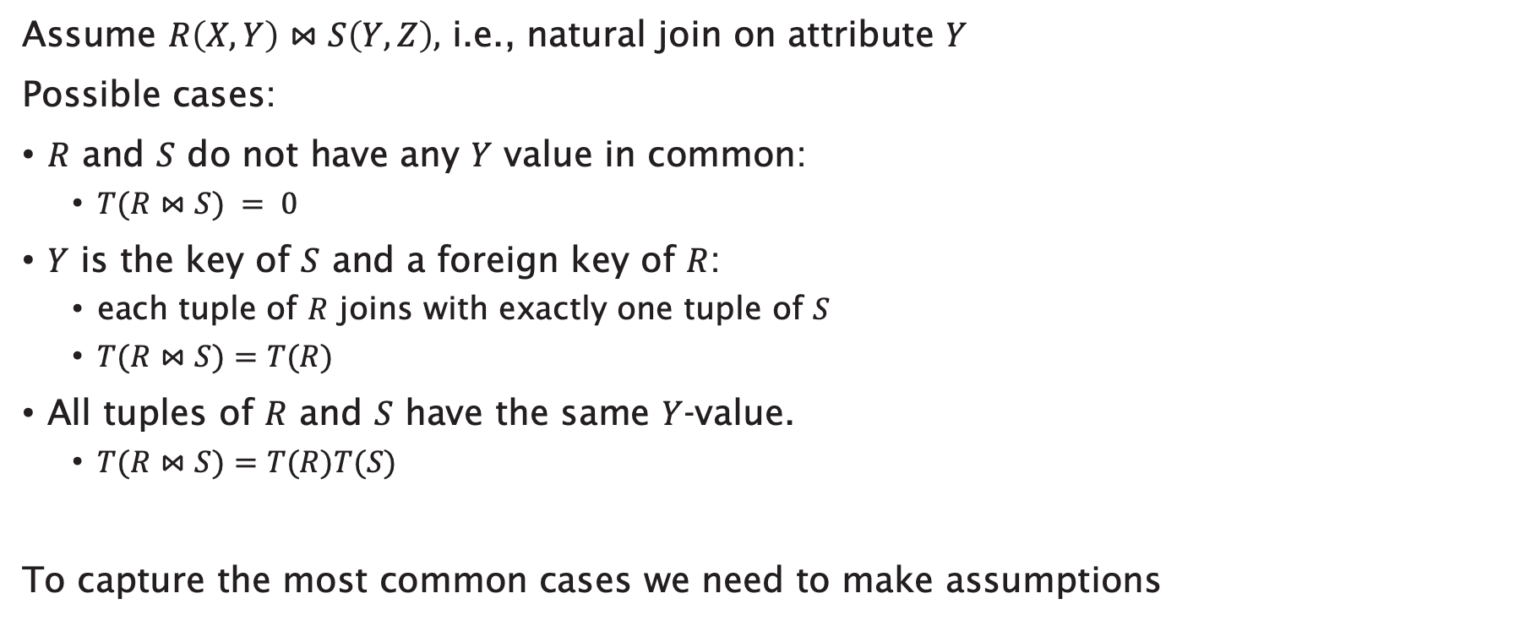
Join
Assume $R\left(X, Y\right)⋈S\left(Y, Z\right),$ i.e., natural join on attribute $Y$
Possible cases:
$R$ and $S$ do not have any $Y$ value in common:
  $T(R⋈S) = 0$
$Y$ is the key of $S$ and a foreign key of $R$:
  each tuple of $R$ joins with exactly one tuple of $S$
  $T(R⋈S)=T(R)$
All tuples of $R$ and $S$ have the same $Y$-value.
  $T(R⋈S)=T(R)T(S)$
To capture the most common cases we need to make assumptions

Slide 27
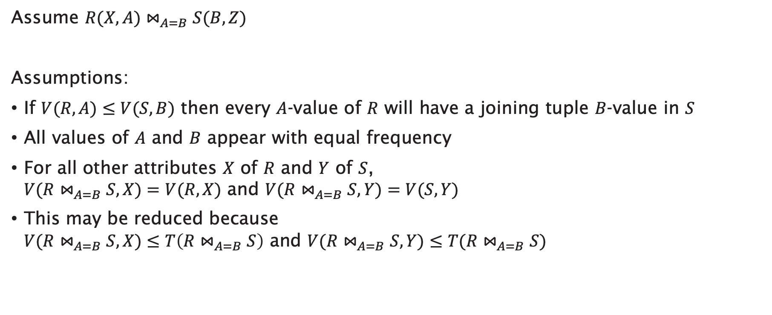
Join
Assume $R(X, A)⋈_{A=B}S(B, Z)$
Assumptions:
If $V(R, A)≤V(S, B)$ then every $A$-value of $R$ will have a joining tuple $B$-value in $S$
All values of $A$ and $B$ appear with equal frequency
For all other attributes $X$ of $R$ and $Y$ of $S$,
$V(R⋈_{A=B}S, X)=V(R,X)$ and $V(R⋈_{A=B}S, Y)=V(S, Y)$
This may be reduced because
$V(R⋈_{A=B}S, X)≤T\left(R⋈_{A=B}S\right)$ and $V(R⋈_{A=B}S, Y)≤T(R⋈_{A=B}S)$

Slide 28

Join
$$T(R⋈_{A=B}S)=\frac{T(R)T(S)}{max⁡(V(R,A),V(S,B))}$$
$$V(R⋈_{A=B}S, A)=V(R⋈_{A=B}S, B)=min⁡(V(R, A), V(S, B))$$

Slide 29

Further Join
If there are multiple pairs of join attributes:
$$T\left(R⋈_{R1=S1 ∧ R2=S2}S\right)=\frac{T\left(R\right)T(S)}{\max\left(V\left(R,R1\right),V\left(S,S1\right)\right)max⁡(V\left(R,R2\right),V\left(S,S2\right))}$$

Slide 30
Further Statistics
Distinct values assumes that each attribute value appears with equal frequency
  Potentially unrealistic
  Gives inaccurate estimates for joins and selects
Other approaches based on histograms:
  Equal-width: divide the attribute domain into equal parts, give tuple counts for each
  Equal-height: sort tuples by attribute, divide into equal-sized sets of tuples and give maximum value for each set
  Most-frequent values: give tuple counts for top-n most frequent values

Slide 31

Histograms
Let $R(A, B, C)$ be a relation with 10000 tuples.
Consider the following equal-width histogram on $A$:
$$Τ(σ_{A=10}(R))= ?$$
range | [1,10] | [11,20] | [21,30] | [31,40] | [41,50]
tuples | 50 | 2000 | 2000 | 3000 | 2950

Slide 32

Histograms
Let $R(A, B, C)$ be a relation with 10000 tuples.
Consider the following equal-width histogram on $A$:
$$Τ(σ_{A=10}(R))=\frac{50}{10000}×\frac{1}{10}×T(R)$$
range | [1,10] | [11,20] | [21,30] | [31,40] | [41,50]
tuples | 50 | 2000 | 2000 | 3000 | 2950

Slide 33
Query Optimisation

Slide 34
Cost estimation
The “cost” of an operator is the cardinality of its output relation
  Cost of processing or materialising its output
Overall query plan cost is the sum of cardinalities of intermediate relations
  Excluding the leaves (i.e. input relations)
  Excluding the end result (i.e. cost of the final operator)
Now that we have a way of judging whether one plan is better than another...
...all we need to do to find the optimal plan is to compare all the possible plans
So how many possible plans are there?

Slide 35


How many query trees?
Considering plans with only $×$ or $⋈$, and with $n$ relations:
$$n=1$$
R

Slide 36



How many query trees?
Considering plans with only $×$ or $⋈$, and with $n$ relations:
$$n=2$$
R
S
S
R
Note: while $×$ and $⋈$ are symmetric, their corresponding physical operators aren’t;
the actual cost of $R⋈S$ may be different from that of $S⋈R$
Notes:
Physical join operators are not symmetric – left vs right input matters

Slide 37

How many query trees?
Considering plans with only $×$ or $⋈$, and with $n$ relations:
T
S
T
R
S
R
R
S
R
T
S
R
S
T
T
R
T
S
$$n=3$$
R
R
S
S
T
T
S
T
T
S
R
T
T
R
R
S
S
R

Slide 38

How many query trees?
Considering plans with only $×$ or $⋈$, and with $n$ relations:
$$n=4$$
4! permutations of the relations for each of those shapes
120 different query trees

Slide 39
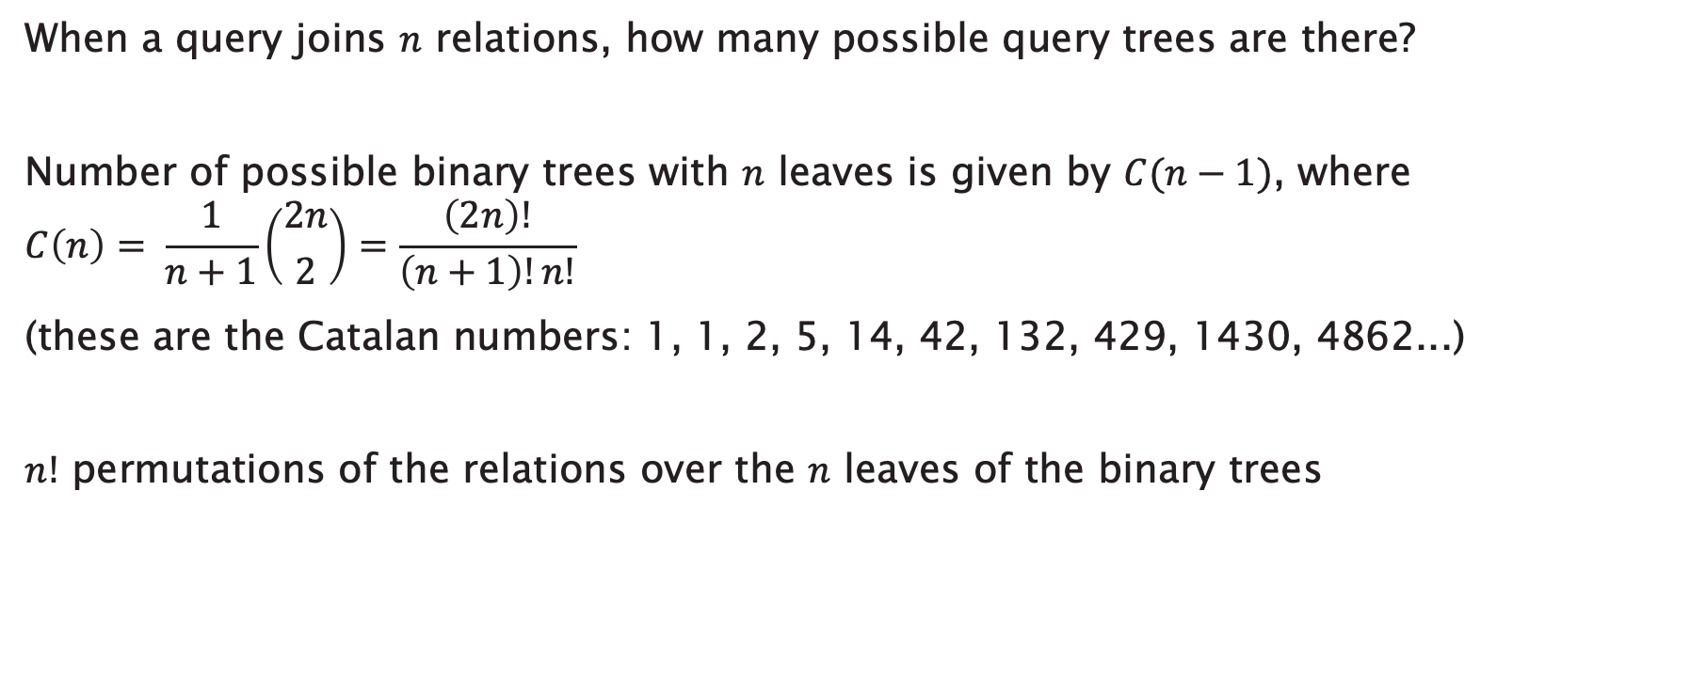
How many query trees?
When a query joins $n$ relations, how many possible query trees are there?
Number of possible binary trees with $n$ leaves is given by $C(n−1)$, where
$$C\left(n\right)= \frac{1}{n+1}\left({2n \atop 2}\right)=\frac{\left(2n\right)!}{\left(n+1\right)!n!}$$
(these are the Catalan numbers: 1, 1, 2, 5, 14, 42, 132, 429, 1430, 4862...)
$n!$ permutations of the relations over the $n$ leaves of the binary trees
#relns | 1 | 2 | 3 | 4 | 5 | 6 | 7 | 8
#trees | 1 | 2 | 12 | 120 | 1680 | 30240 | 665280 | 17297280

Slide 40
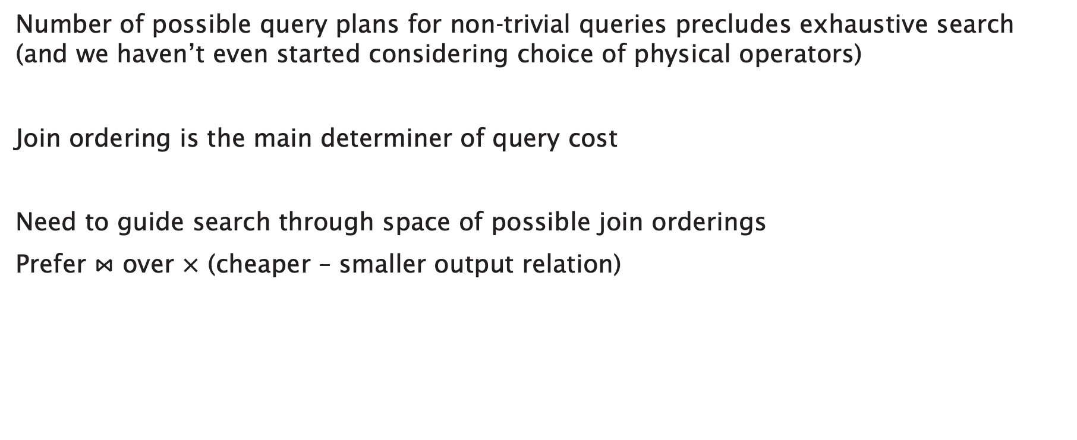
Join ordering
Number of possible query plans for non-trivial queries precludes exhaustive search
(and we haven’t even started considering choice of physical operators)
Join ordering is the main determiner of query cost
Need to guide search through space of possible join orderings
Prefer $⋈$ over $×$ (cheaper – smaller output relation)

Slide 41
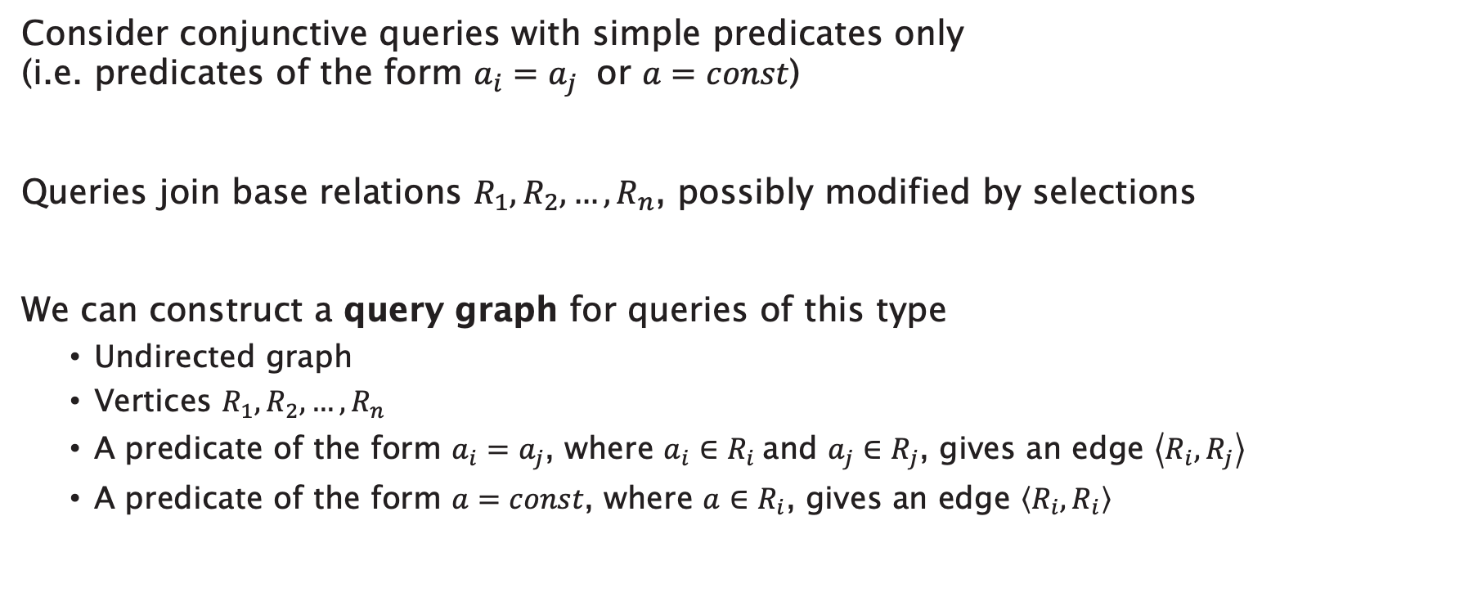
Query graphs
Consider conjunctive queries with simple predicates only
(i.e. predicates of the form $a_{i}=a_{j}$ or $a=const$)
Queries join base relations $R_{1},R_{2},…,R_{n}$, possibly modified by selections
We can construct a query graph for queries of this type
  Undirected graph
  Vertices $R_{1},R_{2},…,R_{n}$
  A predicate of the form $a_{i}=a_{j}$, where $a_{i}∈R_{i}$and $a_{j}∈R_{j}$, gives an edge $\left\langle R_{i},R_{j}\right\rangle$
  A predicate of the form $a=const$, where $a∈R_{i}$, gives an edge $\left\langle R_{i},R_{i}\right\rangle$

Slide 42






Query graphs
PROJECT
PNUMBER | PLOCATION | DNUM
DEPARTMENT
DNUMBER | MGRSSN
EMPLOYEE
SSN | LNAME | ADDRESS | DATE
SELECT PNUMBER, DNUM, LNAME, ADDRESS, DATE
FROM PROJECT, DEPARTMENT, EMPLOYEE
WHERE DNUM=DNUMBER AND
MGRSSN=SSN AND
PLOCATION=‘Stafford’
$$PROJECT$$
$$DEPARTMENT$$
$$EMPLOYEE$$
$$DNUM=DNUMBER$$
$$MGRSSN=SSN$$
$$PLOCATION=‘Stafford’$$

Slide 43
Query graph shapes
chain
cycle
star
clique
tree
cyclic

Slide 44
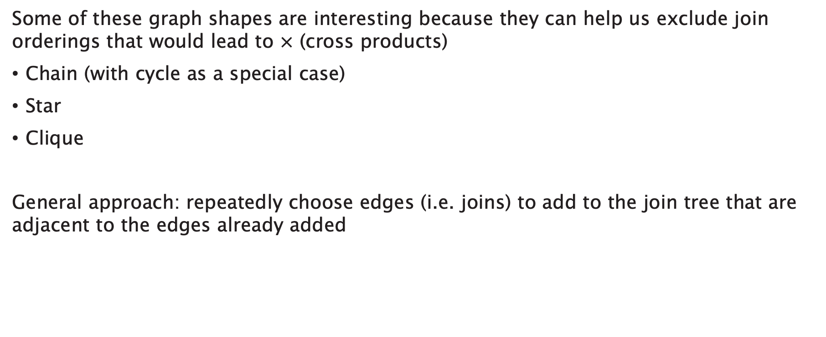
Query graphs and join ordering
Some of these graph shapes are interesting because they can help us exclude join orderings that would lead to $×$ (cross products)
Chain (with cycle as a special case)
Star
Clique
General approach: repeatedly choose edges (i.e. joins) to add to the join tree that are adjacent to the edges already added

Slide 45
Join trees
Choice of join tree shapes also constrains search space
Two main classes of join tree
Linear (left-deep, right-deep, zig-zag)
Bushy
Choice depends on:
Algorithms chosen (i.e. physical plan operators)
Execution model

Slide 46
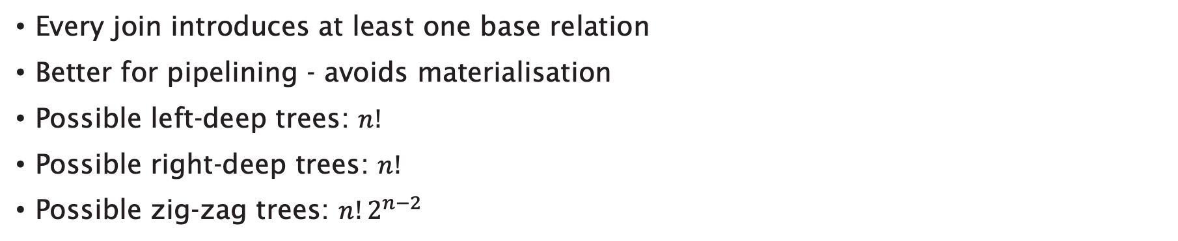
Linear join trees
Every join introduces at least one base relation
Better for pipelining - avoids materialisation
Possible left-deep trees: $n!$
Possible right-deep trees: $n!$
Possible zig-zag trees: $n!2^{n−2}$
left-deep
zig-zag
right-deep

Slide 47

Linear join trees
Combine with insights from query graph:
Left/right-deep + chain: $2^{n−1}$ possible join trees without $×$
Left/right-deep + star: $2∗\left(n−1\right)!$ possible join trees without $×$
Left/right-deep + clique: $n!$ possible join trees without $×$

Slide 48

Bushy join trees
Some joins may not join any base relations
Need not be balanced
Better for parallel processing
Possible bushy trees: $n!C\left(n−1\right)={\left(2n\right)!}/{n!}$
bushy

Slide 49
Optimisation approaches
Wide variety of approaches – no single best approach
Heuristic – transformation rules, keep transformed plan if cheaper
Dynamic programming
Randomised – avoid local minima by randomly jumping within big search spaces
...
(we could have a whole Part IV module on just this topic!)

Slide 50

Heuristic approach
Start with canonical form
Push $σ$ operators down the tree
Introduce joins (combine $×$ and $σ$ to create $⋈$)
Determine join order
Push $π$ operators down the tree

Slide 51





Optimising query trees
PROJECT
PNUMBER | PNAME
WORKS_ON
SSN | PNO
EMPLOYEE
ESSN | LNAME | BDATE
SELECT LNAME
FROM EMPLOYEE, WORKS_ON, PROJECT
WHERE PNAME=‘Aquarius’ AND
PNUMBER=PNO AND
ESSN=SSN AND
BDATE > ‘1957-12-31’
$$PROJECT$$
$$WORKS_ON$$
$$EMPLOYEE$$
$$PNUMBER=PNO$$
$$ESSN=SSN$$
$$PNAME=‘Aquarius’$$
$$BDATE>‘\text{1957−12−31}’$$

Slide 52
Query trees and canonical form
Useful to only consider left-deep trees
  Fewer possible left-deep trees than possible bushy trees - smaller search space when investigating join orderings
  Left deep trees work well with common join algorithms
  (nested-loop, index, one-pass – about which more later)
Canonical form should be:
  a left-deep tree of products with
  a conjunctive selection above the products and
  a projection (of the output attributes) above the selection

Slide 53






Canonical form
$$π_{LNAME}$$
$$σ_{PNAME=“Aquarius” ∧ PNUMBER=PNO ∧ ESSN=SSN ∧ BDATE>”1957−12−31”}$$
$$×$$
$$×$$
$$PROJECT$$
$$EMPLOYEE$$
$$WORKS_ON$$

Slide 54
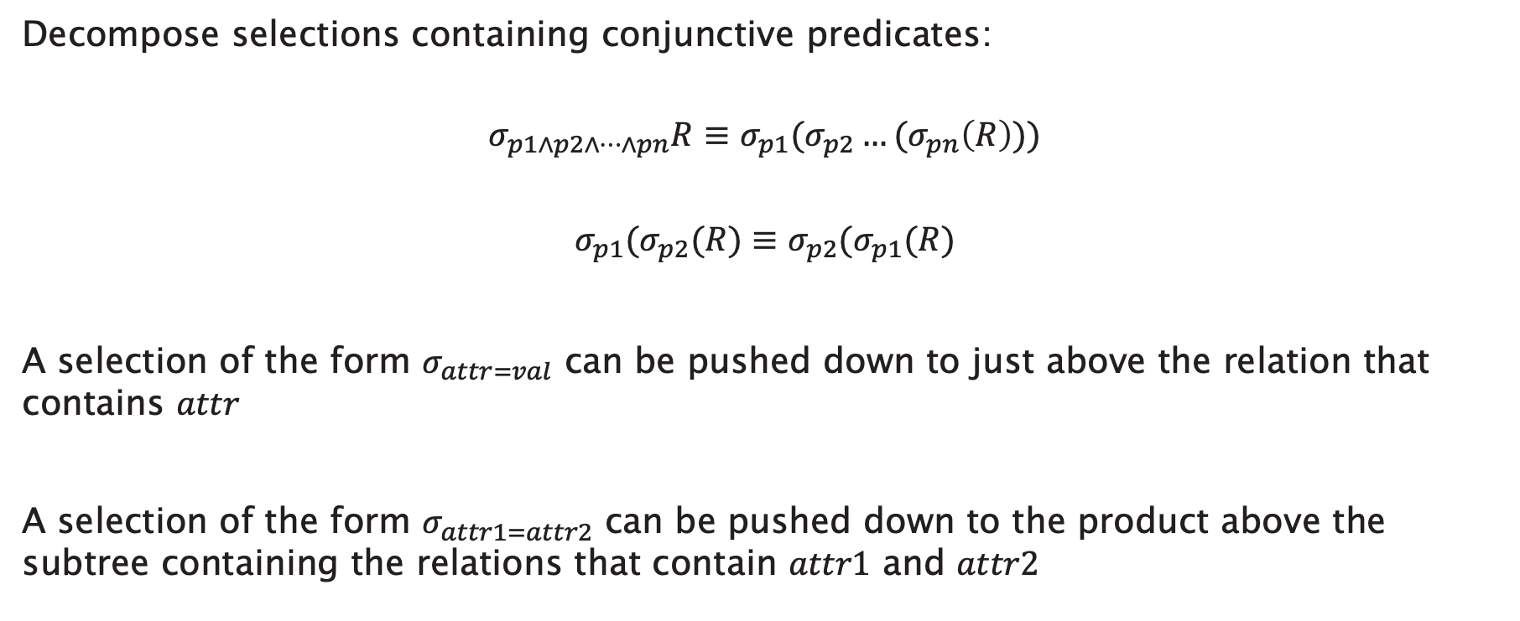

Move $σ$ down
Decompose selections containing conjunctive predicates:
$$σ_{p1∧p2∧…∧pn}R≡σ_{p1}(σ_{p2}…{(σ}_{pn}\left(R\right)))$$
$$σ_{p1}(σ_{p2}(R)≡σ_{p2}(σ_{p1}(R)$$
A selection of the form $σ_{attr=val}$ can be pushed down to just above the relation that contains $attr$
A selection of the form $σ_{attr1=attr2}$ can be pushed down to the product above the subtree containing the relations that contain $attr1$ and $attr2$

Slide 55









Move $σ$ down
$$π_{LNAME}$$
$$σ_{PNUMBER=PNO}$$
$$×$$
$$σ_{ESSN=SSN}$$
$$σ_{PNAME=“Aquarius”}$$
$$×$$
$$PROJECT$$
$$σ_{BDATE>”1957−12−31”}$$
$$WORKS_ON$$
$$EMPLOYEE$$

Slide 56
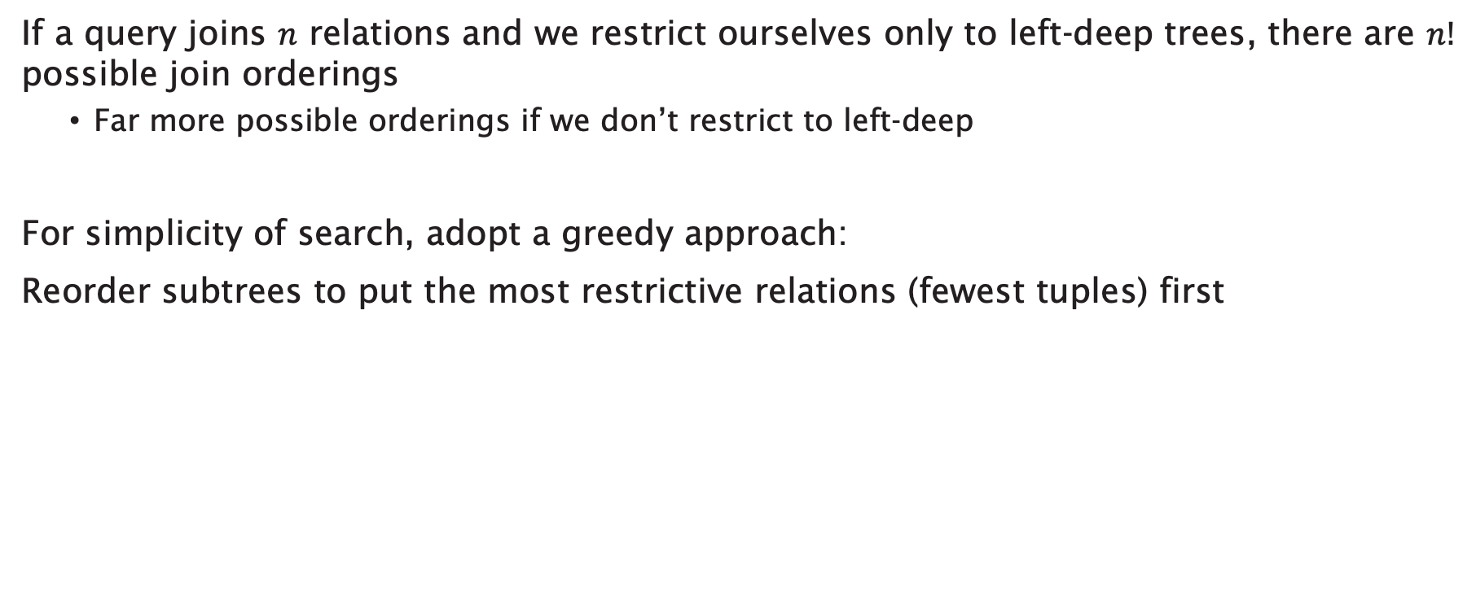
Reorder Joins
If a query joins $n$ relations and we restrict ourselves only to left-deep trees, there are $n!$ possible join orderings
  Far more possible orderings if we don’t restrict to left-deep
For simplicity of search, adopt a greedy approach:
Reorder subtrees to put the most restrictive relations (fewest tuples) first

Slide 57








Reorder joins
$$π_{LNAME}$$
$$σ_{PNUMBER=PNO}$$
$$×$$
$$σ_{ESSN=SSN}$$
$$σ_{PNAME=“Aquarius”}$$
$$×$$
$$PROJECT$$
$$σ_{BDATE>”1957−12−31”}$$
$$WORKS_ON$$
$$EMPLOYEE$$

Slide 58









Reorder Joins
$$π_{LNAME}$$
$$σ_{ESSN=SSN}$$
$$×$$
$$σ_{PNUMBER=PNO}$$
$$σ_{BDATE>”1957−12−31”}$$
$$×$$
$$EMPLOYEE$$
$$σ_{PNAME=“Aquarius”}$$
$$WORKS_ON$$
$$PROJECT$$

Slide 59

Create joins
Combine $×$ with adjacent $σ$ to form $⋈$
Uses the relational transformation $σ_{p}(R×S)≡R⋈_{p}S$
Much cheaper than product followed by selection

Slide 60








Create joins
$$π_{LNAME}$$
$$⋈_{ESSN=SSN}$$
$$⋈_{PNUMBER=PNO}$$
$$σ_{BDATE>”1957−12−31”}$$
$$σ_{PNAME=“Aquarius”}$$
$$WORKS_ON$$
$$EMPLOYEE$$
$$PROJECT$$

Slide 61

Move $π$ down
If intermediate relations are to be kept in buffers (i.e. materialised), reducing the degree of those relations (= number of attributes) allows us to use fewer buffer frames

Slide 62









Move $π$ down
$$π_{LNAME}$$
$$⋈_{ESSN=SSN}$$
$$π_{ESSN}$$
$$π_{SSN,LNAME}$$
$$⋈_{PNUMBER=PNO}$$
$$σ_{BDATE>”1957−12−31”}$$
$$π_{PNUMBER}$$
$$π_{ESSN,PNO}$$
$$EMPLOYEE$$
$$σ_{PNAME=“Aquarius”}$$
$$WORKS_ON$$
$$PROJECT$$

Slide 63




Optimised logical query plan
$$π_{LNAME}$$
$$⋈_{ESSN=SSN}$$
$$π_{ESSN}$$
$$π_{SSN,LNAME}$$
$$⋈_{PNUMBER=PNO}$$
$$σ_{BDATE>”1957−12−31”}$$
$$π_{PNUMBER}$$
$$π_{ESSN,PNO}$$
$$EMPLOYEE$$
$$σ_{PNAME=“Aquarius”}$$
$$WORKS_ON$$
$$PROJECT$$

Slide 64
Execution Models

Slide 65
Execution models
A physical query plan is a tree of physical plan operators
The execution model defines:
  the interface that connects operators to each other
  how data is propagated between operators
  how operators are scheduled
Operator interface
  Relation(s) in, relation out
  Producer-consumer relationship

Slide 66
Pipelining
Pipelining – read input, process, propagate output to next operator
Benefits of pipelining:
  No buffering (because no materialisation)
  Faster execution (no materialisation, so no disk I/Os)
  More in-memory operations
Not all operators can be pipelined
  Some require intermediate relations to be materialised
  Some operators will always block

Slide 67
Iterators
Standard interface on each operator:
open()
getNext()
close()
Query engine calls the interface on the root operator
Calls to interface are propagated down the tree
op
op
open()
getNext()
tuple
getNext()
tuple
getNext()
end of stream
close()

Slide 68
Synchrony versus asynchrony
As presented, the operator interface is synchronous
  Operators don’t generate tuples until getNext() is called
  In reality, different operators will have different evaluation times
  Some operators may block – causing the whole plan to block
Move to an asynchronous implementation by introducing buffering:
  Within the operator calling the interface (the push model)
  Within the operator being called (the pull model)
  In the connections between operators (the stream model)
Asynchronous implementations minimise time during which blocking occurs

Slide 69
The push model
Propagate from the leaves upwards
Producer propagates tuples as soon as they’re available
Producer propagates tuples regardless of whether consumer has yet called getNext()
Consumer buffers incoming tuples until it calls getNext()
Minimises idle time, good for pipelining
op
buffer
op

Slide 70
The pull model
Propagation driven from the root
Producer buffers tuples until getNext() is called
On-demand, close to pure implementation
op
op
buffer

Slide 71
The stream model
Connections as first-class objects:
  FIFO queues of tuples
Producer propagates tuples to the queue as soon as they’re available
Consumer call to getNext() does not block if there’s something in the queue
Asynchronous operators (but synchronous streams), good for parallelisation
op
queue
op

Slide 72
Physical Plan Operators

Slide 73
Physical Plan Operators
Algorithm that implements one of the basic relational operations that are used in query plans
For example, relational algebra has join operator
How that join is carried out depends on:
  structure of relations
  size of relations
  presence of indexes and hashes
  ...

Slide 74
Computation Model
Need to choose good physical-plan operators
  Estimate the “cost” of each operator
  Key measure of cost is the number of disk accesses
  (far more costly than main memory accesses)
Assumption: arguments of operator are on disk, result is in main memory

Slide 75

Cost Parameters
$M$ Main memory available for buffers
$S(R)$ Size of a tuple of relation $R$ (in blocks)
$B(R)$ Blocks used to store relation $R$
$T(R)$ Number of tuples in relation $R$ (cardinality of $R$)
$V(R,a)$ Number of distinct values for attribute $a$ in relation $R$

Slide 76
Clustered File
Tuples from different relations that can be joined (on particular attribute values) stored in blocks together
R1 R2 S1 S2
R3 R4 S3 S4

Slide 77
Clustered Relation
Tuples from relation are stored together in blocks, but not necessarily sorted
R1 R2 R3 R4
R5 R6 R7 R8

Slide 78
Clustering Index
Index that allows tuples to be read in an order that corresponds to physical order
a
10
I_{a}
16
19
23
44
57

Slide 79
Scanning

Slide 80

Scan
Read all of the tuples of a relation $R$
Read only those tuples of a relation $R$ that satisfy some predicate
Two variants:
  Table scan
  Index scan

Slide 81

Table Scan
Tuples arranged in blocks
  All blocks known to the system
  Possible to get blocks one at a time
I/O Cost
  $B(R)$ disk accesses, if $R$ is clustered
  $T(R)$ disk accesses, if $R$ is not clustered
Notes:
R clustered – R only stored in blocks by itself

Slide 82

Index Scan
An index exists on some attribute of $R$
  Use index to find all blocks holding $R$
  Retrieve blocks for $R$
I/O Cost
  $B(R)+B(I_{R})$ disk accesses if clustered
  $B(R)≫B(I_{R})$ so treat as only $B(R)$
  $T(R)$ disk accesses if not clustered

Slide 83
One-Pass Algorithms

Slide 84
One-Pass Algorithms
Read data from disk only once
Typically require that at least one argument fits in main memory
Three broad categories:
  Unary, tuple at a time (i.e. select, project) – non-blocking
  Unary, full-relation (i.e. duplicate elimination, grouping) – may be blocking
  Binary, full-relation – typically blocking

Slide 85
Unary, tuple at a time
foreach block of R:
copy block to input buffer
perform operation (select, project) on each tuple in block
move selected/projected tuples to output buffer
R
input
output
op

Slide 86
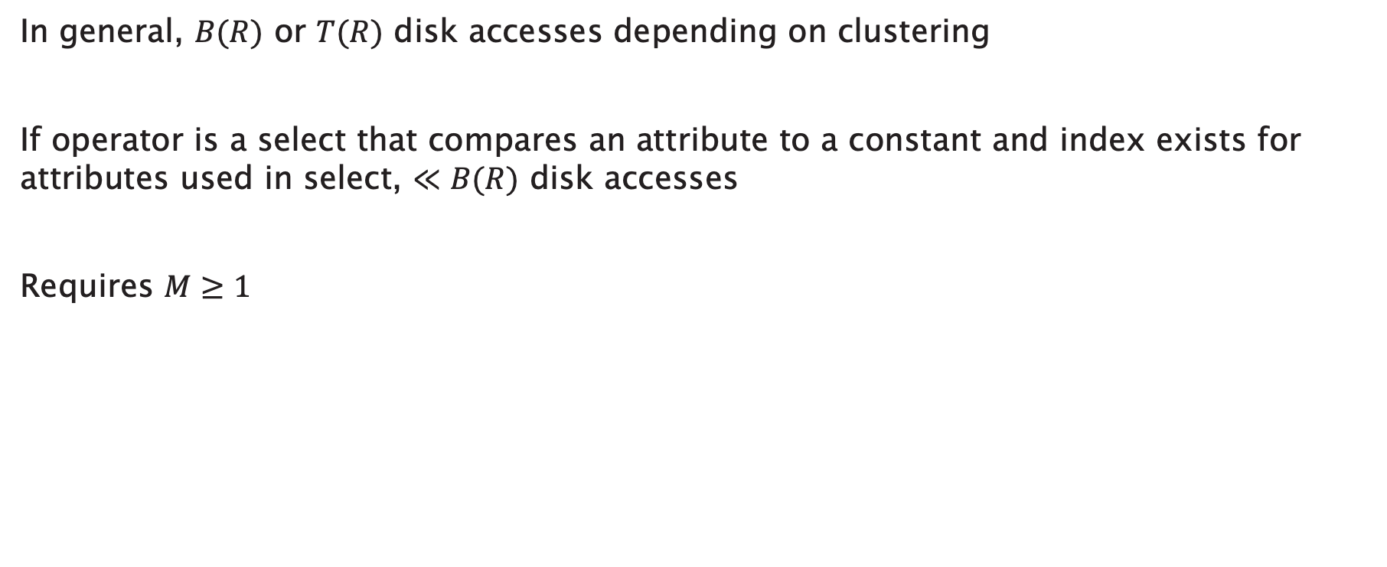
Unary, tuple at a time: Cost
In general, $B(R)$ or $T(R)$ disk accesses depending on clustering
If operator is a select that compares an attribute to a constant and index exists for attributes used in select, $≪B(R)$ disk accesses
Requires $M≥1$

Slide 87
Unary, full-relation
foreach block of R
copy block to input buffer
update accumulator
move tuples to output buffer
R
input
output
op
accumulator

Slide 88
Unary, full-relation: Duplicate elimination
foreach block of R:
copy block to input buffer
foreach tuple in block
if tuple is not in accumulator
copy to accumulator
copy to output buffer

Slide 89
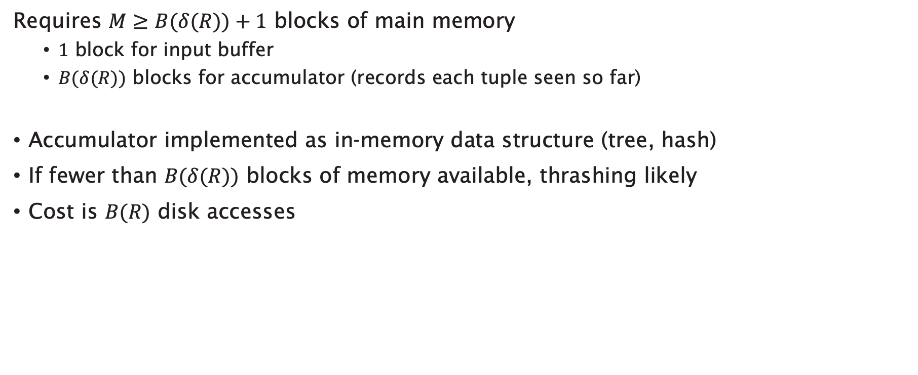
Unary, full-relation: Duplicate elimination
Requires $M≥B(δ(R))+1$ blocks of main memory
  $1$ block for input buffer
  $B(δ(R))$ blocks for accumulator (records each tuple seen so far)
Accumulator implemented as in-memory data structure (tree, hash)
If fewer than $B(δ(R))$ blocks of memory available, thrashing likely
Cost is $B(R)$ disk accesses

Slide 90

Unary, full-relation: Grouping
Grouping operators: min, max, sum, count, avg
Accumulator contains per-group values
Output only when all blocks of $R$ have been consumed
Cost is $B(R)$ disk accesses

Slide 91

Binary, full-relation
Union, intersection, difference, product, join
  We’ll consider join in detail
In general, cost is $B(R) + B(S)$
  $R$, $S$ are operand relations
Requirement for one pass operation: $min⁡(B(R), B(S))≤M−1$

Slide 92
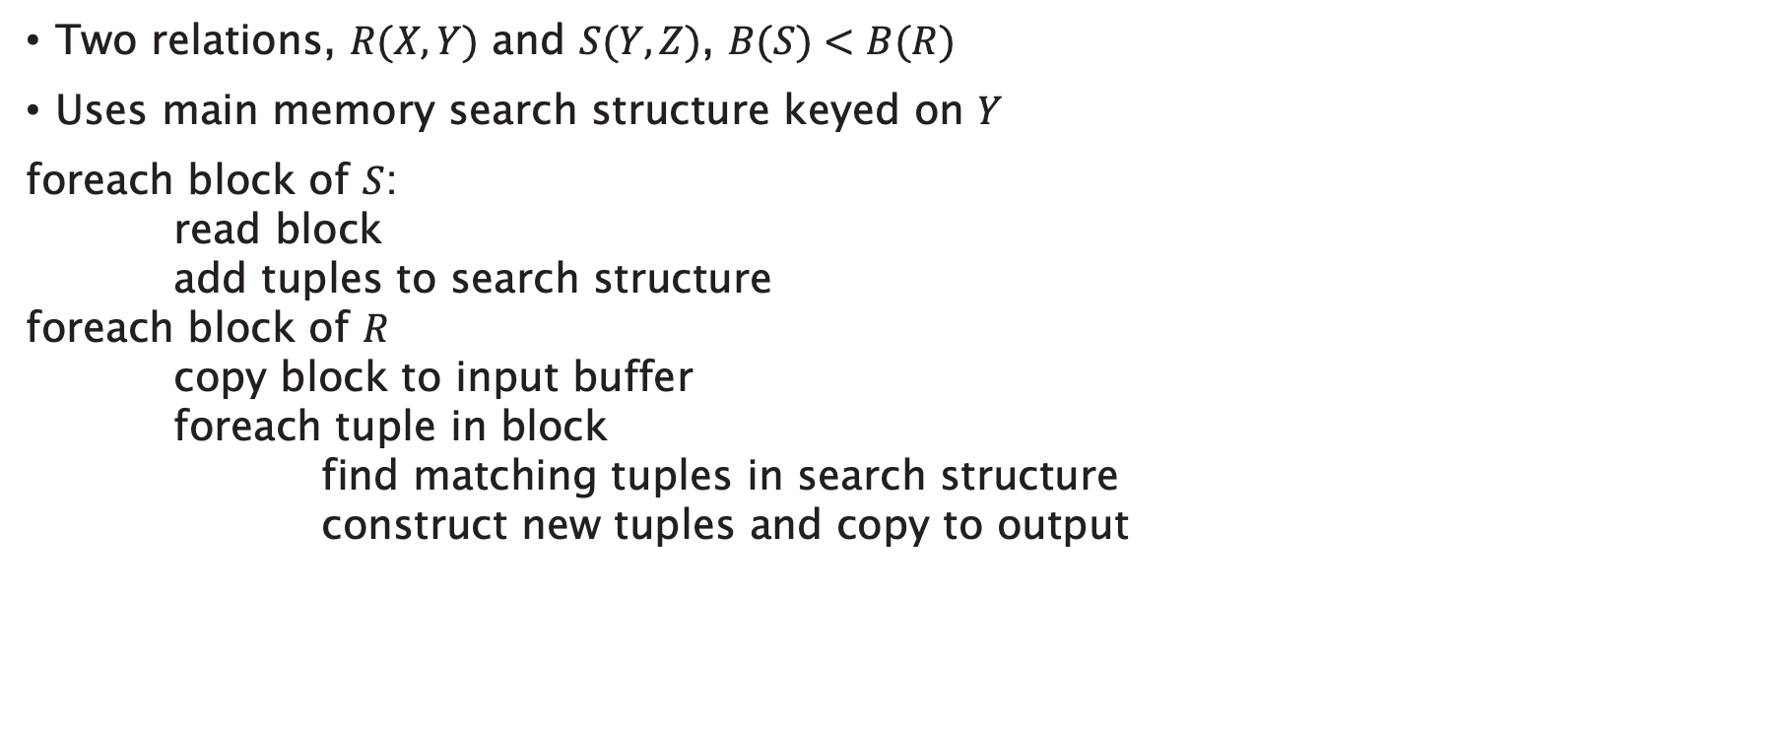
Binary, full-relation: Join
Two relations, $R(X,Y)$ and $S(Y,Z)$, $B(S)<B(R)$
Uses main memory search structure keyed on $Y$
foreach block of $S$:
read block
add tuples to search structure
foreach block of $R$
copy block to input buffer
foreach tuple in block
find matching tuples in search structure
construct new tuples and copy to output
Notes:
Considering natural join only; equijoin is similar, theta-join requires additional selection

Slide 93

Nested-loop join
Also known as iteration join
Assuming that we’re joining relations $R$, $S$ on attribute $a$:
foreach $r∈R$
foreach $s∈S$
if $r.a=s.a$ then output $\left\langle r,s\right\rangle$
Notes:
Note: assume that left relation is the outer

Slide 94
Factors that affect cost
Are the tuples of the relation stored physically together? (clustered)
Are the relations sorted by the join attribute?
Do indexes exist?

Slide 95

Example
Consider a join between relations $R1$, $R2$ on attribute $a$:
$$T\left(R1\right)=10,000$$
$$T\left(R2\right)=5,000$$
$$S(R1)=S(R2)=0.1$$
$$M=101$$

Slide 96
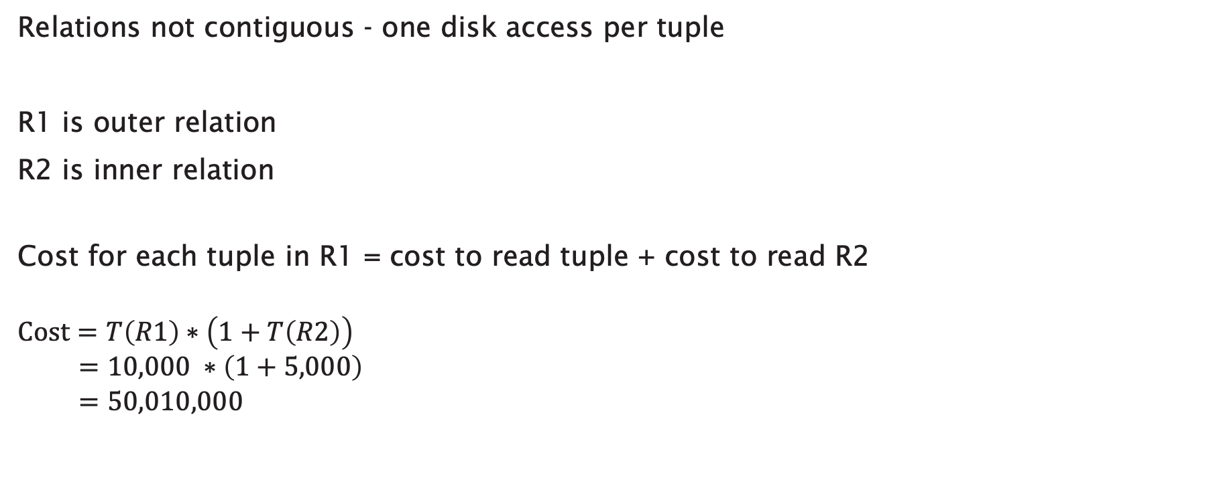
Attempt #1: Tuple-based nested loop join
Relations not contiguous - one disk access per tuple
R1 is outer relation
R2 is inner relation
Cost for each tuple in R1 = cost to read tuple + cost to read R2
$$Cost=T\left(R1\right)∗\left(1+T\left(R2\right)\right) \\ =10,000 ∗\left(1+5,000\right) \\ =50,010,000$$

Slide 97

Can we do better?
Use all available main memory ($M=101$)
Read outer relation R1 in chunks of 100 blocks
Read all of inner relation R2 (using 1 block) + join

Slide 98
Attempt #2: Block-based nested loop join
Tuples of R1 stored in a 100-block chunk = 100 * 1/S(R1)
= 1,000 tuples
Number of 100-block chunks to store R1 = T(R1) / 1,000
= 10
Cost to read one 100-block chunk of R1 = 1,000 disk accesses
Cost to process each chunk = 1000 + T(R2) = 6,000 disk accesses
Total cost = 10 * 6,000 = 60,000 disk accesses

Slide 99
Can we do better?
What happens if we reverse the join order?
  R1 becomes the inner relation
  R2 becomes the outer relation

Slide 100
Attempt #3: Join reordering
Tuples of R2 stored in a 100-block chunk = 100 * 1/S(R2)
= 1,000 tuples
Number of 100-block chunks to store R1 = T(R2) / 1,000
= 5
Cost to read one 100-block chunk of R2 = 1,000 disk accesses
Cost to process each chunk = 1000 + T(R1) = 11,000
Total cost = 5 * 11,000 = 55,000 disk accesses

Slide 101
Can we do better?
What happens if the tuples in each relation are contiguous? (i.e. clustered)

Slide 102
Attempt #4: Contiguous relations
B(R1) = T(R1)/S(R1) = 1,000
B(R2) = T(R2)/S(R2) = 500
Cost to read one 100-block chunk of R2 = 100 disk accesses
Cost to process each chunk = 100 + B(R1) = 1,100
Total cost = (B(R2) / 100) * 1,100 = 5,500 disk accesses

Slide 103
Can we do better?
What happens if both relations are contiguous and sorted by a, the join attribute?

Slide 104
Attempt #5: Merge join
Read each block of R1 and R2 once only
Total cost = B(R1) + B(R2)
= 1,000 + 500
= 1,500 disk accesses

Slide 105
Two-Pass Algorithms

Slide 106
Can we do better?
What if R1 and R2 aren’t sorted by a?
...need to sort R1 and R2 first

Slide 107
Merge Sort
(i) For each 100 block chunk of R:
  Read chunk
  Sort in memory
  Write to disk
R1
sorted
chunks
...
R2
memory

Slide 108
Merge Sort
(ii) Read all chunks + merge + write out
sorted
chunks
sorted
file
...
memory

Slide 109
Merge Sort: Cost
Each tuple is read, written, read, written
Sort cost R1: 4 x 1,000 = 4,000 disk accesses
Sort cost R2: 4 x 500 = 2,000 disk accesses

Slide 110
Attempt #6: Merge join with sort
R1, R2 contiguous, but unordered
Total cost = sort cost + join cost
= 6,000 + 1,500
= 7,500 disk accesses
Nested loop cost = 5,500 disk accesses
  Merge join with sort does not necessarily pay off

Slide 111
Attempt #6, part 2
If R1 = 10,000 blocks contiguous
R2 = 5,000 blocks not ordered
Nested loop cost = (5,000/100) * (100 + 10,000)
= 505,000 disk accesses
Merge join cost = 5 * (10,000+5,000)
= 75,000 disk accesses
In this case, merge join (with sort) is better

Slide 112
Can we do better?
Do the entire files need to be sorted?
R1
sorted runs
Join
R2

Slide 113
Attempt #7: Improved merge join
Read R1 + write R1 into runs
Read R2 + write R2 into runs
Merge join
Total cost = 2,000 + 1,000 + 1,500 = 4,500 disk accesses

Slide 114
Two-pass Algorithms using Hashing
Partition relation into M-1 buckets
In general:
  Read relation a tuple at a time
  Hash tuple to bucket
  When bucket is full, move to disk and reinitialise bucket

Slide 115
Hash-Join
The tuples in R1 and R2 are both hashed using the same hashing function on the join attributes
Read R1 and write into buckets
Read R2 and write into buckets
Join R1, R2
Total cost = 3 * (B(R1) + B(R2))
= 3 * (1,000 + 500)
= 4,500 disk accesses

Slide 116
Index-based Algorithms

Slide 117
Can we do better?
What if we have an index on the join attribute?
Assume R2.a index exists and fits in memory
Assume R1 contiguous, unordered
Notes:
Assume that right relation has the index

Slide 118
Attempt #8: Index join
Cost: Reads: 500 disk accesses
foreach R1 tuple:
  probe index – free
  if match, read R2 tuple: 1 disk access

Slide 119
How many matching tuples?
(a) If R2.a is key, R1.a is foreign key
expected number of matching tuples = 1

Slide 120
How many matching tuples?
(b) If V(R2,C) = 5000, T(R2) = 10,000 and uniform assumption,
expected matching tuples = 10,000/5,000 = 2

Slide 121
How many matching tuples?
(c) Assume domain(R2, C)=1,000,000, T(R2) = 10,000
with alternate assumption
expected matching tuples = 10,000 /1,000,000 = 1/100

Slide 122
Attempt #8: Index join
(a) Cost = 500+5000 * 1 * 1 = 5,500 disk accesses
(b) Cost = 500+5000 * 2 * 1 = 10,500 disk accesses
(c) Cost = 500+5000 * 1/100 * 1 = 550 disk accesses

Slide 123
Summary

Slide 124
Query Processing
Parse query
Select logical query plan
Generate logical query plan
use
heuristics
Rewrite logical query plan
choose
cheapest
Select physical query plan
Execute plan

Slide 125
Next Lecture:
Transactions and Concurrency

