Slide 2
Ontology Engineering
COMP6256 Knowledge Graphs for AI Systems
Dr Nicholas Gibbins - nmg@ecs.soton.ac.uk

Slide 3
Ontology Types
Representation ontologies
Describe low level primitive representations e.g. RDFS, OWL
General or upper-level ontologies
Describe high-level, abstract, concepts; Usually domain independent e.g. Cyc, DOLCE, WordNet, SUMO
Domain ontologies
Describe a particular domain extensively e.g. Gene Ontology, CIDOC CRM
Application ontologies
Designed to answer to the needs of a particular application e.g. FOAF, ESWC06

Slide 4
Ontology Building Methodologies
No standard methodology for ontology construction
There are a number of methodologies and best practices
The following life cycle stages are usually shared by the methodologies:
Specification - scope and purpose
Conceptualisation - determining the concepts and relations
Formalisation - axioms, restrictions
Implementation - using some ontology editing tool
Evaluation - measure how well you did
Documentation - document what you did
Notes:
If you ask O developers which methodology they use .. They will most likely have no answer!

Slide 5
Specification
Specifying the ontology’s purpose and scope
Why are you building this ontology?
What will this ontology be used for?
What is the domain of interest?
An ontology for car sales probably doesn't need to know much about types and prices of engine oil
How much detail do you need?
Notes:
Let‘s do an office ontology!!!

Slide 6
Specification: Competency Questions
What are the questions you need the ontology to answer?
These are competency questions
Make a list of such questions and use as a check list when designing the ontology
Helps to define scope, level of detail, evaluation, etc.

Slide 7
Specification: Competency Questions
The questions that you REALLY need
You probably don’t need to worry about the questions that “perhaps someone might need to ask someday”
The questions that CAN BE answered
Can you get the necessary data to answer those questions?
Permanent lack of some data may render parts of the ontology useless!

Slide 8
Conceptualisation
Identify the concepts to include in your ontology, and how they relate to each other
Depends on your defined scope and competency questions
Define unambiguous names and descriptions for classes and properties (more on this in Documentation)
Reach agreement (the hard part!)
The best tool to use:

Slide 9
Conceptualisation
Start with pen and paper, diagramming software (e.g. Visio, Mind Maps), or cards/postit notes

Slide 10
Conceptualisation: Reuse
Ontologies are meant to be reusable!
Technology for reusing ontologies is still limited
Always a good idea to check any existing models or ontologies
Check your database models or off-the-shelf ontologies
Check existing ontologies
No need to reinvent the wheel, unless it is easier to do so!
Ontology search engines
Swoogle, Watson, lodlaundromat

Slide 11
What can you reuse?
Databases
Vocabularies
Ontologies
Some much re-used ontologies
For describing persons: FOAF
For describing documents: Dublin Core
For describing social media: SIOC
For describing vocabulary hierarchies: SKOS
For describing e-commerce: Good Relations
For Web metadata: schema.org
...

Slide 12
Formalisation
Moving from a list of concepts to a formal model
Define the hierarchy of concepts and relations
Also note down any restrictions
E.g. NonProfitOrg isDisjoint from ProfitOrg
An email address is unique

Slide 13
Formalisation: Building the Class Hierarchy
Top-down
Start with the most general classes and finish with the most detailed classes
Bottom-up
Start with the most detailed classes and finish with the most general ones
Middle-out
Start with the most obvious classes
Group as required
Then go upwards and downwards to the more general and more detailed classes respectively
Good for controlling scope and detail
Notes:
Noy calls the last one “combination” which is misleading

Slide 14
Formalisation: Middle-Out Approach
Staff
Student
University

Slide 15
Formalisation: Middle-Out Approach
Person
Organisation
Staff
Student
University
Research
Staff
Teaching
Staff
Undergrad
Student
Postgrad
Student

Slide 16
Formalisation: Middle-Out Approach
Person
affiliatedTo
Organisation
worksAt
Staff
Student
University
studiesAt
Research
Staff
Teaching
Staff
Undergrad
Student
Postgrad
Student

Slide 17
Formalisation: Naming Conventions
Not rules, but conventions
Avoid spaces and uncommon delimiters in class and relation names
e.g. use PetFood or Pet_Food instead of Pet Food or Pet*Food
Capitalise each word in a class name
e.g. PetFood instead of Petfood or even petfood
Start names of relations with a lowercase letter
e.g. pet_owner, petOwner
Use singular nouns for classes
e.g. Pet, Person, Shop

Slide 18
Formalisation: Class or Relation?
Is it a class or a relation?
It depends!
If the subclass doesn’t need any new relations (or restrictions), then consider making it a relation
Student
type of study
Full time
Part time
Student
Full Time Student
Part Time Student

Slide 19
Formalisation: Class or Instance?
Is it a class or an instance?
If it can have its own instances, then it should be a class
If it can have its own subclasses, then it should be a class
Student
University
rdf:type
rdf:type
John Smith
studiesAt
Uni of Soton

Slide 20
Formalisation: Transitivity of Class Hierarchy
subClassOf relation is always transitive
Car is a subclass of Vehicle
Vehicle is a subclass of TransportationObject
Any instance of Car is also a TransportationObject
subClassOf is not the same as “part of”
(see meronymy pattern later this lecture)
TransportationObject
rdfs:subClassOf
Vehicle
rdfs:subClassOf
Car
Car
partOf
Wheel

Slide 21
Formalisation: Tidy Your Hierarchy
Avoid subClassOf clutter!
Break down your hierarchy further if you have too many direct subclasses of a class
Staff
Technician
Administrator
Research Fellow
Senior Lecturer
Senior RF
Lecturer
Res. Assistant
Professor

Slide 22
Formalisation: Tidy Your Hierarchy
Avoid subClassOf clutter!
Break down your hierarchy further if you have too many direct subclasses of a class
Staff
Technician
Administrator
Academic
Lecturer
Researcher
Research Fellow
Res. Assistant
Senior Lecturer
Professor
Senior RF

Slide 23
Formalisation: Where to Point my Relation?
Relations should point to the most general class
But not too general
e.g relations pointing to Thing!
And not too specific
e.g. relations pointing to the bottom of the hierarchy
As a rule of thumb, if the domain or range of a relation is a disjunction (union) of classes, some refactoring is probably required

Slide 24
Formalisation: Where to Point my Relation?
Staff
works for
University
Technician
Administrator
Researcher
Academic
Module
teaches
Research Fellow
Lecturer
Res. Assistant
Senior Lecturer
Senior RF
Professor

Slide 25
Formalisation: Where to Point my Relation?
Staff
works for
University
Technician
Administrator
Academic
Module
teaches
Researcher
Lecturer
Research Fellow
Res. Assistant
Senior Lecturer
Senior RF
Professor

Slide 26
Implementation
Choose a language
e.g. RDFS, OWL...
Implement it with an ontology editor
e.g. Protégé, SWOOP, TopQuadrant
Edit the class hierarchy
Add relationships
Add restrictions
Select appropriate value types, cardinality, etc
Use a reasoner to check the consistency of your ontology
e.g. Racer, Pellet, Fact++, HermiT
Best to do this as you go along – easier to trace bugs in your modelling

Slide 27
Evaluation: Verification
Is your ontology correct?
Is it syntactically correct?
Is it consistent?
Implementing the ontology in an ontology editor helps to get the syntax correct
Using a reasoner helps you check that it’s consistent
You can also validate your OWL ontology online:
http://visualdataweb.de/validator/

Slide 28
Evaluation: Validation
Does your ontology successfully do what you set out to do?
Check the ontology against your competency questions
Write the questions in SPARQL or in similar query languages
Can you get the answers you need?
Is it quick enough?
Add additional properties or restructure the ontology to increase efficiency?

Slide 29
Documentation
Documenting the design and implementation rational is crucial for future usability and understanding of the ontology
Rational, design options, assumptions, decisions, examples, etc.
Structured documentation may clarify these assumptions
Douglas Skuce proposed a convention for structured documentation of ontological assumptions in 1995
Conceptual assumptions (C) (long definition, comparing with other classes/properties)
Terminological assumptions (T) (alternative terms used)
Definitional assumption (D) (short definition)
Examples (E)

Slide 30
Structured documentation
Instead of putting C/T/D/E into a single rdfs:comment, structure the metadata using appropriate properties from RDFS and SKOS (import SKOS into your ontology)
Conceptual assumptions (C)
skos:scopeNote, rdfs:comment
Terminological assumptions (T)
skos:prefLabel, skos:altLabel, rdfs:label
Definitional assumptions (D)
skos:definition
Examples (E)
skos:example
Use rdfs:isDefinedBy to indicate if definition is taken from an external source

Slide 31
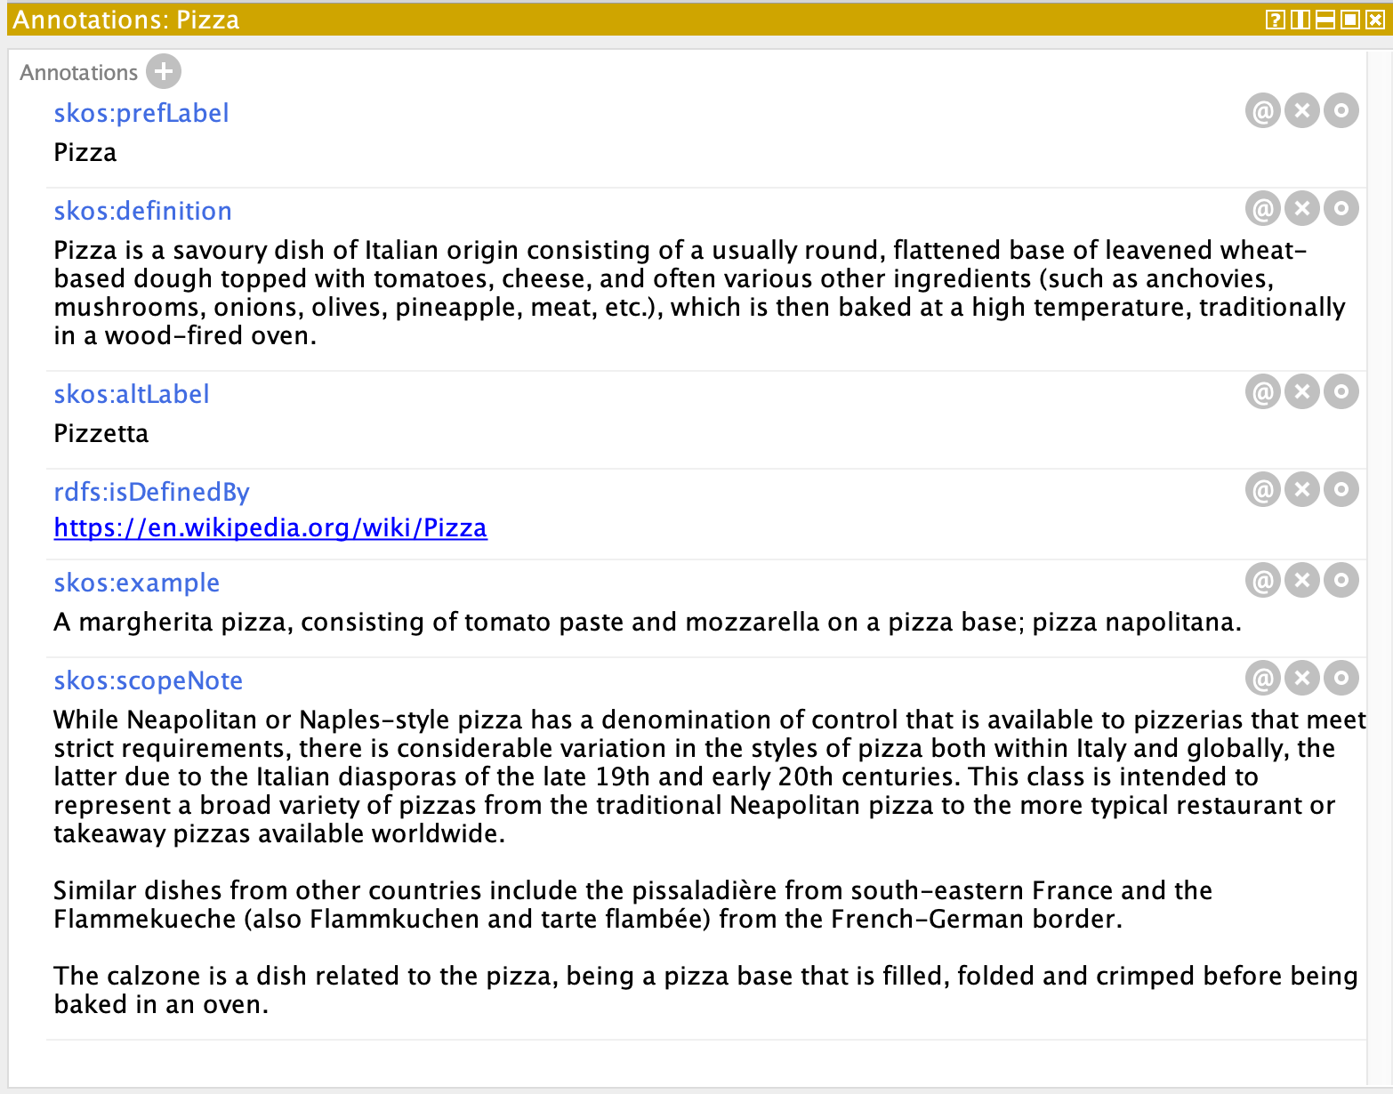

Slide 32
Summary
Ontology construction is an iterative process
Build ontology, try to use it, fix errors, extend, use again, and repeat
There is no single correct model for your domain
The same domain may be modelled in several ways
Following best practices helps to build good ontologies
Well scoped, documented, structured
Reuse existing ontologies if possible
Check your database models and existing ontologies
Reuse or learn from existing representations
(most ontology editing tools don’t yet provide good support for reuse)

Slide 33
Common Pitfalls
Over scaling and complicating your ontology
Need to learn when to stop expanding the ontology
Lack of documentation
For the design rationale, vocabulary and structure decisions, intended use, etc.
Redundancy
Increase chances of inconsistencies and maintenance cost
Using ambiguous terminology
Others might misinterpret your ontology
Mapping to other ontologies will be more difficult

Slide 34
Next Lecture: Ontology Design Patterns

