Slide 2
RDF Schema and Description Logics
COMP6256 Knowledge Graphs for AI Systems
Dr Nicholas Gibbins – nmg@ecs.soton.ac.uk

Slide 3
Using RDF to define RDFS
RDFS is a simple ontology language for use with RDF
RDFS is an RDF vocabulary which contains:
Classes for defining classes and properties
Properties for defining basic characteristics of classes and properties
  Global property domains and ranges
Some ancillary properties
  Defined by, see also

Slide 4
Notes on RDF and RDFS namespaces
Most terms in RDF Schema are defined as part of the RDFS namespace
http://www.w3.org/2000/01/rdf-schema# , abbreviated here as rdfs:
Two terms are defined as part of the RDF namespace: rdf:type and rdf:Property
http://www.w3.org/1999/02/22-rdf-syntax-ns# , abbreviated as rdf:
This is a historical accident, but can trip up the unwary
Be careful when using these terms in SPARQL queries!

Slide 5
RDF Schema class definitions
We wish to define the class Person:
ex:Person
rdf:type
rdfs:Class
ex:Person rdf:type rdfs:Class .

Slide 6
RDF Schema class definitions
Employee is a subclass of Person
ex:Person
rdfs:subClassOf
ex:Employee
rdf:type
rdfs:Class
ex:Employee rdf:type rdfs:Class ;
rdfs:subClassOf ex:Person .

Slide 7
RDF Schema class semantics
rdfs:subClassOf is transitive:
  (A rdfs:subClassOf B) and (B rdfs:subClassOf C) implies (A rdfs:subClassOf C)
ex:Person
rdfs:subClassOf
ex:Employee
rdfs:subClassOf
rdfs:subClassOf
Ex:PartTime Employee

Slide 8
RDF Schema class semantics
rdfs:subClassOf is reflexive
  All classes are subclasses of themselves
ex:Person
rdfs:subClassOf

Slide 9
RDF Schema class semantics
rdf:type distributes over rdf:subClassOf:
  (A rdfs:subClassOf B) and (C rdf:type A) implies (C rdf:type B)
ex:Person
rdf:type
rdfs:subClassOf
ex:Employee
rdf:type
John Smith

Slide 10
RDF Schema property definitions
We wish to define the property worksFor:
ex:WorksFor
rdf:type
rdf:Property
ex:WorksFor rdf:type rdf:Property .

Slide 11
RDF Schema property definitions
Important difference between RDF and object-oriented programming languages
  OO languages define classes in terms of the properties they have
  RDF defines properties in terms of the classes whose instances they relate to each other
The domain of a property is the class that the property runs from
The range of a property is the class that a property runs to

Slide 12
RDF Schema property definitions
The property worksFor relates objects of class Employee to objects of class Company
ex:Company
rdfs:range
ex:worksFor
rdf:type
rdf:Property
ex:Employee
rdfs:domain
ex:worksFor rdf:type rdf:Property ;
rdfs:domain ex:Employee ;
rdfs:range ex:Company .

Slide 13
RDF Schema property definitions
Specialisation exists in properties as well as classes
  worksFor is a subproperty of affiliatedTo
ex:affiliatedTo
rdfs:subPropertyOf
ex:worksFor
rdf:type
rdf:Property
ex:worksFor rdf:type rdf:Property ;
rdfs:subPropertyOf ex:affiliatedTo

Slide 14
RDF Schema property semantics
rdfs:subPropertyOf is transitive and reflexive
  Entailment of superproperties
ex:affiliatedTo
rdfs:subPropertyOf
John Smith
Example Inc.
ex:worksFor

Slide 15
RDF Schema property semantics
Type entailments from range and domain constraints
ex:Employee
ex:Company
rdfs:range
rdf:type
rdfs:domain
rdf:type
John Smith
Example Inc.
ex:worksFor

Slide 16
RDF Schema predefined classes
rdfs:Class
rdf:Property
rdfs:Resource
rdfs:Literal
rdfs:Datatype
rdf:XMLLiteral
rdfs:Resource
rdfs:subClassOf
rdfs:subClassOf
rdfs:subClassOf
rdfs:Class
rdfs:Literal
rdf:Property
rdfs:subClassOf
rdfs:subClassOf
rdfs:subClassOf
rdfs:Datatype
xsd:String
rdf:XMLLiteral
xsd:integer
rdf:type

Slide 17
RDF Schema ancillary features
rdfs:label is used to give a human-readable name for a resource
<#person-01269> rdfs:label “John Smith” .
rdfs:comment is used to give a human-readable description for a resource
<#Employee> rdfs:comment “A person who works.” .
rdfs:seeAlso is used to indicate a resource which can be retrieved to give more information about something
rdfs:isDefinedBy indicates a resource which is responsible for the definition of something (a subproperty of rdfs:seeAlso)

Slide 18
Description Logics

Slide 19
Why do we need Description Logics?
RDF Schema isn’t sufficient for all tasks
  There are things you can’t express
  There are things you can’t infer

Slide 20
Description Logics
A family of knowledge representation formalisms
  A subset of first order predicate logic (FOPL)
  Decidable – trade-off of expressivity against algorithmic complexity
  Well understood – derived from work in the mid-80s to early 90s
  Model-theoretic formal semantics
  Simpler syntax than FOPL
Used as the foundation for the web ontology language OWL
This module assumes that you're familiar with FOPL.
If you need a refresher, the following resource is available:
  Johnsonbaugh, R. (2014) Discrete Mathematics, 7th ed. Chapter 1. (ebook via library)
Notes:
KL-ONE – 1985
LOOM – 1987
CLASSIC – 1991

Slide 21
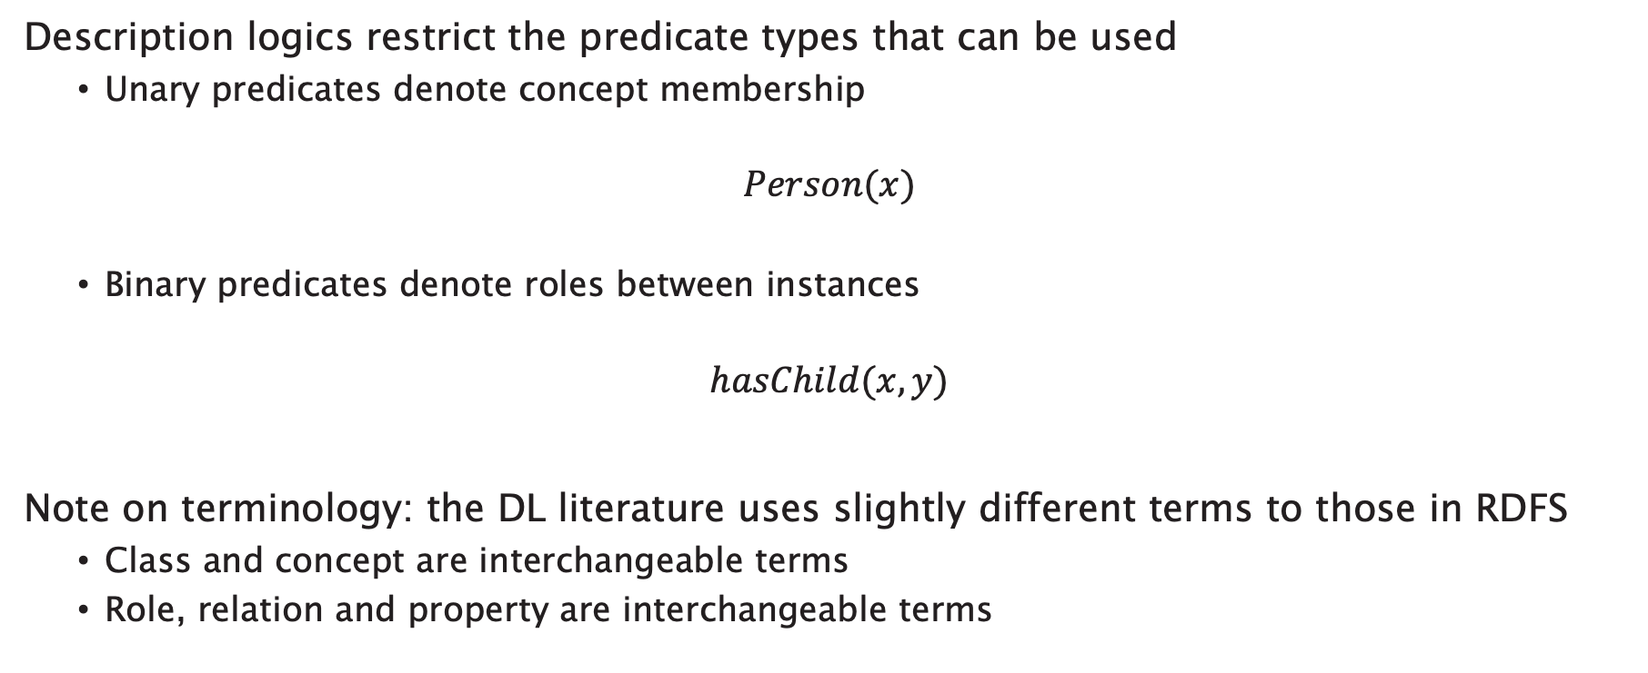
Description Logics
Description logics restrict the predicate types that can be used
  Unary predicates denote concept membership
$$Person(x)$$
  Binary predicates denote roles between instances
$$hasChild(x,y)$$
Note on terminology: the DL literature uses slightly different terms to those in RDFS
  Class and concept are interchangeable terms
  Role, relation and property are interchangeable terms
Notes:
Nomenclature:
Concept = class
Role = property or relation

Slide 22
Defining ontologies with Description Logics
Describe classes (concepts) in terms of their necessary and sufficient conditions
Consider an attribute A of a class C:
Attribute A is a necessary condition for membership of C
  If an object is an instance of C, then it has A
Attribute A is a sufficient condition for membership of C
  If an object has A, then it is an instance of C

Slide 23
Description Logic Reasoning Tasks
Satisfaction
  “Can this class have any instances?"
Subsumption
  "Is every instance of class C necessarily an instance of class D?"
Classification
  "What classes is this object an instance of?"

Slide 24
Concepts as sets
A
B
v
y
x
w
z
R

Slide 25
Syntax

Slide 26
Expressions
Description logic expressions consist of:
Concept and role descriptions:
  Atomic concepts: Person
  Atomic roles: hasChild
  Complex concepts: “person with two living parents”
  Complex roles: “has parent’s brother” (i.e. "has uncle")
Axioms that make statements about how concepts or roles are related to each other:
  “Every person with two living parents is thankful”
  “hasUncle is equivalent to has parent’s brother”

Slide 27
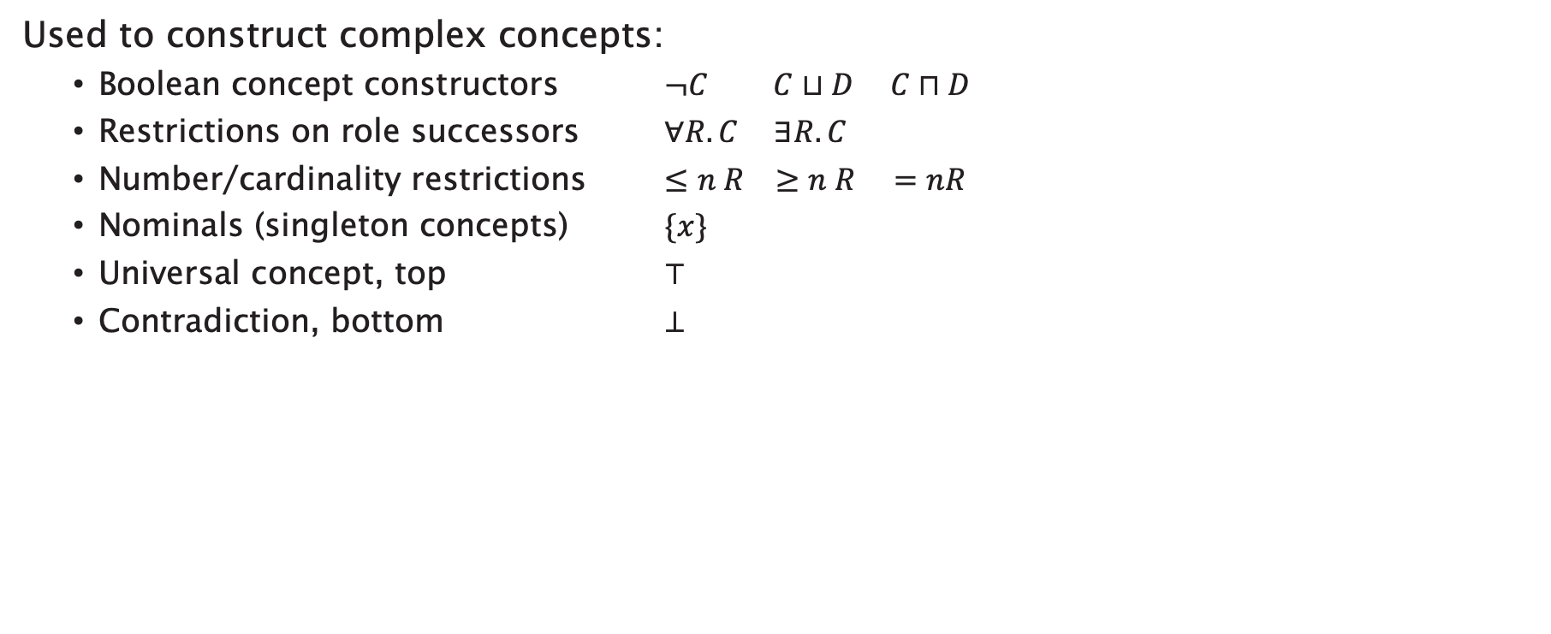
Concept Constructors
Used to construct complex concepts:
  Boolean concept constructors $¬C C⊔D C⊓D$
  Restrictions on role successors $∀R.C ∃R.C$
  Number/cardinality restrictions $≤n R ≥n R =nR$
  Nominals (singleton concepts) $\{x\}$
  Universal concept, top $⊤$
  Contradiction, bottom $⊥$

Slide 28

Role Constructors
Used to construct complex roles:
  Concrete domains (datatypes)
  Inverse roles $R^{−}$
  Role composition $R∘S$
  Transitive roles $R^{+}$

Slide 29
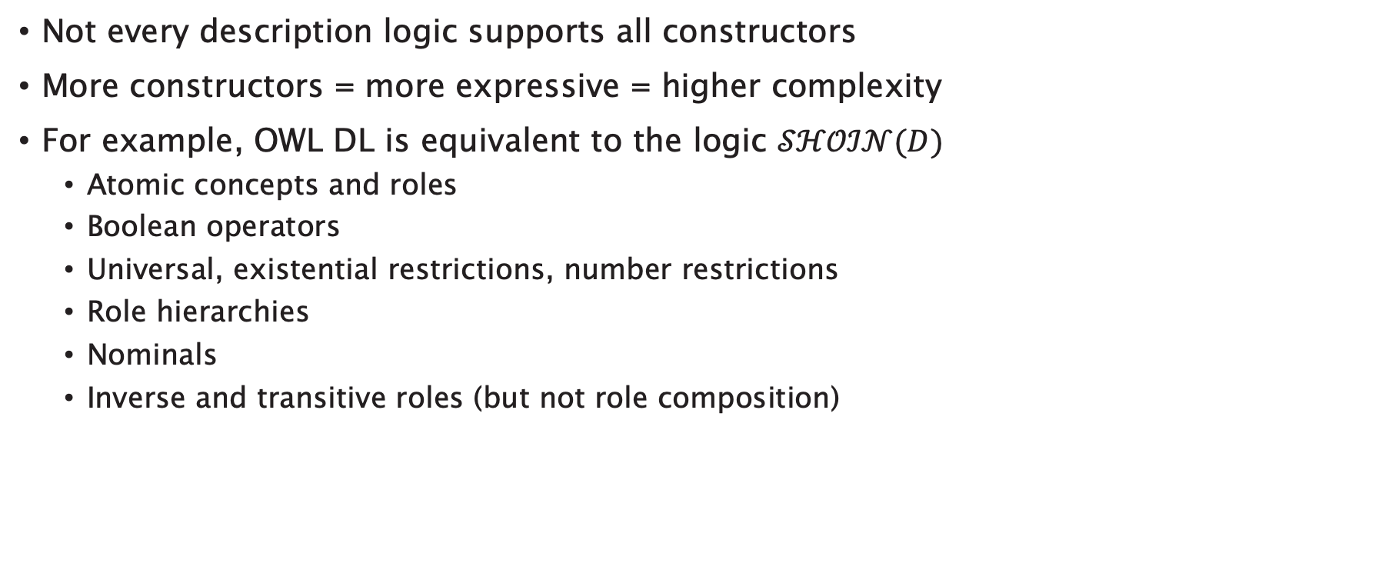
OWL and Description Logics
Not every description logic supports all constructors
More constructors = more expressive = higher complexity
For example, OWL DL is equivalent to the logic $𝒮ℋ𝒪ℐ𝒩(D)$
  Atomic concepts and roles
  Boolean operators
  Universal, existential restrictions, number restrictions
  Role hierarchies
  Nominals
  Inverse and transitive roles (but not role composition)

Slide 30

Boolean Concept Constructors: Intersection
$$Child⊓Happy$$
The class of things which are both
children and happy
Read as “Child AND Happy”
Child
Happy

Slide 31

Boolean Concept Constructors: Union
$$Rich⊔Famous$$
The class of things which are rich or famous
(or both)
Read as “Rich OR Famous”
Rich
Famous

Slide 32

Boolean Concept Constructors: Complement
$$¬Happy$$
The class of things which are not happy
Read as “NOT Happy”
Happy

Slide 33

Restrictions: Existential
$$∃hasPet.Cat$$
The class of things which have some pet that is a cat
  must have at least one pet
Read as “hasPet SOME Cat”
john
Cat
Dog
felix
fluffy
fido
jane
jenny
hasPet

Slide 34
Restrictions: Existential
$$∃hasPet.Cat$$
The class of things which have some pet that is a cat
  must have at least one pet
Read as “hasPet SOME Cat”
john
Cat
Dog
felix
fluffy
fido
jane
jenny
hasPet

Slide 35

Restrictions: Universal
$$∀hasPet. Cat$$
The class of things all of whose pets are cats
  Or, which only have pets that are cats
  includes those things which have no pets
Read as “hasPet ONLY Cat”
john
Cat
Dog
felix
fluffy
fido
jane
jenny
hasPet
Notes:
Note that felix, fluffy and fido are also members of the class, because none of them have pets either!

Slide 36
Restrictions: Universal
$$∀hasPet. Cat$$
The class of things all of whose pets are cats
  Or, which only have pets that are cats
  includes those things which have no pets
Read as “hasPet ONLY Cat”
john
Cat
Dog
felix
fluffy
fido
jane
jenny
hasPet
Notes:
Note that felix, fluffy and fido are also members of the class, because none of them have pets either!

Slide 37
Restrictions: Universal
$$∀hasPet. Cat$$
The class of things all of whose pets are cats
  Or, which only have pets that are cats
  includes those things which have no pets
Read as “hasPet ONLY Cat”
john
Cat
Dog
felix
fluffy
fido
jane
jenny
hasPet
Notes:
Note that felix, fluffy and fido are also members of the class, because none of them have pets either!

Slide 38

Restrictions: Number
$$=1 hasPet$$
The class of things which have exactly one pet
john
Cat
Dog
felix
fluffy
fido
jane
jenny
hasPet

Slide 39
Restrictions: Number
$$=1 hasPet$$
The class of things which have exactly one pet
john
Cat
Dog
felix
fluffy
fido
jane
jenny
hasPet

Slide 40

Restrictions: Number
$$≥2 hasPet$$
The class of things which have at least two pets
john
Cat
Dog
felix
fluffy
fido
jane
jenny
hasPet

Slide 41
Restrictions: Number
$$≥2 hasPet$$
The class of things which have at least two pets
john
Cat
Dog
felix
fluffy
fido
jane
jenny
hasPet

Slide 42
Knowledge Bases
A description logic knowledge base (KB) has two parts:
TBox: terminology
  A set of axioms describing the structure of the domain
  (i.e., a conceptual schema)
  Concepts, roles
ABox: assertions
  A set of axioms describing a concrete situation (data)
  Instances

Slide 43
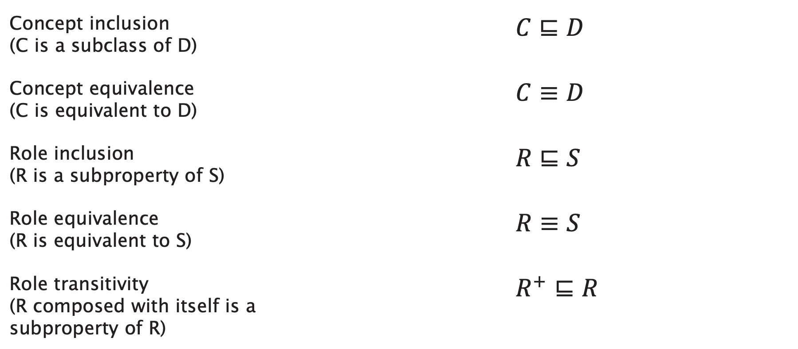
TBox Axioms
Concept inclusion (C is a subclass of D) | $$C⊑D$$
Concept equivalence (C is equivalent to D) | $$C≡D$$
Role inclusion (R is a subproperty of S) | $R⊑S$
Role equivalence (R is equivalent to S) | $R≡S$
Role transitivity (R composed with itself is a subproperty of R) | $$R^{+}⊑R$$

Slide 44
Revisiting Necessary and Sufficient Conditions
“Attribute A is a necessary/sufficient condition for membership of C”
Instead of talking directly about A, we can make a class expression (using the concept constructors) that represents the class of things with attribute A – call it D
  Membership of D is necessary/sufficient for membership of C

Slide 45
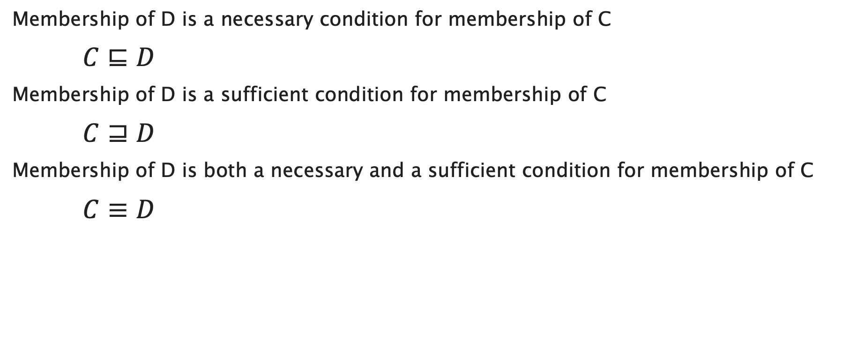
Revisiting Necessary and Sufficient Conditions
Membership of D is a necessary condition for membership of C
$C⊑D$
Membership of D is a sufficient condition for membership of C
$C⊒D$
Membership of D is both a necessary and a sufficient condition for membership of C
$C≡D$

Slide 46

Revisiting Necessary and Sufficient Conditions
Some common terminology:
$$C⊑D$$
  C is a primitive or partial class
$$C≡D$$
  C is a defined class
(you’ll see these terms used in the Protégé OWL Tutorial)

Slide 47

ABox Axioms
Concept instantiation
  $$C(x)$$
  x is of type C
Role instantiation
  $$R(x, y)$$
  x has R of y

Slide 48
Axiom Examples
Every person is either living or dead
Every happy child has a loving parent
Every child who eats only cake is unhealthy
No elephants can fly
A mole is a sauce from Mexico that contains chili
All Englishmen are mad

Slide 49
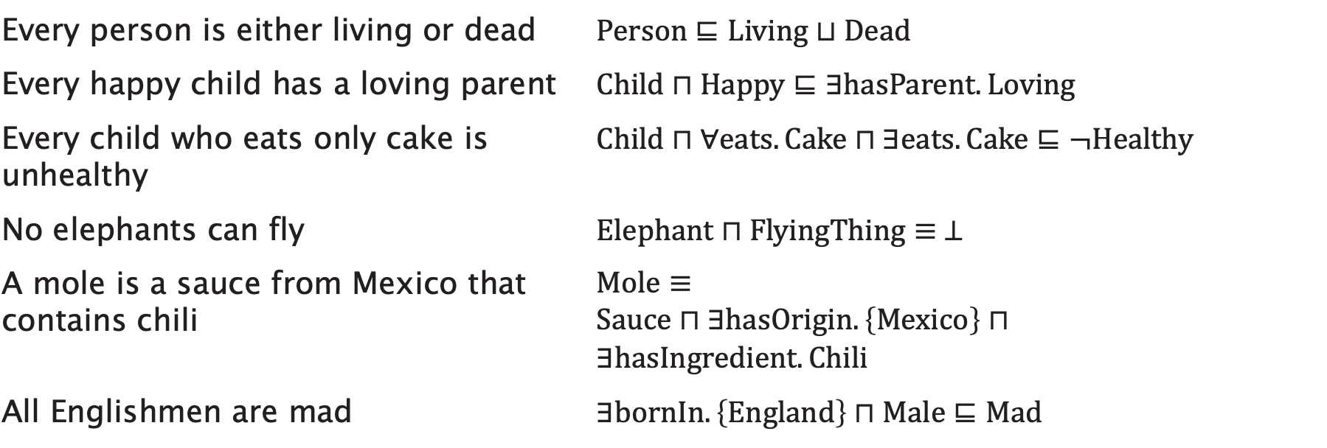
Axiom Examples
Every person is either living or dead | $$Person⊑Living⊔Dead$$
Every happy child has a loving parent | $$Child⊓Happy⊑∃hasParent.Loving$$
Every child who eats only cake is unhealthy | $$Child⊓∀eats.Cake⊓∃eats.Cake⊑¬Healthy$$
No elephants can fly | $$Elephant⊓FlyingThing≡ ⊥$$
A mole is a sauce from Mexico that contains chili | $$Mole≡ \\ Sauce⊓∃hasOrigin.\left\{Mexico\right\}⊓ \\ ∃hasIngredient.Chili$$
All Englishmen are mad | $$∃bornIn.\left\{England\right\}⊓Male⊑Mad$$

Slide 50
Tips for Description Logic Axioms
No single ‘correct’ answer - different modelling choices
Break sentence down into pieces
  e.g. “successful man”, “spicy ingredient” etc
  Look for nouns and adjectives (concepts)
  Look for verb phrases (roles)
Look for indicators of axiom type:
  “Every X is Y” - inclusion axiom
  “X is Y” - equivalence axiom
Remember that ∀R.C is satisfied by instances which have no value for R

Slide 51


Slide 52
Semantics

Slide 53
Description Logics and Predicate Logic
Description Logics are a subset of first order Predicate Logic with a simplified syntax
Every DL expression can be converted into an equivalent FOPL expression

Slide 54
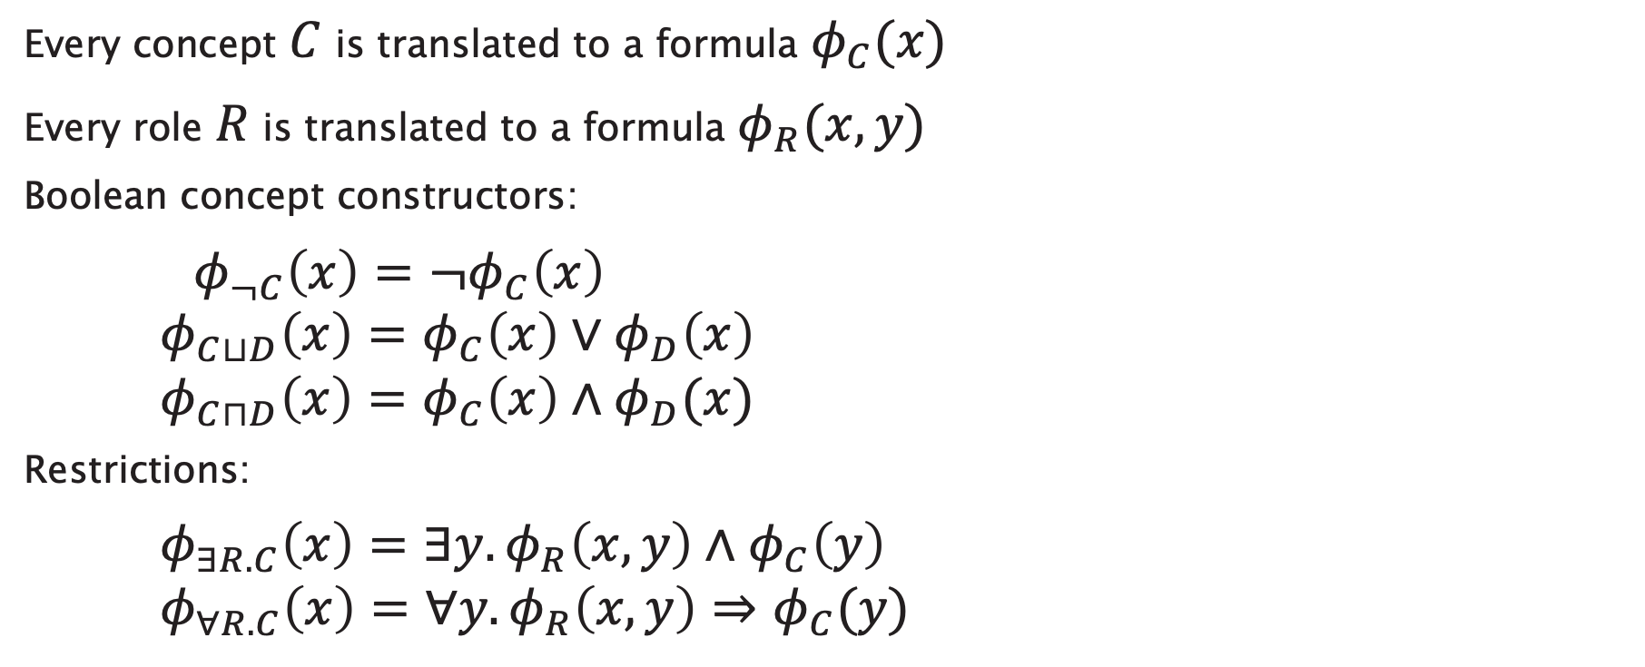
Description Logics and Predicate logic
Every concept $C$ is translated to a formula $φ_{C}(x)$
Every role $R$ is translated to a formula $φ_{R}(x,y)$
Boolean concept constructors:
$φ_{¬C}\left(x\right)=¬φ_{C}\left(x\right)$
$φ_{C⊔D}\left(x\right)=φ_{C}\left(x\right)∨φ_{D}\left(x\right)$
$φ_{C⊓D}\left(x\right)=φ_{C}\left(x\right)∧φ_{D}(x)$
Restrictions:
$φ_{∃R.C}\left(x\right)=∃y.φ_{R}\left(x,y\right)∧φ_{C}\left(y\right)$
$φ_{∀R.C}\left(x\right)=∀y.φ_{R}\left(x,y\right)⇒φ_{C}(y)$

Slide 55

Description Logics and Predicate logic
Axioms are translated as follows:
Concept inclusion $C⊑D$
$∀x.φ_{C}\left(x\right)⇒φ_{D}(x)$
Concept equivalence $C≡D$
$∀x.φ_{C}\left(x\right)⇔φ_{D}(x)$
Notes:
EXAMPLE: Every person is male or female

Slide 56
Example
“Every child who eats cake is happy”

Slide 57

Example
“Every child who eats cake is happy”
$$Child⊓∃eats.Cake⊑Happy$$

Slide 58

Example
“Every child who eats cake is happy”
$$Child⊓∃eats.Cake⊑Happy$$
$$∀x φ_{Child⊓∃eats.Cake}\left(x\right)⇒φ_{Happy}\left(x\right)$$

Slide 59
Example
“Every child who eats cake is happy”
$$Child⊓∃eats.Cake⊑Happy$$
$$∀x φ_{Child⊓∃eats.Cake}\left(x\right)⇒φ_{Happy}\left(x\right)$$

Slide 60
Example
“Every child who eats cake is happy”
$$Child⊓∃eats.Cake⊑Happy$$
$$∀x φ_{Child⊓∃eats.Cake}\left(x\right)⇒φ_{Happy}\left(x\right)$$

Slide 61
Example
“Every child who eats cake is happy”
$$Child⊓∃eats.Cake⊑Happy$$
$$∀x φ_{Child⊓∃eats.Cake}\left(x\right)⇒φ_{Happy}\left(x\right)$$

Slide 62
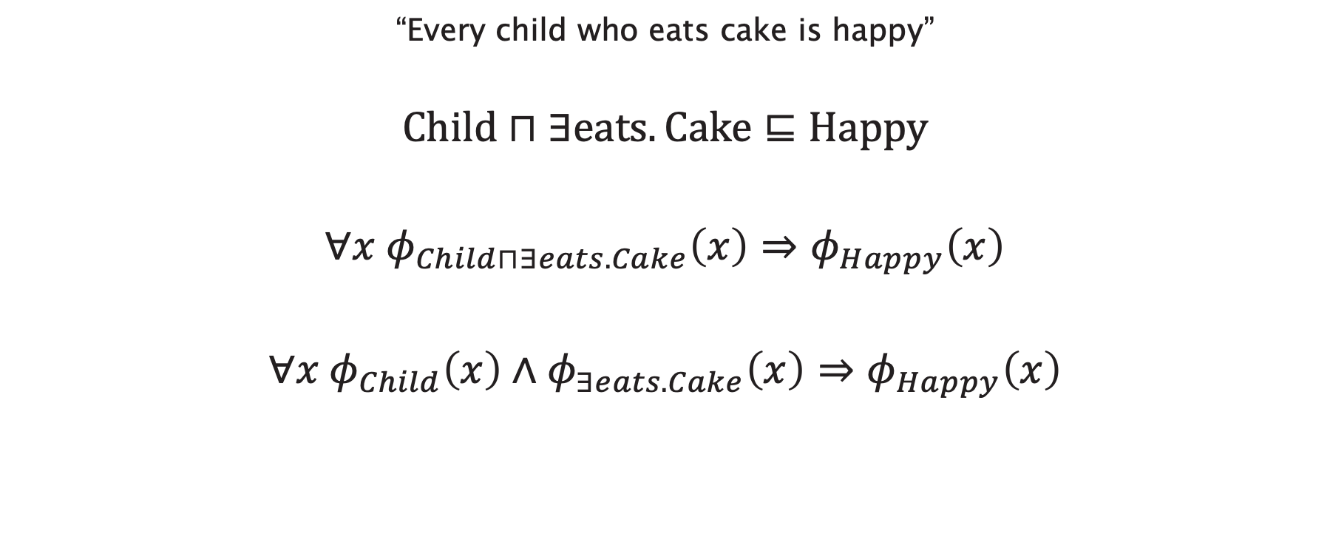
Example
“Every child who eats cake is happy”
$$Child⊓∃eats.Cake⊑Happy$$
$$∀x φ_{Child⊓∃eats.Cake}\left(x\right)⇒φ_{Happy}\left(x\right)$$
$$∀x φ_{Child}\left(x\right)∧φ_{∃eats.Cake}\left(x\right)⇒φ_{Happy}\left(x\right)$$

Slide 63
Example
“Every child who eats cake is happy”
$$Child⊓∃eats.Cake⊑Happy$$
$$∀x φ_{Child⊓∃eats.Cake}\left(x\right)⇒φ_{Happy}\left(x\right)$$
$$∀x φ_{Child}\left(x\right)∧φ_{∃eats.Cake}\left(x\right)⇒φ_{Happy}\left(x\right)$$

Slide 64
Example
“Every child who eats cake is happy”
$$Child⊓∃eats.Cake⊑Happy$$
$$∀x φ_{Child⊓∃eats.Cake}\left(x\right)⇒φ_{Happy}\left(x\right)$$
$$∀x φ_{Child}\left(x\right)∧φ_{∃eats.Cake}\left(x\right)⇒φ_{Happy}\left(x\right)$$

Slide 65
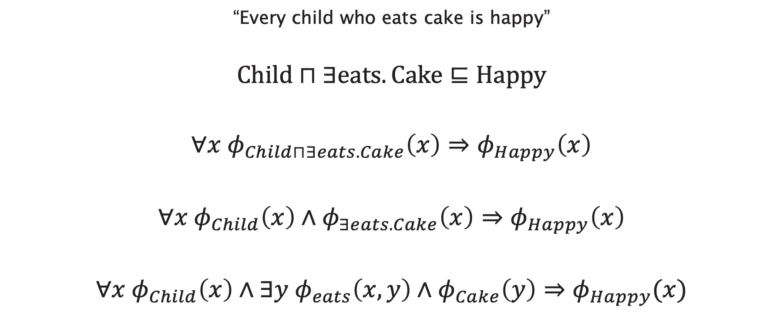
Example
“Every child who eats cake is happy”
$$Child⊓∃eats.Cake⊑Happy$$
$$∀x φ_{Child⊓∃eats.Cake}\left(x\right)⇒φ_{Happy}\left(x\right)$$
$$∀x φ_{Child}\left(x\right)∧φ_{∃eats.Cake}\left(x\right)⇒φ_{Happy}\left(x\right)$$
$$∀x φ_{Child}\left(x\right)∧∃y φ_{eats}\left(x,y\right)∧φ_{Cake}\left(y\right)⇒φ_{Happy}(x)$$

Slide 66
Example
“Every child who eats cake is happy”
$$Child⊓∃eats.Cake⊑Happy$$
$$∀x φ_{Child⊓∃eats.Cake}\left(x\right)⇒φ_{Happy}\left(x\right)$$
$$∀x φ_{Child}\left(x\right)∧φ_{∃eats.Cake}\left(x\right)⇒φ_{Happy}\left(x\right)$$
$$∀x φ_{Child}\left(x\right)∧∃y φ_{eats}\left(x,y\right)∧φ_{Cake}\left(y\right)⇒φ_{Happy}(x)$$

Slide 67
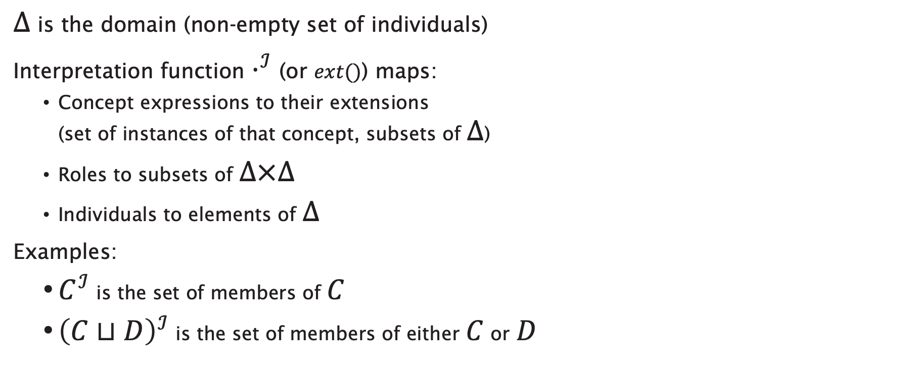
Description Logic Semantics
$Δ$ is the domain (non-empty set of individuals)
Interpretation function $⋅^{ℐ}$ (or $ext()$) maps:
  Concept expressions to their extensions
  (set of instances of that concept, subsets of $Δ$)
  Roles to subsets of $Δ×Δ$
  Individuals to elements of $Δ$
Examples:
  $C^{ℐ}$ is the set of members of $C$
  ${\left(C⊔D\right)}^{ℐ}$ is the set of members of either $C$ or $D$

Slide 68
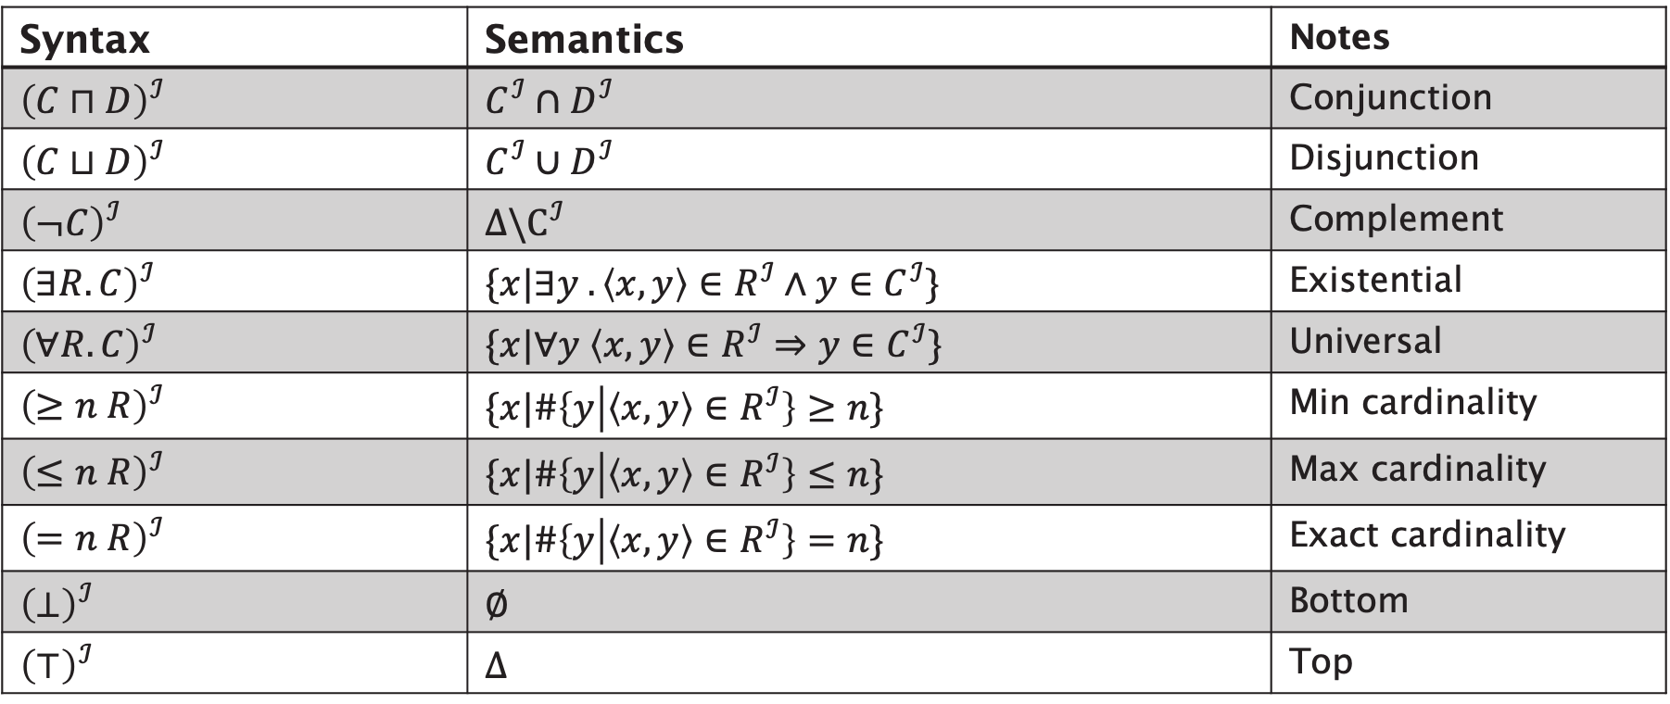
Description Logic Semantics
Syntax | Semantics | Notes
$${\left(C⊓D\right)}^{ℐ}$$ | $$C^{ℐ}∩D^{ℐ}$$ | Conjunction
$${\left(C⊔D\right)}^{ℐ}$$ | $$C^{ℐ}∪D^{ℐ}$$ | Disjunction
$${\left(¬C\right)}^{ℐ}$$ | $$Δ\backslash C^{ℐ}$$ | Complement
$${\left(∃R.C\right)}^{ℐ}$$ | $$\{x|∃y .\left\langle x, y\right\rangle ∈R^{ℐ}∧y∈C^{ℐ}\}$$ | Existential
$${\left(∀R.C\right)}^{ℐ}$$ | $$\{x|∀y \left\langle x, y\right\rangle ∈R^{ℐ}⇒y∈C^{ℐ}\}$$ | Universal
$${\left(≥n R\right)}^{ℐ}$$ | $$\{x|\#\left\{y | \left\langle x, y\right\rangle ∈R^{ℐ}\right\}≥n\}$$ | Min cardinality
$${\left(≤n R\right)}^{ℐ}$$ | $$\{x|\#\left\{y | \left\langle x, y\right\rangle ∈R^{ℐ}\right\}≤n\}$$ | Max cardinality
$${\left(=n R\right)}^{ℐ}$$ | $$\{x|\#\left\{y | \left\langle x, y\right\rangle ∈R^{ℐ}\right\}=n\}$$ | Exact cardinality
$${\left(⊥\right)}^{ℐ}$$ | $$∅$$ | Bottom
$${\left(⊤\right)}^{ℐ}$$ | $$Δ$$ | Top

Slide 69

Interpretation Example
Δ
$Δ=\left\{v, w, x, y, z\right\}$
$$A^{ℐ}=\left\{v, w, x\right\} \\ B^{ℐ}=\left\{x, y\right\} \\ R^{ℐ}=\{\left\langle v,w\right\rangle ,\left\langle v,x\right\rangle ,\left\langle y,x\right\rangle ,\left\langle x,z\right\rangle \}$$
$$A^{ℐ}$$
$$B^{ℐ}$$
v
y
x
w
z
R

Slide 70

Interpretation Example
Δ
$${\left(¬B\right)}^{ℐ}= \\ {\left(A⊔B\right)}^{ℐ}= \\ {\left(¬A⊓B\right)}^{ℐ}= \\ {\left(∃R.B\right)}^{ℐ}= \\ {\left(∀R.B\right)}^{ℐ}= \\ {\left(∃R.\left(∃R.A\right)\right)}^{ℐ}= \\ {\left(∃R.¬\left(A⊓B\right)\right)}^{ℐ} \\ {\left(∃R^{−}.A\right)}^{ℐ}= \\ {\left(R^{+}\right)}^{ℐ}=$$
$$A^{ℐ}$$
$$B^{ℐ}$$
v
y
x
w
z
R

Slide 71

Answers
Δ
$${\left(¬B\right)}^{ℐ}=\{v,w,z\} \\ {\left(A⊔B\right)}^{ℐ}=\{v,w,x,y\} \\ {\left(¬A⊓B\right)}^{ℐ}=\{y\} \\ {\left(∃R.B\right)}^{ℐ}=\{v,y\} \\ {\left(∀R.B\right)}^{ℐ}=\{y,w,z\} \\ {\left(∃R.\left(∃R.A\right)\right)}^{ℐ}=\{\} \\ {\left(∃R.¬\left(A⊓B\right)\right)}^{ℐ}=\left\{v,x\right\} \\ {\left(∃R^{−} .A\right)}^{ℐ}=\left\{w, x, z\right\} \\ {\left(R^{+}\right)}^{ℐ}=\{\left\langle v,w\right\rangle ,\left\langle v,x\right\rangle ,\left\langle v,z\right\rangle , \left\langle y,x\right\rangle , \left\langle y,z\right\rangle ,\left\langle x,z\right\rangle \}$$
$$A^{ℐ}$$
$$B^{ℐ}$$
v
y
x
w
z
R

Slide 72
DL Reasoning Revisited

Slide 73
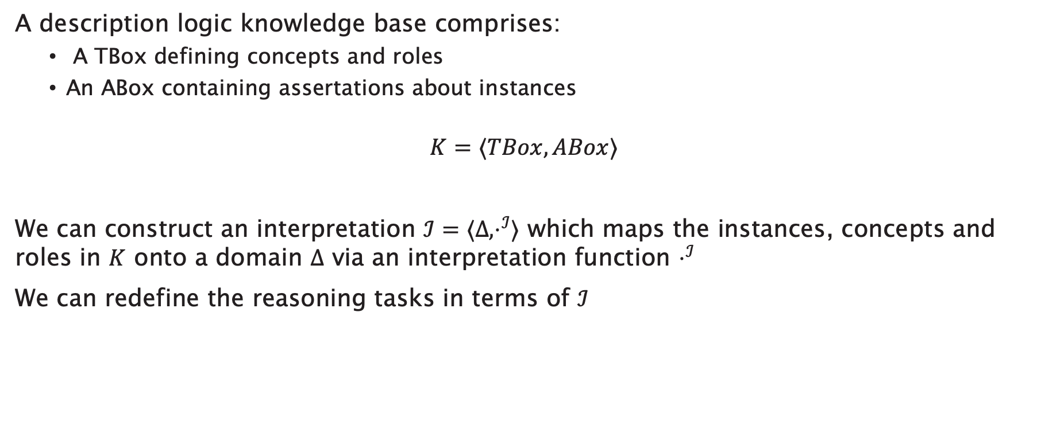
DL Reasoning Revisited
A description logic knowledge base comprises:
  A TBox defining concepts and roles
  An ABox containing assertations about instances
$$K=⟨TBox, ABox⟩$$
We can construct an interpretation $ℐ=⟨Δ,⋅^{ℐ}⟩$ which maps the instances, concepts and roles in $K$ onto a domain $Δ$ via an interpretation function $⋅^{ℐ}$
We can redefine the reasoning tasks in terms of $ℐ$

Slide 74

Satisfaction
“Can this class have any instances?”
A class $C$ is satisfiable with respect to a KB $K$ iff
there exists an interpretation $ℐ$ of $K$ with $C^{ℐ}≠∅$

Slide 75

Subsumption
“Is every instance of this class necessarily an instance of this other class?”
A class $C$ is subsumed by a class $D$ with respect to a KB $K$ iff
for every interpretation $ℐ$ of $K$, $C^{ℐ}⊆D^{ℐ}$

Slide 76

Equivalence
“Is every instance of this class necessarily an instance of this other class, and vice versa?”
A class $C$ is equivalent to a class $D$ with respect to a KB $K$ iff
for every interpretation $ℐ$ of $K$, $C^{ℐ}=D^{ℐ}$

Slide 77

Classification
“Is this individual necessarily an instance of this class?”
An individual $x$ is an instance of class $C$ wrt a KB $K$ iff
for every interpretation $ℐ$ of $K$, $x^{ℐ}∈C^{ℐ}$

Slide 78
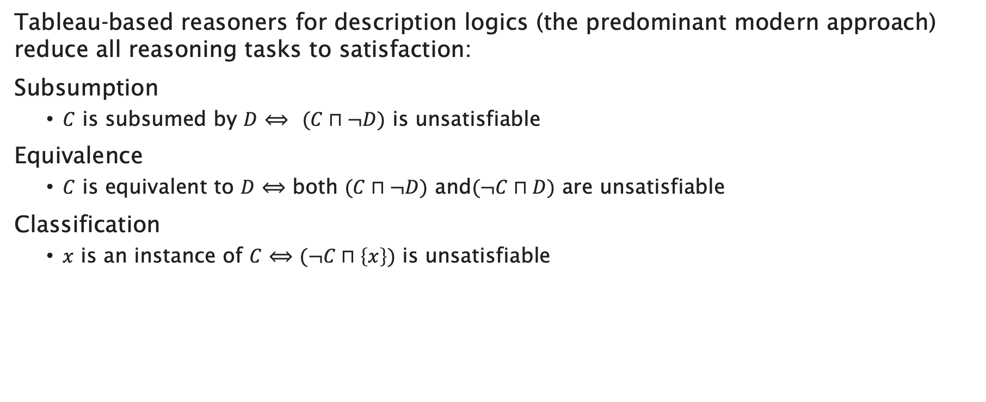
Reduction to Satisfaction
Tableau-based reasoners for description logics (the predominant modern approach) reduce all reasoning tasks to satisfaction:
Subsumption
  $C$ is subsumed by $D$ $⟺$ $(C⊓¬D)$ is unsatisfiable
Equivalence
  $C$ is equivalent to $D$ $⟺$ both $(C⊓¬D)$ and$(¬C⊓D)$ are unsatisfiable
Classification
  $x$ is an instance of $C$ $⟺$ $(¬C⊓\left\{x\right\})$ is unsatisfiable

Slide 79
Further Reading
Daniele Nardi and Ronald J. Brachman (2003) An Introduction to Description Logics, in Franz Baader, Diego Calvanese, Deborah L. McGuinness, Daniele Nardi and Peter F. Patel-Schneider (eds) The Description Logic Handbook: Theory, implementation and applications, Cambridge University Press, 2003, pp.1-40.
F. Baader and W. Nutt (2003) Basic Description Logics, in Franz Baader, Diego Calvanese, Deborah L. McGuinness, Daniele Nardi and Peter F. Patel-Schneider (eds) The Description Logic Handbook: Theory, implementation and applications, Cambridge University Press, 2003, pp.47-100.

Slide 80
Next Lecture: OWL

