Slide 2
COMP6256
Knowledge Graphs for AI Systems
Dr Nicholas Gibbins - nmg@ecs.soton.ac.uk

Slide 3
Course Aims
Understand the key ideas behind knowledge graphs and the Semantic Web
Explain the state of the art in SW and knowledge graph technologies
Gain practical experience of ontology design in OWL
Understand the future directions of the Semantic Web, and its relationship with other Web developments

Slide 4
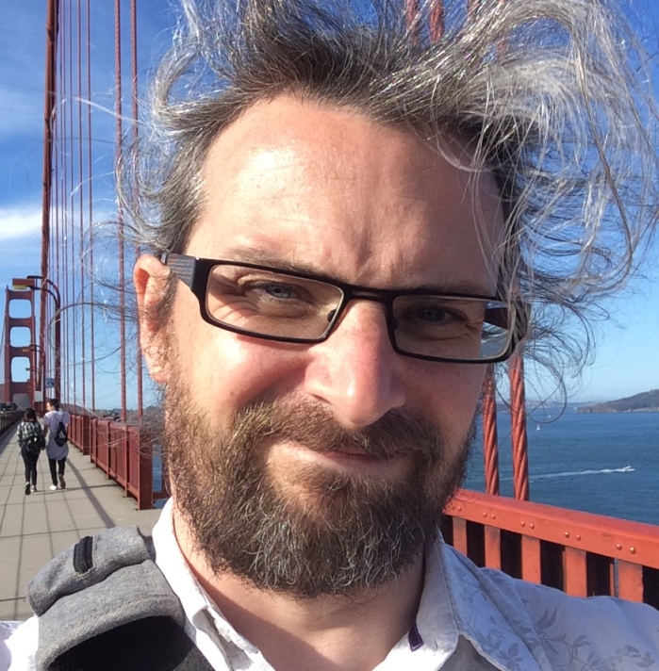
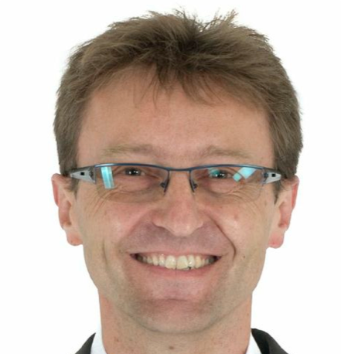
Lecturers
Dr Nicholas Gibbins
nmg@ecs.soton.ac.uk
Prof. Steffen Staab
srs2m14@ecs.soton.ac.uk
Dr Shoaib Jameel
M.S.Jameel@southampton.ac.uk

Slide 5
Course Structure
Three lectures per week:
Monday 11.00 in 54/7035
Wednesday 9.00 in 54/10031
Thursday 11.00 in 13/3019

Slide 6
Teaching Schedule
Week 18: Introduction, RDF and Linked Data (nmg)
Week 19: Linked Data and SPARQL (nmg)
Week 20: Ontologies, RDF Schema, Description Logics (nmg)
Week 21: OWL, Protégé, Ontology Engineering (nmg)
Week 22: Shacl, schema.org (srs)
Week 23: Knowledge graphs and property graphs (nmg/sj)
Week 24: RDF query processing, ontology alignment (srs)
Week 25: Knowledge graph embedding (srs)
EASTER VACATION

Slide 7
Teaching Schedule
Week 30: Rules, OWL2 Reasoning, OWL2 EL (sj)
Week 31: Open/closed world queries, OWL2 RL and Datalog (sj)
Week 32: OWL2 QL, Chase, query rewriting, ontology-based data integration (sj)
Week 33: Review
Topics in italics are currently provisional

Slide 8
Assessment
Examination: 75% (120 minutes, 3 questions from 5)
Ontology design coursework: 25%
Detailed specification published in week 21
Submission due week 30
Feedback due week 33

Slide 9
Industrial Action
There are 18 days of industrial action scheduled between now and Easter:
  Week 18: 1 Feb
  Week 19: 9 Feb, 10 Feb
  Week 20: 14 Feb, 15 Feb, 16 Feb
  Week 21: 21 Feb, 22 Feb, 23 Feb
  Week 22: 27 Feb, 28 Feb, 1 Mar, 2 Mar
  Week 24: 16 Mar, 17 Mar
  Week 25: 20 Mar, 21 Mar, 22 Mar
There are COMP6256 lectures scheduled on the highlighted dates
These lectures may not take place

Slide 10
Introduction to the Semantic Web
Notes:
The World Wide Web was invented by Tim Berners-Lee (amongst others), a physicist working at CERN
TBL’s original vision of the Web was much more ambitious than the reality of the existing (syntactic) Web
TBL (and others) have since been working towards realising this vision, which has become known as the Semantic Web

Slide 11
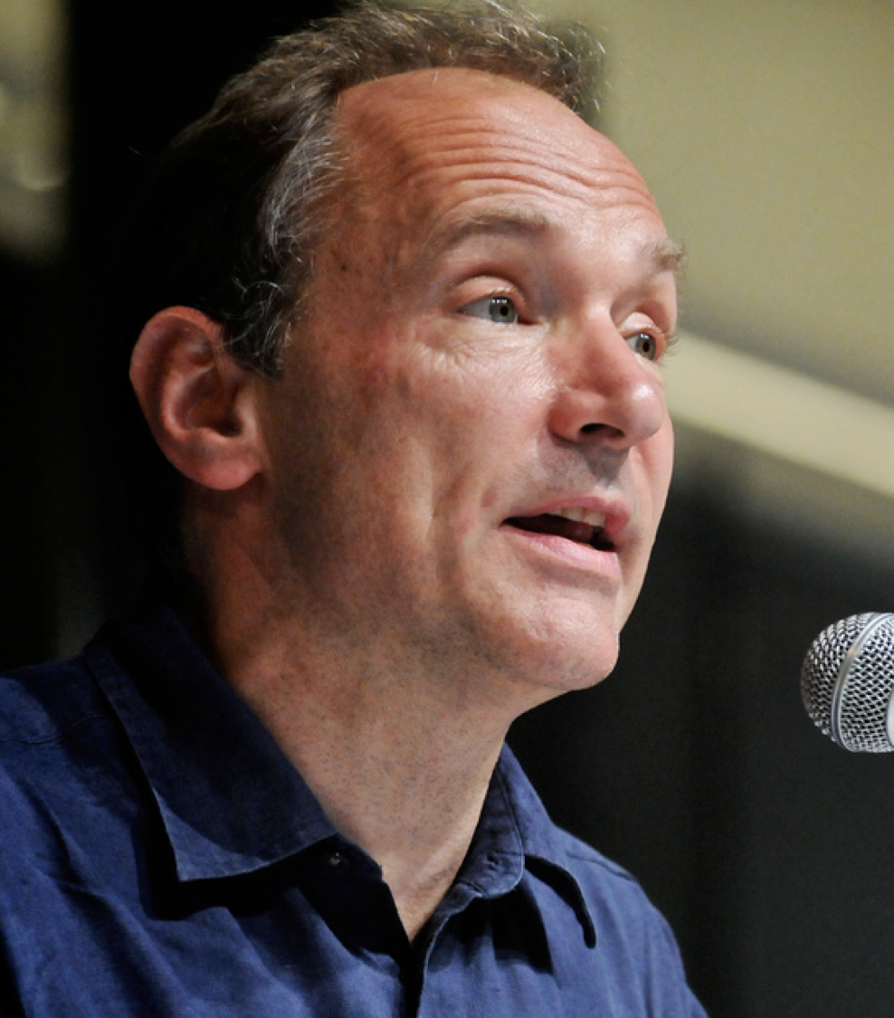
The World Wide Web:
Past, Present and Future
a goal of the Web was that, if the interaction between person and hypertext could be so intuitive that the machine-readable information space gave an accurate representation of the state of people's thoughts, interactions, and work patterns, then machine analysis could become a very powerful management tool, seeing patterns in our work and facilitating our working together
Berners-Lee, T. (1996) The World Wide Web: Past, Present and Future. https://www.w3.org/People/Berners-Lee/1996/ppf.html

Slide 12
Weaving the Semantic Web
I have a dream for the Web [in which computers] become capable of analyzing all the data on the Web – the content, links, and transactions between people and computers. A ‘Semantic Web’, which should make this possible, has yet to emerge, but when it does, the day-to-day mechanisms of trade, bureaucracy and our daily lives will be handled by machines talking to machines.
T. Berners-Lee (1999) Weaving the Web. San Francisco, CA: Harper

Slide 13

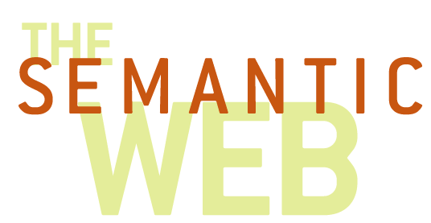
What is the Semantic Web?
“The goal of the Semantic Web initiative is as broad as that of the Web: to create a universal medium for the exchange of data. It is envisaged to smoothly interconnect personal information management, enterprise application integration, and the global sharing of commercial, scientific and cultural data. Facilities to put machine-understandable data on the Web are quickly becoming a high priority for many organizations, individuals and communities.
The Web can reach its full potential only if it becomes a place where data can be shared and processed by automated tools as well as by people.”
W3C (2013) Semantic Web Activity Statement. https://www.w3.org/2001/sw/Activity

Slide 14
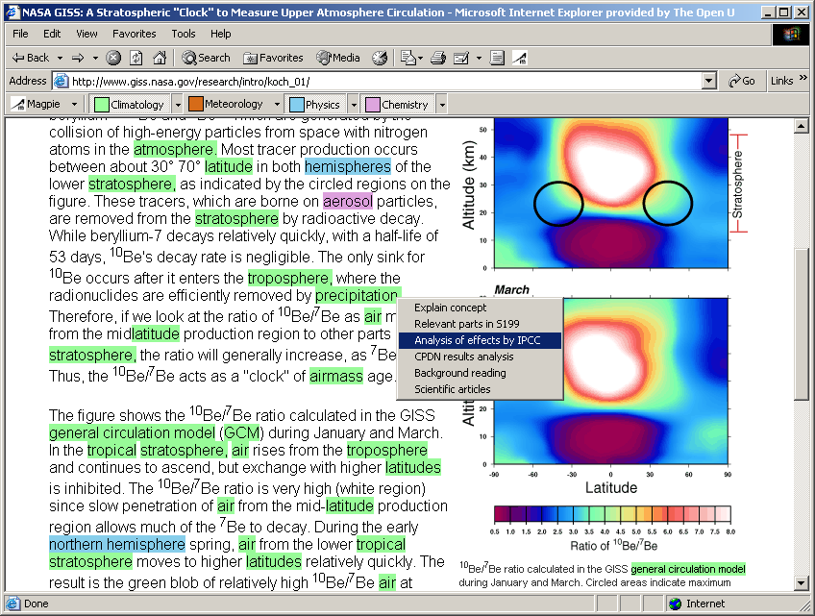
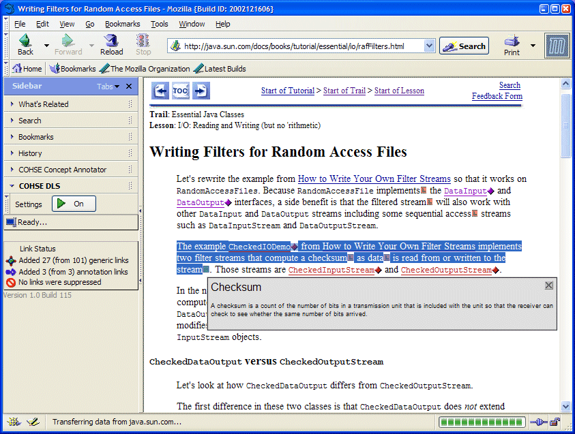
The Annotated Web
Add structure to unstructured data
  Annotate existing web pages
  Classify web pages
  Use natural language techniques to extract information from web pages
Annotations enable enhanced browsing and searching

Slide 15
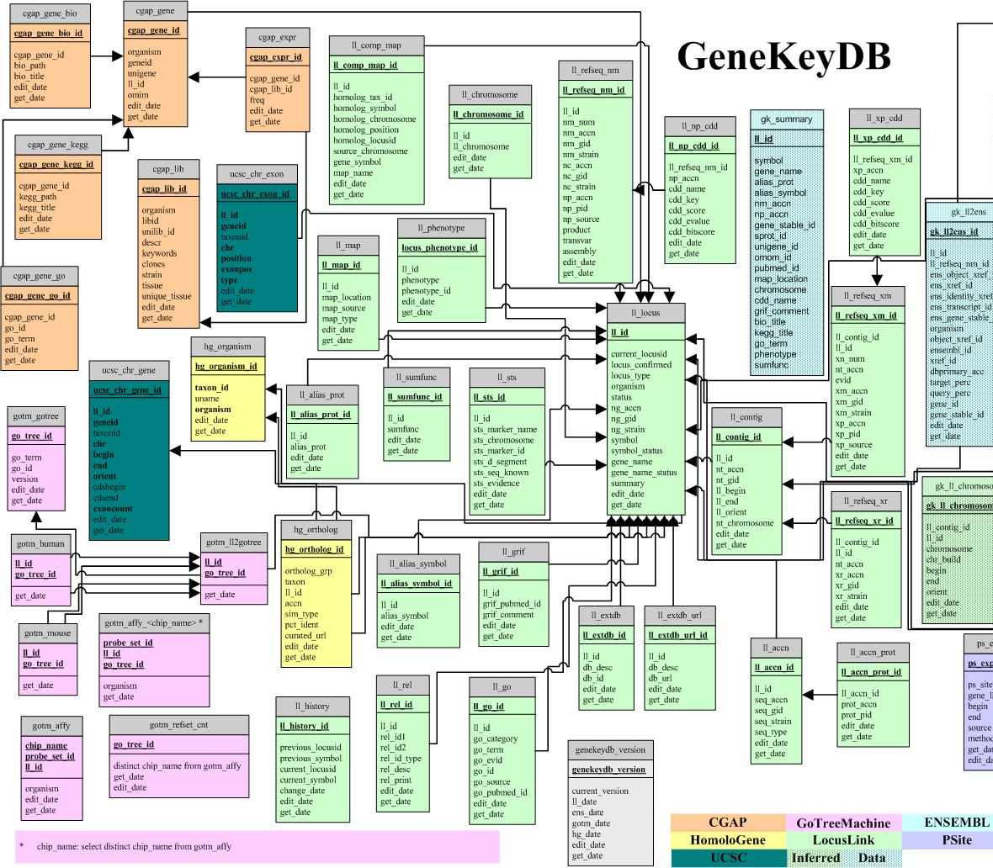
The Web of (Linked) Data
Make the most of the structure you already have
  Expose existing databases in a common format
  Express database schemas in a machine-understandable form
Common format allows the integration of data in unexpected ways
Machine-understandable schemas allow reasoning about data

Slide 16
Rocket Science (not)
Is this rocket science? Well, not really. The Semantic Web, like the World Wide Web, is just taking well established ideas, and making them work interoperably over the Internet. This is done with standards, which is what the World Wide Web Consortium is all about. We are not inventing relational models for data, or query systems or rule-based systems. We are just webizing them.
Berners-Lee, T. (2001) Business Model for the Semantic Web, http://www.w3.org/DesignIssues/Business

Slide 17
Basic Concepts

Slide 18
The World Wide Web vs. the Semantic Web
The World Wide Web is the Web for people
  Information is predominantly textual
  Technologies include URI, HTTP, XML, HTML
The Semantic Web is the Web for machines
  Information needs to be structured
  Technologies include RDF, RDFS, OWL
  (in addition to those for the Web)

Slide 19
Machine readable vs. machine understandable
On the World Wide Web, information needs humans to give it interpretation
  Information is predominantly natural language
  Difficult to mediate by software agents
On the Semantic Web, information is structured so that it can be interpreted by machines
  Humans need not interact directly with Semantic Web information – mediation through agents
Formal meaning is critical to understanding

Slide 20
Machine readable vs. machine understandable
XML is a machine readable format:
It can be parsed to give an unambiguous document structure
but
It has no formal meaning
Meanings of XML interchange formats must be explicitly agreed

Slide 21
Machine readable: XML
<foo bar=“2003386947”>
<baz qux=“19J”>502-224</baz>
<quux>2</quux>
<quuux>3998SB</quuux>
</foo>
foo
bar=2003386947
baz
quux
quuux
quz=19J
502-224
2
3998SB

Slide 22
Machine readable: XML
<order ref=“2003386947”>
<part catalogue=“19J”>502-224</part>
<quantity>2</quantity>
<customer>3998SB</customer>
</order>
order
ref=2003386947
part
quantity
customer
catalogue=19J
502-224
2
3998SB

Slide 23
Machine readable vs. machine understandable
RDF is a machine understandable format
The structures generated by an RDF parser have a formal meaning
RDF is a framework for interchange formats that provides a base level of common understanding
RDF provides basic notions of classes and properties
RDF enables simple inference (certain types of deduction may be made from existing knowledge)

Slide 24
Semantic Web Technical Architecture

Slide 25
The Semantic Web layer cake
User Interface and Applications
Trust
Attribution
Proof
Explanation
SPARQL
(queries)
OWL
Rules
Ontologies +
Inference
Signature
Encryption
RDF Schema
RDF
Metadata
XML + Namespaces
Standard syntax
URI
Unicode
Identity

Slide 26
Resource Description Framework
Underlying model of triples used to describe the relations between entities
  Subject-Predicate-Object (compare Entity-Attribute-Value)
  Predicates are analogous to link types
RDF Semantics
edited by
Pat Hayes
subject
predicate
object
Notes:
Network knowledge representation
Labelled, directed graph
Entities as nodes, relations as edges

Slide 27
Example
Take a citation:
  Tim Berners-Lee, James Hendler and Ora Lassila. The Semantic Web. Scientific American, May 2001
We can identify a number of distinct statements in this citation:
  There is an article titled “The Semantic Web”
  One of its authors is a person named “Tim Berners-Lee” (etc)
  It appeared in a publication titled “Scientific American”
  It was published in May 2001

Slide 28
Example
We can represent these statements graphically:
date
2001-05
The Semantic Web
Tim Berners-Lee
creator
name
title
James Hendler
creator
name
publishedIn
Ora Lassila
creator
name
Scientific American
title

Slide 29
Example
There are two types of node in this graph:
Literals, which have a value but no identity
(a string, a number, a date)
Resources, which represent objects with identity
(a web page, a person, a journal)
Scientific American

Slide 30
Example
Resources are identified by URIs
Properties are resources that are used as predicates
Collection of properties constitutes a vocabulary (or ontology)
http://purl.org/dc/elements/1.1/title
http://www.scientificamericancom/
Scientific American
subject
predicate
object

Slide 31
Resource Description Framework
RDF is a framework for representing information about resources
Triple-based data model (abstract syntax)
Uses URIs to identify resources and relations
Model-theoretic semantics
Various serialisation formats (RDF/XML, Turtle, JSON-LD, RDFa, etc)

Slide 32
RDF Vocabulary Description Language
RDF lets us make assertions about resources using a given vocabulary
RDF does not let us define these domain vocabularies by itself
RDF Schema is an RDF vocabulary which we can use to define other vocabularies
Define classes of objects and their relationship with other classes
Define properties that relate objects together and their characteristics

Slide 33
Mixing Vocabularies
date
2001-05
The Semantic Web
Tim Berners-Lee
creator
name
title
James Hendler
creator
name
publishedIn
Ora Lassila
creator
name
foaf
Scientific American
title
dc
bibo
Notes:
The triple-based graph model makes it possible to mix terms from different vocabularies in the same graph

Slide 34
OWL Web Ontology Language
RDF Schema is not expressive enough for many applications
Only supports explicit class/property hierarchies
Only supports global range and domain constraints
OWL provides more expressive features:
Property restrictions (local range/cardinality/value constraints)
Equivalence and identity relations
Property characteristics (transitive/symmetric/functional)
Complex classes (set operators, enumerated classes, disjoint classes)

Slide 35
SPARQL
The SPARQL Protocol and RDF Query Language
Expressive SQL-like language for querying RDF systems
HTTP-based RESTful protocol

Slide 36
Next Lecture:
Vocabularies and Applications

