Slide 2
Open Access: The Web and Scientific Knowledge
COMP3227 Web Architecture & Hypertext Technologies
Dr Heather Packer – hp3@ecs.soton.ac.uk

Slide 3
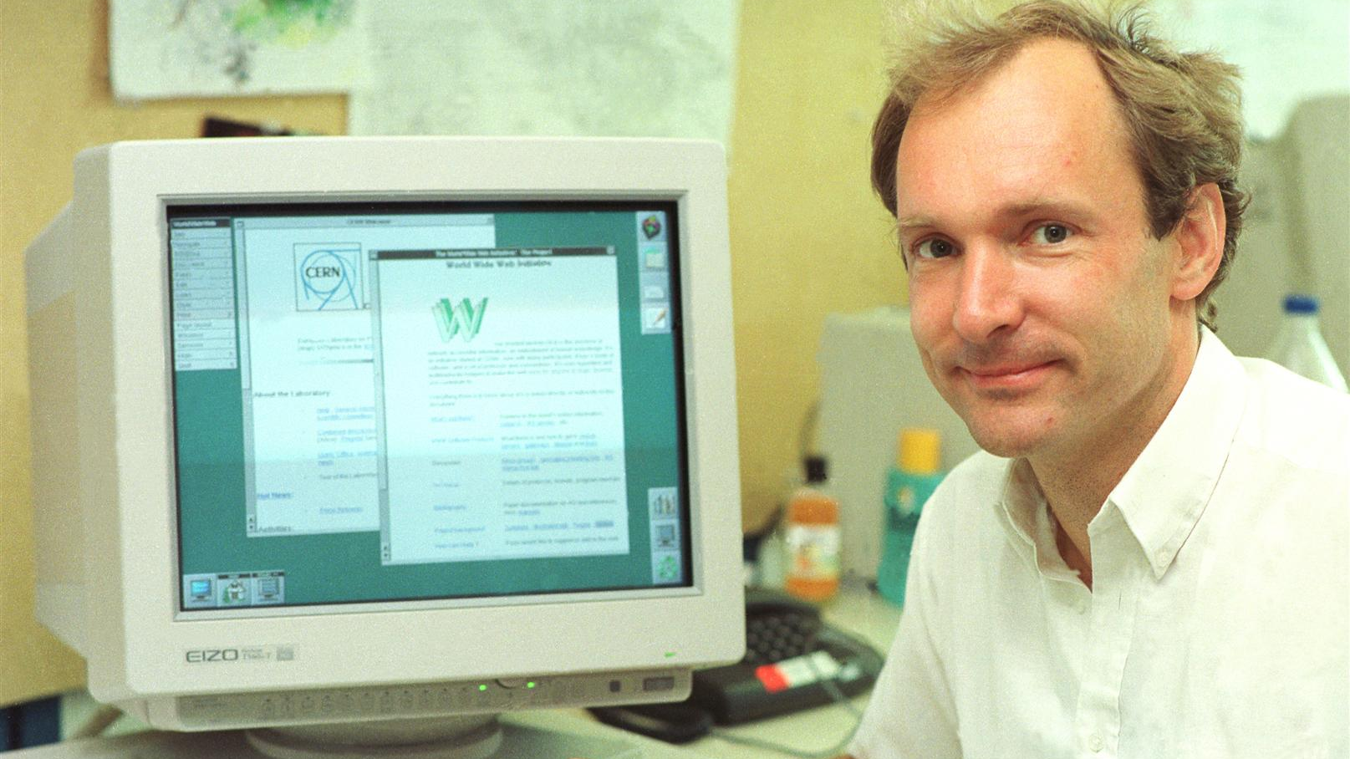
The Original Web Challenge? “In those days, there was different information on different computers, but you had to log on to different computers to get at it. Also, sometimes you had to learn a different program on each computer. Often it was just easier to go and ask people when they were having coffee…” Sir Tim Burners-Lee

Slide 4
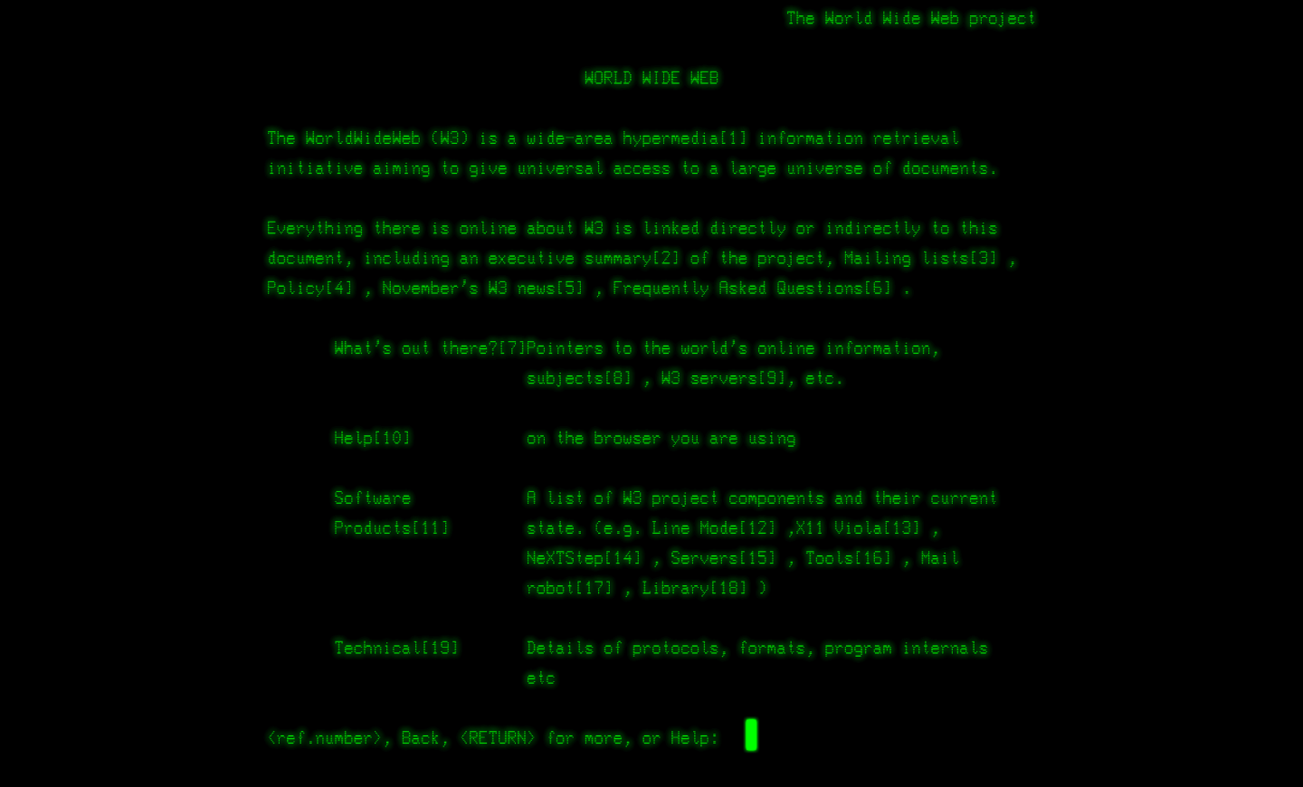

Slide 5
Open Access: Tim’s Problem
Publishers owned the academic publications
Authors writes article
Author signs over copyright to publishing company
Publishing company publishes article
Publishing company payment from university libraries
Author receives academic credit
Publication glory
Citations
Universities created a whole new industry and students read and write paid for by external company
Universities and researchers are knowledge producers and knowledge consumers
researchers
publishers
read
write

Slide 6
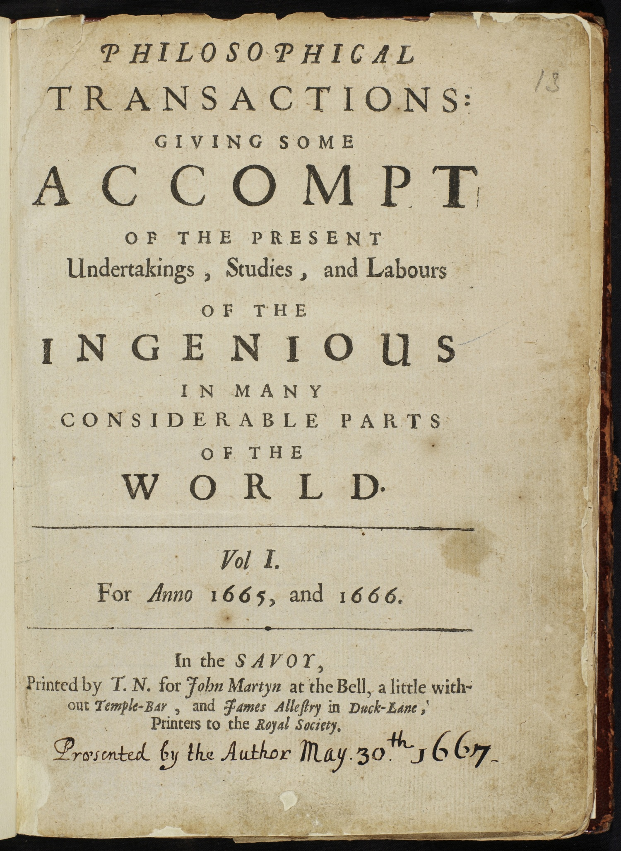
Scholarly Publishing 1665-1960
Scientific and scholarly societies publish their own journals
First scientific journal March 1665
The Royal Society publishes “Philosophical Transactions”
University Presses not for profit but were for prestige
For the benefit of their members, for the benefit of science

Slide 7
Private Sector
After the war 1948 Robert Maxwell decided to publish scientific journals and set up Pergamon Press which was quickly and hugely profitable
Bringing “aggressive publishing in science”
In 1960’s Universities were expanding
UK Robbins Report/expansion of higher education & science budget
In 1968/9 STM Association founded for publishers
The new demand made for a very profitable system – with an increasing number of commercial publishers moving into STM
STM - The International Association of Scientific, Technical and Medical Publishers

Slide 8
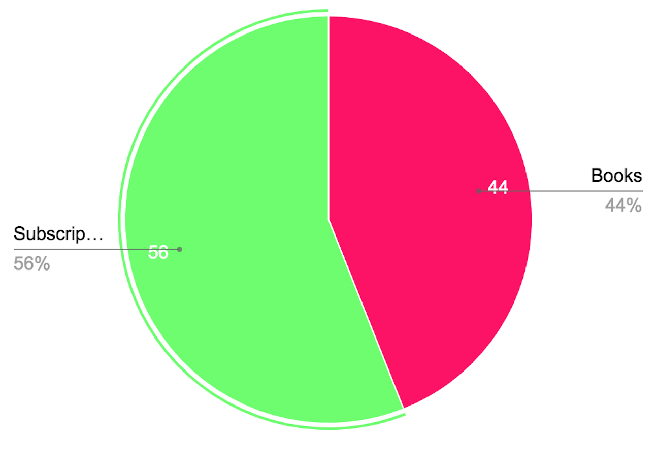
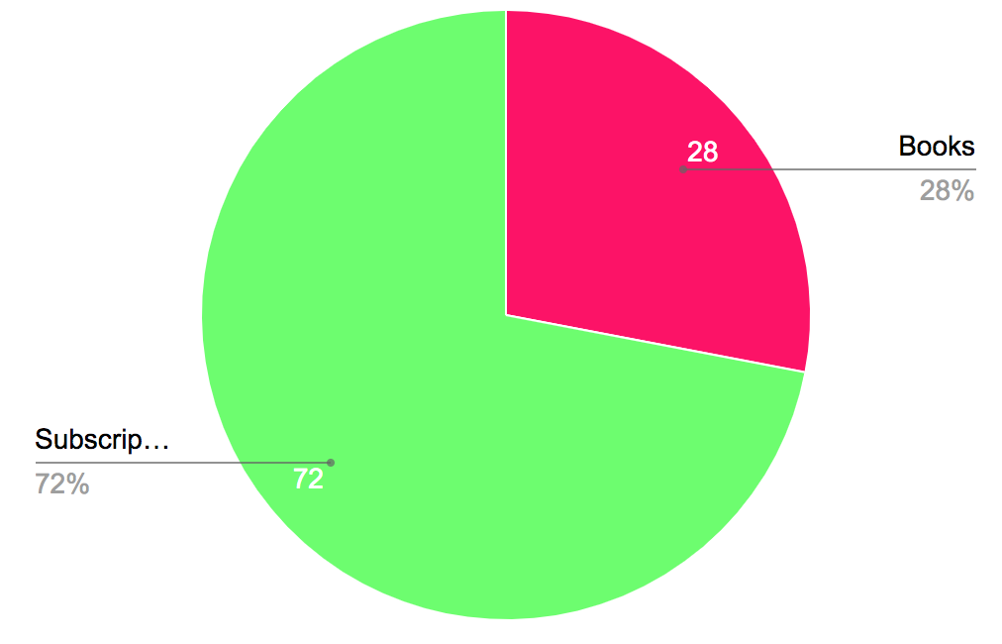
The Serial Crisis
Subscription prices continued to rise
Some research fields were more affected than others
Association of Research Libraries
investigated budgets
In 2002 the Modern Language
Association hoped that electronic
publishing would solve the crisis
2009-2010 saw 70% budget cuts
1986
1998

Slide 9
Publications
Year | Not OA | OA
2009 | 807,672 | 361,932
2010 | 824,427 | 389,100
2011 | 876,706 | 445,341
2012 | 917,504 | 503,875
2013 | 971,428 | 569,939
2014 | 1,010,275 | 625,503
2015 | 1,017,187 | 677,841
2016 | 1,044,540 | 731,812
2017 | 1,086,564 | 736,656
2018 | 1,208,464 | 684,636
Data, gathered through the analysis of Scopus data and Unpaywall data

Slide 10
The Problem with Paywalls
Restricts access to research papers
Prevents research being used
Prevents research from being built upon

Slide 11
The Twin Peaks Problem
≈24,000 journals with 2,500,000 article/yr
Pay wall for access
Limited access based on universities budgets
Well funded universities can only afford a fraction of subscriptions
Less well funded universities can afford even fewer subscriptions
≈£10,000 per year for access to some journals, and prices increasing
Universities are measured by their impact
Fewer readers means less impact (fewer citations)

Slide 12
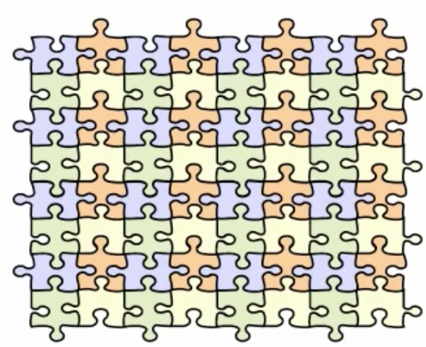
The Literature: As We Imagine
Integrated
Citations
Readily available
Standing on the shoulders of giants
“we see more and farther than our predecessors, not because we have keener vision or greater height, but because we are lifted up and borne aloft on their gigantic stature”

Slide 13
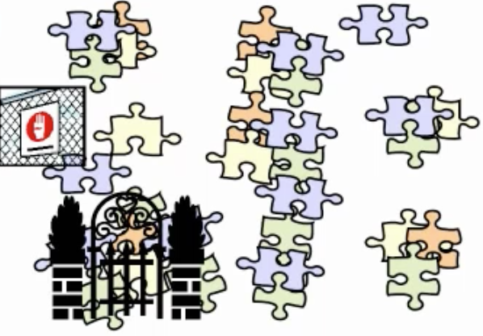
The Literature: As It Is
Inaccessible
Hidden behind pay walls
Not subscribed too
Disjoint
Books
Online journals
Scientific magazines

Slide 14
Open Access

Slide 15
Open Access (OA)
Open Access to Scientific and Scholarly Research Literature
OA is movement for organising and disseminating the worlds research knowledge through Web technology
Free of cost
Other access barriers
Focuses on Peer Reviewed Literature
Open access logo, designed by Public Library of Science

Slide 16
The Budapest Open Access Initiative (BOAI)
The BOAI publishes a set of principles for open access and research literature
Released February 14th, 2002
It arose from a conference hosted in Budapest by the Open Society Institute in 2001
This small gathering of individuals is recognised as one of the major defining events of the open access movement.
Old tradition of scholarly publishing + New technology of the Internet =
Public good: free and unrestrictive access to peer-reviewed journal literature

Slide 17
Open Access Definition
“By "open access" to this literature, we mean its free availability on the public internet, permitting any users to read, download, copy, distribute, print, search, or link to the full texts of these articles, crawl them for indexing, pass them as data to software, or use them for any other lawful purpose, without financial, legal, or technical barriers other than those inseparable from gaining access to the internet itself. The only constraint on reproduction and distribution, and the only role for copyright in this domain, should be to give authors control over the integrity of their work and the right to be properly acknowledged and cited.”
- The Budapest Open Access Initiative

Slide 18
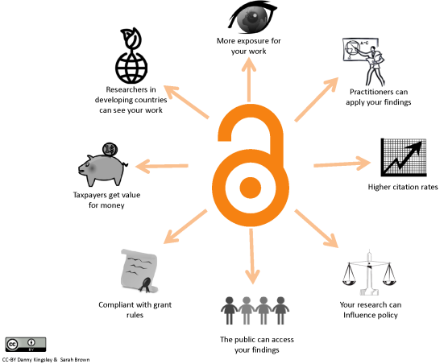
Full Open Access Ideal
The entire full-text refereed corpus online
On every researcher’s desktop, everywhere
24 hours a day
All papers citation-interlinked
Fully searchable, navigable, retrievable

Slide 19
Traditional Subscription Publishing
Limited Dissemination, economic efficiency & social impact
Paywall
Libraries purchase subscriptions
Very limited permissions
Slow process

Slide 20
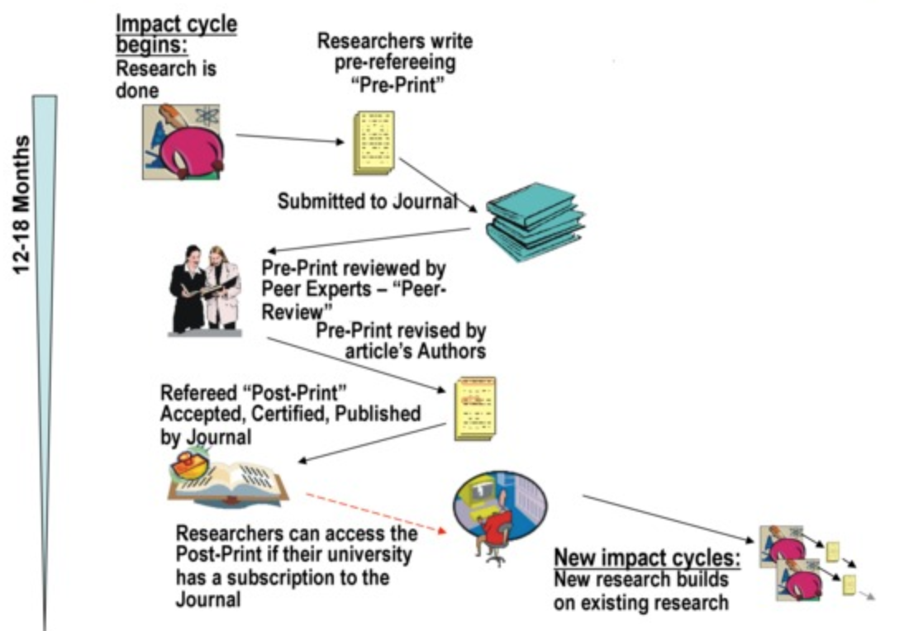
Limited Access: Limited Research Impact
Research is a process
Can take more than a year and a half for a journal

Slide 21
Gold Open Access
Maximised Dissemination, economic efficiency & social impact
Articles freely, permanently and immediately accessible by everyone
Copyright retained by authors
Very few restrictions on use

Slide 22
Green Open Access
Increased Dissemination, economic efficiency & social impact
Self Archiving
A version is freely available
Publish pre or post publication

Slide 23
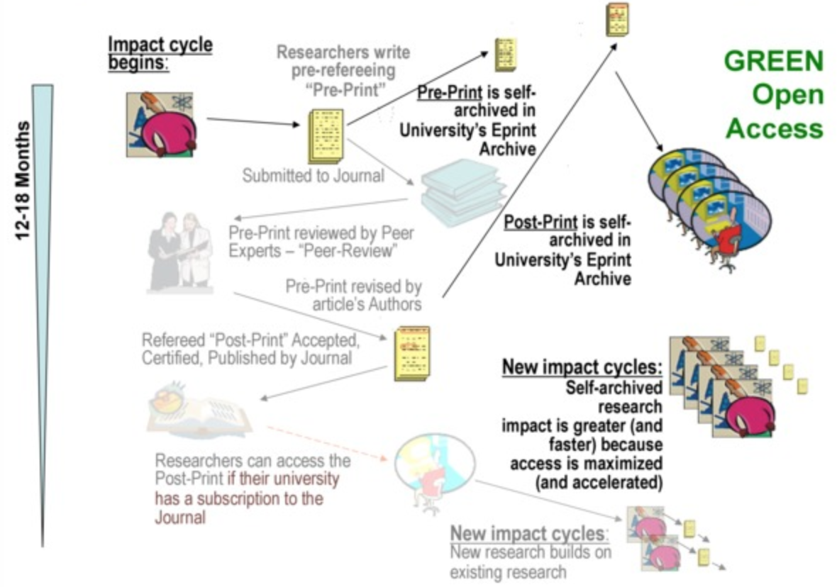
Green Open Access Pre-Prints
Preprints allow people to view work immediately
However, impact is greater after peer reviewed publications

Slide 24
Green OA Advantages
Early Advantage: Self archiving preprints before publications hastens and increases usage and citations
Quality Advantage: Self-archiving postprints immediately upon publication hastens and increases usage and citation
Higher quality articles benefit more
Usage Advantage: Self-archiving both pre/post prints increases downloads
Higher quality articles benefits more!
Full bibilograhy, see http://opcit.eprints.org/oacitation-biblio.html

Slide 25
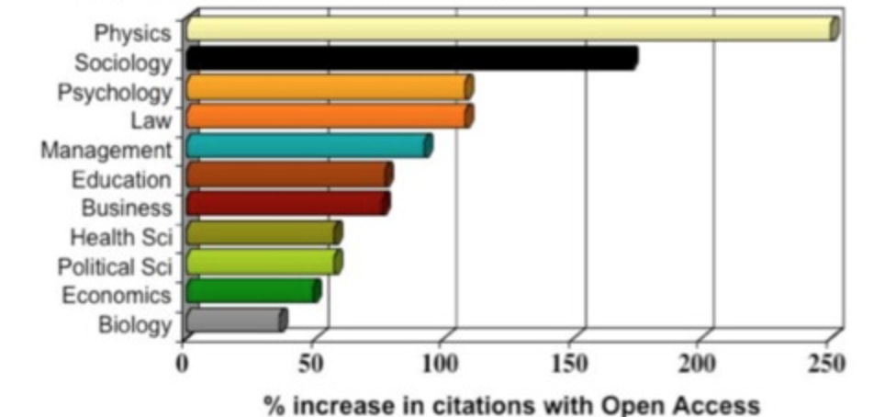
Open Access
Full bibilograhy, see http://opcit.eprints.org/oacitation-biblio.html

Slide 26
Publications
Year | Not OA (%) | OA (%) | Gold OA(%) | Green OA(%)
2009 | 69.1 | 30.9 | 4.69 | 20.44
2010 | 67.9 | 32.1 | 5.98 | 21.8
2011 | 66.3 | 33.7 | 7.7 | 22.92
2012 | 64.6 | 35.4 | 9.86 | 24.24
2013 | 63.0 | 37.0 | 11.37 | 25.64
2014 | 61.8 | 38.2 | 13.02 | 27.15
2015 | 60.0 | 40.0 | 14.32 | 28.22
2016 | 58.8 | 41.2 | 15.16 | 28.99
2017 | 59.6 | 40.4 | 16.98 | 26.91
2018 | 63.8 | 36.2 | 18.47 | 15.29
Data, gathered through the analysis of Scopus data and Unpaywall data

Slide 27
Open Access Strategies
Green: Self Archiving | Gold: Publishing
Journal processes continue as normal | Journal changes business model
Authors deposit a copy of their papers into an ‘open access repository’ | Readers no longer pay to read
Public copy is a supplement to the publishers official article for those who can’t afford a subscription | Instead, authors pay to publish or their funders

Slide 28
Problems with OA
20% of new papers are Open Access 2019
50% of new papers, all versions, are behind a paywall
Green OA relies on publishers polices
Romeo service tracks publisher policies
http://www.sherpa.ac.uk/romeo
Gold OA relies on publishers changing their model
Scientific publications is lucrative (18% profits)
Academia highly values the peer review process

Slide 29
Open Access Repositories
Open-access repository or open archive
Free, immediate and permanent access for anyone to use, download and distribute
Institutional or disciplinary
They provide free access to research for users outside the institutional community
Open Archives Initiative Protocol for Metadata Harvesting (OAI-PMH)
A protocol developed for harvesting metadata descriptions of records in an archive so that services can be built using metadata from many archives
Repositories must be interoperable according to OAI-PMH
Search engines harvest the content of open access repositories, constructing a database of worldwide, free of charge available research

Slide 30
Role of the Repository
Who takes responsibility for curating the research knowledge of the world?
Privately owned, profit making, publishing industry
University, research institution, knowledge creator

Slide 31
Next: Telling Tales part 2

