Slide 2
Web Caching, Proxies and CDNs
COMP3227 Web Architecture & Hypertext Technologies
Dr Heather Packer – hp3@ecs.soton.ac.uk

Slide 3
Caching
Caching stores the result of an operation so that future operations return faster
Computation is slow
Computation will run multiple times
When the output is the same for a particular input

Slide 4
Web Caching
The temporary storage (caching) of frequently accessed data for rapid access
Typically caches store “static assets”
HTML pages
Images
Stylesheets, Javascript
Caches can be located at various points in a network
Reduces access time/latency for clients
Reduces bandwidth usage across slower links
Reduces load on a server

Slide 5
Browser Cache
Browsers maintain a small cache
Stored locally
Cache for a single user or application
Browser sets a caching policy, deciding what data to cache
User specific content
Expensive content
Local Browser
Origin Server
resource
Browser Cache

Slide 6
What can be Cached?
Cache friendly
Logos and brand images
Style sheets
Javascript files, site and library
Fonts
Downloadable content
Media files
Be careful caching:
Data
HTML pages
Frequently modified Javascript and CSS
Content requested with authentication cookies
Never cache
Sensitive data
User-specific data that frequently changes

Slide 7
Caching using Conditional requests
Last-Modified: Tue 17 Nov 2020 08:00:20 GMT
GET Requests: If-Modified-Since:
HTTP Status code: 304 Not Modified
Etag: “0123456789ABCDEF…”
GET Request: If-None-Match:
HTTP Status code: 304 Not Modified

Slide 8
Controlling Caches with HTTP: Last-Modified Header
GET Conditional GET
GET / HTTP/1.1
Host: comp3220.ecs.soton.ac.uk
Accept: */*
HTTP/1.1 200 OK
Date: Wed 18 Nov 2020 17:43:20 GMT
Connection: keep-alive
Content-Type: text/html; charset=UTF-8
Content-Length: 4003
Last-Modified: Tue 17 Nov 2020 08:00:20 GMT
GET / HTTP/1.1
Host: comp3220.ecs.soton.ac.uk
Accept: */*
If-Modified-Since: Tue 17 Nov 2020 08:00:20 GMT
HTTP/1.1 304 Not Modified
Date: Wed 15 Nov 2017 07:55:10 GMT
Connection: keep-alive
Last-Modified: Tue 17 Nov 2020 08:00:20 GMT

Slide 9
Caching Headers
HTTP Response header Cache-Control:
Flags
no-store
no-cache
max-age=
must-revalidate
public
private
Use of Cache-Control headers to be determined by website architect/designer

Slide 10
HTTP with Cache-Control Header
GET GET
GET / HTTP/1.1
Host: comp3220.ecs.soton.ac.uk
Accept: */*
HTTP/1.1 200 OK
Date: Wed 18 Nov 2017 17:43:20 GMT
Connection: keep-alive
Content-Type: text/html; charset=UTF-8
Content-Length: 4003
Last-Modified: Tue 17 Nov 2020 08:00:20 GMT
Cache-Control: max-age=86400
* No request sent *

Slide 11
Different Web Caching Solutions
Caches can be located at various points in a network
Browser Cache
Embedded in the browser
Proxy Cache
Reverse Proxy Cache

Slide 12
Proxy Cache
Cache located close to the clients (hosted by University or Internet Service Provider)
Decrease bandwidth usage
Decreases network latency
Scale provides the main advantage: many users within the ISP may all be asking for the same web pages
ISPs use this approach to decrease bandwidth across their networks
Server
Local Machine
resource
Proxy Cache

Slide 13
Reverse Proxy Cache
Cache proxy located closer to the origin web server
Usually deployed by a Web host
Decreases load on the Web service (e.g. database)
Several reverse proxy caches implemented together can for a Content Delivery Network
Server
Local Machine
Reverse
Proxy Cache
resource

Slide 14
Web Proxies

Slide 15
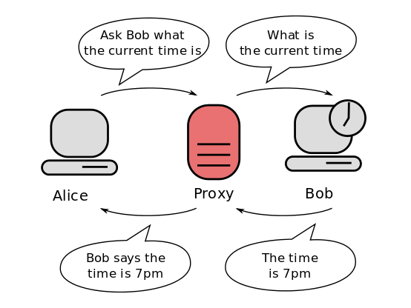
Web Proxy Architecture
A web proxy is a network service
They receive web requests from clients and make requests on their behalf to web servers
A web proxies behaviour differs depending on their function

Slide 16
No Proxy

Slide 17
Proxy Types
P
Forward Proxy
Open Proxy
Reverse Proxy
P
P

Slide 18
Forward Proxy – Content Filtering
P
Restricts requests
Blocks blacklisted URLs
Response can be scanned
Unwanted content
Malware

Slide 19
Forward Proxy – Content Translation
P
Transform responses
Reduce bandwidth usage by client
Commonly used by mobile phone networks
Recompress images at lower resolution
Minimising HTML, CSS and JavaScript
Inject content into web pages e.g. adverts

Slide 20
Open Forward Proxy - Access Services Anonymously
P
Client accessing website via proxy:
Masks their IP address
Modifies their location (via GeoIP)
Improve anonymity
Defeat geo-blocking
No filtering, encryption, or checks over content

Slide 21
Reverse Proxy – Load-balancing
P
Distributes incoming web requests to a pool of web servers (targets)
Performance and availability
Many strategies including: round robin, weighted round robin
Health checks ensure resilience

Slide 22
Reverse Proxy – Content Switching
static
P
html
api
Examine incoming request and direct traffic to specific web servers
Can use:
Host or path based e.g. https://example.com/static -> static webserver
IP address, cookie or user-agent

Slide 23
Reverse Proxy – Protocol Translation
P
HTTPS SSL/TLS off-loading (OSI Layer 6)
Incoming web requests over https, internal communications via http
HTTP/2 to HTTP/1.x (OSI Layer 7)
IPv6 <-> IPv4 (OSI Layer 3)

Slide 24
Reverse Proxy – Monitoring and filtering
P
Monitor incoming requests
Access logs / statistics
Filter incoming requests
Check security credentials (eg valid API tokens)
Rate limit requests
Intrusion detection and handling DDoS attacks
Applying security policies (WAF)

Slide 25
Content Delivery Networks

Slide 26
Motivation Scenario
Stream video content to 100,000+ simultaneous users
You could use a single large “mega-server”
Single point of failure
Point of network congestion
Long path to distant clients
Multiple copies of video sent over outgoing link
This solution doesn’t work in practice

Slide 27
Content Delivery Network
CDN a geographically distributed network of proxy servers (edge nodes)
Hosts static content (such as images, videos, CSS and JS)
Data travels to user via the shortest path (reduced latency)

Slide 28
CDN
Origin Server
CDN Connection
User
Connection
User
Edge Server

Slide 29
CDN
Services that use CDNs
Netflix
Amazon
Reddit
Twitch
gov.uk
PayPal
Shopify
BBC.com
Vimeo
YouTube
Hulu
Wikipedia
CNN
New York Times
The Guardian
Stack Overflow
GitHub
Stripe
Quora
Video streaming
Software downloads
Web and mobile content acceleration
Payment services
E-commerce
News

Slide 30
Commercial CDNs
Limelight Networks
Level 3 Communications
Akamai Technologies
Amazon CloudFront (cloudping.info)
CloudFlare

Slide 31
Motivational Scenario
Streaming video to 100,000+ simultaneous users
Working Web solution: store/serve many copies of video at multiple geographically distributed sites (CDN)
Two strategies:
Push CDN servers deep into many access networks
Close to users
Placed near ISP
Used by Akamai, 1700 locations
Place larger clusters at key points in the network near internet exchanges
Internet exchanges where network providers connect their networks to each other
Dedicated high speed private networks are used to connect the clusters together
Used by Limelight
Better latency and better network performance.
Harder to maintain because there are many more servers in the CDN.
Higher latency and lower performance for the end user
Easier to manage but with higher latency and lower performance for the end user.

Slide 32
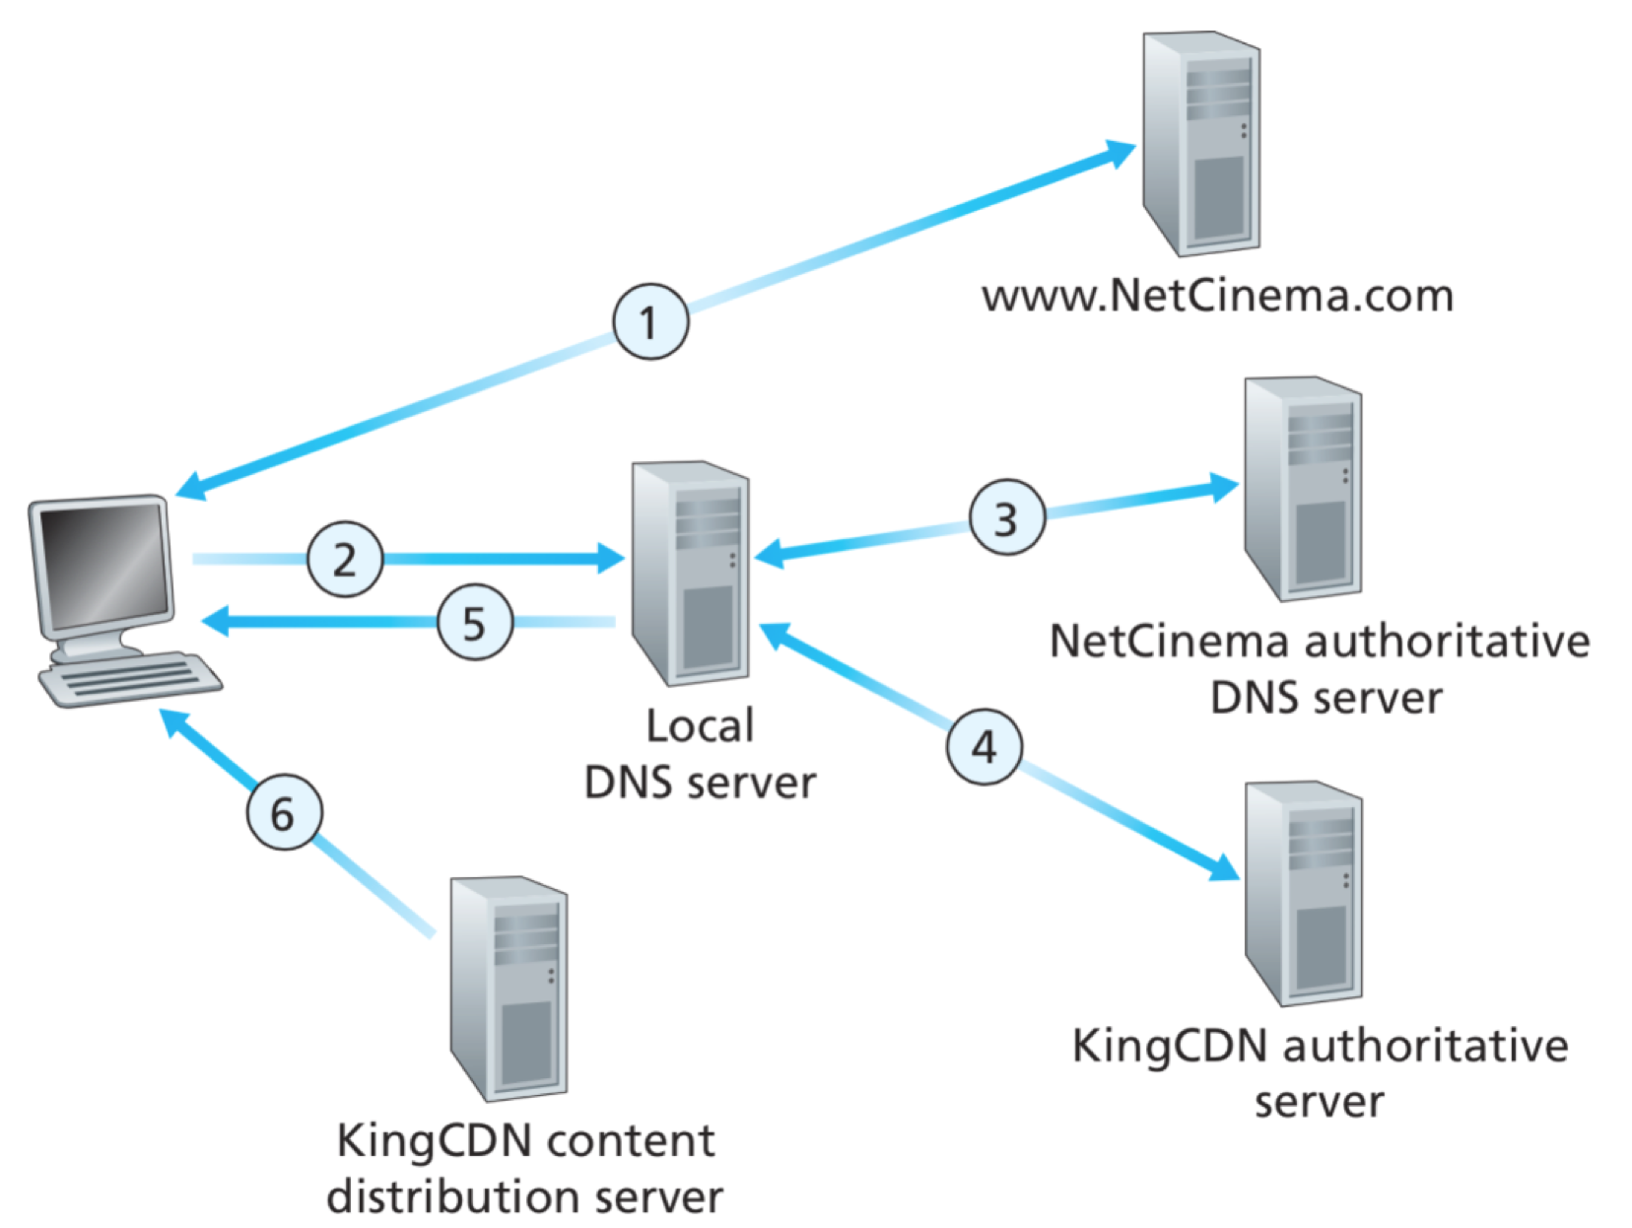
CDN: Simple content access scenario
A CDN has to be able to tell clients where to find resources
A client will request a file, with one URL but retrieve it from another
http://video.netcinema.com/6Y7B23V
http://KingCDN.com/NetC6Y7B23V
Notes:
https://www.chegg.com/homework-help/questions-and-answers/question-4-2-pts-consider-example-cdn-operation-described-slide-153-replicated-convenience-q47761303

Slide 33
Contacts www.netcinema.com and receives a link to a video http://video.netcinema.com/6Y7B23V

Slide 34
2. Resolves Domain name via local DNS video.netcinema.com

Slide 35
3. NetCinema’s DNS returns cdn1.KingCDN.com
4. Resolves Domain name cdn1.KingCDN.com
5. Returns IP of cdn1.KingCDN.com

Slide 36
6. Requests URL http://cdn1.KingCDN.com/NetC6Y7B23V

Slide 37
CDN Cluster Selection Strategy
The CDN’s DNS decides which edge server to use
Pick CDN node geographically closest to client
Pick CDN node with shortest delay (min hops) to client (CDN nodes periodically ping access ISPs, report results to CDN DNS)
Or let the Client decide – give client a list of several CDN servers

Slide 38
Case Study: Netflix’s first Approach
Owned very little infrastructure, uses 3rd party services
Own registration, payment servers
Amazon (3rd party) cloud services
Netflix uploads studio master to Amazon cloud
Create multiple version of movie (different encodings) in cloud
Upload versions from cloud to CDNs
Three 3rd party CDNs host/stream Netflix content: Akamai, Limelight, Level-3

Slide 39
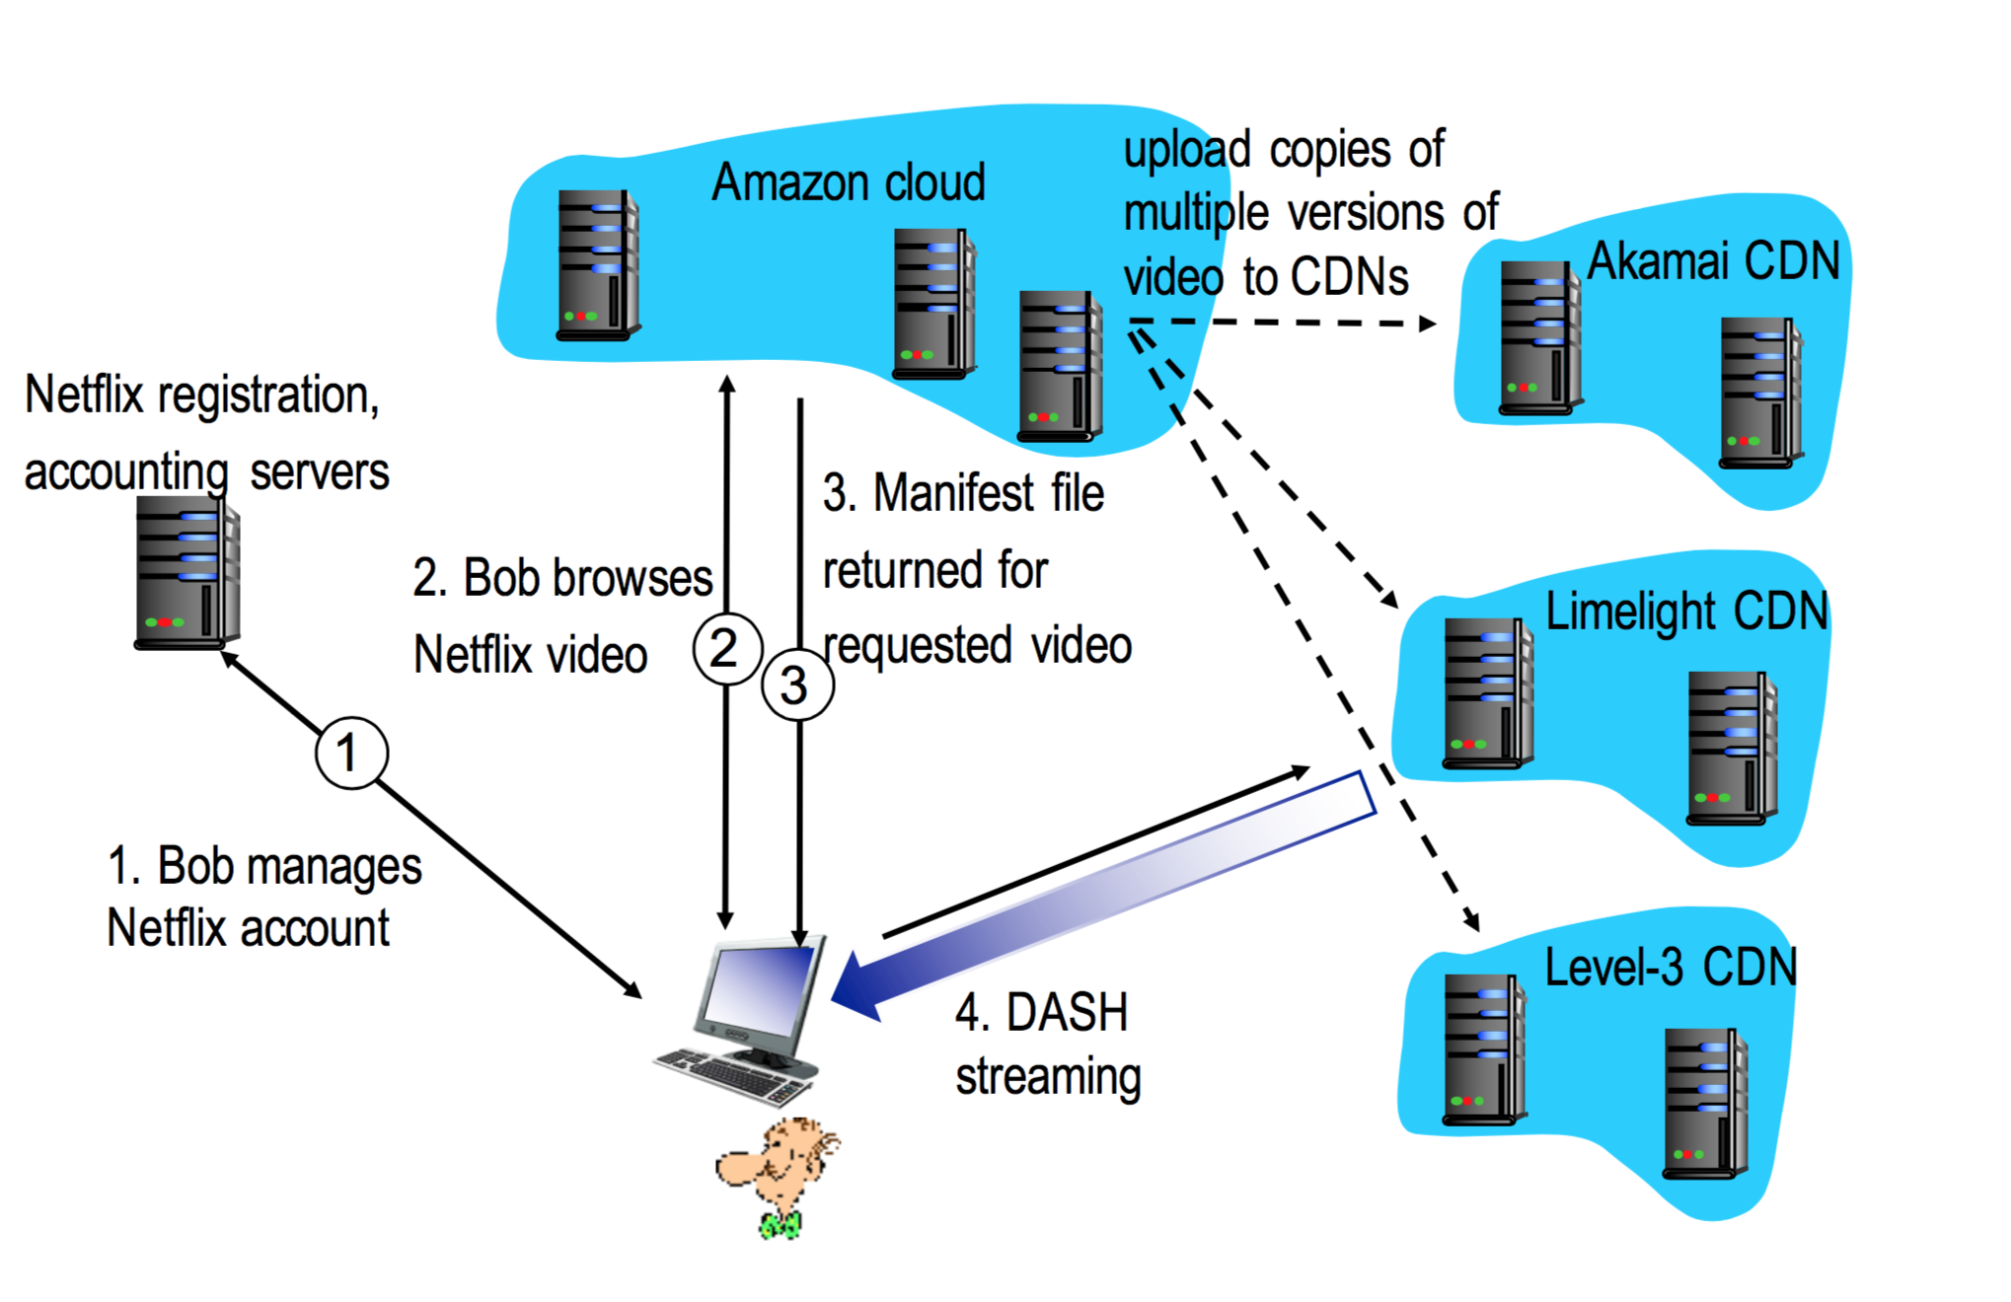
Case Study: Netflix

Slide 40
DASH - Dynamic Adaptive Streaming over HTTP
Server
Divides video files into multiple chucks
Each chunk stored encoded at different bit rates
Manifest file: provides URLs for different chunks
Client
Periodically measures server-to-client bandwidth
Consulting manifest, requests one chunk at a time
Chooses maximum coding rate sustainable given current bandwidth
Can choose different coding rates at different points in time (depending on available bandwidth at time)
The intelligence happens at the client level to make sure that there is no buffer starvation or overflow

Slide 41
MPEG-DASH Adoption
MPEG DASH is independent, open and international standard, which has broad support from the industry
HTML5 Media Source Extensions and HbbTV are MPEG-DASH enabled
Heavy plugins like Silverlight and Flash perform poorly and cause security issues
Chrome dropped the Silverlight support
It was a problem for the majority of premium video providers
Video providers delivered their streams via Smoothstreaming and Playready DRM, which enforced Silverlight
These providers switch to using HTML5 with MPEG-DASH and MPEG-CENC based DRM

Slide 42
Netflix OpenConnect
Netflix wanted the absolute best streaming they could get, while lowering cost
High optimised for delivery large files, still use Akamai for small assets
Data centers around the world
There may be a data center with a couple of racks that contain the entire Netflix library
Others might only have 80% of the most popular content
Unpopular material will have to travel further
Client Intelligence
Calculates best edge server to use (based on bit rate and closeness)
Selects which edge server based on the required bit rate and latency
Continually probes the best way of receiving content

Slide 43
Next: Web Advertising

