Slide 2
COMP3227 Web Architecture and Hypertext Technologies
Dr Heather Packer – hp3@ecs.soton.ac.uk

Slide 3
What’s this module about?
What is the Web?
How is the Web made?
What came before the Web?
Where is the Web going?
Notes:
How does it work?
What are the constituent technologies?
How are those technologies integrated into a consistent whole?
Web as socio-technical construct
History of hypertext, how that influenced (or didn't influence) the Web
What was new about the Web that we didn’t have before
Future directions of the Web

Slide 4
What’s this module not about?
How to write HTML (although we will look at its evolution and capabilities)
How to write CSS (although we will look at its capabilities)
How to set up a web server
How to write applications in PHP/ASP.NET/Ruby on Rails/Django/node.js
Other ECS modules cover some of this, most notably COMP6205 Web Development
Some material is covered in more depth in COMP6215 Semantic Web Technologies

Slide 5
Module structure
Three lectures per week:
Monday 2pm in 85/2209
Wednesday 10am in 7/3023
Friday 4pm in 85/2209
One lab per week (starting in Week 3):
Thursday 10am in 59/ECS Computing Lab
Links to all module resources will be at https://secure.ecs.soton.ac.uk/module/COMP3227/

Slide 6
Laboratories
Starting Week 3 (w/c 17 Oct 2021)
The first four labs have formative exercises to prepare you for the coursework:
HTTP
HTML
CSS
REST
Subsequent labs will run as coursework clinics

Slide 7
Assessment
Examination: 50% (120 minutes, 3 questions from 4)
REST architecture coursework: 50%
Specification published in week 1
Submission due week 9
Feedback due week 15

Slide 8
Week-by-week topics
Week 1: Hypertext and the Architecture of the Web (hsp/rcg)
Week 2: Web Protocols (hsp/rcg)
Week 3: Web Formats (hsp/rcg)
Week 4: Styling the Web, and Advanced Protocols (hsp/rcg)
Week 5: RESTful Web Services (hsp/rcg)
Week 6: History of Hypertext (nmg)
Week 7: Open Hypermedia (hsp/rcg)
Week 8: Web Graph and Search Engines (hsp/rcg)
Week 9: Caching, Content Delivery and Web Advertising (hsp/rcg)
Week 10: Linked Data, Open Data and Open Access (hsp/rcg)
Week 11: Intellectual Property and Net Neutrality (rcg)
Week 15: Review (hsp/rcg)

Slide 9
A note on assessable content
Not everything we cover on this module can be sensibly assessed, so we'll indicate topics of which you only need a high-level understanding as follows.
If a topic concerns technologies which are currently undergoing standardisation (and so which are subject to change), we'll indicate it like this:
If a topic goes into large amounts of detail that's primarily there only for illustrative purposes, we'll indicate it like this:

Slide 10
The World Wide Web

Slide 11
What is the World Wide Web?

Slide 12
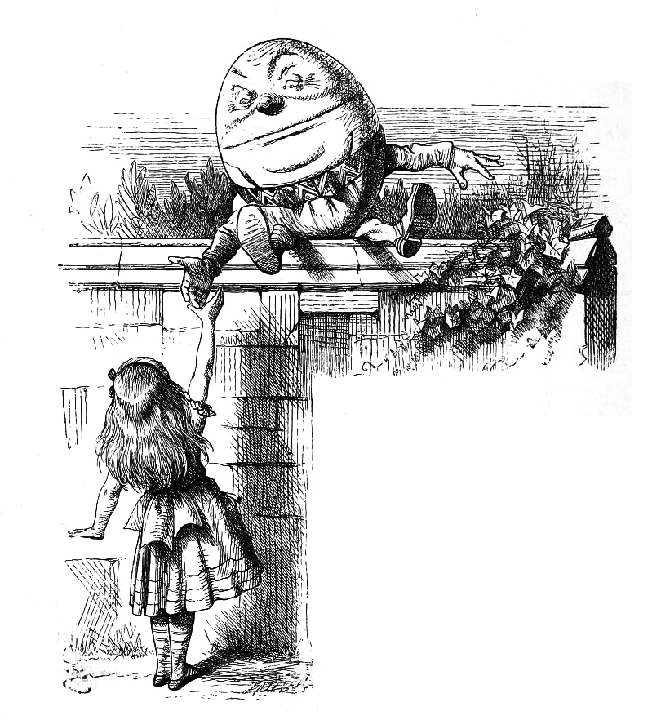
“When I use a word,” Humpty Dumpty said, in rather a scornful tone, “it means just what I choose it to mean—neither more nor less.”

Slide 13
Before the Web
A user typed a host address into a client program
The client communicated with a file server using the File Transfer Protocol (FTP)
The user typed commands into the client:
To navigate to the right directory
To specify whether the file being transferred was binary or ASCII
To get the right file
The server sent a file back
The client stored the file on the hard disk
The user printed the file, or used a separate viewer
Notes:
Interaction characterised as downloading

Slide 14
The Web experience
A user clicks on a link in a browser
(the browser talks to a web server)
(the server sends a document back)
The browser displays the document
The user clicks on another link (etc)
Notes:
Interaction characterised as browsing

Slide 15
Web evolution
The Web is for scientists (1991-1995)
The Web is for commerce (1996-2000)
The Web is for users (2000-2005)
The Web as application platform (2005-)

Slide 16
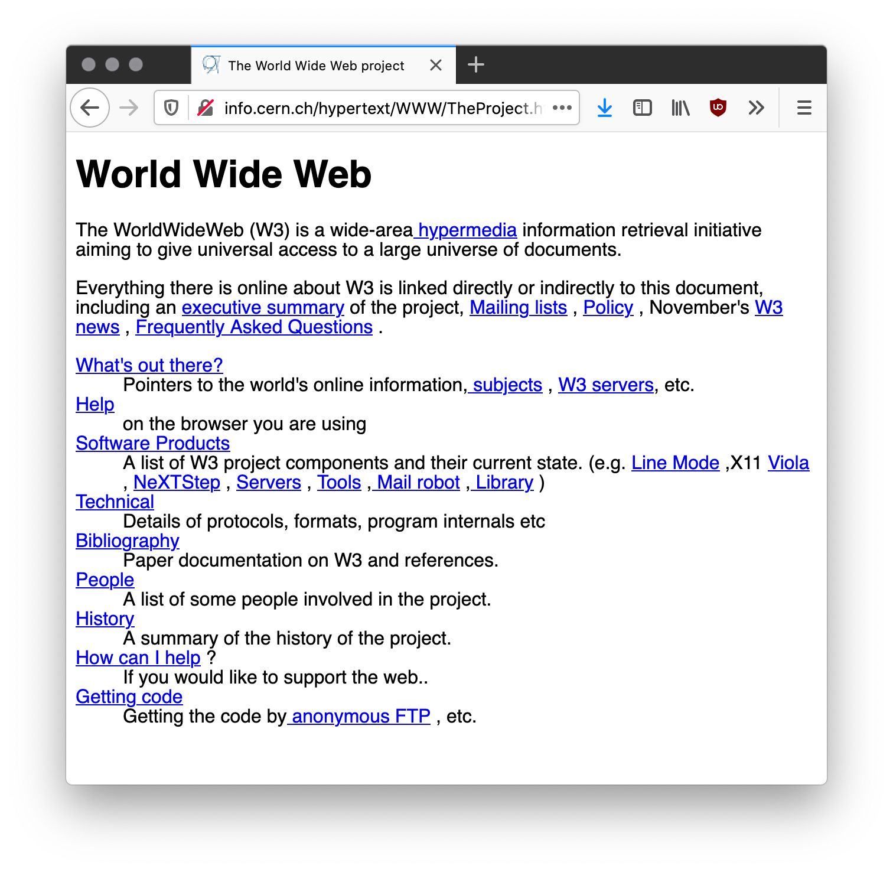
Web evolution
The Web is for scientists (1991-1995)
Berners Lee 1991
High Energy Physics and Computer Scientists
Library science community
Document-centric
Web pages
PDF and PostScript files
Limited interactivity
Many browsers

Slide 17
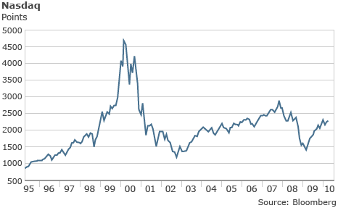
Web evolution
The Web is for scientists (1991-1995)
The Web is for commerce (1996-2000)
Mosaic broswer developed at the National Center for Supercomputing Applications at the University of Illinois and Urbana Champaign
Invention of Secure Sockets
Netscape released JavaScript
Microsoft released Cascading Style Sheets (CSS)
The dot-com bubble

Slide 18
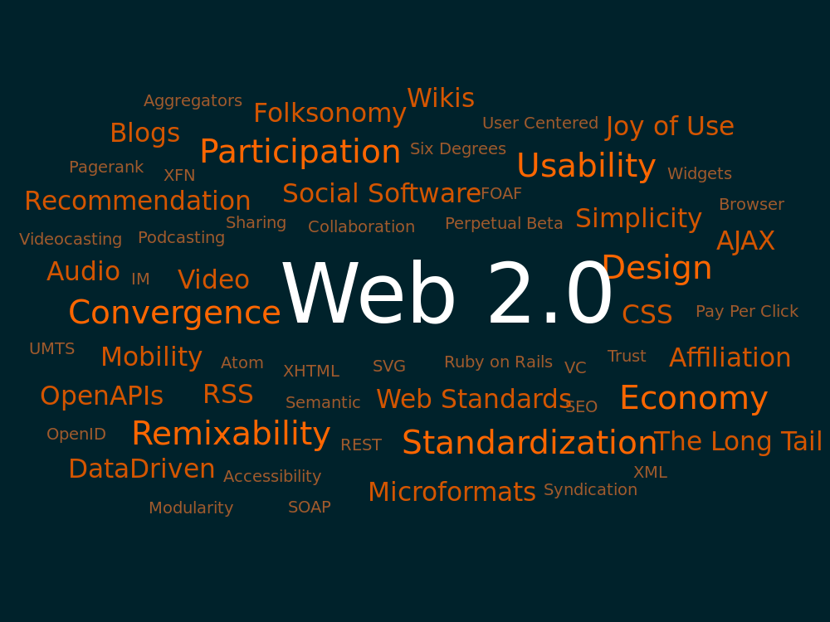
Web Evolution
The Web is for scientists (1991-1995)
The Web is for commerce (1996-2000)
The Web is for users (2000-2005)
Tim O'Reilly, Web 2.0 (marketing slogan?)
Commerce
Emphasis on user-generated content
JavaScript
Web browser as rich client
Semantic Web
W3C had mostly been in control of the standards

Slide 19
Web Evolution
The Web is for scientists (1991-1995)
The Web is for commerce (1996-2000)
The Web is for users (2000-2005)
The Web as application platform (2005-)
Semantic Web
W3C vs Browser manufacturers
HTML5 Application platform
Shift in emphasis from documents to applications

Slide 20
What is the World Wide Web?

Slide 21
A distributed information system that provides access to hypertext documents and other objects of interest
We have a general name for these objects of interest:
resources

Slide 22
What is a resource?
“Familiar examples [of resources] include an electronic document, an image, a source of information with a consistent purpose (e.g., ‘today's weather report for Los Angeles’), a service (e.g., an HTTP-to-SMS gateway), and a collection of other resources. A resource is not necessarily accessible via the Internet; e.g., human beings, corporations, and bound books in a library can also be resources. Likewise, abstract concepts can be resources, such as the operators and operands of a mathematical equation, the types of a relationship (e.g., ‘parent’ or ‘employee’), or numeric values (e.g., zero, one, and infinity).”
Berners-Lee, T. et al (2005) Uniform Resource Identifier (URI): Generic Syntax. RFC3986.

Slide 23
Web Architecture
Resources are identified by URIs (Uniform Resource Identifiers)
Resources have representations in different formats (HTML, text, PDF)
Resources can be interacted with using network protocols (HTTP)
URI
http://www.bbc.co.uk/weather/2637487
identifies
Resource
accesses
today’s BBC weather forecast for Southampton
Representation
Metadata:
Content-Type: text/html
Data:
<html>
<head>
<title>BBC Weather – Southampton</title>
...
</html>
represents

Slide 24
Web Principles
All entities of interest should be identified by URIs
All URIs should be resolvable (i.e. you can use them to fetch something)
When you resolve a URI, you get some data about the identified resource
Data should be provided using standard formats
Data should be linked with other data

Slide 25
5 Stars of Linked Data (2010) for Organisations
★ Available on the Web (in whatever format) under an open licence
★★ As above, but as machine-readable structured data (e.g. Excel instead of an image of a table)
★★★ As above, but in a non-proprietary format (e.g. CSV instead of Excel)
★★★★ As above, but using W3C standards (RDF, SPARQL) to identify things, so that others can point at your data
★★★★★ As above, but linked to other people’s data to provide context

Slide 26
What is the World Wide Web

Slide 27
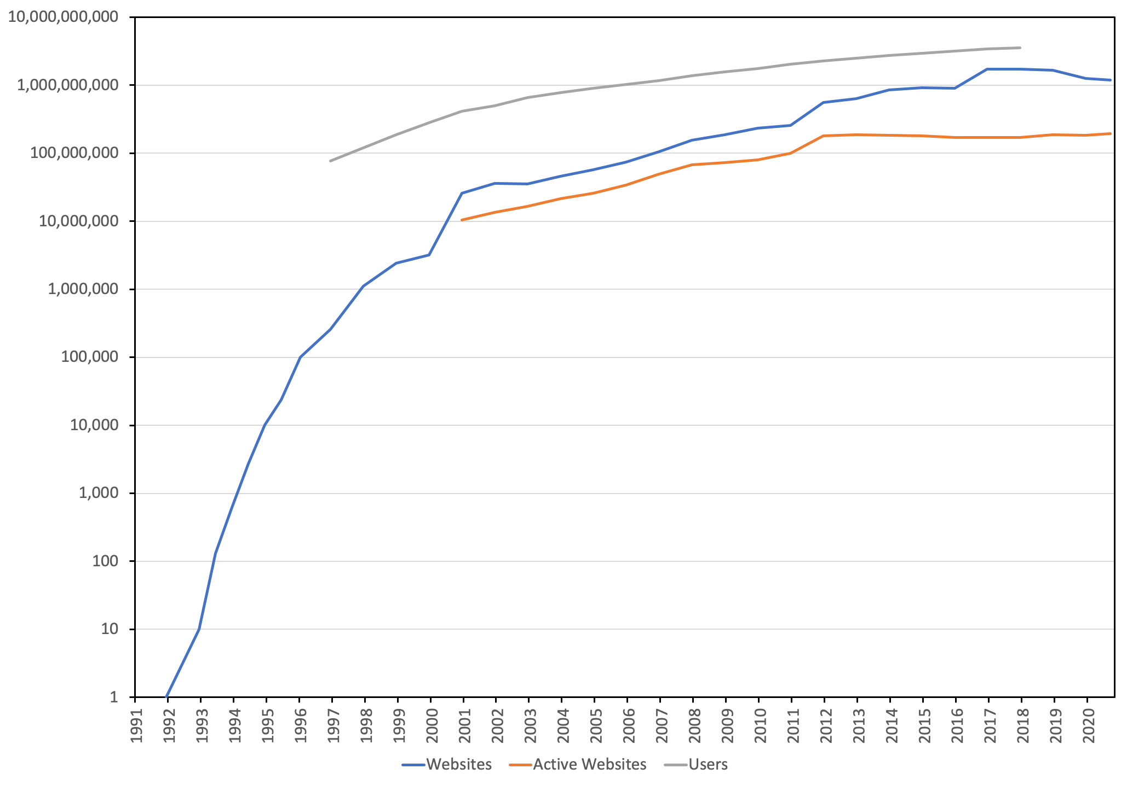
Web Growth
Netcraft's survey of web servers
Number of users - International Telecommunications Union
Monthly survey of active websites
Netcraft (2020) Web Server Survey. Available online at: https://news.netcraft.com/archives/category/web-server-survey/
Notes:
Number of web pages on the indexed Web ~=5.5 billion

Slide 28
Web Growth
Netcraft (2020) Web Server Survey. Available online at: https://news.netcraft.com/archives/category/web-server-survey/

Slide 29
Web Growth
Increasing by a factor of 10
Netcraft (2020) Web Server Survey. Available online at: https://news.netcraft.com/archives/category/web-server-survey/

Slide 30
Web Growth
Netcraft (2020) Web Server Survey. Available online at: https://news.netcraft.com/archives/category/web-server-survey/

Slide 31
Web Growth
4.5 Billion Users 2017
7.5 Billion People 2017
8 Billion People 2022
100 different pages a day
Netcraft (2020) Web Server Survey. Available online at: https://news.netcraft.com/archives/category/web-server-survey/

Slide 32
Measuring the Web
How many webpages are there?
Harder to count than websites (deep Web – not linked)
Estimate size of the indexed Web using search engines
Around 800 million in 1999 (compare with ~3 million websites)
At least 10 billion in 2005 (compare with ~34 million active websites)
At least 1 trillion in 2016 (compare with ~170 million websites)
What is the diameter of the Web?
How many links do you need to follow to travel between an arbitrary pair of webpages?
Longest shortest finite path
Even harder to measure...
Estimated at 19 in 1999
Lawrence, S. and Giles, C.L. (1999) Accessibility of information on the Web. Nature, 400, pp. 107-109. Albert, R. and Barabási, A-L. (1999) Diameter of the World-Wide Web. Nature, 401, pp.130-133.

Slide 33
The Shape of the Web
Meusel et al. 2015
LSCC - Large strongly connected component
Broder, A. et al (2000) Graph Structure in the Web. Computer Networks 33, pp. 309-320. Meusel, R. et al (2015) Graph Structure in the Web – Revisited. In Proceedings of the 14th International World Wide Web Conference. pp. 427–432.

Slide 34
Next Lecture: Hypertext

