Slide 2
Distributed Databases
COMP3211 Advanced Databases
Dr Nicholas Gibbins – nmg@ecs.soton.ac.uk

Slide 3
Overview
Fragmentation
  Horizontal (primary and derived), vertical, hybrid
Query processing
  Localisation, optimisation (semijoins)
Concurrency control
  Centralised 2PL, Distributed 2PL, deadlock
Reliability
  Two Phase Commit (2PC)
Replication
The CAP Theorem

Slide 4
What is a distributed database?
A collection of sites connected by a communications network
Each site is a database system in its own right, but the sites have agreed to work together
A user at any site can access data anywhere as if data were all at the user's own site

Slide 5
DDBMS Principles

Slide 6
Local autonomy
The sites in a distributed database system should be autonomous or independent of each other
Each site should provide its own security, locking, logging, integrity, and recovery. Local operations use and affect only local resources and do not depend on other sites

Slide 7
No reliance on a central site
A distributed database system should not rely on a central site, which may be a single point of failure or a bottleneck
Each site of a distributed database system provides its own security, locking, logging, integrity, and recovery, and handles its own data dictionary. No central site must be involved in every distributed transaction.

Slide 8
Continuous operation
A distributed database system should never require downtime
A distributed database system should provide on-line backup and recovery, and a full and incremental archiving facility. The backup and recovery should be fast enough to be performed online without noticeable detrimental affect on the entire system performance.

Slide 9
Location independence
Applications should not know, or even be aware of, where the data are physically stored; applications should behave as if all data were stored locally
Location independence allows applications and data to be migrated easily from one site to another without modifications.

Slide 10
Fragmentation independence
Relations can be divided into fragments and stored at different sites
Applications should not be aware of the fact that some data may be stored in a fragment of a table at a site different from the site where the table itself is stored.

Slide 11
Replication independence
Relations and fragments can be stored as many distinct copies on different sites
Applications should not be aware that replicas of the data are maintained and synchronized automatically.

Slide 12
Distributed query processing
Queries are broken down into component transactions to be executed at the distributed sites

Slide 13
Distributed transaction management
A distributed database system should support atomic transactions
Critical to database integrity; a distributed database system must be able to handle concurrency, deadlocks and recovery.

Slide 14
Hardware independence
A distributed database system should be able to operate and access data spread across a wide variety of hardware platforms
A truly distributed DBMS system should not rely on a particular hardware feature, nor should it be limited to a certain hardware architecture.

Slide 15
Operating system independence
A distributed database system should be able to run on different operating systems

Slide 16
Network independence
A distributed database system should be designed to run regardless of the communication protocols and network topology used to interconnect sites

Slide 17
DBMS independence
An ideal distributed database system must be able to support interoperability between DBMS systems running on different nodes, even if these DBMS systems are unalike
All sites in a distributed database system should use common standard interfaces in order to interoperate with each other.

Slide 18
Distributed Databases vs. Parallel Databases
Distributed Databases
Local autonomy
No central site
Continuous operation
Location independence
Fragmentation independence
Replication independence
Distributed query processing
Distributed transactions
Hardware independence
Operating system independence
Network independence
DBMS independence

Slide 19
Distributed Databases vs. Parallel Databases
Parallel Databases
Local autonomy
No central site
Continuous operation
Location independence
Fragmentation independence
Replication independence
Distributed query processing
Distributed transactions
Hardware independence
Operating system independence
Network independence
DBMS independence

Slide 20
Fragmentation

Slide 21
Why Fragment?
Fragmentation allows:
  localisation of the accesses of relations by applications
  parallel execution (increases concurrency and throughput)

Slide 22
Fragmentation Approaches
Horizontal fragmentation
  Each fragment contains a subset of the tuples of the global relation
Vertical fragmentation
  Each fragment contains a subset of the attributes of the global relation
horizontal
fragmentation
global relation
vertical
fragmentation

Slide 23
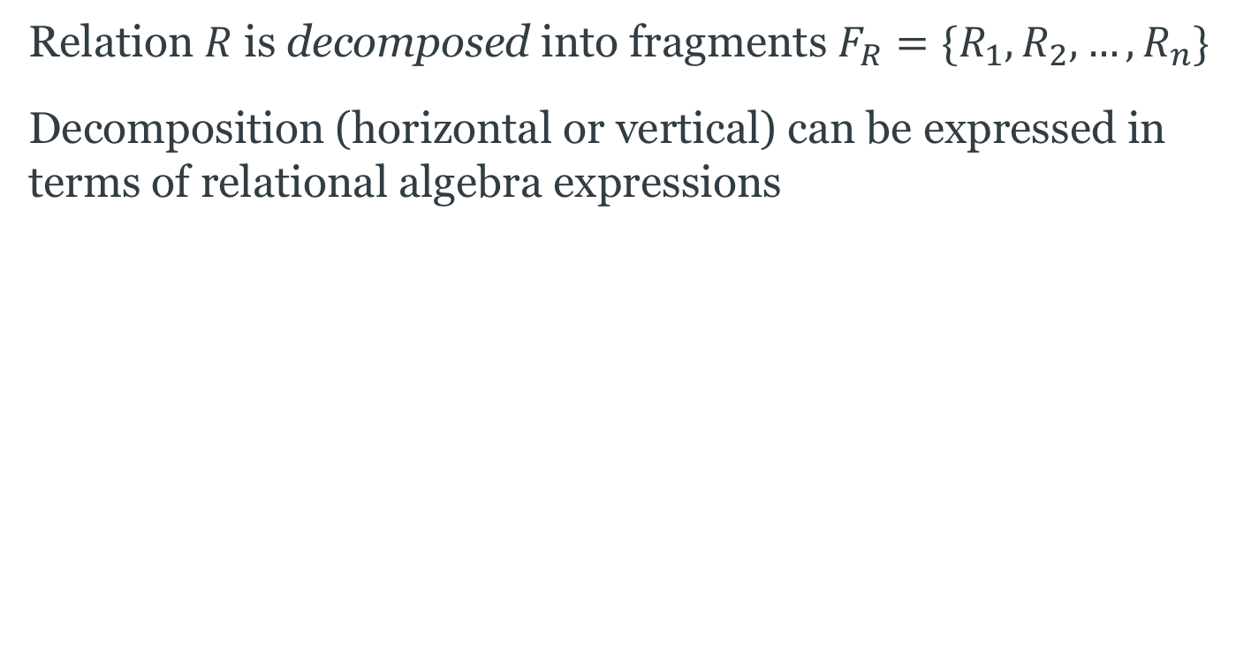
Decomposition
Relation $R$ is decomposed into fragments $F_{R}=\{R_{1},R_{2}, …, R_{n}\}$
Decomposition (horizontal or vertical) can be expressed in terms of relational algebra expressions

Slide 24
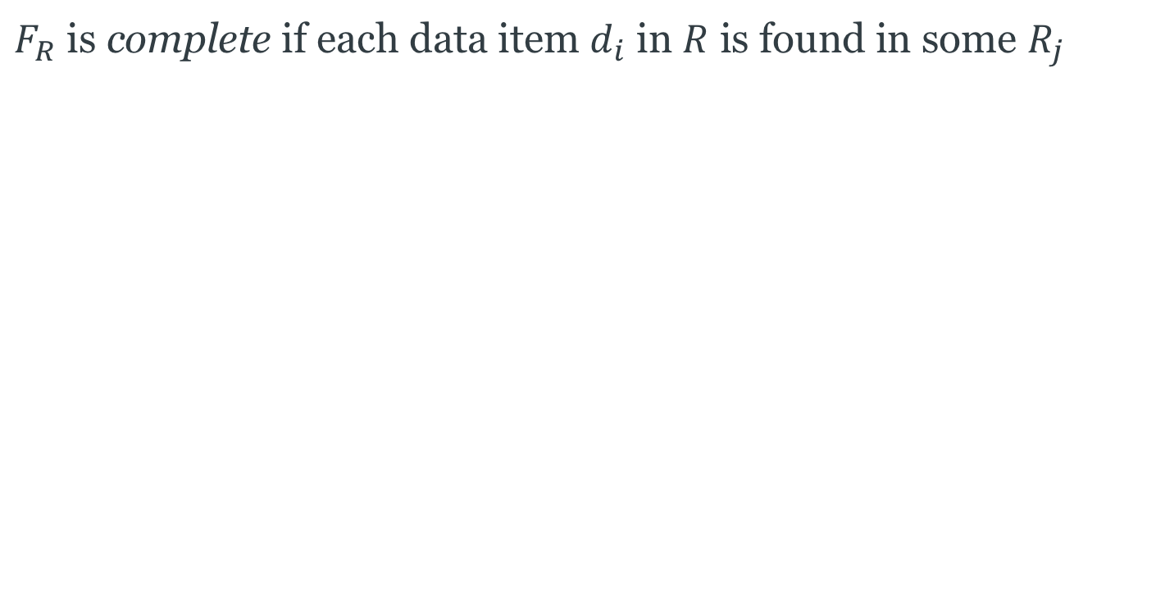
Completeness
$F_{R}$ is complete if each data item $d_{i}$ in $R$ is found in some $R_{j}$

Slide 25

Reconstruction
$R$ can be reconstructed if it is possible to define a relational operator $▽$ such that
$R=▽R_{i}$, for all $Ri∈F_{R}$
Note that $▽$ will be different for different types of fragmentation

Slide 26
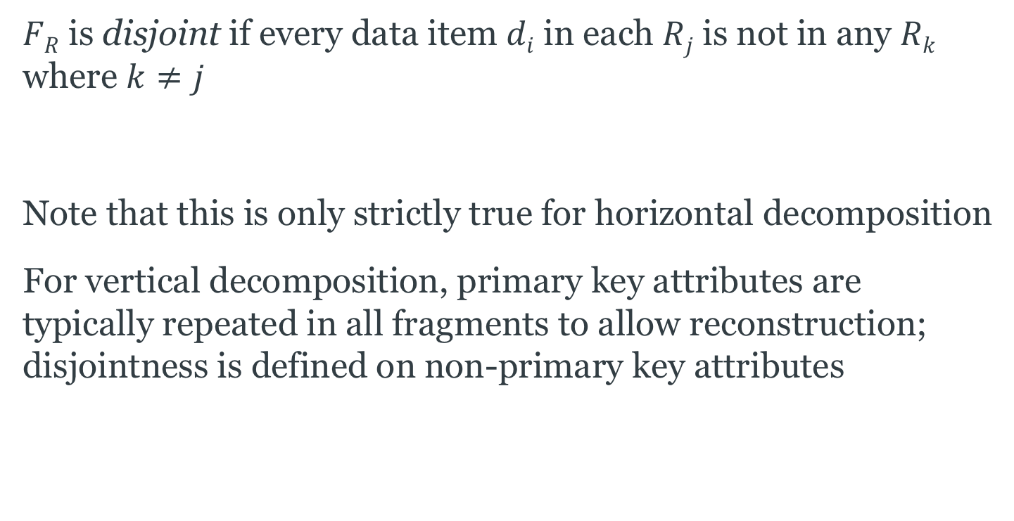
Disjointness
$FR$ is disjoint if every data item $di$ in each $Rj$ is not in any $Rk$
where $k≠j$
Note that this is only strictly true for horizontal decomposition
For vertical decomposition, primary key attributes are typically repeated in all fragments to allow reconstruction; disjointness is defined on non-primary key attributes

Slide 27
Horizontal Fragmentation
Each fragment contains a subset of the tuples of the global relation
Two versions:
  Primary horizontal fragmentation
  performed using a predicate defined on the relation being partitioned
  Derived horizontal fragmentation
  performed using a predicate defined on another relation

Slide 28
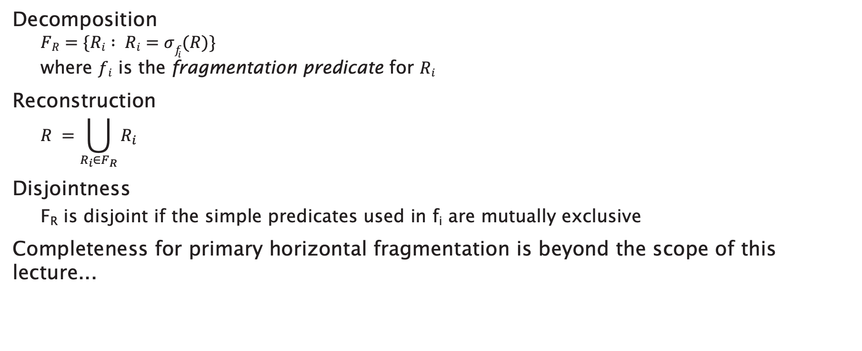
Primary Horizontal Fragmentation
Decomposition
  $$FR=\{Ri : Ri=σf_{i}(R)\}$$
  where $fi$ is the fragmentation predicate for $Ri$
Reconstruction
  $$R =\bigcup_{R_{i}∈F_{R}}{R_{i}}$$
Disjointness
  F_{R} is disjoint if the simple predicates used in f_{i} are mutually exclusive
Completeness for primary horizontal fragmentation is beyond the scope of this lecture...
Notes:
Complete – equal probability of access to any tuple from any fragment
Minimal – all predicates should be relevant (accessed differently by some application)

Slide 29
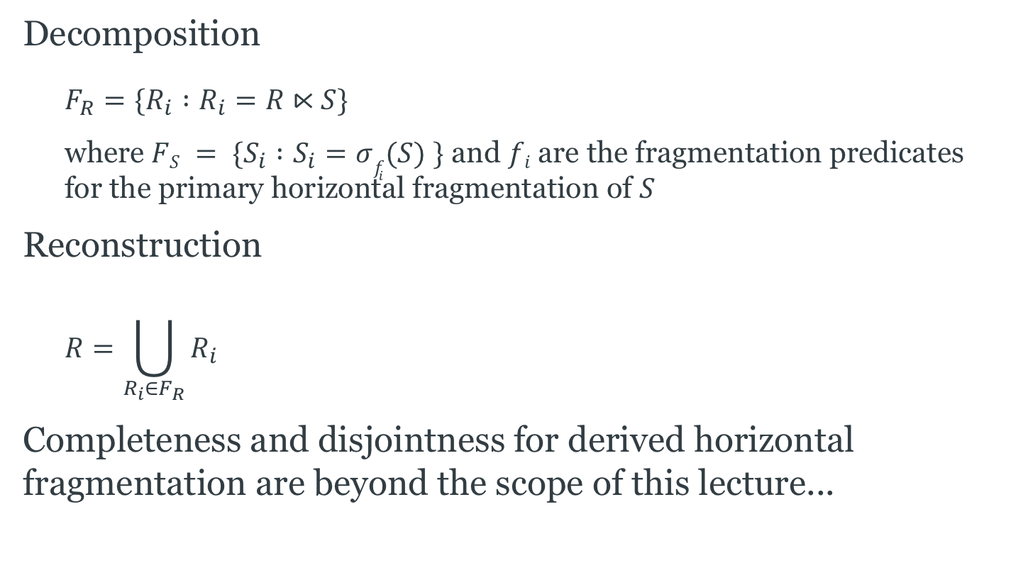
Derived Horizontal Fragmentation
Decomposition
  $$F_{R}=\{R_{i} :R_{i}=R⋉S\}$$
  where $FS = \{S_{i} :S_{i}=σf_{i}(S) \}$ and $fi$are the fragmentation predicates for the primary horizontal fragmentation of $S$
Reconstruction
  $$R=\bigcup_{R_{i}∈F_{R}}{R_{i}}$$
Completeness and disjointness for derived horizontal fragmentation are beyond the scope of this lecture...

Slide 30
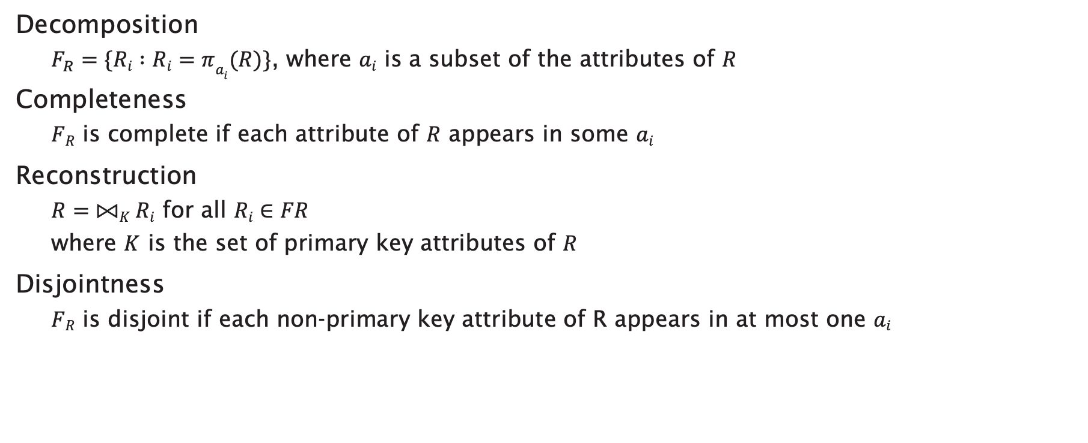
Vertical Fragmentation
Decomposition
  $F_{R}=\{Ri :Ri=πa_{i}(R)\}$, where $ai$ is a subset of the attributes of $R$
Completeness
  $FR$ is complete if each attribute of $R$ appears in some $ai$
Reconstruction
  $R=⨝K Ri$ for all $Ri∈FR$
  where $K$ is the set of primary key attributes of $R$
Disjointness
  $FR$ is disjoint if each non-primary key attribute of R appears in at most one $ai$

Slide 31
Hybrid Fragmentation
Horizontal and vertical fragmentation may be combined:
  Vertical fragmentation of horizontal fragments
  Horizontal fragmentation of vertical fragments

Slide 32
Query Processing

Slide 33
Localisation
Fragmentation expressed as relational algebra expressions
Global relations can be reconstructed using these expressions
  a localisation program
Naïvely, generate distributed query plan by substituting localisation programs for relations
  use reduction techniques to optimise queries

Slide 34
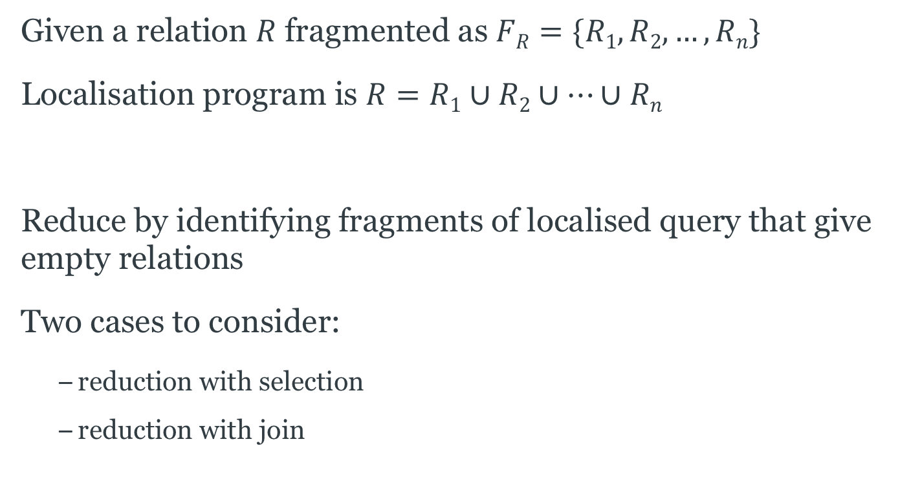
Reduction for Horizontal Fragmentation
Given a relation $R$ fragmented as $FR=\{R1, R2, …, Rn\}$
Localisation program is $R=R1∪R2∪…∪Rn$
Reduce by identifying fragments of localised query that give empty relations
Two cases to consider:
  reduction with selection
  reduction with join

Slide 35
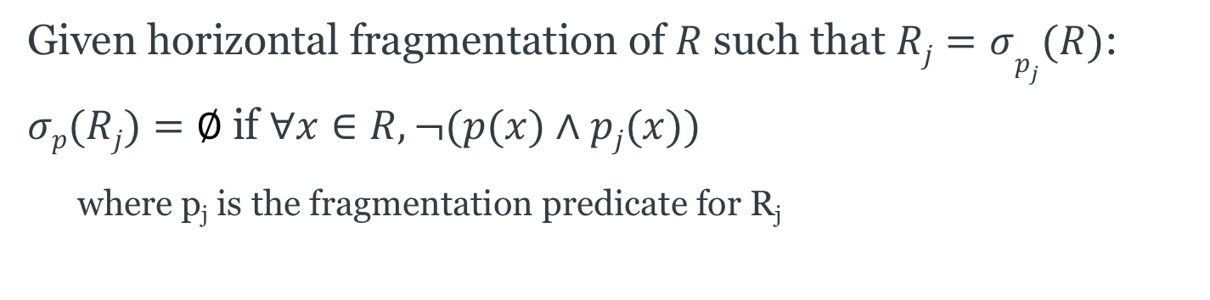
Horizontal Selection Reduction
Given horizontal fragmentation of $R$ such that $Rj=σp_{j}(R)$:
$σp(Rj)=∅$if $∀x∈R, ¬(p(x)∧pj(x))$
  where p_{j} is the fragmentation predicate for R_{j}

Slide 36


Horizontal Selection Reduction
Given horizontal fragmentation of $R$ such that $Rj=σp_{j}(R)$:
$σp(Rj)=∅$if $∀x∈R, ¬(p(x)∧pj(x))$
  where p_{j} is the fragmentation predicate for R_{j}
$$σp$$
$$R$$
query

Slide 37




Horizontal Selection Reduction
Given horizontal fragmentation of $R$ such that $Rj=σp_{j}(R)$:
$σp(Rj)=∅$if $∀x∈R, ¬(p(x)∧pj(x))$
  where p_{j} is the fragmentation predicate for R_{j}
$$σp$$
$$σp$$
∪
$$R$$
$$R1$$
$$R2$$
...
$$Rn$$
query
localised query

Slide 38


Horizontal Selection Reduction
Given horizontal fragmentation of $R$ such that $Rj=σp_{j}(R)$:
$σp(Rj)=∅$if $∀x∈R, ¬(p(x)∧pj(x))$
  where p_{j} is the fragmentation predicate for R_{j}
$$σp$$
$$σp$$
$$σp$$
∪
$$R$$
$$R1$$
$$R2$$
...
$$Rn$$
$$R2$$
query
localised query
reduced query

Slide 39
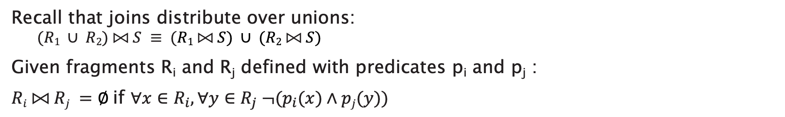
Horizontal Join Reduction
Recall that joins distribute over unions:
  $$(R1 ∪ R2) ⨝ S ≡ (R1 ⨝ S) ∪ (R2 ⨝ S)$$
Given fragments R_{i} and R_{j} defined with predicates p_{i} and p_{j} :
$Ri ⨝ Rj =∅$if $∀x∈R_{i}, ∀y∈R_{j} ¬(p_{i}(x)∧pj(y))$

Slide 40



Horizontal Join Reduction
Recall that joins distribute over unions:
  $$(R1 ∪ R2) ⨝ S ≡ (R1 ⨝ S) ∪ (R2 ⨝ S)$$
Given fragments R_{i} and R_{j} defined with predicates p_{i} and p_{j} :
$Ri ⨝ Rj =∅$if $∀x∈R_{i}, ∀y∈R_{j} ¬(p_{i}(x)∧pj(y))$
$$⨝$$
$$R$$
$$S$$
query

Slide 41







Horizontal Join Reduction
Recall that joins distribute over unions:
  $$(R1 ∪ R2) ⨝ S ≡ (R1 ⨝ S) ∪ (R2 ⨝ S)$$
Given fragments R_{i} and R_{j} defined with predicates p_{i} and p_{j} :
$Ri ⨝ Rj =∅$if $∀x∈R_{i}, ∀y∈R_{j} ¬(p_{i}(x)∧pj(y))$
$$⨝$$
$$⨝$$
$$∪$$
$$R$$
$$S$$
$$R1$$
$$R2$$
$$…$$
$$Rn$$
$$S$$
query
localised query

Slide 42







Horizontal Join Reduction
Recall that joins distribute over unions:
  $$(R1 ∪ R2) ⨝ S ≡ (R1 ⨝ S) ∪ (R2 ⨝ S)$$
Given fragments R_{i} and R_{j} defined with predicates p_{i} and p_{j} :
$Ri ⨝ Rj =∅$if $∀x∈R_{i}, ∀y∈R_{j} ¬(p_{i}(x)∧pj(y))$
$$⨝$$
$$⨝$$
$$∪$$
$$∪$$
$$⨝$$
$$⨝$$
$$R$$
$$S$$
$$R1$$
$$R2$$
$$…$$
$$Rn$$
$$S$$
$$R3$$
$$S$$
$$R5$$
$$S$$
query
localised query
reduced query

Slide 43
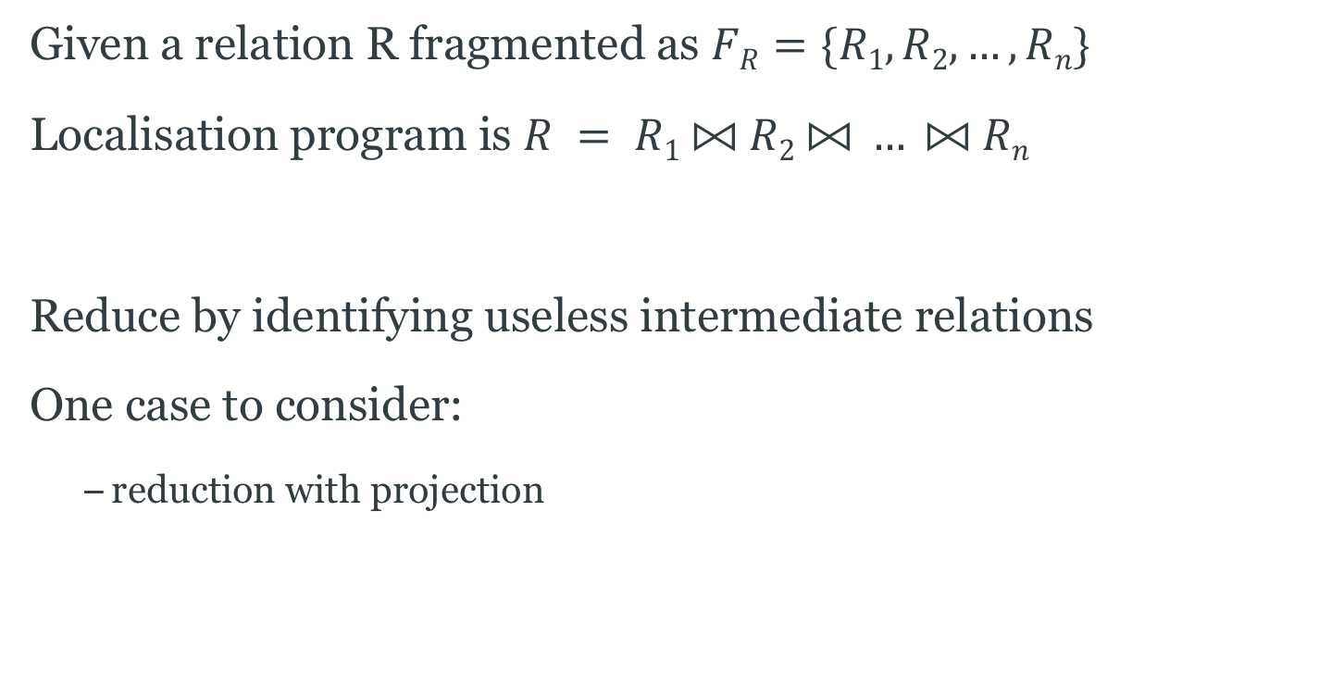
Reduction for Vertical Fragmentation
Given a relation R fragmented as $FR=\{R1, R2, …, Rn\}$
Localisation program is $R = R1 ⨝ R2 ⨝ … ⨝ Rn$
Reduce by identifying useless intermediate relations
One case to consider:
  reduction with projection

Slide 44
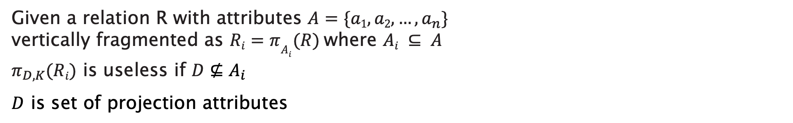
Vertical Projection Reduction
Given a relation R with attributes $A=\{a1, a2, …, a_{n}\}$
vertically fragmented as $Ri=πA_{i}(R)$where $Ai ⊆ A$
$π_{D,K}(Ri)$ is useless if $D⊈A_{i}$
$D$ is set of projection attributes

Slide 45

Vertical Projection Reduction
Given a relation R with attributes $A=\{a1, a2, …, a_{n}\}$
vertically fragmented as $Ri=πA_{i}(R)$where $Ai ⊆ A$
$π_{D,K}(Ri)$ is useless if $D⊈A_{i}$
$D$ is set of projection attributes
$$π_{D,K}$$
$$R$$
query

Slide 46

Vertical Projection Reduction
Given a relation R with attributes $A=\{a1, a2, …, a_{n}\}$
vertically fragmented as $Ri=πA_{i}(R)$where $Ai ⊆ A$
$π_{D,K}(Ri)$ is useless if $D⊈A_{i}$
$D$ is set of projection attributes
$$π_{D,K}$$
$$π_{D,K}$$
⨝
$$R$$
$$R1$$
$$R2$$
...
$$Rn$$
query
localised query

Slide 47

Vertical Projection Reduction
Given a relation R with attributes $A=\{a1, a2, …, a_{n}\}$
vertically fragmented as $Ri=πA_{i}(R)$where $Ai ⊆ A$
$π_{D,K}(Ri)$ is useless if $D⊈A_{i}$
$D$ is set of projection attributes
$$π_{D,K}$$
$$π_{D,K}$$
$$π_{D,K}$$
⨝
$$R$$
$$R1$$
$$R2$$
...
$$Rn$$
$$R2$$
query
localised query
reduced query

Slide 48
Distributed Joins

Slide 49

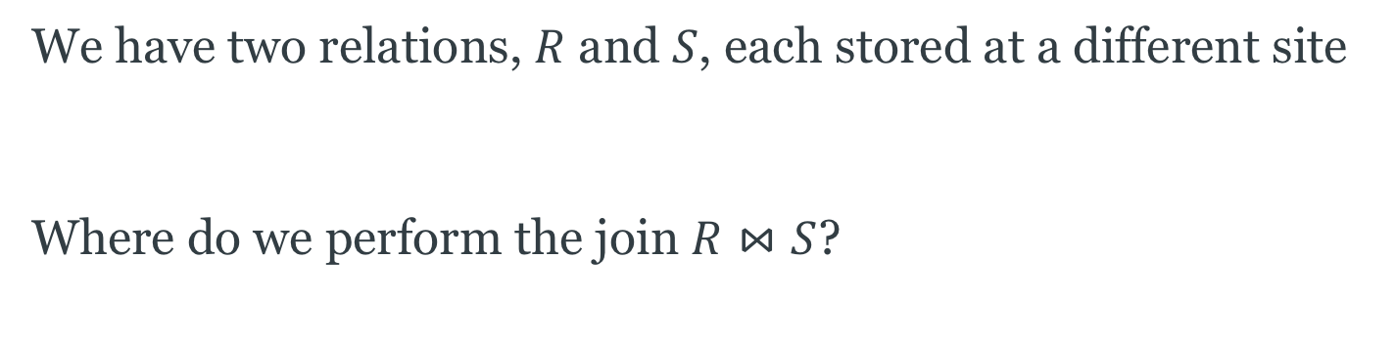


The Distributed Join Problem
We have two relations, $R$ and $S$, each stored at a different site
Where do we perform the join $R⋈S$?
Site 1
Site 2
$$R$$
$$R⋈S$$
$$S$$

Slide 50



The Distributed Join Problem
We can move one relation to the other site and perform the join there
  CPU cost of performing the join is the same regardless of site
  Communications cost depends on the size of the relation being moved
Site 1
Site 2
$$⋈$$
$$R$$
$$S$$

Slide 51
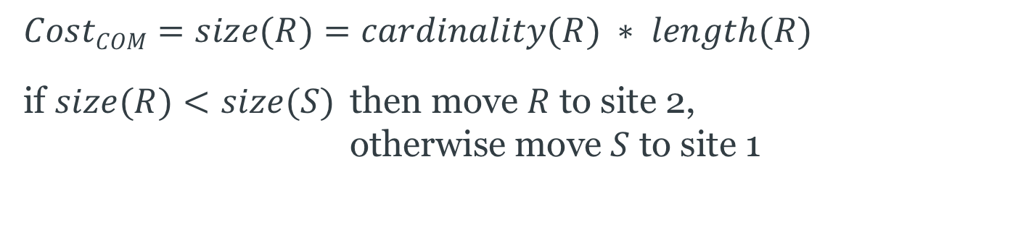
The Distributed Join Problem
$$CostCOM=size(R)=cardinality(R) ∗ length(R)$$
if $size(R)<size(S)$ then move $R$ to site 2,
otherwise move $S$ to site 1
Site 1
Site 2
$$⋈$$
$$R$$
$$S$$

Slide 52
Semijoin Reduction
We can further reduce the communications cost by only moving that part of a relation that will be used in the join
Use a semijoin...
Site 1
Site 2
$$R$$
$$R⋈S$$
$$S$$

Slide 53

Semijoins
Recall that $R⋉_{p}S ≡ πR(R⋈_{p}S)$
  where $p$ is a predicate defined over $R$ and $S$
  $πR$ projects out only those attributes from $R$
$$size(R⋉_{p}S)<size(R⋈_{p}S)$$
$$R⋈_{p}S≡(R⋉_{p}S)⋈_{p}S \\ R⋈_{p}S≡R⋈_{p}(R⋊_{p}S) \\ R⋈_{p}S≡(R⋉_{p}S)⋈_{p}(R⋊_{p}S)$$

Slide 54
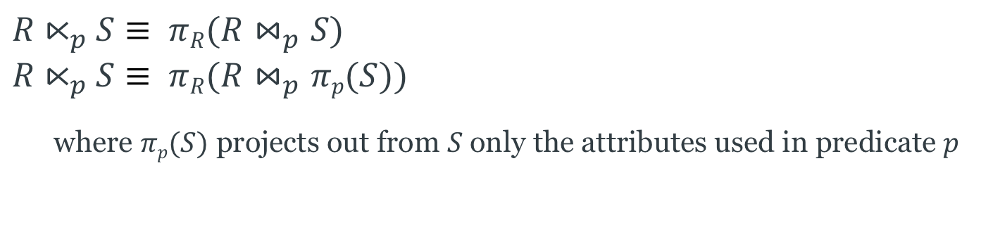
Semijoin Reduction
$$R⋉_{p}S≡ πR(R⋈_{p}S) \\ R⋉_{p}S≡ πR(R⋈_{p}πp(S))$$
  where $πp(S)$ projects out from $S$only the attributes used in predicate $p$
Site 1
Site 2
$$R$$
$$S$$

Slide 55
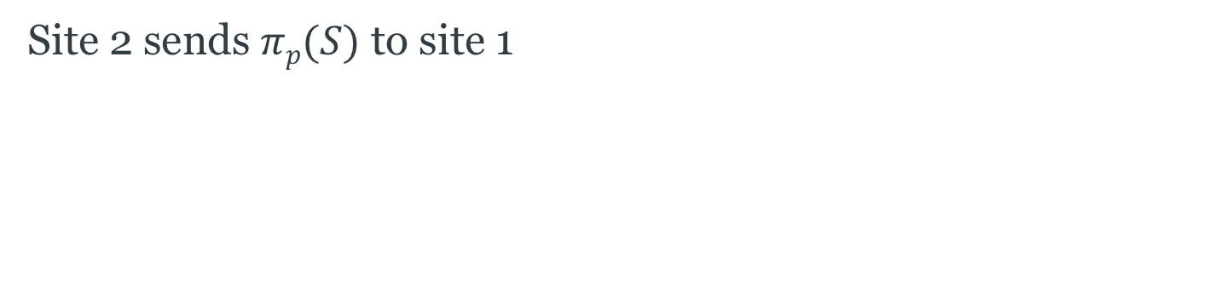

Semijoin Reduction, step 1
Site 2 sends $πp(S)$ to site 1
Site 1
Site 2
$$πp(S)$$
$$R$$
$$S$$

Slide 56
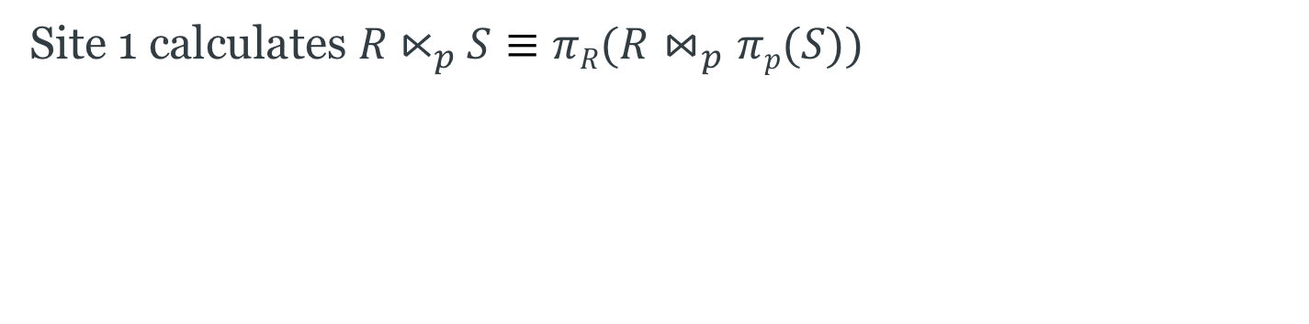

Semijoin Reduction, step 2
Site 1 calculates $R⋉_{p}S≡πR(R⋈_{p}πp(S))$
Site 1
Site 2
$$R$$
$$S$$
$$R⋉_{p}S$$

Slide 57
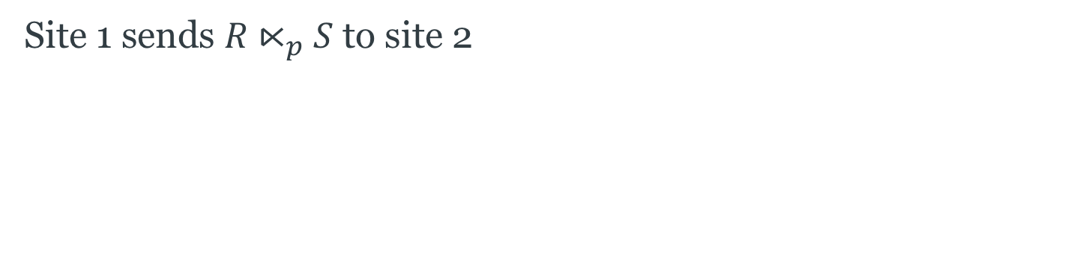

Semijoin Reduction, step 3
Site 1 sends $R⋉_{p}S$ to site 2
Site 1
Site 2
$$R$$
$$R⋉_{p}S$$
$$S$$
$$R⋉_{p}S$$

Slide 58
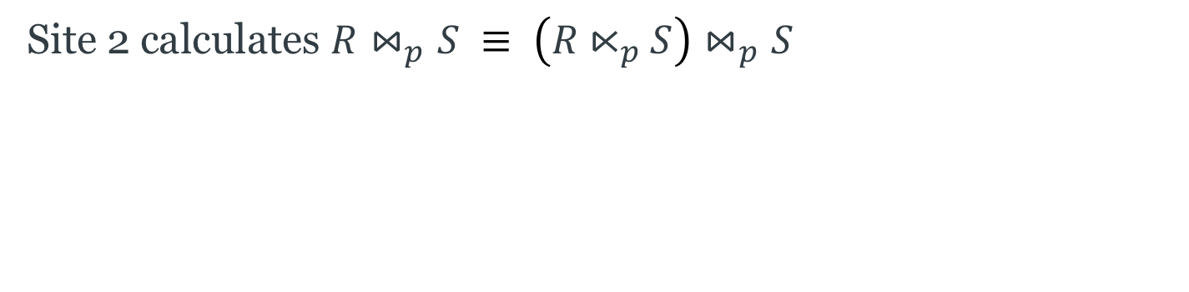

Semijoin Reduction, step 4
Site 2 calculates $R⋈_{p}S ≡ \left(R⋉_{p}S\right)⋈_{p}S$
Site 1
Site 2
$$R$$
$$S$$
$$R⋉_{p}S$$
$$R⋈_{p}S$$

Slide 59
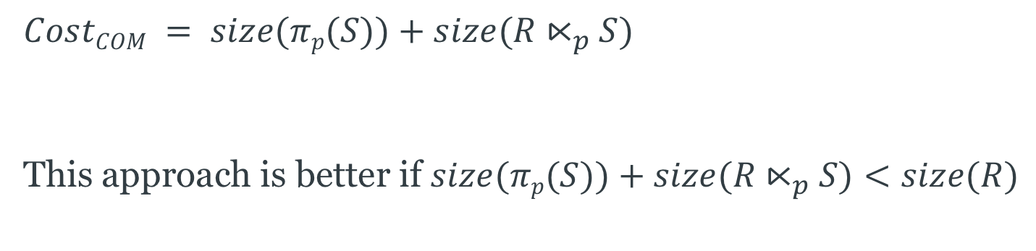
Semijoin Reduction
$$CostCOM = size(πp(S))+size(R⋉_{p}S)$$
This approach is better if $size(πp(S))+size(R⋉_{p}S)<size(R)$
Site 1
Site 2
$$R$$
$$S$$
$$R⋉_{p}S$$
$$R⋈_{p}S$$
Notes:
The semijoin approach is better if a few tuples of R participate in the join.
The join approach is better if almost all tuples of R participate in the join, because the semijoin approach requires an additional transfer of a projection on the join attribute.

Slide 60
Concurrency Control

Slide 61
Distributed Transactions
Transaction processing may be spread across several sites in the distributed database
  The site from which the transaction originated is known as the coordinator
  The sites on which the transaction is executed are known as the participants
P
transaction
C
P
P

Slide 62
Distribution and ACID
Non-distributed databases aim to maintain isolation
  Isolation: A transaction should not make updates externally visible until committed
Distributed databases commonly use two-phase locking (2PL) to preserve isolation
  2PL ensures serialisability, the highest isolation level

Slide 63
Two-Phase Locking
Two phases:
  Growing phase: obtain locks, access data items
  Shrinking phase: release locks
Guarantees serialisable transactions
#locks
LOCK
POINT
BEGIN
END
time
growing phase
shrinking phase

Slide 64
Distribution and Two-Phase Locking
In a non-distributed database, locking is controlled by a lock manager
Two main approaches to implementing two-phase locking in a distributed database:
  Centralised 2PL (C2PL)
  Responsibility for lock management lies with a single site
  Distributed 2PL (D2PL)
  Each site has its own lock manager

Slide 65
Centralised Two-Phase Locking (C2PL)
Coordinating site runs transaction manager TM
Participant sites run data processors DP
Lock manager LM runs on central site
DP
TM
LM

Slide 66
Centralised Two-Phase Locking (C2PL)
Coordinating site runs transaction manager TM
Participant sites run data processors DP
Lock manager LM runs on central site
TM requests locks from LM
DP
TM
LM
lock request

Slide 67
Centralised Two-Phase Locking (C2PL)
Coordinating site runs transaction manager TM
Participant sites run data processors DP
Lock manager LM runs on central site
TM requests locks from LM
If granted, TM submits operations to processors DP
DP
TM
LM
lock request
operation
lock granted

Slide 68
Centralised Two-Phase Locking (C2PL)
Coordinating site runs transaction manager TM
Participant sites run data processors DP
Lock manager LM runs on central site
TM requests locks from LM
If granted, TM submits operations to processors DP
When DPs finish, TM sends message to LM to release locks
DP
TM
LM
lock request
operation
lock granted
end of operation
release locks

Slide 69
Centralised Two-Phase Locking (C2PL)
LM is a single point of failure
  less reliable
LM is a bottleneck
  affects transaction throughput
DP
TM
LM
lock request
operation
lock granted
end of operation
release locks

Slide 70
Distributed Two-Phase Locking (D2PL)
Coordinating site C runs TM
Each participant runs both an LM and a DP
DP
LM
TM

Slide 71
Distributed Two-Phase Locking (D2PL)
Coordinating site C runs TM
Each participant runs both an LM and a DP
TM sends operations and lock requests to each LM
DP
LM
TM
operation +
lock request

Slide 72
Distributed Two-Phase Locking (D2PL)
Coordinating site C runs TM
Each participant runs both an LM and a DP
TM sends operations and lock requests to each LM
If lock can be granted, LM forwards operation to local DP
DP
LM
TM
operation +
lock request
operation

Slide 73
Distributed Two-Phase Locking (D2PL)
Coordinating site C runs TM
Each participant runs both an LM and a DP
TM sends operations and lock requests to each LM
If lock can be granted, LM forwards operation to local DP
DP sends “end of operation” to TM
DP
LM
TM
operation +
lock request
operation
end of operation

Slide 74
Distributed Two-Phase Locking (D2PL)
Coordinating site C runs TM
Each participant runs both an LM and a DP
TM sends operations and lock requests to each LM
If lock can be granted, LM forwards operation to local DP
DP sends “end of operation” to TM
TM sends message to LM to release locks
DP
LM
TM
operation +
lock request
operation
end of operation
release locks

Slide 75
Distributed Two-Phase Locking (D2PL)
Variant:
DPs may send “end of operation” to their own LM
LM releases lock and informs TM
DP
LM
TM
operation +
lock request
operation
end of operation
+ release locks
end of operation

Slide 76
Deadlock
Deadlock exists when two or more transactions are waiting for each other to release a lock on an item
Three conditions must be satisfied for deadlock to occur:
  Concurrency: two transactions claim exclusive control of one resource
  Hold: one transaction continues to hold exclusively controlled resources until its need is satisfied
  Wait: transactions wait in queues for additional resources while holding resources already allocated

Slide 77
Wait-For Graph
Representation of interactions between transactions
Directed graph containing:
  A vertex for each transaction that is currently executing
  An edge from T1 to T2 if T1 is waiting to lock an item that is currently locked by T2
Deadlock exists iff the WFG contains a cycle
T1
T3
T2

Slide 78
Distributed Deadlock
Two types of Wait-For Graph
  Local WFG
  (one per site, only considers transactions on that site)
  Global WFG
  (union of all LWFGs)
Deadlock may occur
  on a single site
  (within its LWFG)
  between sites
  (within the GWFG)

Slide 79
Distributed Deadlock Example
Consider the wait-for relationship T1→T2→T3→T4→T1
with T1, T2 on site 1 and T3, T4 on site 2
Site 1
Site 2
T1
T4
T2
T3

Slide 80
Distributed Deadlock Example
Consider the wait-for relationship T1→T2→T3→T4→T1
with T1, T2 on site 1 and T3, T4 on site 2
Site 1
Site 2
T1
T4
T2
T3

Slide 81
Managing Distributed Deadlock
Three main approaches:
Prevention
  pre-declaration
Avoidance
  resource ordering
  transaction prioritisation
Detection and Resolution

Slide 82
Prevention
Guarantees that deadlocks cannot occur in the first place
Transaction pre-declares all data items that it will access
TM checks that locking data items will not cause deadlock
Proceed (to lock) only if all data items are available (unlocked)
Con: difficult to know in advance which data items will be
accessed by a transaction

Slide 83
Avoidance
Two main sub-approaches:
Resource ordering
  Concurrency controlled such that deadlocks won’t happen
Transaction prioritisation
  Potential deadlocks detected and avoided

Slide 84
Resource Ordering
All resources (data items) are ordered
Transactions always access resources in this order
Example:
  Data item A comes before item B
  Both transactions need to get locks on A and B
  All transactions must get a lock on A before trying for a lock on B
  No transaction will ever be left with a lock on B and waiting for a lock on A

Slide 85
Transaction Prioritisation
Each transaction has a timestamp that corresponds to the time it was started: ts(T)
  Transactions can be prioritised using these timestamps
When a lock request is denied, use priorities to choose a transaction to abort
  WAIT-DIE and WOUND-WAIT rules

Slide 86
WAIT-DIE and WOUND-WAIT
T_{i} requests a lock on a data item that is already locked by T_{j}
The WAIT-DIE rule:
  if ts(T_{i}) < ts(T_{j})
  then T_{i} waits
  else T_{i} dies (aborts and restarts with same timestamp)
The WOUND-WAIT rule:
  if ts(T_{i}) < ts(T_{j})
  then T_{j} is wounded (aborts and restarts with same timestamp)
  else T_{i} waits
  note: WOUND-WAIT pre-empts active transactions

Slide 87
Detection and Resolution
Study the GWFG for cycles (detection)
Break cycles by aborting transactions (resolution)
Selecting minimum total cost sets of transactions to abort is NP-complete
Three main approaches to deadlock detection:
  centralised
  hierarchical
  distributed

Slide 88
Centralised Deadlock Detection
One site is designated as the deadlock detector (DD) for the system
Each site sends its LWFG (or changes to its LWFG) to the DD at intervals
DD constructs the GWFG and looks for cycles

Slide 89
Hierarchical Deadlock Detection
Each site has a DD, which looks in the site’s LWFG for cycles
Each site sends its LWFG to the DD at the next level, which merges the LWFGs sent to it and looks for cycles
These DDs send the merged WFGs to the next level, etc
deadlock
detectors
site 1
site 2
site 3
site 4

Slide 90
Distributed Deadlock Detection
Responsibility for detecting deadlocks is delegated to sites
LWFGs are modified to show relationships between local transactions and remote transactions
Site 1
Site 2
T1
T4
T2
T3

Slide 91
Distributed Deadlock Detection
LWFG contains a cycle not involving external edges
  Local deadlock, resolve locally
LWFG contains a cycle involving external edges
  Potential deadlock – communicate to other sites
  Sites must then agree on a victim transaction to abort

Slide 92
Reliability

Slide 93
Distribution and ACID
Non-distributed databases aim to maintain atomicity and durability of transactions
  Atomicity: A transaction is either performed completely or not at all
  Durability: Once a transaction has been committed, changes should not be lost because of failure
As with parallel databases, distributed databases use the two-phase commit protocol (2PC) to preserve atomicity
  Increased cost of communication may require a variant approach

Slide 94
Centralised 2PC
Communication only between the coordinator and the participants
  No inter-participant communication

Slide 95
Centralised 2PC
Communication only between the coordinator and the participants
  No inter-participant communication
C

Slide 96
Centralised 2PC
Communication only between the coordinator and the participants
  No inter-participant communication
prepare T
P1
P2
C
P3
P4
P5

Slide 97
Centralised 2PC
Communication only between the coordinator and the participants
  No inter-participant communication
prepare T
vote-commit T
vote-abort T
P1
P2
C
P3
C
P4
P5

Slide 98
Centralised 2PC
Communication only between the coordinator and the participants
  No inter-participant communication
prepare T
vote-commit T
vote-abort T
P1
P2
C
P3
C
P4
P5
voting phase

Slide 99
Centralised 2PC
Communication only between the coordinator and the participants
  No inter-participant communication
prepare T
vote-commit T
vote-abort T
commit T
abort T
P1
P1
P2
P2
C
P3
C
P3
P4
P4
P5
P5
voting phase

Slide 100
Centralised 2PC
Communication only between the coordinator and the participants
  No inter-participant communication
prepare T
vote-commit T
vote-abort T
commit T
abort T
ack
P1
P1
P2
P2
C
P3
C
P3
C
P4
P4
P5
P5
voting phase

Slide 101
Centralised 2PC
Communication only between the coordinator and the participants
  No inter-participant communication
prepare T
vote-commit T
vote-abort T
commit T
abort T
ack
P1
P1
P2
P2
C
P3
C
P3
C
P4
P4
P5
P5
voting phase
decision phase

Slide 102
Linear 2PC
First phase from the coordinator to the participants
Second phase from the participants to the coordinator
Participants may unilaterally abort

Slide 103
Linear 2PC
First phase from the coordinator to the participants
Second phase from the participants to the coordinator
Participants may unilaterally abort
C

Slide 104
Linear 2PC
First phase from the coordinator to the participants
Second phase from the participants to the coordinator
Participants may unilaterally abort
prepare T
VC/VA T
VC/VA T
VC/VA T
VC/VA T
C
P1
P2
P3
P4
P5

Slide 105
Linear 2PC
First phase from the coordinator to the participants
Second phase from the participants to the coordinator
Participants may unilaterally abort
voting phase
prepare T
VC/VA T
VC/VA T
VC/VA T
VC/VA T
C
P1
P2
P3
P4
P5

Slide 106
Linear 2PC
First phase from the coordinator to the participants
Second phase from the participants to the coordinator
Participants may unilaterally abort
voting phase
prepare T
VC/VA T
VC/VA T
VC/VA T
VC/VA T
C
P1
P2
P3
P4
P5
C/A T
C/A T
C/A T
C/A T
C/A T

Slide 107
Linear 2PC
First phase from the coordinator to the participants
Second phase from the participants to the coordinator
Participants may unilaterally abort
voting phase
prepare T
VC/VA T
VC/VA T
VC/VA T
VC/VA T
C
P1
P2
P3
P4
P5
C/A T
C/A T
C/A T
C/A T
C/A T
decision phase

Slide 108
Distributed 2PC
Participants send responses to coordinator plus all other participants
Each participant can individually determine the global decision
No need for second phase

Slide 109
Distributed 2PC
Participants send responses to coordinator plus all other participants
Each participant can individually determine the global decision
No need for second phase
C

Slide 110
Distributed 2PC
Participants send responses to coordinator plus all other participants
Each participant can individually determine the global decision
No need for second phase
prepare T
P1
P2
C
P3
P4
P5

Slide 111
Distributed 2PC
Participants send responses to coordinator plus all other participants
Each participant can individually determine the global decision
No need for second phase
vote-commit T
vote-abort T
C
prepare T
P1
P1
P2
P2
C
P3
P3
P4
P4
P5
P5

Slide 112
Comparison
Linear 2PC involves fewer messages
Centralised 2PC provides opportunities for parallelism
Linear 2PC has worse response time performance
Both Linear 2PC and Distributed 2PC require the coordinator to provide identities of all participants in the "prepare T" message

Slide 113
Replication

Slide 114
Replication
So far, we've assumed that there is a single copy of any given data item
We may wish to replicate data for several reasons:
  System availability
  Remove single points of failure
  Performance
  Reduce communications overhead by moving data closer to its access points
  Scalability
  Support growth in accesses while keeping response times acceptable

Slide 115

Replication
Need to distinguish a logical data item $x$ from the physical data items $x_{1}…x_{n}$ that are its replicas
(note that not all data items may be replicated)
If the system provides replication transparency, transactions will issue read and write operations on the logical data items

Slide 116
Consistency
Transactions which access replicated data items are global transactions
  must be executed at multiple sites
  local transactions access only non-replicated data items
When a global transaction updates copies of a replicated data item on different sites, the values of the copies may be different at a given point in time
A replicated database is in a mutually consistent state if all copies of each of its data items have identical values
  Strong mutual consistency: all copies of a data item have the same value at the end of an update transaction
  Weak mutual consistency: all copies of a data item eventually have the same value
  (also known as eventual consistency)

Slide 117



Consistency
Mutual consistency and transactional consistency are not the same!
Transactional consistency requires serialisability
Consider the following example:
Site A
Site B
Site C
$$x_{A}$$
$$x_{B}$$
$$y_{B}$$
$$x_{C}$$
$$y_{C}$$
$$z_{C}$$
We have the following three transactions:
  T1: x=20; write(x); commit
  T2: read(x); y=x+y; write(y); commit
  T3: read(x); read(y); z=(x*y)/100; write(z); commit

Slide 118
Consistency
The histories for sites A,B,C are as follows:
  H_{A} = write₁(x_{A}); commit₁
  H_{B} = write₁(x_{B}); commit₁; read₂(x_{B}); write₂(y_{B}); commit₂
  H_{C} = write₂(y_{C}); commit₂; read₃(x_{C}); read₃(y_{C}); write₃(z_{C}); commit₃; write₁(x_{C}); commit₁
Serialisation order in H_{B} is T1;T2, whereas that in H_{C} is T2;T3;T1
Global history is not serialisable (therefore transactional consistency not preserved)
However, x_{A}=x_{B}=x_{C} and y_{B}=y_{C} (therefore mutual consistency is preserved)
We can introduce the notion of one-copy serialisability (1SR):
The effects of transactions on replicated data should be the same as if they had been performed serially on unreplicated data

Slide 119
Updates
Where are updates to databases first performed?
Centralised: updates performed first on a master copy
  Single master: single site holds the master copy of all data items
  Primary copy: sites holding master copies of each data item may be different
Distributed: updates applied first to any replica
(also referred to as multi-master or update anywhere)

Slide 120
Update Propagation
How are updates propagated to all replicas?
Eager propagation: changes are propagated during the lifetime of the global transaction
Lazy propagation: changes may be propagated after the global transaction has committed

Slide 121
Eager Update Propagation
When transaction commits, all replicas have same value: strong mutual consistency
Updates to replicas are atomic, as part of transaction
Doesn't matter which replicas get read subsequently – they're all the same
Read-one/write-all (ROWA) behaviour is characteristic of eager approaches
"during the lifetime" allows some flexibility:
Synchronous propagation: apply update to all replicas when write is performed
Deferred propagation: apply update to all replicas at the end of the transaction before commit (include updates in "prepare T" message as part of 2PC?)

Slide 122
Lazy Update Propagation
Transaction commits before changes are propagated
Lower response times than with eager update propagation
Updates are subsequently propagated in refresh transactions which contain the update operations from the transaction
Aim for eventual consistency (weak mutual consistency)

Slide 123
Update Propagation
Centralised/distributed and eager/lazy are orthogonal concerns
Replication protocols exist for each combination
Replication transparency is a related concern that affects centralised approaches

Slide 124
Eager Centralised (Single Master) Limited Transparency
Read-only transactions are submitted to TM on local site
Update transactions must be submitted to the master site TM (limited transparency)
read(x) operations performed on master copy x_{m}
write(x) operations performed on master copy x_{m}, and then write(x) forwarded to all other sites (either deferred or synchronously)
Update execution at other sites needs to carry out conflicting updates in the same order as on the master—order by timestamps

Slide 125
Eager Centralised (Single Master) Full Transparency
For full replication transparency, need to submit all transactions to local site TM
Coordinating TM at application site
Acts as coordinator for both read-only and update transactions
Simple approach: forward all operations to master site for execution
Potential heavy load on master site
Can we do better?

Slide 126
Eager Centralised (Single Master) - Reads
Coordinating site
Master site
Other site
Other site
TM
LM
DP
DP
DP
transaction
read(x)
lock-shared-(x)
grant
read(x_{i})

Slide 127
Eager Centralised (Single Master) - Writes
Coordinating site
Master site
Other site
Other site
TM
LM
DP
DP
DP
transaction
write(x)
lock-exclusive-(x)
write(x_{m})
grant
write(x_{i})
write(x_{j})

Slide 128
Eager Centralised (Primary Copy) Full Transparency
Each replicated data item can have a different master (the primary copy)
No single master to determine global serialisation order
Coordinating TM at application site
Forward each operation to the primary site for that data item
Primary site propagates operation to other sites
Requires that each site knows the location of the primary copy of each data item
LM on each site is responsible for the data items for which it has the primary copy

Slide 129
Eager Distributed
No master copies of data items
Updates can originate on any site
Writes applied first to local replica, then propagated to other replicas
Changes made by propagated write become permanent on commit
Concurrent conflicting writes must be executed in the same order at every site – use existing concurrency control techniques

Slide 130
Lazy Centralised (Single Master) Limited Transparency
Read-only transactions are submitted to TM on local site
Update transactions must be submitted to the master site TM
read(x) operations performed on master copy x_{m}
write(x) operations performed on master copy x_{m}
Once update transaction is committed, update is propagated to other sites as a refresh transaction
Ordering of refresh transactions preserved by using timestamps from master site

Slide 131
Lazy Centralised (Single Master) Full Transparency
Two potential problems:
Difficult to achieve a one-copy serialisable global history
A transaction may not see its own updates

Slide 132
Problem 1: Set up
A master site M and a second site S
Data items x and y, replicated on both M and S
Two transactions:
  T1: read(x); write(y); commit (submitted to S)
  T2: write(x); write(y); commit (submitted to M)

Slide 133
Problem 1: Execution trace
T1 submits read₁(x) to site S, which executes it
T2 submits write₂(x) to site M, which executes it
T2 submits write₂(y) to site M, which executes it
T2 submits commit₂ to site M
Site M commits T2
T1 submits write₁(y) to site S, which forwards it to M
Site M executes write1(x), and sends confirmation to S
T1 submits commit₁ to site S, which forwards it to M
Site M commits T1, and sends confirmation to S
Site S commits T1
Site M sends refresh transaction for T2 to site S, which executes and commits it
Site M sends refresh transaction for T1 to site S, which executes and commits it

Slide 134
Problem 1
This gives us the following histories on sites M and S:
H_{M} = write₂(x_{m}); write₂(y_{m}); commit₂; write₁(x_{m}); commit₁
H_{S} = read₁(x_{S}); commit₁; write_{2R}(x_{s}); write_{2R}(y_{s}); commit_{2R}; write_{1R}(x_{s}); commit_{1R}
The resulting global history is non-1SR
For 1SR, refresh transactions must be executed in the same order as the original transactions are committed on the master site
One approach: use timestamps on transactions and data items to ensure that correct values are read.
Bernstein, P. et al (2006) Relaxed-currency serializability for middle-tier caching and replication. Proceedings of the 2006 ACM SIGMOD international conference on management of data. pp.599-610

Slide 135
Problem 2: Set up
A master site M and a second site S
A data item x, replicated on both M and S
One transaction:
  T1: write(x); read(x); commit (submitted to S)

Slide 136
Problem 2: Execution trace
T1 submits write₁(x) to site S, which forwards it to M
write1(x) is executed at site M, and confirmation sent back to S
T1 submits read₁(x) to site S, which executes it
T1 submits commit₁ to site S, which forwards it to M
Site M commits T1 and sends confirmation sent back to S
Site S commits T1
Site M sends refresh transaction for T1 (containing write(x)) to site S
Site S executes the refresh transaction and commits it
(what is the value of x that T1 reads in step 3?)

Slide 137
Problem 2
Possible approach:
Maintain a list of the updates that a transaction performs
When a read() is executed, check list
If data item being read has already been written during this transaction, execute read at master

Slide 138
Lazy Distributed
Execution on coordinating site is easy
  Make changes, send refresh transactions
Management and reconciliation of updates at other sites is difficult

Slide 139
The CAP Theorem

Slide 140
The CAP Theorem
In any distributed system, there is a trade-off between:
Consistency
  Each server always returns the correct response to each request
Availability
  Each request eventually receives a response
Partition Tolerance
  Communication may be unreliable (messages delayed, messages lost, servers partitioned into groups that cannot communicate with each other), but the system as a whole should continue to function

Slide 141
The CAP Theorem
CAP is an example of the trade-off between safety and liveness in an unreliable system
  Safety: nothing bad ever happens
  Liveness: eventually something good happens
We can only manage two of three from C, A, P
  Typically we sacrifice either availability (liveness) or consistency (safety)

Slide 142
Next Lecture:
Data Warehousing

