Slide 2
The Protégé Ontology Editor
COMP6215 Semantic Web Technologies
Dr Nicholas Gibbins – nmg@ecs.soton.ac.uk

Slide 3
Protégé
Download Protégé Desktop 5.5.0 from http://protege.stanford.edu/
Integrates reasoning into the ontology design process
  Check your ontology for consistency, subsumption, etc
  Available DL reasoners:
    HermiT – http://www.hermit-reasoner.com/
    Pellet – http://pellet.owldl.com/
    FaCT++ – http://owl.man.ac.uk/factplusplus

Slide 4
Manchester DL syntax
The DL syntax we’ve used so far is a ‘traditional’ syntax for logical expressions
  Not well understood by non-logicians
  Not easy to type (lots of special symbols)
The Manchester DL syntax is a more user-friendly syntax for use in tools
  Used extensively in Protégé
  http://www.w3.org/TR/owl2-manchester-syntax/

Slide 5
Manchester Syntax Summary
Traditional DL Syntax | Manchester Syntax
$$C⊓D$$ | C and D
$$C⊔D$$ | C or D
$$¬C$$ | not C
$$∃R.C$$ | R some C
$$∀R.C$$ | R only C
$$≥n R$$ | R min n
$$≤n R$$ | R max n
$$=n R$$ | R exactly n
$$∃R.\{x\}$$ | R value x
$$≥n R.C$$ | R min n C
Reflexive property | R Self
Datatype restrictions | int[>=2, <=15]

Slide 6
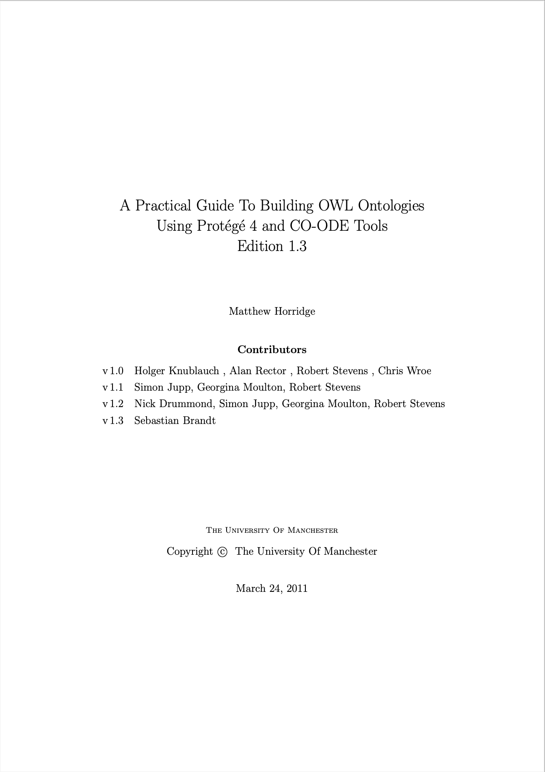
ESSENTIAL READING!
Horridge et al (2011) A Practical Guide to Building OWL Ontologies using Protégé 4 and CO-ODE Tools
http://owl.cs.manchester.ac.uk/publications/talks-and-tutorials/protg-owl-tutorial/

Slide 7
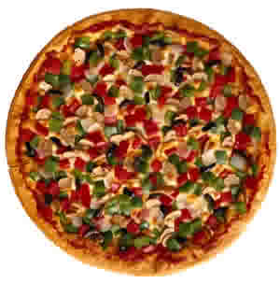
Example ontology: OWL Pizzas
Build an ontology for describing pizzas and their ingredients
Must be able to determine whether pizzas are:
  Vegetarian
  Vegan
  Spicy
  Contain allergens (nuts, dairy)
  Low-calorie

