Slide 2
Ontology Design Patterns
COMP6215 Semantic Web Technologies
Dr Nicholas Gibbins – nmg@ecs.soton.ac.uk

Slide 3
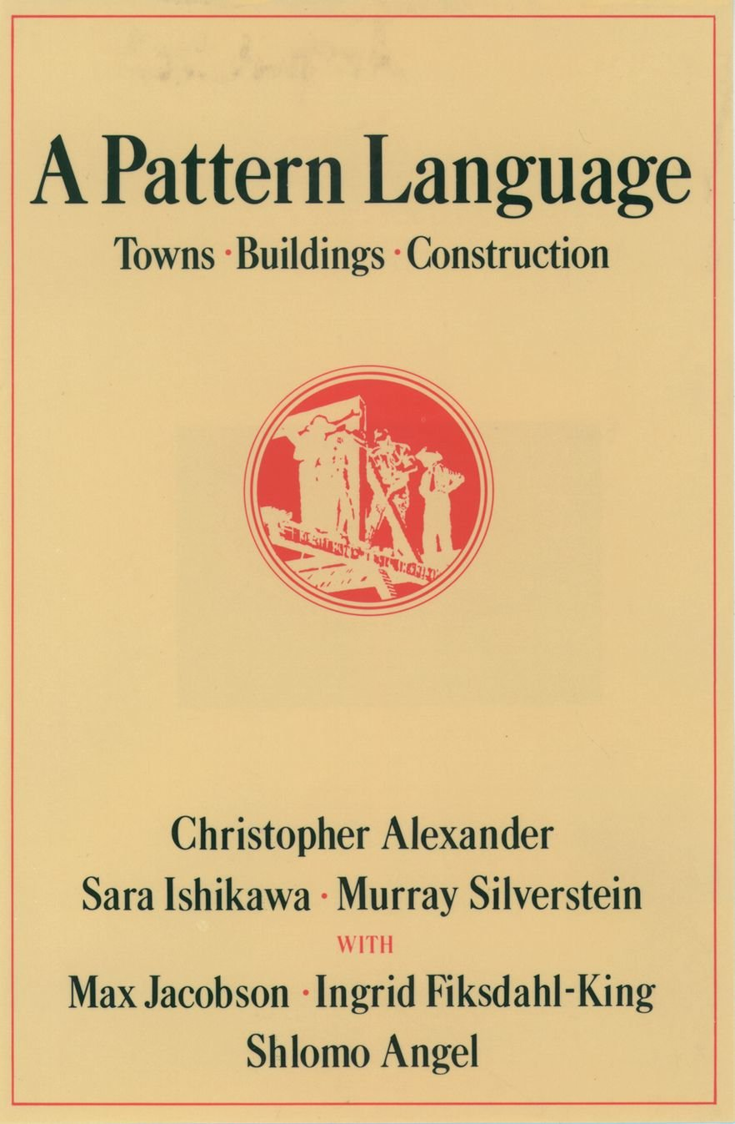
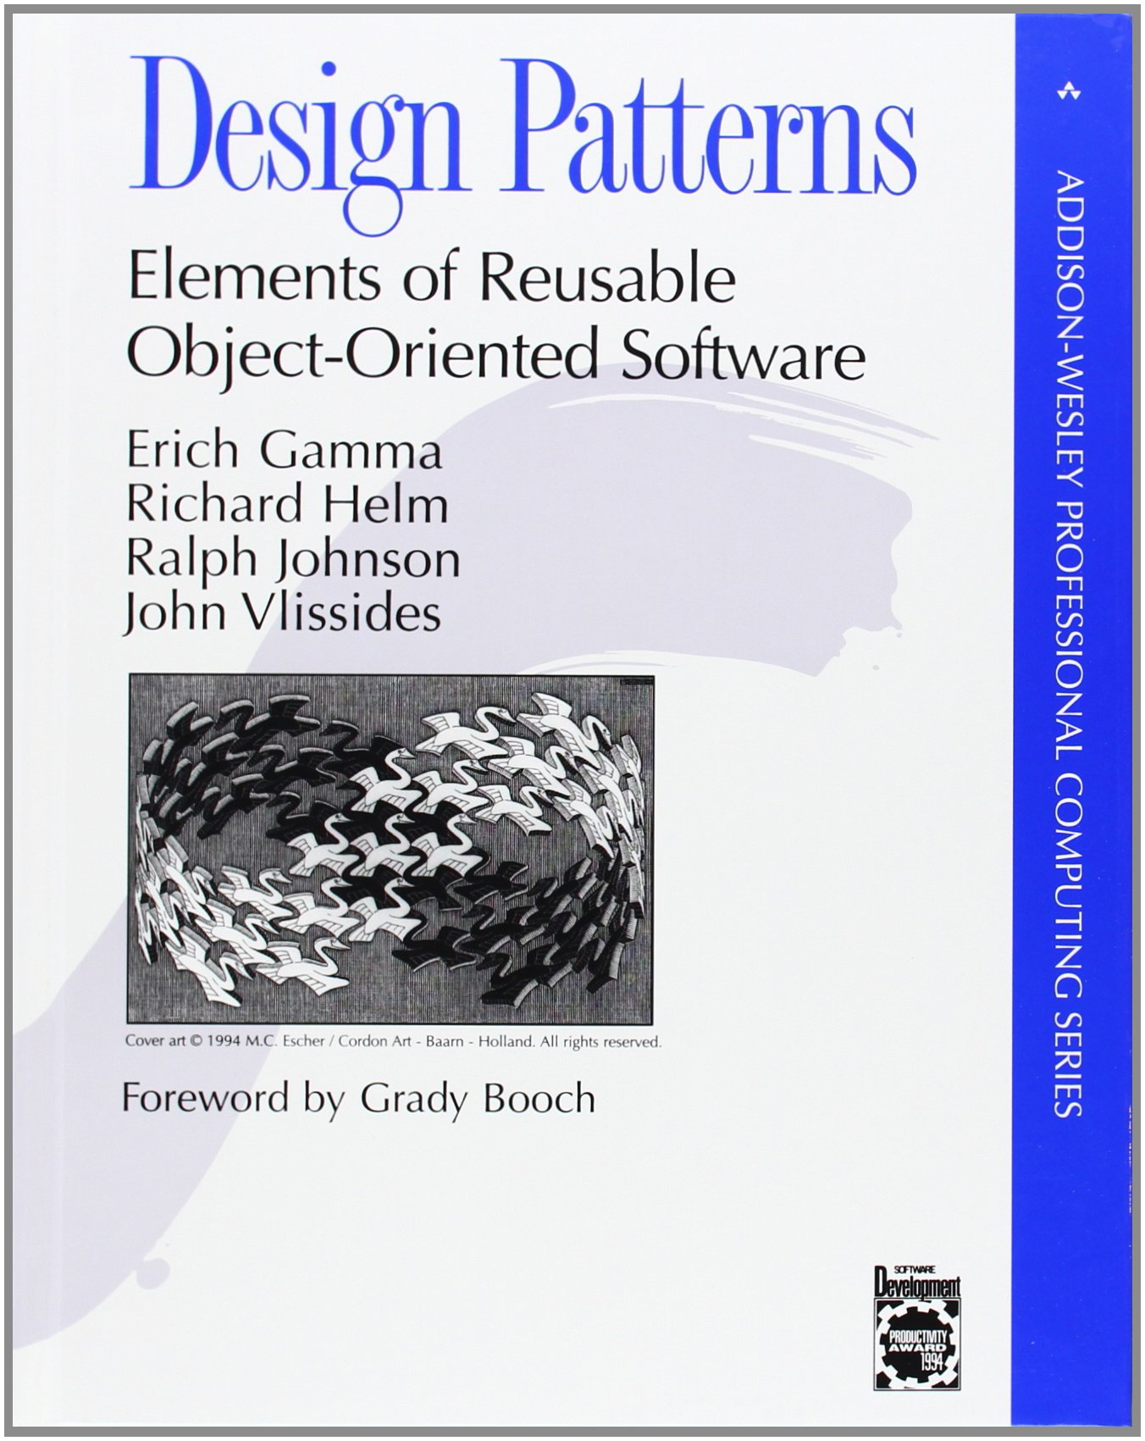
Design Patterns
Patterns are general, reusable solutions to commonly occurring problems
Concept originated with Christopher Alexander’s work on architecture
Popularised in software engineering by the “gang of four”
Subject of study by the knowledge engineering community

Slide 4
Design Patterns for the Semantic Web
N-ary relations
How can we say more about a relation instance?
How do we represent an ordered sequence of relations?
Value partitions and value sets
How do we represent a fixed list of values?
Part-whole hierarchies
How do we represent hierarchies other than the subclass hierarchy?

Slide 5
N-ary Relations

Slide 6
Binary Relations
In RDF and OWL, binary relations link two individuals, or an individual and a value
The properties birthYear and fatherOf are binary relations
birthYear
Holbein the Elder
1460
fatherOf
Holbein the Younger

Slide 7
Relations with Additional Information
In some cases, we need to associate additional info with a binary relation
e.g. certainty, strength, dates
For example, Holbein the Elder’s date of birth is unconfirmed
He was born in either 1460 or 1465
How can we represent this uncertainty?
0.6
certainty
birthYear
1460
Holbein the Elder
0.4
certainty
1465
birthYear

Slide 8
N-ary Relations
N-ary relations link an individual to more than a one value
Possible use cases:
A relation needs additional info e.g. a relation with a rating value
Two binary relations are related to each other e.g. body_temp (high, normal, low), and trend (rising, falling)
A relation between several individuals e.g. someone buys a book from a bookstore
Linking from, or to, an ordered list of individuals e.g. an airline flight visiting a sequence of airports

Slide 9
Pattern 1: Reified Relation
To represent additional information about a relation:
Create a new class to represent the relation
Individuals of this class are instances of the relation
Relation class can have additional properties to describe more information about the relation
C
A
p
B

Slide 10
Use case 1: additional information
Jack has given the film ‘I Am Legend’ a four-star rating
We need to represent a quantitative value to describe the rating relation
Film
Film
Person
The Omega Man
I am Legend
film
film
Rating
Rating
Jack
**
rating
rating
****

Slide 11
Use case 1: additional information
RatingRelation
I am Legend
ratedObject
Jack
issuedRating
ratingValue
****
$$Person ⊑ ∀ issuedRating.RatingRelation$$
$$RatingRelation ⊑ ∃ ratedObject.Film ⊓ ≤1 ratedObject$$
$$RatingRelation ⊑ ∀ ratingValue.Rating⊓ ≤1 ratingValue$$

Slide 12
Use case 2: different aspects of a relation
Steve has a temperature which is high, but falling
We need to represent different aspects of the temperature that Steve has
Temperature
temperatureValue
elevated
Steve
hasTemperature
falling
temperatureTrend

Slide 13
Use case 3: no distinguished participant
John buys a “Lenny the Lion” book from orinoco.com for $15 as a birthday gift
No distinguished subject for the relation
i.e. no primary relation to convert into a Relation Class as in cases 1 and 2
hasBuyer
hasPurpose
John
birthday gift
hasSeller
hasAmount
hasObject
orinoco.com
$15
Lenny the Lion
Source: W3C

Slide 14
Use case 3: no distinguished participant
$$Purchase ⊑∃ hasBuyer. Person ⊓ =1 hasBuyer$$
$$Purchase ⊑∃ hasSeller. Company ⊓ =1 hasSeller$$
$$Purchase ⊑∃ hasObject. Object$$
$$Purchase ⊑∀ hasAmount. Quantity ⊓ =1 hasAmount$$
$$Purchase ⊑∀ hasPurpose. Purpose$$

Slide 15
Pattern 2: Sequence of arguments
United Airlines, flight 1377 visits the following airports: LAX, DFW, and JFK
For such an example, we need to represent a sequence of arguments
flightSequence
destination
UA1377
UA1377_1
LAX
nextSegment
destination
UA1377_2
DFW
nextSegment
destination
UA1377_3
JFK

Slide 16
Pattern 2: Sequence of arguments
$\text{⊤} ⊑ ∀ flightSequence^{−}.Flight$ (flightSequence rdfs:domain Flight)
$\text{⊤} ⊑ ∀ flightSequence.FlightSegment$ (flightSequence rdfs:range FlightSegment)
$\text{⊤} ⊑ ≤1 flightSequence$ (flightSequence is functional)
$\text{⊤} ⊑ ∀ nextSegment^{−}.FlightSegment$ (nextSegment rdfs:domain FlightSegment)
$\text{⊤} ⊑ ∀ nextSegment.FlightSegment$ (nextSegment rdfs:range FlightSegment)
$\text{⊤} ⊑ ≤1 nextSegment$ (nextSegment is functional)
$\text{⊤} ⊑ ∀ destination^{−}.FlightSegment$ (destination rdfs:domain FlightSegment)
$\text{⊤} ⊑ ∀ destination.Airport$ (destination rdfs:range Airport)
$$FlightSegment⊑ =1 destination⊓ ≤1 nextSegment$$
$$FinalFlightSegment≡FlightSegment⊓ =0 nextSegment$$

Slide 17
Value Partitions and Value Sets

Slide 18
Descriptive Features
Descriptive features are quite common in ontologies:
Size = {small, medium, large}
Risk = {dangerous, risky, safe}
Health status = {good health, medium health, poor health}
Also called “qualities”, “modifiers” and “attributes”
A property can have only one value for each feature to ensure consistency
Three main approaches:
Enumerated individuals (a value set)
Disjoint classes (a value partition)
Datatype values (not considered in this lecture)

Slide 19
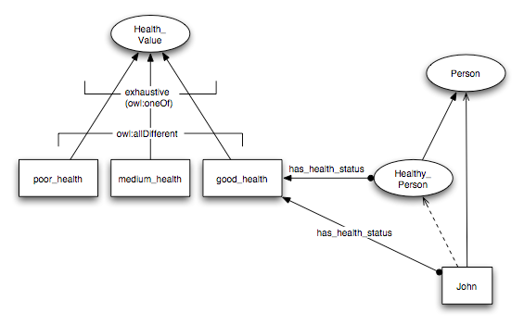
Value Sets
Values of descriptive feature are individuals

Slide 20
Value Sets
A health value can be either poor, medium or good:
$$HealthValue≡\{ poorHealth, mediumHealth, goodHealth \}$$
Poor, medium and good are all different from each other:
$$poorHealth≠mediumHealth$$
$$poorHealth≠goodHealth$$
$$mediumHealth≠goodHealth$$
A healthy person is a person who has some health status which is the value good:
$$HealthyPerson≡Person⊓∃hasHealthStatus.\{ goodHealth \}$$

Slide 21
Notes on Value Sets
Need axioms to set the three health values to be different from each other
This way, a person cannot have more than one health value at a time
Values cannot be further partitioned
e.g. cannot have fairly_good_health as a subtype of good_health
Only one set of values is allowed for a feature
The class HealthValue cannot be equivalent to more than one set of distinct values
Doing so will cause inconsistencies
Notes:
Owl:differentFrom can be set from the individual editor. Click on the individual purple icon and select this property and a value from the ontology

Slide 22
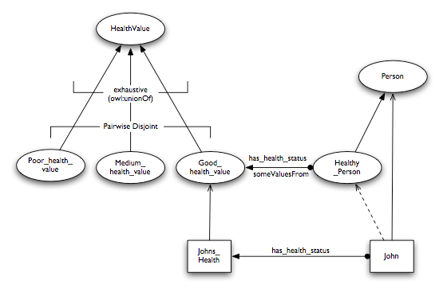
Value Partitions
Values of descriptive features are disjoint subclasses:

Slide 23
Value Partitions
Poor, medium and good are types of health value:
$$PoorHealth⊑HealthValue$$
$$MediumHealth⊑HealthValue$$
$$GoodHealth⊑HealthValue$$
Covering axiom (the only types of health value are poor, medium and good):
$$HealthValue≡PoorHealth⊔MediumHealth⊔GoodHealth$$
Poor, medium and good are pairwise disjoint:
$$PoorHealth⊓MediumHealth≡ ⊥$$
$$PoorHealth⊓GoodHealth≡ ⊥$$
$$MediumHealth⊓GoodHealth≡ ⊥$$
A healthy person is a person who has some health status which is an instance of good
$$HealthyPerson≡Person⊓∃hasHealthStatus.GoodHealth$$

Slide 24
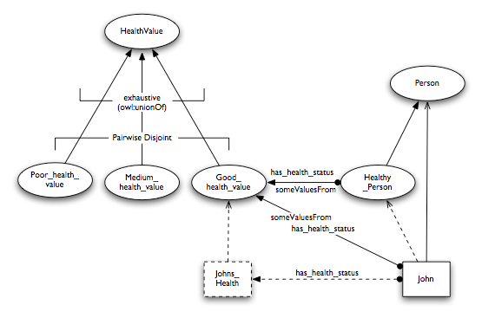
Value Partitions
The instance JohnsHealth can be made anonymous

Slide 25
Notes on Value Partitions
Values can be further partitioned
Simply add subclasses to the value classes
Can have alternative partitions of the same feature
OWL 2 contains specific support for defining disjoint unions
$$C≡C_{1}⊔C_{2}⊔…⊔C_{n}$$
$$C_{1}⊓C_{2}≡ ⊥$$
$$C_{1}⊓C_{3}≡ ⊥$$
$$…$$
$$C_{n−1}⊓C_{n}≡ ⊥$$

Slide 26
Part-Whole Hierarchies

Slide 27
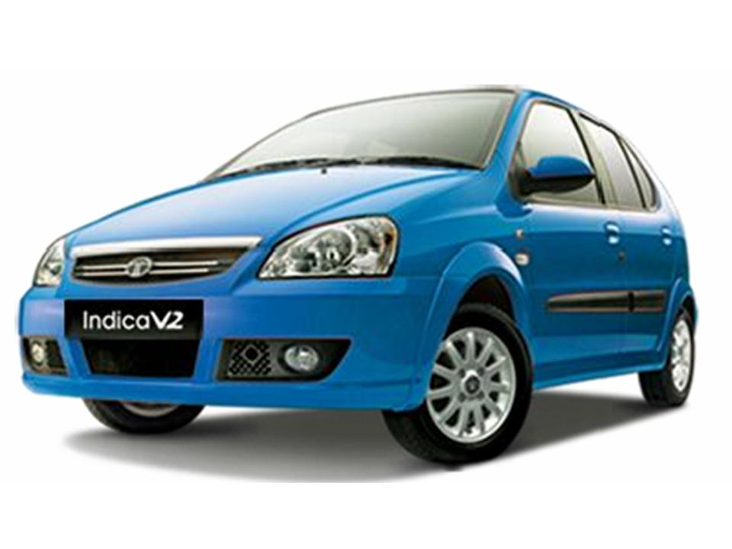
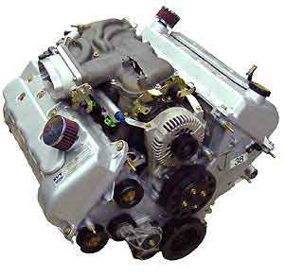
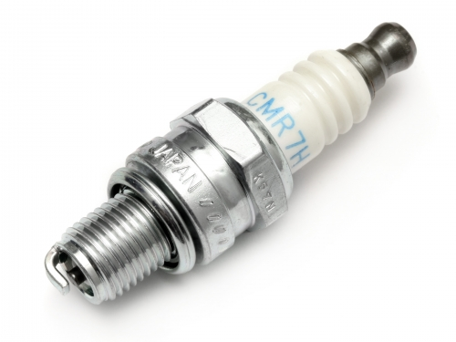
Meronymies (part-whole relations)
Taxonomies are not the only hierarchical relation that we wish to model
A spark plug isn’t a kind of engine (class-instance)
A spark plug is a part of an engine

Slide 28
Simple Part-Whole Representation
We need two properties:
$partOf$ (a transitive property)
$directPartOf$ (a subproperty of $partOf$)
$$part of∘partOf⊑partOf$$
$$directPartOf⊑partOf$$

Slide 29
Part-Whole Hierarchies
Represent part-whole relationships between classes using existential restrictions:
Every spark plug is a direct part of some engine: $SparkPlug⊑∃directPartOf.Engine$
Every engine is a direct part of some car: $Engine⊑∃directPartOf.Car$
Every wheel is a direct part of some car: $Wheel⊑∃directPartOf.Car$

Slide 30
Defining Classes of Parts
Extend the ontology with classes of parts for each level, so that the reasoner can automatically derive a class hierarchy:
A car part is a part of some car: $CarPart≡∃partOf.Car$
A direct car part is a direct part of some car: $DirectCarPart≡∃directPartOf.Car$
An engine part is a part of some engine: $EnginePart≡∃partOf.Engine$
A reasoner will infer that $EnginePart⊑CarPart$ (but not $EnginePart⊑DirectCarPart$)

Slide 31
Fault Location
Once we have a meronymy, we can use it to inherit features within that hierarchy
For example, a reasoner could infer that a fault in a part is a fault in a whole
Need a new property for the location of a fault: $hasLocus$
Need a new class for faults: $Fault$
We can then define general types of located faults:
$$FaultInCar≡Fault⊓∃hasLocus.CarPart$$
$$FaultInEngine≡Fault⊓∃hasLocus.EnginePart$$

Slide 32
Fault Location
Now we can define specific types of located fault:
$$DirtySparkPlug⊑Fault⊓∃hasLocus.SparkPlug$$
$$FlatTyre⊑Fault⊓∃hasLocus.Wheel$$
The definition of the hierarchy allows a reasoner to infer that:
$$DirtySparkPlug⊑FaultInCar$$
$$DirtySparkPlug⊑FaultInEngine$$
$$FlatTyre⊑FaultInCar$$
But not:
$$FlatTyre⊑FaultInEngine$$

Slide 33
Further Reading

Slide 34
SWBP Notes
Defining N-ary Relations on the Semantic Web http://www.w3.org/TR/swbp-n-aryRelations
Representing Specified Values in OWL http://www.w3.org/TR/swbp-specified-values
Simple part-whole relations in OWL Ontologies http://www.w3.org/2001/sw/BestPractices/OEP/SimplePartWhole/

