Slide 2
Data Storage
COMP3211 Advanced Databases
Dr Nicholas Gibbins - nmg@ecs.soton.ac.uk

Slide 3
Overview
Storage Organisation
Secondary storage
Buffer management
The Five-Minute Rule
Disk Organisation
  Data Items
  Records
  Blocks

Slide 4
Storage Organisation

Slide 5
The Memory Hierarchy
Cache
Main Memory
Secondary Storage
Tertiary Storage

Slide 6
The Memory Hierarchy: Cache
Volatile storage
Very fast, very expensive, limited capacity
Hierarchical
Typical capacities and access times:
  Registers – ~10¹ bytes, 1 cycle
  L1 – ~10⁴ bytes, <5 cycles
  L2 – ~10⁵ bytes, 5-10 cycles
Cache
Main Memory
Secondary Storage
Tertiary Storage
Notes:
Typical figures – Intel Xeon E5-2407 (Xeon E5 2nd gen – early 2014) - $250
32B of gp registers
L1 32kiB per core SRAM
L2 256 kiB per core DRAM
L3 10 MiB
Intel Core i7-10700F 2.9GHz (10th gen – early 2020) £250
8 core
128B of gp registers (16 x 64b)
L1 64kiB per core
L2 256kiB per core
L3 16MiB shared

Slide 7
The Memory Hierarchy: Main Memory
Volatile storage
Fast, affordable, medium capacity
Typical capacity: 10⁹-10¹⁰ bytes
Typical access time: 10⁻⁸ s (20-30 cycles)
Cache
Main Memory
Secondary Storage
Tertiary Storage

Slide 8
The Memory Hierarchy: Secondary Storage
Non-volatile storage
Slow, cheap, large capacity
Typical capacity: 10¹¹-10¹² bytes
Typical access time: 10⁻³ s (10⁶ cycles)
Cache
Main Memory
Secondary Storage
Tertiary Storage

Slide 9
The Memory Hierarchy: Tertiary Storage
Non-volatile storage
Very slow, very cheap, very large capacity
Typical capacity: 10¹³-10¹⁷ bytes
Typical access time: 10¹-10² s
Cache
Main Memory
Secondary Storage
Tertiary Storage

Slide 10
Secondary Storage

Slide 11
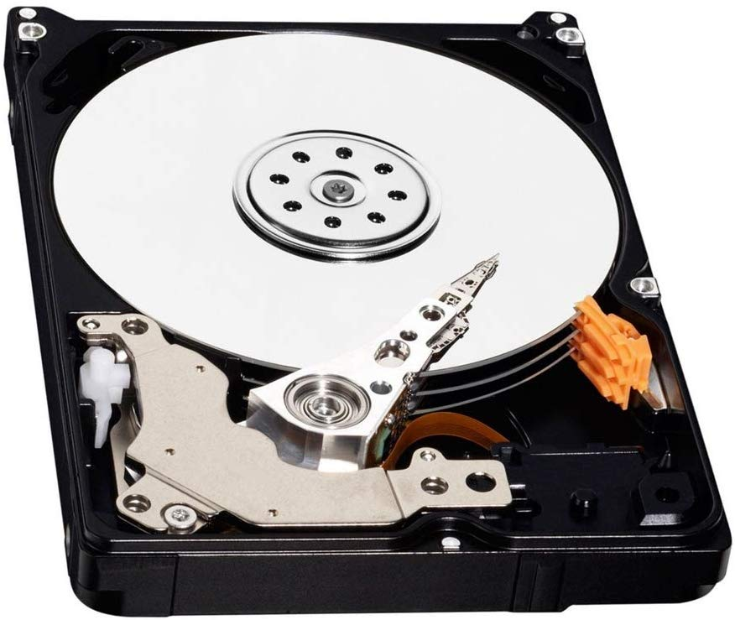
Hard Disk Drives
Typical secondary storage medium for databases

Slide 12
spindle
platter/disk
(surfaces on
both sides)
head
arm
actuator

Slide 13
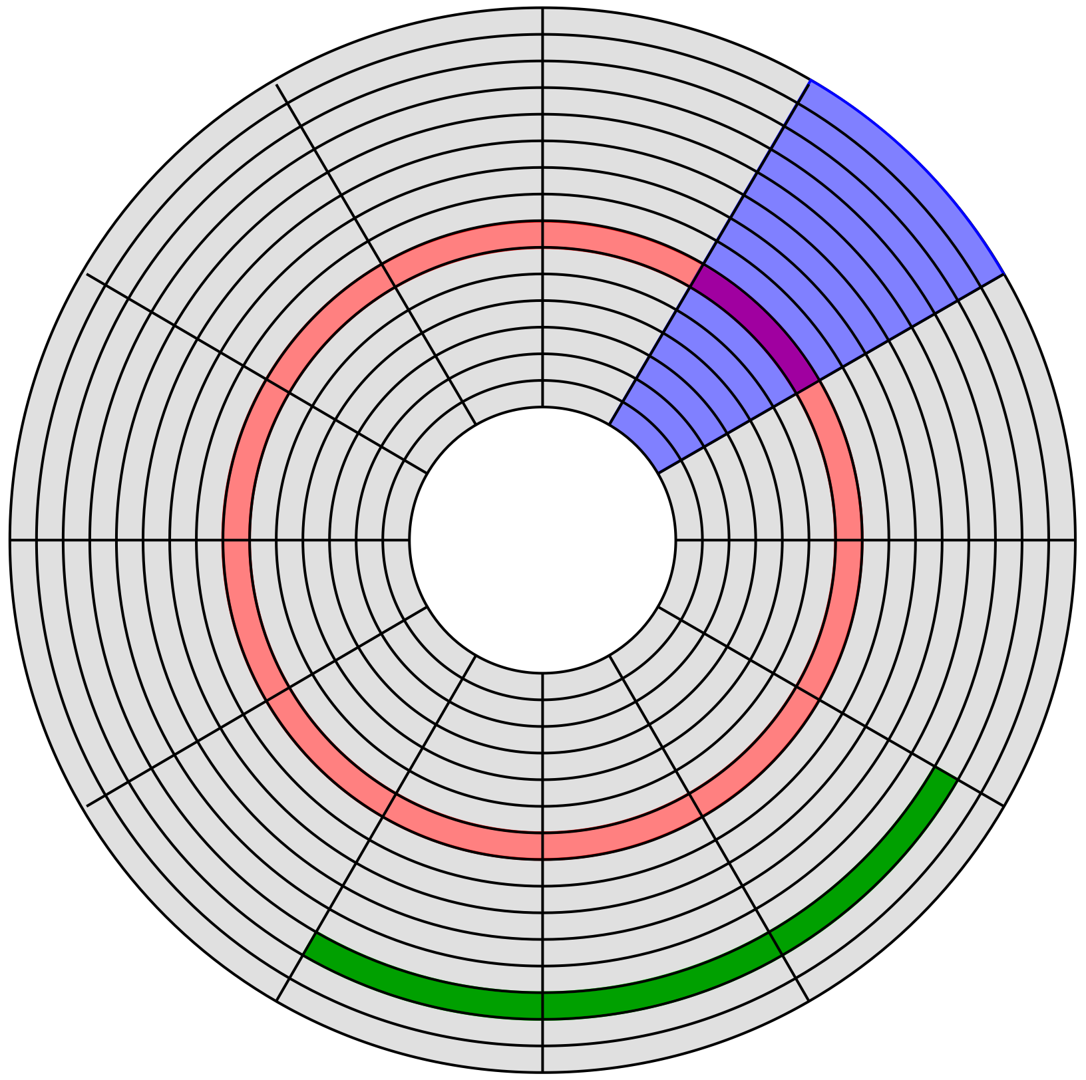
Disk Structure
geometrical sector
track sector
track
cylinder is the same
track on all surfaces
cluster

Slide 14
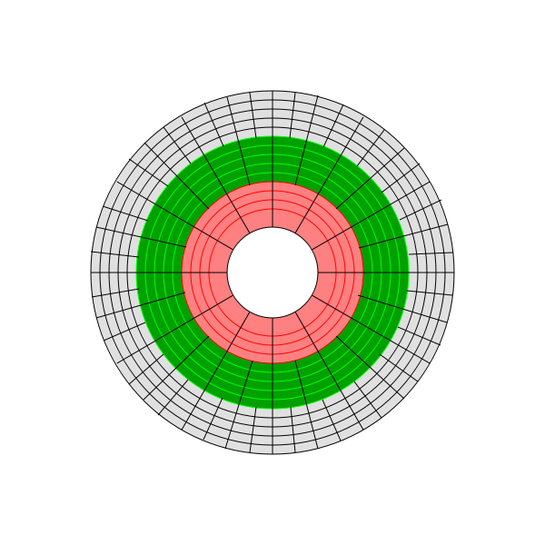
Zone Bit Recording
Tracks closer to the disc edge are longer than those closer to the axis
  Bit densities vary in order to ensure a constant number of bits per sector
Instead, we can vary the number of sectors per track (depending on track location)
  Improves overall storage density
  A hybrid of constant linear velocity (CLV) and constant angular velocity (CAV)

Slide 15
Disk Sector Format
Terms:
  Gap – separator between sectors
  Sync – indicates start of sector
  Address mark – indicates sector’s number/location
  ECC – error correcting code (may be distributed)
For 4k Advanced Format:
  gap+sync+mark = 15 bytes
  data = 4096 bytes
  ecc = 100 bytes
  2.7% overhead
gap
sync
mark
data
ecc

Slide 16

Disk Access Time: Reading
Access Time = Seek Time +
Rotational Delay +
Transfer Time
block requested
access time
block in memory

Slide 17
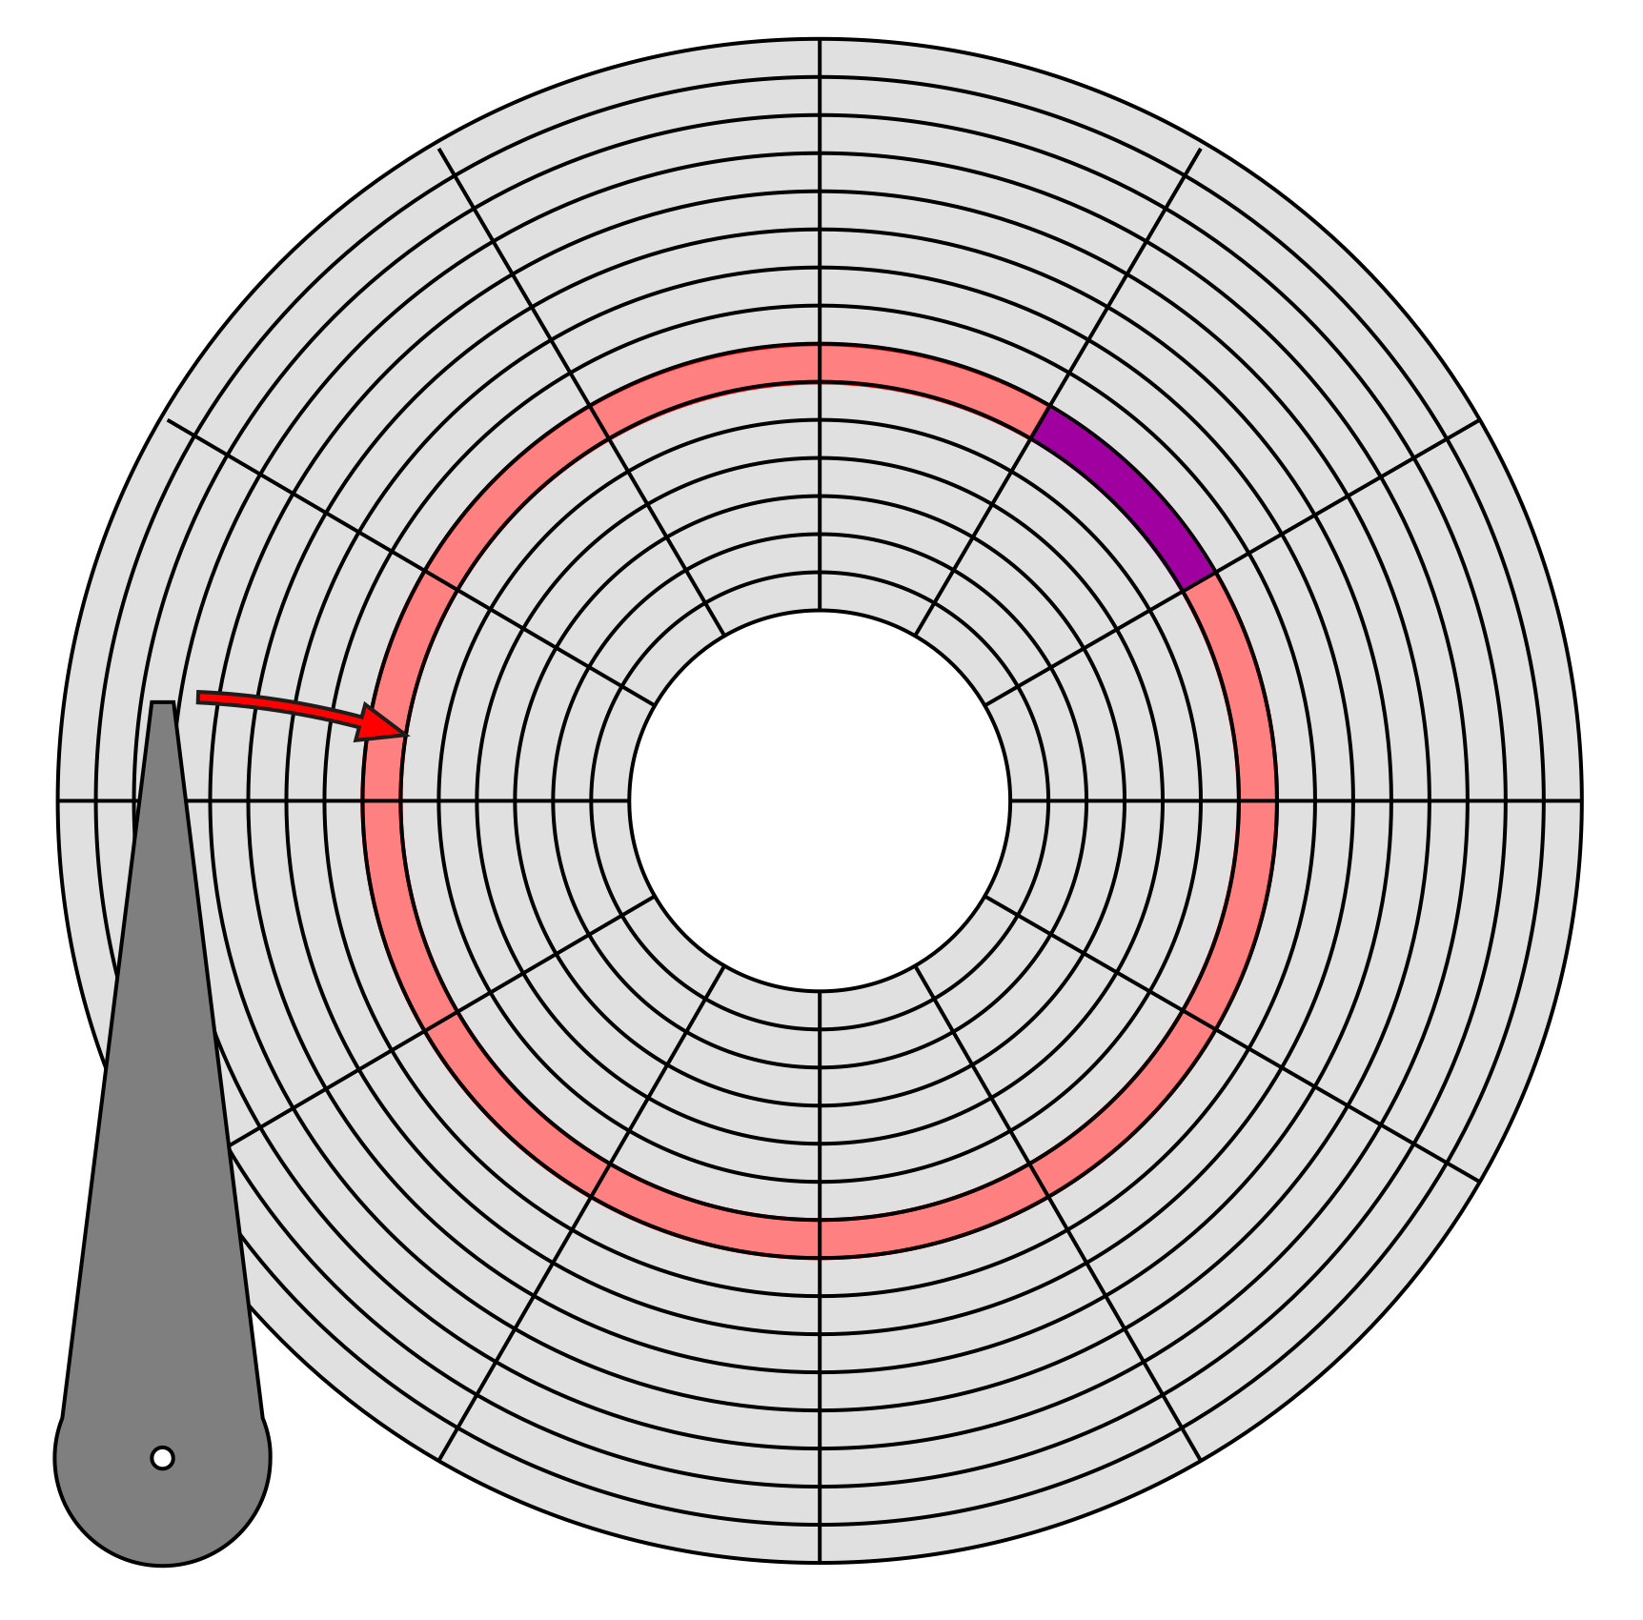
Seek Time
Time taken for head assembly to move to a given track
Average seek time range:
  4ms for high end drives
  15ms for mobile devices

Slide 18
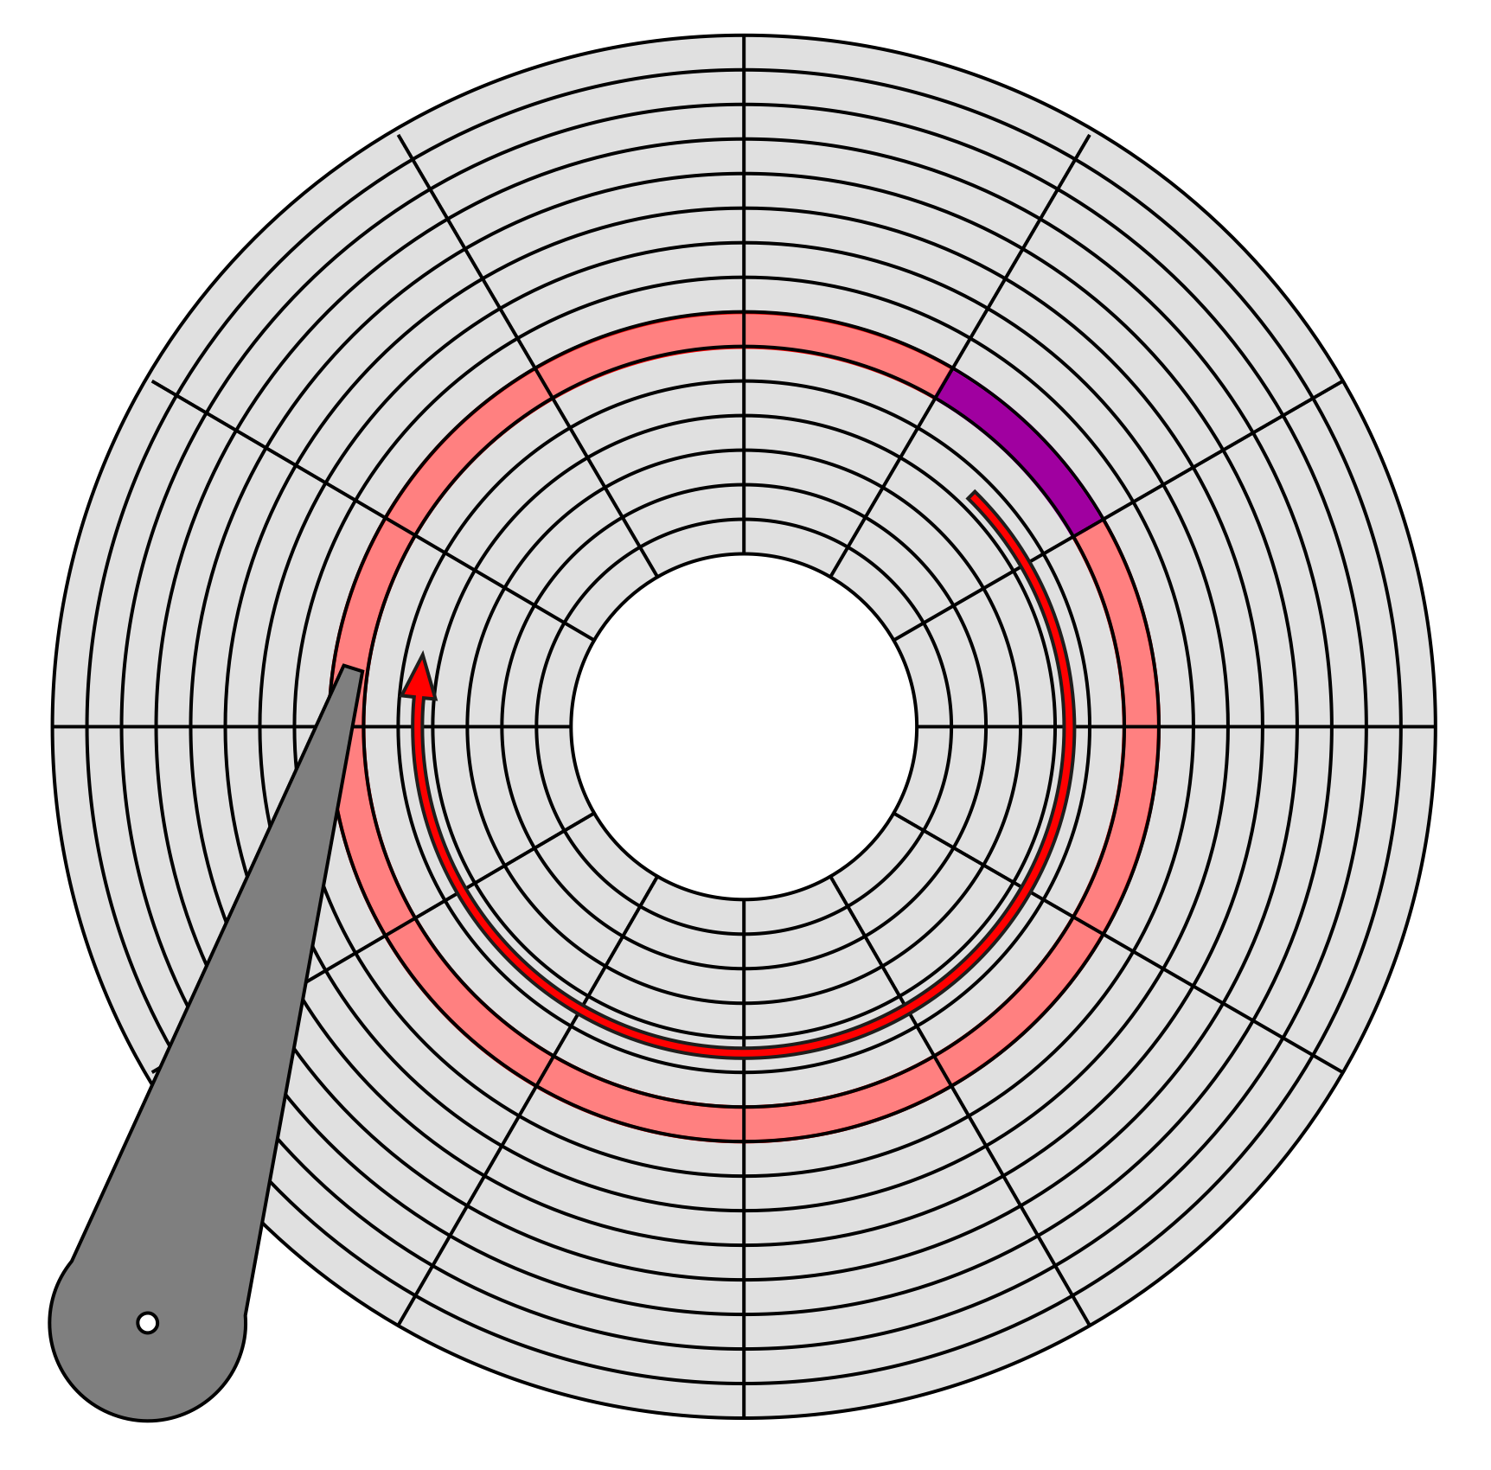
Rotational Delay (Latency)
Average delay = time for 0.5 rev
rotational speed [rpm] | average delay [ms]
4,200 | 7.14
5,400 | 5.56
7,200 | 4.17
10,000 | 3.00
15,000 | 2.00

Slide 19
Transfer Time
Transfer rate ranges from:
  up to 1000 Mbit/sec
  432 Mbit/sec 12x Blu-Ray disk
  1.23 Mbits/sec 1x CD
  for SSDs, limited by interface
  e.g., SATA 3000 Mbit/s
Transfer time = block size / transfer rate

Slide 20
Sequential Access
So far, random access - what about reading “next” block?
Access time = ( block size / transfer rate ) + negligible costs
Negligible costs:
  skip inter-block gap
  switch track (within same cylinder)
  switch to adjacent cylinder occasionally
In general, sequential i/o is much less expensive than random i/o
Notes:
if double buffer, stagger blocks, etc
random: 10ms
seq: 1ms

Slide 21
Disk Access Time: Writing
Costs similar to those for reading, unless we wish to verify data
Verifying requires that we read the block we’ve just written
Access Time = Seek Time +
Rotational Delay (1/2 rotation) +
Transfer Time (for writing) +
Rotational Delay (full rotation) +
Transfer Time (for verifying)

Slide 22
Disk Access Time: Modifying
Read Block
Modify in Memory
Write Block
Verify Block (optional)

Slide 23
Disk Access Time: Modifying
Access Time = Seek Time +
Rotational Delay (1/2 rotation) +
Transfer Time (for reading) +
Rotational Delay (full rotation) +
Transfer Time (for writing) +
[ Rotational Delay (full rotation) +
Transfer Time (for verifying)
]

Slide 24
Block Addressing
Cylinder-head-sector
  Physical location of data on disk
  ZBR causes problems (sectors vary by tracks)
Logical Block Addressing
  Blocks located by integer index
  HDD firmware maps LBA addresses to physical locations on disk
  Allows remapping of bad blocks

Slide 25
Block Size Selection?
The size of blocks affects I/O efficiency:
Big blocks reduce the costs of access
  Fewer seeks (seek time + rotational delay) for the same amount of data
Big blocks also increase the amount of irrelevant data read
  If you’re trying to read a single record in a block, larger blocks force you to read more data

Slide 26
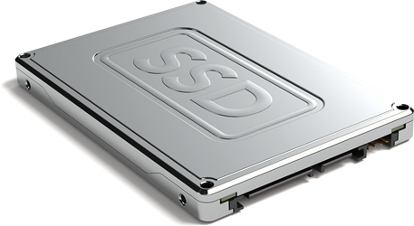
But what about Solid State Drives?

Slide 27
Solid State Drives
Typically based on NAND flash memory
More expensive than HDD (~4-5x)
  Getting cheaper over time
  Global SSD production was expected to exceed HDD production in 2021
Typically smaller maximum size than HDD (~1-2TB)
Considerably higher I/O performance
Asymmetric read/write performance (writes are slower)
Limited number of program-erase cycles (~100,000 – wear levelling used)
Notes:
Samsung have a 16TB SSD, but that’s an outlier.

Slide 28
HDD versus SSD
Random I/Os per second (IOPS) = 1/ (seek + latency + transfer)
 | HDD * | SSD **
Random Read IOPS | 125-150 IOPS | ~50,000 IOPS
Random Write IOPS | 125-150 IOPS | ~40,000 IOPS
* Assumes 10,000 rpm HDD with SATA 3Gb/s interface
** OCZ 480GB Vertex 3 (c. 2012) with SATA 6Gb/s interface

Slide 29
Buffer Management

Slide 30
The Buffer Pool
Far more blocks of secondary storage than space in main memory – need to be selective about what’s kept in memory
Buffer pool organised into frames (size of database block, plus metadata)
X
X
X
buffer
pool
higher-level
code
disk
Notes:
Far more blocks of secondary storage than main memory = need to be selective about what gets kept in main memory
DBMS sets aside an area of main memory, organised as frames (= size of database block)
When a block is read from disc, it’s read into a frame in the buffer pool (

Slide 31
Buffer Metadata
Each frame in the buffer pool has:
  a pin count (number of current users of the block in that frame)
  a dirty flag (1 if the copy in the buffer has been changed, 0 otherwise)
  an access time (optional – used for LRU replacement)
  a loading time (optional – used for FIFO replacement)
  a clock flag (optional – used for Clock replacement)

Slide 32
Requesting a Block
if buffer pool already has a frame containing the block
then increment pin count (“pin the block”)
else if there is an empty frame
then read block into empty frame and set pin count to 1
else choose a frame to be replaced
if dirty bit on the replacement frame is set
then write block in replacement frame to disk
endif
read block into replacement frame and set pin count to 1
endif
endif

Slide 33
Buffer Replacement Strategies
A frame will not be selected for replacement until its pin count is 0
If there’s more than one frame with a pin count of 0, use a replacement strategy to choose the frame to be replaced
  Least Recently Used (LRU)
  Select the frame with the oldest access time
  First In First Out (FIFO)
  Select the frame with the oldest loading time
  Clock
  Approximation of LRU – cycle through each buffer in turn, if a buffer hasn’t been accessed in a full cycle then mark it for replacement

Slide 34
Single Buffering
Read B1 → Buffer
Process Data in Buffer
Read B2 → Buffer
Process Data in Buffer ...

Slide 35
Single Buffering
Buffer
load from disk
Disk
B1
B2
B3
B4
B5
B6
B7
B8

Slide 36
Single Buffering
Buffer
B1
process block
Disk
B1
B2
B3
B4
B5
B6
B7
B8

Slide 37
Single Buffering
Buffer
load from disk
Disk
B1
B2
B3
B4
B5
B6
B7
B8

Slide 38
Single Buffering
Buffer
B2
process block
Disk
B1
B2
B3
B4
B5
B6
B7
B8

Slide 39
Single Buffering
Buffer
load from disk
Disk
B1
B2
B3
B4
B5
B6
B7
B8

Slide 40
Single Buffering Cost
Single buffer time = n(P + R)
where P = time to process a block
R = time to read a block
n = number of blocks

Slide 41
Double Buffering
Use a pair of buffers:
  While reading a block and writing into buffer A
  Process block previously read into buffer B
  After block read into A, process A and read next block into B
Notes:
Also: pre-fetching

Slide 42
Double Buffering
Buffer
load from disk
Disk
B1
B2
B3
B4
B5
B6
B7
B8

Slide 43
Double Buffering
process block
Buffer
B1
load from disk
Disk
B1
B2
B3
B4
B5
B6
B7
B8

Slide 44
Double Buffering
process block
Buffer
B2
load from disk
Disk
B1
B2
B3
B4
B5
B6
B7
B8

Slide 45
Double Buffering
process block
Buffer
B3
load from disk
Disk
B1
B2
B3
B4
B5
B6
B7
B8

Slide 46
Double Buffering
If time to process a block > time to read a block:
Double buffer time = R + nP
Single buffer time = n(R+P)

Slide 47
The Five Minute Rule

Slide 48
The Five Minute Rule
Data referenced every five minutes
should be memory resident

Slide 49
The Five Minute Rule
The Five Minute Rule for trading memory for disc accesses
Jim Gray & Franco Putzolu
May 1985
The Five Minute Rule, Ten Years Later
Goetz Graefe & Jim Gray
December 1997
The five-minute rule 20 years later (and how flash memory changes the rules)
Goetz Graefe
July 2009
The Five-Minute Rule 30 years later, and its impact on the storage hierarchy
Raja Appuswamy, Goetz Graefe, Renata Borovica-Gajic and Anatasia Ailamaki
November 2019

Slide 50
The Five Minute Rule
Assume a block is accessed every X seconds:
CD = cost if we keep that block on disk
  $D = cost of disk unit
  I = number of IOs that unit can perform per second
  In X seconds, unit can do XI IOs
  So, CD = $D / XI

Slide 51
The Five Minute Rule
Assume a block is accessed every X seconds:
CM = cost if we keep that block in RAM
  $M = cost of 1MB of RAM
  P = number of pages in 1MB RAM
  So CM = $M / P

Slide 52
The Five Minute Rule
Assume a block is accessed every X seconds:
If CD is smaller than CM,
  keep block on disk
  else keep in memory
Break even point when CD = CM, or X = ($D P) / (I $M)

Slide 53
Using 1997 numbers
P = 128 blocks/MB (8kB pages)
I = 64 accesses/sec/disk (16ms to read 8kB)
$D = $2000/disk (9GB HDD + controller)
$M = $15/MB of RAM
X = 266 seconds (about 5 minutes)
(did not change much from 1985 to 1997)
Notes:
64 IOPS = 15ms per IO

Slide 54
Using 2007 numbers
P = 256 blocks/MB (4KB pages)
I = 83 accesses/sec/disk (12ms to read 4KB)
$D = $80/disk (250GB SATA HDD)
$M = $0.047/MB of RAM
X = 5,248 seconds (about 1.5 hours)

Slide 55
Using 2007 numbers
P = 256 blocks/MB (4KB pages)
I = 6,200 accesses/sec/disk (0.16ms to read 4KB)
$D = $999/disk (32GB SSD)
$M = $0.047/MB of RAM
X = 876 seconds (about 15 minutes)

Slide 56
Using 2016 numbers
P = 256 blocks/MB (4KB pages)
I = 64,000 accesses/sec/disk (0.015ms to read 4KB)
$D = $685/disk (240GB SSD)
$M = $0.034/MB of RAM
X = 805 seconds (about 13.5 minutes)
Notes:
HP Value Endurance 240GB SSD - £476
Crucial 64GB Kit (16GBx4) DDR4-2400 - $560

Slide 57
The changing memory hierarchy
The falling price of SSD makes it a viable tier between the performance of DRAM and the capacity of HDDs
  The break-even for DRAM-SSD on modern systems is again ~5 minutes
  (the DRAM-HDD case is now about 4 hours)
  The break-even for SSD-HDD is now about 1.5 *days*
  The energy costs of DRAM are much greater (>10x) than SSD
  The energy costs of HDD are much greater than tape (idling consumption)
  Likely transition to NVDIMM memory (DRAM+NAND flash)
 | 1987 | 1997 | 2007 | 2018
DRAM | $5000 | $14.6 | $0.05 | $0.005
HDD | $83 | $0.22 | $0.0003 | $0.00002
SDD |  |  | $0.03 | $0.0005

Slide 58
Disk Organisation

Slide 59
Overview
Data Items
Records
Blocks
Files

Slide 60
Data Items

Slide 61
Data Items
We might wish to store:
  a salary
  a name
  a date
  a picture
We have: bytes
8 bits

Slide 62
Representing numbers
Integer (short): 2 bytes
  e.g. 57 is
Real numbers: IEEE 754 (floating point)
  1 bit sign, n bits for mantissa, m bits for exponent
0
0
0
0
0
0
0
0
0
0
1
1
1
0
0
1

Slide 63
Representing characters
Various coding schemes: ASCII, utf-8
‘A’
‘c’
CR
0
1
0
0
0
0
0
1
0
1
1
0
0
0
1
1
0
0
0
0
1
1
0
1

Slide 64
Representing booleans
1 byte per value
True
False
We can pack more than one value per byte, if we’re desperate
1
1
1
1
1
1
1
1
0
0
0
0
0
0
0
0

Slide 65
Representing dates
Days since a given date (integer)
  1st Jan 1900
  1st Jan 1970 (UNIX epoch)
ISO8601 dates
  Calendar dates: YYYYMMDD (8 characters)
  Ordinal dates: YYYYDDD (7 characters)

Slide 66
Representing times
Seconds since midnight (integer)
ISO8601 times
  HHMMSS (6 characters)
  HHMMSSFF (8 characters, to represent fractional seconds)
Notes:
See also UNIX time (seconds since the UNIX epoch)
What will happen at 03:14:07 Tuesday 19 January 2038?
(stored as signed 32-bit signed int – storing as 64-bit signed int would fix problem permanently; overflows after the expected lifetime of the universe)
Other encodings: Java uses 64-bit signed int for milliseconds after 1 Jan 1970 – 292 million year range.

Slide 67
Representing strings
E
C
S
...
Null terminated
Length given
Fixed length
3
E
C
S
...
E
C
S

Slide 68
Representing bit arrays
length
bits

Slide 69
In general...
Data items are either
  Fixed length (integers, characters, etc)
  Variable length (strings, bit arrays) usually with length given at start
May also include type of data item
  Tells us how to interpret the item
  Tells us size, if fixed

Slide 70
Records

Slide 71
Records
Collection of related data items (fields)
  e.g. Employee record consists of:
    name field
    salary field
    employment start date field

Slide 72
Record types
Records may have fixed or variable formats
Records may have fixed or variable lengths

Slide 73
Fixed format records
Schema describes the structure of records:
  number of fields
  types of fields
  order in record
  meaning of each field

Slide 74
Example: Fixed format record
Employee record structure:
  e#, 2 byte integer
  name, 10 char
  dept, 2 byte code
schema
5 5
s m i t h
0 2
records
8 3
j o n e s
0 1

Slide 75
Variable format records
Schema-less format
  Record itself contains format: “self-describing”
Useful for sparse records, repeating fields, evolving formats
May waste space compared to a fixed format record
Notes:
But repeating fields does not require variable format

Slide 76
Example: Variable format record
code identifying field as name
string type
string length
no. of fields
2
5 I 4 6
4 S 4 F o r d
integer type
code identifying field as e#

Slide 77
Record headers
Data at beginning of record that describes record:
  record type (points to schema)
  record length
  timestamp
Intermediate between fixed and variable format

Slide 78
Blocks

Slide 79
Storing records in blocks
5 5
s m i t h
0 2
8 3
j o n e s
0 1
records
2
5 I 4 6
4 S 4 F o r d
8 3
j o n e s
0 1
2
5 I 4 6
4 S 4 F o r d
5 5
s m i t h
0 2
8 3
j o n e s
0 1
blocks
...
file
Notes:
Assume fixed-length blocks
Assume single file

Slide 80
Block header
Data at beginning that describes block
May contain:
  File ID (or RELATION or DB ID)
  This block ID
  Record directory
  Pointer to free space
  Type of block (e.g. contains recs type 4; is overflow, …)
  Pointer to other blocks “like it”
  Timestamp ...

Slide 81
Placing records in blocks
Considerations:
  separating records
  spanned vs. unspanned
  sequencing
  indirection

Slide 82
Separating records in a block
Three approaches:
  use fixed length records - no need to separate
  use a special marker to indicate record end
  give record lengths (or offsets)
    within each record
    in block header
R1
R2
R3

Slide 83
Spanned vs. Unspanned
Unspanned: each record must fit within a single block
Spanned: records may be split between blocks
R1
R2
R3
R4
R5
R1
R2
R3a
R3b
R4
R5

Slide 84
Spanned records
need indication
of continuation
(from where?)
R1
R2
R3a
R3b
R4
R5
need indication
of partial record
“pointer” to rest

Slide 85
Spanned vs. Unspanned
Unspanned records are much simpler, but may waste space…
Spanned records are essential if record size > block size

Slide 86
Sequencing
Sequencing: ordering records in file (and block) by some key value
Makes it possible to efficiently read records in order
  e.g., to do a merge-join — discussed later in module

Slide 87
Sequencing Options
Next record physically contiguous:
Linked records:
R1
R2
R3
R1
R2

Slide 88
Sequencing Options
Overflow area
header
R1
Records
in sequence
R2
R3
R2.1
R4
R1.3
R5
R4.7

Slide 89
Indirection
How do we refer to records?
Many options:
  physical addressing
  indirect addressing
  other options in between
Tradeoff between:
  flexibility (easier to move records on insertion/deletion)
  cost (of maintaining indirection)
Rx

Slide 90
Physical Addressing
Device
Cylinder
Head
Sector
Offset in block
Block ID
Record ID =

Slide 91
Indirect Addressing
map
Record ID | Physical Address
physical
address
id
Record ID is arbitrary bit string

Slide 92
Indirection in block
Typical implementation
  Records can be shifted within block without changing record ID
  Access to a given record ID is fast – only a single block access needed
record ID
block ID
offset
offset table
#entries
free space
record 4
record 3
record 2
record 2
record 1

Slide 93
Address Management
Every block and record has two addresses:
  a database address (when in secondary storage)
  a memory address (when copied into a buffer)
Translation table records mapping from database addresses to memory addresses:
When in a buffer, using only memory addresses (= pointers) is more efficient
DB address | Memory address

Slide 94
Pointer Swizzling
General term for techniques used to translate database address space to virtual memory address space
Swizzled pointers typically consist of
  One bit to indicate whether the pointer is a database address or a memory address
  A database or memory pointer, as appropriate
Translation table is used to convert pointers (and to record the conversion)

Slide 95
Swizzling
Buffer
Disk
Block 1
A
B_{d}
C_{d}
B
Block 2
C
database pointer
memory pointer

Slide 96
Swizzling
Buffer
Disk
Block 1
Block 1
load into
buffer
A
B_{d}
C_{d}
A
B_{d}
C_{d}
B
B
Block 2
C
database pointer
memory pointer

Slide 97
Swizzling
Buffer
Disk
Block 1
Block 1
A
B_{m}
C_{d}
A
B_{d}
C_{d}
swizzled
pointer
B
B
Block 2
C
database pointer
memory pointer

Slide 98
Swizzling
Buffer
Disk
Block 1
Block 1
A
B_{m}
C_{d}
A
B_{d}
C_{d}
B
B
Block 2
Block 2
C
load into
buffer
C

Slide 99
Swizzling
Buffer
Disk
Block 1
Block 1
A
B_{m}
C_{m}
A
B_{d}
C_{d}
B
B
swizzled
pointer
Block 2
Block 2
C
C

Slide 100
Swizzling Strategies
Automatic
  As soon as block brought into memory, locate all pointers and addresses and enter them into translation table
  Replace pointers in blocks with new entries
On Demand
  Leave all pointers unswizzled when block in brought into memory
  Swizzle pointers only when dereferenced
No swizzling
  Use translation table to map pointers on each dereference
Notes:
On demand – use segmentation fault to drive swizzling

Slide 101
Unswizzling
Reverse of the swizzling operation – rewrite memory addresses as database addresses
  Use the translation table
  Translation table is designed to map from DB address to memory address – need an index
Need to be aware of the relationship between unswizzling and unpinning
  Blocks in the buffer pool are pinned to indicate that some part of the DBMS is using their contents
  However, a block may be pinned if there are swizzled pointers that point to that block
  In order to unpin the block (to allow the frame to be reused), we need to unswizzle any pointers to that block
Notes:
Pinned due to recovery operations
Pinned due to references from other blocks in memory

Slide 102
Swizzling
Buffer
Disk
Block 1
Block 1
A
B_{m}
C_{m}
A
B_{d}
C_{d}
B
B
Block 2
Block 2
C
C

Slide 103
Swizzling
Buffer
Disk
Block 1
Block 1
A
B_{m}
C_{d}
A
B_{d}
C_{d}
B
B
Block 2
Block 2
block to unpin
and write
C
C
unswizzled
pointer

Slide 104
Swizzling
Buffer
Disk
Block 1
Block 1
A
B_{m}
C_{d}
A
B_{d}
C_{d}
B
B
Block 2
Block 2
C
C
write to disk

Slide 105
Insertion and Deletion

Slide 106
Insertion: the easy case
Records not in sequence
  Insert new record at end of file or in deleted slot
  If records are variable size, not as easy...

Slide 107
Insertion: the hard case
Records in sequence
  If free space “close by”, not too bad...
  Or use overflow idea...

Slide 108
Insertion considerations
How much free space should we leave:
In each block?
In each track?
In each cylinder?
How often should we reorganise files?
Free
space

Slide 109
Deletion
Two main options:
  Immediately reclaim space
  Mark space as deleted
block
Rx

Slide 110
Deletion marking
May need a chain of deleted records (for re-use)
Need a way to mark deleted records:
  special characters
  delete field
  in map

Slide 111
Deletion tradeoffs
How expensive is it to move valid record to free space for immediate reclaim?
How much space is wasted?
  e.g., deleted records, delete fields, free space chains,...

Slide 112
Deletion considerations
How do we deal with dangling pointers?
R1
?

Slide 113
Tombstones
Leave “MARK” in map or old location
Physical IDs
this space
never reused
this space
may be reused

Slide 114
Tombstones
Leave “MARK” in map or old location
Logical IDs
map
ID
LOC
7788
Never reuse
ID 7788 nor
space in map...

Slide 115
Further Reading

Slide 116
Further Reading
Chapter 13 of Garcia-Molina et al
Gray, J. and Putzolu, F. 1987. The 5 minute rule for trading memory for disc accesses and the 10 byte rule for trading memory for CPU time. Proceedings of SIGMOD 1987, 395-398.
Gray, J. and Graefe, G. 1997. The five-minute rule ten years later, and other computer storage rules of thumb. SIGMOD Record. 26(4), 63-68.
Graefe, G. 2009. The five-minute rule 20 years later (and how flash memory changes the rules). Communications of the ACM. 52(7), 48-59.
Appuswamy, R., Graefe. G., Borovica-Gajic. R. and Ailamaki. A. 2019. The Five-Minute Rule 30 years later, and its impact on the storage hierarchy. Communications of the ACM 62(11), pp. 114-120.

Slide 117
Next Lecture: Access Structures

