Slide 2
Net Neutrality
COMP3220 Web Infrastructure
Dr Heather Packer
hp3@ecs.soton.ac.uk

Slide 3
Summary
‘‘Net Neutrality is the principle that Internet Service Providers (ISPs) must treat all Internet communications equally, and not discriminate or charge differently based on user, content, website, platform, application, type of equipment, source address, destination address, or method of communication.’’
Easley et al.
Easley, R., Guo, H., Krämer, J. - From Net Neutrality to Data Neutrality, Information Systems Research 29(2):253–272

Slide 4
Summary
Actors
Infrastructure services, mobile phone and network companies
Big industry, publishing companies, tech companies
Individual content creators
Content consumers
Different actors have different perspectives on Net Neutrality
Actors from the same sector can have different views
Net Neutrality is a simple principle however it’s complicated because people’s opinions and motivations

Slide 5
For Net Neutrality
For | Argument
Accessibility | Access to the Internet and the Web is considered a human right An open, public system consisting of privately owned components Maintaining a standardization for internet data transmission is essential for growth
Experimentation | The web we see today benefited from an open internet Should provide equal access for start ups and big companies
Free Speech | ISPs should not become gatekeepers of the internet Push their service vs a competitors Control access to certain sources of information Pay for speech
Unbiased | ISP should not control what the internet is used for No discrimination for types of the data Protect content and content providers
Choice | Promotes competition amongst content providers
Innovation and Creativity | Supports innovation and new businesses

Slide 6
Against Net Neutrality
Against | Argument
Provide investment for infrastructure improving accessibility for all | Internet Infrastructure is not free Government are increasingly requiring internet access for all; affordable, rural coverage Need to expand the internet but in an affordable way Net Neutrality limits the options ISPs have to raises funds Profits will go to share holders
Regulation | To support privacy in case law Stop illegal content through blocking domains
Increases the quality | Not open, but brings positive change by providing access to useful information
Bringing internet to 3rd world countries | Poor connectivity and cheap non-smart phone devices
Anti-competitive | ISPs are competing with each other to provide better and cheaper services They need to find competitive elements to do this ISPs need freedom to operate in different ways Net neutrality might stifle network innovation and can kill competition

Slide 7
Opinion
Have you experienced net neutrality?
Are you pro or against net neutrality and why?
Does Net Neutrality promote innovation?
Does Net Bias promote innovation?

Slide 8
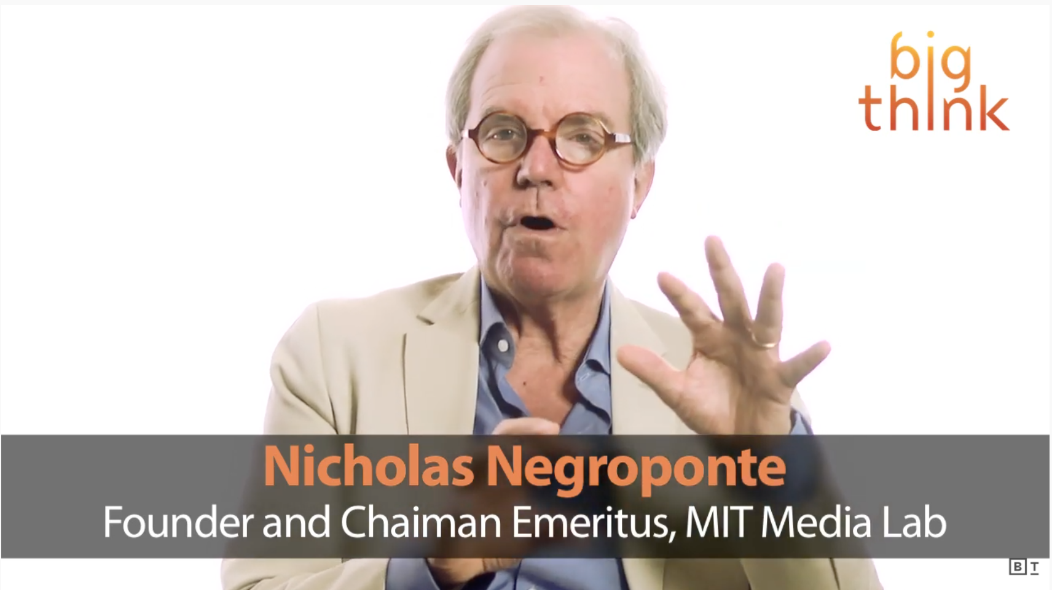
Net Neutrality Misunderstanding
Watch https://www.youtube.com/watch?v=Ttl47rss9Rk
Net neutrality proponents accept that data types should be treated differently BUT ISPs should not be treating data with the same type differently
No preferential treatment for one video streaming company
https://www.youtube.com/watch?v=Ttl47rss9Rk

Slide 9
BBC Utopian View 2040
It’s a summer morning in 2040. The internet is all around you and all the things that you’re about to do during your day will fall into place thanks to the data streams flying across the internet. Public transport to the city dynamically adjusts schedules and routes to account for delays. Buying your kids the perfect birthday presents is easy because their data tells your shopping service exactly what they will want. Best of all, you’re alive despite a near-fatal accident last month because doctors in the hospital’s emergency department had easy access to your medical history.
This is the ideal vision of the web
Helps save lives and makes day to day decisions easier because of information
https://www.bbc.com/future/article/20141015-will-we-fear-tomorrows-internet

Slide 10
BBC Dystopian View 2040
It’s a winter evening in 2040 and the world is a darker place. The internet is teeming with cybercrime and it’s become impossible to go online without making your bank account vulnerable or risking identity theft. Trolls have taken over social networking, the web is ludicrously priced and segmented, meaning only the rich can access the most useful and up-to-date resources. If that wasn’t bad enough, in some countries people’s every move is constantly monitored by secret police using networked sensors and internet communications. Even if you can get online, would you want to?
Can you identify the themes that relate to net neutrality?
Is this scenario likely?
https://www.bbc.com/future/article/20141015-will-we-fear-tomorrows-internet

Slide 11
Predictions of Losing NN
Very small sample of opinion
Most likely
Content will be blocked
Content will be slow and throttled
Small businesses will struggle to compete
Least likely
Speeds will get faster
Customers can pay for better service
Rural internet access will get worse
ISP pick winners and losers
More innovation for internet of things
More data collection, less privacy
Restrictive data caps
More broadband investment
https://qz.com/1158328/what-will-happen-now-that-net-neutrality-is-gone-we-asked-the-experts/

Slide 12
Fragmented Web
The Internet or "the Internets"? Ian Peter, a pioneer Internet rights activist thinks that the Internet will cease to be just one entity. He wrote:
'The Internet will fragment. Global connectivity will continue to exist, but through a series of separate channels controlled by a series of separate protocols. Our use of separate channels for separate applications will be necessitated by security problems, cyber policy of nations and corporations, and our continued attempts to find better ways to do things.’
https://www.salon.com/2014/03/12/dystopian_doom_or_global_village_what_the_internet_will_look_like_in_2025/

Slide 13
Fragmented Web?
There are lots of paid for tv streaming services
Netflix
Now tv
Disney
Amazon
etc
To watch your favourite shows you must subscribe and pay for multiple services
Imagine that you had to subscribe and pay for multiple services on the web, how would it effect the content you consumed?

Slide 14
Dystopian Future - https://wayforward.archive.org/ia2046/
Go to https://wayforward.archive.org/ia2046/
Explore the fictional timeline, click on the event for more detail
What is Section 230?
Is this timeline far fetched?
How likely do you think that other overlay networks would be used in place of the www in this scenario?
If Section 230 is defunct do you think there would there be a divide in the functionality of the www US vs the rest of the world?

Slide 15
Tech Companies
What are the arguments for a tech company to supporting Net Neutrality?
What are the arguments for a tech company not to supporting Net Neutrality?

Slide 16
Academia
What are the arguments for a university to supporting Net Neutrality?
What are the arguments for a university not to supporting Net Neutrality?

Slide 17
You
What are the most important arguments for you to supporting Net Neutrality?
What are the most important arguments for you not to supporting Net Neutrality?

