Slide 1
Research and Open Access
COMP3220 Web Infrastructure
hp3@ecs.soton.ac.uk
Dr Heather S Packer

Slide 2
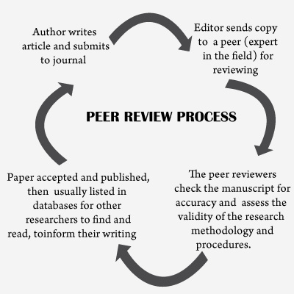
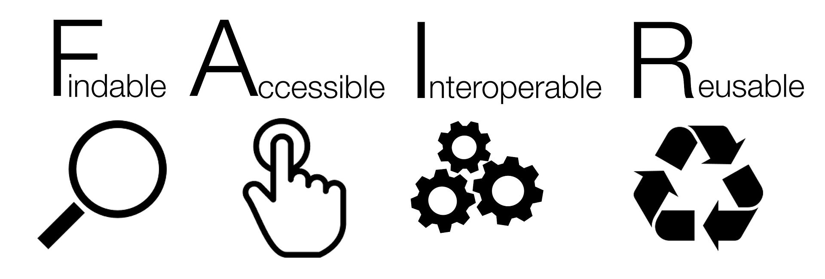
The Web, Research and Open Access
Sir Tim Burners-Lee invented the www to share research
Research Process, rigor and scrutiny
Research Impact
Open Access
Gold Open Access
Green Open Access
FAIR Open Data and Research Software

Slide 3
University of Southampton’s Statement of Impact
“New breakthroughs in all disciplines have the ability to make our lives better. We believe it is our responsibility to do all that we can to make the leap from academic publication to real-life solutions so that our research helps everyone it can.
Our impact on government policy - We collaborate with government policy makers to create change and tackle society's global challenges.
Our impact on society - Our Public Engagement with Research unit inspires and supports high-quality public engagement with research across the University.
Impact on teaching - Our emphasis on research-led teaching means that our students are taught the latest theories, research and innovations from experts in their field.
Impact on business - We are successful at commercialising our research and working with businesses to help create useful innovations.”
https://www.southampton.ac.uk/research/impact.page

Slide 4
University REF and Impact
Universities are assessed by Research Excellence Framework (REF)
To provide accountability for public investment in research and produce evidence of the benefits of this investment.
To provide benchmarking information and establish reputational yardsticks, for use within the HE sector and for public information.
To inform the selective allocation of funding for research.
Assesses universities purely on their research output
The REF determines the quality of researchers and students they attract
Having access to journals plays a big role in the success of the university
Universities can’t afford to subscribe to all journals
Highly subscribed to journals have greater reach and receive more citations
Less subscribed to journals have less reach and publications receive fewer citations

Slide 5
Publication Model
Academics write the papers
Peer review process performed by academics
Peer review process handled by publishing company
Publishing company publishes publications

Slide 6
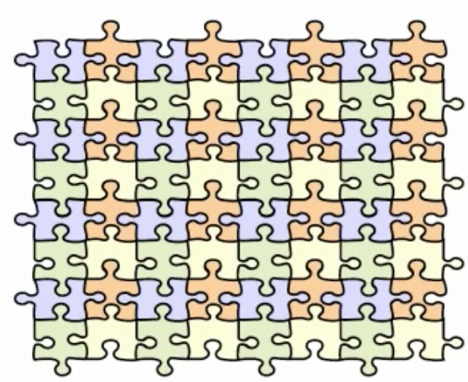
Ideal Research
Integrated
Citations
Readily available
Standing on the shoulders of giants
“we see more and farther than our predecessors, not because we have keener vision or greater height, but because we are lifted up and borne aloft on their gigantic stature”

Slide 7
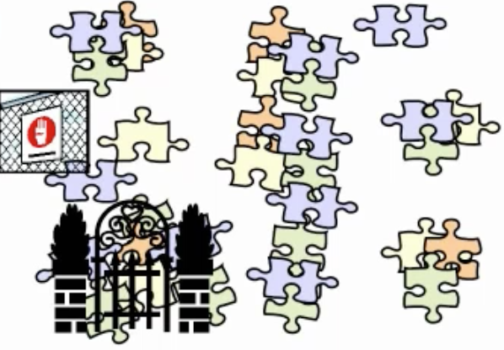
The Literature: As It Is
Inaccessible
Hidden behind pay walls
Not subscribed too
Disjoint
Books
Online journals
Scientific magazines

Slide 8
Should universities, researchers and the general public have to pay a subscription or per article fee to read scientific research?
Restricts access to research papers
Prevents research being used
Prevents research from being built upon
Publishes need revenues to operate and provide publishing services

Slide 9
Should universities, researchers and the general public have to pay a subscription or per article fee to read scientific research?
Restricts access to research papers
Prevents research being used
Prevents research from being built upon
Publishes need revenues to operate and provide publishing services

Slide 10
“its free availability on the public internet, permitting any users to read, download, copy, distribute, print, search, or link to the full texts of these articles, crawl them for indexing, pass them as data to software”
- The Budapest Open Access Initiative

Slide 11
Full Open Access Ideal
The entire full-text refereed corpus online
On every researcher’s desktop, everywhere
24 hours a day
All papers citation-interlinked
Fully searchable, navigable, retrievable

Slide 12
Open Access Publications
Gold open access is where an author publishes their article in an online open access journal.
Green open access is where an author publishes their article in any journal and then self-archives a copy in a freely accessible institutional or specialist online archive known as a repository, or on a website.
Notes:
.

Slide 13
Open Access Publications
Green: Self Archiving | Gold: Publishing
Journal processes continue as normal | Journal changes business model
Authors deposit a copy of their papers into an ‘open access repository’ | Readers no longer pay to read
Public copy is a supplement to the publishers official article for those who can’t afford a subscription | Instead, authors pay to publish or their funders
Also an institutional record of its work for sharing, reuse, marketing etc

Slide 14
Should universities and researchers have to pay for their research to be published with open access?
Yes because of lost revenue to the publishing company
Yes because publishers are providing a service
No because this would restrict published research to that which has sufficient funding to pay the fees
If they should pay how much should it be?

Slide 15
Should universities and researchers have to pay for their research to be published with open access?
Yes because of lost revenue to the publishing company
Yes because publishers are providing a service
No because this would restrict published research to that which has sufficient funding to pay the fees
If they should pay how much should it be?

Slide 16
Publication Fees
Publisher | Article Processing Charge | Fully OA or Hybrid?
American Chemical Society | $5,000* - $5,000 | Hybrid
BioMed Central | $1,290 - $2,580 | Open Access
Cambridge University Press | $600 - $4,500 | Hybrid
Elsevier | $100 - $5,000 | Hybrid
Hindawi | $550 - $2,250 | Open Access
Nature Communications | £3300 | Open Access
Nature Publishing Group | $1,100 - $5,200 | Hybrid
PLOS | $1,600 - $3,000 | Open Access
SAGE | $400 - $3,000 | Hybrid
Springer | $3,000 | Hybrid
Taylor & Francis | $500 - $2,950 | Open Access
Wiley | $1,300 - $5,200 | Hybrid
* Note that the University pays a heavily discounted price of $2000 because the University is a subscriber to ACS journals and many individuals are members of the Society.
https://www.openaccess.cam.ac.uk/publishing-open-access/how-much-do-publishers-charge-open-access

Slide 17
Requirements for Open Access from Funders
Most major research funders mandate for outputs to be made open access
Non-compliance with a funder's policy can result in
Partially withheld funding
Illegibility for future funding
Publications need to be open access to be eligible for REF assessment
Most funders also require that the supporting research data should be made available open access

Slide 18
What are the advantages of Open access preprints and post print?
Early Advantage: Self archiving preprints before publications hastens and increases usage and citations
Higher quality articles benefit more: top 20% of articles receive 80% of citations
Quality Advantage: Self-archiving postprints immediately upon publication hastens and increases usage and citation
Higher quality articles benefit more
Usage Advantage: Self-archiving both pre/post prints increases downloads
Higher quality articles benefits more!

Slide 19
What are the advantages of Open access preprints and post print?
Early Advantage: Self archiving preprints before publications hastens and increases usage and citations
Higher quality articles benefit more: top 20% of articles receive 80% of citations
Quality Advantage: Self-archiving postprints immediately upon publication hastens and increases usage and citation
Higher quality articles benefit more
Usage Advantage: Self-archiving both pre/post prints increases downloads
Higher quality articles benefits more!

Slide 20
What are the problems with Gold OA?
Relies on publishers changing their business model
Scientific publishing is very lucrative (18% profits)
Gold publishers making slow advances

Slide 21
What are the problems with Gold OA?
Relies on publishers changing their business model
Scientific publishing is very lucrative (18% profits)
Gold publishers making slow advances

Slide 22
What are the problems with Green OA?
Copyright assignment to publishing company means the author no longer has the right to control the paper
Relies on “publisher usage policy”
May not allow submission to a repository
Many not allow copies to be made for teaching, research assessment or career advancement processes
Difficult to manage
Many journals with different policies
Romeo service tracks publisher policies (http://www.sherpa.ac.uk/Romeo)

Slide 23
What are the problems with Green OA?
Copyright assignment to publishing company means the author no longer has the right to control the paper
Relies on “publisher usage policy”
May not allow submission to a repository
Many not allow copies to be made for teaching, research assessment or career advancement processes
Difficult to manage
Many journals with different policies
Romeo service tracks publisher policies (http://www.sherpa.ac.uk/Romeo)

Slide 24
Who should take responsibility for curating the research knowledge of the world?
Privately owned, profit making, publishing industry
University, research institution, knowledge creator
The Institutional repository is a place where the member of an institution can curate their intellectual outputs/knowledge capital

Slide 25
Who should take responsibility for curating the research knowledge of the world?
Privately owned, profit making, publishing industry
University, research institution, knowledge creator
The Institutional repository is a place where the member of an institution can curate their intellectual outputs/knowledge capital

