Slide 2
Telling Tales: Hypertext Writing
Part 2
COMP3220 Web Infrastructure
Dr Nicholas Gibbins - nmg@ecs.soton.ac.uk

Slide 3

Ludic Hypertext
http://www.flickr.com/photos/jamesrbowe/4001776922/

Slide 4
Ludic Narrative
Game + Story … but what’s in a game?
Different forms of play:
  Competition (agon)
  Chance (alea)
  Simulation (mimicry)
  Disorientation (ilinx)
Different types of play:
  Structured, explicit rules (ludus)
  Unstructured, spontaneous (paidia)
Caillois, R. (1961) Man, Play and Games. New York: Free Press of Glencoe.
Notes:
Les Jeux et les Hommes

Slide 5
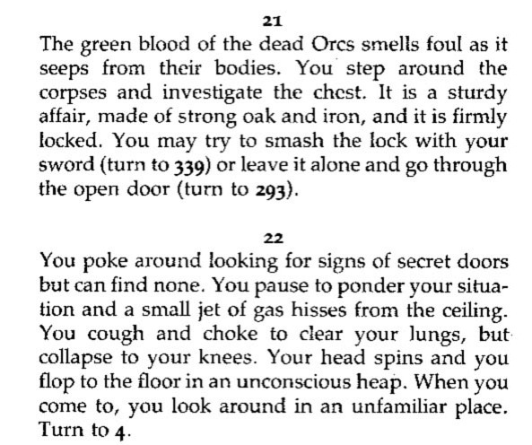
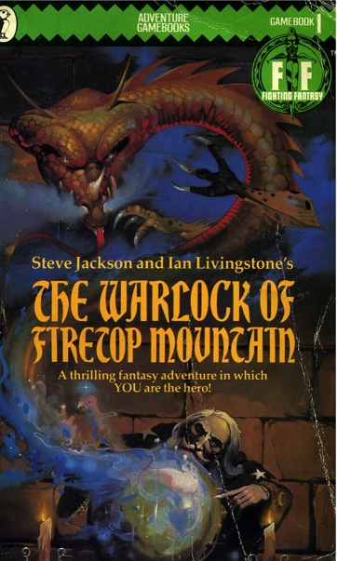
Fighting Fantasy (1982-)
Combines CYOA-style second person narrative with Dungeons & Dragons-style rules
  Non-linear story
  Numbered paragraphs
  (more finely-grained narrative)
  Mixture of explicit and random
  choices (aleatory reading)
  External state
  (hit points, inventory, etc)
Jackson, S. & Livingstone, I. (1982) The Warlock of Firetop Mountain. Harmondsworth: Puffin.
Notes:
1980s fantasy boom – hypertext books!
Some self-published solo D&D adventures predate
Largely a paper-based fusion of role-playing games and computer adventure games
Ludic hypertext

Slide 6
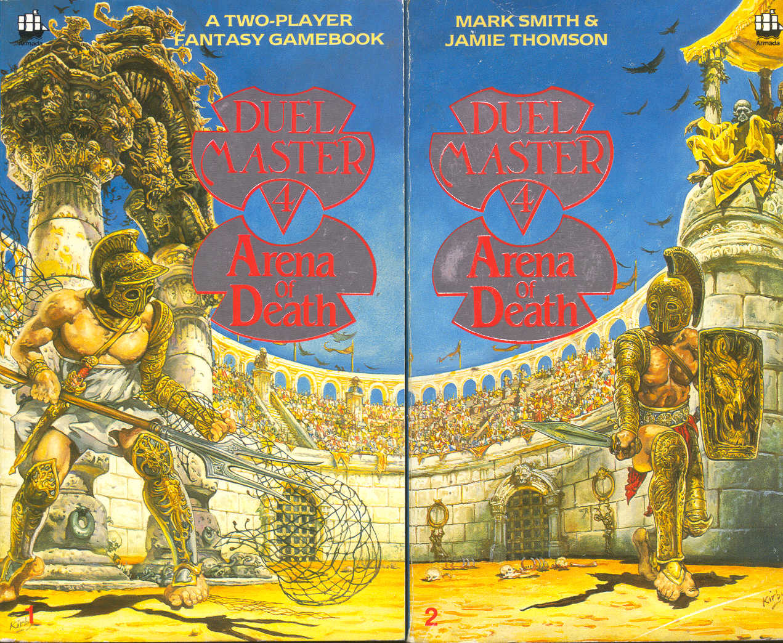
Duel Master (1986-7)
Two-player gamebook (agon)
  Non-linear story
  Split across two paired books
  (even/odd numbered lexia)
  Shared state and synchronization
  (keywords, WAIT)
  Mixture of explicit and random choices
  (aleatory reading)
Smith, M. & Thomson, J. (1987) Arena of Death. London: Armada Books.

Slide 7
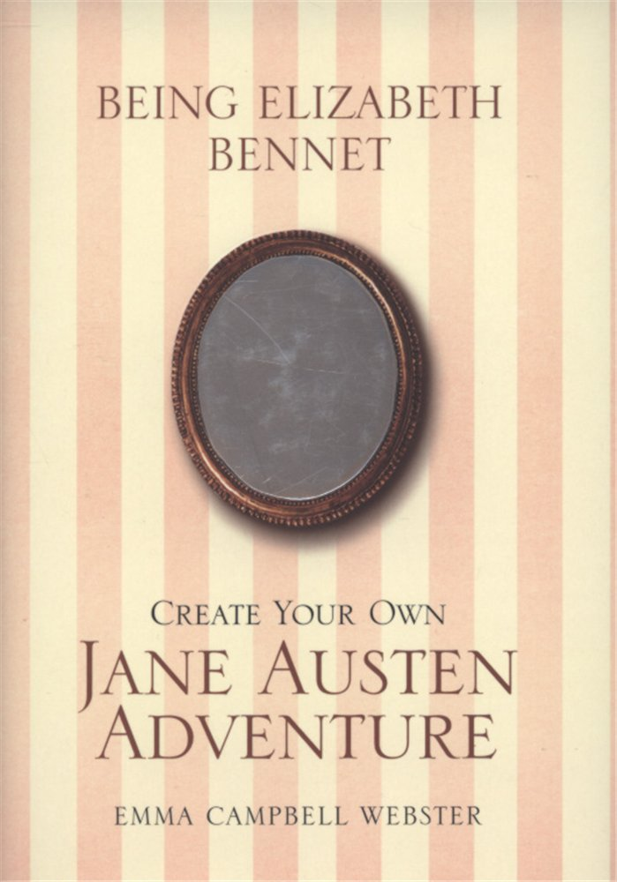
Being Elizabeth Bennet (2007)
Second person narrative
  Again, non-linear story
  Simple rules
  No aleatory aspects
Mimicry aimed at a different demographic to that of other gamebooks!
Campbell Webster, E. (2007) Being Elizabeth Bennet. London: Atlantic.
Notes:
See also do-over novels: Heather McElhatton’s Pretty Little Mistakes and A Million Little Mistakes
Arguably an alternative narrative in which the eponymous protagonist, having decided that she’s too clever and too confident for Mr. Darcy, sits down to write a comedy of manners beginning “It is a truth universally acknowledged…”

Slide 8
Dark Cults (1983)
Storytelling card game
  Story assembled from random selection of text fragments (alea)
  Aim is to improvise a narrative around the story
Rules ensure well-formed stories
  Card types limit which cards may be played next
Integral competition (agon)
  Play alternates between players (Life and Death)
  Scores assigned to different card types for each player
Rahman, K. (1983) Dark Cults. Theilman, MN: Dark House Publishing.
Notes:
See also: Bernstein’s Card Shark

Slide 9

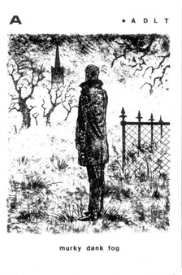
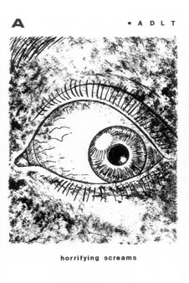
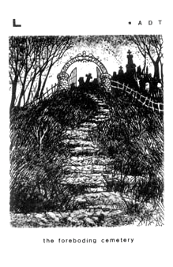
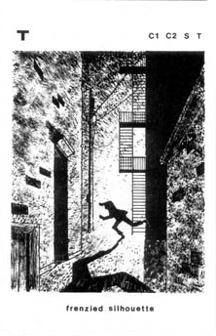
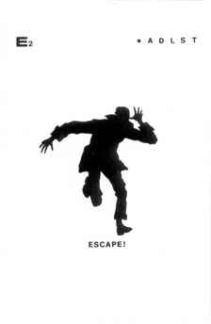
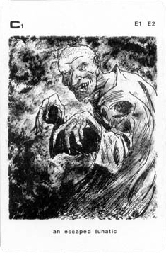
Dark Cults (1983)
Rahman, K. (1983) Dark Cults. Theilman, MN: Dark House Publishing.

Slide 10
Card Shark
A Card Shark node (or card) contains some text, typically a brief, focused passage
Each card may also specify constraints on the context in which it may appear
Reader receives seven random cards, based on constraints chooses which card to visit next, repeats
Social Shark: collaborative, competitive reading
  Readers take it in turns to play cards
  Points awarded to readers for the playing of particular cards
Bernstein, M. (2001) Card Shark and Thespis: exotic tools for hypertext narrative. Proceedings of the 12th ACM Conference on Hypertext and Hypermedia, pp 41-50..

Slide 11
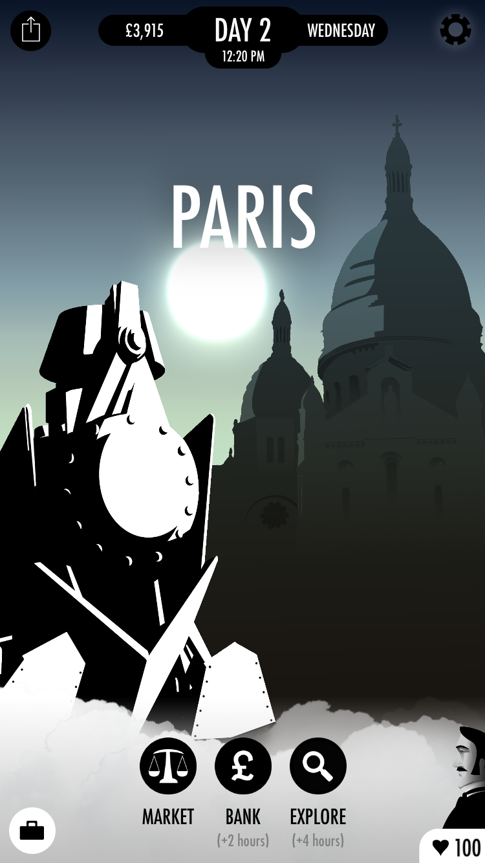
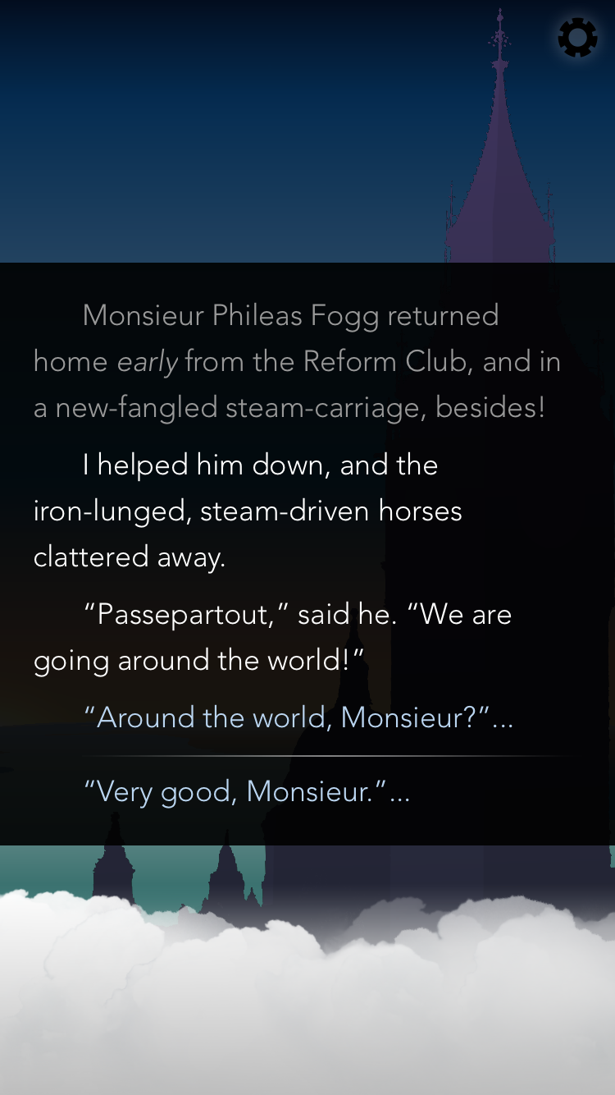
80 Days
Second person narrative
  Non-linear story
  Fine-grained lexia (short paragraphs)
  No aleatory aspects
Some overlap between interactive fiction and (ludic) hypertext fiction
  In general, interactive fiction presents a less constrained choice to the reader
  (80 Days is an interactive fiction outlier)
80 Days (2014) [Video Game] Cambridge, UK: Inkle.
Montfort, N. (2005) Twisty Little Passages: An approach to interactive fiction. Cambridge, MA: MIT Press
Notes:
Inkle have also created a series of video game adaptations of Steve Jackson’s Sorcery! books (see Fighting Fantasy)

Slide 12

Hypertext Comics
http://www.flickr.com/photos/dolmansaxlil/5606944557/

Slide 13
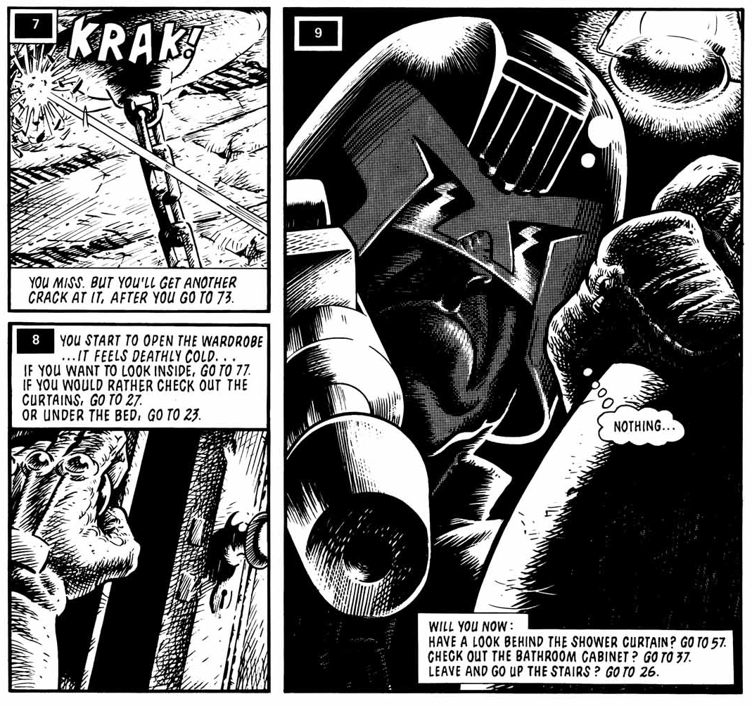
Hypercomics (1986-)
Early hypertext comics based on gamebooks
  Dice Man 1-5 (1986)
  You are Maggie Thatcher (1987)
Typically second person narrative
  Numbered frames/pages
  Explicit choices in captions
  Ludic elements
Talbot, B. et al, (1986) House of Death. Dice Man, no. 1, London: IPC Magazines.

Slide 14
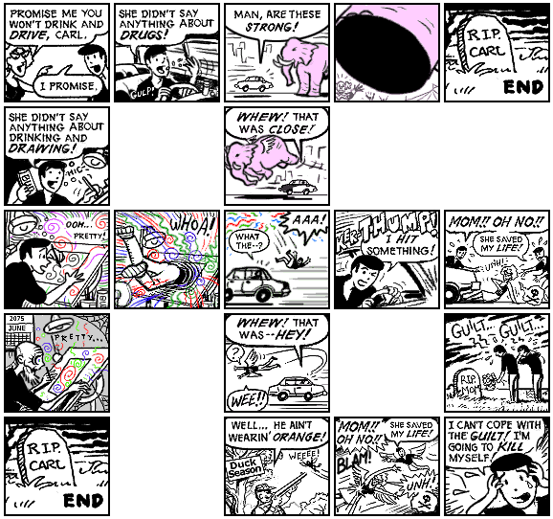
Carl (2001)
Implicit choices in alternate frames
  Relies on left-to-right, top-to-bottom reading conventions
  Spatial juxtaposition of frames on the printed page permits multiple reading paths
Examined by Scott McCloud in Understanding Comics
McCloud, S. (2001) Choose Your Own Carl. http://www.scottmccloud.com/
McCloud, S. (1993) Understanding Comics. Northampton, MA: Tundra Publishing.
Notes:
Hypertextual narrative – reading order is left/top to right/bottom
Many other examples (albeit less hypertextual) that rely on spatial juxtaposition to indicate parallel action - Dave Sim’s Cerebus, Alan Moore’s Watchmen

Slide 15
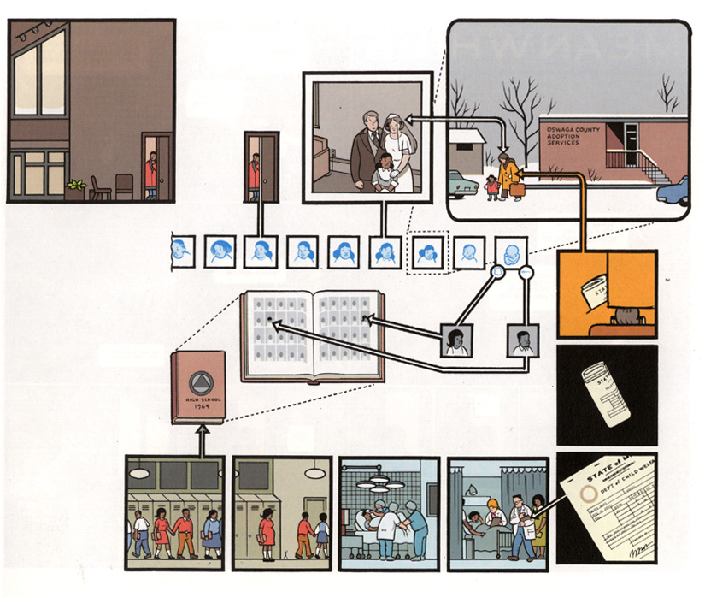
Jimmy Corrigan (2001)
Ware, C. (2001) Jimmy Corrigan: The Smartest Kid On Earth, London: Jonathan Cape.
Notes:
Linear story, but with sections of non-linear narrative that are read as a gestalt.

Slide 16
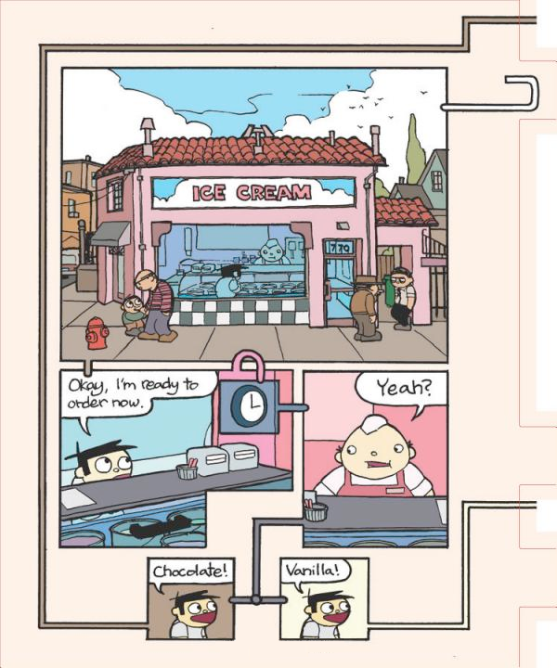
Meanwhile (2010)
Visual grammar for linking:
Tabs for inter-page navigation
Shiga, J. (2010) Meanwhile. New York: Amulet Books.
Notes:
Comment on visual grammar
Non-linear story

Slide 17

Hypertext Poetry
http://www.flickr.com/photos/rossap/4160004956/

Slide 18
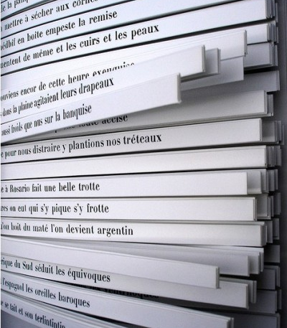
Cent Mille Milliards
De Poèmes (1961)
Book of sonnets
  Each of the fourteen lines is printed on a separate strip
  10 alternatives for each line
  Reader chooses which of the ten alternatives to read for each line
  10¹⁴ = 100,000,000,000,000 poems
Queneau, R. (1961) Cent mille milliards de poèmes. Paris: Éditions Gallimard.
Notes:
Another ergodic work from the Oulipo group.

Slide 19
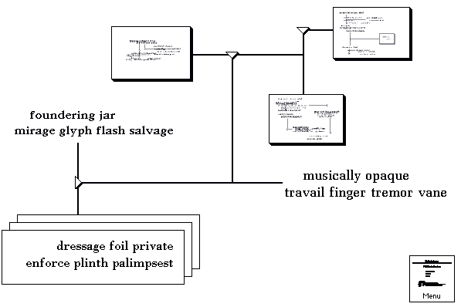
Hypertext Poetry
Rosenberg, J. (2005) Diagrams Series 6, #1.

Slide 20

Hypertext Drama
http://www.flickr.com/photos/slimjim/2169745303/

Slide 21
Drama vs. Hyperdrama
Traditional drama:
  presents the playwright’s (and director’s) preferred account (narrative) of a story
  distinguishes between on-stage and off-stage
Hyperdrama:
  allows the audience to follow different narratives (and to choose when to switch narratives)
  continues action off-stage
Deemer, C. (1999) The New Hyperdrama: How hypertext scripts are changing the parameters of dramatic storytelling. In Theatre in Cyberspace: Issues of Teaching, Acting and Directing (ed. Schrum S.A.) New York: Peter Lang.
Notes:
http://www.ibiblio.org/cdeemer/newhype.htm
See also: interactive drama

Slide 22
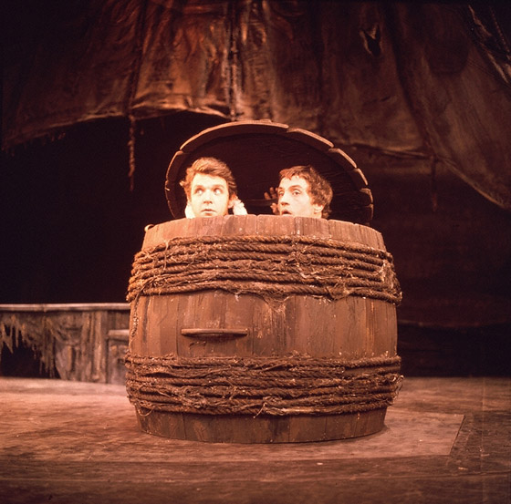
Rosencrantz and Guildenstern are Dead (1966)
Additional narrative centred on minor characters in Hamlet
  Non-ergodic, therefore not hyperdrama
  Intertextual – in semiotic terms, Hamlet is the hypotext and R&G is the hypertext
Stoppard, T. (1973) Rosencrantz and Guildenstern are Dead. London: Faber and Faber.
Notes:
First staged in 1966
Example of a boundary case – the audience can’t choose to leave Hamlet or R&G and follow the other play, so this isn’t ergodic and therefore not hyperdrama.
See also Alan Ayckbourn’s Norman Conquests (Table Manners, Living Together, Round and Round the Garden) from 1973, and his later House and Garden (from 1999) in which the two plays are performed simultaneously.

Slide 23
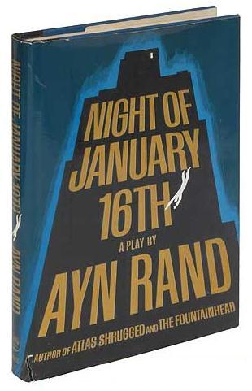
Night of January 16th (1935)
Courtroom drama by Ayn Rand, centred on a murder trial
  Members of the audience are selected to form a jury
  The jury’s verdict determines the ending of the play (ergodic)
Rand, A. (1936) Night of January 16th: a comedy-drama in three acts. New York: Longmans & Co.

Slide 24
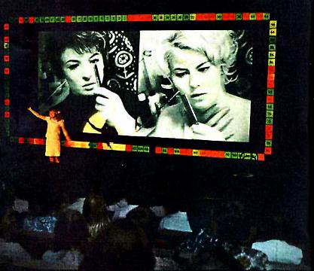
Kinoautomat (1967)
Czech experimental interactive film
  First shown at Expo 67 in Montreal
  Film is stopped at intervals and audience is asked how they think the film should be continued
  Audience votes on two options (red/green) with the majority determining the future path of the film (ergodic)
Kinoautomat: Človĕk a jeho dům (1967) Directed by Činčera, R., Roháč, J. and Svitáček, V [Film]. Czechoslovakia.
Notes:
”One Man and his House”
Satire of democracy – audience choice doesn’t actually affect the outcome.
Banned in 1972!

Slide 25
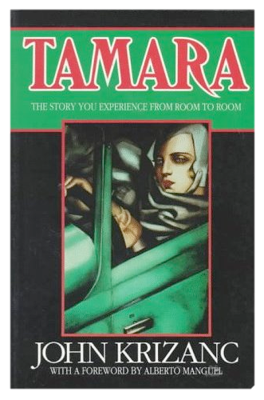
Tamara (1981)
Play takes place in a large house
  Actors perform simultaneously in up to nine different rooms
  Spectators must choose which actor(s) they follow (ergodic)
  Multiple narratives
Krizanc, J. (1989) Tamara: A play. London: Methuen Drama.
Notes:
Based on 1927 diary entries of the housekeeper at Il Vittoriale, the villa of Gabriele D'Annunzio.
Tamara de Lempicka invited to paint D’Annunzio’s portrait.
Play ran for ten years in Los Angeles

Slide 26
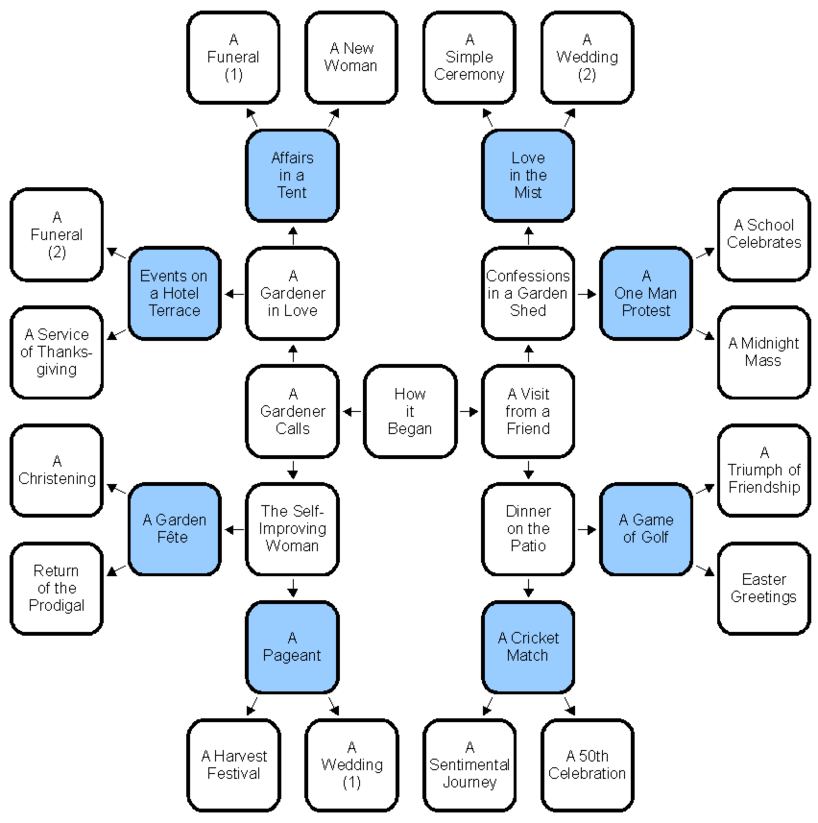
Intimate Exchanges (1982)
Group of eight stories originating from an opening scene
  Two actors play all of the roles in the play
  Story repeatedly splits in two
  Sixteen possible endings
  Non-linear story
The actors choose which path to take at each split, not the audience
  Non-linear, but not conventionally ergodic!
Ayckbourn, A. (1982) Intimate Exchanges. New York: Samuel French.

Slide 27
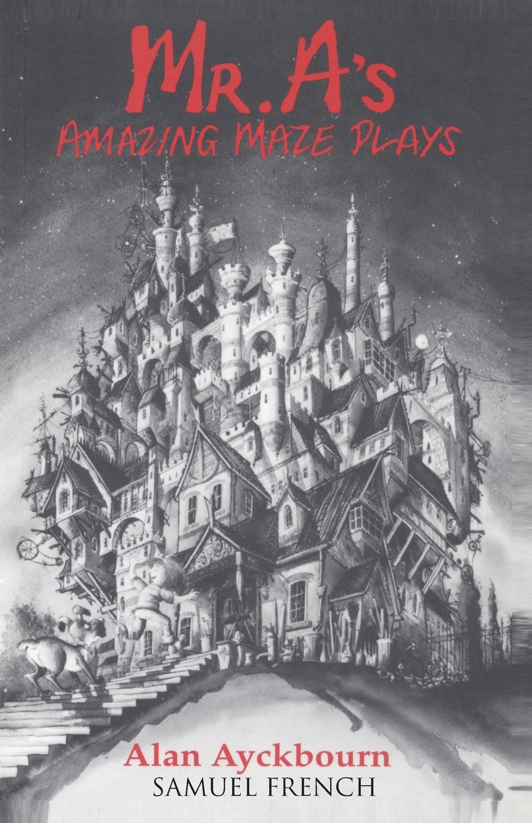
Mr A’s Amazing Maze Plays (1988)
Children’s play in which the main characters (a young girl and her dog) explore a deserted house
  Main characters take directions from the audience (ergodic)
  30 locations in the house, not all of which are visited in a single performance
  Non-linear story
Ayckbourn, A. (1993) Mr A’s Amazing Maze Plays. New York: Samuel French.

Slide 28

Timecode (2000)
Film composed of four overlapping narratives
  Filmed simultaneously as four continuous 90-minute takes
  Screen divided into quarters, all four films projected at same time
  Audience ‘choose’ which sub-film to watch (ergodic)
Timecode (2000) Directed by Figgis, M. [Film]. Culver City, CA: Screen Gems.

Slide 29
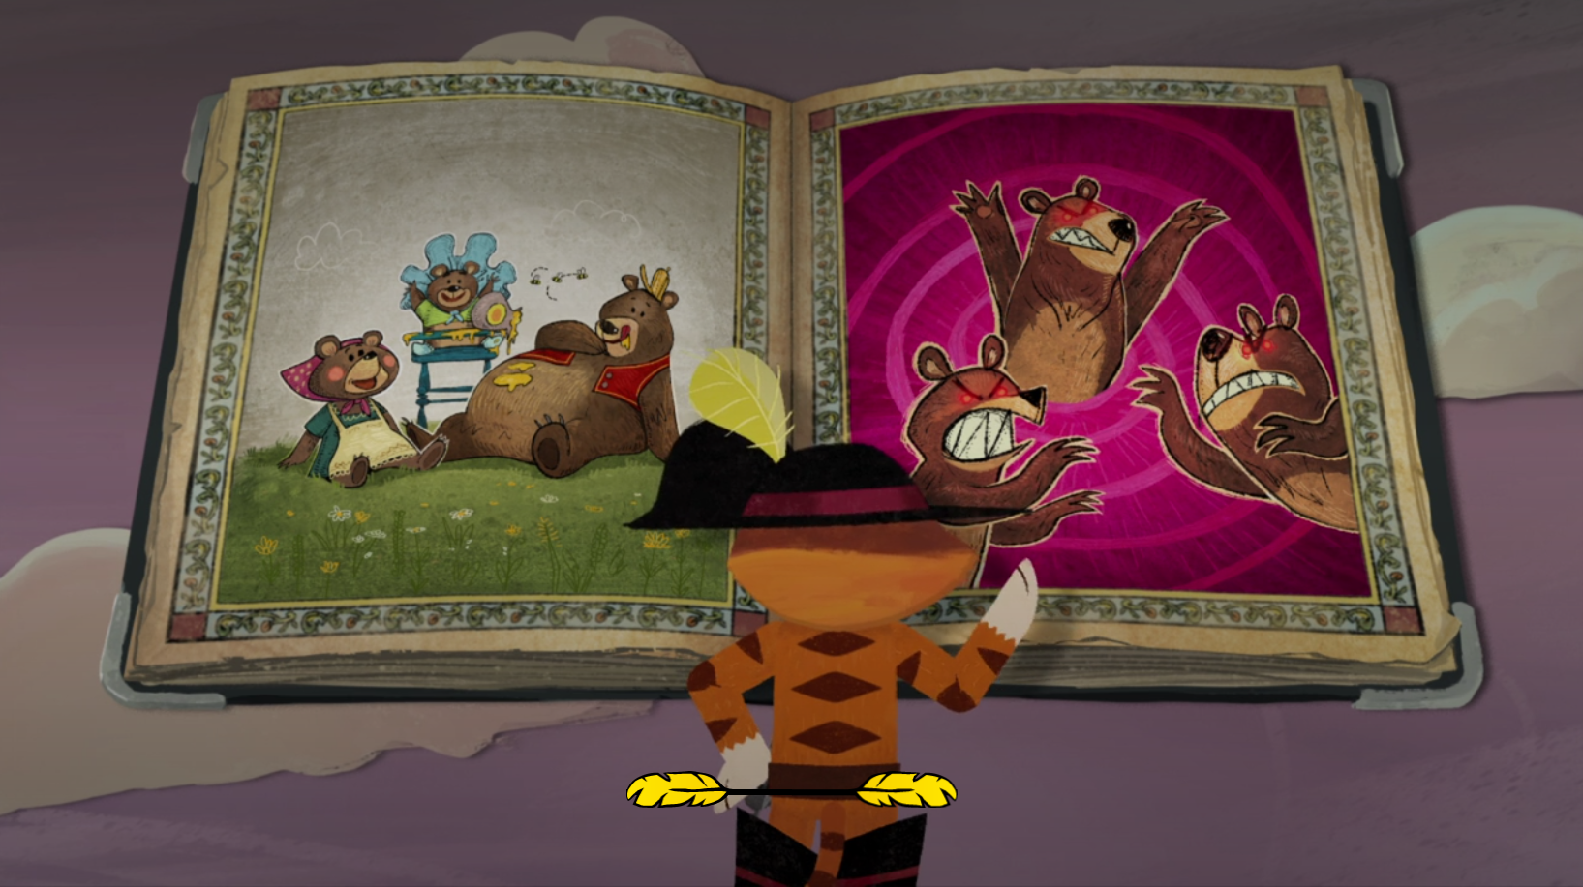
Puss in Book (2017)
Interactive children’s film from the Shrek franchise
  Film broken up into a series of episodes
  Binary choice presented at the end of each episode
Puss in Book: Trapped in an Epic Tale (2017) Directed by Burdine, R. and Castuciano, J. [Film] Los Gatos, CA: Netflix.
Notes:
Netflix soon to add an interactive version of Black Mirror

Slide 30
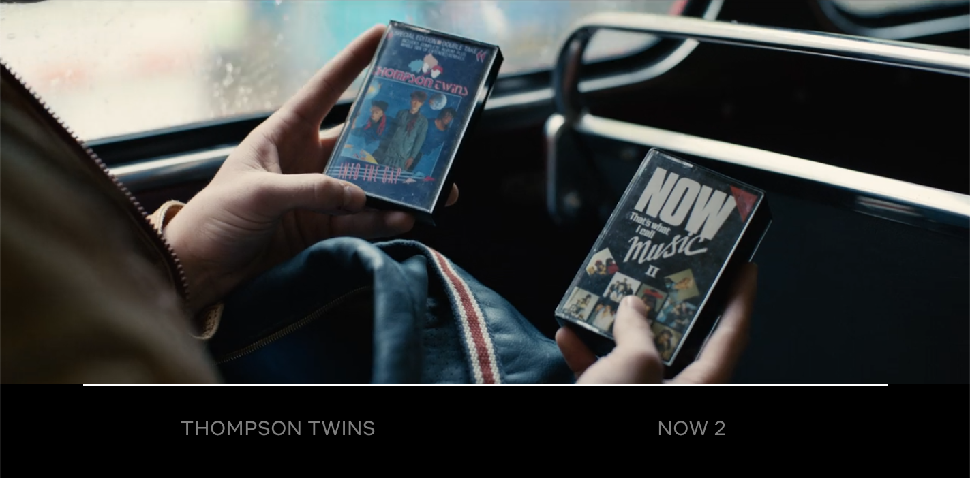
Black Mirror: Bandersnatch (2018)
Interactive film written by Charlie Brooker
  Repeated binary choices throughout film
Black Mirror: Bandersnatch (2018) Directed by Slade, D. [Film] Los Gatos, CA: Netflix.

Slide 31
Summary

Slide 32
Summary
Non-linearity is the essence of hypertext
  Hypertext fiction may be non-linear in story, narrative or text
  Non-linearity may equally apply to poetry, comics, film and drama
Hypertext is also ergodic
  Non-trivial effort typically manifests itself as choice
  May also involve ludic elements

Slide 33
Next Lecture: Web Graph

