Slide 1
Cookies and Web Advertising
COMP3220 Web Infrastructure
Dr Heather S Packer
hp3@ecs.soton.ac.uk

Slide 2
Web Advertising Summary
Cookies, browser cookies or tracking cookies,
They are small, often encrypted text files, located in browser directories.
Used to help users navigate their websites efficiently and perform certain functions.
Third party companies use them to collect preferences and to identify users
Cookies are created by
The website
Ads run by the website
Other elements
Digital Display Advertising
Google AdWords
Google AdSense
Third Party Advertisers
Bidding architectures

Slide 3
What are the benefits to online advertising compared with print?

Slide 4
What are the benefits to online advertising compared with print?
Cost
Low costs compared to offline.
Social media, provides a low-cost means for advertisers to engage with large established communities.
Measurability Online advertisers can collect data on their ads
size of the potential audience or actual audience response
how a visitor reached their advertisement, whether the advertisement resulted in a conversion, and whether an ad was viewable.
Formatting advertisers can include images, video, audio, and links, and are interactive.
Targeting
Target a market segment
Uses geo-targeting and user’s preferences to display relevant ads.
They can track whether a visitor has already seen an ad and time exposures to people
Coverage
Online advertising can reach nearly every global market, and online advertising influences offline sales.
Speed
Very quick to deploy
Easy to modify or replace ad copy more rapidly than offline

Slide 5
Costs
Advertising spend for a given audience template is agreed in advance
Cost per Mille CPM
Price of 1,000 advertisement impressions on one web page
Cost per Click CPC
Price based on how many times an ad is clicked
Cost per Action CPA
Price based on number of conversions
Click Through Rate CTR
Metric that is commonly used based on number of clicks per impression served

Slide 6
Costs
Which pricing model is the most attractive for a potential user?
What pricing model is the most attractive for an advertising company?
How could you choose between each model?

Slide 7
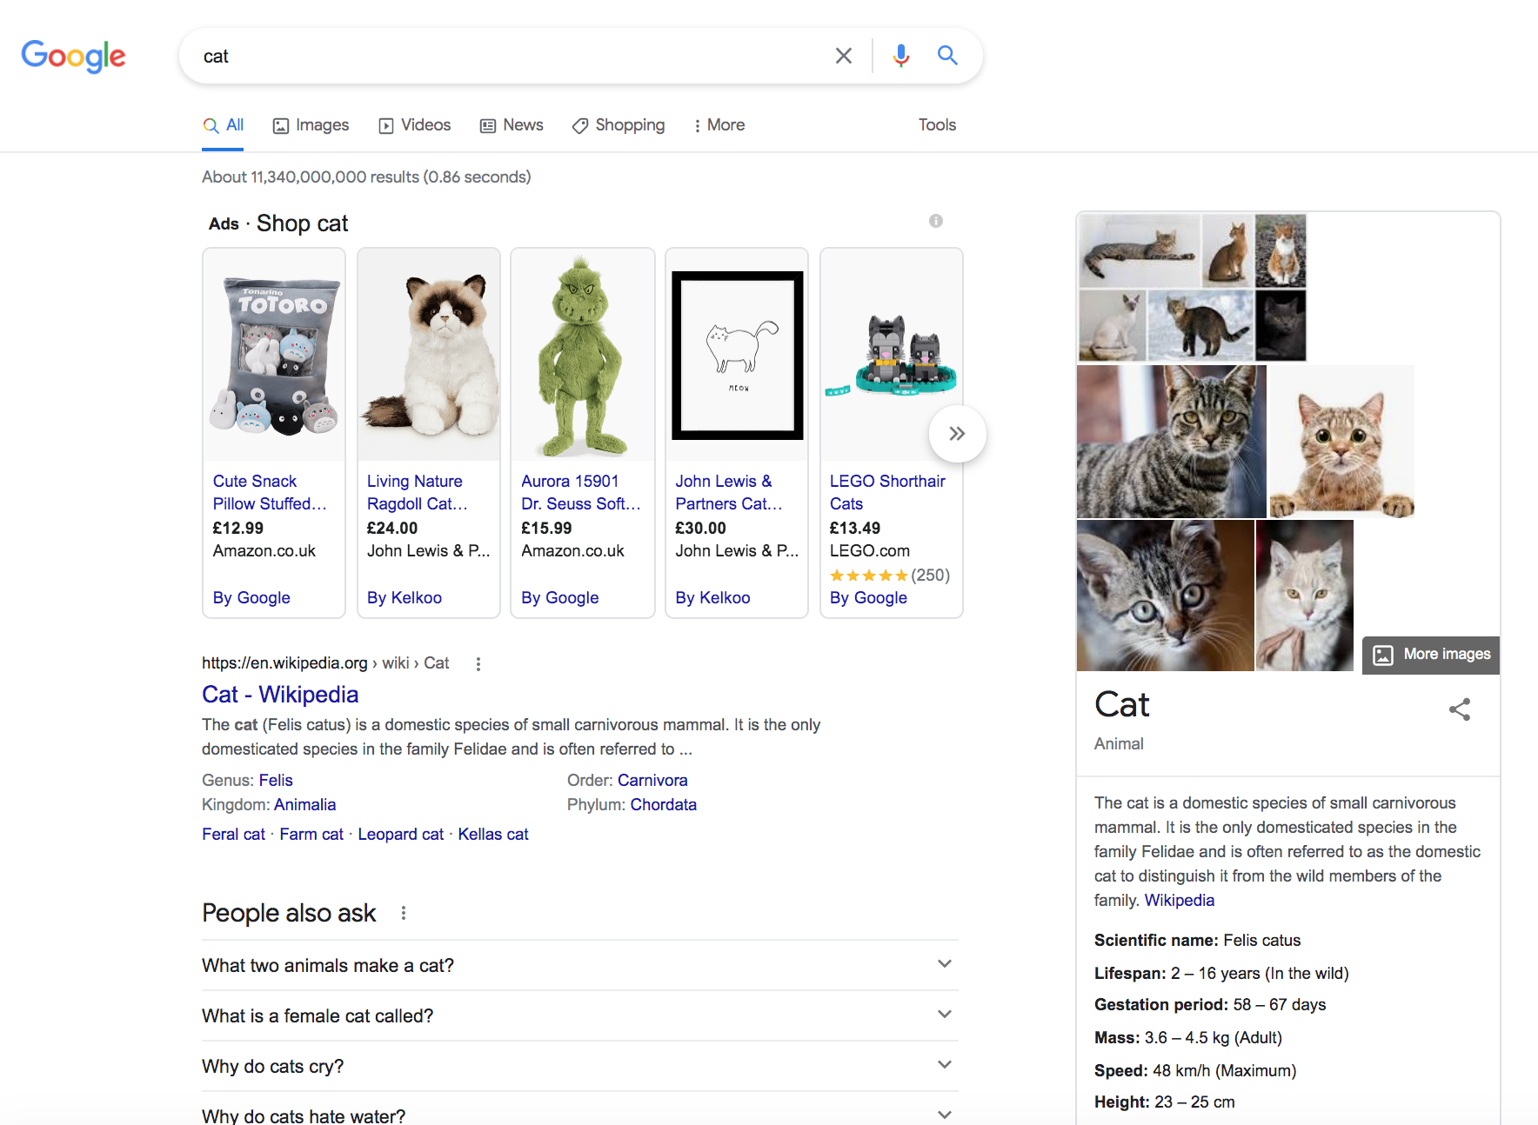
AdWords

Slide 8
AdSense Auctions
Ad auction for an ad unit that shows one ad
Ad auction for an ad unit that shows two ads
Advertiser | CPC Bid | Quality Score | Ad shown?
Alice | £5 | 10 | Shown
Bob | £3 | 10 | Not shown
Charlie | £1 | 10 | Not shown
Advertiser | CPC Bid | Quality Score | Ad shown? | Relative CTR of Position
Alice | £5 | 10 | Shown | 3.0
Bob | £3 | 10 | Shown | 1.0
Charlie | £1 | 10 | Not shown | N/A
https://support.google.com/adsense/answer/160525?hl=en-GB

Slide 9
Third Party Web Advertising
Do brands bid directly on the Ad exchange?
What happens in the Ad Exchange?
What does the Demand Side Platform do?
What does the Supply Side Platform do?
Image from: https://en.wikipedia.org/wiki/Demand-side_platform

Slide 10
Third Party Web Advertising
Do brands bid directly on the Ad exchange?
No the agency bids on behalf of the brands
The agency bids on the behalf of many brands
The agency can place bids on many ad exchanges
What happens in the Ad Exchange?
The bidding takes place on the exchange
Serves up the winning add
What does the Demand Side Platform do?
Supplies the DSP with information about the ad and the brand
Provides bids to the ad exchange
What does the Supply Side Platform do?
Supplies information about the advertising space on a webpage and may include location of ad, context of page, size of advertising space.
Image from: https://www.adexchanger.com/ad-exchange-news/conflicting-truths-about-auction-duplication/

Slide 11
Third Party Web Advertising
Do brands bid directly on the Ad exchange?
No the agency bids on behalf of the brands
The agency bids on the behalf of many brands
The agency can place bids on many ad exchanges
What happens in the Ad Exchange?
The bidding takes place on the exchange
Serves up the winning add
What does the Demand Side Platform do?
Supplies the DSP with information about the ad and the brand
Provides bids to the ad exchange
What does the Supply Side Platform do?
Supplies information about the advertising space on a webpage and may include location of ad, context of page, size of advertising space.
Image from: https://www.adexchanger.com/ad-exchange-news/conflicting-truths-about-auction-duplication/

Slide 12
Third Party Web Advertising
Do brands bid directly on the Ad exchange?
No the agency bids on behalf of the brands
The agency bids on the behalf of many brands
The agency can place bids on many ad exchanges
What happens in the Ad Exchange?
The bidding takes place on the exchange
Serves up the winning add
What does the Demand Side Platform do?
Supplies the DSP with information about the ad and the brand
Provides bids to the ad exchange
What does the Supply Side Platform do?
Supplies information about the advertising space on a webpage and may include location of ad, context of page, size of advertising space.
Image from: https://www.adexchanger.com/ad-exchange-news/conflicting-truths-about-auction-duplication/

Slide 13
Third Party Web Advertising
Do brands bid directly on the Ad exchange?
No the agency bids on behalf of the brands
The agency bids on the behalf of many brands
The agency can place bids on many ad exchanges
What happens in the Ad Exchange?
The bidding takes place on the exchange
Serves up the winning add
What does the Demand Side Platform do?
Supplies the DSP with information about the ad and the brand
Provides bids to the ad exchange
What does the Supply Side Platform do?
Supplies information about the advertising space on a webpage and may include location of ad, context of page, size of advertising space.
Image from: https://www.adexchanger.com/ad-exchange-news/conflicting-truths-about-auction-duplication/

Slide 14
Third Party Web Advertising
Do brands bid directly on the Ad exchange?
No the agency bids on behalf of the brands
The agency bids on the behalf of many brands
The agency can place bids on many ad exchanges
What happens in the Ad Exchange?
The bidding takes place on the exchange
Serves up the winning add
What does the Demand Side Platform do?
Supplies the DSP with information about the ad and the brand
Provides bids to the ad exchange
What does the Supply Side Platform do?
Supplies information about the advertising space on a webpage and may include location of ad, context of page, size of advertising space.
Image from: https://www.adexchanger.com/ad-exchange-news/conflicting-truths-about-auction-duplication/

Slide 15
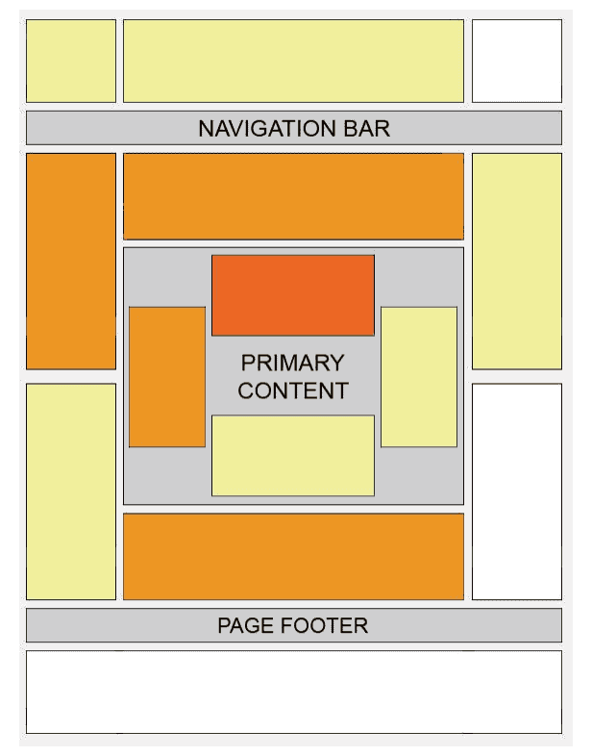
Aggregation Search Engine for Adopting Pets
Search engine for finding a pet to adopt, aggregates results from pet adoption agencies from around the world.
Where to place adverts on domain specific search engine?
What’s an appropriate advert topics?
Third party or Google AdSense?
What’s the best costing strategy?
Notes:
Google doesn't display more than one ad for a business on a page of search results, so you’ll find it difficult to test multiple third parties at once.

Slide 16
Tech Blogger
Blog with tech with reviews on the latest tech, gaming and camera equipment.
Where to place adverts on domain specific search engine?
What’s an appropriate advert topics?
Third party or Google AdSense?
What’s the best costing strategy?
Notes:
Google doesn't display more than one ad for a business on a page of search results, so you’ll find it difficult to test multiple third parties at once.

Slide 17
Cookie Tools
https://cookiedatabase.org/
Cookie database
Data Passports
https://www.cookieserve.com/
Search any website
https://www.allaboutcookies.org/
General information

Slide 18
Websites
https://www.google.com
https://www.amazon.com
https://www.thespruceeats.com/best-cookie-delivery-services-4795715
One of your most visited website

Slide 19
Cookies
What are you perception of Cookies?
Do you have the tools/options to control how they are used?

