Slide 1
Caching Web Proxies and Content Delivery Networks
COMP3220 Web Infrastructure
Dr Heather S. Packer
hp3@ecs.soton.ac.uk

Slide 2
Caching Web Proxies and CDN Summary
Caching
What can be cached and what can’t
Terminology Origin server, Hit, Miss, Stale content, Cache hit ratio, Validation, Invalidation
Cache control headers
Browser Cache
Web Cache
Reverse Proxy Cache
Content Delivery Networks
Architecture of CDNs
Distributed network of proxy servers and data centres
Netflix example

Slide 3
CDN
Why would you want to use a CDN?
Benefits include reducing bandwidth costs
Improving page load times
Increasing global availability of content
What services do you use that use a CDN?
Netflix
Amazon
Reddit
Twitch
gov.uk
PayPal
Shopify
BBC.com
HBO Max
Vimeo
YouTube
Hulu
Wikipedia
CNN
Video streaming
Software downloads
Web and mobile content acceleration

Slide 4
CDN
Why would you want to use a CDN?
Benefits include reducing bandwidth costs
Improving page load times
Increasing global availability of content
What services do you use that use a CDN?
Netflix
Amazon
Reddit
Twitch
gov.uk
PayPal
Shopify
BBC.com
HBO Max
Vimeo
YouTube
Hulu
Wikipedia
CNN
Video streaming
Software downloads
Web and mobile content acceleration

Slide 5
CDN
What services do you use that use a CDN?
Netflix
Amazon
Reddit
Twitch
gov.uk
PayPal
Shopify
BBC.com
HBO Max
Vimeo
YouTube
Hulu
Wikipedia
CNN
New York Times
The Guardian
Stack Overflow
GitHub
Stripe
Quora
Video streaming
Software downloads
Web and mobile content acceleration
Payment services
E-commerce

Slide 6
CDN
What services do you use that use a CDN?
Netflix
Amazon
Reddit
Twitch
gov.uk
PayPal
Shopify
BBC.com
HBO Max
Vimeo
YouTube
Hulu
Wikipedia
CNN
New York Times
The Guardian
Stack Overflow
GitHub
Stripe
Quora
Video streaming
Software downloads
Web and mobile content acceleration
Payment services
E-commerce

Slide 7
CDN
Build a CDN for a large cooperation:
How would you pick a CDN
How would you optimise it for response times

Slide 8
CDN
Build a CDN for a blog:
How would you pick a CDN
How would you optimise it for response times.
Cheap
Not much traffic from local country?

Slide 9
Case Study: Future Learn
Future learn is a digital education platform owned by The Open University in England
A Massive Open Online Course (MOOC) learning platform
250 UK and international partners
17 million international users

Slide 10
Case Study: Future Learn – Web Science MOOC
6 week curriculum
58 Articles
1 Audio
25 Discussions
5 Quizzes
1 Test
32 Video

Slide 11
Case Study: Future Learn – CDN Requirements
What are the important considerations for Future Learn and their networking requirements?

Slide 12
Case Study: Future Learn – CDN Requirements
What are the important considerations for Future Learn and their networking requirements?
Variety of media types including video
Reliable delivery with good quality
World-wide reach
Potentially challenging network conditions
Learning resources do not change much
However, some user submitted content

Slide 13
Case Study: Future Learn – Reality
Take a typical Future Learn page and inspect the page to see what CDNs are used
Chrome Dev Tools
Webpagetest.org

Slide 14
Case Study: Future Learn – Reality
www.futurelearn.com DNS www.futurelearn.com.cdn.cloudflare.net
Extensive use of CloudFlare’s CDN
https://www.futurelearn.com/info/courses/web-science/0/steps/11913
Served by backend (via reverse proxy)
Backend is Wordpress (clues in the HTML)
Course page not cached

Slide 15
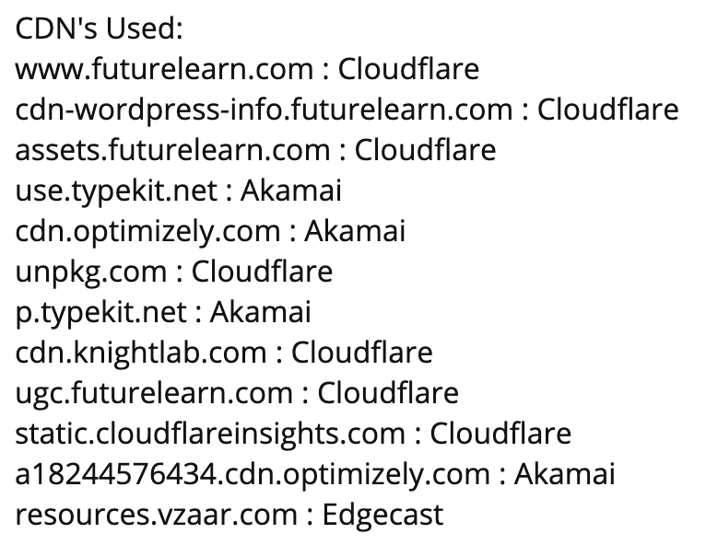
Case Study: Future Learn – Reality
Static resources served from various CDNs
Mostly Cloudflare
Some 3rd party libraries served elsewhere

Slide 16
Case Study: Future Learn – Reality
Video Served from vzaar.com platform
Video on demand service
Mp4 video
No HLS (at least for a short video)

Slide 17
Case Study: Wikimedia Foundation
Wiki properties
Reference: Wikipedia, Wikibooks, Wiktionary, Wikiquote, …
Collections: Wikimedia Commons, Wikiversity, Wikispecies
Software: MediaWiki, Wikidata
21 billion read requests / month
55 million edits
https://techblog.wikimedia.org/2020/10/14/wikimedias-cdn/

Slide 18
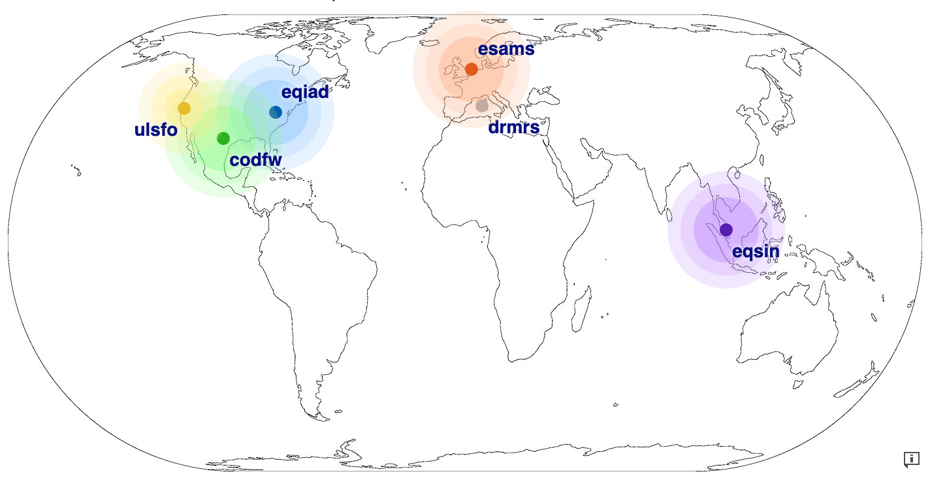
Case Study: Wikimedia Networking
6 Clusters
Core
Virgina, USA
Texas, USA
Edge caches
San Francisco, USA
Amsterdam, NL
Singapore
Marseille, FR (planned)
High speed fibre links
https://techblog.wikimedia.org/2020/10/14/wikimedias-cdn/

Slide 19
Case Study: Wikimedia Architecture
Run their own CDN
GeoDNS routes user requests to closest edge cluster
6 Edge caches (4 edge + 2 at core DC)
2 Core clusters
Replicated databases
GeoDNS
Edge
Edge
Edge
Edge
Edge
Edge
Core
Core
Replicated DB
Replicated DB
https://techblog.wikimedia.org/2020/10/14/wikimedias-cdn/

Slide 20
Case Study: Wikimedia Architecture Edge Node
Load balancer (by IP hash)
Apache Traffic Server
In-memory cache (Varnish)
On-disk cache (ATS)
90% of requests are served from cache
Load Balancer
In Memory cache
Disk Cache
https://techblog.wikimedia.org/2020/10/14/wikimedias-cdn/

