Slide 1
Search Engines
COMP3220 Web Infrastructure
Dr Heather S. Packer
hp3@ecs.soton.ac.uk

Slide 2
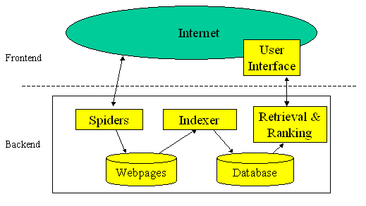
Summary of Search Engines
Components of a search engine
Crawlers/Spiders
Indexers
Ranking algorithms
UI/Browser
Data stores
Evolution of the web
Scale
Technological advancements
Historical events
People’s expectations
Image taken from Comparison of two approaches to building a vertical search tool - Scientific Figure on ResearchGate. Available from: https://www.researchgate.net/figure/Typical-search-engine-architecture_fig1_268238742 [accessed 20 Nov, 2021]

Slide 3
What’s the difference between Vertical and Domain Specific Searches, and Search Engines?
A Vertical or Domain Specific Search Engine focuses on a specific segment of online content, such as topic, media type, or genre of content.
Web search engines index large portions of the World Wide Web using a web crawler
Vertical or Domain Specific Search Engine typically use a focused crawler which attempts to index only relevant web.
Vertical or Domain Specific Search Engines can focus on individual verticals, or multiple vertical searches.
What Vertical Searches do you use?

Slide 4
What’s the difference between Vertical and Domain Specific Searches, and Search Engines?
A Vertical or Domain Specific Search Engine focuses on a specific segment of online content, such as topic, media type, or genre of content.
Web search engines index large portions of the World Wide Web using a web crawler
Vertical or Domain Specific Search Engine typically use a focused crawler which attempts to index only relevant web.
Vertical or Domain Specific Search Engines can focus on individual verticals, or multiple vertical searches.
What Vertical Searches do you use?

Slide 5
What’s the difference between Vertical and Domain Specific Searches, and Search Engines?
A Vertical or Domain Specific Search Engine focuses on a specific segment of online content, such as topic, media type, or genre of content.
Web search engines index large portions of the World Wide Web using a web crawler
Vertical or Domain Specific Search Engine typically use a focused crawler which attempts to index only relevant web.
Vertical or Domain Specific Search Engines can focus on individual verticals, or multiple vertical searches.
What Vertical Searches do you use?

Slide 6
Search Verticals & Domain Specific Searches
WaybackMachine archive
https://archive.org/web/
TinEye intelligent image search
https://tineye.com/
Campsearch for complex queries by age-group, size, location and cost
https://www.campsearch.com/
Listennotes for Podcasts
https://www.listennotes.com/
Congress.gov United States Congress legislative information
https://www.congress.gov/

Slide 7
Vertical search and domain specific services can offers several potential benefits over more general search engines. Why is this?

Slide 8
Vertical search and domain specific services can offers several potential benefits over more general search engines. Why is this?
Greater precision due to limited scope
Leverage domain knowledge including taxonomies and ontologies
Support of specific unique user tasks
“Domain-specific search solutions focus on one area of knowledge, creating customized search experiences, that because of the domain's limited corpus and clear relationships between concepts, provide extremely relevant results for searchers” John Battelle The Search (2005)

Slide 9
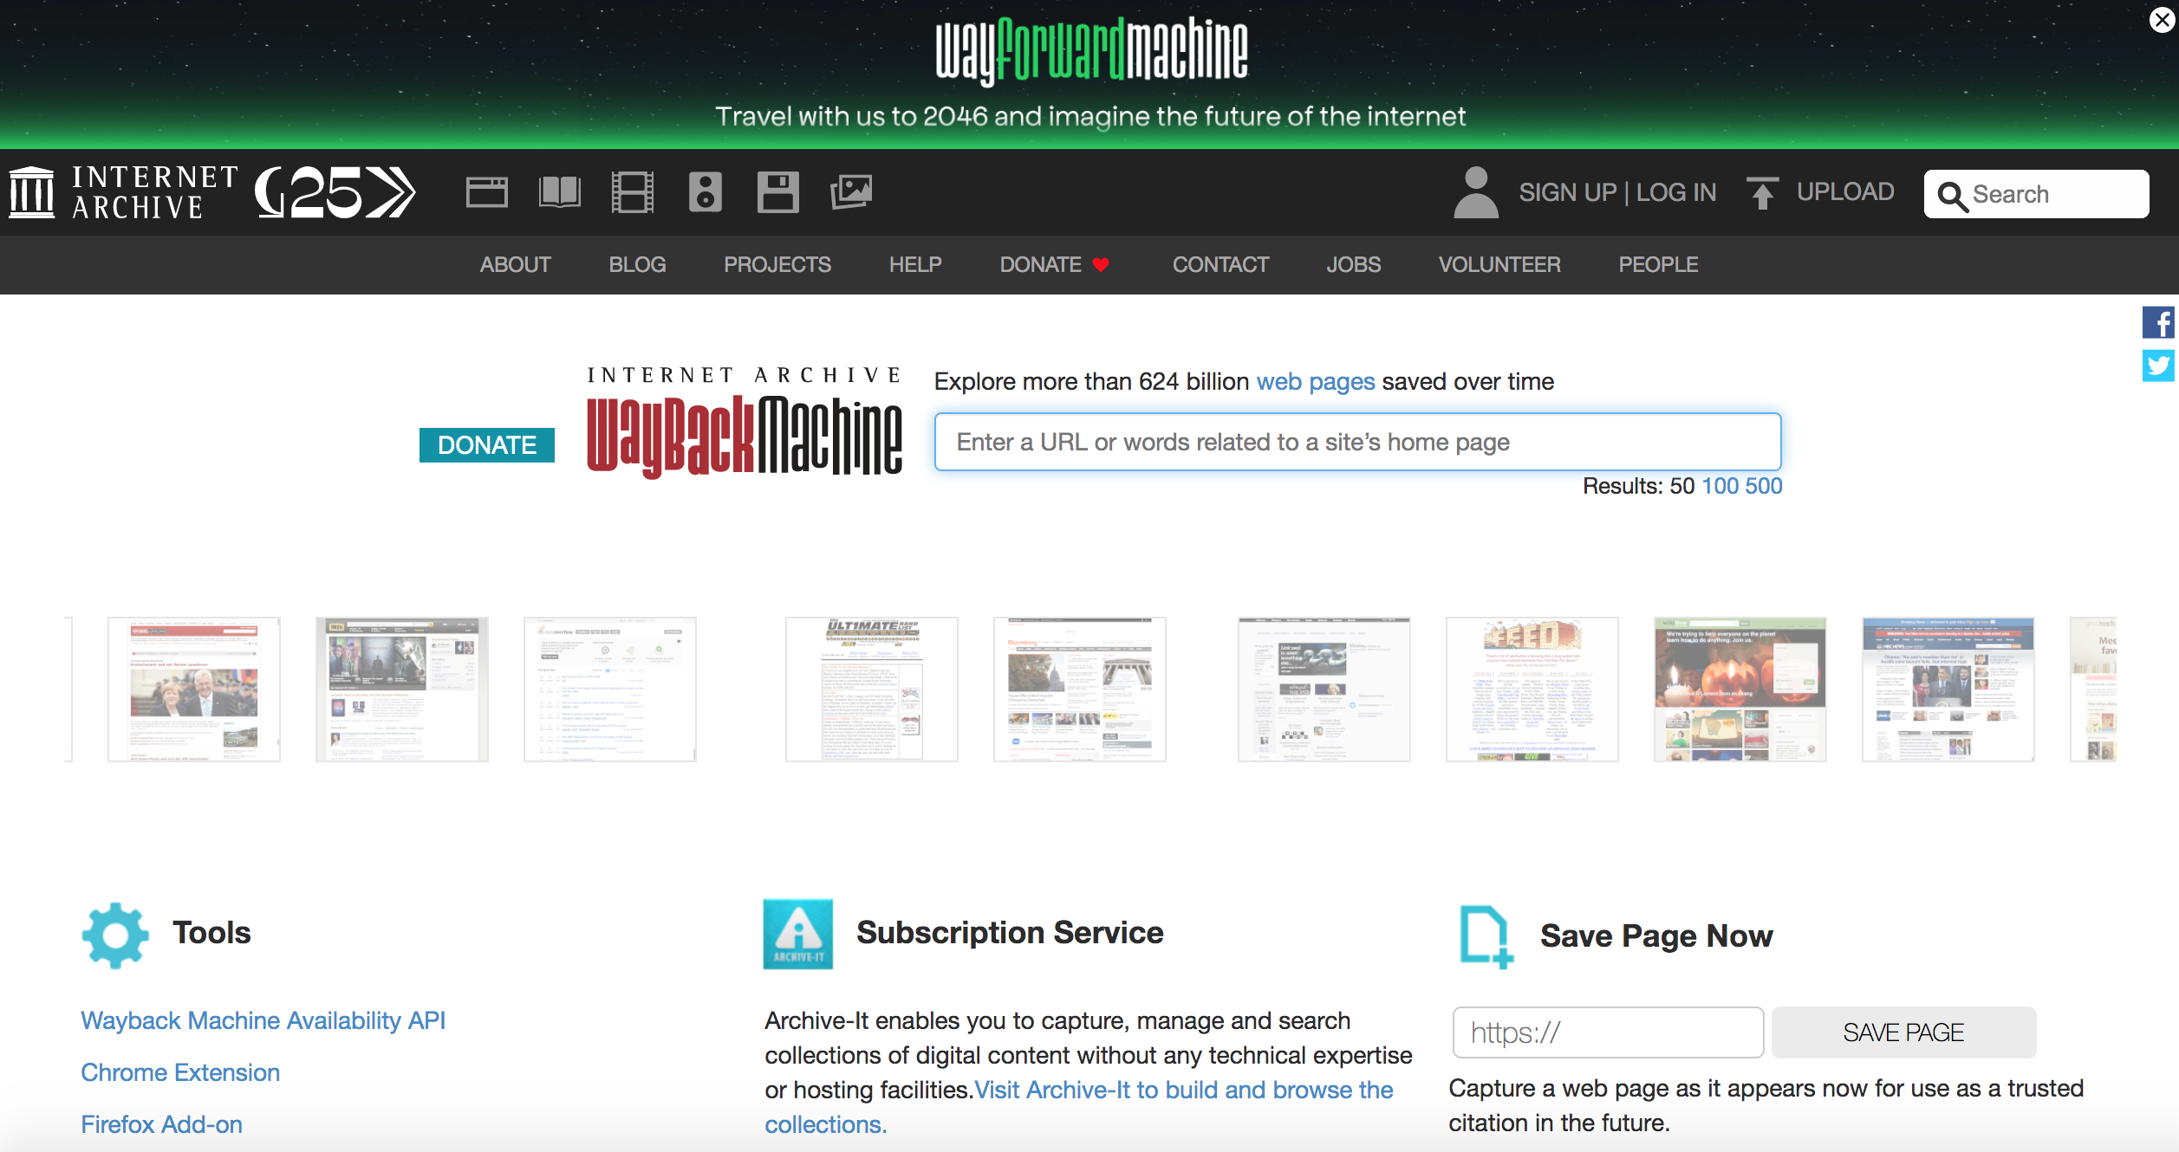
Wayback Machine Example

Slide 10
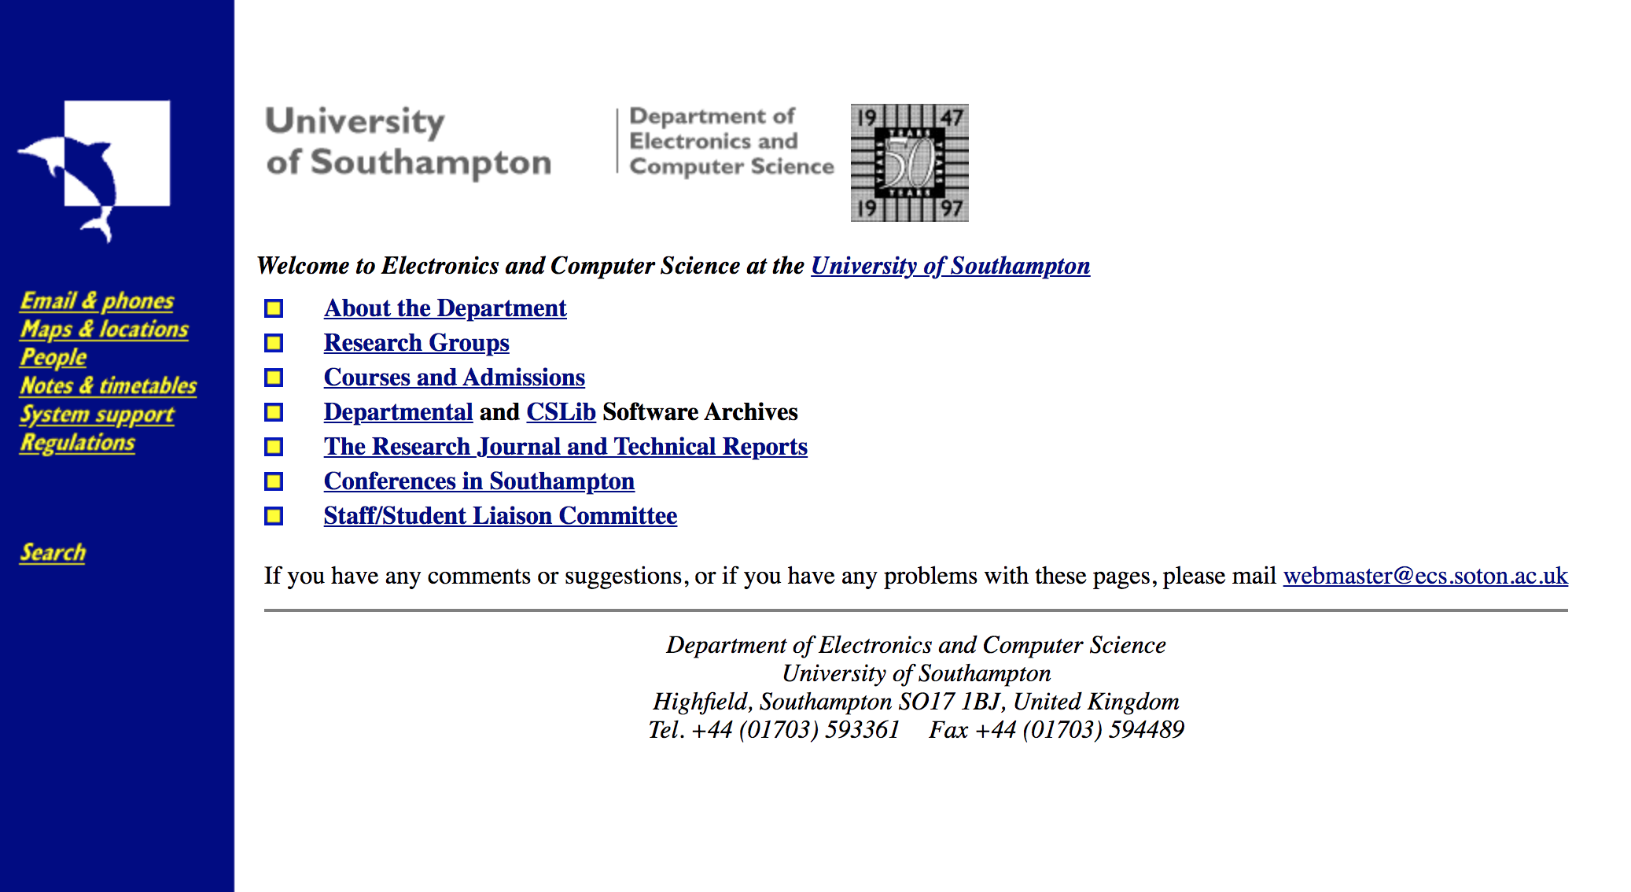
ECS 1996

Slide 11
ECS Jun 1997

Slide 12
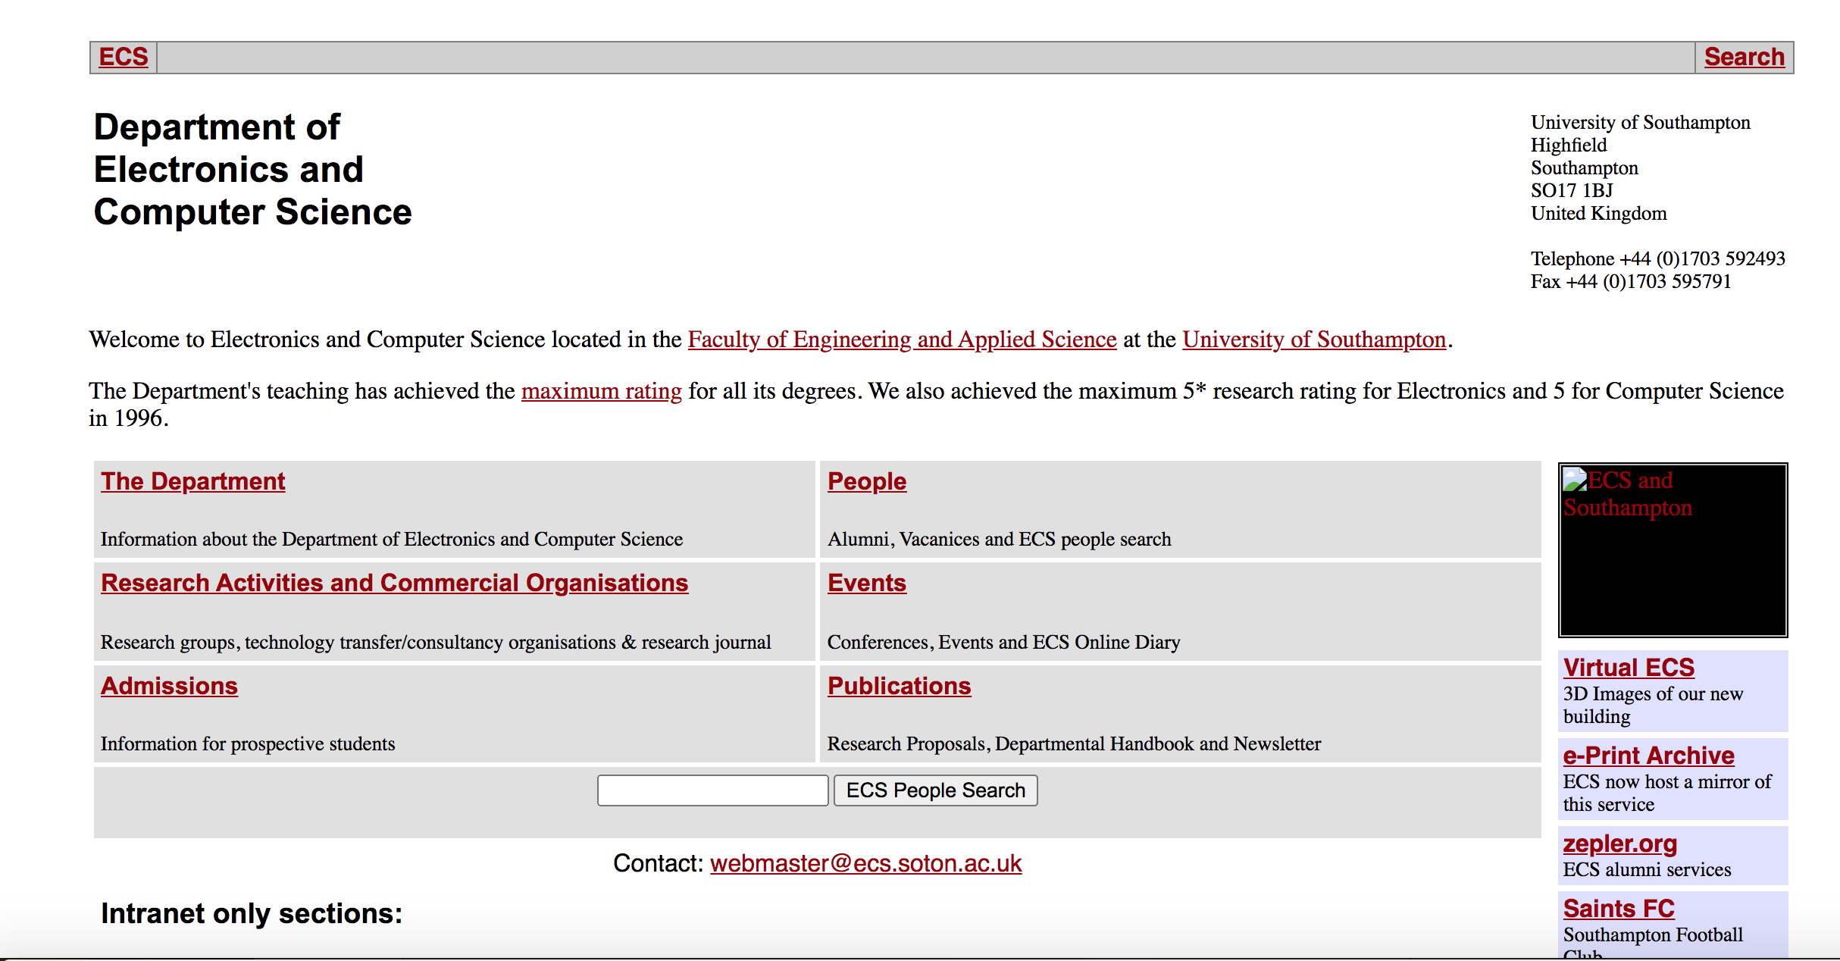
ECS Dec 1998

Slide 13
ECS April 1999

Slide 14
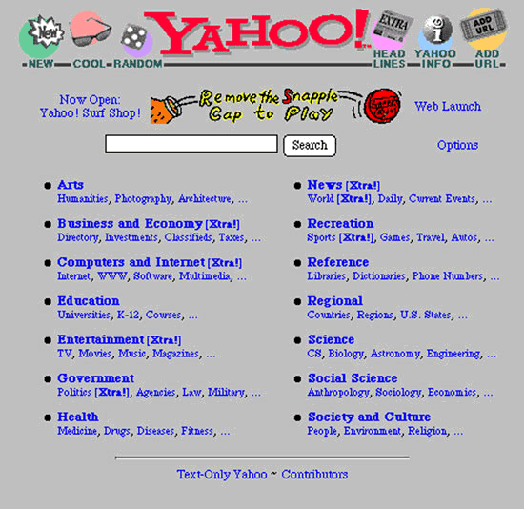
ECS April 1999

Slide 15
ECS 2003

Slide 16
ECS 2004

Slide 17
ECS 2011

Slide 18
ECS 2014

Slide 19
ECS 2020

Slide 20
Summary Observations
Design layout changed every single year 1996-1999
1999 looks a lot like yahoo directory from 1994
1996-2003 simple designs
2014 University Wide scheme adopted
2020 Heavy use of large images
Increasing use of images

Slide 21
UoS Electronics and Computer Science
The 2011 version of the website has more links and more contextual information compared to the 1996 version
What would that added complexity mean for the scale of indexers between 1996 257,601 websites and 2011 346,004,403?

Slide 22
UoS Electronics and Computer Science
What would that added complexity mean for the scale of indexers between 1996 257,601 websites and 2011 346,004,403?
Crawling involves larger webpages so more bandwidth
More media types such as images and videos
Search indexes are larger
More crawlers needed
Processing and creating indexes takes more resources

Slide 23
WayBack Machine
What information would the Wayback Machine’s crawler collect?
URLs
Dates
HTML
How important is freshness to the Wayback Machine?
Every incremental page?
Web masters can request for their pages to be archived
How do you think it differs from Google or Bing?
No ranking results direct matches

Slide 24
WayBack Machine
What information would the Wayback Machine’s crawler collect?
URLs
Dates
HTML
How important is freshness to the Wayback Machine?
Every incremental page?
Web masters can request for their pages to be archived
How do you think it differs from Google or Bing?
No ranking results direct matches

Slide 25
WayBack Machine
What information would the Wayback Machine’s crawler collect?
URLs
Dates
HTML
How important is freshness to the Wayback Machine?
Every incremental page?
Web masters can request for their pages to be archived
How do you think it differs from Google or Bing?
No ranking results direct matches

Slide 26
WayBack Machine
What information would the Wayback Machine’s crawler collect?
URLs
Dates
HTML
How important is freshness to the Wayback Machine?
Every incremental page?
Web masters can request for their pages to be archived
How do you think it differs from Google or Bing?
No ranking results direct matches

Slide 27
Wayback Machine
Use your phone or laptop and look up one of your most used websites
What is the biggest difference between the first archive and the last?
Can you tell when it was designed to be mobile friendly?
Do you think you could recreate the HTML for a page for the first archive? How about the last?
How many images were used on the first archive?
How has the menu changed?
How has the number of links on the page changed?

Slide 28
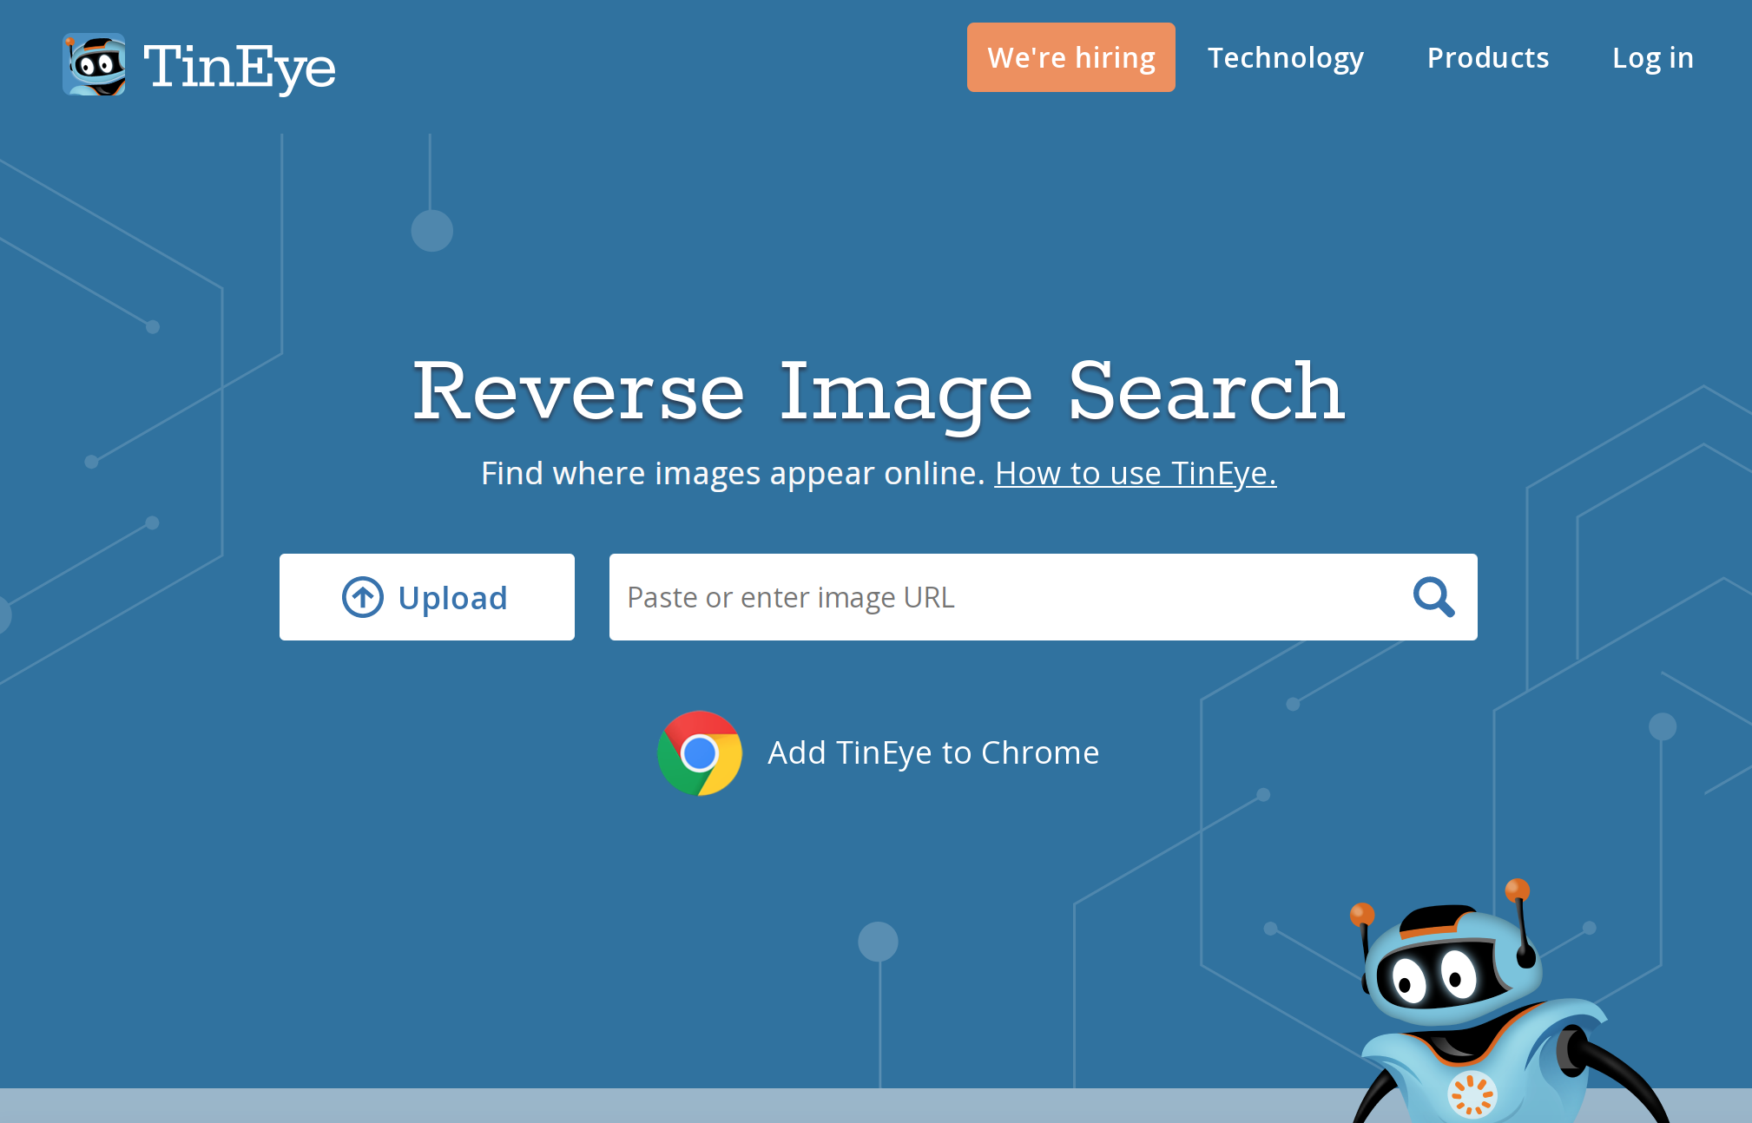
Tin Eye Example

Slide 29
Reverse Image Searches
TinEye
Image verification
Fraud detection
Image review and moderation
No metadata about the image
Partial matches
TinEye’s Search Engine
Creates a unique digital fingerprint
Fingerprint stored in an index for a user
Fingerprint compared to indexed fingerprints
First image from ecs.soton.ac.uk from wayback machine 2003

Slide 30
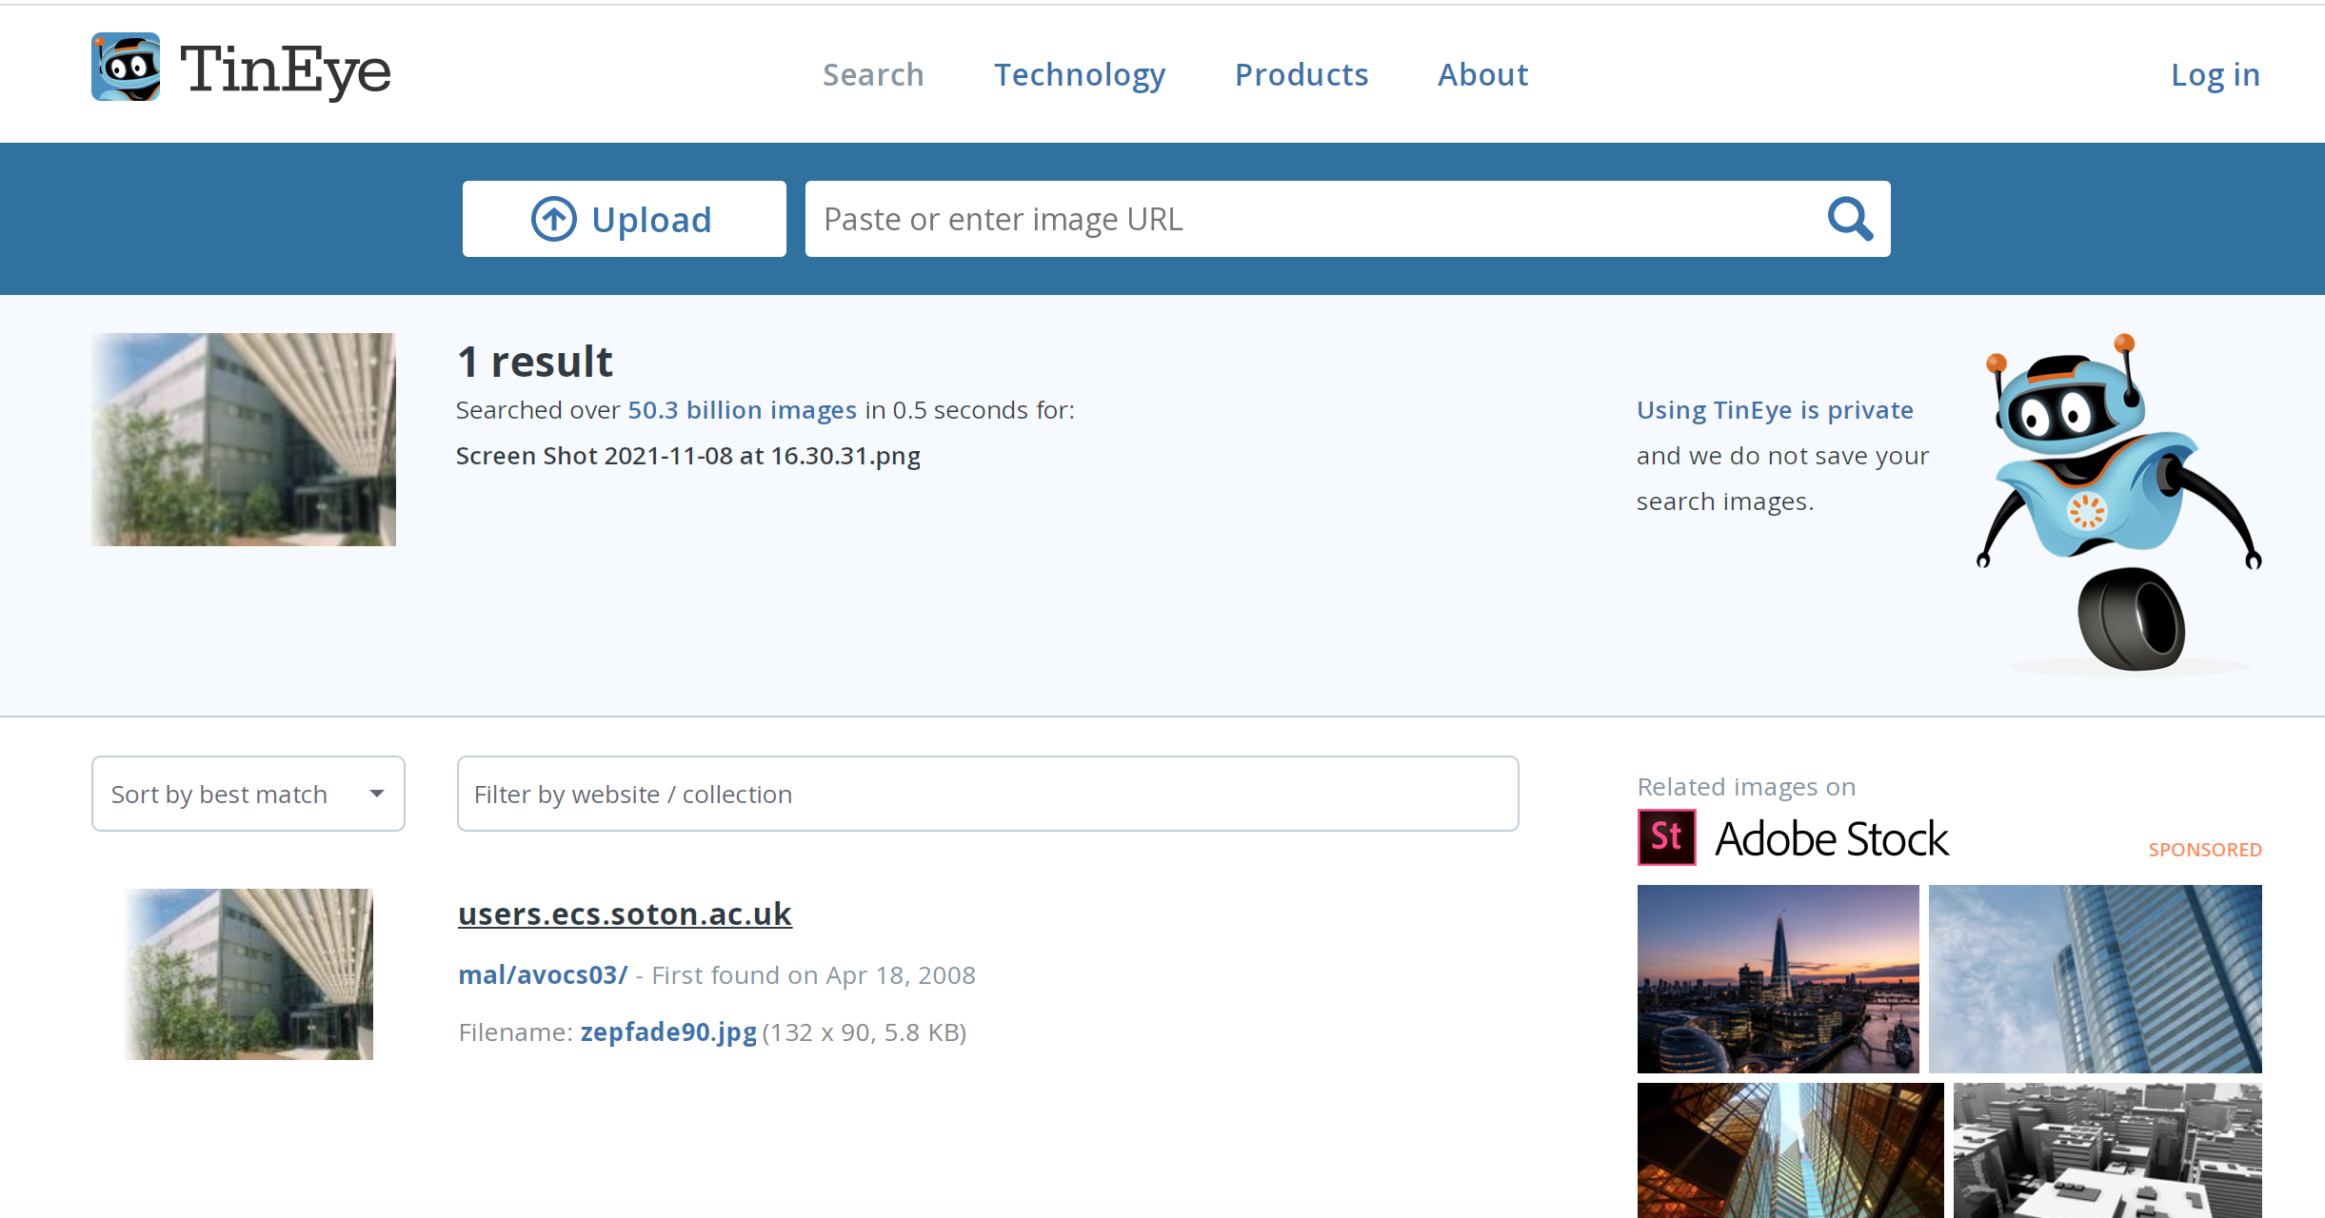
TinEye

Slide 31
TinEye
Use tineye.com to do an image search
What do you notice about the results?
What other meta information was available the result?
What kind of information would the crawler collect?
Can you tell how the image was ranked?
How does it differ from your regular text based search engine?
What are the different ranking strategies you could use?

Slide 32
Ranking Strategies

Slide 33
Reported Google Ranking Strategies
1. Domain Age
2. Keyword Appears in Top Level Domain
3. Domain registration length
5. Domain History: A site with volatile ownership or several drops
6. Exact Match Domain:
7. Public vs. Private WhoIs: Private WhoIs information may be a sign of “something to hide”.
8. Penalized WhoIs Owner, identified as a scammer
9. Country TLD extension:
10. Keyword in Title Tag
11. Title Tag Starts with Keyword
12. Keyword in Description Tag
13. Keyword Appears in H1 Tag
14. TF-IDF
15. Content Length
16. Table of Contents
17. Latent Semantic Indexing Keywords in Content (LSI)
18. LSI Keywords in Title and Description Tags
19. Page Covers Topic In-Depth
20. Page Loading Speed via HTML
21. Use of AMP
22. Entity Match
23. Google Hummingbird (Semantics of page)
24. Duplicate Content
25. Rel=Canonical tag use to combat duplicate content
26. Image Optimization
27. Content Recency
28. Magnitude of Content Updates
29. Historical Page Updates
30. Keyword Prominence
31. Keyword in H2, H3 Tags
32. Outbound Link Quality
33. Outbound Link Theme
34. Grammar and Spelling
35. Syndicated Content
36. Mobile-Friendly Update
37. Mobile Usability
38. “Hidden” Content on Mobile
39. Helpful “Supplementary Content”
40. Content Hidden Behind Tabs
41. Number of Outbound Links
42. Multimedia
43. Number of Internal Links Pointing to Page
44. Quality of Internal Links Pointing to Page
45. Broken Links
46. Reading Level
47. Affiliate Links
48. HTML errors/W3C validation
49. Domain Authority
50. Page’s PageRank
51. URL Length
52. URL Path
53. Human Editors
54. Page Category
55. Keyword in URL
56. URL String
57. References and Sources
58. Bullets and Numbered Lists
59. Priority of Page in Sitemap
60. Too Many Outbound Links
61. UX Signals From Other Keywords Page Ranks For
62. Page Age
63. User Friendly Layout
64. Parked Domains
65. Useful Content
https://backlinko.com/google-ranking-factors

Slide 34
Reported Google Ranking Strategies
66. Content Provides Value and Unique Insights
67. Contact Us Page
68. Domain Trust/TrustRank
69. Site Architecture
70. Site Updates
71. Presence of Sitemap
72. Site Uptime
73. Server Location
74. SSL Certificate
75. E-A-T: Short for “Expertise, Authoritativeness, Trustworthiness”
76. Duplicate Meta Information On-Site
77. Breadcrumb Navigation
78. Mobile Optimized
79. YouTube
81. Use of Google Analytics and Google Search Console
82. User reviews/Site reputation
83. Core Web Vitals
84. Linking Domain Age
85. # of Linking Root Domains
86. # of Links from Separate C-Class IPs
87. # of Linking Pages
88. Backlink Anchor Text
89. Alt Tag (for Image Links)
90. Links from .edu or .gov Domains
91. Authority of Linking Page
92. Authority of Linking Domain
93. Links From Competitors
94. Links from “Expected” Websites
95. Links from Bad Neighborhoods
96. Guest Posts
97. Links From Ads
98. Homepage Authority
99. Nofollow Links
100. Diversity of Link Types
101. “Sponsored” or “UGC” Tags
102. Contextual Links
103. Excessive 301 Redirects to Page
104. Internal Link Anchor Text
105. Link Title Attribution
106. Country TLD of Referring Domain
107. Link Location In Content
108. Link Location on Page
109. Linking Domain Relevancy
110. Page-Level Relevancy
111. Keyword in Title
112. Positive Link Velocity
113. Negative Link Velocity
114. Links from “Hub” Pages
115. Link from Authority Sites
116. Linked to as Wikipedia Source
117. Co-Occurrences
118. Backlink Age
119. Links from Real Sites vs. “Splogs”
120. Natural Link Profile
121. Reciprocal Links
122. User Generated Content Links
123. Links from 301
124. Schema.org Usage
125. TrustRank of Linking Site
126. Number of Outbound Links on Page
127. Forum Links
128. Word Count of Linking Content
129. Quality of Linking Content
130. Sitewide Links
131. RankBrain: RankBrain is Google’s AI algorithm.
132. Organic Click Through Rate for a Keyword
https://backlinko.com/google-ranking-factors

Slide 35
Reported Google Ranking Strategies
133. Organic CTR for All Keywords
134. Bounce Rate
135. Direct Traffic
136. Repeat Traffic
137. Pogosticking, a type of bounce.
138. Blocked Sites
139. Chrome Bookmarks
140. Number of Comments
141. Dwell Time
142. Query Deserves Freshness
143. Query Deserves Diversity
144. User Browsing History
145. User Search History
146. Featured Snippets
147. Geo Targeting
148. Safe Search
149. “YMYL” Keywords
150. DMCA Complaints
151. Domain Diversity
152. Transactional Searches
153. Local Searches
154. Top Stories box
155. Big Brand Preference
156. Shopping Results
157. Image Results
158. Easter Egg Results
159. Single Site Results for Brands
160. Payday Loans Update
161. Brand Name Anchor Text
162. Branded Searches
163. Brand + Keyword Searches
164. Site Has Facebook Page and Likes
165. Site has Twitter Profile with Followers
166. Official Linkedin Company Page
167. Known Authorship
168. Legitimacy of Social Media Accounts
169. Brand Mentions on Top Stories
170. Unlinked Brand Mentions
171. Brick and Mortar Location
172. Panda Penalty
173. Links to Bad Neighborhoods
174. Redirects
175. Popups or “Distracting Ads”
176. Interstitial Popups to mobile users
177. Site Over-Optimization
178. Gibberish Content
179. Doorway Pages
180. Ads Above the Fold
181. Hiding Affiliate Links
182. Fred: Series of Google updates starting in 2017
183. Affiliate Sites
184. Autogenerated Content
185. Excess PageRank Sculpting
186. IP Address Flagged as Spam
187. Meta Tag Spamming
188. Hacked Site
189. Unnatural Influx of Links
190. Penguin Penalty
191. Link Profile with High % of Low Quality Links
192. Links From Unrelated Websites
193. Unnatural Links Warning
194. Low-Quality Directory Links: According to Google, backlinks from low-quality directories can lead to a penalty.
195. Widget Links
196. Links from the Same Class C IP
https://backlinko.com/google-ranking-factors

Slide 36
Reported Google Ranking Strategies
197. “Poison” Anchor Text
198. Unnatural Link Spike
199. Links From Article Directories and Press Releases
200. Manual Actions
201. Selling Links
202. Google Sandbox
203. Google Dance, algorithm to check gaming ranking
204. Disavow Tool
205. Reconsideration Request
206. Temporary Link Schemes
https://backlinko.com/google-ranking-factors

Slide 37
TinEye Search Engine
What are the different ranking strategies you could use?
14. TF-IDF
19. Page Covers Topic In-Depth
26. Image Optimization
42. Multimedia
65. Useful Content
88. Backlink Anchor Text
89. Alt Tag (for Image Links)
98. Homepage Authority
110. Page-Level Relevancy
111. Keyword in Title

Slide 38
TinEye Search Engine
What are the different ranking strategies you could use?
14. TF-IDF
19. Page Covers Topic In-Depth
26. Image Optimization
42. Multimedia
65. Useful Content
88. Backlink Anchor Text
89. Alt Tag (for Image Links)
98. Homepage Authority
110. Page-Level Relevancy
111. Keyword in Title

Slide 39
Podcast Search Engine
What are the most relevant ranking strategies you could use for a podcast domain specific search engine?
10. Keyword in Title Tag
16. Table of Contents
32. Outbound Link Quality
42. Multimedia
65. Useful Content
98. Homepage Authority
110. Page-Level Relevancy
111. Keyword in Title
141. Dwell Time

Slide 40
Podcast Search Engine
What are the most relevant ranking strategies you could use for a podcast domain specific search engine?
10. Keyword in Title Tag
16. Table of Contents
32. Outbound Link Quality
42. Multimedia
65. Useful Content
98. Homepage Authority
110. Page-Level Relevancy
111. Keyword in Title
141. Dwell Time

Slide 41
Academic Search Engine
What are the most relevant ranking strategies you could use for a research publications specific search engine?
10. Keyword in Title Tag
14. TF-IDF
16. Table of Contents
23. Google Hummingbird (Semantics of page)
57. References and Sources
65. Useful Content
98. Homepage Authority
110. Page-Level Relevancy
111. Keyword in Title
141. Dwell Time

Slide 42
Academic Search Engine
What are the most relevant ranking strategies you could use for a research publications specific search engine?
10. Keyword in Title Tag
14. TF-IDF
16. Table of Contents
23. Google Hummingbird (Semantics of page)
57. References and Sources
65. Useful Content
98. Homepage Authority
110. Page-Level Relevancy
111. Keyword in Title
141. Dwell Time

