Slide 2
Web Graph**
COMP3220 Web Infrastructure
Dr Heather S. Packer
hp3@ecs.soton.ac.uk
**This content is supplementary to the pre recorded content
Notes:
**This content is supplementary to the pre recorded content

Slide 3
The Web and Graph Theory
We can represent the web as a graph or network
We can apply graph theory which tells us properties about the network
4 Centrality Measures
Degree
Exposure to the network
Opportunity to directly influence
Number of edges connected to a node
Betweenness
Informal power, gate keeping, brokering, controls flow of browsing
The number of shortest paths going through a node
Closeness
Estimates time to receive information, indirect influence, point of rapid diffusion
Closeness is the average of the shortest distances to all other nodes in the graph
Eigenvector
Connection to influential nodes of high degree
“not what you know but who you know”
Eigenvector measures the popularity by looking at the quality of links
Identifies whether a node is connected to influential nodes

Slide 4
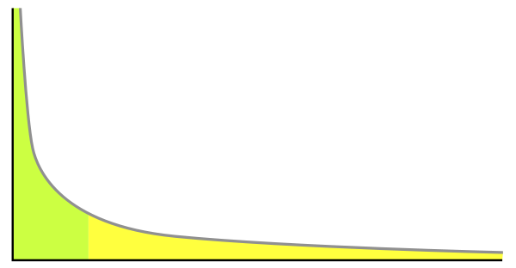
The Web and Graph Theory
Degree Distribution
Normal Distribution
Power Law
Scale Free network
When the network grows, the underlying structure remains the same.
Learning Outcomes
Calculate the four different centrality measures for a directed graph
Describe the different meanings of the the centrality measures
Understand the relationship between the Power Law and Scale Free Networks
Power Law The right has a long tail, and to the left are the few that dominate (also known as the 80-20 rule).
Notes:
probability distribution of these degrees over the whole network

Slide 5
“Web Graph is an over-simplification of the web.”
Discuss:
What Web Graph can do
What Web Graph cannot do
Notes:
Web graph doesn’t not do anything about the content of the page
- Quality
Doesn’t talk about popularity / visits to the page

Slide 6
The Web and Graph Theory
“Web Graph is an over-simplification of the web.”
Discuss:
What Web Graph can do
Study how the web is interconnected
Study how the web grows
Ranking pages
Identifying authorities in the web
What Web Graph cannot do:
Does not consider anything about the content of the page such as the quality of the content
Does not consider the popularity of the page or page views
Notes:
Web graph doesn’t not do anything about the content of the page
- Quality
Doesn’t talk about popularity / visits to the page

Slide 7
Cities, Flights and Connectivity
How can we model cities and flights using a graph?
Cities are nodes
Flights are edges
Why are these cities connected to each other?
There is demand because of business, tourism and migration
Airlines focus their operations on certain airports and form alliances
Capital cities, points of interest
Geographical topology eg how built up an area is or whether an airport can be built there
What are hubs and what makes a good hubs?
Nodes with large numbers of connections
Well-connected to rest of the graph

Slide 8
Cities, Flights and Connectivity
How can we model cities and flights using a graph?
Cities are nodes
Flights are edges
Why are these cities connected to each other?
There is demand because of business, tourism and migration
Airlines focus their operations on certain airports and form alliances
Capital cities, points of interest
Geographical topology eg how built up an area is or whether an airport can be built there
What are hubs and what makes a good hubs?
Nodes with large numbers of connections
Well-connected to rest of the graph

Slide 9
Cities, Flights and Connectivity
How can we model cities and flights using a graph?
Cities are nodes
Flights are edges
Why are these cities connected to each other?
There is demand because of business, tourism and migration
Airlines focus their operations on certain airports and form alliances
Capital cities, points of interest
Geographical topology eg how built up an area is or whether an airport can be built there
What are hubs and what makes a good hubs?
Nodes with large numbers of connections
Well-connected to rest of the graph

Slide 10
Cities, Flights and Connectivity
How can we model cities and flights using a graph?
Cities are nodes
Flights are edges
Why are these cities connected to each other?
There is demand because of business, tourism and migration
Airlines focus their operations on certain airports and form alliances
Capital cities, points of interest
Geographical topology eg how built up an area is or whether an airport can be built there
What are hubs and what makes a good hubs?
Nodes with large numbers of connections
Well-connected to rest of the graph

Slide 11
BA Edinburgh
Edinburgh
London
Southampton
Palma de Mallorca
Florence

Slide 12
BA Faro
Edinburgh
London
Southampton
Florence
Faro

Slide 13
BA Florence
Edinburgh
London
Southampton
Florence
Faro

Slide 14
BA Ibiza
Edinburgh
London
Southampton
Palma de Mallorca
Florence
Faro
Ibiza

Slide 15
BA Palma
Glasgow
Edinburgh
London
Southampton
Palma de Mallorca
Florence
Faro

Slide 16
BA Southampton
Glasgow
Edinburgh
Berlin
London
Southampton
Limoges
Nice
Bergerac
Palma de Mallorca
Florence
Malaga
Mykonos
Faro
Ibiza

Slide 17
London
Glasgow
Edinburgh
Berlin
115 European destinations
26 North American
6 Central and South Asia
7 Far East and Australia
20 Latin American and Caribbean
17 Middle Eastern and Africa
London
Southampton
Limoges
Nice
Bergerac
Palma de Mallorca
Florence
Malaga
Mykonos
Faro
Ibiza

Slide 18
Airports/Node | Edges
Bergerac | 2
Berlin | 2
Edinburgh | 4
Faro | 2
Florence | 3
Glasgow | 2
Ibiza | 2
Limoges | 2
London | 191
Malaga | 2
Mykonos | 2
Nice | 2
Palma de Mallorca | 4
Southampton | 11

Slide 19
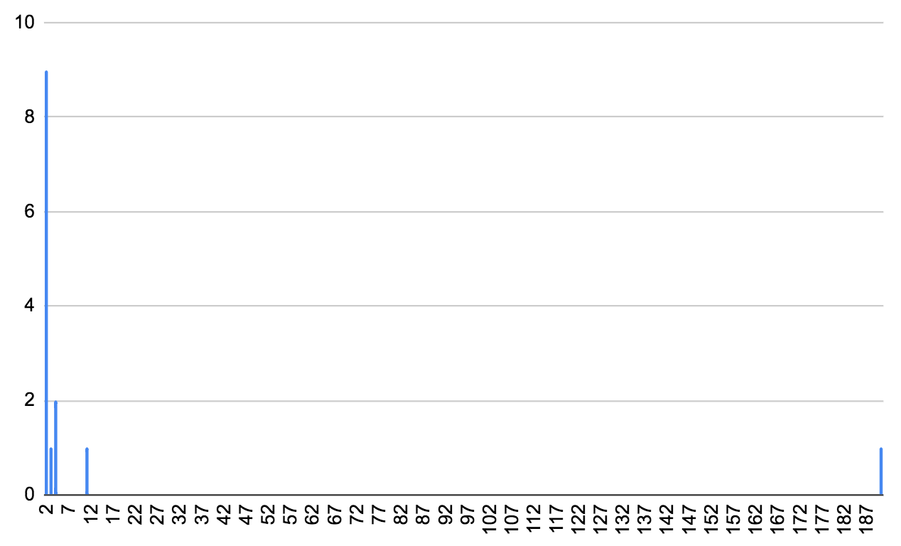
BA UK Connections

Slide 20
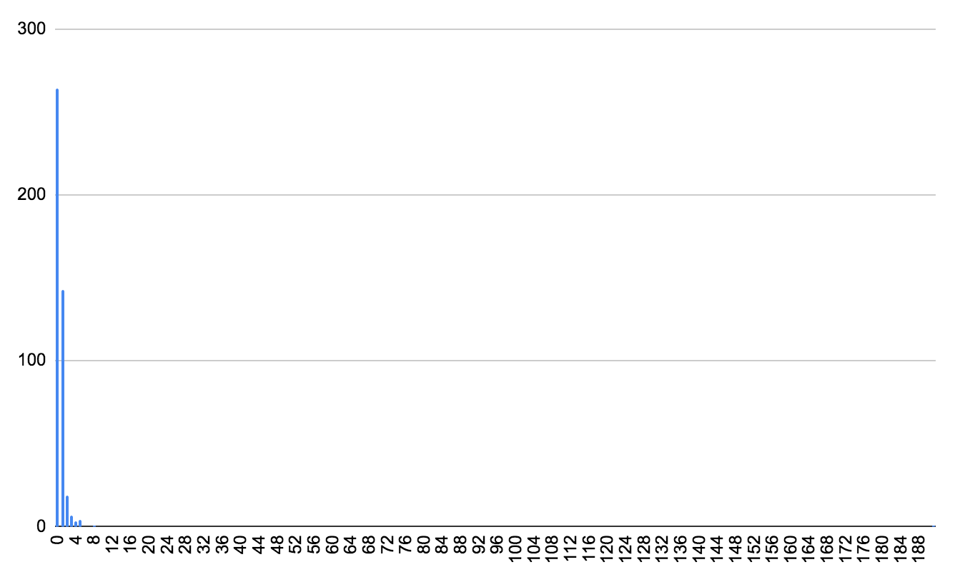
BA World-wide Connections

Slide 21
OpenFlights.org
Export from 2017
3425 Airports and 19257 Routes
User submitted data
Routes between airports
No distance or number of flights/airlines per route

Slide 22
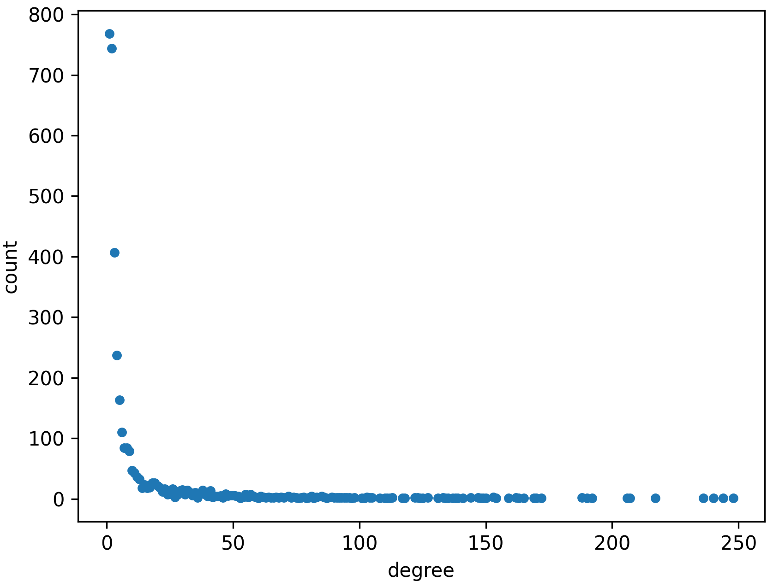
OpenFlights.org airports degree distribution

Slide 23
OpenFlights.org airports degree distribution
What properties does the degree distribution have?
Where would other airlines like to connect to the network?
Distance
Hub
What similarities / differences does this example have with the web?
Evolving graph
Degree distribution suggests preferential attachment
Making links between web pages is easy; between airports is expensive. This may impact how the graphs grow
Describe preferential attachment in:
Airlines
Instagram
Webpages
Notes:
Looks like power law

Slide 24
OpenFlights.org airports degree distribution
What properties does the degree distribution have?
Where would other airlines like to connect to the network?
Distance
Hub
What similarities / differences does this example have with the web?
Evolving graph
Degree distribution suggests preferential attachment
Making links between web pages is easy; between airports is expensive. This may impact how the graphs grow
Describe preferential attachment in:
Airlines
Instagram
Webpages
Notes:
Looks like power law

Slide 25
OpenFlights.org airports degree distribution
What properties does the degree distribution have?
Where would other airlines like to connect to the network?
Distance
Hub
What similarities / differences does this example have with the web?
Evolving graph
Degree distribution suggests preferential attachment
Making links between web pages is easy; between airports is expensive. This may impact how the graphs grow
Describe preferential attachment in:
Airlines
Instagram
Webpages
Notes:
Looks like power law

Slide 26
OpenFlights.org airports degree distribution
What properties does the degree distribution have?
Where would other airlines like to connect to the network?
Distance
Hub
What similarities / differences does this example have with the web?
Evolving graph
Degree distribution suggests preferential attachment
Making links between web pages is easy; between airports is expensive. This may impact how the graphs grow
Describe preferential attachment in:
Airlines
Instagram
Webpages
Notes:
Looks like power law

Slide 27
What do the Measures Tell You?
Degree
Betweenness
Closeness
Eigenvector

Slide 28
What do the measures tell you?
Code | City
AMS | Amsterdam
ANC | Anchorage
ATL | Atlanta, USA
BCN | Barcelona
CDG | Paris
DME | Moscow
DXB | Dubai
FCO | Rome
FRA | Frankfurt
IST | Istanbul
JFK | New York
LAX | Los Angeles
LHR | London
MAD | Madrid
MUC | Munich
ORD | Chicago
PEK | Beijing
SEA | Seattle
YYZ | Toronto
ZRH | Zurich
Degree | Betweenness | Closeness | Eigenvector
AMS, 0.0724 | ANC, 0.0725 | FRA, 0.3986 | AMS, 0.1679
FRA, 0.0713 | LAX, 0.0652 | CDG, 0.3961 | FRA, 0.1664
CDG, 0.0701 | CDG, 0.0619 | LHR, 0.3941 | CDG, 0.1595
IST, 0.0689 | DXB, 0.0565 | AMS, 0.3898 | MUC, 0.1485
ATL, 0.0634 | FRA, 0.0511 | DXB, 0.3895 | FCO, 0.1363
PEK, 0.0605 | PEK, 0.0496 | LAX, 0.3856 | LHR, 0.1361
ORD, 0.0602 | AMS, 0.0493 | JFK, 0.3836 | IST, 0.1293
MUC, 0.0561 | SEA, 0.0481 | YYZ, 0.3791 | BCN, 0.1281
DME, 0.0555 | ORD, 0.0479 | IST, 0.3771 | ZRH, 0.1260
DXB, 0.0549 | YYZ, 0.0427 | ORD, 0.3765 | MAD, 0.1230

Slide 29
What do the measures tell us?
Code | City
AMS | Amsterdam
ANC | Anchorage
ATL | Atlanta, USA
BCN | Barcelona
CDG | Paris
DME | Moscow
DXB | Dubai
FCO | Rome
FRA | Frankfurt
IST | Istanbul
JFK | New York
LAX | Los Angeles
LHR | London
MAD | Madrid
MUC | Munich
ORD | Chicago
PEK | Beijing
SEA | Seattle
YYZ | Toronto
ZRH | Zurich
Degree Centrality
Number of links connecting to a node
Airports with the most number of routes
Implies larger airports?
Wide array of destinations
Convenient (more destinations without having to change plane)
Degree
AMS, 0.0724
FRA, 0.0713
CDG, 0.0701
IST, 0.0689
ATL, 0.0634
PEK, 0.0605
ORD, 0.0602
MUC, 0.0561
DME, 0.0555
DXB, 0.0549

Slide 30
What do the measures tell us?
Code | City
AMS | Amsterdam
ANC | Anchorage
ATL | Atlanta, USA
BCN | Barcelona
CDG | Paris
DME | Moscow
DXB | Dubai
FCO | Rome
FRA | Frankfurt
IST | Istanbul
JFK | New York
LAX | Los Angeles
LHR | London
MAD | Madrid
MUC | Munich
ORD | Chicago
PEK | Beijing
SEA | Seattle
YYZ | Toronto
ZRH | Zurich
Degree Centrality
Number of links connecting to a node
Airports with the most number of routes
Implies larger airports?
Wide array of destinations
Convenient (more destinations without having to change plane)
Degree
AMS, 0.0724
FRA, 0.0713
CDG, 0.0701
IST, 0.0689
ATL, 0.0634
PEK, 0.0605
ORD, 0.0602
MUC, 0.0561
DME, 0.0555
DXB, 0.0549

Slide 31
What do the measures tell us?
Code | City
AMS | Amsterdam
ANC | Anchorage
ATL | Atlanta, USA
BCN | Barcelona
CDG | Paris
DME | Moscow
DXB | Dubai
FCO | Rome
FRA | Frankfurt
IST | Istanbul
JFK | New York
LAX | Los Angeles
LHR | London
MAD | Madrid
MUC | Munich
ORD | Chicago
PEK | Beijing
SEA | Seattle
YYZ | Toronto
ZRH | Zurich
Betweenness
Number of times the node falls on the shortest path between two nodes in the graph
Gateway airports that connect clusters of airports together
Betweenness
ANC, 0.0725
LAX, 0.0652
CDG, 0.0619
DXB, 0.0565
FRA, 0.0511
PEK, 0.0496
AMS, 0.0493
SEA, 0.0481
ORD, 0.0479
YYZ, 0.0427

Slide 32
What do the measures tell us?
Code | City
AMS | Amsterdam
ANC | Anchorage
ATL | Atlanta, USA
BCN | Barcelona
CDG | Paris
DME | Moscow
DXB | Dubai
FCO | Rome
FRA | Frankfurt
IST | Istanbul
JFK | New York
LAX | Los Angeles
LHR | London
MAD | Madrid
MUC | Munich
ORD | Chicago
PEK | Beijing
SEA | Seattle
YYZ | Toronto
ZRH | Zurich
Betweenness
Number of times the node falls on the shortest path between two nodes in the graph
Gateway airports that connect clusters of airports together
Betweenness
ANC, 0.0725
LAX, 0.0652
CDG, 0.0619
DXB, 0.0565
FRA, 0.0511
PEK, 0.0496
AMS, 0.0493
SEA, 0.0481
ORD, 0.0479
YYZ, 0.0427

Slide 33
What do the measures tell us?
Code | City
AMS | Amsterdam
ANC | Anchorage
ATL | Atlanta, USA
BCN | Barcelona
CDG | Paris
DME | Moscow
DXB | Dubai
FCO | Rome
FRA | Frankfurt
IST | Istanbul
JFK | New York
LAX | Los Angeles
LHR | London
MAD | Madrid
MUC | Munich
ORD | Chicago
PEK | Beijing
SEA | Seattle
YYZ | Toronto
ZRH | Zurich
Closeness
Average length of the shortest path to all other nodes in the graph
Well-connected hubs
Closeness
FRA, 0.3986
CDG, 0.3961
LHR, 0.3941
AMS, 0.3898
DXB, 0.3895
LAX, 0.3856
JFK, 0.3836
YYZ, 0.3791
IST, 0.3771
ORD, 0.3765

Slide 34
What do the measures tell us?
Code | City
AMS | Amsterdam
ANC | Anchorage
ATL | Atlanta, USA
BCN | Barcelona
CDG | Paris
DME | Moscow
DXB | Dubai
FCO | Rome
FRA | Frankfurt
IST | Istanbul
JFK | New York
LAX | Los Angeles
LHR | London
MAD | Madrid
MUC | Munich
ORD | Chicago
PEK | Beijing
SEA | Seattle
YYZ | Toronto
ZRH | Zurich
Closeness
Average length of the shortest path to all other nodes in the graph
Well-connected hubs
Closeness
FRA, 0.3986
CDG, 0.3961
LHR, 0.3941
AMS, 0.3898
DXB, 0.3895
LAX, 0.3856
JFK, 0.3836
YYZ, 0.3791
IST, 0.3771
ORD, 0.3765

Slide 35
What do the measures tell us?
Code | City
AMS | Amsterdam
ANC | Anchorage
ATL | Atlanta, USA
BCN | Barcelona
CDG | Paris
DME | Moscow
DXB | Dubai
FCO | Rome
FRA | Frankfurt
IST | Istanbul
JFK | New York
LAX | Los Angeles
LHR | London
MAD | Madrid
MUC | Munich
ORD | Chicago
PEK | Beijing
SEA | Seattle
YYZ | Toronto
ZRH | Zurich
Eigenvector
Measure of influence a node has on a network
All European
Densely connected core
Its not where you are but where you can travel to
Eigenvector
AMS, 0.1679
FRA, 0.1664
CDG, 0.1595
MUC, 0.1485
FCO, 0.1363
LHR, 0.1361
IST, 0.1293
BCN, 0.1281
ZRH, 0.1260
MAD, 0.1230

Slide 36
What do the measures tell us?
Code | City
AMS | Amsterdam
ANC | Anchorage
ATL | Atlanta, USA
BCN | Barcelona
CDG | Paris
DME | Moscow
DXB | Dubai
FCO | Rome
FRA | Frankfurt
IST | Istanbul
JFK | New York
LAX | Los Angeles
LHR | London
MAD | Madrid
MUC | Munich
ORD | Chicago
PEK | Beijing
SEA | Seattle
YYZ | Toronto
ZRH | Zurich
Eigenvector
Measure of influence a node has on a network
All European
Densely connected core
Its not where you are but where you can travel to
Eigenvector
AMS, 0.1679
FRA, 0.1664
CDG, 0.1595
MUC, 0.1485
FCO, 0.1363
LHR, 0.1361
IST, 0.1293
BCN, 0.1281
ZRH, 0.1260
MAD, 0.1230

Slide 37
The Web and Graph Theory
Preferential attachment means the more connected a node is the more likely it is to receive links
Describe preferential attachment in:
Airlines
Adding a route to a well-connected airport improves passenger numbers
Instagram
Users with more followers are more visible to potential followers
Webpages
Authors linking to web pages are more likely to link to a well-known page
Notes:
Looks like power law

Slide 38
The Web and Graph Theory
Preferential attachment means the more connected a node is the more likely it is to receive links
Describe preferential attachment in:
Airlines
Adding a route to a well-connected airport improves passenger numbers
Instagram
Users with more followers are more visible to potential followers
Webpages
Authors linking to web pages are more likely to link to a well-known page
Notes:
Looks like power law

Slide 39
The Web and Graph Theory
Preferential attachment means the more connected a node is the more likely it is to receive links
Describe preferential attachment in:
Airlines
Adding a route to a well-connected airport improves passenger numbers
Instagram
Users with more followers are more visible to potential followers
Webpages
Authors linking to web pages are more likely to link to a well-known page
Notes:
Looks like power law

Slide 40
The Web and Graph Theory
Preferential attachment means the more connected a node is the more likely it is to receive links
Describe preferential attachment in:
Airlines
Adding a route to a well-connected airport improves passenger numbers
Instagram
Users with more followers are more visible to potential followers
Webpages
Authors linking to web pages are more likely to link to a well-known page
Notes:
Looks like power law

Slide 41
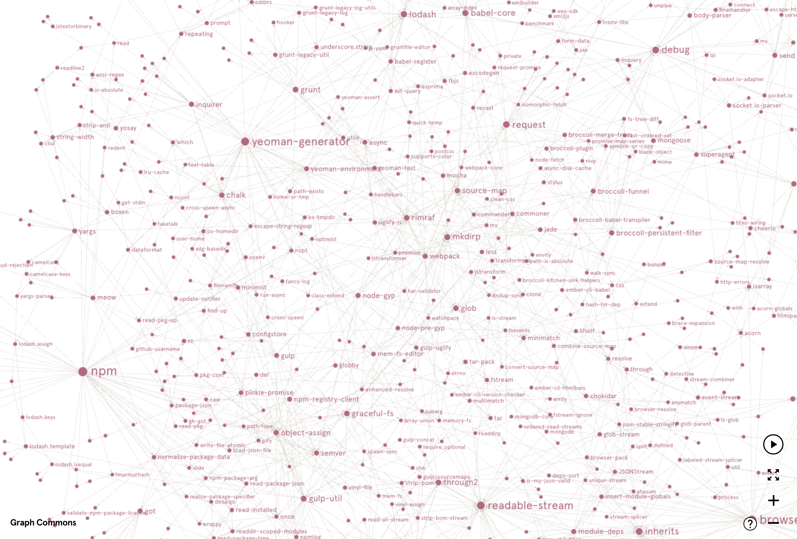
Software dependencies
Software Library Dependency Network
NPM: Node/JavaScript libraries
GraphCommons viewer
https://bit.ly/3HJFHRF
Use “View all in chart” in side menu

Slide 42
Software dependencies
Imagine you are a security researcher looking for vulnerabilities in software packages. What techniques would you use to find software packages to review?
Degree centrality would give you packages that are most directly imported
Would not take into account “A imports B imports C”
EigenVector would give packages that are part of other large software packages with large number of similar dependencies
Ideally you would weight nodes by popularity / downloads of the package
Notes:
Degree centrality would give you the packages that are most directly imported but its not transitive ie A imports B imports C
Betweenness
Closeness centrality would be those with the least dependencies. May indicate getting security fixes out would be quick.
EigenVector would give packages that are part of other large software packages that have large numbers of dependencies
Maybe you can weight the nodes by popularity / downloads of the package

Slide 43
Software dependencies
Imagine you are a security researcher looking for vulnerabilities in software packages. What techniques would you use to find software packages to review?
Degree centrality would give you packages that are most directly imported
Would not take into account “A imports B imports C”
Eigenvector would give packages that are part of other large software packages with large number of similar dependencies
Ideally you would weight nodes by popularity / downloads of the package
Notes:
Degree centrality would give you the packages that are most directly imported but its not transitive ie A imports B imports C
Betweenness
Closeness centrality would be those with the least dependencies. May indicate getting security fixes out would be quick.
EigenVector would give packages that are part of other large software packages that have large numbers of dependencies
Maybe you can weight the nodes by popularity / downloads of the package

Slide 44
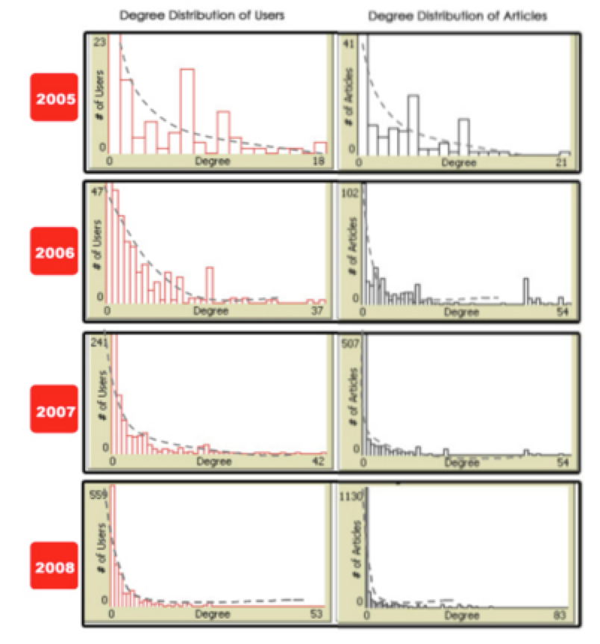
Wikipedia 2005-2008 Node Distribution
Ingawale et al. calculated the:
Degree Distribution of Users
Degree Distribution of Articles
The more time elapses the more obvious power law distribution
Ingawale, Myshkin, Amitava Dutta, Rahul Roy, and Priya Seetharaman. "The small worlds of Wikipedia: implications for growth, quality and sustainability of collaborative knowledge networks." (2009).

Slide 45
Wikipedia 2005-2008 Node Distribution
What does this finding tell us about Wikipedia?
Preferential attachment process is in play
New pages have to be linked to existing pages so human editors naturally form structures like disambiguation pages, list pages
Pages tend to link to more general/wider concepts - potential requirement for successful submission?
Ingawale, Myshkin, Amitava Dutta, Rahul Roy, and Priya Seetharaman. "The small worlds of Wikipedia: implications for growth, quality and sustainability of collaborative knowledge networks." (2009).
Notes:
Preferential attachment process is in play.
New pages have to be linked to existing pages so human editors naturally form structures like disambiguation pages, list pages.
Pages tend to link to more general/wider concepts (requirement for successful edit/submission?)

Slide 46
Wikipedia 2005-2008 Node Distribution
What does this finding tell us about Wikipedia?
Preferential attachment process is in play
New pages have to be linked to existing pages so human editors naturally form structures like disambiguation pages, list pages
Pages tend to link to more general/wider concepts - potential requirement for successful submission?
Ingawale, Myshkin, Amitava Dutta, Rahul Roy, and Priya Seetharaman. "The small worlds of Wikipedia: implications for growth, quality and sustainability of collaborative knowledge networks." (2009).
Notes:
Preferential attachment process is in play.
New pages have to be linked to existing pages so human editors naturally form structures like disambiguation pages, list pages.
Pages tend to link to more general/wider concepts (requirement for successful edit/submission?)

