Slide 2
The Web Standards Process
COMP3220 Web Infrastructure
Dr Nicholas Gibbins – nmg@ecs.soton.ac.uk

Slide 3
How are web standards made?

Slide 4


Slide 5
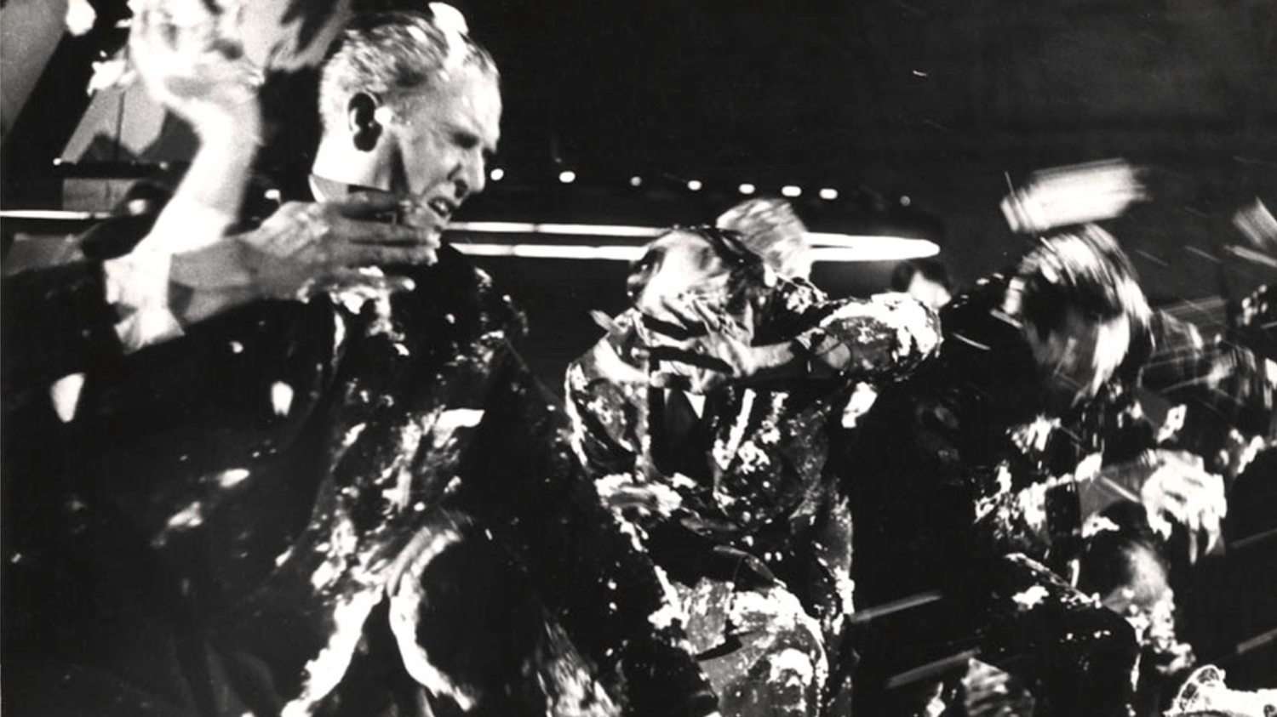

Slide 6
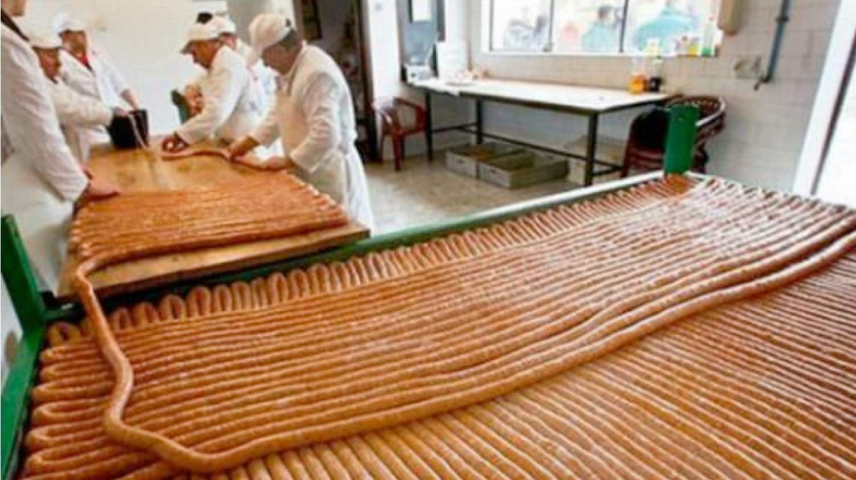

Slide 7
Who makes web standards?

Slide 8






What counts as a Web standards organisation?
Notes:
W3C (1994)
Organization for the Advancement of Structured Information Standards (originally SGML Open in 1993)
IETF (1986)
International Digital Publishing Federation (1999-2017)
ISO (1947)

Slide 9
IETF Structure and Process

Slide 10
The Internet Engineering Task Force
We reject: kings, presidents and voting.
We believe in: rough consensus and running code.
David Clark
Be conservative in what you send and liberal in what you accept.
Jon Postel
http://www.ietf.org/
Notes:
Formed in 1986
Not a membership organisation – anyone can become involved
Consensus driven
Meetings 3x per year
Typical attendence at IETF meetings c. 1200 (from a maximum of ~2800 in 2000)

Slide 11
IETF Structure
Process management
RFC approval
Architectural advice
and oversight
IESG
IAB
IRTF
Areas
GEN
APS
INT
O&M
RAI
RTG
SEC
TSV
Working
Groups
Notes:
IESG – Internet Engineering Steering Group (ADs)
IAB – Internet Architecture Board
Areas (2x ADs each, except GEN)
GEN – General
APS – Applications
INT – Internet
O&M – Operations and Management
RAI – Real-Time Applications and Infrastructure
RTG – Routing
SEC – Security
TSV – Transport Services
Working Groups and BOFs

Slide 12
IETF Document Types
Requests for Comments (RFC)
  Started as informal notes
  Some are Internet standards documents (STD)
  Some give policies or procedures (Best Current Practice – BCP)
  Some are informational
  Others are more whimsical (April Fool’s RFCs)
Notes:
David Waitzman (1 April 1990). Standard for the transmission of IP datagrams on Avian Carriers. IETF. RFC 1149

Slide 13
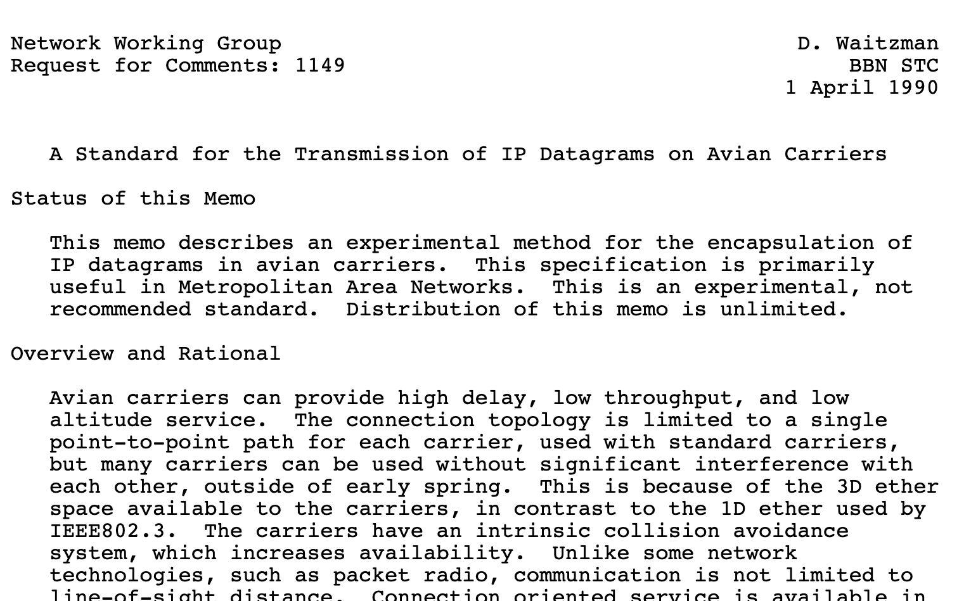

Slide 14
IETF Document Types
Requests for Comments (RFC)
  Started as informal notes
  Some are Internet standards documents (STD)
  Some give policies or procedures (Best Current Practice – BCP)
  Some are informational
  Others are more whimsical (April Fool’s RFCs)
Internet Drafts
  Preliminary technical specifications
  Only valid for six months, unless updated
  Removed from official repository on expiry
Notes:
David Waitzman (1 April 1990). Standard for the transmission of IP datagrams on Avian Carriers. IETF. RFC 1149

Slide 15
W3C Structure and Process

Slide 16
The World Wide Web Consortium
A membership organisation - must join in order to participate*
Key players:
  Director (TimBL)
  Team: Permanent staff, support workings of W3C
  Advisory Committee (AC): Contains a representative from each member organisation. Reviews proposals from Director
  Advisory Board (AB): Guides W3C in non-technical matters
  Technical Architecture Group (TAG): Coordinates cross-technology architecture developments
* with some exceptions

Slide 17
W3C Structure
Working Group
  Chartered for a specific duration to deliver a particular standard
Interest Group
  Chartered discussion forum
Community Group
  Discussion forum open to non-members

Slide 18
W3C Technical Report types
Recommendation
Proposed Recommendation
Candidate Recommendation
Working Drafts
  First Public Working Draft, Last Call Working Draft
Notes
  Member Note, Working Group Note
FPWD
WD
LCWD
CR
PR
REC

Slide 19

Case Study: HTML

Slide 20



The Evolution of HTML: 1991-1995
1990
HTML Tags
HTML DTD
HTML
HTML+
NCSA Mosaic released
IETF HTML WG founded
W3C founded
Netscape released
1995
HTML 2.0
HTML 3.0
Internet Explorer released
2000
informal
Internet Draft
RFC
W3C WD
W3C REC
ISO Standard
Notes:
Oct 1991 HTML Tags
Jun 1992 HTML DTD first draft, 1.1 in Nov
Jan 1993 Mosaic released
Jun 1993 Hypertext Markup Language (Internet Draft)
Nov 1993 HTML+ (Internet Draft)
Sep 1994 IETF HTML WG founded
Oct 1994 W3C founded
Oct 1994 Netscape 0.9 released
Apr 1995 HTML 3.0 (Internet Draft)
Aug 1995 IE released
Nov 1995 HTML 2.0 (RFC1866)
Nov 1995 HTML Forms (RFC1867)
Dec 1995 IETF HTML WG disbanded

Slide 21
Trouble in the Working Group
IETF HTML WG formed in September 1994
By 1995, the IETF HTML WG had grown unwieldy
  Over 100 members in the group
  “I came back after just three days away to find over 2000 messages waiting”
Disbanded in December 1995
W3C HTML Editorial Review Board formed in February 1996
  Became W3C HTML WG in December 1996

Slide 22


Embrace and Extend
“To a certain extent, Microsoft built its business on the Web by extending HTML features.”
Dave Raggett
By the mid-90s, Netscape and Microsoft were creating their own proprietary extensions to HTML
  <font>
  <marquee>
  <blink>
“This page is best viewed in browser X”

Slide 23
De Jure versus De Facto Standards
De Jure: “according to law”
  De jure standards created to extend existing practice
  HTML 3.0, HTML 4.0, XHTML 1.0
De Facto: “as a matter of fact”
  De facto standards created to codify existing practice
  HTML 2.0, HTML 3.2

Slide 24

The Evolution of HTML: 1995-2000
1990
HTML Tags
HTML DTD
HTML
HTML+
NCSA Mosaic released
IETF HTML WG founded
W3C founded
Netscape released
1995
HTML 2.0
HTML 3.0
Internet Explorer released
+ tables, forms
W3C HTML WG
XML
Opera released
HTML 3.2
HTML 4.0
XML 1.0
HTML in XML
Netscape open-sourced
HTML 4.01
2000
ISO HTML
XHTML 1.0
informal
Internet Draft
RFC
W3C WD
W3C REC
ISO Standard
Notes:
May 1996 HTML Tables (RFC1942)
Aug 1996 HTML Client-side Image Maps (RFC1980)
Jan 1997 HTML I18N (RFC2070)
Jan 1997 HTML 3.2 (W3C REC)
Dec 1997 HTML 4.0 (W3C REC)
Dec 1999 HTML 4.01 (W3C REC)
1999 Netscape bought by AOL
May 2000 ISO HTML (ISO/IEC 15445:2000)

Slide 25



The Evolution of HTML: 2000-2005
2000
XHTML 1.0
XHTML 2.0
Mozilla released
Safari released
Opera/Mozilla Paper
Firefox released
2005
2010
informal
Internet Draft
RFC
W3C WD
W3C REC
ISO Standard

Slide 26
Opera/Mozilla Paper
Position Paper for the W3C Workshop on Web Applications and Compound Documents
Critical of official W3C direction for HTML (i.e. XHTML)
Seven principles:
  Backwards compatibility and clear migration path
  Well-defined error handling
  Users should not be subject to authoring errors
  Practical use
  Scripting is here to stay
  Device-specific profiling should be avoided
  Open process

Slide 27
Web Hypertext Application Technology WG
Formed in 2004 in response to perceived slow HTML standards development in W3C
Founder members: Apple, Mozilla and Opera
  Now includes Google (with move of HTML5 editor Ian Hickson from Opera) and Microsoft
Treats HTML 5 as a “living standard”, maintained by an “informed editor”
Membership types:
  Invitation-only Members
  Open Contributors

Slide 28

The Evolution of HTML: 2005-2010
2000
XHTML 1.0
XHTML 2.0
Mozilla released
Safari released
Opera/Mozilla Paper
WHATWG formed
Firefox released
2005
HTML5
XHTML 2.0
W3C HTML WG formed
HTML5
Final Netscape release Chrome released
XHTML 2.0 WG disbanded
2010
informal
Internet Draft
RFC
W3C WD
W3C REC
ISO Standard
WHATWG

Slide 29
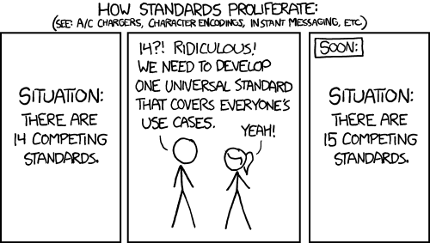
https://xkcd.com/927/

Slide 30
The Evolution of HTML: 2010-
2010
HTML5
HTML5 LCWD
W3C WHATWG CG formed
HTML5 CR
HTML5
2015
HTML5.1
HTML5.1 v2
HTML5.2
HTML5.3
W3C/WHATWG MOU
2020
informal
Internet Draft
RFC
W3C WD
W3C REC
ISO Standard
WHATWG
Notes:
Increasing acrimony between W3C and WHATWG over ownership of the standard
Ownership of the text of the standard
Implementation for CR vs commitment to implement
MOU signed in 2019
WHATWG is responsible for principal development of HTML/DOM
W3C gives input to WHATWG via HTML WG
W3C endorses WHATWG review drafts as W3C Recommendations

Slide 31
W3C/WHATWG Memorandum of Understanding
Attempt to settle the dispute between W3C and WHATWG over control/ownership of the HTML and DOM standard
WHATWG became responsible for principal development of HTML/DOM
W3C gives input to WHATWG via HTML WG
W3C endorses WHATWG review drafts as W3C Recommendations
(still the practice in 2021?)

Slide 32
Further Reading
Internet Engineering Task Force (IETF)
  http://www.ietf.org/
The Tao of IETF
  http://www.ietf.org/tao.html
World Wide Web Consortium (W3C)
  http://www.w3.org/
W3C Consortium Process Document
  https://www.w3.org/Consortium/Process/
Memorandum of Understanding Between W3C and WHATWG
  https://www.w3.org/2019/04/WHATWG-W3C-MOU.html
A History of HTML (1998). From Raggett on HTML 4
  http://www.w3.org/People/Raggett/book4/ch02.html

Slide 33
Next Lecture: Caching and Proxies

