Slide 2
Trailblazers: History of Hypertext Part 3
COMP3220 Web Infrastructure
Dr Nicholas Gibbins – nmg@ecs.soton.ac.uk

Slide 3
Hypertext Systems
http://www.flickr.com/photos/mwichary/2355783479/

Slide 4
HES/FRESS (1967)
Hypertext Editing System developed at Brown University
Used by NASA to produce and manage documentation for the Apollo programme
Carmody, S. et al (1969) A Hypertext Editing System for the /360. Pertinent Concepts in Computer Graphics: Proceedings of the Second University of Illinois Conference on Computer Graphics, pp.291-330.
Notes:
Hypertext Editing System (1967)
Project started by Andries van Dam, also involved Ted Nelson
(van Dam and Nelson were contemporaries from Swarthmore – Nelson graduated in 1959 while van Dam graduated in 1960 – who later re-encountered each other at the 1967 Spring Joint Computer Conference in Atlantic City)
File Retrieval and Editing System (1968)

Slide 5
ZOG (1972)
Developed at Carnegie-Mellon University
Features:
Early proponent of the “card” or “frame” model of hypertext (c.f. index cards)
One-way links, embedded in frames
Robertson, G. et al (1981) The ZOG approach to man-machine communication. Int. J. Man-Machine Studies, 14, pp.461-488.
Notes:
ZOG is not an acronym
Grounded in work from cognitive science – 1972 workshop on new techniques in cognitive research at CMU
Originally designed as a system to join and document various early AI systems, including Terry Winograd's SHRDLU
Tree-like structure of frames

Slide 6
Akscyn R.M. and McCracken D.L. (1981) ZOG and the USS CARL VINSON. Computer Science Research Review 1980-1981. USA: Carnegie Mellon University.
Notes:
ZOG was installed on the Nimitz-class nuclear carrier USS Carl Vinson to handle a variety of shipboard training and administrative tasks.

Slide 7
KMS (1983)
Akscyn, R.M. et al (1988) KMS: A distributed hypermedia system for managing knowledge in organizations. Communications of the ACM, 31(7), pp. 820-835.
Notes:
Commercial descendant of ZOG developed by Rob Akscyn and Donald McCracken (Knowledge Systems spinoff from CMU in 1981)
First presented at Hypertext 87

Slide 8
Hyperties (1983)
Developed by Ben Shneiderman at the University of Maryland
Features:
Link previews
Links point to whole documents
Shneiderman, B. (1987) User interface design for the Hyperties electronic encyclopedia. Proceedings of Hypertext '87, pp. 199-205.
Notes:
Shneiderman – HCI researcher, introduced the direct manipulation interaction style which he applied to the design of Hyperties
Hyperties was used for the first electronic journal issue – July 1988 issue of the Communications of the ACM, which contained papers from the Hypertext ‘87 conference

Slide 9
Intermedia (1985)
Developed at Brown University
Features:
Links stored separately from text
Bidirectional linking
Graphics
Garrett, L.N. et al (1986) Intermedia: issues, strategies, and tactics in the design of a hypermedia document system. Proceedings of the 1986 ACM Conference on Computer-Supported Cooperative Work, pp.163-174.
Notes:
Continued Brown’s work on hypertext following HES and FRESS
Early open hypermedia system

Slide 10
NoteCards (1985)
Developed at Xerox PARC (Trigg, Moran and Halasz)
Features:
Hierarchical browser
Programmable API
Graphics
Halasz, F.G. et al (1986) NoteCards in a Nutshell. SIGCHI Bulletin, 18(4), pp.45-52.
Notes:
Influential – beginning of PARC research into hypertext.
Halasz later published his experience of NoteCard.

Slide 11
HyperCard (1987)
Developed by Apple Computer Inc., and bundled with new Mac SEs.
Features:
OO programming language (HyperTalk)
Graphics
Widely used for application development
Notes:
Example application development – the Miller brothers’ graphic adventure game Myst

Slide 12
Miller, R. and Miller, R. (1993) Myst [Video game]. Mead, WA, USA: Cyan, Inc.

Slide 13
Conklin on Hypertext

Slide 14
Hypertext: An Introduction and Survey
“The concept of hypertext is quite simple: windows on the screen are associated with objects in a data base and links are provided between these objects, both graphically (i.e. as labelled icons) and in the data base (i.e. as pointers).”
Conklin, J. (1987) Hypertext: An introduction and survey. IEEE Computer, 20(9), pp.17-41.
Notes:
Conklin at the time was at Microelectronics and Computer Technology Corporation (MCC), and had written
a hypertext-like system of his own: gIBIS (the graphical issue-based information system)

Slide 15
Disadvantages of hypertext
Disorientation
The tendency to lose one's sense of location and direction in a non-linear document
“Lost in Hyperspace”
Cognitive overhead
The additional effort and concentration necessary to maintain several tasks or trails at one time.

Slide 16
A hypertext typology
Macro Literary Systems
Large on-line libraries in which inter-document links are machine supported; all publishing, reading, collaboration, and criticism takes place within the network
e.g. Memex, NLS/Augment, Xanadu

Slide 17
A hypertext typology
Macro Literary Systems
Problem Exploration Tools
Tools to support early unstructured thinking on a problem when many disconnected ideas come to mind
Early authoring and outlining
Problem solving
Programming and design
e.g. gIBIS
Notes:
gIBIS – Conklin’s own work (first presented at Hypertext 87)
typed links for recording and structuring discussions

Slide 18
A hypertext typology
Macro Literary Systems
Problem Exploration Tools
Structured Browsing Systems
Smaller-scale systems for teaching, reference, and public information, where speed of access and ease of use is crucial
Typically designed only for reading, not for authoring
e.g. ZOG/KMS, Hyperties

Slide 19
A hypertext typology
Macro Literary Systems
Problem Exploration Tools
Structured Browsing Systems
General Hypertext Technology
Research platforms to allow experimentation with a range of hypertext applications; most commonly applied to reading, writing, collaboration
e.g. NoteCards, Intermedia, HES/FRESS

Slide 20
Halasz on Hypertext

Slide 21
Reflections on Notecards
In 1989, Halasz identified seven issues for the next generation of hypertext systems:
Search and query
Composites
Virtual Structures
Computation over networks
Versioning
Support for collaboration
Extensibility
Halasz, F. (1989) Reflections on Notecards: seven issues for the next generation of hypermedia systems, Communications of the ACM, 31(7), pp. 836-852.
Notes:
Member of the Notecards team at Xerox
Originally presented at Hypertext '87

Slide 22
The seven issues
Issue 1: Search and query in a hypermedia network
Link navigation is not always the best way to find things
Better might be content-based or structural search
Issue 2: Composites - augmenting the basic model
A way of representing and dealing with sets (or sub-networks) of nodes and links as unique entities separate from their components
Issue 3: Virtual structures
Documents created/defined by queries (could be considered equivalent to views in a relational database)

Slide 23
The seven issues
Issue 4: Computation in (over) hypermedia networks
APIs allow cards to be orchestrated and scripts to be executed when certain events occur
Issue 5: Versioning
Versioning was a natural feature of early OSs that was discarded by Microsoft for DOS (versioning of hypertext is difficult)
Issue 6: Support for collaborative work
Issue 7: Extensibility and tailorability
The ability to change the system to extend and change behaviours, have different appearances and use different hypertext models
Notes:
Issue 4 – Trellis (more later)

Slide 24
Halasz on Hypertext (part 2)

Slide 25
Seven Issues Revisited
Halasz gave a keynote at Hypertext ‘91 in San Antonio that reconsidered and amended his seven issues:
Ending the tyranny of the link
Open Systems
User interfaces for large information spaces
Very large hypertexts
http://www2.parc.com/spl/projects/halasz-keynote/

Slide 26
Ending the Tyranny of the Link
Hypermedia that includes non-network structures as well as virtual structures on an equal footing with network structures.
Wider variety of hypermedia “data models”
Provides increased opportunity for integration with a variety of complementary systems and technologies
Notes:
Effectively a restatement of his earlier issue #7

Slide 27
Open Systems
“The monolithic hypermedia system of the 1980s is no longer a viable species (!)”
Introduction of open hypermedia systems:
Decompose hypertext system into separate components
Define communications protocols and formats for coordination

Slide 28
User Interfaces for Large Information Spaces
Interfaces that allow users to manipulate large network structures on a workstation screen is a long-standing problem for many hypermedia systems
Many previous systems used some form of network browser, but not always successfully

Slide 29
Very Large Hypertexts
Very large: >10s or 100s of thousands of documents (!)
Large hypertexts uncommon at this time
One of the main selling points in the hypertext vision has been its proficiency in helping to manage VERY LARGE document collections
Challenge is to build a useable industrial-strength hypertext system capable of handling 10,000 documents (!)

Slide 30
...and then the Web happened

Slide 31
1990
Three new Hypertext systems made their first appearance
The World Wide Web
Hyper-G
Microcosm
The above list is roughly in ascending order of the degree to which they addressed Halasz’s seven issues…
…and in descending order of their uptake

Slide 32
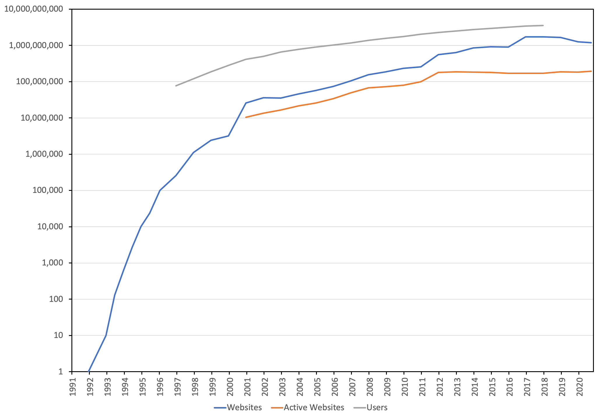
Web Growth
Netcraft (2020) Web Server Survey. Available online at: https://news.netcraft.com/archives/category/web-server-survey/

Slide 33
What is (was) the Web?
The idea of a boundless information world in which there is:
A system of identifiers for resources (URIs)
A network protocol that can be used to interact with those resources (HTTP)
A mark-up language used for representing resources (HTML) which every client must understand how to render – and which can contain links to other resources

Slide 34
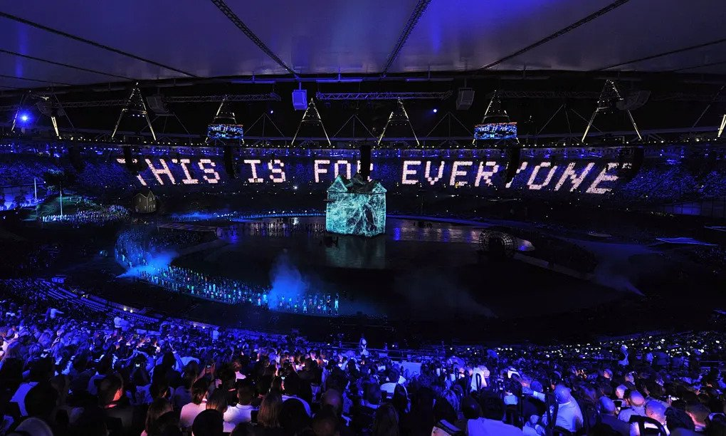

Slide 35
Next Lecture: Open Hypermedia

