Slide 2
Trailblazers: History of Hypertext
COMP3220 Web Infrastructure
Dr Nicholas Gibbins – nmg@ecs.soton.ac.uk

Slide 3
Revisiting Nelson’s definition
The history of hypertext is intrinsically bound up with the history of knowledge organisation
Nelson, T.H. (1965) A File Structure for the Complex, the Changing and the Indeterminate. Proceedings of the 20th ACM National Conference.

Slide 4
From the Middle Ages to the Age of Enlightenment
St Cuthbert Gospel, 7th century England

Slide 5
The Talmud
Central text of Rabbinical Judaism after the Jewish-Roman Wars
Encoding of earlier oral tradition
Commentaries on original text
Commentaries on commentaries
Mishnah C2-3rd
Later commentaries
and cross-references
Rashi C11th
Gemara C5-6th
Tosafot C12-13th
Notes:
Central text upper: Mishnah, earlier oral tradition (c. 220 CE),
Central text lower: Gemara, analysis of the Mishnah (c. 450CE)
RH: Rashi, early medieval commentaries by Rabbi Shlomo ben Yitzhak (France, C11-12)
LH: Tosafot, medieval commentaries by a variety of scholars (France/Germany, C12-13)
Outer columns: modern commentaries, cross references

Slide 6
Richard White of Basingstoke
dunce
Author of Historiarum libri cum notis antiquitatum Britannicarum (1597-1607)
One of the earliest scholars to make use of endnotes.
"as bees take honey from different flowers, so we must take materials from all sorts of different authors and, once they have been systematically collected, store them away, as it were, in the proper combs.”
Notes:
“History books with notes of British Antiquities”
Facts mainly taken from Annio di Viterbo’s Antiquitatum Variarum (1498) (thus largely fabricated)

Slide 7
The birth of the encyclopedia
Comprehensive in scope, systematic in organisation
Ephraim Chambers’ Cyclopædia in 1728
Denis Diderot’s Encyclopédie in 1751
Common features:
Subject-based classification of entries
Cross-references between entries
Notes:
Encyclopaedia, or a Systematic Dictionary of the Sciences, Arts, and Crafts

Slide 9
Organising Utopia
Notes:
The history of hypertext is closely related to the history of information science and information management

Slide 11
Paul Otlet (1868-1944)
Belgian lawyer, internationalist and ‘father of Information Science’
Created the Universal Decimal Classification for libraries (still in use around the world)
With Henri La Fontaine, established the Répertoire Bibliographique Universel in 1895
Notes:
La Fontaine received the Nobel Peace Prize in 1913 for his work as the head of the International Peace Bureau, and was the Belgian delegate at the Versailles Peace Conference in 1919

Slide 12
The external make-up of a book, its format and the personality of its author are unimportant provided that its substance, its sources of information and its conclusions are preserved and can be made an integral part of the organisation of knowledge
Otlet, P. (1892) Something About Bibliography. In International Organisation and Dissemination of Knowledge: Selected Essays of Paul Otlet. Edited and translated from French by W.B. Rayward., 1990. Amsterdam: Elsevier.
Notes:
First published work on knowledge organisation

Slide 13
The ideal would be to strip each article or each chapter in a book of whatever is a matter of fine language or repetition or padding and to collect separately on cards whatever is new and adds to knowledge. These cards, minutely subdivided, each one annotated as to the genus and species of the information they contain, because they are separate could then be accurately placed in a general alphabetical catalogue [...]
Otlet, P. (1892) Something About Bibliography. In International Organisation and Dissemination of Knowledge: Selected Essays of Paul Otlet. Edited and translated from French by W.B. Rayward., 1990. Amsterdam: Elsevier.
Notes:
Introduces the monographic principle (see later work of Ostwald), but not referred to as such.

Slide 14
Répertoire Bibliographique Universel
Notes:
RBU – fee-based service (Otlet visible at back)
Human-driven search engine
15 million 3x5 index cards by 1934
“What works have been written by this or that author?” and “What has been written on this or that subject?”

Slide 15
Desk Set (1957) Directed by Walter Lang [Film]. USA: 20th Century Fox.
Notes:
Still a common enough occurrence as late as the 1950s as to be the subject of a romantic comedy starring Katharine Hepburn and Spencer Tracey (Desk Set, 1957)

Slide 16
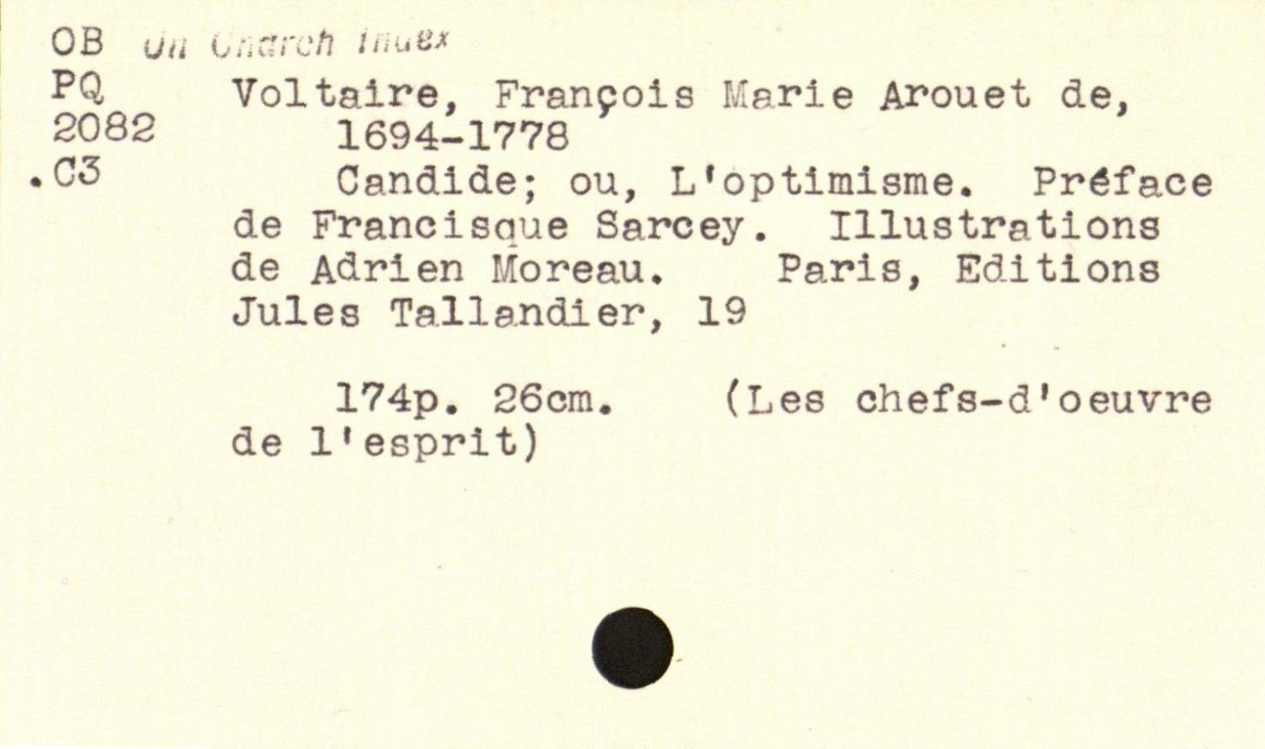
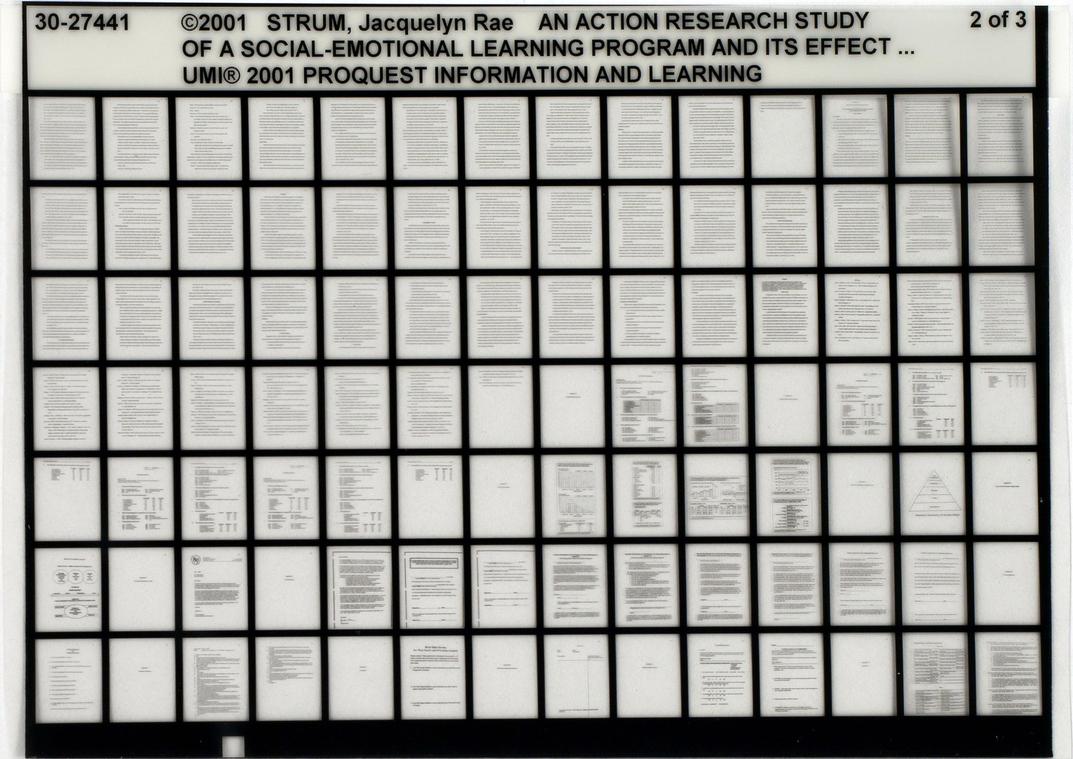
Notes:
Championed the standard 3” x 5” index card
Proposed standard microfiche in 1906

Slide 17
The Mundaneum
A central repository for all the world’s knowledge!
First envisaged in 1910 by Otlet and La Fontaine
Built on the earlier Repertoire Bibliographique Universel
With support from the Belgian government, established in Brussels in 1919
Notes:
Image above is the original location of the Mundaneum in the Palais du Cinquantenaire in Brussels – the Palais Mondial was Otlet’s original name for the Mundaneum
La Fontaine at far right.
Indexed using UDC
100,000s of files, 1,000,000s of images
Cards contain both bibliographic and substantive information
Le Réseau Universel d'lnformation et Documentation

Slide 18
The World City
Otlet’s visionary plan for a city that brought together international institutions, containing the Mundaneum at its heart
Design by Le Corbusier in 1929, to be built outside Geneva alongside the palace of the League of Nations
Fondation Le Corbusier
Notes:
Criticism by Czech architect Karel Teige in 1929:
The whole ideological scheme for the Mundaneum, as explained by Otlet, is an illusion, a vain wish, a utopia; a music of the future about which the only certainty is that if it does happen, it will happen differently than Otlet and Le Corbusier have imagined. This is not the place to outline in detail the errors in the ideological program for the Mundaneum: […] To ask how Otlet imagines international cooperation to be a solution to questions of political, diplomatic and vested interests of individual governments, military and national rivalry: To ask how a world institute under the supervision of the League of Nations, created from states having different social systems, could elaborate plans for the social transformation of the world. We can only mention that this ideological proposal of Mundaneum does not have a concrete rationale or a realistic chance of realization, as long as the League of Nations is a society of governments, powers, diplomacy and armies, and not a “wider league”; a union of nations, not a government built up on the basis of cultural work; above all, not an international political alliance of modern mankind, that being a conception which is completely unknown and which is probably not even in the program of the League of Nations, as Otlet and Le Corbusier seem to realize.
Brussels Mundaneum site closed after the Belgian government withdrew funding for the Mundaneum in 1934

Slide 19
Otlet, P. (1934) Traité de Documentation. Brussels: Editiones Mundaneum, p.41.
Notes:
Brussels Mundaneum site closed after the Belgian government withdrew funding for the Mundaneum in 1934
Traité do Documentation: le livre sure le livre published in 1934
THINGS: the universe, reality, the cosmos
Our MINDS think about fragments of things
SCIENCE manages and coordinates our thoughts
BOOKS transcribe science by areas of knowledge (a collection of books forms a library)
The BIBLIOGRAPHY inventories and catalogues books (the collection of bibliographic entries forms the Universal Bibliographic Index (RBU))
The ENCYCLOPEDIA concentrates, classifies and coordinates the content of books
CLASSIFICATION serves science, books, the bibliography and the encyclopedia at the same time, following the patterns that minds discover in things,

Slide 20
Notes:
1941 drawing of a scholar’s workstation
From Traité (§52.2.C, p.428)
Here the Working Table is no longer loaded with any book. In their place stands a screen and within range a telephone. There in the distance, in an immense building, are all the books and all the information, with all the space required for their registration and handling, with all the apparatus of its catalogs, bibliographies and indexes, with all the redistribution data on cards, sheets and files, with the choice and combination operated by a well-qualified permanent staff. The place of storage and classification also becomes a place of distribution, remotely with or without wire, television or teletaugraphy. From there, the page to be read is displayed on the screen so that the answer to the questions posed by telephone, wired or wireless can be known. A screen would be double, quadruple or tenfold if it were to multiply the texts and the documents to be compared simultaneously; there would be a loudspeaker if the sight should be helped by a given hearing, if the vision should be supplemented by an audition. Such an assumption, a Wells certainly would like it. Utopia today because it does not exist anywhere yet, but it could become the reality of tomorrow provided that our methods and instrumentation are further perfected. And this improvement could go so far as to make automatic the call of documents on the screen (simple classification numbers, books, pages); automatic also the consecutive projection, provided that all the data has been reduced in their analytical elements and arranged to be implemented by the selection machines.

Slide 21
Wilhelm Ostwald
German chemist, Nobel Prize winner and polymath
Inspired by Otlet’s work, established die Brücke (the Bridge) in 1911 using his prize money
Hapke, T. (1998) Wilhelm Ostwald, the “Brücke” (Bridge), and Connections to Other Bibliographic Activities at the Beginning of the Twentieth Century. Proceedings of the 1998 Conference on the History and Heritage of Science Information Systems. pp.139-147.
Notes:
Ostwald process – manufacture of nitric acid – Nobel in 1909
Coined the term “mole”
Later interest in colour theory
Brücke collaborators: Adolt Saager and Karl Bührer

Slide 22
Die Brücke
International Institute for the Organizing of Knowledge Work
Short-lived – wound up in 1913
Reduced literature to small units of recorded knowledge (‘monos’) that could be arranged and linked with other units
Monos categorised using Dewey Decimal Classification
Notes:
The monograph principle (described by Otlet, possibly as a result of his acquaintance with Ostwald) – one sheet, one topic
Mono – small card/leaflet in a standardised format (Weltformat)
Linked via classification

Slide 23
Die Brücke
Die Brücke is planned as a central station, where any question which may be raised with respect to any field of intellectual work whatever finds either direct answer or else indirect, in the sense that the inquirer is advised as to the place where he can obtain sufficient information
Ostwald, W. (1913) Scientific Management for Scientists. Scientific American, 108(1), pp. 5-6.
Notes:
Bankrupt in 1913, abolished in 1914

Slide 24
Technical University of Hamburg-Harburg
Notes:
Weltformat – based on work of Karl Bührer (of the Central Swiss Geo-Commercielle society), who founded the “International Mono Society” –
standardised formats – adapted to form basis of ISO A,B,C,D series paper sizes (ISO216 via DIN476 published in 1922)
Weltformat I – 1cm x 1.41cm
Weltformat II – 1.41cm x 2cm
Weltformat X (22.9cm x 32.4cm) corresponds to ISO C4.

Slide 25
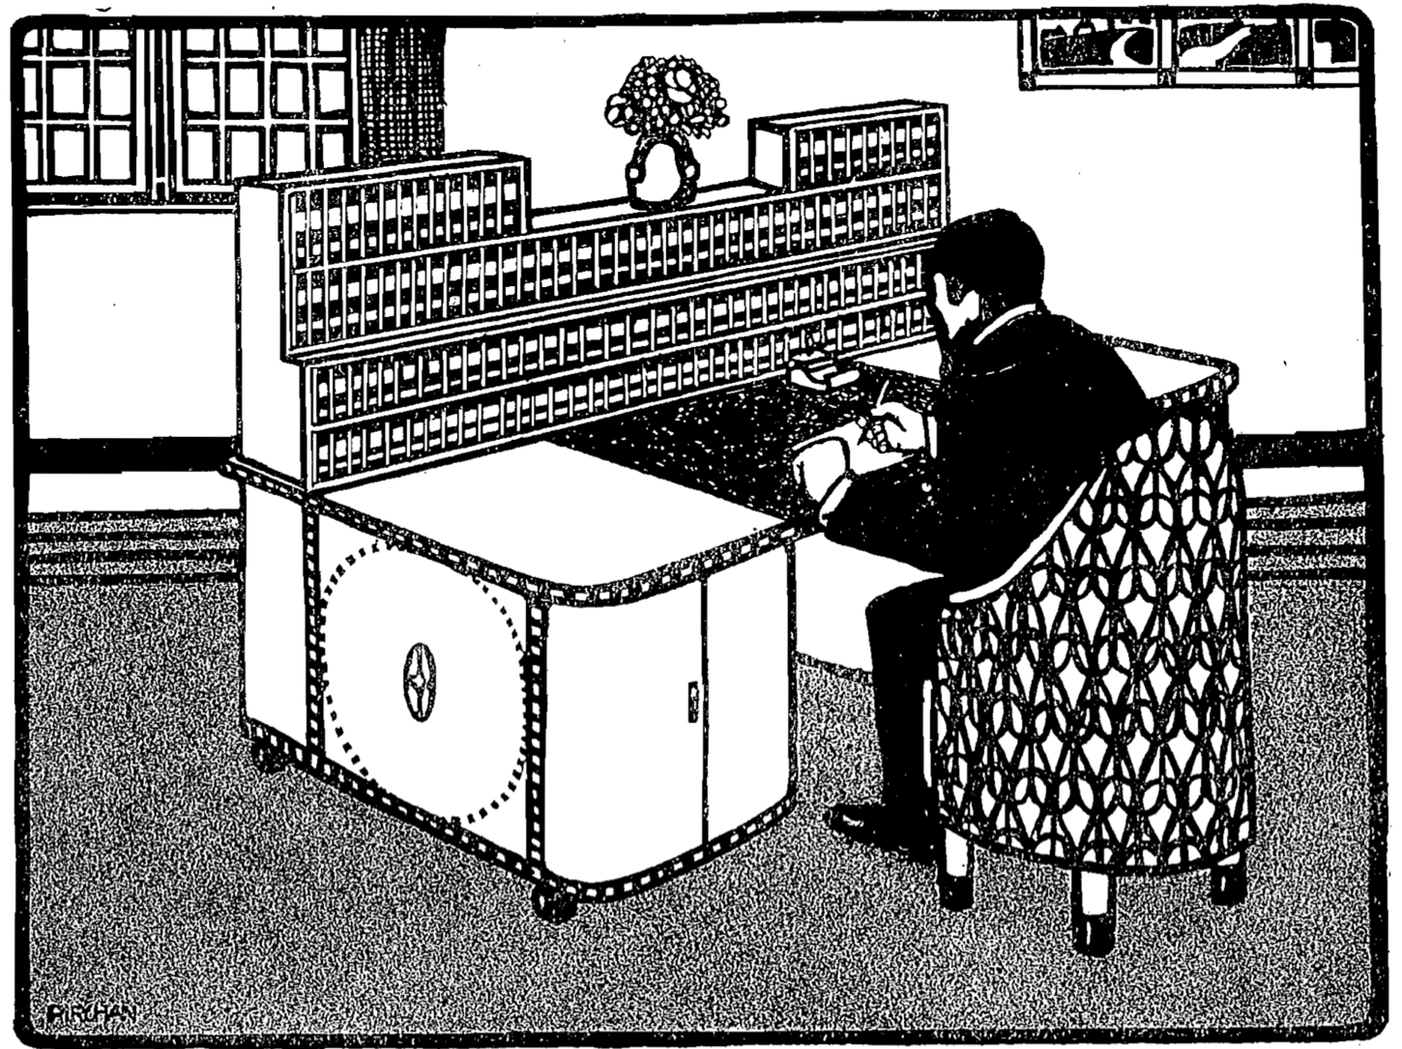
Bührer, K.W. (1912) Raumnot und Weltformat. München: Die Brücke, p.15.
Notes:
Lack of Space and the World Format

Slide 26
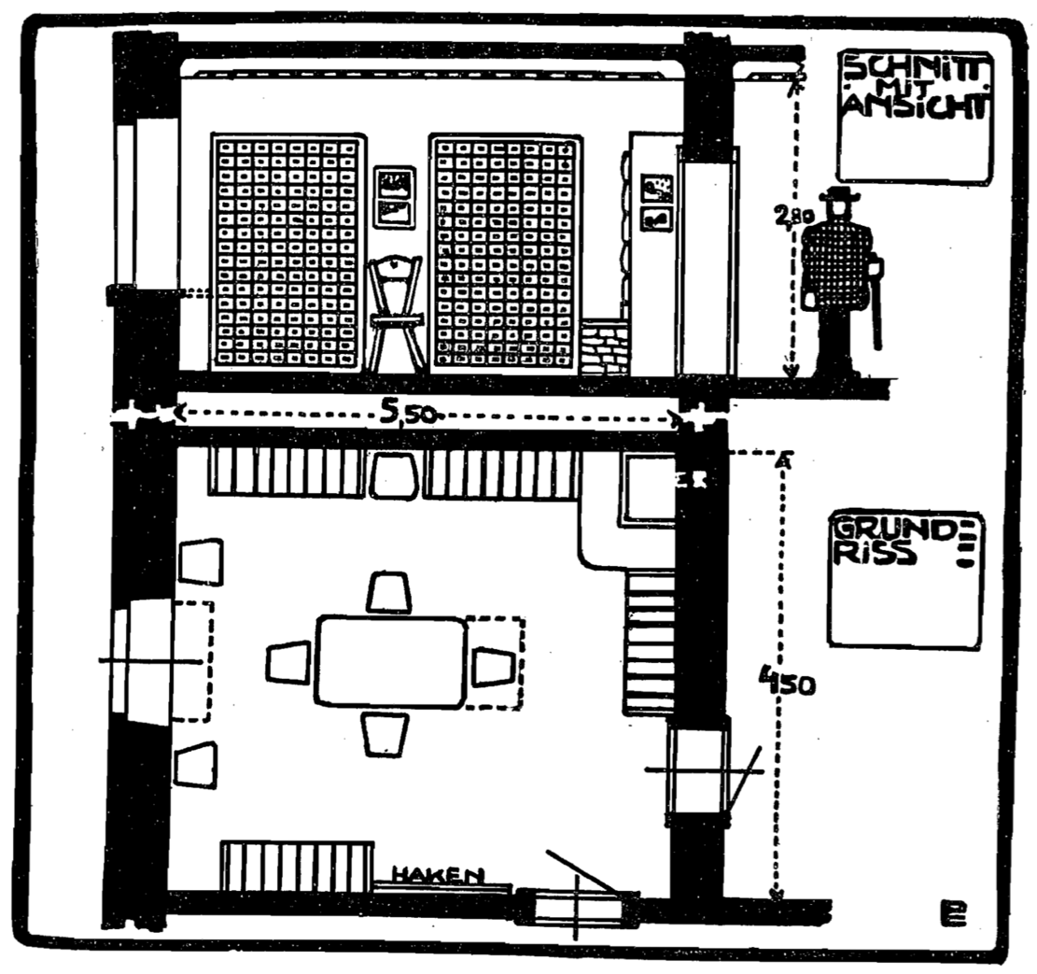
Bührer, K.W. (1912) Raumnot und Weltformat. München: Die Brücke, p.21.

Slide 27
Das Gehirn der Welt
[The] cerebral results of creative minds have already assumed a thoroughly international character. [...] Every member of this small community of intellectual leaders works essentially for himself, and the happiness of the individual depends on whether he can connect with his fellow workers, who perhaps live far from him in another country and in another language.
Ostwald, W. (1912) Das Gehirn der Welt. München: Die Brücke.
Notes:
“das Gehirn der Welt” = “the World Brain”

Slide 28
Das Gehirn der Welt
Thus we conclude that, with the best attitudes and the broadest and most noble mindsets of such organisational idealists, the means to harness such great thought for the intellectual benefit of mankind is a central organ, so to speak a brain of the whole world.
Ostwald, W. (1912) Das Gehirn der Welt. München: Die Brücke.

Slide 29
Things to Come (1936) Directed by William Cameron Menzies [Film]. London: London Films
Notes:
H.G. Wells on the set of Things to Come in 1936 (pictured with Raymond Massey and Pearl Argyle

Slide 30
The World Brain
It is probable that the idea of an encyclopaedia may undergo very considerable extension and elaboration in the near future [...] the core would be a world synthesis of bibliography and documentation with the indexed archives of the world. A great number of workers would be engaged perpetually in perfecting this index of human knowledge and keeping it up to date.
Wells, H.G. (1938) World Brain, London: Methuen and Co. Ltd.
Notes:
Met Otlet (and Emmanuel Goldberg) at the First World Congress on Documentation, organised by Otlet in Paris in 1937.
Posits a World Encyclopedia as a continuation of the work of Diderot et al
Explicitly draws the link with internationalist organisations like the League of Nations.
“The time is close at hand when any student, in any part of the world, will be able to sit with his projector in his own study at his or her convenience to examine any book, any document, in an exact replica."

Slide 31
The World Brain
!
Wells, H.G. (1938) World Brain, London: Methuen and Co. Ltd.
Notes:
This description seems awfully familiar...

Slide 32
Interlude, 1939-1945
Notes:
Mundaneum damaged in 1940 during German occupation (building was used to exhibit art of the Third Reich)
Ostwald died in 1932
Otlet died in 1944
Wells died in 1946
Slide shows the Trinity Test explosion – the first atomic bomb.

Slide 33
Next Lecture: Trailblazers, Part 2

