Slide 2
REST in Practice
COMP3220 Web Infrastructure
Dr Nicholas Gibbins – nmg@ecs.soton.ac.uk

Slide 3
Web Services as state machines
Consider a hypothetical online bookseller: Orinoco Books
When we create an order, the order may be in one of a number of discrete states:
Open: we can add or remove items to our order
Paid: we have successfully sent payment to Orinoco, and can no longer change our order
Shipping: Orinoco is preparing and dispatching our order
Delivered: we have received our order
The order moves between states in response to our interactions with Orinoco

Slide 4
UML Statecharts: states and transitions
Common graphical notation for describing state machines
Object-oriented extension to Harel’s statechart
(you’ll need this for your coursework!)
Tip: label states with nouns or adjectives and transitions with verbs or verb phrases
transitions between states
door
open
close door
door closed
open door
states

Slide 5
UML Statecharts: pseudostates
Two distinguished pseudostates:
Initial state
Final state
Choice pseudostate:
[value <= balance]
guards (used to choose which path to take)
[value > balance]

Slide 6
Orinoco Workflow
change
order
open
pay
[success]
paid
create
order
[failure]
prepare
cancel
delivered
deliver
shipping
check
status

Slide 7
Revisiting the Richardson Maturity Model

Slide 8
Richardson Maturity Model
Hypermedia
HTTP
URI
Notes:
Compare with identity, interaction, representation

Slide 9
Richardson Level 1
Multiple URIs used for resources
Key resource type from the workflow is an order
http://orinoco.com/order/{order_id}

Slide 10
Richardson Level 2
We have different URIs for each order (resource)
How do we interact with the orders?
create a new order
change order (add/remove items)
cancel an order
checkout and payment (submit order)
check order status
Use appropriate HTTP methods!

Slide 11
Create an order
change
order
open
pay
[success]
paid
create
order
prepare
cancel
[failure]
delivered
deliver
shipping
check
status

Slide 12
Create an order
Can use either PUT or POST:
PUT to a new URI
new URI: http://orinoco.com/order/{order_id}
client chooses order id
POST to an existing URI
existing URI: http://orinoco.com/order/
server chooses order id

Slide 13
PUT to a new URI
PUT /order/1234 HTTP/1.1 Host: orinoco.com Content-Type: application/xml Content-Length: 107 <order xmlns=“http://schema.orinoco.com/order”> <items> </items> </order>
HTTP/1.1 201 Created Date: Tue, 29 Oct 2019 17:10:00 GMT Content-Length: 0

Slide 14
POST to an existing URI
POST /order/ HTTP/1.1 Host: orinoco.com Content-Type: application/xml Content-Length: 107 <order xmlns=“http://schema.orinoco.com/order”> <items> </items> </order>
HTTP/1.1 201 Created Location: /order/1234 Date: Tue, 29 Oct 2019 17:10:00 GMT

Slide 15
POST to an existing URI
POST /order/ HTTP/1.1 Host: orinoco.com Content-Type: application/xml Content-Length: 107 <order xmlns=“http://schema.orinoco.com/order”> <items> </items> </order>
HTTP/1.1 201 Created Content-Location: /order/1234 Date: Tue, 29 Oct 2019 17:10:00 GMT <order xmlns=“http://schema.orinoco.com/order”> <items> </items> </order>

Slide 16
Change order
change
order
open
pay
[success]
paid
create
order
prepare
cancel
[failure]
delivered
deliver
shipping
check
status

Slide 17
PUT to an existing URI
PUT /order/1234 HTTP/1.1 Host: orinoco.com Content-Type: application/xml Content-Length: 134 <order xmlns=“http://schema.orinoco.com/order”> <items> <item quantity=“1” isbn=“1234567890”/> </items> </order>
HTTP/1.1 200 OK Date: Tue, 29 Oct 2019 17:15:00 GMT

Slide 18
Conditional PUT
PUT /order/1234 HTTP/1.1 Host: orinoco.com Content-Type: application/xml Content-Length: 134 If-Unmodified-Since: Tue, 29 Oct 2019 17:15:00 GMT <order xmlns=“http://schema.orinoco.com/order”> <items> <item quantity=“1” isbn=“1234567890”/> </items> </order>
HTTP/1.1 412 Precondition Failed Date: Tue, 29 Oct 2019 17:20:00 GMT Content-Length: 0

Slide 19
Cancel an order
change
order
open
pay
[success]
paid
create
order
prepare
cancel
[failure]
delivered
deliver
shipping
check
status

Slide 20
Cancel an order
Use DELETE
DELETE is idempotent
Repeated DELETEs have the same effect as a single DELETE
Status codes may change (e.g. 404 for subsequent DELETEs)

Slide 21
DELETE
DELETE /order/1234 HTTP/1.1 Host: orinoco.com
HTTP/1.1 204 No Content Content-Length: 0 Date: Tue, 29 Oct 2019 17:25:00 GMT

Slide 22
DELETE
DELETE /order/1234 HTTP/1.1 Host: orinoco.com
HTTP/1.1 404 Not Found Content-Length: 0 Date: Tue, 29 Oct 2019 17:25:00 GMT

Slide 23
DELETE
DELETE /order/1234 HTTP/1.1 Host: orinoco.com
HTTP/1.1 410 Gone Content-Length: 0 Date: Tue, 29 Oct 2019 17:25:00 GMT

Slide 24
Payment
change
order
open
pay
[success]
paid
create
order
prepare
cancel
[failure]
delivered
deliver
shipping
check
status

Slide 25
Richardson Level Three
CRUD isn’t everything!
Limited application model
In our scenario, payment doesn’t fit cleanly into the CRUD model
Encourages tight coupling through URI templates
Simple pattern
Use hypertext links to indicate protocols
What are the next steps that you can take?
What are the next resources?

Slide 26
Where are the links?
<order xmlns=“http://schema.orinoco.com/order”> <items> <item quantity=“1” isbn=“1234567890”/> </items> <status>open</status> </order>
What can you do next?

Slide 27
Media Types
application/xml doesn’t have specific link semantics
Can adopt standard hypermedia format (HTML, Atom, etc)
Widely understood by software agents
Needs to be adapted to domain
Can create domain-specific format that supports application
Direct supports domain
Maintains visibility of messages at the protocol level
Not widely understood
Use link types to define protocols

Slide 28
text/html
Use OPTIONS to determine the right HTTP method to use with links
Allow: header in response lists allowed methods (for payment, PUT?)
Need to define link types for use with rel: microformats, RDF, etc
<html xmlns="http://www.w3.org/1999/xhtml”> <body> <div class="order”> <ul class="items”> <li class="item”> <p class=”isbn">1234567890</p> <p class="quantity">1</p> </li> </ul> <a href="https://orinoco.com/payment/1234” rel="payment">payment</a> </div> </body> </html>

Slide 29
application/vnd.orinoco+xml
Proprietary (vendor-specific) media type
Uses POX for business data
Uses (e.g.) Atom link elements for hypermedia control
<order xmlns=“http://schema.orinoco.com/order”> <items> <item quantity=“1” isbn=“1234567890”/> </items> <link href=“https://orinoco.com/payment/1234” rel=“payment”/> <status>open</status> </order>

Slide 30
Link: header
GET /order/1234 HTTP/1.1
Host: orinoco.com
HTTP/1.1 200 OK Content-Type: application/vnd.orinoco+xml Link: <https://orinoco.com/payment/1234>; rel="payment"
<order xmlns=“http://schema.orinoco.com/order”> <items> <item quantity=“1” isbn=“1234567890”/> </items> </order>

Slide 31
Check order status
change
order
open
pay
[success]
paid
create
order
prepare
cancel
[failure]
delivered
deliver
shipping
check
status

Slide 32
Check order status
Use GET
GET is idempotent
GET has no side-effects!

Slide 33
GET
GET /order/1234 HTTP/1.1 Host: orinoco.com
HTTP/1.1 200 OK Content-Type: application/xml Content-Length: 107 Date: Tue, 30 Oct 2018 16:30:00 GMT <order xmlns=“http://schema.orinoco.com/order”> <items> </items> <status>open</status> </order>

Slide 34
GET
GET /order/9999 HTTP/1.1 Host: orinoco.com
HTTP/1.1 404 Not Found Content-Length: 0 Date: Tue, 30 Oct 2018 16:30:00 GMT

Slide 35
Collections and Elements
Extra conventions for talking about collections of elements
An order can be considered to be a collection
An item in the order is an element of that collection
Some consensus of semantics of HTTP methods for these
In our case:
http://orinoco.com/order/ is a collection
http://orinoco.com/order/{order_id} is an element

Slide 36
RESTful Methods for Collections
Method | Behaviour
GET | List the members of the collection (list of URIs)
PUT | Replace the entire collection with another collection
POST | Create a new member in the collection and automatically assign it a URI
DELETE | Delete the entire collection

Slide 37
RESTful Methods for Collection Elements
Method | Behaviour
GET | Retrieve a representation of the specified element
PUT | Replace the specified element of the collection, or if it doesn’t exist create it
POST | Treat the specified member as a collection and create a new element in it
DELETE | Delete the specified member of the collection

Slide 38
Orinoco Workflow
PUT /order/{order_id} 200 OK
open
PUT /payment/{order_id}
201 Created
paid
POST /order 201 Created
prepare
DELETE /order/{order_id} 204 No Content
400 Bad Request
delivered
deliver
shipping
GET /order/{order_id} 200 OK

Slide 39
Further Reading

Slide 40
Further Reading
REST in Practice tutorial slides
http://www.slideshare.net/guilhermecaelum/rest-in-practice
Webber et al (2010) REST in Practice. Sebastopol, CA: O’Reilly Media

Slide 41
Documenting REST

Slide 42
Documentation
What are the key aspects of a RESTful interface?
How should we document each of these?
What does a developer need to know to use our service?

Slide 43
Identification

Slide 44
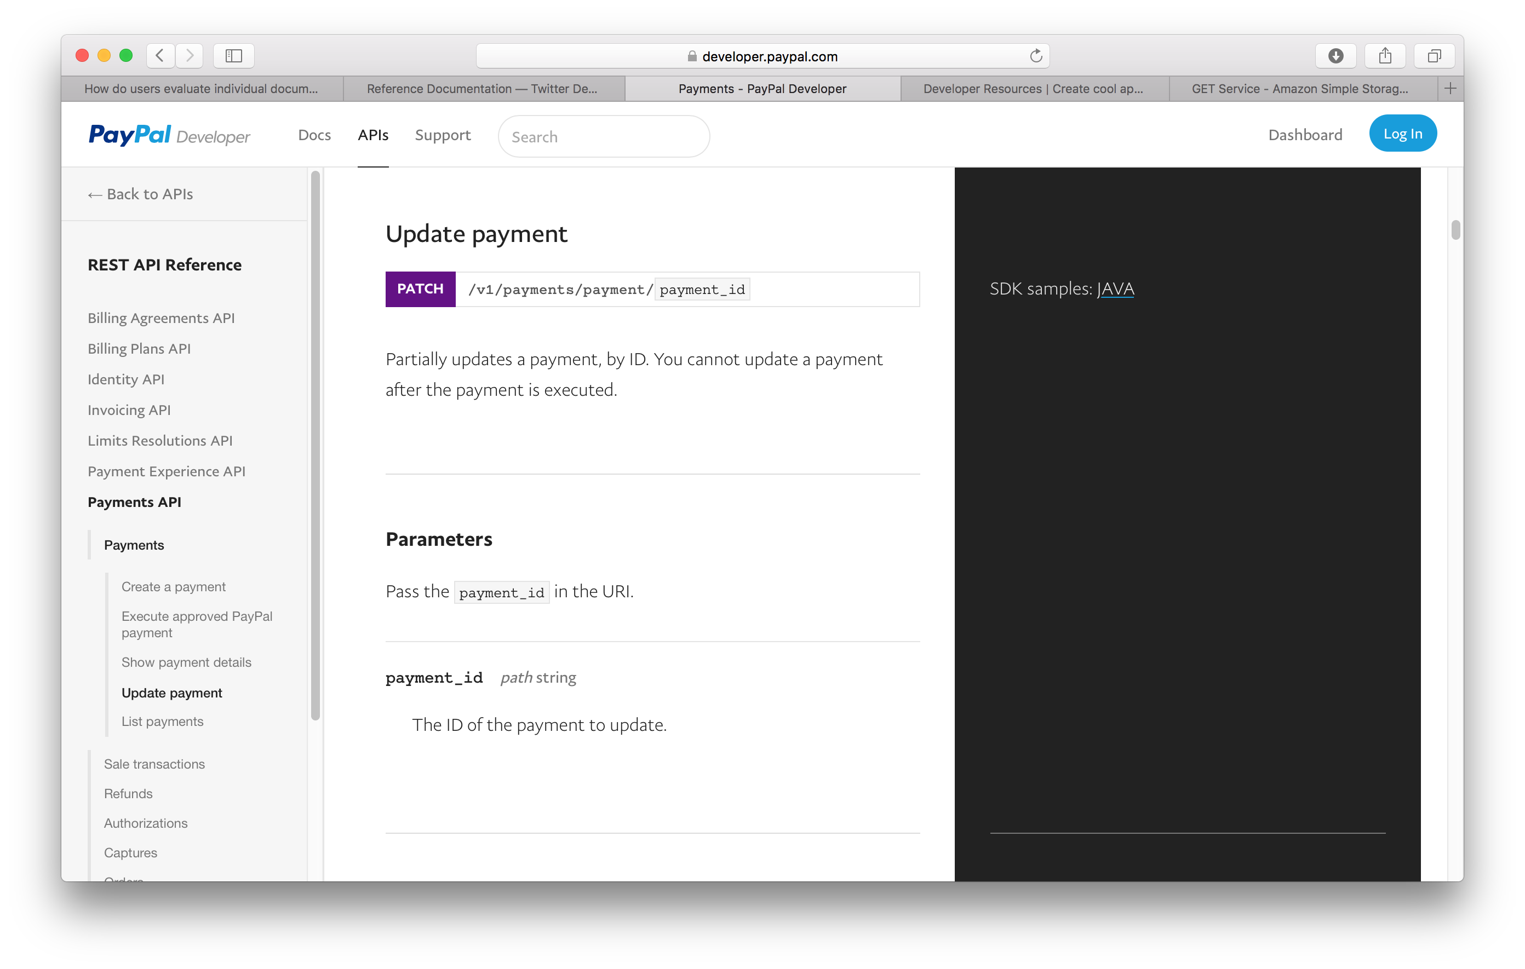
URIs

Slide 45
URI Parameters

Slide 46
Interaction

Slide 47
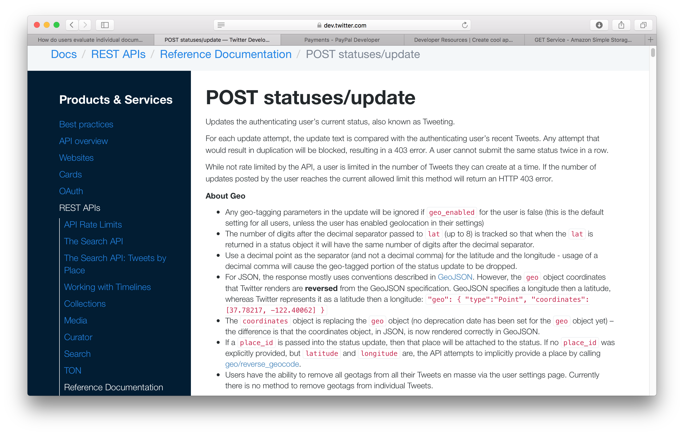
Methods

Slide 48
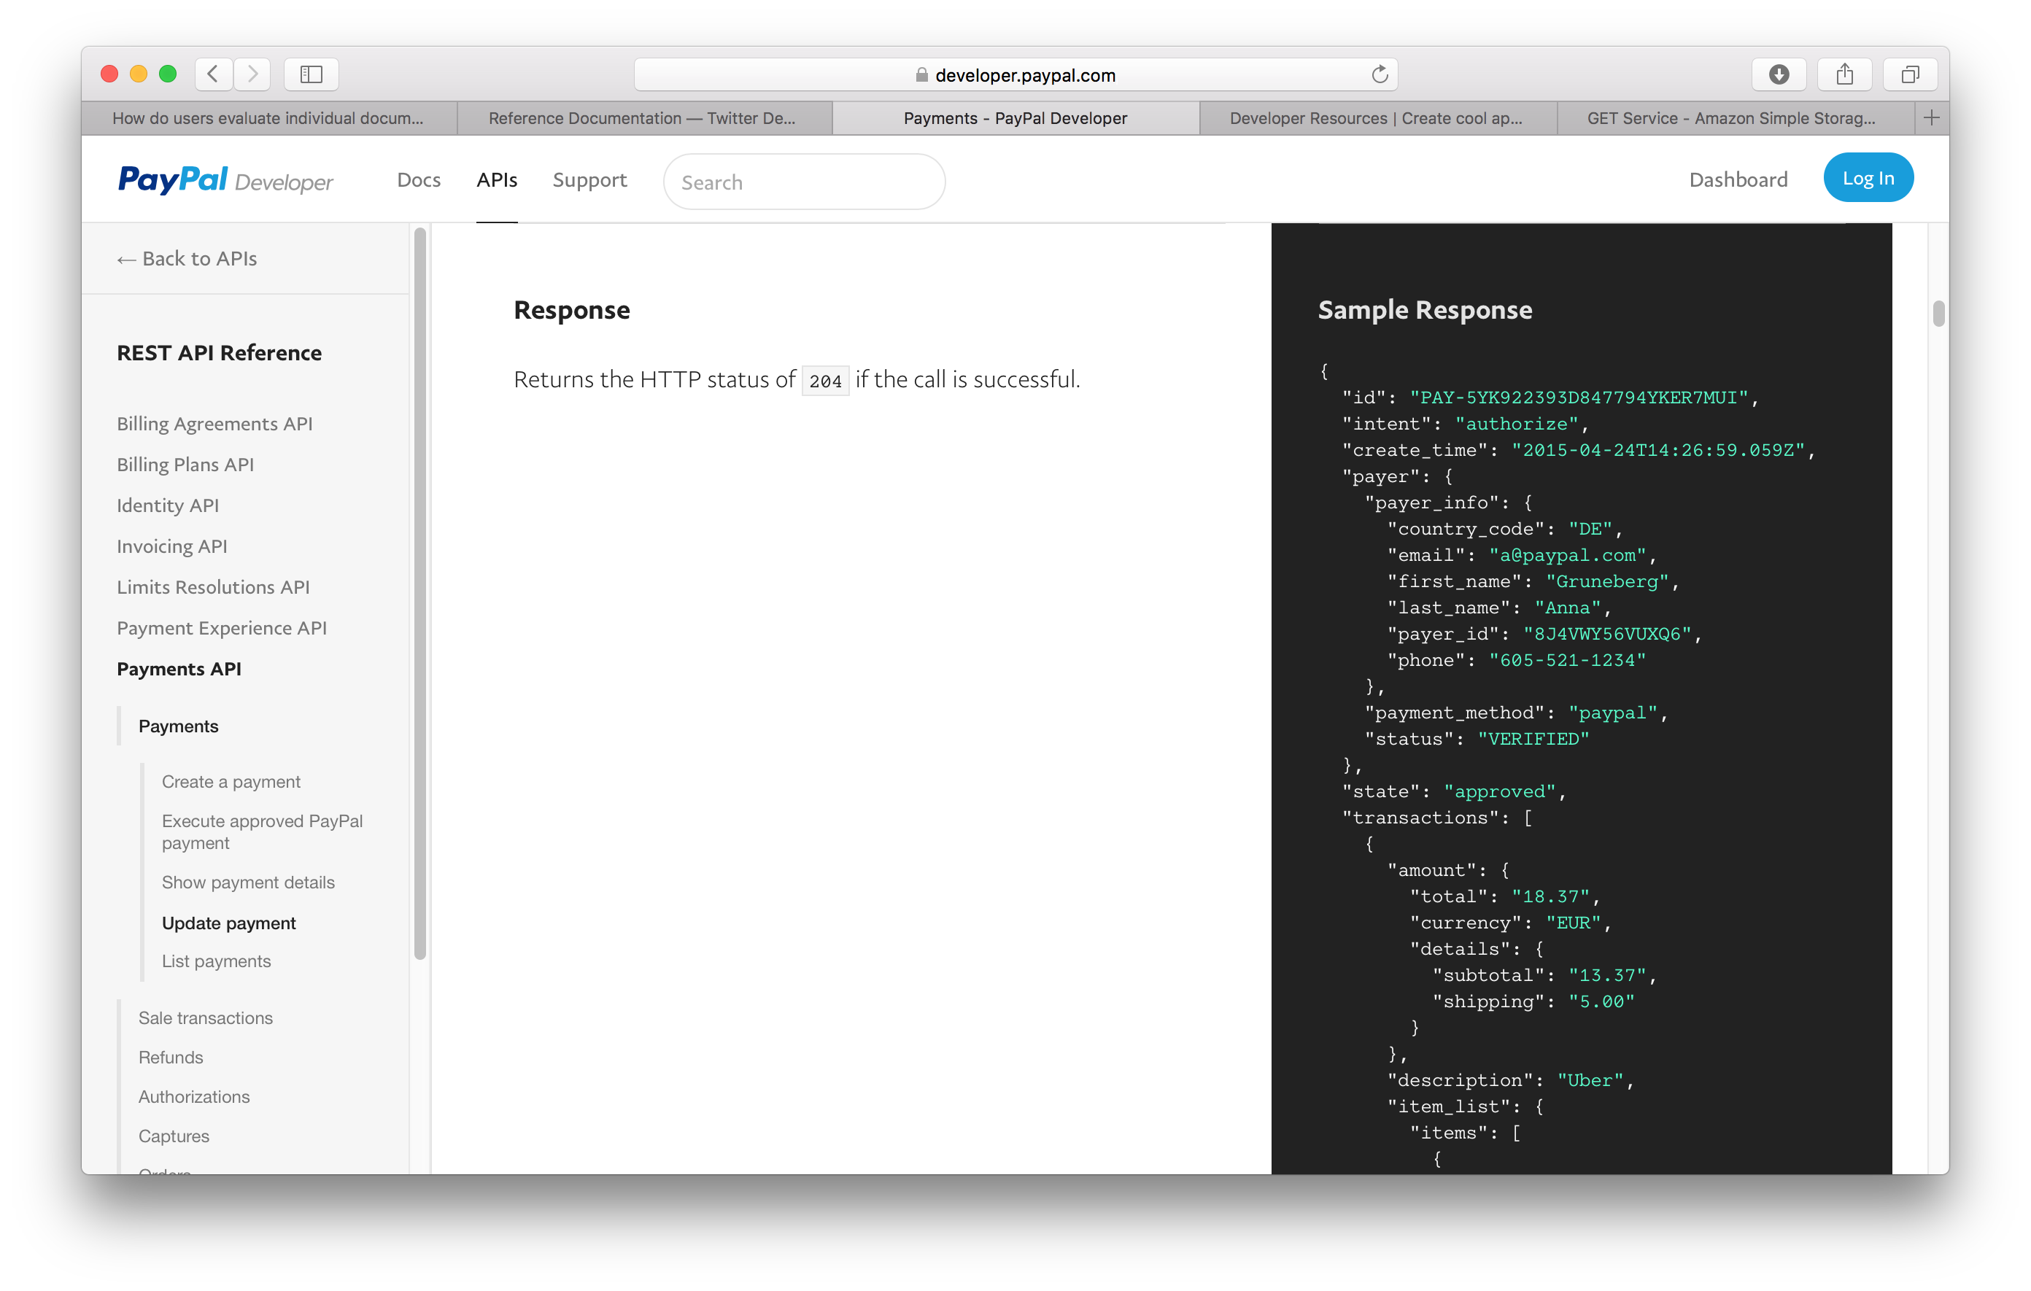
Status Codes

Slide 49
Headers
Mostly for Authorisation
OAuth 2.0, etc
Consider how the various Accept-*: headers might be used.

Slide 50
Representation

Slide 51
Representation

Slide 52
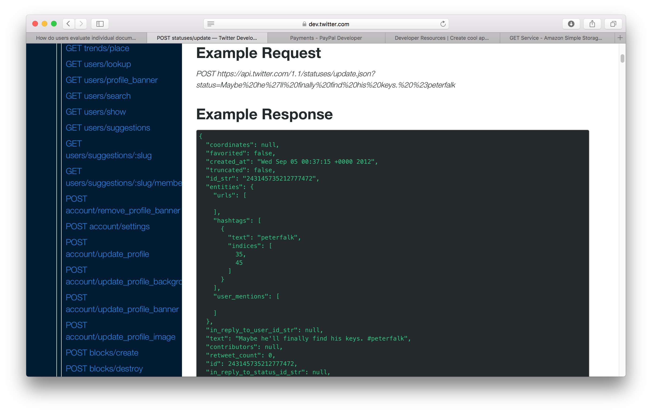
Examples

Slide 53
HATEOAS

Slide 54
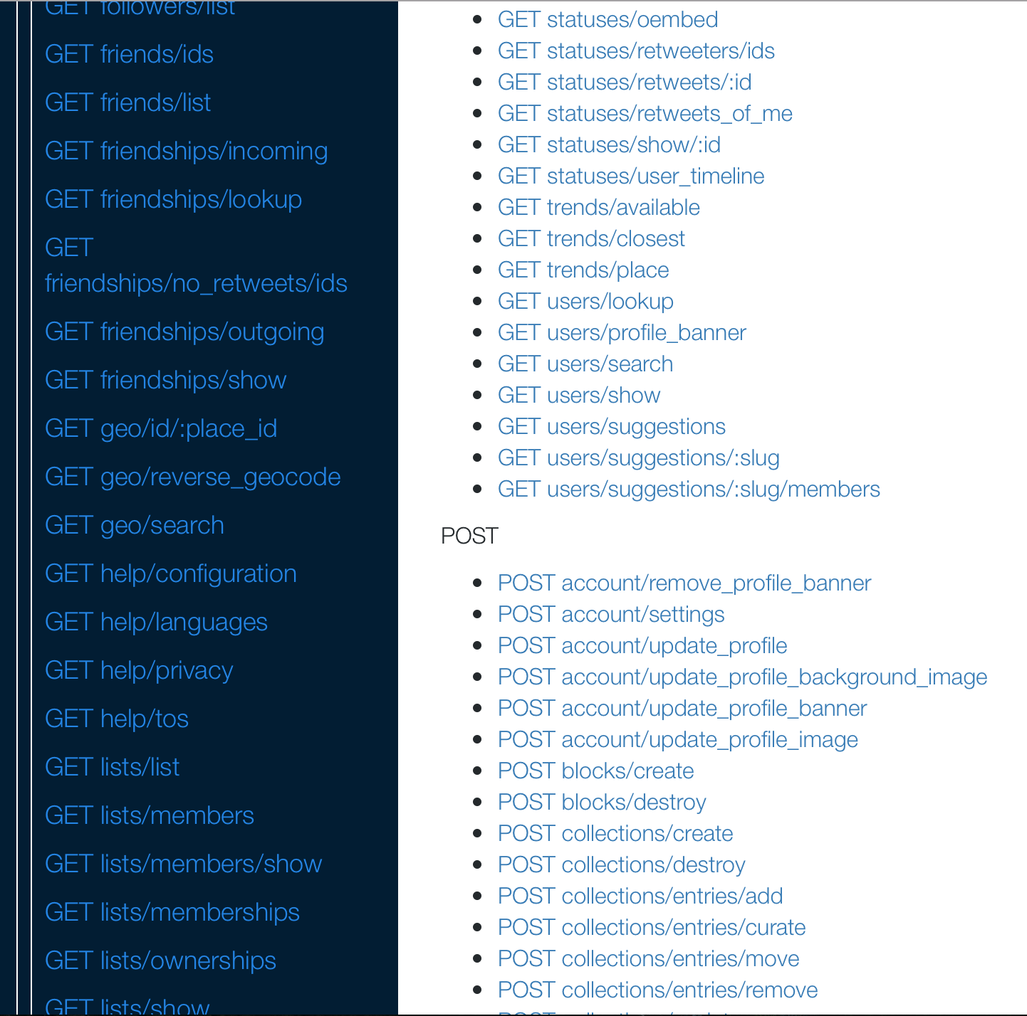
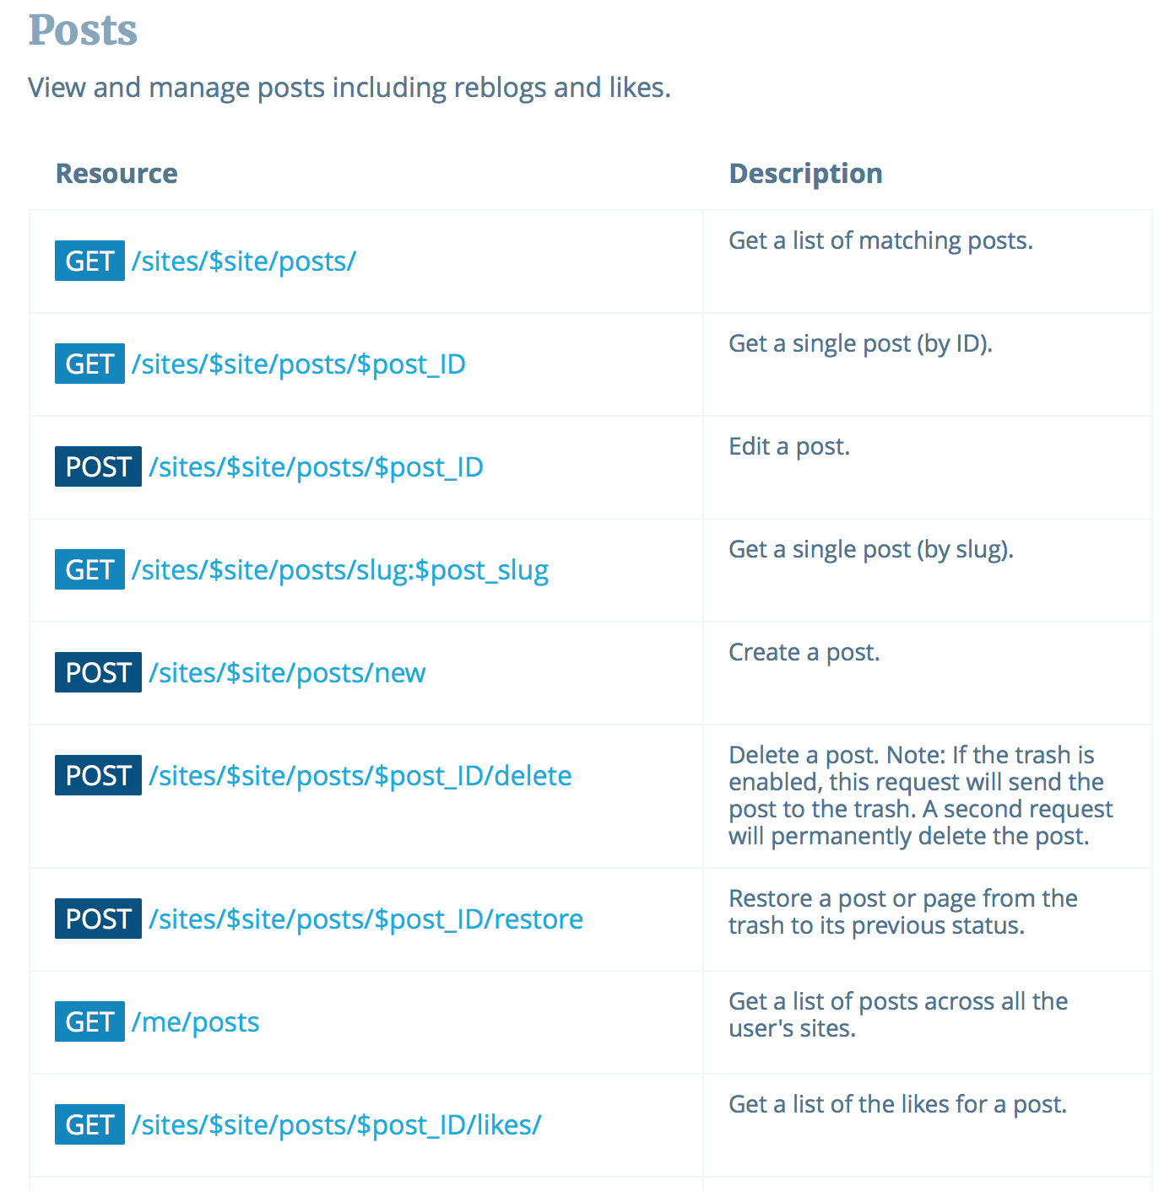
Listings

Slide 55
OpenAPI

Slide 56
OpenAPI
Originated with Swagger tool for designing RESTful APIs
Represents API descriptions in JSON or YAML (Yet Another Markup Language)
We’ll concentrate on the YAML serialization

Slide 57
OpenAPI metadata
OpenAPI description starts with:
Version number of OpenAPI in use
Simple metadata about the service in the info: block
openapi: 3.0.0 info: version: 1.0.0 title: Orinoco API description: The API for the Orinoco online bookseller

Slide 58
Servers
API endpoints are defined relative to a base URI
Defined in OpenAPI using the servers: block
servers: - url: https://orinoco.com description: Live server _ url: https://test.orinoco.com description: Test server (uses dummy data)

Slide 59
Components
components: block used to define repeatedly-used information
Most often used to define format of message bodies
components: schemas: order: type: object properties: items: type: array item: type: string status: type: string

Slide 60
Paths
Lists available paths on the server
e.g. https://orinoco.com/order/1234
For each path, lists:
The methods which can be used on that path
The content of any request body which should accompany the method (for PUT, POST)
The responses which may be received from the method (including response bodies)

Slide 61
Path Example
paths: /order{order_id}: get: description: Obtain information about an order parameters: - name: order_id in: path required: true schema: type: string

Slide 62
Path Example
paths: /order{order_id}: get: ... responses: ‘200’: description: Successfully returned an order content: application/xml: schema: $ref: ‘#/components/schemas/order’

Slide 63
Summary
Documentation should cover all the bases of the web architecture
Identification – parameterised URIs
Interaction – HTTP methods, status codes and headers
Representation – formats for request and response, with examples
Listings of all of the above

Slide 64
RESTful API Examples
Twitter
https://developer.twitter.com/en/docs/api-reference-index
Paypal
https://developer.paypal.com/docs/api/payments/
Imgur
https://apidocs.imgur.com
Wordpress
https://developer.wordpress.org/rest-api/

Slide 65
Tools and Further Reading
Swagger API development tool
https://swagger.io/
Overview of OpenAPI
https://swagger.io/docs/specification/about/
OpenAPI Specification
https://github.com/OAI/OpenAPI-Specification

Slide 66
Next Lecture: Trailblazers

