Slide 2
Authentication and Authorisation
COMP3220 Web Infrastructure
Dr Nicholas Gibbins – nmg@ecs.soton.ac.uk

Slide 3
HTTP authentication
Simple authentication of user agent using HTTP headers
  Origin server sends WWW-Authenticate: header containing challenge (scheme and realm)
  User agent sends Authorization: header containing credentials
Authentication schemes:
  Basic
  User agent sends base64( username + ":" + password )
  Bearer
  OAuth 2.0 token

Slide 4

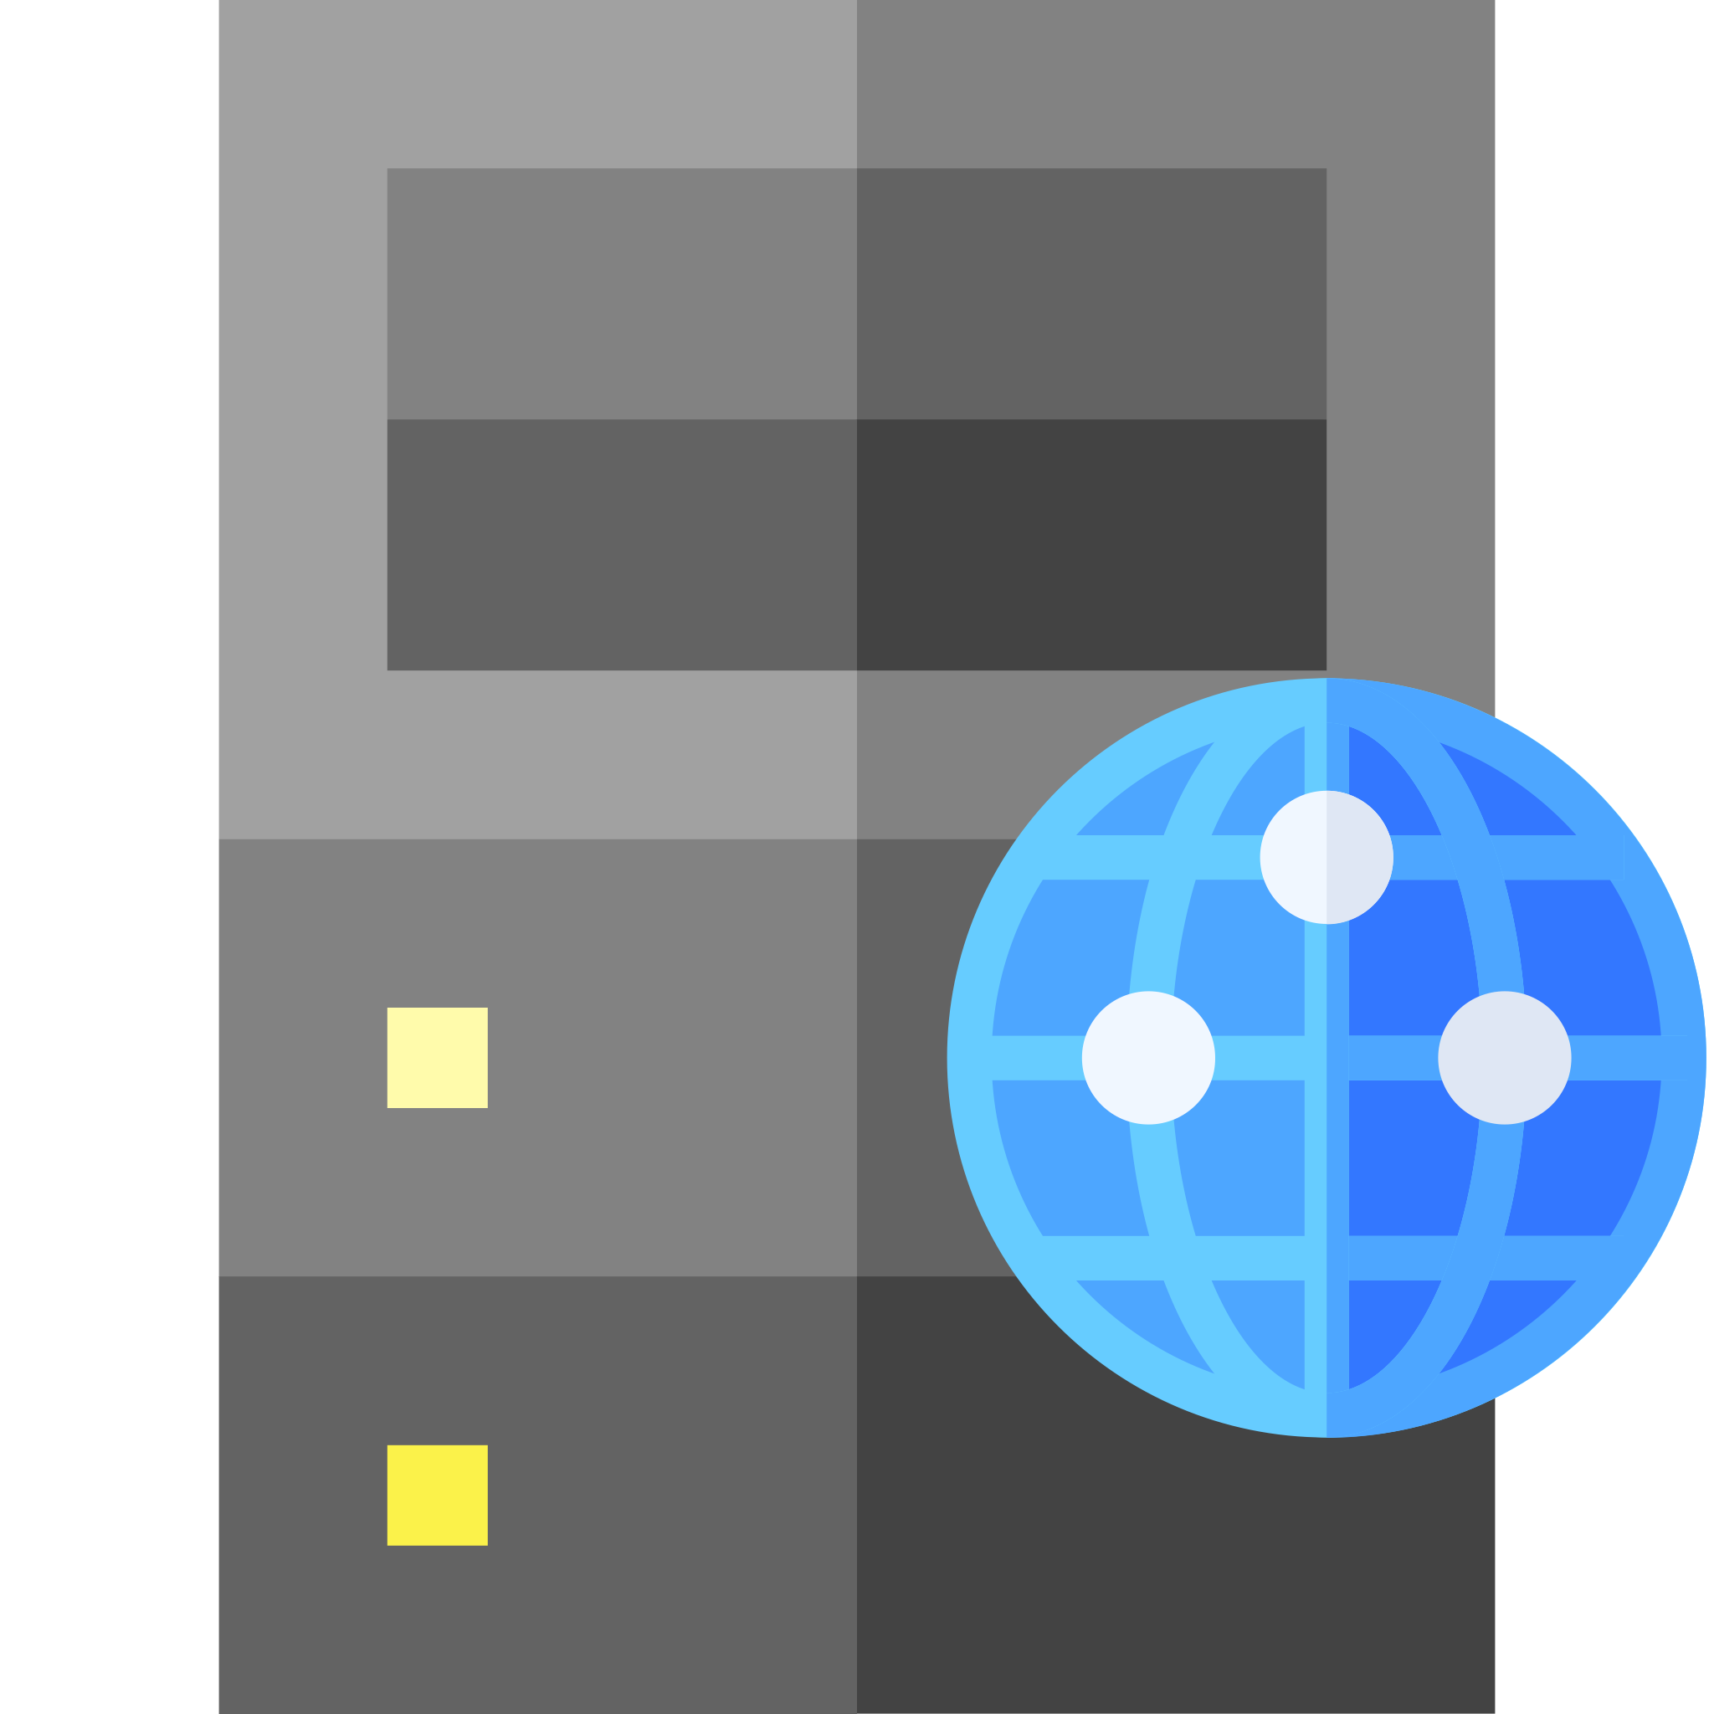
Basic authentication scheme
GET / HTTP/1.1
Host: example.org
HTTP/1.1 401 Unauthorized
WWW-Authenticate: Basic realm="Access to Example"
GET / HTTP/1.1
Host: example.org
Authorization: Basic c3F1ZWFtaXNoOm9zc2lmcmFnZQo=
HTTP/1.1 200 OK
...

Slide 5
Basic authentication scheme
GET / HTTP/1.1
Host: example.org
HTTP/1.1 401 Unauthorized
WWW-Authenticate: Basic realm="Access to Example"
GET / HTTP/1.1
Host: example.org
Authorization: Basic bmV2ZXJnb2luZ3RvZ2l2ZTp5b3V1cAo=
HTTP/1.1 403 Forbidden

Slide 6
Proxy authentication
Similar challenge/response mechanism for authenticating with a proxy
  Proxy sends Proxy-Authenticate: header containing challenge
  User agent sends Proxy-Authorization: header containing credentials

Slide 7

Proxy authentication
GET http://example.org/ HTTP/1.1
Host: example.org
HTTP/1.1 407 Proxy Authentication Required
Proxy-Authenticate: Basic realm="Access to Proxy"
GET http://example.org/ HTTP/1.1
Host: example.org
Proxy-Authorization: Basic c3F1ZWFtaXNoOm9zc2lmcmFnZQo=
HTTP/1.1 200 OK
...

Slide 8
OAuth 2.0
Modern Web applications are federations of interacting services
The password problem: how can we give an application access to our data held by a service (a "protected resource") without giving it our password for that service?
This is a problem of authorisation, rather than simply authentication

Slide 9



OAuth 2.0 roles
The resource owner
  An entity capable of granting access to a protected resource. May be a combination of a person (an end-user) and their user agent
The resource server
  The server hosting the protected resources, capable of accepting and responding to protected resource requests using access tokens
The client
  An application making protected resource requests on behalf of the resource owner and with its authorisation
The authorisation server
  The server issuing access tokens to the client after successfully authenticating the resource owner and obtaining authorisation.

Slide 10
Abstract protocol flow
obtain
access
token
use
access
token
delegate
access

Slide 11
OAuth 2.0 protocol flows
Authorisation Code Grant
  Client obtains access token directly from authorisation server ("3-legged")
  Flow relies on redirection via user agent
Implicit Grant
  All communication goes through user agent ("2-legged")
  Commonly used by single page applications
Resource Owner Password Credentials Grant
  Resource owner gives credentials to client (requires trust relationship)
Client Credential Grant
  Client authenticates directly with authorisation server

Slide 12
Registration
Client registers with the authorisation server before the protocol starts
  Client issued with a client_id – unique string (not a secret)
Client and authorisation server establish an authentication method
  Client password, use with HTTP Basic Authentication
  client_id, client_secret sent in request body (not recommended)
Endpoints
  Authorisation endpoint (e.g. https://auth.org/auth )
  Client redirection endpoint (e.g. https://client.org/cb )
  Token endpoint (e.g. https://auth.org/token )

Slide 13
Authorisation Code Grant
2. user authenticates
4. authorisation
code
5. access token
1. authorisation
request
6. resource
access
3. authorisation
code

Slide 14
1. authorisation request
1. authorisation request
3. authorisation code
3. authorisation code
HTTP/1.1 302 Found
Location: https://auth.org/auth?
response_type=code&
client_id=s6BhdRkqt3&
redirect_uri=https://client.org/cb
authorisation endpoint
issued during registration
redirection endpoint
GET /auth?response_type=code&client_id=s6BhdRkqt3&redirect_uri=
https%3A%2F%2Fclient%2Eorg%2Fcb HTTP/1.1
Host: auth.org
authorisation code
HTTP/1.1 302 Found
Location: https://client.org/cb?code=SplxlOBeZQQYbYS6WxSbIA
GET /cb?code=SplxlOBeZQQYbYS6WxSbIA HTTP/1.1
Host: client.org

Slide 15
4. authorisation code
5. access token
POST /token HTTP/1.1
Host: auth.org
Authorization: Basic czZCaGRSa3F0MzpnWDFmQmF0M2JW
Content-Type: application/x-www-form-urlencoded
grant_type=authorization_code&
code=SplxlOBeZQQYbYS6WxSbIA&
redirect_uri=https://client.org/cb
agreed during registration
authorisation code
HTTP/1.1 200 OK
Content-Type: application/json;charset=UTF-8
Cache-Control: no-store
{ "access_token":"2YotnFZFEjr1zCsicMWpAA",
"token_type":"bearer",
"expires_in":3600,
"refresh_token":"tGzv3JOkF0XG5Qx2TlKWIA" }
used to access resource
used to get new access token

Slide 16
6. resource access
access token
GET /resource HTTP/1.1
Host: example.org
Authorization: Bearer 2YotnFZFEjr1zCsicMWpAA
HTTP/1.1 200 OK
...

Slide 17
4. refresh token
5. access token
POST /token HTTP/1.1
Host: auth.org
Authorization: Basic czZCaGRSa3F0MzpnWDFmQmF0M2JW
Content-Type: application/x-www-form-urlencoded
grant_type=refresh_token&
refresh_token=tGzv3JOkF0XG5Qx2TlKWIA
HTTP/1.1 200 OK
Content-Type: application/json;charset=UTF-8
Cache-Control: no-store
{ "access_token":"2YotnFZFEjr1zCsicMWpAA",
"token_type":"bearer",
"expires_in":3600,
"refresh_token":"tGzv3JOkF0XG5Qx2TlKWIA" }

Slide 18
Further reading
Fielding, R. and Reschke, J. (2014) Hypertext Transfer Protocol (HTTP/1.1): Authentication. RFC7235.
  https://tools.ietf.org/html/rfc7235
Reschke, J. (2015) The 'Basic' HTTP authentication scheme. RFC7617.
  https://tools.ietf.org/html/rfc7617
Hardt, D. (2012) The OAuth 2.0 authorization framework. RFC6749.
  https://tools.ietf.org/html/rfc6749
Jones, M. and Hardt, D. (2012) The OAuth 2.0 Authorization Framework: Bearer Token Usage. RFC6750
  https://tools.ietf.org/html/rfc6750

