Slide 2
Securing HTTP
COMP3220 Web Infrastructure
Dr Nicholas Gibbins – nmg@ecs.soton.ac.uk

Slide 3


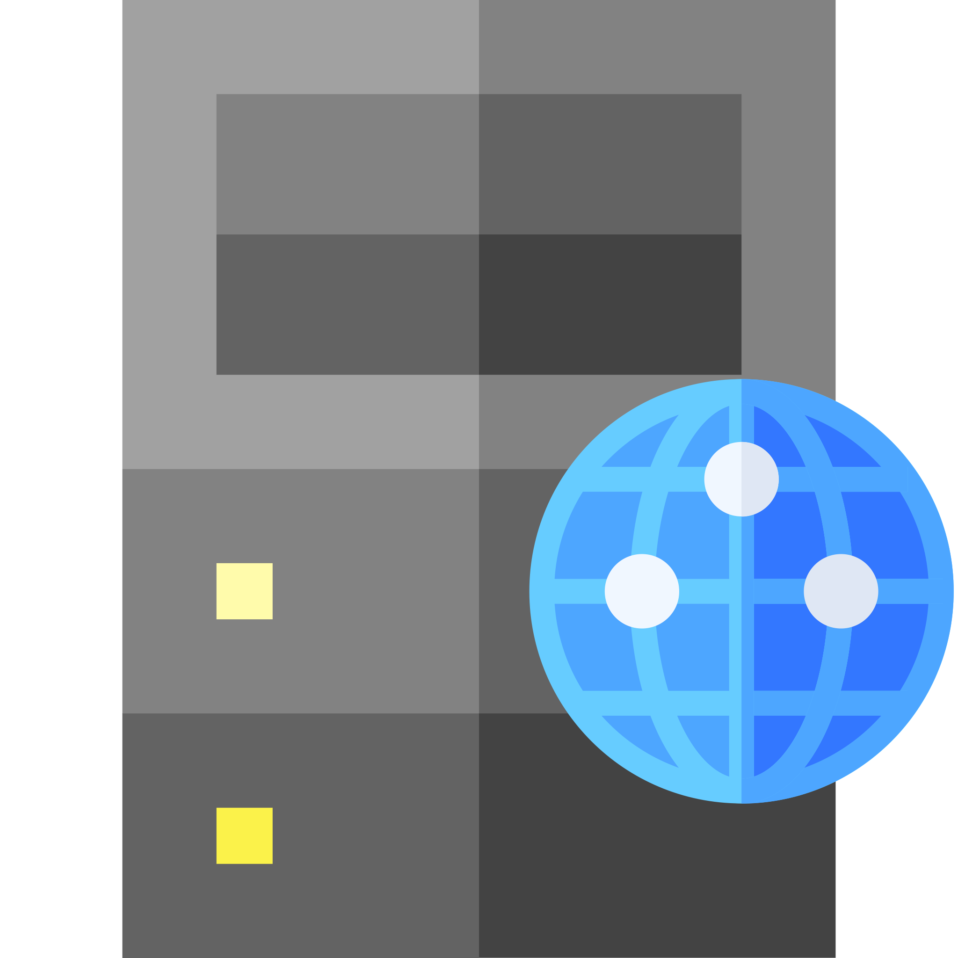

Securing HTTP
As originally designed, HTTP sends all data in the clear
Vulnerable to interception by third parties
GET X
200 OK
X

Slide 4
Transport Layer Security
The foundation for Secure HTTP (HTTPS)
  Formerly known as Secure Sockets Layer (SSL) – dates back to 1995
  Protocol for establishing secure communications channels between internet hosts
  Also used for protocols other than HTTP: IMAP, POP3, FTP, SMTP
Despite the name, considered an application layer protocol
(in the OSI 7-layer model, a session layer protocol)

Slide 5

Cryptography 101
Confidentiality – data cannot be read by unauthorised parties
Integrity – data cannot be modified by unauthorised parties without being detected
Authentication – authorised parties can prove who they are
Non-Repudiation – the author of data cannot deny that authorship
Alice
Bob
Eve

Slide 6


Symmetric-key Encryption
Uses a single key for both encryption and decryption
Generally fast
Examples: AES, IDEA, 3DES
Key exchange is an issue
encrypt
decrypt
plain
text
cypher
text
plain
text

Slide 7




Asymmetric-key Encryption
Keys are generated in pairs
Each key can decrypt what the other has encrypted
Given one key from a pair, cannot work out the other key
Generally slower than symmetric encryption
Examples: RSA, ElGamal, Elliptic-Curve Cryptography

Slide 8
Public Key Cryptography
Commonly-used term for asymmetric-key encryption
Refers to the different roles of the keys in a pair
Public key
Shared with all by the owner
Used to encrypt messages sent to the owner
Private key
Kept a secret by the owner
Used by the owner to decrypt messages sent to them

Slide 9

Cryptographic hash algorithms
Algorithm that turns an arbitrary-sized message into a fixed size bit string
(the digest or hash, typically 256 or 512 bits long)
Lossy transformation
  Given a digest cannot easily calculate the corresponding message
  Brute force attacks, rainbow table attacks
  Used to ensure integrity
Modern hash algorithms: SHA-2, SHA-3
Older insecure hash algorithms: MD5, SHA-1
hash
#

Slide 10

Digital signatures
Authentication, non-repudiation, integrity of messages
Generate a cryptographic hash of the message
Encrypt the hash with your private key
Attach the encrypted hash to the message
hash
#
#
Notes:
Authentication – you can demonstrate that you signed it
Non-repudiation – you can’t deny that you signed it
Integrity – it can be demonstrated that the message hasn’t been tampered with

Slide 11
Signature verification
Decrypt the encrypted hash with the public key
Generate a cryptographic hash of the message
Compare the hashes
hash
#
compare
#
#

Slide 12

Certificates
A public key that has been digitally signed by a trusted third party
(a Certificate Authority or CA)
  Used to make guarantees about ownership of a public key
  CA public keys typically incorporated into browsers or operating systems

Slide 13
Key exchange
Symmetric cryptography needs a shared key
How can two parties agree a shared key over an insecure channel?
?
Alice
Bob
Eve

Slide 14
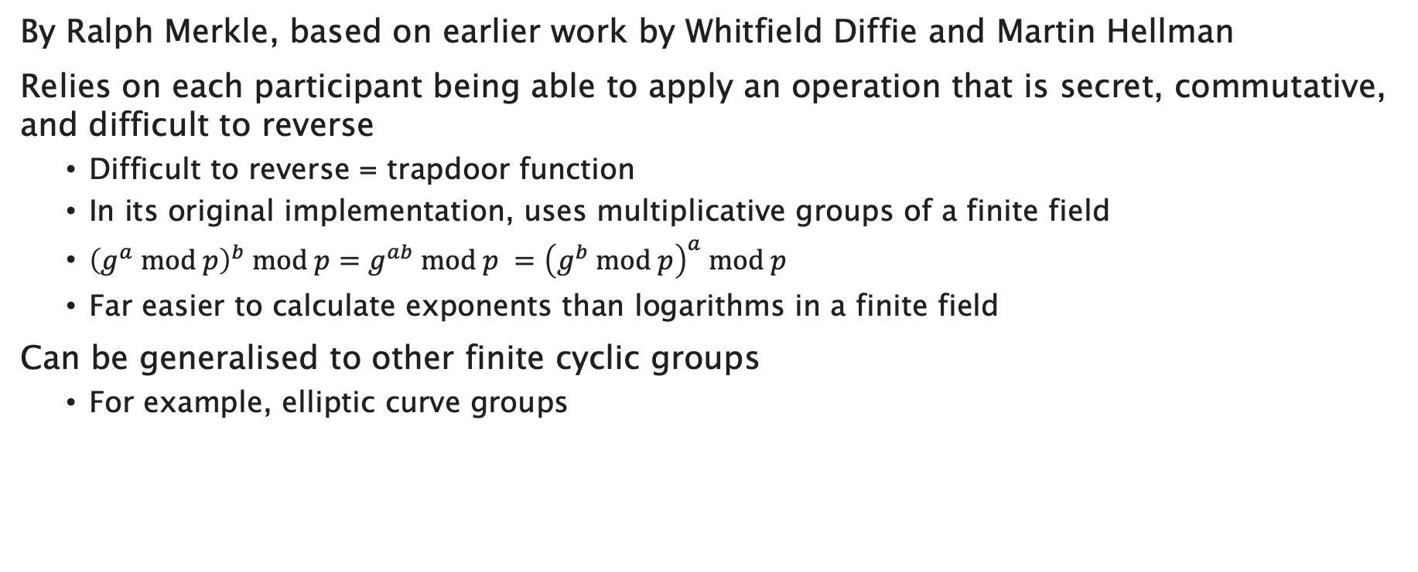
Diffie-Hellman key exchange
By Ralph Merkle, based on earlier work by Whitfield Diffie and Martin Hellman
Relies on each participant being able to apply an operation that is secret, commutative, and difficult to reverse
  Difficult to reverse = trapdoor function
  In its original implementation, uses multiplicative groups of a finite field
  ${\left(g^{a} mod p\right)}^{b} mod p=g^{ab} mod p ={\left(g^{b} mod p\right)}^{a} mod p$
  Far easier to calculate exponents than logarithms in a finite field
Can be generalised to other finite cyclic groups
  For example, elliptic curve groups
Diffie, W. and Hellman, M. (1976) New Directions in Cryptography. IEEE Transactions on Information Theory. 22(6). pp. 644-654.
Merkle, R.C. (1978) Secure communications over insecure channels. Communications of the ACM. 21(4). pp.294-299.

Slide 15
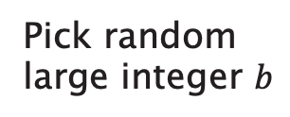
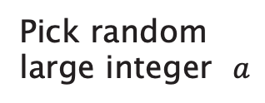

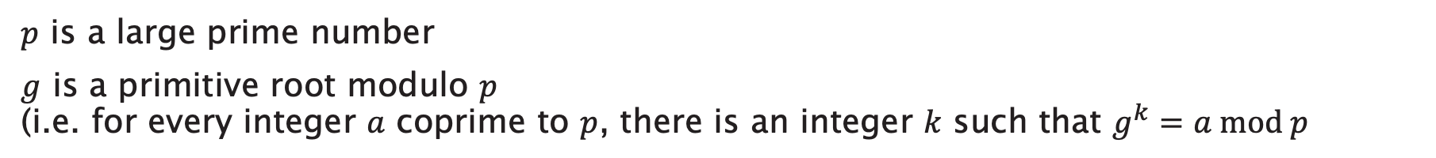





Diffie-Hellman key exchange
$p$ is a large prime number
$g$ is a primitive root modulo $p$
(i.e. for every integer $a$ coprime to $p$, there is an integer $k$ such that $g^{k}=a mod p$
Pick random
large integer $a$
Pick random
large integer $b$
$$A=g^{a} mod p$$
$$B=g^{b} mod p$$
$$A$$
$$B$$
$$Z=B^{a} mod p$$
$$Z=A^{b} mod p$$

Slide 16
Transport Layer Security
Symmetric-key encryption is much faster than asymmetric-key encryption
TLS is a hybrid cryptosystem
  Uses asymmetric-key encryption to agree on a shared symmetric key
  Uses symmetric-key encryption for subsequent application data, using the shared key
TLS 1.2 defined in Aug 2008, TLS 1.3 defined in Aug 2018
  TLS 1.3 offers significant security and efficiency improvements over TLS 1.2
  TLS 1.3 is widely supported by most modern browsers (notable exception: Microsoft)
  Adoption by websites is much lower (<40% as of September 2020)
Dierks, T. and Rescorla, E. (2008) The Transport Layer Security Protocol Version 1.2. RFC5246. Available at: https://tools.ietf.org/html/rfc5246
Rescorla, E. (2018) The Transport Layer Security (TLS) Protocol Version 1.3. RFC8446. Available at: https://tools.ietf.org/html/rfc8446

Slide 17
Transport Layer Security handshake
TLS handshake is the protocol used to agree on the shared symmetric key
Several key exchange algorithms in use – these are the most common cases:
  RSA (TLS 1.2 and earlier only)
  Ephemeral Diffie-Hellman (TLS 1.3 onwards)
Because TLS 1.2 is still in wide use, we’ll look at both TLS 1.2 and TLS 1.3

Slide 18



RSA
(TLS 1.2)
CA public key
server private key
server public key
(signed by CA)
generate random number
n
ClientHello
n
m
ServerHello
m
generate random number
Certificate
CertificateVerify
generate transcript hash
#
#
#
generate transcript hash
ServerHelloDone
verify server public key
generate premaster secret
ClientKeyExchange
construct master secret
construct master secret
+
m
+
n
→
←
m
+
n
+
ChangeCipherSpec
Finished
ChangeCipherSpec
Finished
begin secure communication
begin secure communication

Slide 19
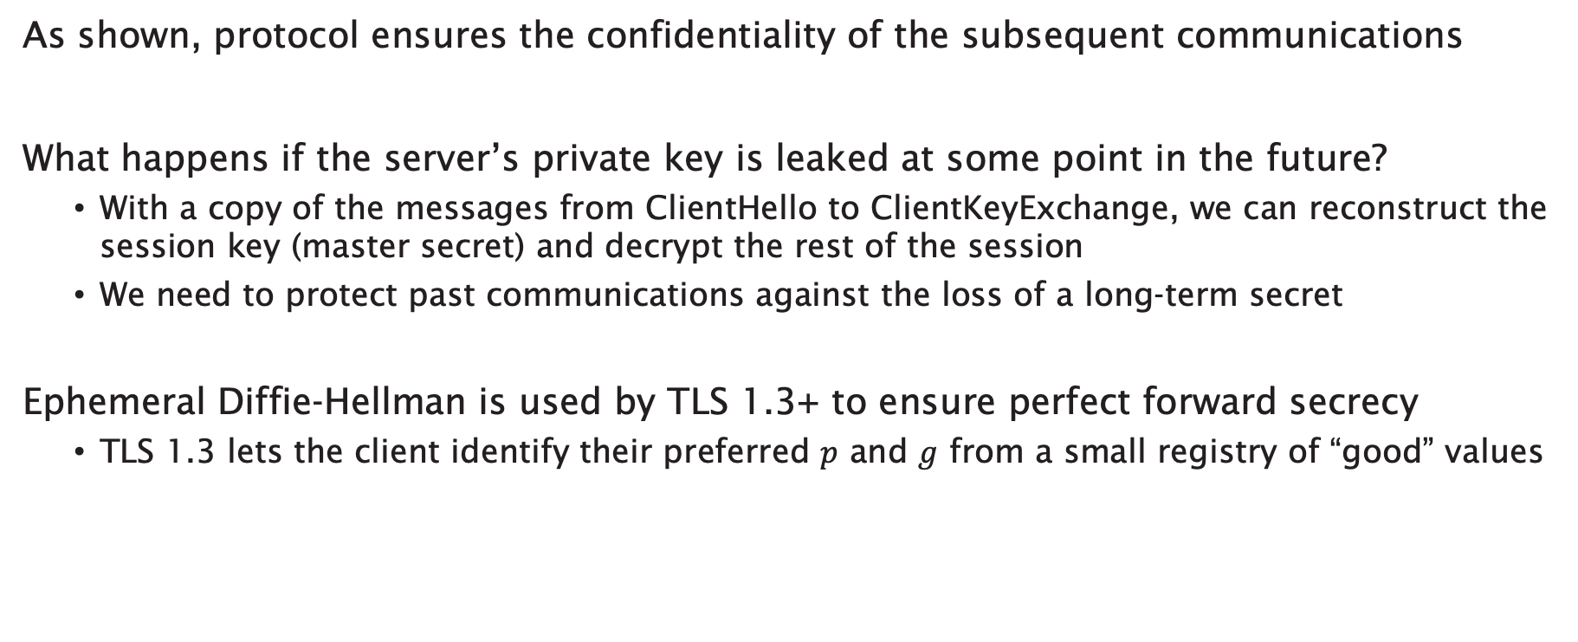
Perfect forward secrecy
As shown, protocol ensures the confidentiality of the subsequent communications
What happens if the server’s private key is leaked at some point in the future?
  With a copy of the messages from ClientHello to ClientKeyExchange, we can reconstruct the session key (master secret) and decrypt the rest of the session
  We need to protect past communications against the loss of a long-term secret
Ephemeral Diffie-Hellman is used by TLS 1.3+ to ensure perfect forward secrecy
  TLS 1.3 lets the client identify their preferred $p$ and $g$ from a small registry of “good” values
Gillmor, D. (2016) Negotiated Finite Field Diffie-Hellman Ephemeral Parameters for Transport Layer Security. RFC7919. Available at: https://tools.ietf.org/html/rfc7919

Slide 20

Latency
The handshake from TLS 1.2 and earlier requires two round trips before secure communications can begin
  Minimum of 4 * 0.067 = 0.27s
This is on top of the 3-way TCP handshake (minimum 0.2s) and before any additional overheads from HTTP
TLS 1.3 reduces the handshake to a single round trip
0.067s
Image: NASA

Slide 21



DHE
(TLS 1.3)
CA public key
server private key
server public key
(signed by CA)
generate random number
n
ClientHello
n
generate public DH key
key_share
m
ServerHello
m
generate random number
key_share
generate public DH key
generate transcript hash
#
#
generate transcript hash
construct shared DH key
construct shared DH key
construct handshake secret
EncryptedExtensions
construct handshake secret
+
#
→
←
#
+
Certificate
authenticate server
CertificateVerify
Finished
generate transcript hash
#’
#’
generate transcript hash
construct master secret
construct master secret
+
#’
→
←
#’
+
begin secure communication
begin secure communication

Slide 22
HTTPS
HTTP over a TLS connection
  Standard port is 443 (as opposed to port 80 for HTTP)
Now common for HTTP URIs to redirect to an equivalent HTTPS URI
  301 Moved Permanently or 308 Permanent Redirect
GET / HTTP/1.1
Host: example.org
HTTP/1.1 301 Moved Permanently
Location: https://example.org/

Slide 23
HTTP Strict Transport Security
301 Moved Permanently requires a redirect for every URI on a website
  Strict-Transport-Security: header allows a website to declare that it is only accessible via HTTPS
  Avoids future redirections for all URIs on that website (and possibly also sub-domains)
GET / HTTP/1.1
Host: example.org
HTTP/1.1 301 Moved Permanently
Location: https://example.org/
Strict-Transport-Security: max-age=31536000; includeSubDomains
Hodges, J. et al (2012) HTTP Strict Transport Security. RFC6797. Available at: https://tools.ietf.org/html/rfc6797

Slide 24
Further Reading
Dierks, T. and Rescorla, E. (2008) The Transport Layer Security (TLS) Protocol Version 1.2. RFC5246.
  https://tools.ietf.org/html/rfc5246
Rescorla, E. (2018) The Transport Layer Security (TLS) Protocol Version 1.3. RFC8446.
  https://tools.ietf.org/html/rfc8446
Diffie, W. and Hellman, M. (1976) New Directions in Cryptography. IEEE Transactions on Information Theory. 22(6). pp. 644-654.
Merkle, R.C. (1978) Secure communications over insecure channels. Communications of the ACM. 21(4). pp.294-299.
Hodges, J. et al (2012) HTTP Strict Transport Security. RFC6797.
  https://tools.ietf.org/html/rfc6797

Slide 25
Authentication and Authorisation

Slide 26
HTTP authentication
Simple authentication of user agent using HTTP headers
  Origin server sends WWW-Authenticate: header containing challenge (scheme and realm)
  User agent sends Authorization: header containing credentials
Authentication schemes:
  Basic
  User agent sends base64( username + ":" + password )
  Bearer
  OAuth 2.0 token

Slide 27
Basic authentication scheme
GET / HTTP/1.1
Host: example.org
HTTP/1.1 401 Unauthorized
WWW-Authenticate: Basic realm="Access to Example"
GET / HTTP/1.1
Host: example.org
Authorization: Basic c3F1ZWFtaXNoOm9zc2lmcmFnZQo=
HTTP/1.1 200 OK
...

Slide 28
Basic authentication scheme
GET / HTTP/1.1
Host: example.org
HTTP/1.1 401 Unauthorized
WWW-Authenticate: Basic realm="Access to Example"
GET / HTTP/1.1
Host: example.org
Authorization: Basic bmV2ZXJnb2luZ3RvZ2l2ZTp5b3V1cAo=
HTTP/1.1 403 Forbidden

Slide 29
Proxy authentication
Similar challenge/response mechanism for authenticating with a proxy
  Proxy sends Proxy-Authenticate: header containing challenge
  User agent sends Proxy-Authorization: header containing credentials

Slide 30

Proxy authentication
GET http://example.org/ HTTP/1.1
Host: example.org
HTTP/1.1 407 Proxy Authentication Required
Proxy-Authenticate: Basic realm="Access to Proxy"
GET http://example.org/ HTTP/1.1
Host: example.org
Proxy-Authorization: Basic c3F1ZWFtaXNoOm9zc2lmcmFnZQo=
HTTP/1.1 200 OK
...

Slide 31
OAuth 2.0
Modern Web applications are federations of interacting services
The password problem: how can we give an application access to our data held by a service (a "protected resource") without giving it our password for that service?
This is a problem of authorisation, rather than simply authentication

Slide 32


OAuth 2.0 roles
The resource owner
  An entity capable of granting access to a protected resource. May be a combination of a person (an end-user) and their user agent
The resource server
  The server hosting the protected resources, capable of accepting and responding to protected resource requests using access tokens
The client
  An application making protected resource requests on behalf of the resource owner and with its authorisation
The authorisation server
  The server issuing access tokens to the client after successfully authenticating the resource owner and obtaining authorisation.

Slide 33
Abstract protocol flow
obtain
access
token
use
access
token
delegate
access

Slide 34
OAuth 2.0 protocol flows
Authorisation Code Grant
  Client obtains access token directly from authorisation server ("3-legged")
  Flow relies on redirection via user agent
Implicit Grant
  All communication goes through user agent ("2-legged")
  Commonly used by single page applications
Resource Owner Password Credentials Grant
  Resource owner gives credentials to client (requires trust relationship)
Client Credential Grant
  Client authenticates directly with authorisation server

Slide 35
Registration
Client registers with the authorisation server before the protocol starts
  Client issued with a client_id – unique string (not a secret)
Client and authorisation server establish an authentication method
  Client password, use with HTTP Basic Authentication
  client_id, client_secret sent in request body (not recommended)
Endpoints
  Authorisation endpoint (e.g. https://auth.org/auth )
  Client redirection endpoint (e.g. https://client.org/cb )
  Token endpoint (e.g. https://auth.org/token )

Slide 36
Authorisation Code Grant
2. user authenticates
4. authorisation
code
5. access token
1. authorisation
request
6. resource
access
3. authorisation
code

Slide 37
1. authorisation request
1. authorisation request
3. authorisation code
3. authorisation code
HTTP/1.1 302 Found
Location: https://auth.org/auth?
response_type=code&
client_id=s6BhdRkqt3&
redirect_uri=https://client.org/cb
authorisation endpoint
issued during registration
redirection endpoint
GET /auth?response_type=code&client_id=s6BhdRkqt3&redirect_uri=
https%3A%2F%2Fclient%2Eorg%2Fcb HTTP/1.1
Host: auth.org
authorisation code
HTTP/1.1 302 Found
Location: https://client.org/cb?code=SplxlOBeZQQYbYS6WxSbIA
GET /cb?code=SplxlOBeZQQYbYS6WxSbIA HTTP/1.1
Host: client.org

Slide 38
4. authorisation code
5. access token
POST /token HTTP/1.1
Host: auth.org
Authorization: Basic czZCaGRSa3F0MzpnWDFmQmF0M2JW
Content-Type: application/x-www-form-urlencoded
grant_type=authorization_code&
code=SplxlOBeZQQYbYS6WxSbIA&
redirect_uri=https://client.org/cb
agreed during registration
authorisation code
HTTP/1.1 200 OK
Content-Type: application/json;charset=UTF-8
Cache-Control: no-store
{ "access_token":"2YotnFZFEjr1zCsicMWpAA",
"token_type":"bearer",
"expires_in":3600,
"refresh_token":"tGzv3JOkF0XG5Qx2TlKWIA" }
used to access resource
used to get new access token

Slide 39
6. resource access
access token
GET /resource HTTP/1.1
Host: example.org
Authorization: Bearer 2YotnFZFEjr1zCsicMWpAA
HTTP/1.1 200 OK
...

Slide 40
4. refresh token
5. access token
POST /token HTTP/1.1
Host: auth.org
Authorization: Basic czZCaGRSa3F0MzpnWDFmQmF0M2JW
Content-Type: application/x-www-form-urlencoded
grant_type=refresh_token&
refresh_token=tGzv3JOkF0XG5Qx2TlKWIA
HTTP/1.1 200 OK
Content-Type: application/json;charset=UTF-8
Cache-Control: no-store
{ "access_token":"2YotnFZFEjr1zCsicMWpAA",
"token_type":"bearer",
"expires_in":3600,
"refresh_token":"tGzv3JOkF0XG5Qx2TlKWIA" }

Slide 41
Further reading
Fielding, R. and Reschke, J. (2014) Hypertext Transfer Protocol (HTTP/1.1): Authentication. RFC7235.
  https://tools.ietf.org/html/rfc7235
Reschke, J. (2015) The 'Basic' HTTP authentication scheme. RFC7617.
  https://tools.ietf.org/html/rfc7617
Hardt, D. (2012) The OAuth 2.0 authorization framework. RFC6749.
  https://tools.ietf.org/html/rfc6749
Jones, M. and Hardt, D. (2012) The OAuth 2.0 Authorization Framework: Bearer Token Usage. RFC6750
  https://tools.ietf.org/html/rfc6750

Slide 42
Next Lecture: Proxies and Caching

