Slide 2
Web Formats
COMP3220 Web Infrastructure
Dr Nicholas Gibbins – nmg@ecs.soton.ac.uk

Slide 3

Web Formats
HTML is the main Web format
  Many other formats in use on the Web
  Many other formats use Web standards
NOTE: This lecture goes into a lot of detail, but for illustrative purposes only. You should be broadly familiar with the range of formats, what they’re for and (roughly) how they work

Slide 4
eXtensible Markup Language

Slide 5
The eXtensible Markup Language
A general purpose markup language
  A W3C-defined subset of the Standard Generalized Markup Language
A markup language for defining domain-specific markup languages
Used as the basis for a number of Web formats:
  Scalable Vector Graphics
  Resource Description Framework
  Synchronised Multimedia Integration Language
  Simple Object Access Protocol
  eXtensible Stylesheet Language Transformations
  (but not HTML5)

Slide 6
XML example
XML declaration
Tells a document processor that
this is XML
<?xml version="1.0"?>
<!DOCTYPE booklist SYSTEM "books.dtd">
<booklist>
<books>
<item cat="S">
<title>I, Robot</title>
<author>Asimov, Isaac</author>
<price>5.95</price>
<quantity>3</quantity>
</item>
<item cat=”C">
<title>Persuasion</title>
<author>Austen, Jane</author>
<price>6.95</price>
<quantity>2</quantity>
</item>
</books>
</booklist>
Reference to a Document Type Definition
Tells a document processor how to parse
this document
Document Type Declaration (doctype)
Tells a document processor what type
of document this is
Notes:
Case sensitive element and attribute names
<books> != <Books> != <BOOKS>

Slide 7
Document Type Definition (DTD)
A formal definition of the grammar for an XML document type
  What elements and attributes exist
  What elements can exist inside other elements (the content model)
  Referenced by the document type declaration
<!DOCTYPE booklist [
<!ELEMENT booklist (books)>
<!ELEMENT books (item)*>
<!ELEMENT item (title, author, price, quantity)>
<!ELEMENT title (#PCDATA)>
<!ELEMENT author (#PCDATA)>
<!ELEMENT price (#PCDATA)>
<!ELEMENT quantity (#PCDATA)>
<!ATTLIST item cat CDATA #REQUIRED>
]>
Element name
Content model
Element definition
Attribute type
Attribute definition
Attribute name
Element name

Slide 8
Well-Formedness versus Validity
An XML document is well-formed if it obeys the syntax rules in the XML spec:
  Single root element
  Elements are correctly nested (no overlapping)
  Tag names contain only legal characters
  Start and end tag names have matching capitalisation
  (to name but a few of the rules)

Slide 9
Well-Formedness versus Validity
An XML document is valid if:
  It contains a reference to a DTD
  It only contains elements and attributes that are defined in that DTD
  Its use of those elements and attributes follows the grammar rules in the DTD
All valid XML documents are well-formed
Not all well-formed XML documents are valid

Slide 10
Other Schema Languages
Document Type Definitions have expressive limitations
  Cannot specify the range of values taken by attributes
  Cannot specify the range of non-markup element content
Two main competitors:
  XML Schema
  RELAX NG
Notes:
XML Schema – W3C standard
Regular Language for XML Next Generation – ISO standard

Slide 11
Scalable Vector Graphics

Slide 12
Scalable Vector Graphics
XML-based language for describing 2D graphics
  Resolution independent
  Support for Javascript event handlers
  Support for manipulation via the Document Object Model (DOM)
  Uses CSS for styling and animation
  Integrates with HTML5

Slide 13

SVG Example
<svg height="150" width="400" xmlns:xlink="http://www.w3.org/1999/xlink">
<defs>
<linearGradient id="grad1" x1="0%" y1="0%" x2="100%" y2="0%">
<stop offset="0%" style="stop-color:rgb(255,255,0);stop-opacity:1" />
<stop offset="100%" style="stop-color:rgb(255,0,0);stop-opacity:1" />
</linearGradient>
</defs>
<ellipse cx="200" cy="70" rx="85" ry="55" fill="url(#grad1)" />
<text x="0" y="15" fill="blue" transform="rotate(30 20,40)">I love
<a xlink:href="http://www.w3.org/SVG/" target="_blank">SVG</a></text>
</svg>

Slide 14
MathML

Slide 15
MathML
XML-based language for expressing mathematical expressions
  Integrates with HTML5
Two sub-languages:
  Presentation-oriented (for display)
  Semantics-oriented

Slide 16
Presentational MathML
<math xmlns="http://www.w3.org/1998/Math/MathML">
<mrow>
<msup><mi>a</mi><mn>2</mn></msup>
<mo>+</mo>
<msup><mi>b</mi><mn>2</mn></msup>
<mo>=</mo>
<msup><mi>c</mi><mn>2</mn></msup>
</mrow>
</math>
a² + b² = c²

Slide 17
Semantic MathML
<math xmlns="http://www.w3.org/1998/Math/MathML”>
<apply>
<eq/>
<apply>
<plus/>
<apply>
<power/><ci>a</ci><cn>2</cn>
</apply>
<apply>
<power/><ci>b</ci><cn>2</cn>
</apply>
</apply>
<apply>
<power/><ci>c</ci><cn>2</cn>
</apply>
</apply>
</math>
a² + b² = c²

Slide 18
Web Data

Slide 19
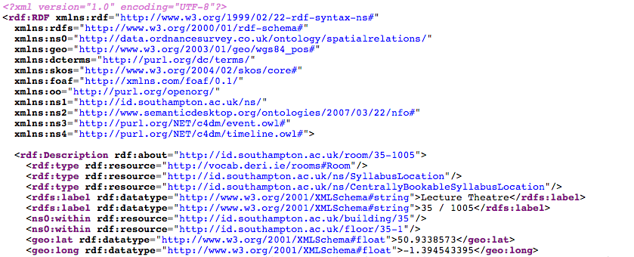
Structured and Linked Data on the Web
The Resource Description Framework
  Subject of a later lecture on this module
  Covered (in considerable depth) in COMP6215 Semantic Web Technologies next semester

Slide 20
ePub

Slide 21
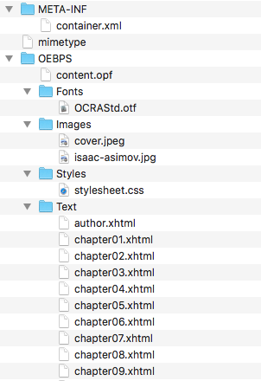
ePub Format
Open vendor-neutral standard for e-books defined by IDPF (now part of W3C)
ZIP file of directory hierarchy containing XML and HTML files
  META-INF/container.xml
  OEBPS/content.opf
Use of HTML allows resizable and reflowable content – essential for adapting to a wide variety of readers
Other common ebook formats take similar approach (ZIP of XML/HTML files)
  Kindle (.azw), Mobipocket, Apple iBooks

Slide 22
META-INF/container.xml
Points to OPF package which describes the other components of the document
<?xml version="1.0" encoding="UTF-8"?>
<container version="1.0”
xmlns="urn:oasis:names:tc:opendocument:xmlns:container">
<rootfiles>
<rootfile full-path="OEBPS/content.opf"
media-type="application/oebps-package+xml"/>
</rootfiles>
</container>

Slide 23
OEBPS/content.opf
Three key components:
  Metadata about document
<metadata xmlns:dc="http://purl.org/dc/elements/1.1/"
xmlns:dcterms="http://purl.org/dc/terms/"
xmlns:opf="http://www.idpf.org/2007/opf"
xmlns:xsi="http://www.w3.org/2001/XMLSchema-instance">
<dc:identifier id="uuid_id" opf:scheme="uuid">
df3d24ec-aa53-4a72-9075-e97b5b7bc26f</dc:identifier>
<dc:title>The Stars, Like Dust</dc:title>
<dc:creator opf:file-as="Asimov, Isaac” opf:role="aut">Isaac Asimov</dc:creator>
<dc:language>en</dc:language>
</metadata>

Slide 24
OEBPS/content.opf
Three key components:
  Metadata about document
  Manifest listing files that comprise document
<manifest>
<item href="Images/cover.jpeg" id="cover"
media-type="image/jpeg"/>
<item href="Styles/stylesheet.css" id="css"
media-type="text/css"/>
<item href="Text/cover.xhtml" id="cover.xhtml"
media-type="application/xhtml+xml"/>
<item href="Text/chapter01.xhtml" id="chapter01.xhtml"
media-type="application/xhtml+xml"/>
...
</manifest>

Slide 25
OEBPS/content.opf
Three key components:
  Metadata about document
  Manifest listing files that comprise document
  Spine listing table of contents
<spine toc="ncx">
<itemref idref="cover.xhtml"/>
<itemref idref="title.xhtml"/>
<itemref idref="chapter01.xhtml"/>
<itemref idref="chapter02.xhtml"/>
<itemref idref="chapter03.xhtml"/>
...
</spine>

Slide 26
OEBPS/Text/chapter01.xhtml
<?xml version="1.0" encoding="utf-8"?>
<!DOCTYPE html PUBLIC "-//W3C//DTD XHTML 1.1//EN” "http://www.w3.org/TR/xhtml11/DTD/xhtml11.dtd">
<html xmlns="http://www.w3.org/1999/xhtml">
<head>
<link href="../Styles/stylesheet.css" rel="stylesheet"
type="text/css"/>
</head>
<body>
<h1>ONE: The Bedroom Murmured</h1>
<p>The bedroom murmured to itself gently. It was almost below the limits of hearing—an irregular little sound, yet quite unmistakable, and quite deadly.</p>
<p>But it wasn’t that which awakened Biron Farrill and dragged him out of a heavy, unrefreshing slumber. He turned his head restlessly from side to side in a futile struggle against the periodic burr-r-r on the end table.</p>
<p>He put out a clumsy hand without opening his eyes and closed contact.</p>
<p>“Hello,” he mumbled.</p>

Slide 27
Office Open XML

Slide 28
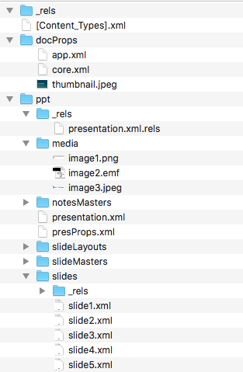
Open Office XML
Microsoft-originated XML-based format
  Standardised by Ecma and ISO/IEC
  Replaced pre-2007 proprietary format
ZIP file of directory hierarchy containing XML
  docprops/ contains metadata
  ppt/slides contains slides
  ppt/media contains images
  _rels translates file names into XML attribute values

Slide 29
<?xml version="1.0" encoding="UTF-8" standalone="yes"?>
<p:sld xmlns:a="http://schemas.openxmlformats.org/drawingml/2006/main"
xmlns:r="http://schemas.openxmlformats.org/officeDocument/2006/relationships"
xmlns:p="http://schemas.openxmlformats.org/presentationml/2006/main">
<p:cSld><p:spTree>
<p:nvGrpSpPr><p:cNvPr id="1" name=""/><p:cNvGrpSpPr/><p:nvPr/></p:nvGrpSpPr>
<p:grpSpPr><a:xfrm><a:off x="0" y="0"/><a:ext cx="0" cy="0"/><a:chOff x="0" y="0"/><a:chExt cx="0" cy="0"/></a:xfrm></p:grpSpPr>
<p:sp><p:nvSpPr><p:cNvPr id="2" name="Title 1"/><p:cNvSpPr><a:spLocks noGrp="1"/></p:cNvSpPr>
<p:nvPr><p:ph type="ctrTitle"/></p:nvPr></p:nvSpPr><p:spPr/>
<p:txBody><a:bodyPr/><a:lstStyle/><a:p><a:r><a:rPr lang="en-GB" dirty="0"/><a:t>Web Formats</a:t></a:r></a:p></p:txBody></p:sp><p:sp><p:nvSpPr><p:cNvPr id="3" name="Subtitle 2"/><p:cNvSpPr><a:spLocks noGrp="1"/></p:cNvSpPr><p:nvPr><p:ph type="subTitle" idx="1"/></p:nvPr></p:nvSpPr><p:spPr/><p:txBody><a:bodyPr/><a:lstStyle/>
<a:p><a:r><a:rPr lang="en-GB" dirty="0"/><a:t>COMP3220 Web Infrastructure</a:t></a:r></a:p>
</p:txBody></p:sp><p:sp><p:nvSpPr><p:cNvPr id="4" name="Text Placeholder 3"/><p:cNvSpPr><a:spLocks noGrp="1"/></p:cNvSpPr><p:nvPr><p:ph type="body" sz="quarter" idx="13"/></p:nvPr></p:nvSpPr><p:spPr/><p:txBody><a:bodyPr/><a:lstStyle/><a:p><a:r><a:rPr lang="en-GB" dirty="0"/><a:t>Dr Nicholas Gibbins </a:t></a:r><a:r><a:rPr lang="mr-IN" dirty="0"/><a:t>–</a:t></a:r><a:r><a:rPr lang="en-GB" dirty="0"/><a:t> </a:t></a:r><a:r><a:rPr lang="en-GB" dirty="0" err="1"/><a:t>nmg@ecs.soton.ac.uk</a:t></a:r><a:endParaRPr lang="en-GB" dirty="0"/></a:p></p:txBody></p:sp></p:spTree><p:extLst><p:ext uri="{BB962C8B-B14F-4D97-AF65-F5344CB8AC3E}">
...

Slide 30
Portable Document Format

Slide 31
Portable Document Format
Not “of the Web”, but important for the Web
  8.5bn HTML documents in Google
  2.3bn PDF documents in Google
Structured for rendering of pre-formatted documents
  Set characters from fonts at position
  Draw lines (etc) at position
  No structure to text: no paragraphs, headings, lists, etc
Often used as official format of record
  Searchable – unlike scanned documents

Slide 32
PDF History
Derived from Adobe’s earlier PostScript language
  Subset of PostScript’s page description language
  (but not a programming language like PostScript)
Other features
  Font embedding in documents
  Structured object storage, with data compression
  Access control and DRM
  Extensible metadata
  Fillable forms, annotations
  Links!

Slide 33
Sample PDF
First Page
Root Object
%PDF-1.0
1 0 obj
<<
/Type /Catalog
/Pages 3 0 R
/Outlines 2 0 R
>>
endobj
2 0 obj
<</Type /Outlines /Count 0>>
endobj
3 0 obj
<<
/Type /Pages
/Count 1
/Kids [4 0 R]
>>
endobj
4 0 obj
<<
/Type /Page
/Parent 3 0 R
/Resources <<
/Font << /F1 7 0 R >>
/ProcSet 6 0 R >>
/MediaBox [0 0 612 792]
/Contents 5 0 R
>>
endobj
5 0 obj
<< /Length 44 >>
stream
BT /F1 24 Tf
100 100 Td (Hello World) Tj ET
endstream
endobj
Outlines Object (TOC)
Drawing commands for first page
Page List
BeginText, use font F1 at size 24, move to (100,100), draw the text “Hello World”, EndText

Slide 34
Sample PDF
Definitions for first page
Index
6 0 obj
[/PDF /Text]
endobj
7 0 obj
<<
/Type /Font
/Subtype /Type1
/Name /F1
/BaseFont /Helvetica
>>
endobj
xref
08
0000000000 65535 f
0000000009 00000 n
0000000074 00000 n
0000000120 00000 n
0000000179 00000 n
0000000322 00000 n
0000000415 00000 n
0000000445 00000 n
trailer
<<
/Size 8
/Root 1 0 R
>>
startxref 553
%%EOF
Fonts for first page
Number of objects, ID of root

Slide 35
Next Lecture: Web APIs

