Slide 2
Identification, Representation, Interaction
COMP3220 Web Infrastructure
Dr Nicholas Gibbins – nmg@ecs.soton.ac.uk

Slide 3
Identification

Slide 4
Uniform Resource Identifiers
A “compact string of characters for identifying an abstract or physical resource”
Example:
http://www.ecs.soton.ac.uk/
General syntax:
<scheme>:<hierarchical part>?<query>#<fragment>
URI
http://www.bbc.co.uk/weather/2637487
identifies
Resource
accesses
today’s BBC weather forecast for Southampton
Representation
Metadata:
Content-Type: text/html
Data:
<html>
<head>
<title>BBC Weather – Southampton</title>
...
</html>
represents
Berners-Lee, T. et al (2005) Uniform Resource Identifier (URI): Generic Syntax. RFC3986. Available at https://tools.ietf.org/html/rfc3986

Slide 5
URI Schemes and Examples
http://www.example.org/aboutus#staff
https://www.example.org/login
mailto:joe@example.org
ftp://example.org/aDirectory/aFile
news:comp.infosystems.www
tel:+1-816-555-1212
ldap://ldap.example.org/c=GB?objectClass?one
urn:oasis:names:tc:entity:xmlns:xml:catalog

Slide 6
Identification Principles
Identifiers should be global
Global naming leads to global network effects.
We want to avoid creating walled gardens.

Slide 7
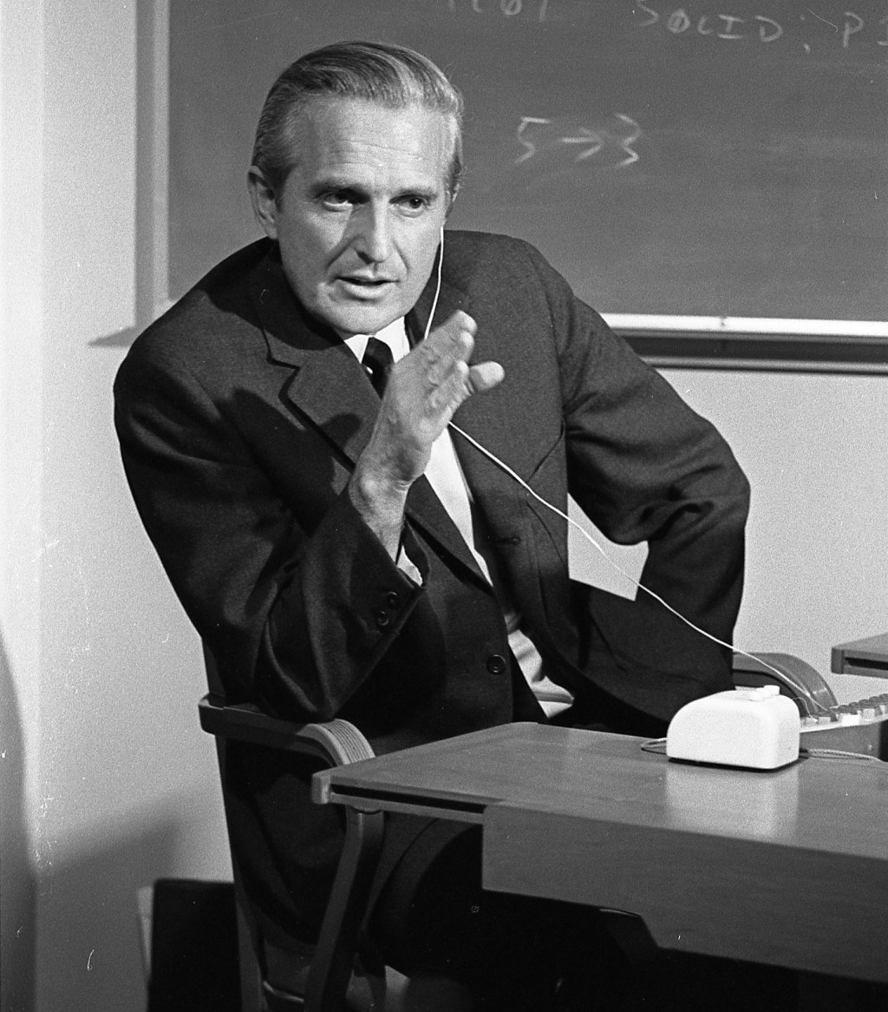
Every object should be addressable
In principle, every object that someone might validly want/need to cite should have an unambiguous address (capable of being portrayed in a manner as to be human readable and interpretable). (e.g., not acceptable to be unable to link to an object within a ‘frame’ or ‘card.’)
Englebart, D.C. (1990) Knowledge-Domain Interoperability and an Open Hyperdocument System. Proceedings of the Conference on
Computer-Supported Collaborative Work.

Slide 8
Identification Principles
Identifiers should be global
Assign distinct identifiers to distinct resources
Using the same URI to directly identify different resources produces a URI collision.
Example: using http://www.ecs.soton.ac.uk/ to refer to both a university department and a web page about that department
Collision often imposes a cost in communication due to the effort required to resolve ambiguities.

Slide 9
Identification Principles
Identifiers should be global
Assign distinct identifiers to distinct resources
Avoid aliases
A URI owner SHOULD NOT associate arbitrarily different URIs with the same resource.
Example: http://www.soton.ac.uk/ and http://www.southampton.ac.uk/ both refer to the same resource – but we can’t tell that just by looking at the identifiers (URIs are opaque)
The value of a given resource can be measured by the number and value of the resources that link to it

Slide 10
The Early Web
Early documents refer to document naming:
“As many protocols are currently used for information retrieval, the address must be capable of encompassing many protocols, access methods or, indeed, naming schemes”
“A hypertext link to a document ought to be specified using the most logical name as opposed to a physical address. This is (almost) the only way of getting over the problem of documents being physically moved. As the naming scheme becomes more abstract, resolving the name becomes less of a simple look-up and more of a search.”
Berners-Lee, T. (1991) Document Naming. Available at: http://www.w3.org/DesignIssues/Naming
Notes:
naming and addressing treated as near-synonyms

Slide 11
The Classical View
Uniform Resource Identifiers
Uniform
Resource
Locators
Uniform
Resource
Names
Explicitly associated with
network protocols
(e.g. http, ftp, etc)
Independent of location
or protocol
(e.g. isbn)

Slide 12
Name resolution
URL resolution is (usually) well-defined (use the listed protocol)
URNs don’t necessarily have well-defined resolution semantics
  Resolving names depends on context
  What does resolution mean for URIs which do not refer to network resources?
Significant development work in the 1998-2002 timeframe, culminating in the Dynamic Delegation Discovery System
  Uses DNS to store a database of rewrite rules for URIs in NAPTR records
Sollins, K. (1998) Architectural Principles of Uniform Resource Name Resolution. RFC2276. Available at: https://tools.ietf.org/html/rfc2276
Daniel, R. and Mealling, M. (1997) Resolution of Uniform Resource Identifiers using the Domain Name System. RFC 2168. Available at: https://tools.ietf.org/html/rfc2168
Mealling, M. and Daniel, R. (2000) The Naming Authority Pointer (NAPTR) DNS Resource Record. RFC 2915. Available at: https://tools.ietf.org/html/rfc2915
Mealling, M. (2002) Dynamic Delegation Discovery System, Part One. RFC3401. Available at https://tools.ietf.org/html/rfc3401

Slide 13
The Modern View
The URL/URN/URI debate has been a long-running issue for the Web
Formal URL/URN distinction is unhelpful, but URL is a useful informal concept
  “a URL is a type of URI that identifies a resource via a representation of its primary access mechanism”
  e.g. a http: URL identifies a resource whose representation can be retrieved using the HTTP protocol
Current practice when creating new URIs is to use http/https schema (regardless of the type of resource) and ensure that it resolves to give “something useful”
  Cheaper than DDDS-like solutions
W3C TAG (2002) ISSUE-14: What is the range of the HTTP dereference function? Available at: https://www.w3.org/2001/tag/group/track/issues/14
W3C/IETF Joint URI Planning Interest Group (2001) URIs, URLs, and URNs: Clarifications and Recommendations 1.0. W3C Note. Available at: http://www.w3.org/TR/uri-clarification/
Berners-Lee, T. (2002) What do URIs identify?. Available at: https://www.w3.org/DesignIssues/HTTP-URI.html

Slide 14
Internationalized Resource Identifiers
URIs as specified in RFC3986 use only US-ASCII characters
IRIs (defined in RFC3987) extend URIs by allowing Unicode characters:
  https://el.wikipedia.org/wiki/Αθήνα
  https://zh.wikipedia.org/wiki/北京市
  https://he.wikipedia.org/wiki/ ירושלים
  Even http://💩.to/
Relies on internationalised domain names
Mapping from IRIs to URIs to support older tools (i.e. Punycode)
Duerst, M. and Suignard, M. (2005) Internationalized Resource Identifiers. RFC3987. Available at: https://tools.ietf.org/html/rfc3987
Klensin, J. (2010) Internationalized Domain Names in Applications: Protocol. RFC5891. Available at: https://tools.ietf.org/html/rfc5891

Slide 15
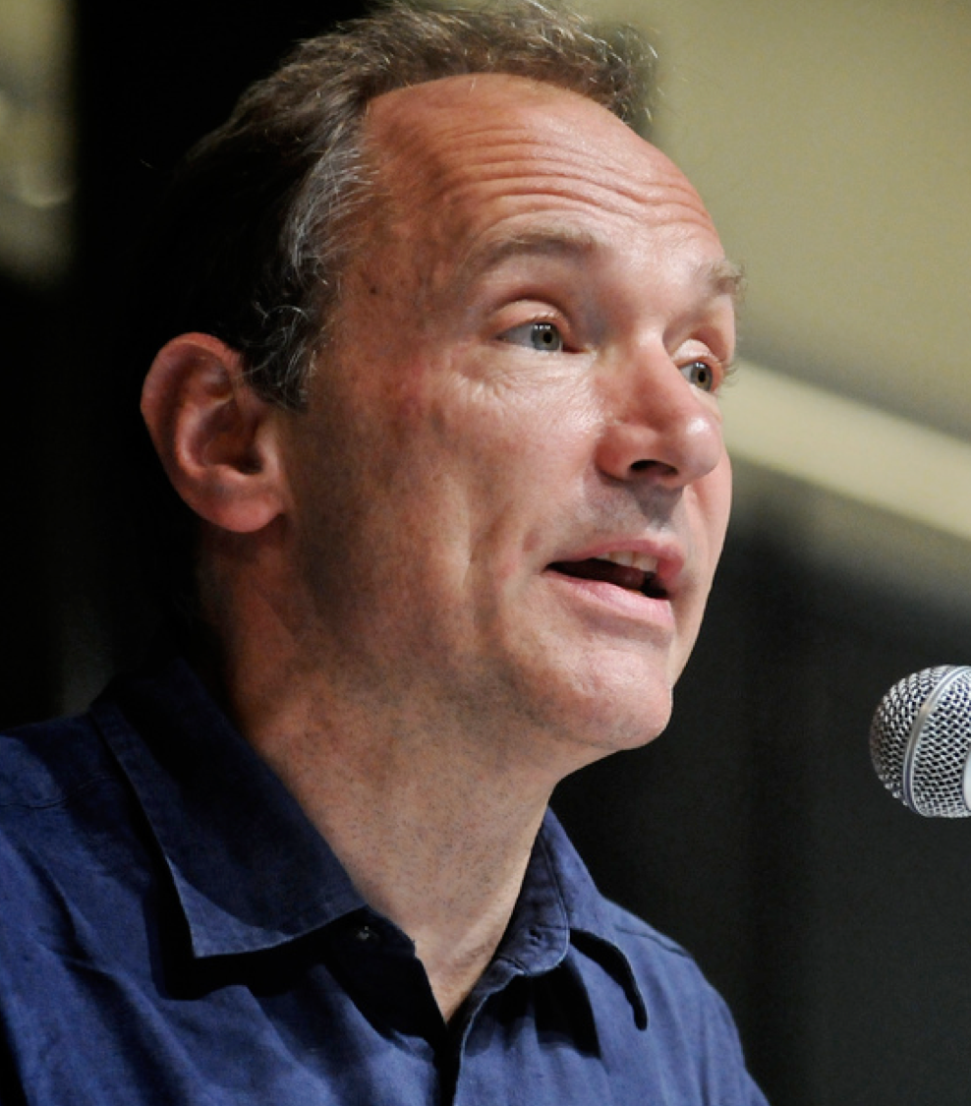
Cool URIs don't change
What makes a cool URI?
A cool URI is one which does not change.
What sorts of URI change?
URIs don't change: people change them.
Berners-Lee, T. (1998) Cool URIs don't change.
Available at: https://www.w3.org/Provider/Style/URI

Slide 16
Cool URIs don't change
Changing a resource’s URI breaks any pages that may have linked to the old URI
  404 Not Found
  Keep the old URI and redirect? (increased latency)
Changing the URI of a resource breaks the principle of avoiding aliases

Slide 17
Representation

Slide 18
Representation
A representation is data that encodes information about resource state.
Representations have metadata
  When were they last modified?
  What format are they in?
Resource
today’s BBC weather forecast for Southampton
Representation
Metadata:
Content-Type: text/html
Data:
<html>
<head>
<title>BBC Weather – Southampton</title>
...
</html>
represents

Slide 19
Internet Media Types
Hierarchical descriptions of data types (used originally in email - MIME)
Top-level types: text, image, audio, video, application
(also multipart and message)
Refinements of these top-level types:
  text/plain, text/html, text/xml, text/csv, …
  image/jpeg, image/gif, image/png, image/tiff, …
  audio/mpeg, audio/ogg, …
  video/mp4, video/quicktime, …
  application/ecmascript, application/pdf, application/rdf+xml, …
Registry of types maintained by IANA
https://www.iana.org/assignments/media-types/media-types.xhtml
Notes:
encoding may be in a number of formats – need to identify formats

Slide 20
Representation Principles
Separate content, presentation and interaction
A representation format should allow authors to separate content from both presentation and interaction concerns.
How a resource is presented to a user (e.g. mobile versus desktop), and how the user interacts with that resource, are independent of the informational content of the resource.

Slide 21
Content, Behaviour, Presentation
ECMAScript
HTML
DOM
CSS
XML
Behaviour
Data Content
Visual Style
XSLT
SVG
PNG
MathML
Web Resource

Slide 22
Representation Principles
Separate content, presentation and interaction
Identify links
A representation format should provide ways to identify links to other resources, including to secondary resources (via fragment identifiers).

Slide 23
Representation Principles
Separate content, presentation and interaction
Identify links
Links should be web-wide
A representation format should allow Web-wide linking, not just internal document linking.
(a corollary of global identifiers)

Slide 24
Representation Principles
Separate content, presentation and interaction
Identify links
Links should be web-wide
Links should use generic identifiers
A representation format should allow content authors to use URIs without constraining them to a limited set of URI schemes.
Formats should be future-proof; we don’t know what identifier types or protocols we’ll be using in the future.

Slide 25
Representation Principles
Separate content, presentation and interaction
Identify links
Links should be web-wide
Links should use generic identifiers
Links should be navigable
A representation format should incorporate hypertext links if hypertext is the expected user interface paradigm.
We would like links between resources to be able to behave like any other hypertext links.

Slide 26
Interaction

Slide 27
Interaction
Resource representations are transmitted using interaction protocols that specify the exchange of messages
  HTTP, FTP, SOAP, NNTP, SMTP, ...
Messages contain both:
  data
  (informational content of the message)
  metadata
  (description of the message or its content)
URI
http://www.bbc.co.uk/weather/2637487
identifies
Resource
accesses
today’s BBC weather forecast for Southampton
Representation
Metadata:
Content-Type: text/html
Data:
<html>
<head>
<title>BBC Weather – Southampton</title>
...
</html>
represents
27

Slide 28
Dereferencing URIs
URIs used to identify resources may indicate protocols that can be used to access those resources
  Though not always: caches, proxies, name resolution services (DNS)
  Many URI schemes define a default interaction protocol
Resource access takes several forms:
  Retrieving a representation of the resource
  Adding or modifying a representation of the resource
  Deleting some or all representations of the resource
URI
http://www.bbc.co.uk/weather/2637487
identifies
Resource
accesses
today’s BBC weather forecast for Southampton
Representation
Metadata:
Content-Type: text/html
Data:
<html>
<head>
<title>BBC Weather – Southampton</title>
...
</html>
represents
28

Slide 29
Interaction Principles
Reuse representation formats
New protocols created for the Web should transmit representations as octet streams typed by Internet media types.

Slide 30
Interaction Principles
Reuse representation formats
Provide representations
A URI owner should provide representations of the resource it identifies.
There is a general expectation that it should be possible to retrieve a representation of any resource.

Slide 31
Interaction Principles
Reuse representation formats
Provide representations
Retrieval should be safe
Agents do not incur obligations by retrieving a representation.
Put another way, the act of retrieving a representation of a resource should not have any significant side-effects (for example, deleting the resource or changing its state).

Slide 32
Interaction Principles
Reuse representation formats
Provide representations
Retrieval should be safe
Reference does not imply dereference
An application developer or specification author should not require networked retrieval of representations each time they are referenced.
Just because you can retrieve a representation of a resource, doesn’t mean that you must.
Example: URIs used to identify document schemas: http://www.w3.org/TR/html4/strict.dtd

Slide 33
Interaction Principles
Reuse representation formats
Provide representations
Retrieval should be safe
Reference does not imply dereference
Representations should be consistent
A URI owner should provide representations of the identified resource consistently and predictably.
We want our identifiers to be persistent: once an identifier has been associated with that resource, it should continue to refer to that resource indefinitely.
(a matter of policy, not technology)

Slide 34
Further Reading
Jacobs, I. and Walsh, N. (2004) Architecture of the World Wide Web, Volume One. W3C Recommendation.
  http://www.w3.org/TR/webarch/
Fielding, R.T. (2000) Architectural Styles and the Design of Network-based Software Architectures. PhD Thesis. University of California at Irvine. Chapter 5.
  http://www.ics.uci.edu/~fielding/pubs/dissertation/top.htm
Berners-Lee, T. et al (2005) Uniform Resource Identifier (URI): Generic Syntax. RFC3986
  https://tools.ietf.org/html/rfc3986
Fielding, R.T. and Reschke, J. (2014) Hypertext Transfer Protocol (HTTP/1.1): Semantics and Content. RFC7231.
  https://tools.ietf.org/html/rfc7231

Slide 35
Next Lecture: HTTP

