Slide 2
The Architecture of the World Wide Web
COMP3220 Web Infrastructure
Dr Nicholas Gibbins – nmg@ecs.soton.ac.uk

Slide 3
The evolving architecture of the Web
In its earliest days, the Web was defined primarily in terms of its implementation
HTTP was what Web browsers and Web servers spoke
HTML was what Web browsers read
As the Web grew, this became an increasing problem
Network issues with early HTTP affected scalability
Nature of application interactions on the Web changed (images, etc)
Limited support for shared caching
The Web architecture addresses this by answering the following questions:
How do all the Web components fit together in a consistent manner?
How should future components fit together with the rest of the Web?

Slide 4
To properly understand the Web architecture, we need to understand what the Web is
To properly understand what the Web is, we need to understand how the Web came to be

Slide 5
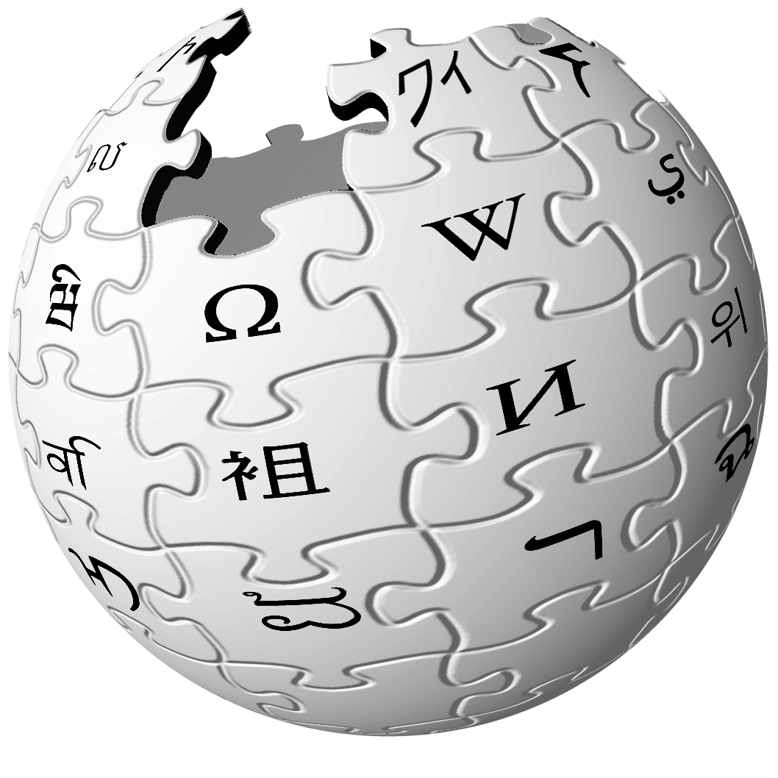
What is the Web?
The Web is a distributed information system that provides access to hypertext documents and other objects of interest
We have a general name for these objects of interest:
resources

Slide 6
What is a resource?
The earliest formal uses of the term "resource" in an Internet context date from 1994
Synonymous with "file" or "network object"
Earliest reference to resources in IETF RFCs is in RFC1580 from March 1994
First formal definition of Uniform Resource Identifiers in RFC1630 from June 1994
Earlier documents submitted by Berners-Lee to IETF talked about documents
EARN Staff (1994) Guide to Network Resource Tools. RFC1580. Available online at https://tools.ietf.org/html/rfc1580 Berners-Lee, T. (1994) Universal Resource Identifiers in WWW: A Unifying Syntax for the Expression of Names and Addresses of Objects on the Network as used in the World-Wide Web. RFC1630. Available online at https://tools.ietf.org/html/rfc1630

Slide 7
What is a resource?
“Familiar examples [of resources] include an electronic document, an image, a source of information with a consistent purpose (e.g., ‘today's weather report for Los Angeles’), a service (e.g., an HTTP-to-SMS gateway), and a collection of other resources. A resource is not necessarily accessible via the Internet; e.g., human beings, corporations, and bound books in a library can also be resources. Likewise, abstract concepts can be resources, such as the operators and operands of a mathematical equation, the types of a relationship (e.g., ‘parent’ or ‘employee’), or numeric values (e.g., zero, one, and infinity).”
Berners-Lee, T. et al (2005) Uniform Resource Identifier (URI): Generic Syntax. RFC3986. Available online at https://tools.ietf.org/html/rfc3986

Slide 8
What is a resource?
“Familiar examples [of resources] include an electronic document, an image, a source of information with a consistent purpose (e.g., ‘today's weather report for Los Angeles’), a service (e.g., an HTTP-to-SMS gateway), and a collection of other resources. A resource is not necessarily accessible via the Internet; e.g., human beings, corporations, and bound books in a library can also be resources. Likewise, abstract concepts can be resources, such as the operators and operands of a mathematical equation, the types of a relationship (e.g., ‘parent’ or ‘employee’), or numeric values (e.g., zero, one, and infinity).”
A resource may change over time yet still be considered the same resource
The Ship of Theseus/my grandfather's axe/Trigger's broom
Berners-Lee, T. et al (2005) Uniform Resource Identifier (URI): Generic Syntax. RFC3986. Available online at https://tools.ietf.org/html/rfc3986

Slide 9
What is a resource?
“Familiar examples [of resources] include an electronic document, an image, a source of information with a consistent purpose (e.g., ‘today's weather report for Los Angeles’), a service (e.g., an HTTP-to-SMS gateway), and a collection of other resources. A resource is not necessarily accessible via the Internet; e.g., human beings, corporations, and bound books in a library can also be resources. Likewise, abstract concepts can be resources, such as the operators and operands of a mathematical equation, the types of a relationship (e.g., ‘parent’ or ‘employee’), or numeric values (e.g., zero, one, and infinity).”
A resource may not be something which can be "retrieved"
Can still be interacted with over the network
Berners-Lee, T. et al (2005) Uniform Resource Identifier (URI): Generic Syntax. RFC3986. Available online at https://tools.ietf.org/html/rfc3986

Slide 10
What is a resource?
“Familiar examples [of resources] include an electronic document, an image, a source of information with a consistent purpose (e.g., ‘today's weather report for Los Angeles’), a service (e.g., an HTTP-to-SMS gateway), and a collection of other resources. A resource is not necessarily accessible via the Internet; e.g., human beings, corporations, and bound books in a library can also be resources. Likewise, abstract concepts can be resources, such as the operators and operands of a mathematical equation, the types of a relationship (e.g., ‘parent’ or ‘employee’), or numeric values (e.g., zero, one, and infinity).”
A resource may not even be something that's "on the Internet"
Berners-Lee, T. et al (2005) Uniform Resource Identifier (URI): Generic Syntax. RFC3986. Available online at https://tools.ietf.org/html/rfc3986

Slide 11
Resource
today’s BBC weather forecast for Southampton

Slide 12
Architectural Bases of the Web
The notion of a resource is central to the architecture of the Web
We need to be able to:
identify them
represent them
interact with them
These are orthogonal considerations

Slide 13
Identification
We need a way to identify resources
Machines need to be able to resolve those identifiers (to "fetch" the resource)
Humans should (ideally) be able to read and write those identifiers
Uniform Resource Identifiers
Arguably the single most important contribution of the Web
URI
http://www.bbc.co.uk/weather/2637487
identifies
Resource
today’s BBC weather forecast for Southampton
13

Slide 14
Representation
A representation is data that encodes information about resource state.
Representations do not necessarily describe the resource, or portray a likeness of the resource, or represent the resource in other senses of the word "represent".
Resource
today’s BBC weather forecast for Southampton
Representation
Metadata:
Content-Type: text/html
Data:
<html>
<head>
<title>BBC Weather – Southampton</title>
...
</html>
represents

Slide 15
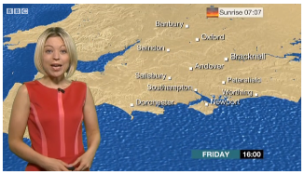
Representation
Representation
Metadata:
Content-Type: video/mp4
Data:
A representation is data that encodes information about resource state
Representations do not necessarily describe the resource, or portray a likeness of the resource, or represent the resource in other senses of the word "represent"
May be multiple representations of a given resource
represents
Resource
today’s BBC weather forecast for Southampton
Representation
Metadata:
Content-Type: text/html
Data:
<html>
<head>
<title>BBC Weather – Southampton</title>
...
</html>
represents

Slide 16
Interaction
Resource representations are transmitted using interaction protocols.
The interactions between Web agents and resources are defined in terms of protocols that specify the exchange of messages
URI
http://www.bbc.co.uk/weather/2637487
identifies
Resource
accesses
today’s BBC weather forecast for Southampton
Representation
Metadata:
Content-Type: text/html
Data:
<html>
<head>
<title>BBC Weather – Southampton</title>
...
</html>
represents
16

Slide 17
Representational State Transfer
The core Web architecture was heavily informed by the work of Roy Fielding
Co-author of HTTP and URI RFCs
Co-founder of the Apache Software Foundation
Fielding defined an architectural style known as representational state transfer or REST
What data elements exist?
What components (i.e. processing elements) exist?
What constraints apply to the interactions between components?
Fielding, R.T. (2000) Architectural Styles and the Design of Network-based Software Architectures. PhD Thesis. University of California at Irvine. Available online at http://www.ics.uci.edu/~fielding/pubs/dissertation/top.htm
Notes:
stateless – no client context stored on server
cacheable – responses may be cached
layered – intermediaries are transparent
uniform interface – resources, manipulation through representations, self-descriptive messages, HATEOAS

Slide 18
Data Elements
Resources
Identifiers (URIs, etc)
Representations (HTML, etc)
Metadata (resource, representation, control)

Slide 19
Components
Origin servers
Definitive source of resource representations
Web server: Apache, nginx, IIS, etc
Gateways
Intermediary selected by origin server
Often used to integrate legacy services
Proxies
Intermediary selected by user agent
Filter, cache, etc
User agents
Browser: Chrome, IE, Safari, Firefox, etc
Notes:
Origin server – definitive source for resource representations
User agent - browser

Slide 20
Components
User
Agent
Proxy
Origin Server
Gateway
Cache

Slide 21
Constraints
Client-Server
Separation of concerns:
user interface (client)
data storage (server)
Improves portability of user interface
Improves scalability by simplifying server
Allows components to evolve separately

Slide 22
Constraints
Client-Server
Stateless
Each request from client to server must contain all of the information necessary to understand the request
No context is stored on the server
Session state is kept entirely on the client
Improves visibility (can consider each request in isolation)
Improves reliability (easier to recover from partial failures)
Improves scalability (reduces server resource usage)
Increases per-interaction overhead

Slide 23
Constraints
Client-Server
Stateless
Caching
Response data must be labelled as cacheable or non-cacheable
If cacheable, client may reuse response data for later requests
Allows some interactions to be eliminated
Reduces average latency of interactions
Stale data reduces reliability

Slide 24
Constraints
Client-Server
Stateless
Caching
Uniform Interface
Uniform interface between components
Identification of resources
Manipulation of resources through representations
Self-descriptive messages
Hypermedia as the engine of application state (HATEOAS)
Improves visibility of interactions
Encourages independent evolvability
Degrades efficiency (depending on optimisation)

Slide 25
Constraints
Client-Server
Stateless
Caching
Uniform Interface
Layered
System components have no knowledge of components beyond those with which they directly interact
Encapsulate legacy services
Introduce intermediaries
Limits system complexity
Improves scalability (load balancing)
Adds latency and overhead (offset by caching)

Slide 26
Constraints
Client-Server
Stateless
Caching
Uniform Interface
Layered
Code on Demand (optional)
Client functionality extended by downloading and executing code
Applets
Scripts
Improves extensibility
Reduces visibility

Slide 27
Further Reading
Jacobs, I. and Walsh, N. (2004) Architecture of the World Wide Web, Volume One. W3C Recommendation.
http://www.w3.org/TR/webarch/
Fielding, R.T. (2000) Architectural Styles and the Design of Network-based Software Architectures. PhD Thesis. University of California at Irvine. Chapters 4-5.
http://www.ics.uci.edu/~fielding/pubs/dissertation/top.htm

Slide 28
Next Lecture: Identification, Representation, Interaction

