Slide 1
A
B
C
Task:
1) Drag the names below under the correct structure. Make sure everyone in your group understands the reason the name is what it is!
3-bromo-1-chlorohexane
D
E
trichlorofluoromethane
2-methylpentan-3-ol
2) Add textboxes to the slides giving the names of the remaining structures. Again, make sure everyone in your group understands the reason the name is what it is!
H
G
F

Slide 2
A
B
C
Task:
1) Drag the names below under the correct structure. Make sure everyone in your group understands the reason the name is what it is!
pentan-1-ol
pentan-1,4-diol
2-methylpentan-3-ol
D
E
1-chlorohexane
cyclohexanol
2) Add textboxes to the slides giving the names of the remaining structures. Again, make sure everyone in your group understands the reason the name is what it is!
H
G
F
3-bromo-1-chlorohexane
trichlorofluoromethane
hex-2-ene

Slide 3
In this problem, you can calculate a value for the enthalpy change of formation of butane using a Hess cycle and the enthalpy changes of combustion of butane and its elements.
i) Rearrange the images below to create the equation representing the formation of 1 mole of butane from its elements in their standard states.
ii) Rearrange the remaining images to create an enthalpy (Hess) cycle to show the relationship between the formation of butane from carbon and hydrogen to the combustion of these elements to give carbon dioxide and water.
Use your enthalpy cycle to calculate a value for the standard enthalpy change of formation of butane.
4 CO_{2(s)} + 5H₂O_{(g)}
4 C_{(s)} + 5H_{2(g)}
ΔH_{c}º(C) | -393 kJ mol⁻¹
ΔH_{c}º(H₂) | -286 kJ mol⁻¹
ΔH_{c}º (C₄H₁₀) | -2877 kJ mol⁻¹
ΔH₂
ΔH₁
ΔH₃
Butane: C₄H₁₀
C₄H_{10(g)}
ΔH₁ = ΔH₂ - ΔH₃
=

Slide 4
In this problem, you can calculate a value for the enthalpy change of formation of butane using a Hess cycle and the enthalpy changes of combustion of butane and its elements.
i) Rearrange the images below to create the equation representing the formation of 1 mole of butane from its elements in their standard states.
ii) Rearrange the remaining images to create an enthalpy (Hess) cycle to show the relationship between the formation of butane from carbon and hydrogen to the combustion of these elements to give carbon dioxide and water.
Use your enthalpy cycle to calculate a value for the standard enthalpy change of formation of butane.
ΔH₁
4 C_{(s)} + 5H_{2(g)}
C₄H_{10(g)}
ΔH_{c}º(C) | -393 kJ mol⁻¹
ΔH_{c}º(H₂) | -286 kJ mol⁻¹
ΔH_{c}º (C₄H₁₀) | -2877 kJ mol⁻¹
ΔH₂
ΔH₃
Butane: C₄H₁₀
4 CO_{2(s)} + 5H₂O_{(g)}
ΔH₁ = ΔH₂ - ΔH₃
= 4x(-393) + 5x(-286) - (-2877) = - 125

Slide 5
Place the following statements in chronological order to describe what happens in a catalytic converter:
The bonds within the pollutant molecules are weakened
This lowers the activation energy for the reactions that subsequently take place
The catalyst is regenerated and can go onto catalyse further reactions
The product molecules are desorbed and leave the catalytic converter
Pollutant molecules enter the catalytic converter from the engine
Bonds then break in the reactants and new bonds are made in the products
Pollutant molecules are adsorbed onto the catalyst surface

Slide 6
Place the following statements in chronological order to describe what happens in a catalytic converter:
Pollutant molecules enter the catalytic converter from the engine
Pollutant molecules are adsorbed onto the catalyst surface
The bonds within the pollutant molecules are weakened
This lowers the activation energy for the reactions that subsequently take place
Bonds then break in the reactants and new bonds are made in the products
The product molecules are desorbed and leave the catalytic converter
The catalyst is regenerated and can go onto catalyse further reactions

Slide 7
Arrange these particles into an appropriate format to show what happens on the catalyst surface to convert CO to CO₂. Add labels
O atom remains on the catalyst surface to undergo further reaction
CO₂ is formed & is desorbed from the catalyst surface
Pt
C
O

Slide 8
Arrange these particles into an appropriate format to show what happens on the catalyst surface to convert CO to CO₂. Add labels
O atom remains on the catalyst surface to undergo further reaction
Bonds start to break between o atoms
Bond starts to form between C + O
CO₂ is formed & is desorbed from the catalyst surface
Pt
C
O

Slide 9
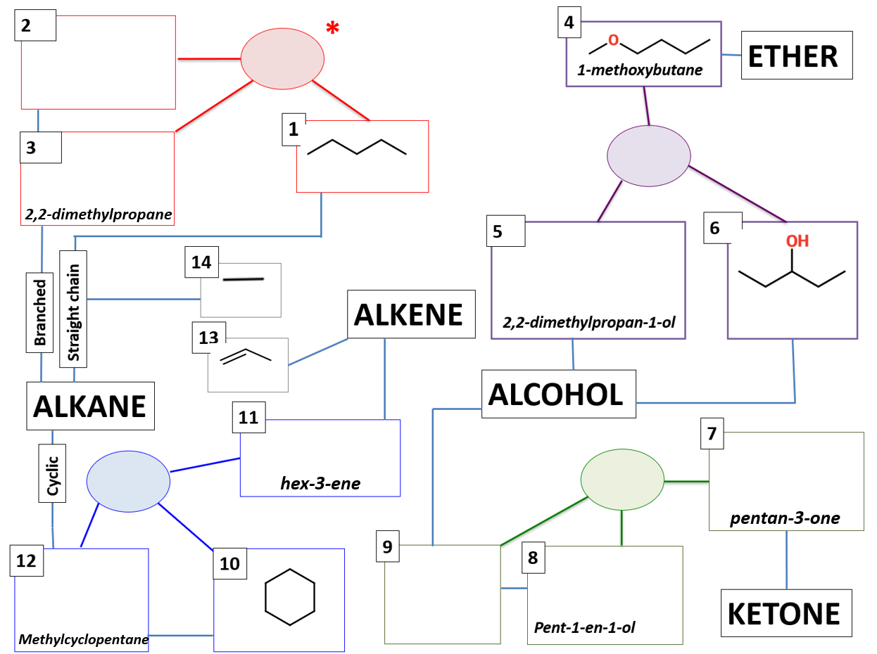
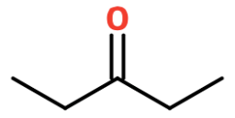
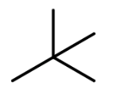
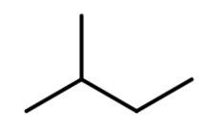
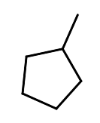
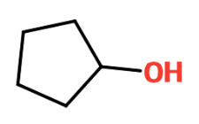
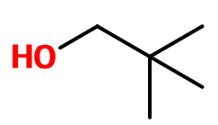
NOTE: Compounds in the same coloured box are isomers of each other
Drag the structures and names into the correct boxes
C₅H₁₂
C₅H₁₂O
C₅H₁₀O
C₆H₁₂
2-methylbutane
pentane
pentan-3-ol
ethane
cyclopentanol
propene
cyclohexane

Slide 10
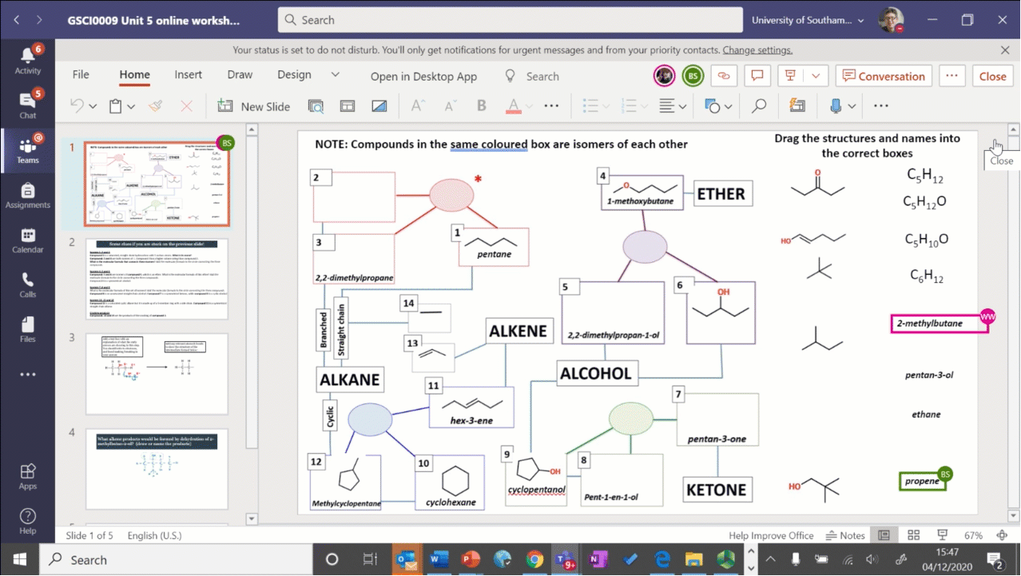

Slide 11
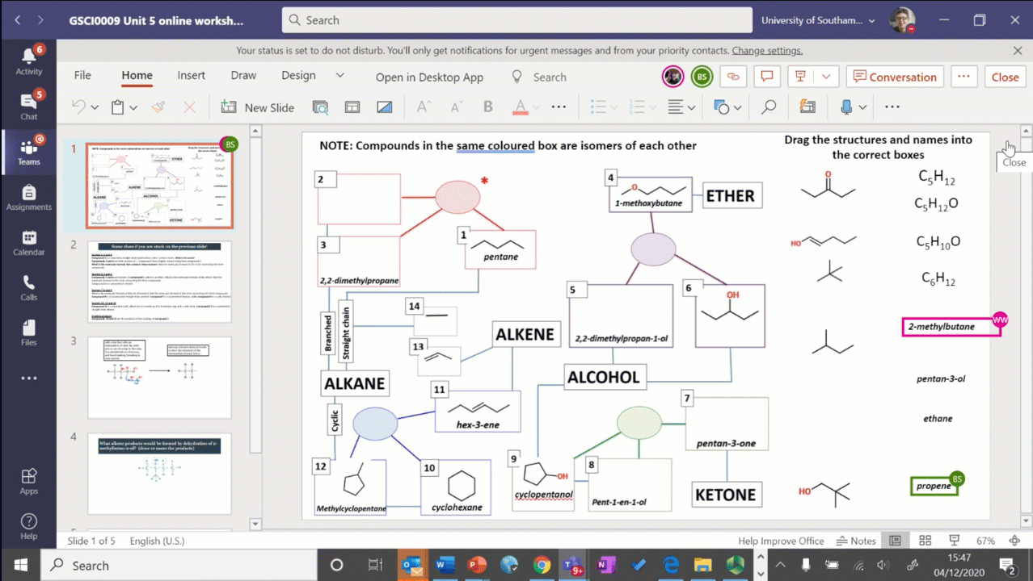

Slide 12
NOTE: Compounds in the same coloured box are isomers of each other
Drag the structures and names into the correct boxes
2-methylbutane
C₅H₁₂
pentane
ethane
pentan-3-ol
C₅H₁₂O
propene
C₅H₁₀O
C₆H₁₂
cyclopentanol
cyclohexane

Slide 13
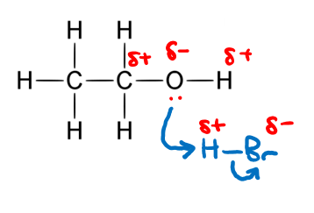
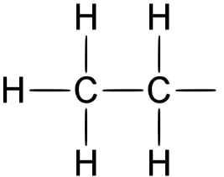
Add a text box with an explanation of what the curly arrows are showing in this step. You should refer to electrons, and bond making/breaking in your answer.
Add any relevant atoms & bonds to show the structure of the intermediate formed below:

Slide 14
Add any relevant atoms & bonds to show the structure of the intermediate formed below:
The curly arrows show the movement of the electrons from one atom to another. The oxygen atom is donating its lone pair to hydrogen, forming a bond with it. As a result of this, the H-Bond is broken, and the Br takes the electrons because it is more electronegative than H

Slide 15
Identify the errors in the mechanism shown and add labels to explain what is wrong with the answers
What is/are the error(s) here?
Enter text
What is/are the error(s) here?
Enter text
What is/are the error(s) here?
Enter text

Slide 17
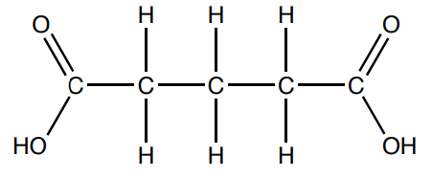
pentan-1,5-dioic acid
Molecular formula
C₅H₈O₄
Infrared Absorption Peaks (IR Spectroscopy)
Wavenumber / cm⁻¹ | Peak Width
Fragmentation Peaks (Mass Spectrometry)
m/z values
.
¹H NMR Data
Chemical Shift / ppm | Integral | Splitting | Peak present in D₂O?
How many peaks would there be in the ¹³C spectrum of the compound?

Slide 19
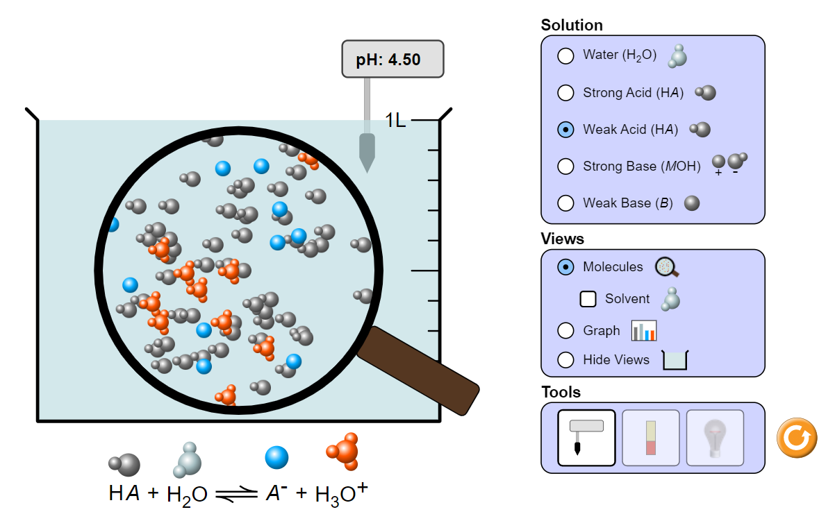
Part 1 – On the introduction tab, explore the different solutions, views and tools, then answer the questions below
Q1) a) What is the difference between a strong acid and a weak acid?
[replace this text with your answer]
Q1) b) How is this shown visually in the simulation? (In your answer, refer to the different types of particles present in the solution)
[replace this text with your answer]

Slide 21
Have a discussion about the points below and add some notes about what you discuss. Spend ~4 mins on each point.
1) What are the strengths and weaknesses that students typically display? (think broadly)
Type your answer here by replacing this text
2) Explore ways in which a student might go about developing their strengths and weaknesses whilst at University and and give some of your suggestions below.
Type your answer here by replacing this text

Slide 22
Have a discussion about the points below and add some notes about what you discuss. Spend ~4 mins on each point.
1) What are the strengths and weaknesses that students typically display? (think broadly)
Weaknesses= time management.
Lack of motivation
Being too social interfers with study time.
Many distractions.
Strengths = Good when working in a team, determination to do well.
2) Explore ways in which a student might go about developing their strengths and weaknesses whilst at University and and give some of your suggestions below.
Make time table to improve time management skills.
Work with other students to motivation.

Slide 23
Consider statements 1 – 8 below. What are the challenges and risks associated with each one? Make notes in the table
Benefits | Challenges | Risks
1) More control over your study time | e.g. Getting used to freedom | e.g. Not having the discipline to study
2) More control over your spare time
3) More choice about when and where to study

Slide 24
Consider statements 1 – 8 below. What are the challenges and risks associated with each one? Make notes in the table
Benefits | Challenges | Risks
1) More control over your study time | e.g. Getting used to freedom 1) Its all online this year | e.g. Not having the discipline to study 1) Lectures are pre-recorded can be watched last minute= rushed = less information retained.
2) More control over your spare time | Getting too relaxed when you have spare time. | May lose track of time easily and find it difficult to get back on track.
3) More choice about when and where to study | Library has to be booked Depends on individuals motivation levels. | Catching covid and your less likely to go if you have to book.# Less work may be done then in a normal year due to a lack of a timetable.

Slide 25
Let’s get started…
Discuss the following questions in your groups:
As you work through Semester 2, how would you describe your levels of motivation? Are you always highly motivated? Has anything changed during the year?
During the foundation year has your level of motivation varied, and if so, what are the likely triggers for that variation?
Looking ahead, how will you maintain high levels of motivation in order to achieve your ambitions?

