Slide 2
Data Streams
COMP3211 Advanced Databases
Dr Nicholas Gibbins – nmg@ecs.soton.ac.uk
2020-2021

Slide 3
From Databases to Data Streams
Traditional DBMS makes several assumptions:
persistent data storage
relatively static records
(typically) no predefined notion of time
complex one-off queries

Slide 4
From Databases to Data Streams
Some applications have very different requirements:
data arrives in real-time
data is ordered (implicitly by arrival time or explicitly by timestamp)
too much data to store!
data never stops coming
ongoing analysis of rapidly changing data

Slide 5
Big Data – The Four Vs
Volume
Amount of data
Variety
Semi-structured, unstructured, schema-free
Veracity
Untrusted, inaccurate
Velocity
Speed of operation, rate of analysis

Slide 6
Big Data – The Four Vs
Volume
Amount of data
Variety
Semi-structured, unstructured, schema-free
Veracity
Untrusted, inaccurate
Velocity
Speed of operation, rate of analysis

Slide 7
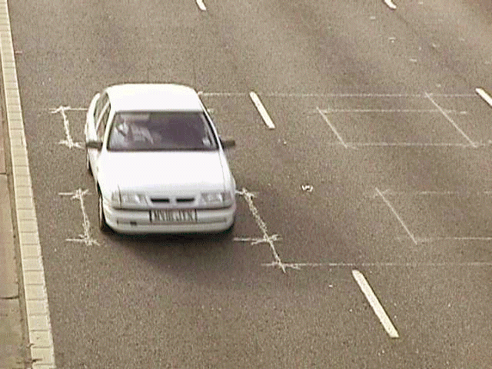
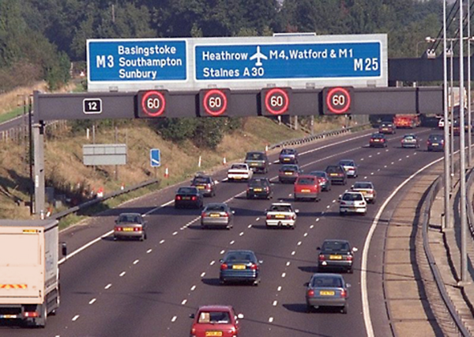
Example Application: MIDAS
Notes:
Motorway Incident Detection and Automatic Signalling
Introduced on M25, Birmingham Box (M42, M5, M6), ~1000km as of 2006
Figure shows M25 (M23 to M4 clockwise)
UK motorway network 3500km, 1.1E11 vehicle kilometres in 2017
If applied to the whole network, c. 7000 readings per second.
Data provided (1minute intervals): flow (no. of vehicles), speed, headway (time between vehicles), occupancy (%), vehicle classification (based on length)

Slide 8
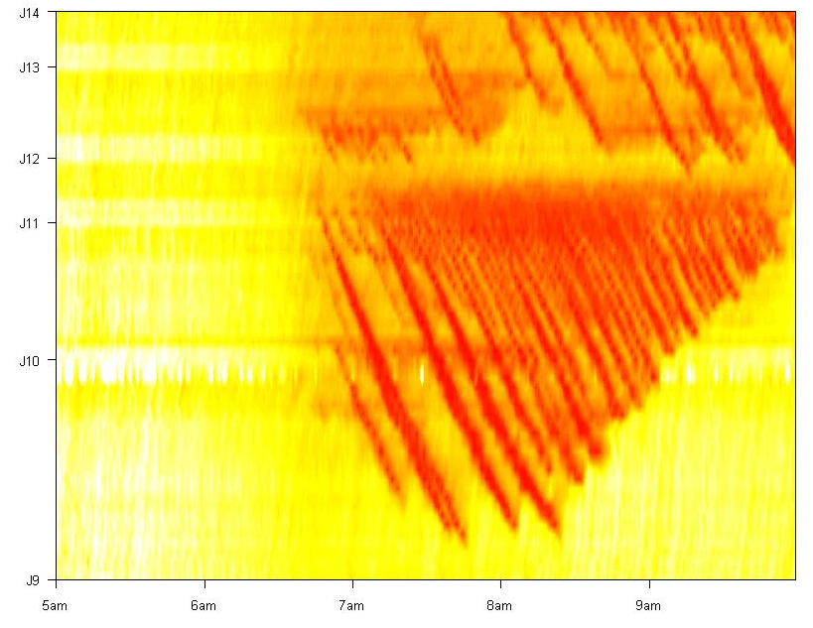
Example Application: MIDAS
Notes:
Motorway Incident Detection and Automatic Signalling
Introduced on M25, Birmingham Box (M42, M5, M6), ~1000km as of 2006
Figure shows M25 (M23 to M4 clockwise)
UK motorway network 3500km, 1.1E11 vehicle kilometres in 2017
If applied to the whole network, c. 7000 readings per second.
Data provided (1minute intervals): flow (no. of vehicles), speed, headway (time between vehicles), occupancy (%), vehicle classification (based on length)

Slide 9
Application Domains
Network monitoring and traffic engineering
Sensor networks, RFID tags
Telecommunications call records
Financial applications
Web logs and click-streams
Manufacturing processes

Slide 10
Data Streams
A (potentially unbounded) sequence of tuples
Transactional data streams: log interactions between entities
Credit card: purchases by consumers from merchants
Telecommunications: phone calls by callers to dialed parties
Web: accesses by clients of resources at servers
Measurement data streams: monitor evolution of entity states
Sensor networks: physical phenomena, road traffic
IP network: traffic at router interfaces
Earth climate: temperature, moisture at weather stations

Slide 11
One-Time versus Continuous Queries
One-time queries
Run once to completion over the current data set
Continuous queries
Issued once and then continuously evaluated over a data stream
“Notify me when the temperature drops below X”
“Tell me when prices of stock Y > 300”

Slide 12
Database Management System
query
results
query processor
stored data
on disk

Slide 13
Data Stream Management System (DSMS)
continuous
query
stream of
results
data
streams
query processor
data
streams

Slide 14
DBMS versus DSMS
DBMS
DSMS
Persistent relations (relatively static, stored)
One-time queries
Random access
“Unbounded” disk store
Only current state matters
Transient streams (on-line analysis)
Continuous queries (CQs)
Sequential access
Bounded main memory
Historical data is important

Slide 15
DBMS versus DSMS
DBMS
DSMS
No real-time services
Relatively low update rate
Data at any granularity
Assume precise data
Access plan determined by query processor, physical DB design
Real-time requirements
Possibly multi-GB arrival rate
Data at fine granularity
Data stale/imprecise
Unpredictable/variable data arrival and characteristics

Slide 16
A Motivation for Stream Processing
Over the past twenty-five years:
CPU performance has increased by a factor of >1,000,000
Typical RAM capacity increased by a factor of >1,000,000
RAM access time has decreased by a factor of >50,000
Typical HD capacity increased by a factor of >50,000
HD access time has decreased by a factor of ~10
Notes:
Memory I/O much faster than disk I/O
SSD access time much faster (0.1ms compared to 5ms), but capacities lower than HD

Slide 17
Architectural Issues
DBMS
DSMS
Resource (memory, disk, per-tuple computation) rich
Extremely sophisticated query processing, analysis
Useful to audit query results of data stream systems.
Query Evaluation: Arbitrary
Query Plan: Fixed.
Resource (memory, per-tuple computation) limited
Reasonably complex, near real time, query processing
Useful to identify what data to populate in database
Query Evaluation: One pass
Query Plan: Adaptive

Slide 18
Query Processing

Slide 19
Example: Continuous Query Language
Queries produce/refer to relations and streams
Based on SQL, with the addition of:
Streams as new data type
Continuous instead of one-time semantics
Windows on streams (derived from SQL-99)
Sampling on streams (basic)
Notes:
Developed for the Stanford STREAM system

Slide 20
Query Processing
Construct query plan based on relational operators, as in an RDBMS
Selection
Projection
Join
Aggregation (group by)
Combine plans from continuous queries (reduce redundancy)
Stream tuples through the resulting network of operators

Slide 21
Tuple-at-a-time Operators
Evaluation requires consideration of only one tuple at a time
Selection and projection
input stream
output stream
op

Slide 22
Full Relation Operators
Some full relation operators can work on a tuple at a time
Count, sum, average, max, min (even with group by)
(order by, however, can’t)
input stream
output stream
op
accumulator

Slide 23
Full Relation Operators
Other (binary) full relation operators can’t
Intersection, difference, product, join
(union, however, can be evaluated tuple-by-tuple)
input stream
output stream
op
input stream

Slide 24
Full Relation Operators
May block when applied to streams
no output until entire input seen, but streams are unbounded
joins may need to join tuples that are arbitrarily far apart
input stream
output stream
op
input stream

Slide 25
Relation/Stream Translation
Some relational operators can work directly on streams
Selection, projection, union, some aggregates
Some relational operators need to work on relations
Join, product, difference, intersection, other aggregates
Stream-to-relation operators
Windows
Relation-to-stream operators
Istream, Dstream, Rstream

Slide 26
Windows
Mechanism for extracting a finite relation (synopsis) from an infinite stream
Various window proposals for restricting operator scope.
Windows based on ordering attribute (e.g. last 5 minutes of tuples)
Windows based on tuple counts (e.g. last 1000 tuples)
Windows based on explicit markers (e.g. punctuations)
Variants (e.g., partitioning tuples in a window)
Various window behaviours
Sliding, tumbling

Slide 27
Sliding Windows
data stream
windows
time
t₋₄
t₋₃
t₋₂
t₋₁
t₀
t₁
t₂
t₃
t₄

Slide 28
Tumbling Windows
data stream
windows
time
t₋₄
t₋₃
t₋₂
t₋₁
t₀
t₁
t₂
t₃
t₄

Slide 29
Join Evaluation
Consider a stream-based join operation:
a conventional join over a pair of windows on the input streams
outputs a stream of tuples joined from the input streams
input
stream
input
stream
⨝
output
stream

Slide 30
Scalability and Completeness
DBMS deals with finite relations
query evaluation should produce all results for a given query
DSMS deals with unbounded data streams
may not be possible to return all results for a given query
trade-off between resource use and completeness of result set
size of buffers used for windows is one example of a parameter that affects resource use and completeness
can further reduce resource use by randomly sampling from streams

Slide 31
Relation-to-Stream Operators
Insert Stream (Istream)
Whenever a tuple is inserted into the relation, emit it on the stream
Delete Stream (Dstream)
Whenever a tuple is deleted from the relation, emit it on the stream
Relation Stream (Rstream)
At every time instant, emit every tuple in relation on the stream

Slide 32
Example CQL Query
SELECT Istream(*) FROM S [rows unbounded] WHERE S.A > 10
S is converted into a relation (of unbounded size!)
Resulting relation is converted back to a stream via Istream

Slide 33
Example CQL Query
SELECT * FROM S WHERE S.A > 10
S is a stream – query plan involves only selection, so window is now unnecessary

Slide 34
Example CQL Query
SELECT * FROM S1 [rows 1000], S2 [range 2 minutes] WHERE S1.A = S2.A AND S1.A > 10
Windows specified on streams
Tuple-based sliding window – [rows 1000]
Time-based sliding window – [range 2 minutes]

Slide 35
Example CQL Query
SELECT Rstream(S.A, R.B) FROM S [now], R WHERE S.A = R.A
Query probes a stored table R based on each tuple in stream S and streams the result
[now] – time-based sliding window containing tuples received in last time step

Slide 36
Query Optimisation
Traditionally relation cardinalities used in query optimiser
Minimize the size of intermediate results.
Problematic in a streaming environment
All streams are unbounded = infinite size!

Slide 37
Query Optimisation
Need novel optimisation objectives that are relevant when input sources are streams
Stream rate based (e.g. NiagaraCQ)
Resource-based (e.g. STREAM)
Quality of service-based (e.g. Aurora)
Continuous adaptive optimisation

Slide 38
Notable DSMS Projects
Aurora, Borealis (Brown/MIT) – sensor monitoring
Niagara (OGI/Wisconsin) – Internet XML databases
OpenCQ (Georgia) – triggers, incr. view maintenance
STREAM (Stanford) – general-purpose DSMS
Telegraph (Berkeley) – adaptive engine for sensors

Slide 39
Stream Processing Frameworks
Open Source frameworks:
Apache Flink
Apache Kafka (developed by LinkedIn)
Apache Storm (developed by Twitter)
Apache Apex
Cloud-based frameworks
AWS Kinesis
Google Cloud Dataflow

Slide 40
Further Reading
A. Arasu et al. STREAM: The Stanford Data Stream Management System, Technical Report, Stanford InfoLab, 2004.
A. Arasu, S. Babu and J. Widom. The CQL continuous query language: semantic foundations and query execution, The VLDB Journal, 15(2), 121-142, 2006.
M. Cherniack et al, Scalable Distributed Stream Processing, Proceedings of the First Biennial Conference on Innovative Data Systems Research (CIDR 2003), 2003.

Slide 41
Next Lecture: Peer-to-Peer Systems

