Slide 1
Concept map: Reactions of benzene and its derivatives
Drag the structures and reaction conditions into the correct boxes
O⁻Na⁺
Cl
Cl
H₂, Ni cat. , 150 ºC
Cl
3 Br₂ (aq)
OH
Cl₂
UV light
Cl
Cl₂
AlCl₃ cat.
Cl
Cl
NH₂
OH
CH₃COCl
AlCl₃ cat.
Br
Br
Phenylamine
3 Cl₂
UV light, heat
NaOH (aq)
Cl
Br
CH₃-Cl
AlCl₃ cat.
NO₂
Benzene
conc. HNO_{3 (aq)}
conc. H₂SO_{4(aq)}
CH₂Cl
CH₃
KMnO₄
O
conc. H₂SO₄
Reflux
COOH
SO₃H

Slide 2
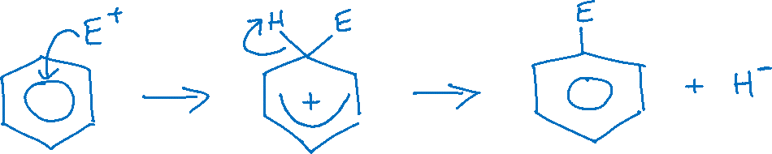
Identify the errors in the mechanism shown and add labels to explain what is wrong with the answers
What is/are the error(s) here?
Enter text
What is/are the error(s) here?
Enter text
What is/are the error(s) here?
Enter text

Slide 3
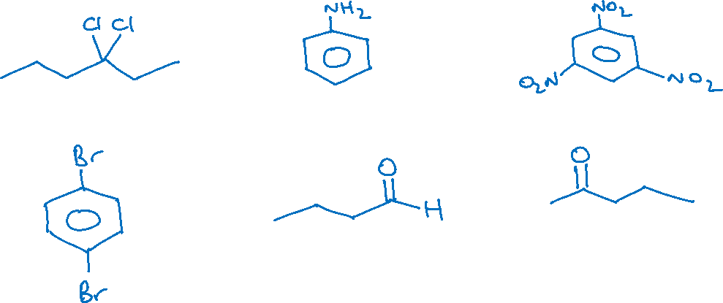
Name the compounds illustrated
Name
Name
Name
Name
Name
Name

Slide 4
Discuss the following question
Cyclohexene reacts readily with bromine, but benzene will only undergo reaction with bromine in the presence of a catalyst. Explain in terms of bonding why this is the case.
Add some notes here
Phenol has different reactivity to benzene in electrophilic substitution reactions. Describe and explain the difference, using the reaction with chlorine as an example.
Add some notes here

